Slide 1
FinTech Cybersecurity and Consumer Trust
Monthly Project Review 3 - Machine Learning, Anomaly Detection, Trust Scoring and Dashboards
Final-year research & development project
[Student name] · [Register no.] · Guide: [Guide name] · [Department / Institution]
Edit the bracketed placeholders on this slide before presenting.

Slide 2
Progress since Review 2
• Supervised models implemented: Logistic Regression, Random Forest, XGBoost with randomised hyper-parameter search
• Unsupervised detectors implemented: Isolation Forest, Local Outlier Factor
• Risk tiers, consumer trust scoring and statistics helpers implemented
• Prometheus exporter, PostgreSQL persistence and 7 provisioned Grafana dashboards developed
• Preliminary experiments run; results are first-run numbers on synthetic data, not final
FinTech Cybersecurity and Consumer Trust | Review 3 | 1

Slide 3
Machine learning implementation
Model | Role | Imbalance handling | Tuned parameters
Logistic Regression | Interpretable baseline | class_weight=balanced | C
Random Forest | Non-linear bagging | balanced_subsample | max_depth, min_samples_leaf, max_features
XGBoost | Boosted trees | scale_pos_weight | depth, learning rate, subsample, colsample, min_child_weight
Isolation Forest / LOF | Label-free detectors | contamination parameter | none (fit without labels)
Protocol: randomised search (average precision) on train; F1-optimal threshold on validation; test used once.
FinTech Cybersecurity and Consumer Trust | Review 3 | 2

Slide 4
Fraud and anomaly detection flow
Cleaned transactions
Features (40)
Train/validation/test (chronological)
Supervised models
Unsupervised detectors
Metrics + risk tiers
Security events -> Isolation Forest
Prometheus + PostgreSQL
FinTech Cybersecurity and Consumer Trust | Review 3 | 3

Slide 5
Preliminary experiment: PR-AUC and ROC-AUC (test set)
Real first-run output (run run_20261109_061947_57b9). Tuning budget n_iter is small; test set has 174 fraud cases, so estimates are noisy.
FinTech Cybersecurity and Consumer Trust | Review 3 | 4

Slide 6
Preliminary experiment: threshold metrics
Model | Precision | Recall | F1 | FPR
logistic_regression | 0.883 | 0.563 | 0.688 | 0.0015
random_forest | 0.928 | 0.667 | 0.776 | 0.0010
xgboost | 0.982 | 0.626 | 0.765 | 0.0002
isolation_forest | 0.365 | 0.437 | 0.398 | 0.0150
local_outlier_factor | 0.187 | 0.287 | 0.226 | 0.0248
Synthetic data: use these to validate the pipeline, not to claim real-world performance.
FinTech Cybersecurity and Consumer Trust | Review 3 | 5

Slide 7
Consumer trust scoring (synthetic survey)
Quantity | Value
Respondents | 355
Mean Consumer Trust Score (0-100) | 56.6
Platform Security Index (0-100) | 79.8
Consumer Trust Index (0-100) | 65.8
Cronbach alpha (all items) | 0.906
Min k-anonymity group | 5
Survey data is synthetic placeholder data; the index is a proposed composite pending sensitivity analysis and real responses.
FinTech Cybersecurity and Consumer Trust | Review 3 | 6

Slide 8
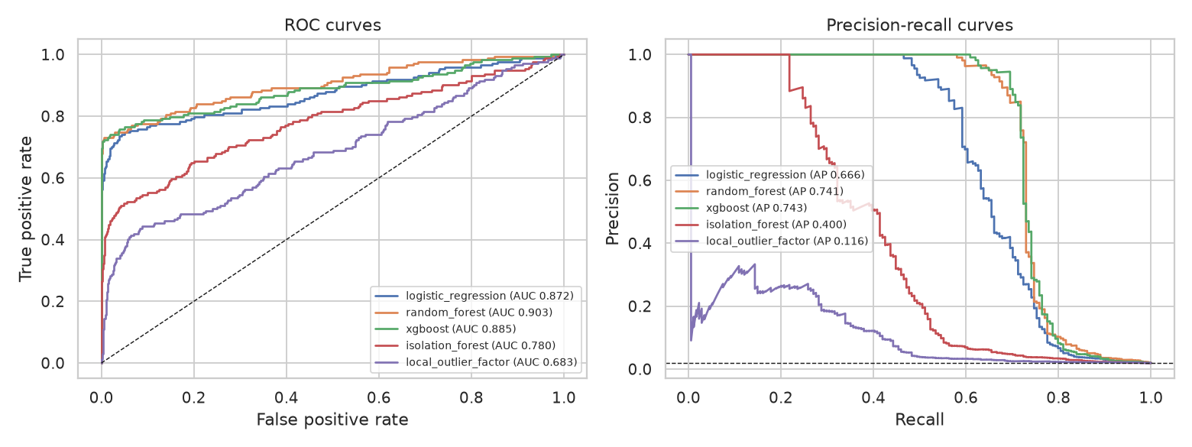
Experimental work: ROC and precision-recall curves
Generated by src/model_evaluation/evaluate.py from the held-out test partition.
FinTech Cybersecurity and Consumer Trust | Review 3 | 7

Slide 9
Grafana dashboard development
Dashboard | Data sources | Status
Research Overview | Prometheus, Loki | Provisioned
Transaction & Fraud Analytics | Prometheus, PostgreSQL | Provisioned
Cybersecurity Threat Monitoring | Prometheus, PostgreSQL, Loki | Provisioned
Consumer Trust Indicators | Prometheus, PostgreSQL | Provisioned
ML Model Performance | Prometheus, PostgreSQL | Provisioned
Data Pipeline Monitoring | Prometheus, PostgreSQL, Loki | Provisioned
Docker Infrastructure Health | Prometheus (cAdvisor) | Provisioned
Panels query metrics computed by the pipeline and a held-out replay through the trained model; no hardcoded values.
FinTech Cybersecurity and Consumer Trust | Review 3 | 8

Slide 10
Issues, risks and next steps
• Increase tuning budget and repeat on several seeds for stable estimates
• Run the optional public credit-card benchmark
• Replace synthetic survey with real, ethics-approved responses
• Finish sensitivity analysis of the trust index; write results chapters (Review 4)
FinTech Cybersecurity and Consumer Trust | Review 3 | 9

