Slide 1
FinTech Cybersecurity and Consumer Trust
Monthly Project Review 4 - Results, Model Comparison, Dashboards and Conclusions
Final-year research & development project
[Student name] · [Register no.] · Guide: [Guide name] · [Department / Institution]
Edit the bracketed placeholders on this slide before presenting.

Slide 2
Completed implementation
Component | Status
Pipeline (collect to report, 14 timed stages) | Complete
Models: LR, RF, XGBoost, Isolation Forest, LOF | Complete
Risk tiers, trust scoring, statistics | Complete
PostgreSQL schema, views, persistence | Complete
Prometheus exporter, Loki logging, 7 Grafana dashboards, alert rules | Complete
16 notebooks, pytest suite, Docker Compose, Makefile | Complete
Real survey data / ethics approval | Pending - bundled survey is synthetic
FinTech Cybersecurity and Consumer Trust | Review 4 | 1

Slide 3
Final system architecture
Docker network: fintech-net (ports bound to localhost)
Worker
Python pipeline
+ /metrics :8000
PostgreSQL
results + metadata
Prometheus
:9090
Grafana :3000
7 dashboards
alerts
JupyterLab
:8888
Promtail →
Loki (logs)
cAdvisor
container stats
Worker writes results to PostgreSQL and JSON logs (→ Promtail → Loki); Prometheus scrapes worker, cAdvisor, Loki and Grafana; Grafana queries Prometheus (PromQL), Loki (LogQL) and PostgreSQL (SQL). Jupyter reads the artefacts the worker produced.
FinTech Cybersecurity and Consumer Trust | Review 4 | 2

Slide 4
Model comparison: PR-AUC, ROC-AUC, F1 (test set)
Run run_20261109_061947_57b9, seed 42. Champion (highest PR-AUC among supervised): xgboost.
FinTech Cybersecurity and Consumer Trust | Review 4 | 3

Slide 5
Performance metrics (test set)
Model | Accuracy | Precision | Recall | F1 | ROC-AUC | PR-AUC | FPR
logistic_regression | 0.9901 | 0.883 | 0.563 | 0.688 | 0.872 | 0.666 | 0.0015
random_forest | 0.9925 | 0.928 | 0.667 | 0.776 | 0.903 | 0.741 | 0.0010
xgboost | 0.9925 | 0.982 | 0.626 | 0.765 | 0.885 | 0.743 | 0.0002
isolation_forest | 0.9743 | 0.365 | 0.437 | 0.398 | 0.780 | 0.400 | 0.0150
local_outlier_factor | 0.9618 | 0.187 | 0.287 | 0.226 | 0.683 | 0.116 | 0.0248
Accuracy is high for any model on ~2% fraud and is not a selection criterion; PR-AUC and FPR are.
FinTech Cybersecurity and Consumer Trust | Review 4 | 4

Slide 6
Statistical comparison
Item | Result
Champion | xgboost
Champion ROC-AUC 95% bootstrap CI | [0.847, 0.918]
McNemar champion vs Logistic Regression | chi2=11.61, p=0.0007
Confusion (champion) | TP=109 FP=2 FN=65 TN=8777
FinTech Cybersecurity and Consumer Trust | Review 4 | 5

Slide 7
Risk tiers (champion, test set)
Tier | Transactions | Frauds | Observed fraud rate | Action
low | 3 | 0 | 0.000 | allow
medium | 7871 | 37 | 0.005 | step-up authentication
high | 912 | 12 | 0.013 | hold for manual review
critical | 167 | 125 | 0.749 | block + alert
FinTech Cybersecurity and Consumer Trust | Review 4 | 6

Slide 8
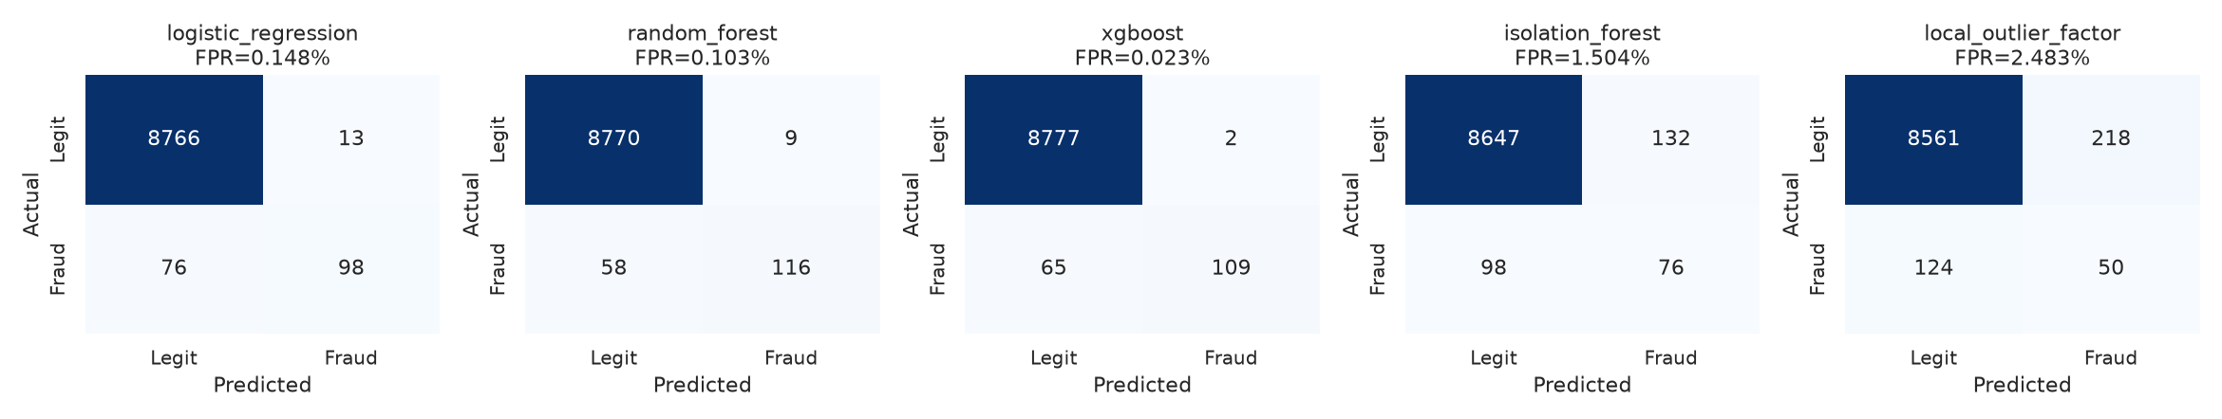
Confusion Matrices
Confusion matrices at validation-tuned thresholds.
FinTech Cybersecurity and Consumer Trust | Review 4 | 7

Slide 9
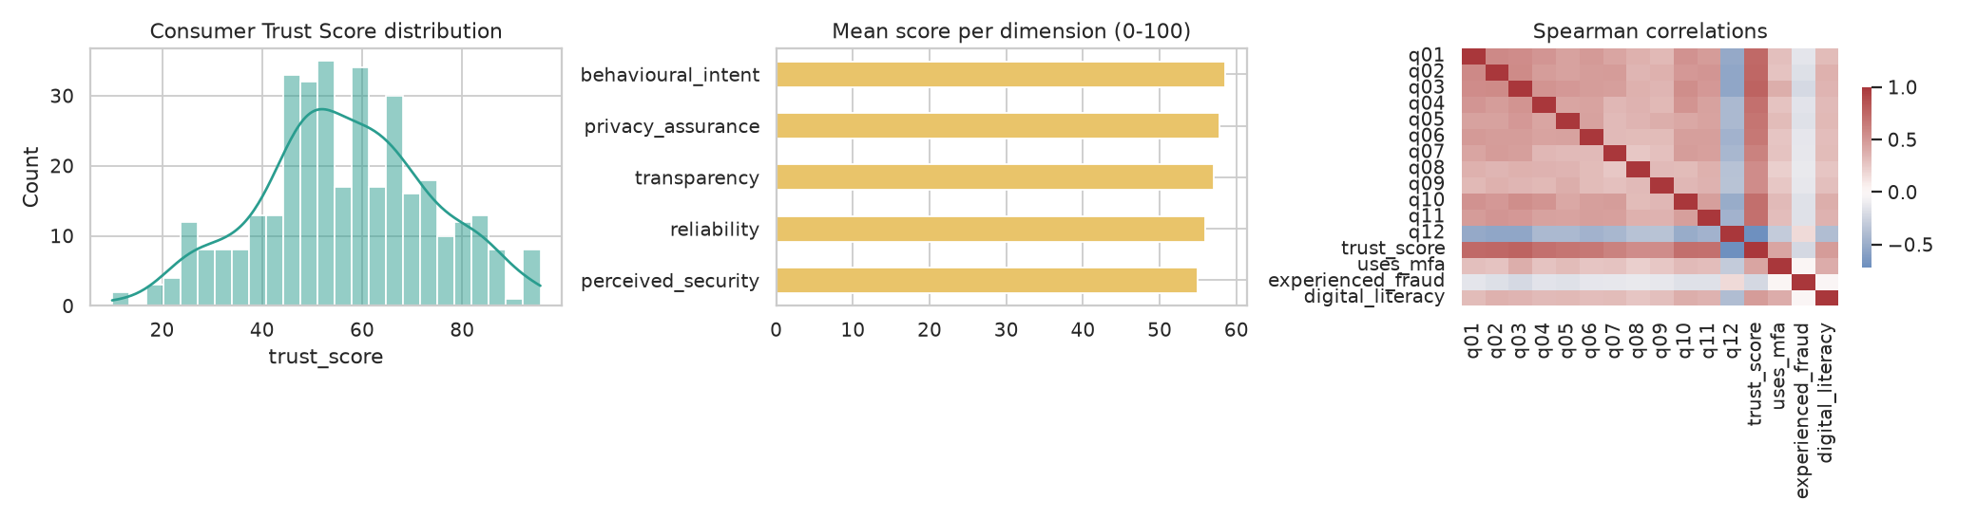
Consumer Trust Overview
Consumer trust (synthetic survey): score distribution, dimensions, correlations.
FinTech Cybersecurity and Consumer Trust | Review 4 | 8

Slide 10
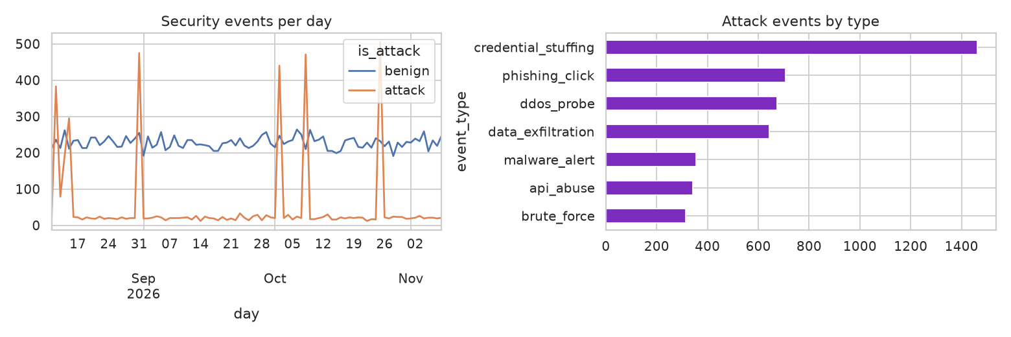
Security Overview
Security events and attack types.
FinTech Cybersecurity and Consumer Trust | Review 4 | 9

Slide 11
Security and trust results
Quantity | Value
Attack block rate | 0.797
Isolation Forest ROC-AUC vs known attacks | 0.994
Mean Consumer Trust Score | 56.6
Platform Security Index | 79.8
Consumer Trust Index | 65.8
Cronbach alpha | 0.906
Survey is synthetic; trust values demonstrate the method and are not findings about real consumers.
FinTech Cybersecurity and Consumer Trust | Review 4 | 10

Slide 12
Grafana dashboard demonstration
• Live demo: Overview, Pipeline Monitoring, Fraud, Model Performance, Trust, Infrastructure
• Add screenshots as review/assets/grafana_*.png and re-run review/scripts/build_all.py
No screenshots were available when this deck was generated.
FinTech Cybersecurity and Consumer Trust | Review 4 | 11

Slide 13
Conclusions
• A reproducible, observable platform links fraud/anomaly detection with a consumer trust measure (3 supervised + 2 unsupervised detectors)
• Tree ensembles are compared with a linear baseline using PR-AUC, recall and false-positive rate rather than accuracy
• Unsupervised detectors are useful without labels but are compared separately from supervised models
• Grafana shows live computed metrics, logs and database results for the entire experiment
FinTech Cybersecurity and Consumer Trust | Review 4 | 12

Slide 14
Limitations
Data and validity
Method
• Synthetic transactions encode our assumptions
• Bundled survey is synthetic
• Few positives in test set widen uncertainty
• No concept drift modelled
• Trust Index is a proposal, not validated
• Single dataset family and limited tuning budget
• Replay stream is not production traffic
• Alertmanager not deployed
FinTech Cybersecurity and Consumer Trust | Review 4 | 13

Slide 15
Future enhancements
• Run on the public ULB dataset and other licensed data; repeat over many seeds
• Real ethics-approved survey; factor analysis and index validation
• Add calibration, cost-sensitive thresholds, explainability (SHAP)
• Drift monitoring and scheduled retraining; Alertmanager notifications
• Combine unsupervised scores with supervised features
FinTech Cybersecurity and Consumer Trust | Review 4 | 14

