Slide 1
Late Refill Risk
Predicting late medication refills from dispensing patterns
Data & AI Hackathon – Track 1 (Healthcare & Digital Pharmacy)
Nilavan Sritharan
Deepika Sivakumar
Aditya Oruganti

Slide 2
Challenge A - The Problem
Can we predict which patient-drug pairs will refill late — before they run out?
Label definition (per hackathon spec)
expected_runout = SRVC_DT + DAYS_SUPLY_NUM
gap = next_fill_date - expected_runout
late = 1 if gap > 7 days (grace window)
5.5M
99.5K
247K
69.6%
Dispensing events
Patients
Patient-drug pairs
Late rate

Slide 3
The Grouping Challenge
Synthetic NDC codes are randomised — systematic prefix analysis found the workable level
Prefix | Unique | Groups >= 3 fills | Verdict
NDC-11 (exact) | 503,683 | 7 | Unusable
NDC-9 | 117,029 | 1,057 | Too sparse
NDC-7 | 14,761 | 65,314 | Possible
NDC-5 | 3,741 | 247,167 | Selected
With real Pharmacy2U data using dm+d/BNF codes, this workaround is unnecessary — drug-level chains would be built directly.

Slide 4


Hybrid Model Architecture
XGBoost
Survival Analysis
(Cox PH)
Target: Will refill be late? (binary)
Metric: PR-AUC + calibration
Calibration: Isotonic (on validation set)
Output: Usable risk score (0–1)
Interpretation: SHAP feature importance
Target: Days until next refill
Metric: C-index
Censoring: 247K intervals XGBoost can't use
Output: KM curves + hazard ratios
Advantage: Scores patients XGBoost drops
Feature Engineering
Gap Statistics
Stockpiling
Cadence Stability
Rolling mean, std, CV, trend, max
Early refill flag, days banked, stockpile
Regularity score, historical late %
Cost patterns
Quantity Patterns
Polypharmacy
Prev pay, cost, burden ratio, pay change
Qty per day, qty changed flag
Unique drugs, 90-day fill count

Slide 5
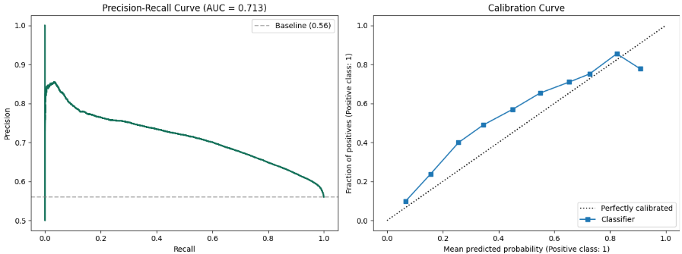
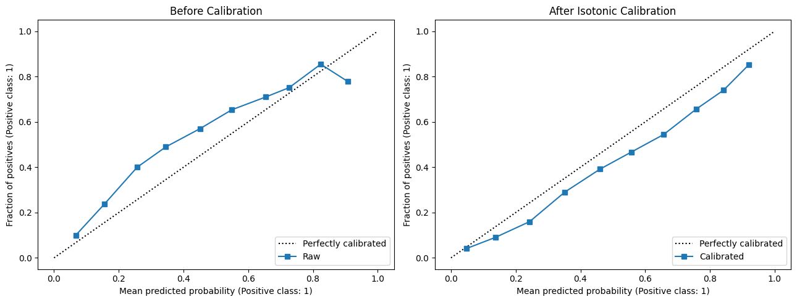
Results
XGBoost – PR-AUC +Calibration
0.709
0.688
0.228
0.633
PR-AUC
ROC-AUC
Brier Score
Cox C-index
baseline: 0.560
random: 0.500
calibrated
random: 0.500
Validation
Isotonic Calibration – (Before vs After)
Split | Rows | Late rate | Period
Train | 684,871 | 73.0% | < Jul 2009
Validation | 188,964 | 67.7% | Jul 2009 – Jan 2010
Test | 148,071 | 56.0% | >= Jan 2010
Temporal splits only — no random splits, no data leakage

Slide 6
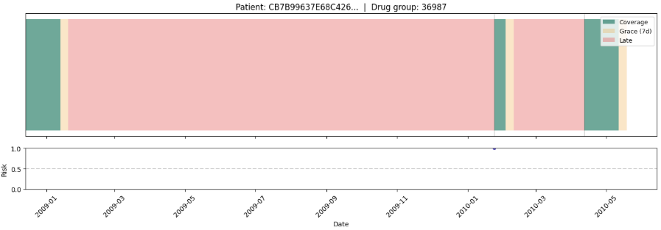
Demo — Actionable Outputs
Risk score table — 77,828 patient-drug pairs scored
Risk score: 1.00 | Tier: High | Late history: 100% | Fills: 2
Patient | Drug | Risk | Tier | Late history | Runout
EC78AF74... | 58016 | 0.924 | HIGH | 100% | 2010-01-28
1324E861... | 58016 | 0.909 | HIGH | 100% | 2010-03-02
D6C90AEA... | 58016 | 0.907 | HIGH | 100% | 2010-03-28
Risk score table
Patient timelines
SHAP + Cox drivers
77,828 pairs with Low/Med/High tiers
Coverage + grace + late + risk overlay
Feature importance + hazard ratios
Synthetic Data Limitation
With Real Pharmacy2U data
Temporal autocorrelation: absent (lift = 1.00x)
Cross-sectional features: flat across quartiles
dm+d/BNF codes for drug-level chains
Temporal persistence as dominant predictor

