Slide 1
Threshold effects in time-delay tracking
SDET COURSE PROJECT
CRLB vs Ziv–Zakai bound for a delay-locked loop and a batch maximum-likelihood estimator of BPSK signals
Extension proposed, not started
PLUTO
Notes:
Good morning. Our project asks when delay estimation suddenly fails at low SNR, and which theory predicts it. Status up front: the work the brief asks for (Sprints 1 to 6) is done and verified; the last slides propose an extension for the remaining 30 percent, which is not started yet.

Slide 2
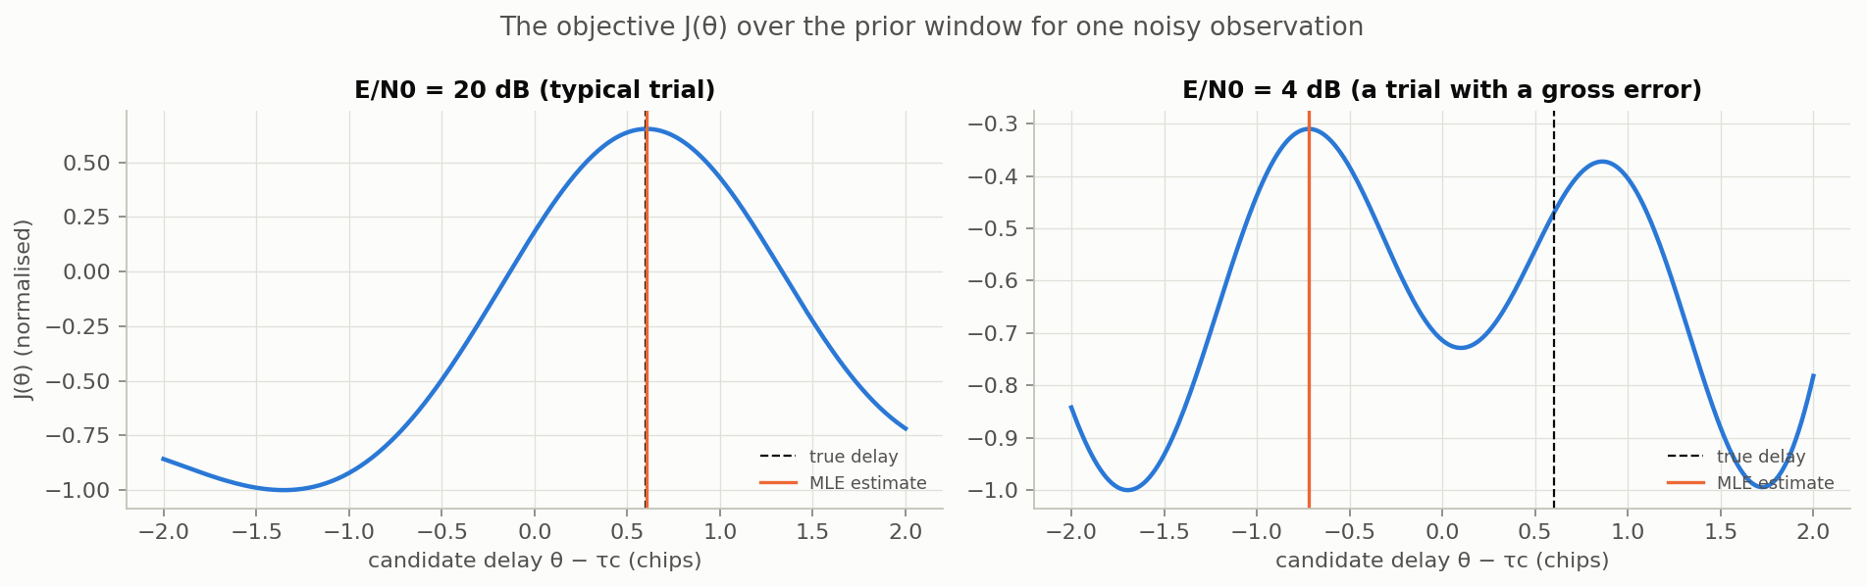
Delay estimation fails abruptly at low SNR
THE PROBLEM
We receive a known BPSK waveform, delayed by an unknown τ and buried in noise: r(t) = s(t − τ) + w(t). GNSS ranging, radar and synchronisation all depend on estimating τ.
At 20 dB one clear peak sits at the true delay. At 4 dB a noise bump 1.3 chips away wins and the estimate jumps. That jump, not a gradual widening, is the threshold effect.
Notes:
At high SNR the estimate sits on the correlation peak. At low SNR a noise bump can win, and the estimate jumps chips away. The right panel is a trial we selected to show the mechanism; about one trial in five looks like this at 4 dB. The project asks where this threshold is, whether the bounds predict it, and why the two estimators behave differently.

Slide 3
Two estimators, two bounds, one model
WHAT THE BRIEF ASKS
Batch MLE
Delay-locked loop (DLL)
Looks at a 64-chip block and picks the delay whose replica fits best. Optimal at high SNR; needs a search.
Feedback tracker using early-minus-late correlations. Cheap and real-time; can lose lock.
Cramér–Rao bound (CRLB)
Ziv–Zakai bound (ZZB)
Bounds the variance of unbiased estimators. Local: sees only the curvature of the true peak.
Bounds the MSE of any estimator via binary detection. Global: sees distant wrong peaks and the prior.
Notes:
The brief asks for both estimators, error versus SNR, comparison with the CRLB, the SNR where they diverge, a derived and simulated ZZB, and an explanation of the DLL versus MLE difference. All of that is done.

Slide 4
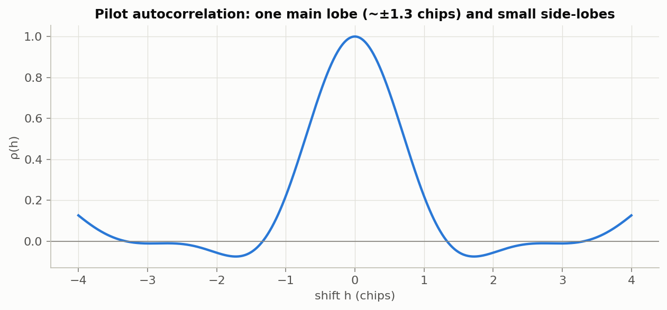
Every modelling choice has a reason
MODEL — NOTEBOOK 00
Choice | Why
Raised-cosine pulse, α = 0.5 | rectangular chips have infinite bandwidth ⇒ CRLB = 0
64-chip known pilot | exact likelihood; one pilot for every method
4 samples per chip | spectrum ends at 0.75 cycles/chip < Nyquist
Delay applied analytically | no interpolation error at high SNR
Uniform prior, Ta = 4 chips | the ZZB needs a prior; Ta = 1 masks the threshold
SNR = batch E/N0; metric = MSE | bounds depend on total energy; estimators are biased below threshold
The autocorrelation’s curvature sets the CRLB; its side-lobes and the prior width set the ZZB.
Notes:
One model for everything, so theory and simulation always describe the same thing. The original Sprint-1 script used an m-sequence with a fixed delay; we changed it because the ZZB needs a random delay with a prior. The qualitative story did not change.

Slide 5
The batch theory is known; tracking dynamics are not
LITERATURE — FOUR SURVEYS
Known
Our observations
Appears open
CRLB and MLE (Kay 1993) · ZZB (Ziv–Zakai 1969; Bell et al. 1997) · MLE threshold prediction (Mallat et al. 2014) · batch ZZB for GNSS code tracking (Emmanuele et al. 2012; Liu et al. 2016) · DLL mean time to lose lock (Holmes 1978; Hasson 1995)
ZZB looseness measured against the best (MMSE) estimator · its pilot dependence and prior-width trend · DLL failure split into acquisition vs loss of lock · a criterion-dependent DLL-vs-MLE answer
Bounds that include the tracker’s dynamics, linked to loss of lock, for PN code delay. Confidence medium-low: we say “we found no prior work that…”, never “first”.
Notes:
We ran four surveys. The first literature survey missed the Emmanuele 2012 and Liu 2016 papers on ZZB for GNSS code tracking; the fourth found them. That is exactly why we phrase novelty carefully. Up to 70 percent our work reproduces known theory, carefully verified; the open part is our proposal.

Slide 6
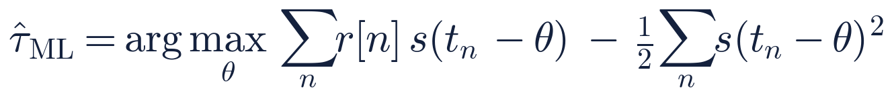
The maximum-likelihood estimator is a matched filter
SPRINT 1 — NOTEBOOK 01
Derivation
Implementation
Check
Gaussian log-likelihood, expand the square, drop the θ-free term Σr²: maximise the correlation with a shifted replica.
J on a 1/64-chip grid over the prior window, then a parabola through the best three points. σ² drops out: no SNR knowledge needed.
Without noise, error = 0.02 % of the CRLB at 30 dB. With noise, MSE/CRLB = 0.997 averaged over 14–30 dB.
Notes:
Three-line derivation on the board if asked: log of a product of Gaussians, expand the square, the sum of r squared does not depend on theta, so we maximise the correlation minus half the replica energy. The energy term is almost constant but we keep it so the estimator is exactly the MLE. We also compute the posterior mean (MMSE) from the same grid of J values.

Slide 7
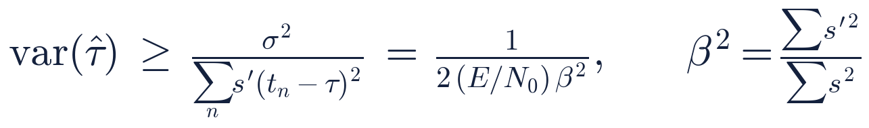
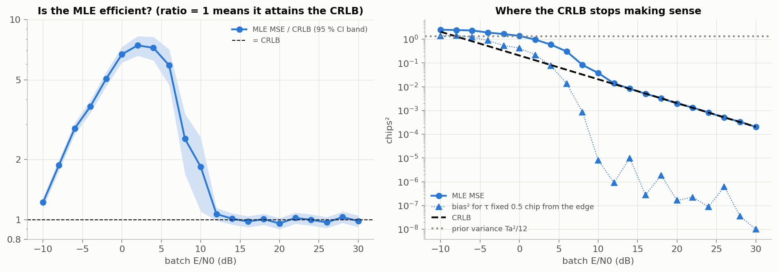
Precision comes from the waveform’s slope
SPRINT 3 — NOTEBOOK 03
Why it fails below threshold
assumes unbiasedness (bias −0.47 chip at 2 dB near the edge)
local: curvature of the true peak only
ignores the prior: exceeds Ta²/12 below −8 dB
Notes:
Score, Fisher information equals one over sigma squared times the sum of the squared derivative, then substitute the noise level. Beta squared is the Gabor bandwidth; we checked it against a frequency-domain computation to 0.05 percent. It also varies by a factor of 2.4 between random pilots, which is why every method uses the same pilot.

Slide 8
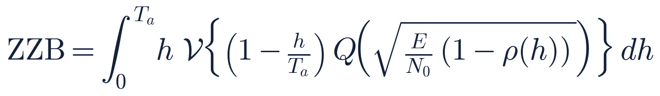
The Ziv–Zakai bound turns estimation into detection
SPRINT 4 — NOTEBOOK 04
1 · Tail integral
2 · Estimator as detector
3 · Two known signals
MSE = a sum over error sizes h of P(|e| ≥ h/2)
decide “τ = φ+h” if the estimate passes φ + h/2; no detector beats the optimal one
P_min = Q(‖s₁ − s₀‖ / 2σ), with ‖s₁ − s₀‖² = 2Σs²(1 − ρ(h))
No signal: Q(0) = ½ ⇒ ZZB → Ta²/12, the prior variance (finite, unlike the CRLB)
Strong signal: 1 − ρ ≈ ½β²h² and ∫h Q(ah)dh = 1/4a² ⇒ ZZB → CRLB
Notes:
If an estimator is usually within half a chip, I can use it to tell delay phi from phi plus one chip. Detection theory says how often any detector must confuse those two; that depends only on the SNR and on how similar the shifted signals are. Summing over every separation gives a lower bound on the MSE. Numerically: 1.3323 versus 1.3333 at zero SNR, and 0.997 times the CRLB at 40 dB. Be ready to derive step 2 and the high-SNR limit on the board.

Slide 9
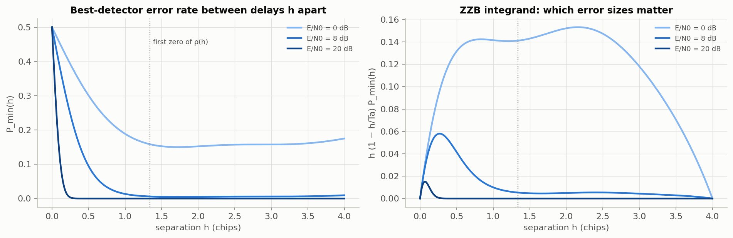
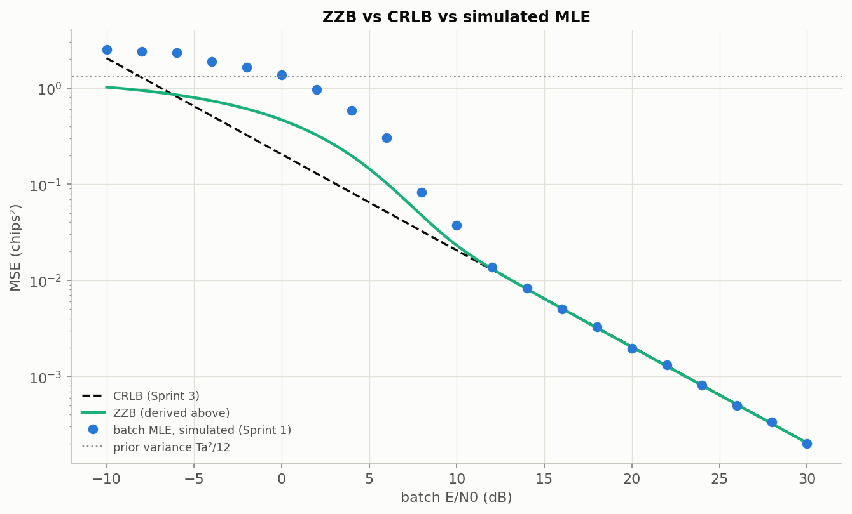
At low SNR, distant delays start to matter
SPRINT 4 — INTUITION AND CHECK
At 20 dB only tiny separations contribute — a local, CRLB-like picture. At 0 dB separations far outside the main lobe contribute: the gross errors. The numerical ZZB reproduces both limits, bends away from the CRLB at 5.95 dB, and stays below the simulated MLE at every SNR.
Notes:
Implementing the ZZB numerically is Sprint-5 material, but we did it early because a derivation is much easier to defend when it reproduces its own limits. Valley filling changes nothing here because the side-lobes are small.

Slide 10
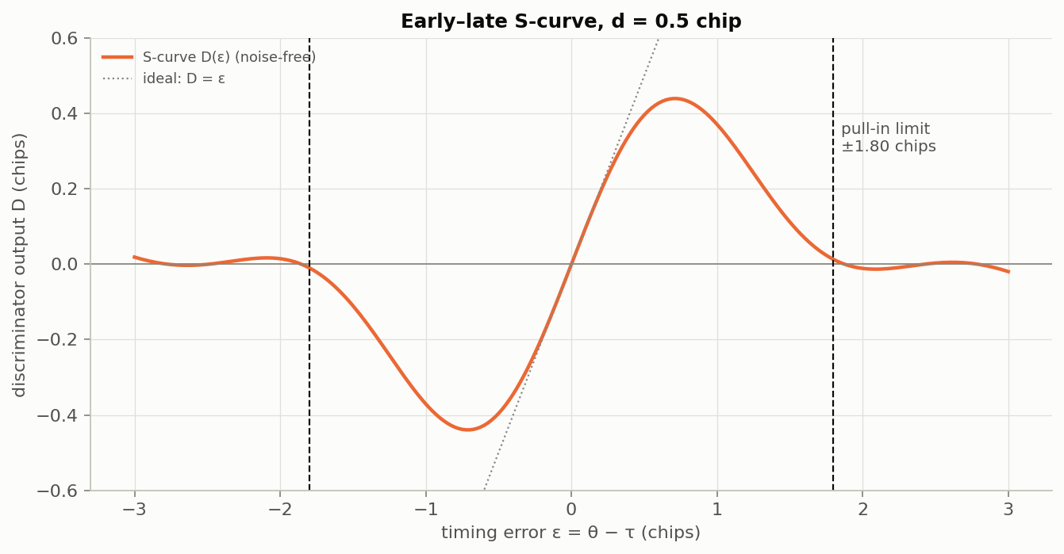
The DLL: a feedback tracker with a limited pull-in range
SPRINT 2 — NOTEBOOK 02
Discriminator: E − L ≈ −2R′(d/2)·ε, so (E − L)/k measures the error ε.
Pull-in ±1.80 chips ⇒ coarse acquisition first. K = 2/17 so the locked loop averages 64 chips, like the batch.
Locked jitter 1.04–1.09 × CRLB — by design of K, not a bound.
Notes:
The loop needed several details we found by testing: per-block replicas, subtracting a pilot-dependent offset (without it the MSE was twice the CRLB at 30 dB), a constant gain, and windows that follow the loop's own timing. The offset uses only the known pilot; with deliberately wrong timing the results were identical, so it does not cheat.

Slide 11
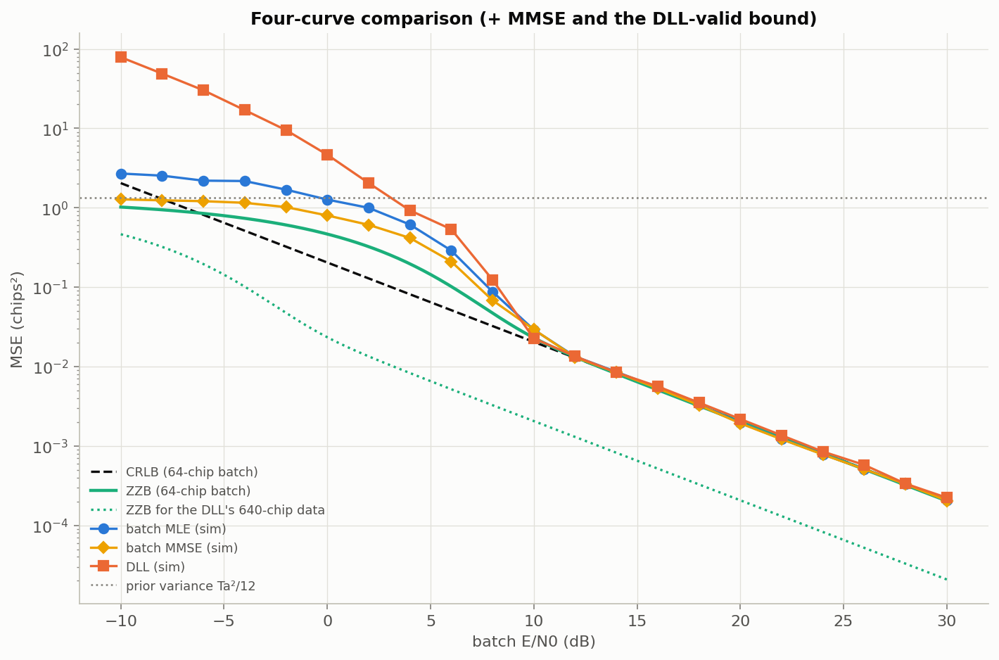
Same bound at high SNR, different failures below threshold
SPRINT 5 — NOTEBOOK 05
Above ≈ 12 dB every method sits on the CRLB (DLL slightly above, by design).
At low SNR the MMSE levels off at the prior variance, as the ZZB predicts: 1.28 vs 1.02 chips² at −10 dB; the MLE is at 2.70.
Below threshold the DLL is far worse: it loses lock and drifts.
Dotted aqua: the ZZB for the DLL’s own 640 chips — the only bound valid for the DLL.
Notes:
The 64-chip ZZB is not a bound for the DLL, because the DLL uses 640 chips of data. So we also plot the ZZB computed for the DLL's own data; the DLL stays above it, as it must. The MMSE is the posterior mean computed from the same likelihood grid as the MLE.

Slide 12
The threshold, located to within about ±0.3 dB
SPRINT 6 — NOTEBOOK 06 · 20,000 TRIALS PER POINT
ZZB (bound)
MMSE (best possible)
Batch MLE
DLL
5.95
8.54
9.52
9.38
dB
dB · 95 % CI [8.35, 9.07]
dB · 95 % CI [9.00, 9.66]
dB · 95 % CI [8.72, 9.98]
2.59 dB bound looseness (ZZB → MMSE): pairwise tests vs rejecting all competing delays
0.85 dB MLE sub-optimality (MMSE → MLE), CI 0.25–1.24, significant
2.7–5.4 dB MLE − ZZB gap across 5 random pilots
Notes:
Threshold = highest E/N0 where MSE first exceeds twice the CRLB; fixed before running. Intervals are bootstrap 95 percent. The MLE value agrees with an independent 40,000-trial check from October (9.4 dB). About three quarters of the gap to the bound is the bound itself being optimistic; the rest is the MLE committing to one peak where the posterior mean hedges. Across pilots, the ZZB threshold moves with each pilot's bandwidth, because thresholds are defined relative to each pilot's own CRLB.

Slide 13
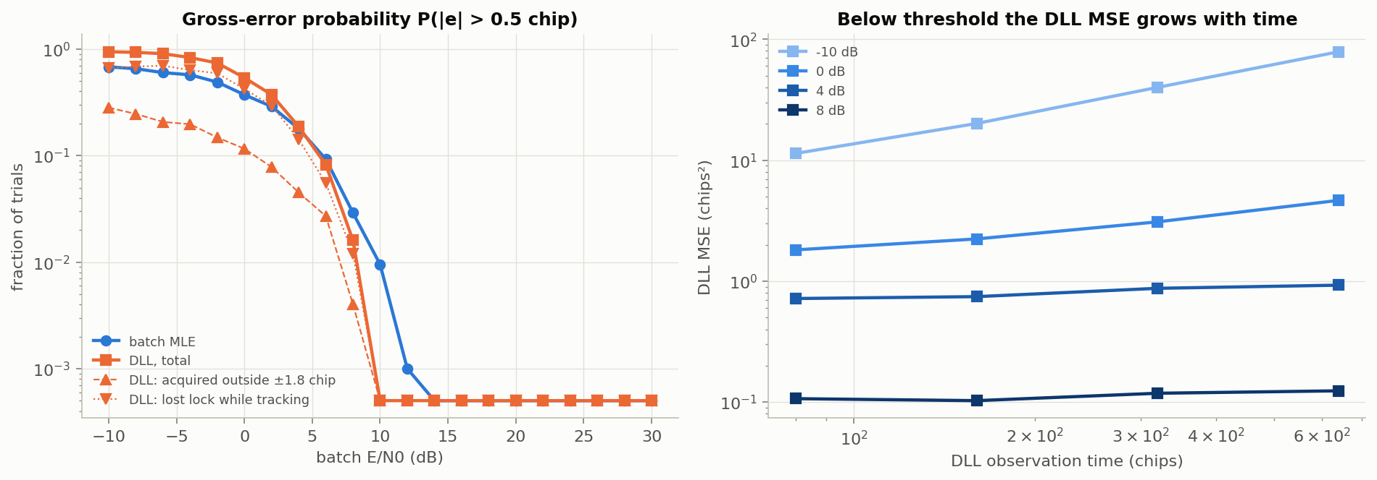
Which is better depends on how you measure failure
SPRINT 6 — DLL VS MLE
Criterion | DLL − MLE threshold | Meaning
MSE > 2 × CRLB | −0.12 dB, CI [−0.87, 0.59] | not significant
P(gross error) > 1 % | −0.68 dB, CI [−0.99, −0.40] | DLL more robust: sees 640 chips
far below threshold | DLL MSE grows with time | loss of lock, unbounded drift
At 0 dB, 54 % of DLL runs fail: 12 % acquired outside the pull-in range, 42 % lost lock while tracking. Loss of lock is a failure the batch MLE does not have.
Notes:
The honest answer to "which is better" is: equal above threshold by design; near threshold the DLL makes fewer gross errors because it observes ten times more data and pulls back from bad acquisitions; far below threshold it is much worse because it loses lock. That tension is what our proposed extension sets out to quantify.

Slide 14
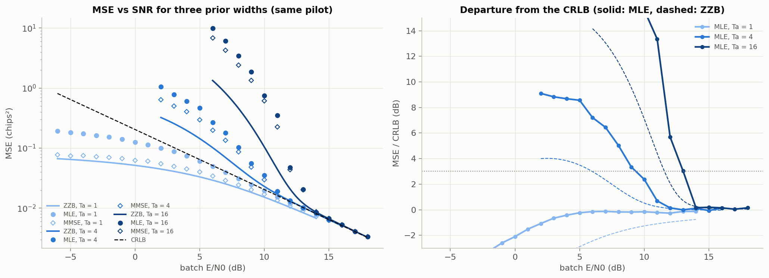
More delay uncertainty means a later threshold
SPRINT 6 SUPPLEMENT — NOTEBOOK 07
Prior width | ZZB | MLE (95 % CI) | MLE − ZZB | Reading
1 chip | none | masked | — | no distant peak to jump to
4 chips | 5.95 dB | 9.34 [8.81, 10.08] dB | 3.4 dB | main study
16 chips | 11.56 dB | 13.01 [11.95, 13.41] dB | 1.5 dB | ZZB relatively tighter
Notes:
A wider window holds more places where noise can create a winning peak, so the threshold moves up by about 3.7 dB from 4 to 16 chips. With a 1-chip window there is no distant peak, so the threshold is masked, not absent. The gap to the ZZB shrinks for the wide prior; we have a plausible reading but have not tested it. 10,000 trials per point.

Slide 15
What held, what was challenged, what we cannot claim
STATUS
Original hypothesis | Outcome
MLE attains the CRLB above threshold | held (0.997)
A threshold exists that the CRLB misses | held
The ZZB captures the threshold | qualitatively; optimistic by 2.6 dB even for the best estimator
DLL and MLE differ for identifiable reasons | held; answer depends on the criterion
Limitations
synthetic data only
constant delay, no Doppler
known pilot, coherent
one DLL design
pilot spread measured, not explained
Notes:
We would rather list the limitations than have you find them. Synthetic data is needed because the bounds require the exact model and ground truth. The one hypothesis that was only partly confirmed is the most interesting: the ZZB is optimistic by about 2.6 dB in the threshold region even compared with the best possible estimator.

Slide 16
Reproduction, observations, and one open question
CONTRIBUTION, HONESTLY
Reproduction
MLE, CRLB, ZZB for delay, batch ZZB for GNSS code tracking, linear DLL theory — carefully re-derived and independently verified
Our observations
gap to the bound split into 2.6 dB looseness + 0.85 dB MLE sub-optimality; pilot and prior-width dependence; DLL failure decomposition
Open (as far as we found)
a bound that includes the tracker’s dynamics and explains loss of lock, for PN code delay
Notes:
Four surveys: an independent validation, a literature survey, a multi-agent deep-research check with three verifiers per claim, and an interdisciplinary check. The fourth found prior work the first two missed, which is why we say "we found no prior work that" rather than claiming to be first.

Slide 17
Where does a delay tracker lose information?
PROPOSED FOR THE REMAINING 30% — NOT STARTED
Our static study split the gap to the bound into looseness and estimator sub-optimality. Tracking adds memory and feedback, and with it a third loss: loss of lock.
H1 Above threshold, a DLL with the steady-state Kalman gain and the exact grid Bayes tracker both reach the posterior CRB.
H2 The DLL leaves the bound earlier; conditioning on lock removes most of the excess.
H3 A Markov-chain model built on our measured S-curve predicts the DLL’s mean time to lose lock and its threshold.
H4 The optimal tracker’s posterior warns of loss of lock earlier than a classical lock detector.
Notes:
The state is one-dimensional, so the optimal Bayes tracker can be computed essentially exactly on a grid; no particle-filter approximation. The posterior CRB for a random-walk delay has a closed-form steady state, which is the scalar Kalman filter, and our DLL is exactly a fixed-gain Kalman filter in its linear regime. H4 connects to integrity monitoring in autonomous navigation. Each hypothesis can fail, and we say what we learn if it does.

Slide 18
Three weeks, highest-value work first
PLAN
Week | Work | Deliverable
1 | random-walk model, posterior CRB, grid Bayes tracker, DLL with Kalman gain; tests | RMSE-vs-SNR comparison (H1, H2)
2 | lock-conditioned error; Markov-chain mean time to lose lock; risk score | MTLL and ROC figures (H3, H4)
3 | ablations (spacing, pilots); optional sequential bound; report | final report and presentation
Shown today: Sprints 1–6, precise thresholds, prior-width study, literature position, this plan
Proposed: everything on this slide — no results yet
Notes:
Week 1 alone already tests H1 and H2. The sequential bound is a stretch goal: the most novel and the most uncertain part. Adjust the week numbers to the actual course calendar.

Slide 19
The CRLB holds down to about 12 dB; below 9.5 dB wrong peaks take over. The ZZB sees them coming, about 2.6 dB too early.
SUMMARY
Next: find out how much of a tracker’s failure is the bound, the estimator, or the loop losing lock.
Questions · repository: github.com/nilavra17ghosh/TIME-DELAY-TRACKING
Notes:
One-sentence recap of the whole talk. Then invite questions. If asked to derive anything, the ZZB step 2 and the high-SNR limit are the most likely.

