Slide 1
Module 1: Why Use Concurrency?
Topic 1.3: Power Wall

Slide 2
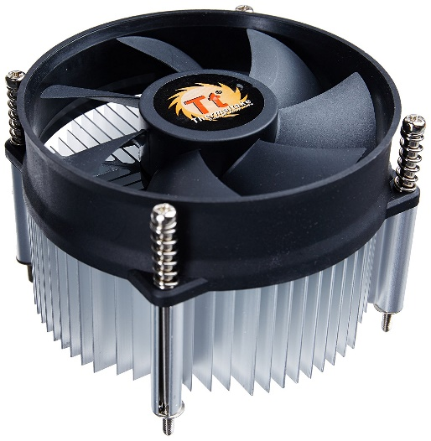
Power/Temperature Problem
Transistors consume power when they switch
Increasing transistor density leads to increased power consumption
Small transistors use less power, but density scaling is faster
High power leads to high temperature
Air cooling (fans) can only remove so much heat

Slide 3
Dynamic Power
P = α * CFV²
α is percent of time switching
C is capacitance (related to size)
F is the clock frequency
V is voltage swing (from low to high)
Voltage is important
0 to 5V uses much more power than 0 to 1.3 V

Slide 4
Dennard Scaling
Voltage should scale with transistor size
Keeps power consumption, and temperature, low
Problem: Voltage can’t go too low
Must stay above threshold voltage
Noise problems occur
Problem: Doesn’t consider leakage power
Dennard scaling must stop

Slide 5
Multi-Core Systems
P = α * CFV²
Cannot increase frequency
Can still add processor cores, without increasing frequency
Trend is apparent today
Parallel execution is needed to exploit multi-core systems
Code made to execute on multiple cores
Different programs on different cores

