Slide 1
Module 2: Concurrency Basics
Topic 1.1: Processes

Slide 2
Processes
An instance of a running program
Things unique to a process
Memory
Code, stack, heap, shared libraries
Virtual address space
Registers
Program counter, data regs, stack ptr, …

Slide 3
Operating Systems
Allows many processes to execute concurrently
Processes are switched quickly
20ms
User has the impression of parallelism
Operating system must give processes fair access to resources

Slide 4
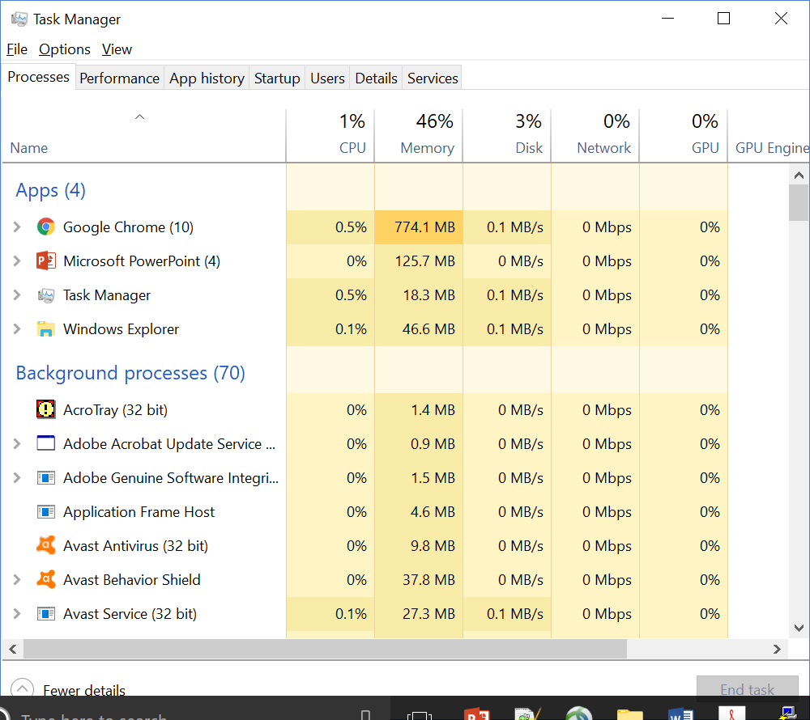
Task Manager
Allows many processes to execute concurrently

