Slide 1
MIRAGE
Measuring the Impact and Reality of Rainwater Harvesting Mandates
A meta-analysis of rooftop rainwater harvesting performance in Indian cities
Vedant Abhangrao (23B2262) | Nilay Shahapure (23B2206) | Arjun Jhunjhunwala (23B1245) | Yash Krishnani (23B1240)
CM617 Sustainability Principles and Practices, IIT Bombay. Pathway 1: Sustainability Research. Sector: Water.
Notes:
Title slide. MIRAGE is a meta-analysis of published performance data for rooftop rainwater harvesting in Indian cities.

Slide 2
Twenty years of mandates, almost no measurement
2003
33
None
Chennai makes RWH compulsory for every building; Bengaluru, Delhi, Mumbai and 20+ others follow
states and union territories have adopted the Model Building Bye-Laws 2016 RWH provision
consolidated quantitative syntheses of what installed systems deliver that we could find
The gap in the evidence
Mandates are enforced at plan approval: no completion certificate or water connection without a structure. After that, checks are rare and results are not published. Single-building case studies, agency demonstration reports and newspaper audits exist, but we found no study that combines them. MIRAGE collects the published numbers, puts them on one scale and asks what the mandate delivers.
Notes:
Set up the problem: compliance is enforced on paper, performance is not measured.

Slide 3
Three questions, four searches
Q1. Performance gap
Q2. Functionality
Q3. Cost
How much of the theoretical rooftop potential do documented systems actually harvest or recharge?
What share of installed systems stay functional, and why do they fail?
What does harvested water cost per kilolitre compared with piped, desalinated and tanker water?
89
43
46
24
performance site records
cost records + 37 price benchmarks
surveys, audits, inspections; 40 sources state failure reasons
mandate instruments
Sources: CGWB compilations and manual, CSE case studies, Lok Sabha replies, Delhi Jal Board and NGT reports, Arghyam, journal papers, campus and company reports, IMD normals, RBI CPI. Every number logged with its URL and the sentence or values taken from the page.
Notes:
Explain the four parallel searches and the logging rule: no number without a URL and a quote.

Slide 4
One metric, three evidence tiers
Potential P = Area (m2) x Rainfall (mm) x C / 1000 [kL/yr] Performance ratio = reported volume / P. C = 0.80 (CGWB manual, Table 7.2: concrete 0.7 to GI sheet 0.9); sensitivity 0.70 and 0.90.
Observed
Agency-reported
Design calculation
Source names a flow meter, a measuring device at the recharge well or a tank-filling record. 7 observations, 5 sites.
Annual volume stated by CGWB or another agency, no instrument named, or given as a share of estimated runoff. 9 observations, 7 sites.
CSE model projects and one CGWB design note where the 'volume harvested' is a stated share of area x rainfall. 19 sites.
Screening: 89 site records found (17 not accessible, 7 added from the cost search and the CGWB compilation), 79 screened, 47 excluded (20 potential only, 9 no area or volume, 3 modelled, 10 no roof area, 5 mixed or inconsistent), 35 observations at 31 sites included
Costs: deflated to 2024 rupees (CPI-IW); 15-year life and O&M 2% of capital are CGWB norms, 8% discount is our assumption (CGWB example: 15%); divided by design yield, then rescaled to observed yield
Functionality: 13 functional-share estimates from 12 surveys; 90 failure-mode mentions from 40 sources coded into 11 categories
Notes:
Walk through the formula and why the tiers matter: the method the source used decides what the number means.

Slide 5
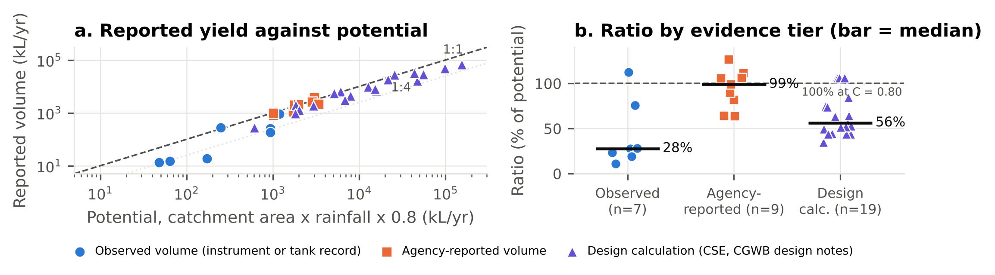
Result 1: in the seven observed cases, yield is about a quarter of potential
Left: reported volume against potential (log scales), 1:1 and 1:4 lines. Right: performance ratio by evidence tier, bars are medians. Observed volumes sit well below agency-reported ones, which cluster at 100% of potential.
Notes:
The headline figure. Point out the blue observed points below the 1:4 line and the orange agency points at or above 1:1.

Slide 6
Who measured it decides the answer
28%
99%
56%
Observed median, n = 7 at 5 sites. 95% CI 19% to 76%; range 11% to 112%
Agency-reported median, n = 9 at 7 sites. 5 of 9 at or above 99% of potential, the most a roof can give at C = 0.80
Design-calculated median, n = 19. These are the shares CSE assumed, not measurements
Sensitivity checks
The one borderline case
Observed median between 25% and 32% for C from 0.90 to 0.70. Dropping the partial-year Goa 2008 observation: 26%. Dropping the two storage-limited houses: 28%.
Observed vs agency-reported: Mann-Whitney U = 10, p = 0.023.
Warud (112%) counts as observed by the rule (flow meter named) but CGWB gives its volume as a round "90%" of rain received, so it may be an assumed share. Graded agency-reported instead: observed median 26% (n = 6), agency-reported median 102%, p = 0.001.
Panjab University's agency figure is stated as "93% of total generated runoff": a design share.
Notes:
The main inference: agency numbers are design numbers. The few metered sites are the only evidence of real performance.

Slide 7
The six midway cases, verified and recomputed
Case | Midway check-in | Final (C = 0.80, stated rainfall) | Status
KITS Ramtek (flow meter) | about 9% | 11% of potential; 19 of 215.7 m3 received | Verified in CGWB 2011 p.73; observed
Goa University | 61 to 76% | 76% (2010); 28% (2008, partial); 19% (2009) | Verified in CSE 2014; observed
BEL Bengaluru | 63 to 75% | 64% (IMD normal 1,077.6 mm) | Verified; storage, not recharge; agency-reported
Panjab University | about 79% | 112% (2,100 m2, 1,059 mm) | Volume is '93% of runoff': design share; agency-reported
Warud (flow meter) | 90% (runoff assumption) | 112% of potential; 90% of rain received | Verified in CGWB 2011 p.73; observed by rule, agency-reported in sensitivity
IIT Delhi Block VI | not comparable (rainfall NR) | 82% with IMD Safdarjung normal | Verified in CGWB 2011 p.44; agency-reported
All six cases are kept. With one runoff coefficient and a stated rainfall basis, two cases (Panjab University, Warud) move above 100% of potential; a volume above potential is a design share, not a measurement. Umaid Heritage and PAU Ludhiana stay excluded (mixed catchment, no roof area); Sri Aurobindo Ashram is a design calculation.
Notes:
Show continuity with the midway check-in and explain each revision.

Slide 8
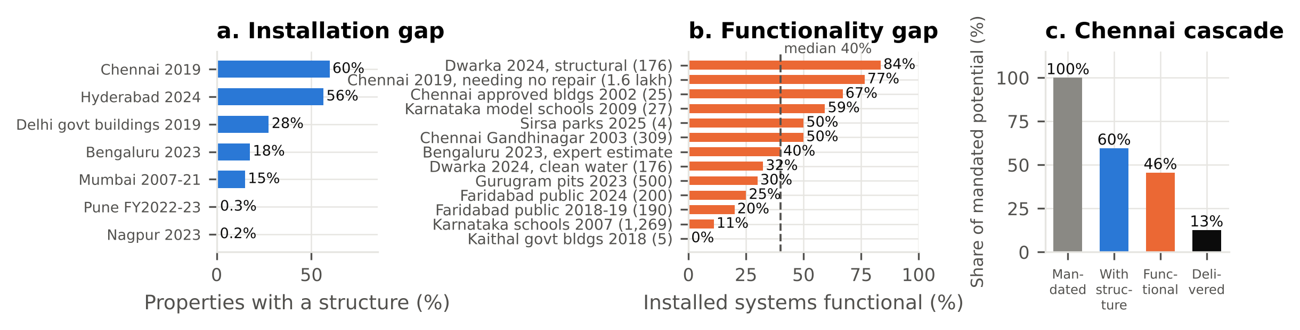
Result 2: installed is not the same as working
Installation: 60% of 2.72 lakh houses inspected in Chennai (2019), 56% in Hyderabad, 18% of connected properties in Bengaluru, below 1% in Pune and Nagpur. Functionality: 13 estimates from 12 surveys, median 40% of installed systems working (0 to 84%). Dwarka 2024: 84% structurally intact, only 32% recharging water free of faecal coliform.
Notes:
Two separate gaps: installation and functionality. Definitions differ between surveys; sample sizes in brackets.

Slide 9
Chennai: from mandate to water delivered
60%
of 2.72 lakh inspected houses had a structure (GCC, Aug-Sep 2019 snapshot)
46%
needing no repair: 77% of the 1.62 lakh structures, same inspection
13%
delivered, at the observed yield ratio of 28% (12% with Warud regraded). Bengaluru by the same chain: about 2%
Notes:
The cascade multiplies three independent figures. Say clearly that the last step uses the observed-tier median from a small sample.

Slide 10
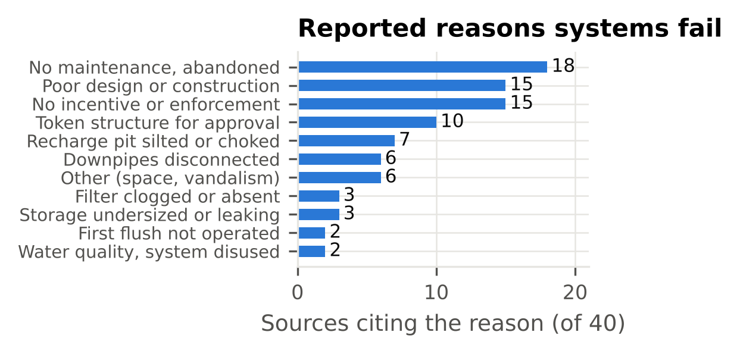
Result 3: why systems fail
Management causes are cited more often than component faults
No maintenance, abandoned: 18 sources
No awareness, incentive or enforcement: 15 sources
Poor design or construction: 15 sources
Token structure, built for compliance only: 10 sources
No maintenance is cited most often; missing incentive or enforcement ties with poor design or construction. Silted pits (7), disconnected downpipes (6) and clogged filters (3) are the faults a routine inspection would catch.
90 mentions from 40 surveys, audits and reports, counted by distinct source, 11 categories.
Notes:
Connect to the course theme: infrastructure as a service that needs an operator, not a one-time artefact.

Slide 11
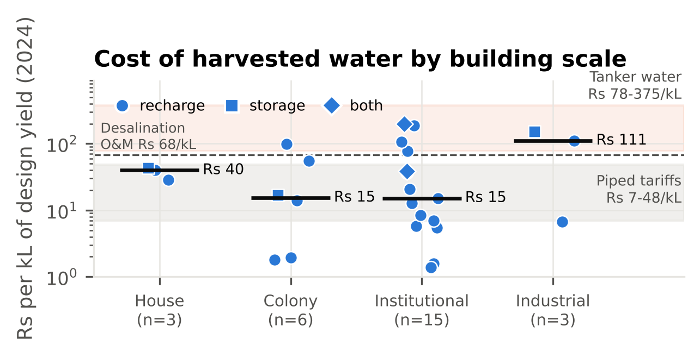
Result 4: cheap at design yield, below tanker prices at observed yield
Rs 21/kL
median levelised cost at design yield, 27 systems (IQR 7 to 66); recharge Rs 15, storage Rs 43
Rs 42/kL
at observed yield (multiplier 2.0): within piped tariffs (Rs 7 to 48), below desalination (Rs 68) and tankers (Rs 78 to 375)
Cost per kL falls steeply with catchment area (Spearman rho = -0.74, p < 0.001); scale groups not separable at these counts (Kruskal-Wallis p = 0.56)
Twenty rows are CSE Delhi projects of 2000 to 2004 (median Rs 13); the five post-2010 rows median Rs 98, about Rs 199 at observed yield, inside the tanker range. 2024 rupees, 15-year life, 8% (Rs 29 at 15%), O&M 2%
Notes:
Cost does not explain the gap. Even at observed yield harvested water beats the tanker water the same cities buy in dry years.

Slide 12
Unmeasured and under-delivering; reported failures point to enforcement
The mandates increased installation. Agencies report what they designed; we found only five metered sites, and those deliver about a quarter of potential.
Structures installed is an output indicator. Water delivered is the outcome. The mandates count structures, not water.
Reported failures point to maintenance and enforcement first; the technical faults listed are ones an inspection would catch.
Cost: within piped tariffs at design yield and below tanker prices even at observed yield for the median system. For an owner, recharge still costs more than piped water while the benefit is shared, so incentives matter.
1. Measure
Require a flow meter or recharge-well level logger on systems above a size threshold, so performance can be verified at all.
2. Inspect, then pay
Tie rebates and penalties to a periodic functional inspection, not a one-time completion certificate. Dwarka shows intact structures can recharge contaminated water.
3. Publish
Report installed-versus-functional counts every year, as Chennai did in 2019, so the gap is visible.
Notes:
Close the argument and give the three recommendations.

Slide 13
Limitations
Small observed tier
Heterogeneous inputs
7 observations at 5 sites, two of them storage-limited houses and one borderline (Warud). The 28% figure is indicative, not representative. Publication bias favours showcase systems, so the true gap is probably larger. Ramtek's low ratio is partly an intake limit of the dug well.
Four observations use an IMD city normal and four a CSE city average, not the year's rainfall. Panjab University's area and volume come from different documents. CSE design calculations use roof plus paved area.
Surveys differ
Costs and causality
Definitions range from 'needing no repair' to 'dry pit'; two estimates come from one Dwarka report and one is an expert estimate. Several figures reach us only through press reports; originals cited where found.
Cost rows are dominated by one programme (CSE Delhi, 2000 to 2004) and depend on the discount rate. Associations are not causal; a weak private incentive to maintain recharge pits is a competing explanation. All of these show why metering is needed.
Notes:
Be plain about what the data can and cannot support.

Slide 14
Contributions and what is submitted
Vedant Abhangrao
Submitted
Search strategy, screening log, mandate search
Report (2 pages, IMRaD) and Supplementary Information (15 pages: full tables, screening log, midway reconciliation, 168 source URLs)
Data: harmonised dataset for performance, cost, functionality, installation, failure modes and mandates; source extraction tables with a URL and verbatim quote for every number
Code: Python scripts that rebuild the dataset, statistics, figures and tables
Every number in the report is traceable to a source URL and a verbatim quote.
Nilay Shahapure
Data harmonisation, analysis code, figures, supplementary document
Arjun Jhunjhunwala
Cost and benchmark search, deflation, levelised cost
Yash Krishnani
Functionality and failure-mode search, report, presentation
All four members extracted records and cross-checked each other's rows against the source quotes.
Notes:
Statement of contributions, as required for the final presentation.

