Slide 1
Problem Statement & Objectives
Silent east to west failures: what Kubernetes readiness cannot see
THE PROBLEM
OBJECTIVES
• Pods can be Running and Ready while cross-node traffic is dropped, delayed, or policy-blocked.
• Liveness/readiness are local checks; node conditions and passive telemetry miss one-way and idle-path failures.
• Teams see application timeouts before the platform can name a cause.
• Probe every directed pod-to-pod path from the nodes workloads actually use.
• Localize the failure: pair, ingress, egress, isolated node, or whole mesh.
• Never report Healthy without evidence; separate hard failure from partial loss.
• Publish the verdict as Kubernetes status + Prometheus metrics, safely.
Ready ≠ Reachable
All pods can report Ready while the cross-node path is down or degraded.
WHAT SUCCESS LOOKS LIKE
DETECTION
FALSE ALARMS
40% LOSS (F5)
HARD FAULTS
60 / 60
0
20.7 s
~85 s
All six scenarios (F1 - F6) × 10 trials; hard-fault latency is the deliberate cost of 3-round hysteresis.
CN 2026 · Self-Healing Network Operator for Kubernetes
1 / 5
Notes:
Kubernetes tells us whether a container is alive, not whether a pod on node A can reach a pod on node B. Liveness and readiness checks are local; node conditions and passive telemetry miss one-way and idle-path failures. The project goal is a trustworthy, localized verdict published as Kubernetes state, with no false Healthy and no destructive remediation.

Slide 2
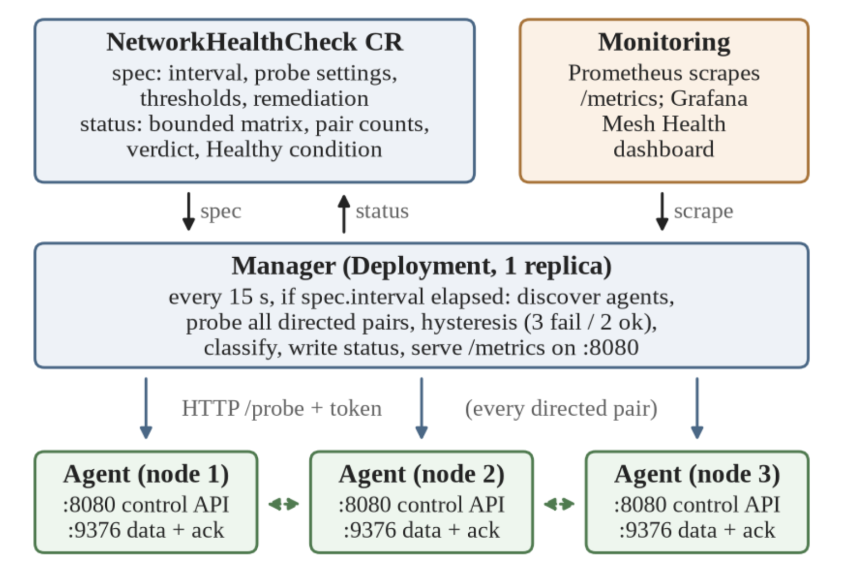
Architecture / Mechanism
Probes at the edge; verdict in the Kubernetes API
ONE ROUND
1. Wait until status.lastProbeTime is older than spec.interval.
2. Discover running agent pods with pod IPs.
3. For every ordered pair s → d, call s:8080/probe?target=d.podIP with a bearer token.
4. Run 5 probes: TCP dial, write payload, read a 1-byte acknowledgement.
5. Build the directed matrix → hysteresis (3 fails / 2 successes) → classify.
6. Write bounded status + metrics; remediation is AlertOnly.
Fig. 1 from the report: manager orchestrates; agents send data-plane probes.
Control :8080 is separate from data :9376, so an agent/control error becomes Unknown, not a fake network fault. Rows = sources, columns = destinations: a failed row is egress, a failed column is ingress.
CN 2026 · Self-Healing Network Operator for Kubernetes
2 / 5
Notes:
The manager never probes from itself. It asks the source agent to probe the destination, so the measurement follows the real pod network. The separate control and data ports let us distinguish a measurement failure from a data-plane failure. The classifier reads the shape of the matrix: a failed row is egress, a failed column is ingress, both is isolation.

Slide 3
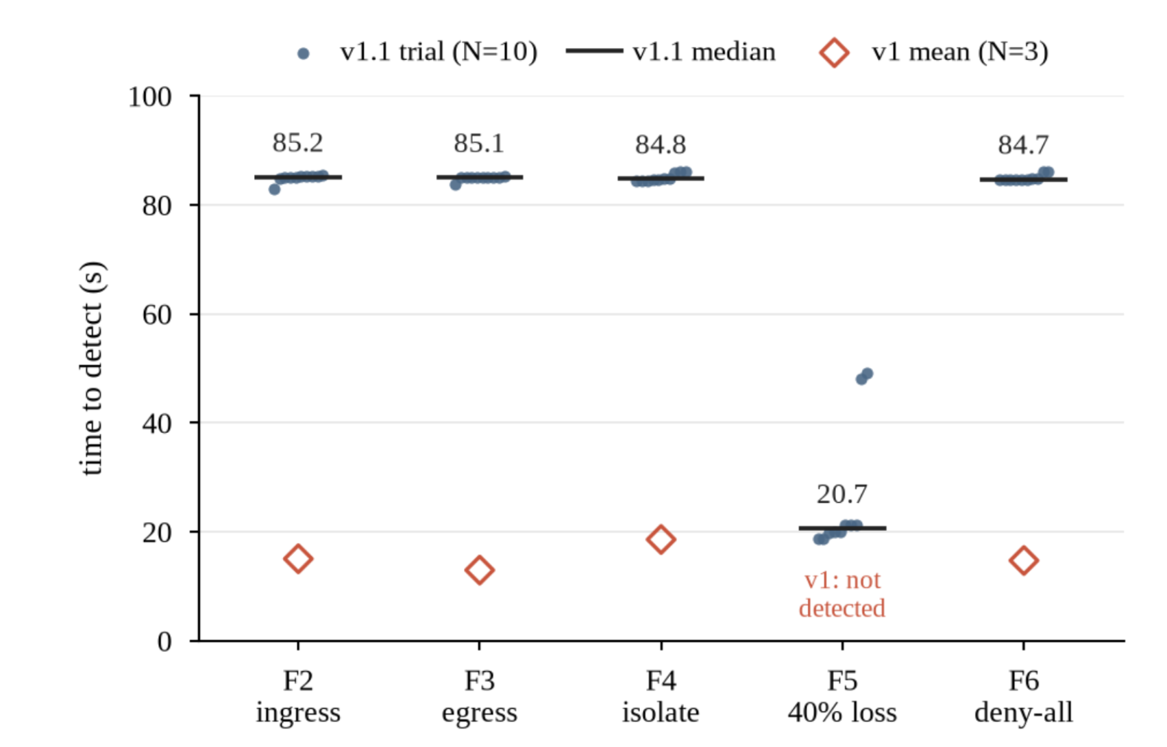
Extension / Issues Fixed / Evaluation
From “connect succeeded” to a trustworthy verdict
WHAT WE BUILT ON TOP OF v1
• Empty matrix: Healthy 1.0 → NoData, confidence 0.
• 40% loss: stayed Healthy → Degraded at a 5% loss threshold.
• One bad round could flip the verdict → live 3-fail / 2-recover hysteresis.
• Bare connect counted as success → bidirectional TCP acknowledgement.
• Open /probe was an SSRF/scanner primitive → token + CIDR allowlist, metadata IP rejected.
• Full matrix in etcd → 500-entry cap + counts + truncation flag.
• “Remediation” deleted probe agents → AlertOnly, no destructive action.
• Dashboard/docs named non-existent metrics → tests assert metric truth.
CORRECT
FALSE ALARMS
F5 MEDIAN
60/60
0
20.7 s
EVALUATION
• F1 healthy + F2-F6 faults × 10 trials: 60/60 correct.
• v1 detected hard faults in 13-19 s but missed F5 and could report Healthy with no data.
Dots: v1.1 trials; bars: v1.1 medians; diamonds: v1 baseline means. Hard faults ~85 s; F5 20.7 s.
CN 2026 · Self-Healing Network Operator for Kubernetes
3 / 5
Notes:
The 85 seconds is not noise. It is the deliberate cost of three consecutive failed rounds plus the 2-second per-probe timeout. F5 is faster because a lossy path still completes some probes, so it needs no failure hysteresis. v1 was faster on hard faults but missed partial loss and could claim health with an empty matrix. We chose correctness and stability over the fastest possible alarm.

Slide 4
Non-Functional Testing Parameters
Performance, scalability, reliability, safety, and operability
Attribute | How we tested it | Result
Performance | MTTD per scenario; healthy RTT; round duration; probes and bytes per round | Hard faults ~85 s; F5 20.7 s median; healthy RTT 0.1-0.6 ms; 30 probes / ≤30 KB per round for 3 nodes
Scalability | Directed full mesh; status-size test with 600 pairs | 6 pairs for 3 nodes, 506 for 23; status capped at 500 entries + full-matrix counts; sampling is future work
Reliability | 10 trials per scenario; 10 healthy controls; flapping fixture; agent-error path | 60/60 correct; 0 false positives; hysteresis and NoData/Unknown prevent false certainty
Safety / Security | Unauthenticated /probe; metadata and off-allowlist targets; remediation test | 401 without token; 403 for 169.254.169.254 / off-CIDR; no pod deletion
Simplicity / Reproducibility | Component count; unit tests; make + scripts | 1 manager + 1 DaemonSet + 1 CRD; 47 unit tests; KIND + Calico testbed rebuilt from scripts
Not measured: MTTR. Remediation is alert-only by design, so recovery is an operator action, not a controller claim.
CN 2026 · Self-Healing Network Operator for Kubernetes
4 / 5
Notes:
We separate measured numbers from design targets. Latency is small because KIND nodes share one host; the useful result is relative behavior and detection latency, not a physical-network benchmark. The status cap is a scalability guard, not a claim that we solved O(N^2) probing. We did not measure MTTR because the controller does not perform destructive repair.

Slide 5
Challenges Faced
Most failures were trust and safety bugs, not detection bugs
Challenge | What went wrong | Fix and evidence
Healthy without evidence | Empty matrix returned Healthy, 1.0 when no agents were running | NoData, confidence 0; unit test and status check
Heavy loss looked healthy | Success = any made 40% loss look reachable | Degraded at ≥5% loss; F5 10/10 correct
False success from a bare connect | A listener that accepts and closes still “succeeded” | Read a 1-byte acknowledgement; accept-close test now fails
Open probe endpoint | /probe accepted any target: SSRF and scanning risk | Bearer token + CIDR allowlist + metadata rejection; 401/403 tests
Remediation hid faults | Deleting agent pods cleared faults injected inside those pods | AlertOnly; faults injected at the KIND node level
Drift and testbed decay | Dashboard queried non-existent metrics; Calico token expired on long-lived KIND | Metric-truth test; documented calico-node restart
Lesson: the hard part was making the verdict trustworthy, bounded, and safe — not making a probe fail.
CN 2026 · Self-Healing Network Operator for Kubernetes
5 / 5
Notes:
Most of these are trust and safety bugs, not detection bugs. The remediation one is the most important: deleting the observer is not healing the network. Once we moved fault injection to the node level, a pod restart could no longer erase the fault. The dashboard and documentation drift mattered because a wrong metric is a wrong claim in a viva or an incident review.

