Slide 1

Seasonal Agriculture Performance Analysis
Nilay Dawn
Brainware University
AICTE STU ID : STU68184726cdff41746421542

Slide 2

PROBLEM STATEMENT
Agricultural activities are influenced by seasonal variations in environmental conditions, farming practices, resource availability and market conditions. As a result, agricultural performance may differ from one season to another. However, raw agricultural data does not clearly explain how agricultural performance changes across seasons or what patterns can be observed in different seasonal conditions. The problem is to analyze the given agricultural dataset and investigate seasonal differences in agricultural performance by identifying meaningful patterns, trends, relationships and variations within the available data.

Slide 3
Project Description
The primary objective of this project is to analyze agricultural data from different seasons and identify meaningful patterns, trends, relationships and differences in agricultural performance.
Explore and understand the dataset.
Clean and prepare the data for analysis.
Examine how agricultural performance varies across seasons.
Identify important seasonal patterns and trends.
Investigate relationships between seasonal conditions and agricultural outcomes.
Compare relevant groups within different seasons.
Identify significant differences or unusual patterns.
Apply appropriate statistical and visualization techniques.
Interpret findings based on evidence from the dataset.
Develop meaningful conclusions and data-driven recommendations.

Slide 4

WHO ARE THE END USERS?
Farmers & Farm Managers: To choose the most suitable crops for each season, optimize water and fertilizer use, minimize pest risks, and improve crop yield and profits.
Agricultural Policy Makers & Government Bodies: To design evidence-based seasonal agricultural policies, plan resource distribution, and develop regional support strategies.
Agronomists & Agricultural Researchers: To study seasonal performance trends, understand climate-crop relationships, and guide improved farming methodologies.
Agribusinesses & Supply Chain Stakeholders: To forecast seasonal harvest volumes, align procurement schedules, manage inventory, and anticipate market price variations.
Financial & Insurance Institutions: To evaluate seasonal production and economic risks, structure tailored crop loan products, and set accurate seasonal insurance covers.

Slide 5

Technology Used
Programming Language & Environment: Python 3 executed within Google Colab
Data Processing & Manipulation:
    Pandas: Used for loading tabular datasets, performing data cleaning, schema inspection, null value profiling, and seasonal aggregations.
    NumPy: Applied for mathematical arrays, numeric data type handling, and median imputation computations.
Data Visualization & Analytics:
    Matplotlib (pyplot): Employed for figure geometry, subplot layouts, customized axes, and presentation-ready plotting.
    Seaborn: Utilized for whitegrid thematic styling, categorical frequency bar charts, and continuous kernel density estimation (KDE) distributions.

Slide 6
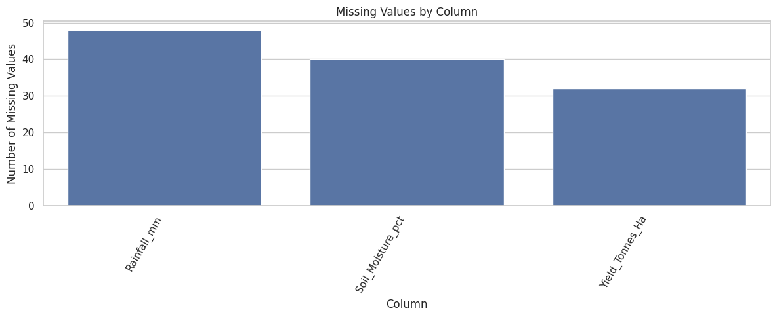
RESULTS - Data Cleaning & Missing Value Treatment
Dataset Profile: 4,000 observations and 28 attributes with 0 duplicate rows across 8 states and 10 districts.
Missing Data Identified:
Rainfall: 48 missing values (1.20%)
Soil Moisture: 40 missing values (1.00%)
Yield: 32 missing values (0.80%)
Imputation Technique: Handled via median imputation for numerical features, successfully bringing the remaining missing values to 0.

Slide 7
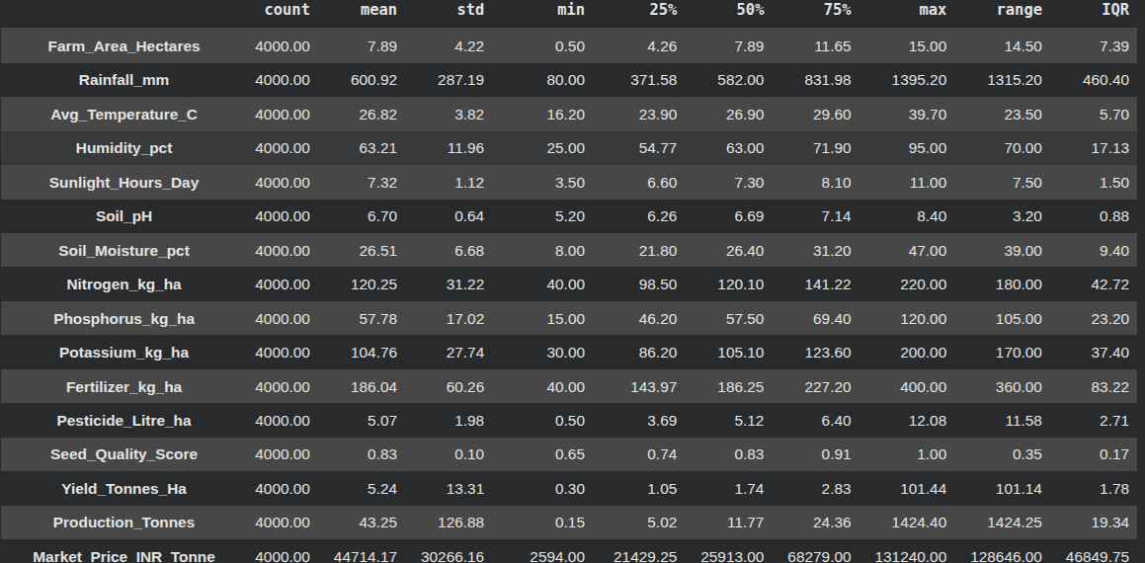
RESULTS – Overall Statistical Summary
[Add screen shots of your code ]
Farm Dynamics: Farm area ranges between 0.50 ha and 15.00 ha, averaging 7.89 ha.
Yield Variations: Mean yield is 5.24 tonnes/ha, while median yield is 1.74 tonnes/ha, indicating positive skewness from high-yield outliers.
Financial Spread: Average total cost is ₹5,26,303.58 compared to an average revenue of ₹6,37,860.05.
Profitability: Net profit averages ₹1,11,556.46 but displays wide variation ranging from a loss of -₹10,19,223.00 to a peak profit of ₹43,45,421.00.

Slide 8
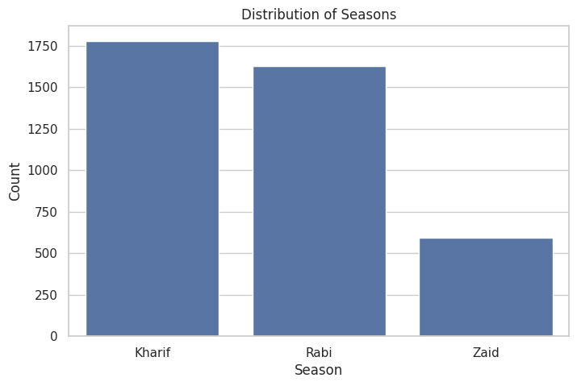
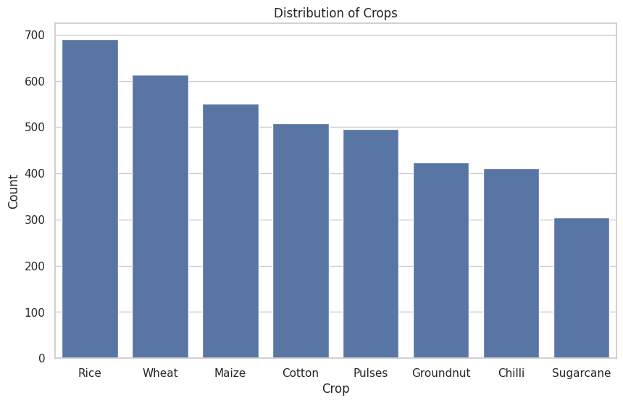
RESULTS – Univariate Categorical Distributions
Seasonal Distribution: Kharif represents the highest volume with 1,779 farm records (44.5%), followed by Rabi and Zaid.
Crop Representation: Rice is the most frequent crop (690 records), followed by balanced representations across Wheat, Maize, Cotton, Pulses, Chilli, Sugarcane, and Groundnut.
Irrigation Systems: Flood irrigation is the most dominant technique (1,310 farms), supported by Drip, Sprinkler, and Rainfed methods.

Slide 9
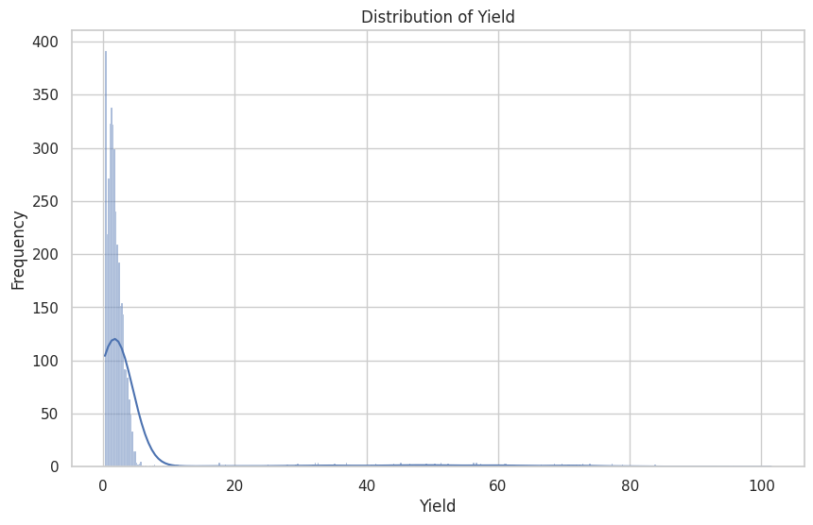
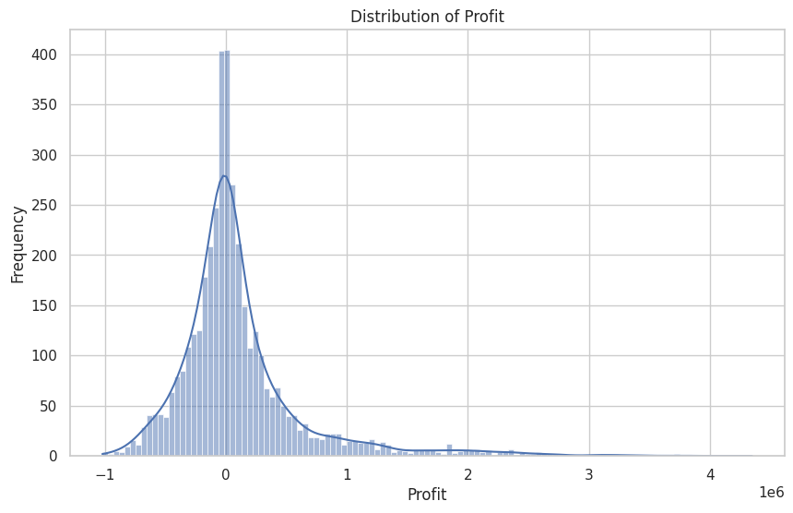
RESULTS – Yield & Profit Distribution Analysis
Yield Skewness & Outliers:
Most crop yields cluster tightly around 1.05 to 2.83 tonnes/ha (median: 1.74 tonnes/ha), but the mean rises to 5.24 tonnes/ha due to exceptional extreme yields reaching up to 101.44 tonnes/ha.
The distribution displays strong right-skewness, showing that standard operations yield modest volumes while select high-efficiency farms achieve massive outputs.
Financial Variance & Spread:
Revenue peaks up to ₹50,80,900.00, while production costs can climb to ₹13,49,990.00.
While 50% of the farms operate close to the break-even mark (median profit: ₹3,673.00), the bottom 25% suffer losses down to -₹10,19,223.00, highlighting severe seasonal and operational income volatility.
Analytical Takeaway:
Simple average metrics mask the operational realities of struggling farms; median-based planning is essential when structuring agricultural credit and support schemes.

Slide 10
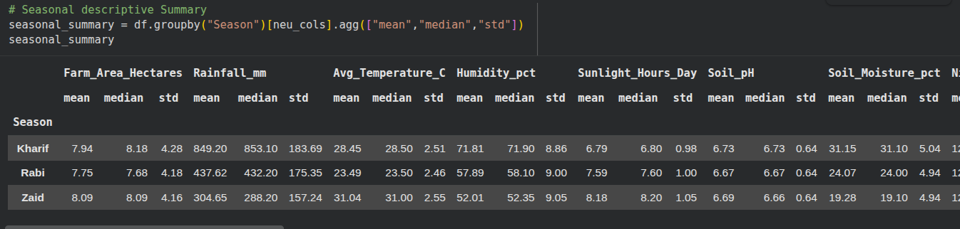
RESULTS – Seasonal Performance Comparison
Weather & Environmental Trends:
Kharif records the highest rainfall (mean 849.20 mm) and soil moisture (mean 31.15%).
Zaid records the highest temperature (mean 31.04°C) and lowest rainfall (mean 304.65 mm).
Agronomic Performance:
Yield peaks in Kharif at 5.63 tonnes/ha, compared to 5.04 tonnes/ha in Rabi and 4.64 tonnes/ha in Zaid.
Disease and pest risk is elevated in Kharif (54.47%) due to heavy moisture, versus 40.48% in Rabi and 38.22% in Zaid.
Economic Outcomes:
Kharif yields the highest mean profit of ₹1,78,914.65.
Zaid registers an average net loss of -₹24,804.82 and a median loss of -₹62,144.00, reflecting severe cost burdens during dry summer conditions.

Slide 11
Future scope
Machine Learning & Predictive Modeling: Implement supervised learning algorithms (such as Random Forest, LightGBM, and XGBoost) to forecast crop yield, production volumes, and profit margins based on seasonal weather and soil parameters.
Resource Optimization & Smart Irrigation: Design an automated advisory framework to optimize irrigation scheduling and fertilizer dosages, directly targeting improvements in water-use efficiency and cost reduction.
Early Pest and Disease Outbreak Prediction: Build an early-warning risk prediction module that correlates temperature, humidity, and rainfall patterns to alert farmers ahead of high-risk periods, especially during the Kharif season.
Crop Recommendation & Market Decision Support: Develop a dynamic recommendation engine helping farmers select the most economically viable crops based on district-level soil profiles, seasonal climate forecasts, and historical price volatility.
Interactive Dashboard Deployment: Package the analytical pipeline into a real-time web dashboard (using Streamlit or Dash) to enable policymakers, agronomists, and local farmers to simulate seasonal scenarios and make data-driven decisions.

Slide 12
GitHub Link
https://github.com/nilayDawn/Seasonal-Agriculture-Performance-Analysis

Slide 13

VOIS Course completion certificate -
Course name- Data Visualization

Slide 14
Thank you
.
.

