Slide 1
Performance Analysis of Different Algorithm for Multiclass Classification on Intel image classification data set
By
Jaykumar (193100008)
Akash Nandalal Gajbhiye (193100039)
Nilay Bhagat (193100043)
Gaurav Kohad (193010037)
Sachin Bhuibar (193010014)

Slide 2
Problem Definition
Analysis of Various Algorithms that can be used for Multiclass Image Classification
Image classification have huge dataset and size and takes lot of computations due to which the time it takes and accuracy has to be considered simultaneously.

Slide 3
Team Members And Contributions
Jaykumar : Commonly used Algorithms
Akash Nandalal Gajbhiye : Commonly used Algorithms
Nilay Bhagat : Data Visualisation & high performance Algorithms
Gaurav Kohad : Data Visualisation & high performance Algorithms
Sachin Bhuibar : Commonly used Algorithms

Slide 4
Libraries Used
Scikit-image is a Python package dedicated to image processing, and using natively numpy arrays as image objects. skimage provides several utility functions that can be used on label images (i.e. images where different discrete values identify different regions.
Os -The OS module in Python provides a way of using operating system dependent functionality. The functions that the OS module provides allows you to interface with the underlying operating system that Python is running on – be that Windows, Mac or Linux.
CV2-OpenCV-Python is a library of Python bindings designed to solve computer vision problems. ... All the OpenCV array structures are converted to and from Numpy arrays. This also makes it easier to integrate with other libraries that use Numpy such as SciPy and Matplotlib.

Slide 5
Tensorflow-TensorFlow is a Python library for fast numerical computing created and released by Google. It is a foundation library that can be used to create Deep Learning models directly or by using wrapper libraries that simplify the process built on top of TensorFlow. TensorFlow is mainly used for: Classification, Perception, Understanding, Discovering, Prediction and Creation. It allows developers to create large-scale neural networks with many layers.
TQDM-TQDM is a progress bar library with good support for nested loops and Jupyter / IPython notebooks. TQDM uses smart algorithms to predict the remaining time and to skip unnecessary iteration displays, which allows for a negligible overhead in most cases.

Slide 6
Algorithms used
CNN
Decision Tree Classifier
KNN
Logistic Regression
Naïve Bayes classification
Neural Network
Random Forest Classifier
Support Vector Machine
XGBoost

Slide 7
Neural Network
Pros
Neural networks are flexible and can be used for both regression and classification problems. Any data which can be made numeric can be used in the model.
Neural networks are good to model with nonlinear data with large number of inputs like images. It is reliable in an approach of tasks involving many features.
Once trained, the predictions are pretty fast.
Neural networks can be trained with any number of inputs and layers.
Neural networks work best with more data points.
Cons
Neural networks are black boxes, meaning we cannot know how much each independent variable is influencing the dependent variables.
It is computationally very expensive and time consuming to train with traditional CPUs.
Neural networks depend a lot on training data. This leads to the problem of over-fitting and generalization. The mode relies more on the training data and may be tuned to the data.

Slide 8
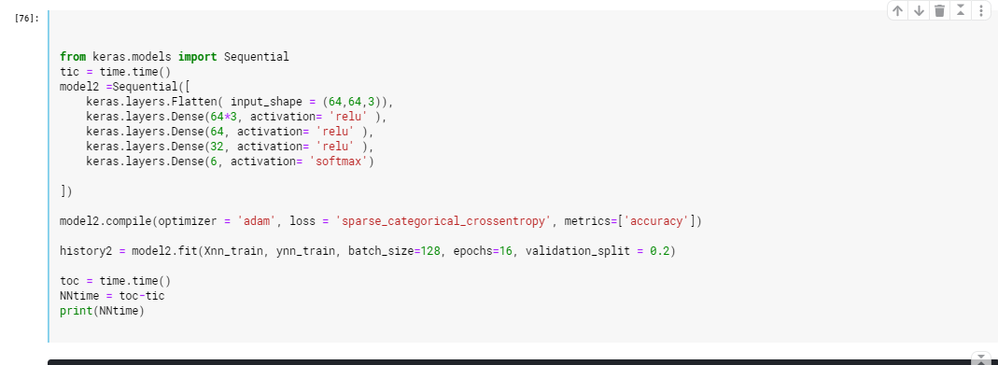
NN(code)

Slide 9
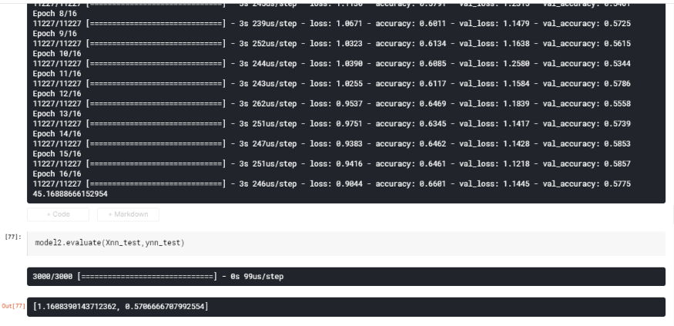
NN(Accuracy)

Slide 10
Random Forest
Pros
The predictive performance can compete with the best supervised learning algorithms.
They provide a reliable feature importance estimate.
They offer efficient estimates of the test error without incurring the cost of repeated model training associated with cross-validation.
Cons
An ensemble model is inherently less interpretable than an individual decision tree.
Training a large number of deep trees can have high computational costs (but can be parallelized) and use a lot of memory.
Predictions are slower, which may create challenges for applications.

Slide 11
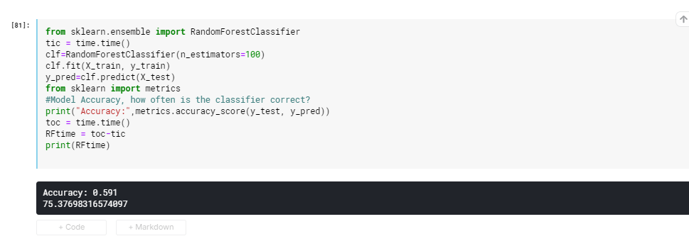
RF(code and Accuracy)

Slide 12
Support Vector Machine
Pros
It works really well with a clear margin of separation.
It is effective in high dimensional spaces.
It is effective in cases where the number of dimensions is greater than the number of samples.
It uses a subset of training points in the decision function (called support vectors), so it is also memory efficient.
Cons
It doesn’t perform well when we have large data set because the required training time is higher
It also doesn’t perform very well, when the data set has more noise i.e. target classes are overlapping
SVM doesn’t directly provide probability estimates, these are calculated using an expensive five-fold cross-validation. It is included in the related SVC method of Python scikit-learn library.

Slide 13
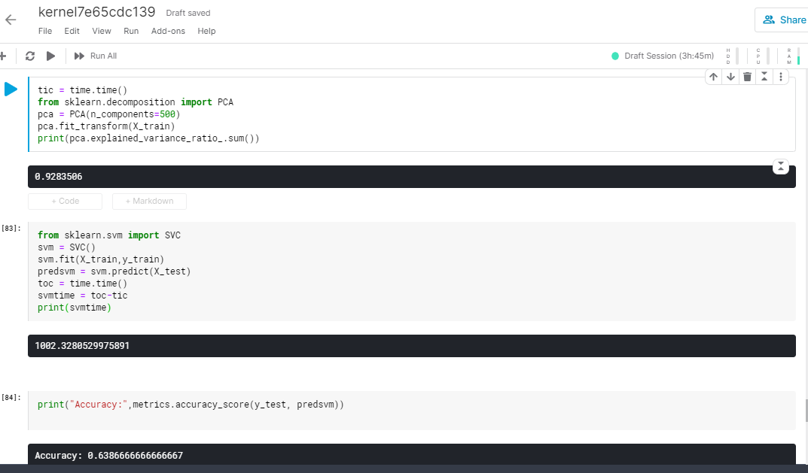
SVM(Code and Accuracy)

Slide 14
XGBoost
Pros
Less feature engineering required (No need for scaling, normalizing data, can also handle missing values well)
Feature importance can be found out(it output importance of each feature, can be used for feature selection)
Fast to interpret.
Outliers have minimal impact.
Handles large sized datasets well.
Good Execution speed.
Good model performance (wins most of the Kaggle competitions).
Less prone to over-fitting.
Cons
Difficult interpretation , visualization tough.
Over-fitting possible if parameters not tuned properly.
Harder to tune as there are too many hyper-parameters.

Slide 15
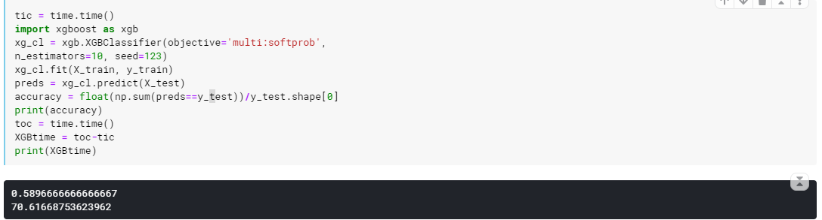
XGB(Code and Accuracy)

Slide 16
Convolutional Neural Network
Pros
it automatically detects the important features without any human supervision.
take advantage of local spatial coherence in the input (often images), which allow them to have fewer weights as some parameters are shared.
takes the form of convolutions, makes them well suited to extract relevant information at a low computational cost.
they are based off how the human brain’s image processing works and copying nature is normally good.
Cons
CNN do not encode the position and orientation of object.
Lack of ability to be spatially invariant to the input data.
Hyperparamter tuning is non-trivial.
Need a large dataset.

Slide 17
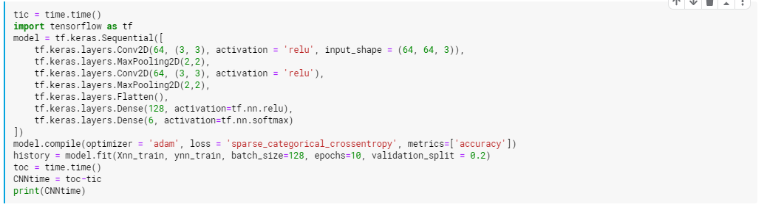
CNN(Code and Accuracy)

Slide 18
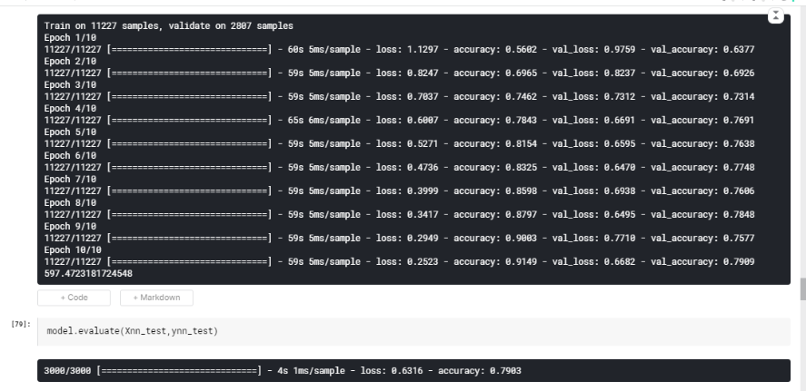

Slide 19
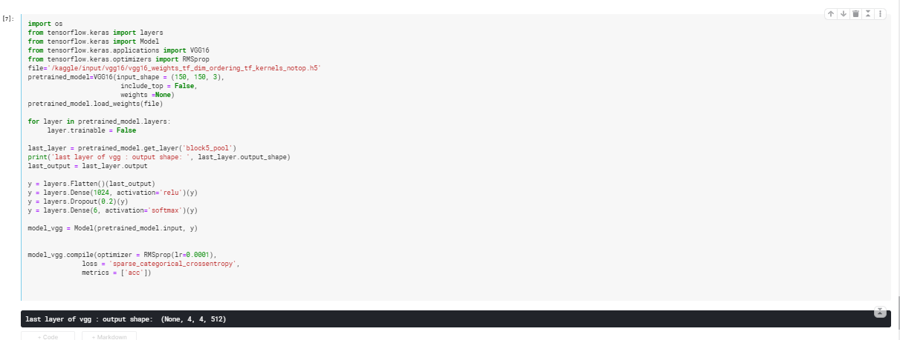
CNN with VGG (Code and Accuracy)

Slide 20
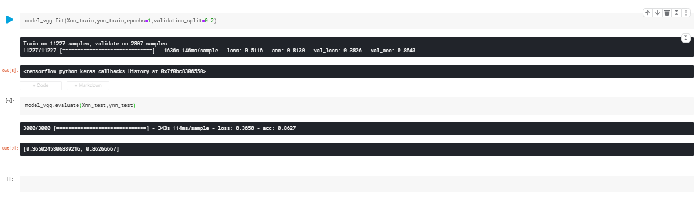

Slide 21
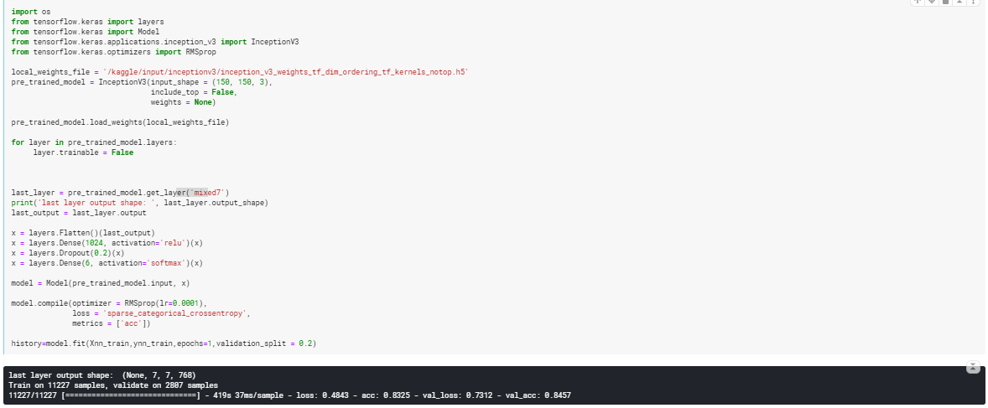
CNN with InceptionV3(Code and Accuracy)

Slide 22
DTC
Pros
Pretty intuitive and simple.
Very easy to implement for multi-class problem.
does not require normalization of data.
Missing values in the data also does NOT affect the process of building decision tree to any considerable extent.
does not require scaling of data as well.
Cons
is relatively expensive as complexity and time taken is more.
It is a slow algorithm.
works well with small number of input variables but accuracy decreases with increase in variables.

Slide 23
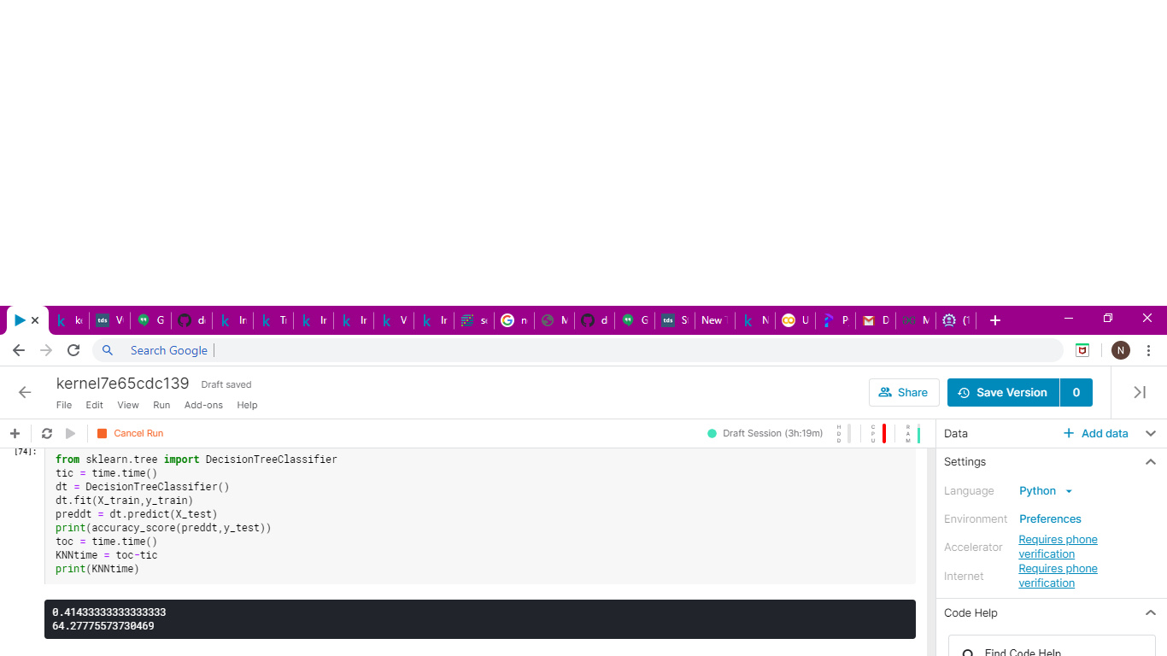
DTC(code and accuracy)

Slide 24
k-NN (K Nearest Neighbors)
Pros
Simple to understand and implement
No assumption about data
Constantly evolving model
One Hyper Parameter
Cons
Slow for large datasets.
Curse of dimensionality
Scaling of data absolute must.
Does not work well on Imbalanced data..
Sensitive to outliers.
Can’t deal well with missing values

Slide 25
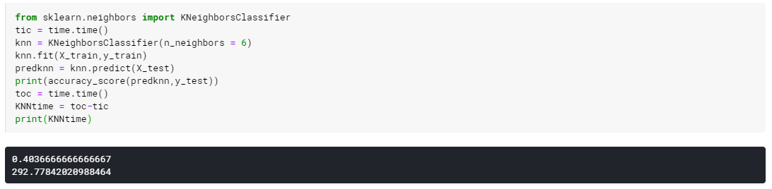
KNN(code and accuracy)

Slide 26
Logistic Regression
Pros
Simple to implement.
Tuning of hyperparameters not needed.
Logistic Regression performs well when the dataset is linearly separable.
Logistic regression is less prone to over-fitting but it can overfit in high dimensional datasets.
Cons
Poor performance on non-linear data.
Poor performance with irrelevant and highly correlated features.
High reliance on proper presentation of data. All the important variables / features should be identified for it to work well.
If the number of observations are lesser than the number of features, Logistic Regression should not be used, otherwise it may lead to overfit.

Slide 27
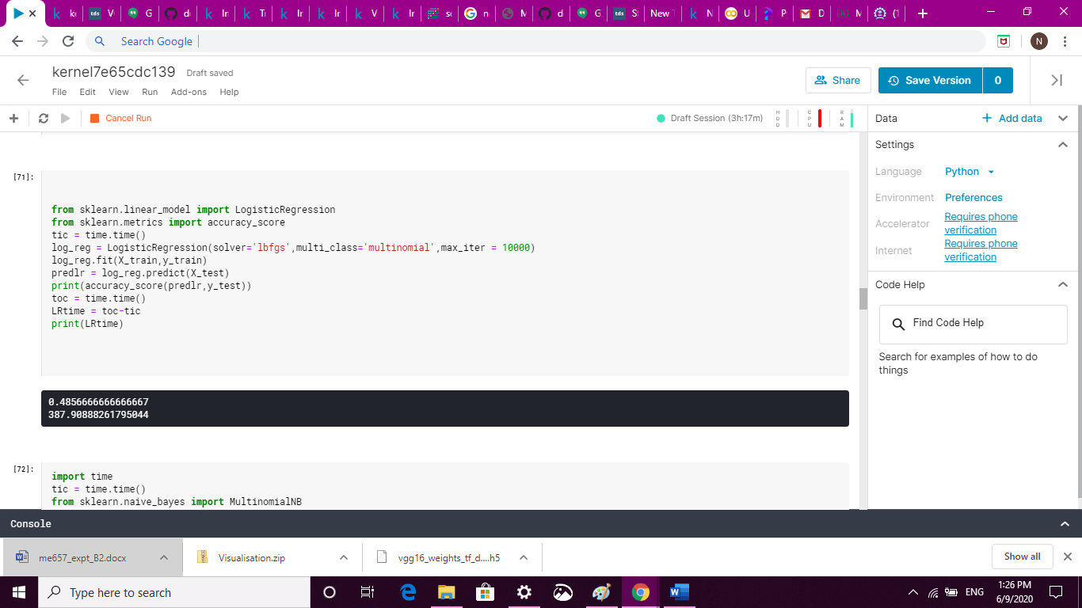
Logistic Regression(code and Accuracy)

Slide 28
Naïve Bayes Classifier
Pros
It is easy and fast to predict class of test data set.
It also perform well in multi class prediction.
When assumption of independence holds, it performs better compare to other models like logistic regression and need less training data.
perform well in case of categorical input variables compared to numerical variable.
Cons
It consider every feature independent which is not the case everytime.
also known as a bad estimator, so the probability outputs from predict_proba are not to be taken too seriously.
model will assign a 0 probability with no observation in data set leading to error.

Slide 29
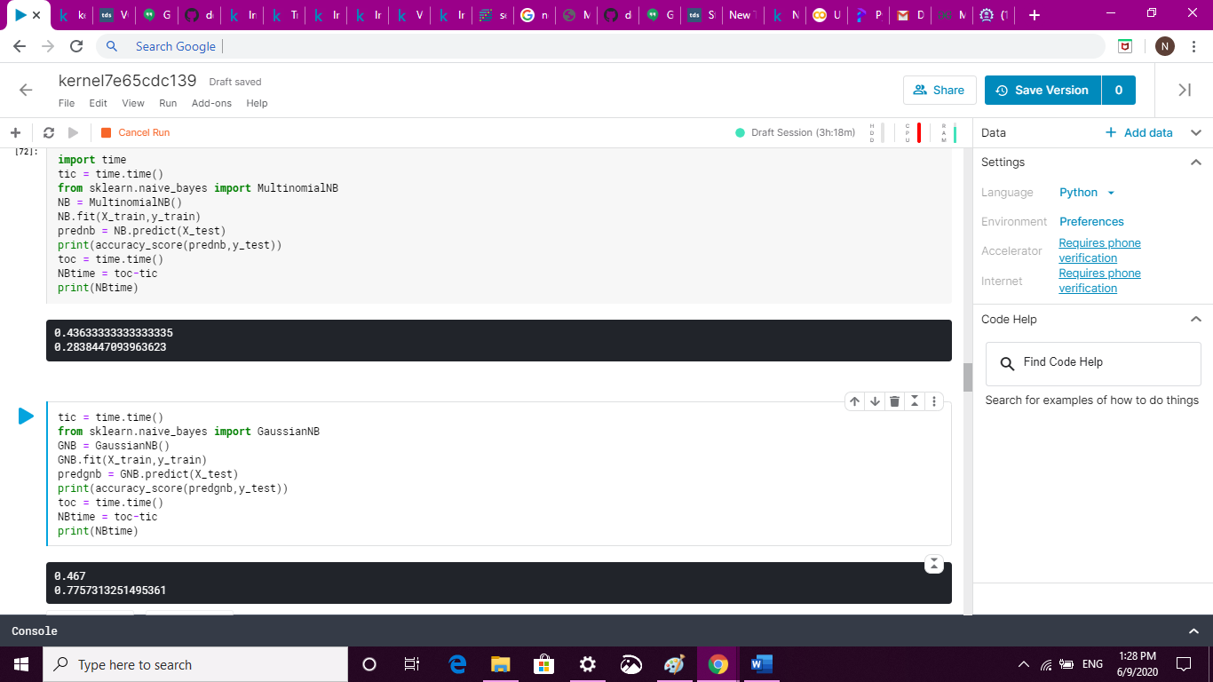
NB Classifier (Code and Accuracy)

Slide 30
Result
Algorithm | Test Accuracy ( % ) | Time ( sec )
Neural Network | 67.06 | 50
Decision Tree | 41.46 | 64
Random Forest | 59.1 | 75
XGBoost | 58.96 | 70
SVM (With PCA) | 63.866 | 1002
CNN | 79 | 604
CNN(VGG16) | 86.26 | 1979
CNN(InceptionV3) | 84.93 | 475
Logistic Regression | 48.56 | 388
Naïve Bayes | 46.7 | 0.77

Slide 31
Conclusions
The most effective algorithm was found to be convolutional neural network.
CNN are most effective in case of image classification problems.
The accuracy level was found to be 79.09% with 14,034 images to train the network and 3000 images for test set.
But for further increase in accuracy we need to use advanced algoritms like VGG and InceptionV3
Logictic Regression not performed well as expected but takes some time and computational resources for such big data set
Naive Bayes accuracy is similar to logistic regression but is very fast. Naive Bayes is very good for rough estimate on small dataset
Random forest performs better than decision tree classifier as expected.
Xgboost doesnot increase accuracy compared to random forest for image classification is verified.

