Slide 1
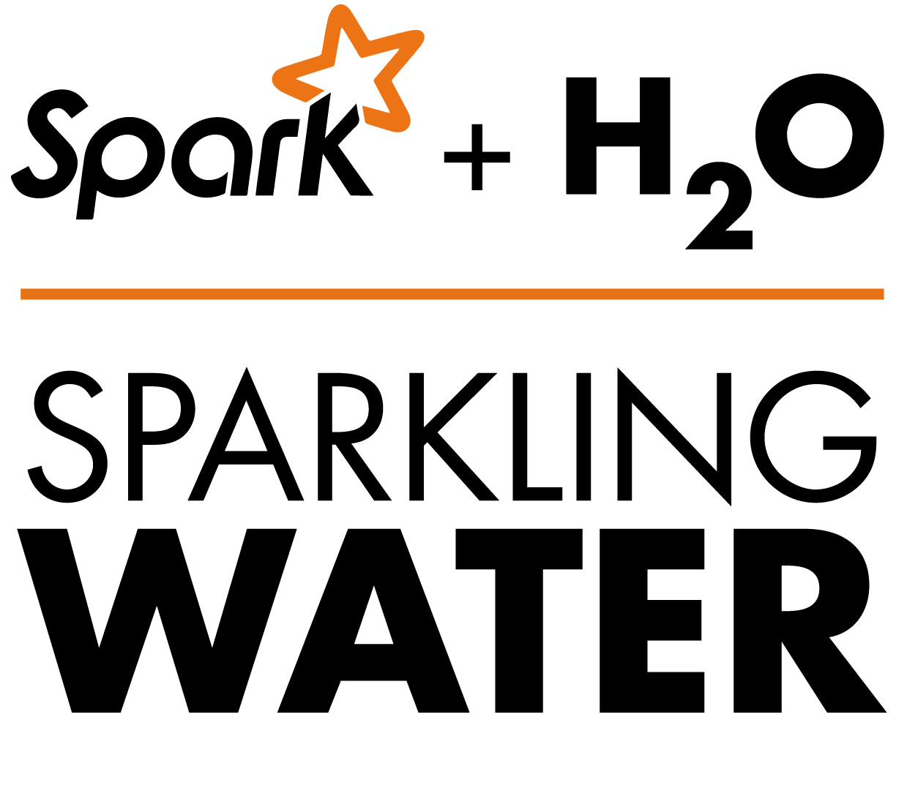

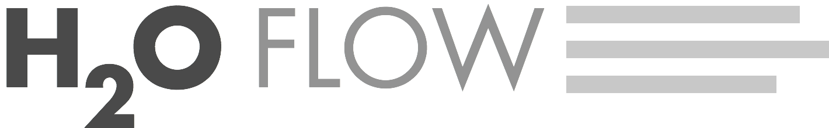

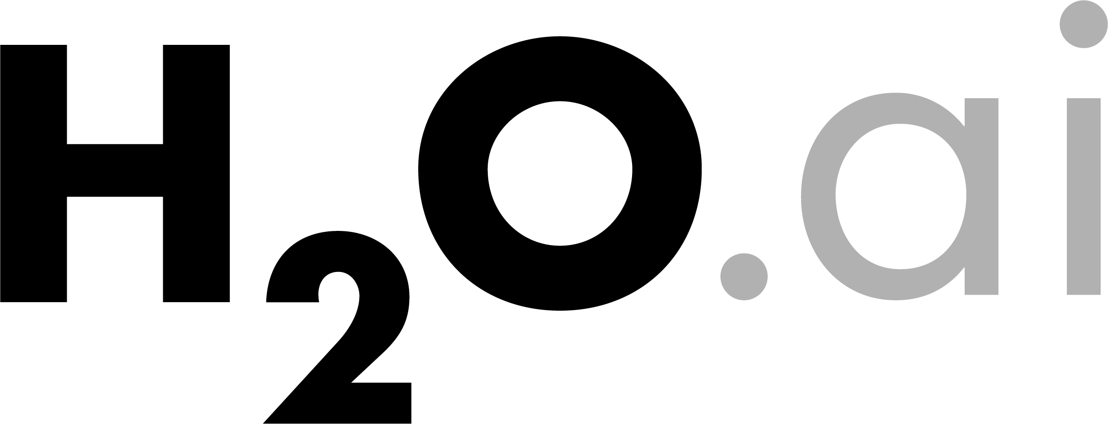
Sparkling Water cluster of size 3 on YARN
Scala main program
YARN container
YARN container
YARN container
Spark executor
Spark executor
Spark executor
worker
worker
worker
client
+Mllib worker
+Mllib worker
+Mllib worker
+Mllib client
YARN node manager
YARN node manager
YARN node manager
Driver
Hadoop + HDFS

