Slide 1
Architecting an Energy-Efficient DRAM System for GPUs
Niladrish Chatterjee, Mike O’Connor, Donghyuk Lee, Daniel R. Johnson,
Stephen W. Keckler, Minsoo Rhu, William J. Dally

Slide 2
Motivation
Energy-efficient DRAM for GPU bandwidth scaling
GPU Performance = Bandwidth
Bandwidth = DRAM Power / Energy-per-bit

Slide 3
HBM2 Energy Consumption
High row-energy
DRAM Bank
DRAM dies in tack
Read 3
Read 1
Activate
Read 2
Row Buffer
Activation Energy:
1819 pJ
2049 pJ
TSV Array
Data Movement Energy:
1366 pJ
683 pJ
I/O Energy:
186 pJ
62 pJ
124 pJ
32
Bytes read
64
96
6.5
10.0
pJ/bit
5.3
Base-layer die with I/O

Slide 4
Low Row Locality in GPU Applications
A small fraction of the 2KB row is accessed
Inter-thread Contention for Row-buffers
Irregular Access Patterns
48%
Average Bytes-Per-Activate : 269 (~1/8th of row)

Slide 5
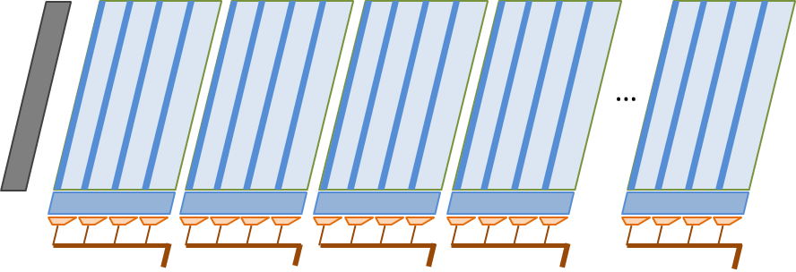
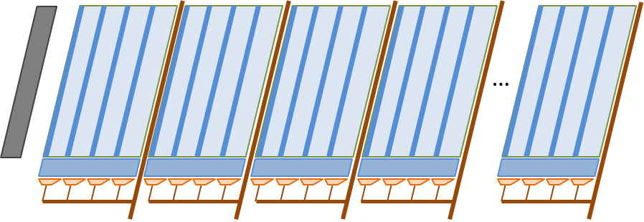
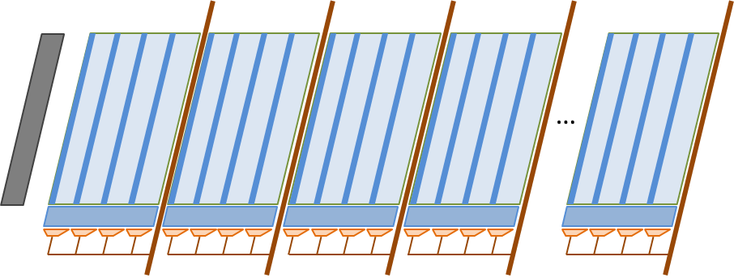
DRAM Bank Architecture
Hierarchical organization
DRAM
Bank
Subarray
Row-decoder
Local Sense Amps
2KB Row Buffer
Wordline Driver
…

Slide 6
Row Activation
Exploiting the hierarchical wordline
Mats
Segment Select Driver
The Master Wordline is driven across the subarray, and the local Wordline drivers redrive the signal in each mat
Subarray
Each subarray is a row of mats, with each mat providing 8 bits of the DRAM atom
Our proposal : selectively activate a subset of the mats
…
Master Wordline Driver
Can we increase the per-mat bandwidth ?
Local Wordline Driver
Column Muxes (32 x 8 bits)
Column Muxes (4 x 8 bits)

Slide 7
Increasing the per-mat bandwidth
High area overhead
Few metal layers in the DRAM process
Area dictated by number of horizontal and vertical tracks
Increasing bandwidth per mat
More metal tracks for data wires and latches in the periphery
Keep the per-mat bandwidth unchanged
Challenge 1 : Reduced per-transfer bandwidth
Challenge 2: Higher Data Movement Energy

Slide 8
Challenge 1: Managing reduced per-transfer bandwidth

Slide 9
Subchannels
Parallel operations in the same bank
Subchannels
Subchannel : Narrow slice of the entire datapath
Subarrays can activate different rows simultaneously
Subchannels can read/write different DRAM atoms in parallel
Aggregate data bandwidth across subchannels is the same as the baseline
…
Implementation requires address latches to support parallel commands

Slide 10
Managing subchannels
Handling the parallelism
The GPU’s memory system is well-suited to exploit subchannels
High memory-level-parallelism and need for bandwidth
Multiple subchannels can be kept busy
Small increase in unloaded DRAM latency does not affect performance
Deep reorder buffers in memory controller
Necessary segments from a row can be identified prior to activation
Subchannels are managed as semi-independent channels
Shared command-and-address bus

Slide 11
Challenge 2: Mitigating increased datapath energy

Slide 12
Datapath energy
Higher datapath energy compared to baseline
16% increase on average
Narrow datapath increases switching activity

Slide 13
Datapath Energy
Depends on data values
8 Single Precision values
Word 7
Word 6
Word 5
Word 4
Word 0
32-byte DRAM atom
4 Double Precision values
Word 7
Word 5
Word 0
MSBs of different words are correlated
LSBs of different words are correlated

Slide 14
Data Transfer
Correlation between successive bytes
Datapath
256-bit internal
No Toggling
I/O Buffer
Correlated parts of words on the same wire
16
17
18
19
20
21
22
23
24
25
26
27
28
29
30
31
128-bit
DDR
0
1
2
3
4
5
6
7
8
9
10
11
12
13
14
15

Slide 15
Data Transfer
30
31
Uncorrelated bits in successive cycles on a wire
High toggle rate
28
29
26
27
Subchannels
24
25
28
29
30
31
Datapath
22
23
24
25
26
27
20
21
20
21
22
23
Solution
Store DRAM atom in reduced toggling order.
Memory controller to scramble and unscramble data
32-bit internal
18
19
16
17
18
19
16
17
12
13
14
15
8
9
10
11
14
15
I/O Buffer
12
13
4
5
6
7
10
11
0
1
2
3
16-bit
DDR
8
9
6
7
Higher energy
4
5
2
3
0
1

Slide 16
Reduced Switching Order
5
7
13
15
Correlated bits sent in successive cycles
21
23
Correlated bits successively on a wire
29
31
Datapath
13
15
5
7
25
27
29
31
21
23
17
19
32-bit internal
17
19
25
27
9
11
1
3
9
11
1
3
Data movement energy is restored to baseline levels
12
14
4
6
4
6
28
30
20
22
12
14
I/O Buffer
16
18
24
26
20
22
0
2
8
10
28
30
16-bit
DDR
24
26
Is there a better order ?
16
18
8
10
0
2

Slide 17
Evaluation

Slide 18
Methodology
Open source CUDA benchmarks (Lonestar, Rodinia), HPC applications, STREAM and GUPS
Games and rendering engines
In-house performance simulator – modeling a NVIDIA Pascal GPU
60 SMs, 6MB LLC, 1TB/s Bandwidth
HBM energy model based on device characteristics, wire capacitances and floorplan

Slide 19
DRAM Energy Consumption
35% reduction
Higher benefits for applications with lower locality.
Mitigating data movement energy important for applications with good locality
HBM2
Subchannels

Slide 20
GPU Performance
13% improvement
High-locality applications can utilize the entire bandwidth.
Small benefits from increased read-write parallelism.
Low Locality
Low memory intensity
High Locality
Low-locality applications benefit from overlapped activates and tFAW relaxation.

Slide 21
Summary
Energy-efficient DRAM a key requirement for continuous performance scaling of GPUs.
GPU-specific DRAMs push envelopes of existing technologies
Co-designing the memory controller and DRAM for energy-efficiency and performance at low area overhead
Further improvements require reducing datapath energy

Slide 22
Thanks !

Slide 23
Backup Slides

Slide 24
Graphics applications
Bytes-per-activate
Average Bytes-per-Activate = 586 (28% of row)

Slide 25
Graphics applications
Energy-per-bit

Slide 26
Local Wordline Driver
LWL
LWD
Mat 0
Mat 1
Mat 2
Mat 3
MWL[0]
MWL[1]
MWL[2]
MWL[3]
MWL[4]
MWL[127]
LWLsel[0]
LWLsel[1]
LWLsel[2]
LWLsel[3]

Slide 27
Subchannel 0
Subchannel 1
Mat 0
Mat 1
Mat 2
Mat 3
MWL[0]
MWL[1]
MWL[2]
MWL[3]
MWL[4]
MWL[127]
SS[0]
SS[1]
LWLsel[0]
LWLsel[1]
LWLsel[2]
LWLsel[3]

