Slide 1
Architecting an Energy-Efficient DRAM System for GPUs
Niladrish Chatterjee, Mike O’Connor, Donghyuk Lee, Daniel R. Johnson,
Stephen W. Keckler, Minsoo Rhu, William J. Dally

Slide 2
Motivation
Energy-efficient DRAM for GPU bandwidth scaling
GPU Performance = Bandwidth
Bandwidth = DRAM Power / Energy-per-bit
Notes:
Why do we need energy-efficient DRAMs for GPU ? The simple answer is for performance. In GPUs, memory bandwidth is a key enabler of performance. Thus memory bandwidth scaling is synonymous with performance scaling. For a given DRAM power budget, the maximum bandwidth is decided by the energy-per-bit. Lower the energy-per-bit, higher the aggregate bandwidth and vice versa. The lack of energy efficiency is becoming an impediment towards building systems with larger aggregate bandwidth. Let’s see how. Traditional, off-package GDDR5 memories consume about 14pJ/bit. These devices were adequate for building systems with moderate amount of bandwidth – keeping the DRAM power envelope within 60Watts. However, if these devices were used to design a modern 1TB/s GPU, then the power consumption would become too high. Stacked, on-package memories, such as HBM, came to the rescue, eliminating the costly I/O links on the PCB, reducing DRAM energy to around 5 pJ/bit and enabling the creation of systems such as the latest Pascal chip. However if we stay on this path, future GPUs with 4TB/s bandwidth, in the exascale timeframe, would again dissipate unacceptable levels of DRAM power at peak. So, there is now a need to come up with the next step after HBM. Thus in this paper, we focus on reducing the energy consumption of DRAM devices.

Slide 3
HBM2 Energy Consumption
High row-energy
DRAM Bank
DRAM dies in tack
Read 3
Read 1
Activate
Read 2
Row Buffer
Activation Energy:
1819 pJ
2049 pJ
TSV Array
Data Movement Energy:
1366 pJ
683 pJ
I/O Energy:
186 pJ
62 pJ
124 pJ
32
Bytes read
64
96
6.5
10.0
pJ/bit
5.3
Base-layer die with I/O
Notes:
To understand the HBM energy consumption we enlist the different components of DRAM energy. First, a row is activated, to bring 2KB of data into the row-buffer. This incurs around 1.8nJ of energy. If we read a DRAM atom, or 32bytes from this row, the data has to travel across the DRAM die, down through TSVs, across the bottom die to the I/O PHYs, and then be sent out to the GPU over the I/O links. Overall, with just one 32Byte read from a row, we incur around 10pJ/bit of energy. A second and third read would amortize the cost of the activate, incuring lower overall energy. So, the DRAM energy consumption with HBM is heavily dependent on the number of bytes that are read from a row, or the bytes-per-activate.

Slide 4
Low Row Locality in GPU Applications
A small fraction of the 2KB row is accessed
Inter-thread Contention for Row-buffers
Irregular Access Patterns
48%
Average Bytes-Per-Activate : 269 (~1/8th of row)
Notes:
Here, we plot the bytes accessed per activate in a wide range of GPU compute applications. We see that barring a few applications, only a small fraction of the row is accessed. This is due to 2 reasons. First, some GPU applications have inherently irregular access patterns. An extreme example is GUPS, which does a series of unrelated loads and stores to memory. But even applications that traverse graphs, like bfs, or perform particle system simulations suffer from this issue. On the other hand, some applications have good per-thread locality, but the fact that a GPU has thousands of threads contending for a small number of row-buffers makes it hard for even a GPU’s memory controller, which employs much much deeper queues and aggressive reordering to find row-hits, unable to mine that locality. For example, even STREAM, which is just marching through a few arrays in a very regular access pattern, uses slightly more than a quarter of the row. On average, around 1/8th of the row is accessed on an activate, which leads to the average HBM energy being 4.8pJ/bit, with roughly 48% of that energy being due to activation and precharge. In this paper, we want to address this problem in a way that doesn’t interefere with DRAM density or performance.

Slide 5
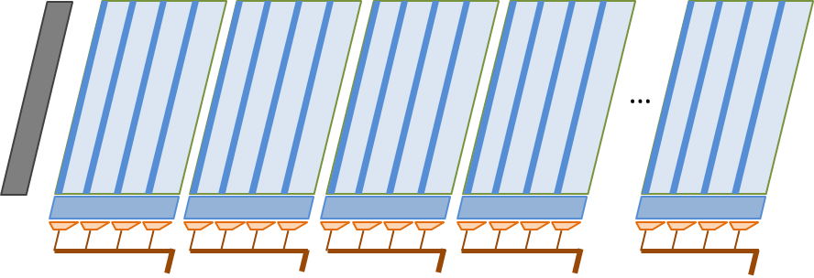
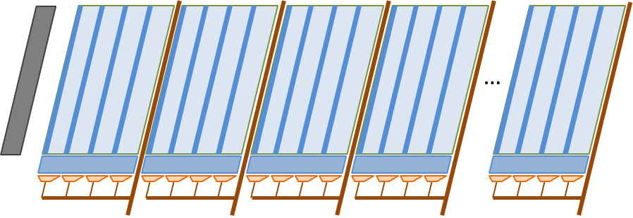
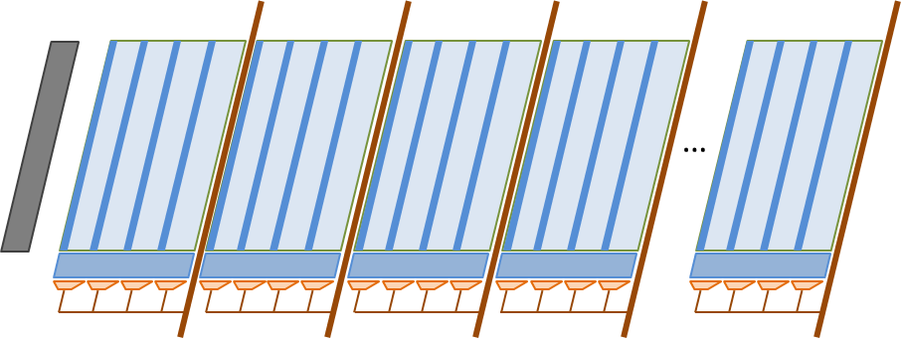
DRAM Bank Architecture
Hierarchical organization
DRAM
Bank
Subarray
Row-decoder
Local Sense Amps
2KB Row Buffer
Wordline Driver
…
Notes:
To understand how we can reduce the activation energy, let us look at the architecture of a DRAM bank. A DRAM bank is a collection of Subarrays or a horizontal row of storage arrays. Although we think of a DRAM bank as having a single row-buffer, physically, each subarray has its own local sense-amplifier stripe or row-buffer, only one of which can stay active in a DRAM bank at a time. On an activate, the row address is decoded, and a wordline is driven across the entire subarray, bringing 2KB of data into the local sense-amplifier.

Slide 6
Row Activation
Exploiting the hierarchical wordline
Mats
Segment Select Driver
The Master Wordline is driven across the subarray, and the local Wordline drivers redrive the signal in each mat
Subarray
Each subarray is a row of mats, with each mat providing 8 bits of the DRAM atom
Our proposal : selectively activate a subset of the mats
…
Master Wordline Driver
Can we increase the per-mat bandwidth ?
Local Wordline Driver
Column Muxes (32 x 8 bits)
Column Muxes (4 x 8 bits)
Notes:
Now let us examine how the activation occurs at a subarray level. A subarray is a row of DRAM mats, where each mat is a 512-bit wide array of DRAM cells. A key thing to note is that a DRAM atom is spread across all the mats of the subarray, with each mat providing 8 bits towards the 32-byte atom. On an activate, first, the Master Wordline Driver drives the master wordline along the entire width of the subarray. And then each mat’s local wordline driver redrives a local wordline, that actually performs the activation of the DRAM cells.
Given this hierarchical organization, clearly, to simplest way to reduce DRAM row energy is by reducing the number of mats that are activated. This is precisely what we do in this paper. Using a set of segment select lines, we pick one set of 4 mats that are activated in unison, making the minimum row-activation granularity 256Bytes. So even though the Master wordline is driven across the entire subarray, the local wordlines are turned on in only those mats, whose local wordline drivers have been enabled. The segment is selected by decoding a segment mask that is sent along with the activation command, in addition to the row-address.
Obviously for this scheme to work, the DRAM atom must be laid out in its entirety in the activated subset of mats. While this is not difficult to achieve, a side-effect of this design is that only a fraction of the whole subarray’s datapath is available to transfer the DRAM atom now. So instead of a 256-bit datapath, we have a 32-bit datapath. The question is, can this be expanded, such that each mat has 8X the bandwidth of a baseline mat ?

Slide 7
Increasing the per-mat bandwidth
High area overhead
Few metal layers in the DRAM process
Area dictated by number of horizontal and vertical tracks
Increasing bandwidth per mat
More metal tracks for data wires and latches in the periphery
Keep the per-mat bandwidth unchanged
Challenge 1 : Reduced per-transfer bandwidth
Challenge 2: Higher Data Movement Energy
Notes:
However, if we are concerned about DRAM density, then we can not simply increase the per-mat bandwidth. This is because a DRAM process is metal limited, and the height and width of the bank is largely determined by the number of metal tracks in those directions. Increasing the bandwidth per mat will require more metal tracks in both these directions, and will also require extra global sense-amplifers in the periphery, all of which contribute to very large area overheads.
So, in this paper, to preserve density while reducing DRAM activation energy, we decide to keep the per-mat bandwidth the same as the in the baseline.
This gives rise to two challenges. First, obviously, each DRAM atom now has a narrower datapath and lower bandwidth to the GPU. The second, perhaps surprising side-effect of this architecture, is that the narrow datapath ends up increasing the data movement energy (i.e. the read/write power). We next look at ways of handling these issues.

Slide 8
Challenge 1: Managing reduced per-transfer bandwidth

Slide 9
Subchannels
Parallel operations in the same bank
Subchannels
Subchannel : Narrow slice of the entire datapath
Subarrays can activate different rows simultaneously
Subchannels can read/write different DRAM atoms in parallel
Aggregate data bandwidth across subchannels is the same as the baseline
…
Implementation requires address latches to support parallel commands
Notes:
The key idea behind mitigating this challenge of reduced per-transfer bandwidth is to use the physical resources of the bank to perform multiple operations. Note that the wide datapath has now been split into several narrow slices – and each of these is a subchannel. Already, as shown in previous work from CMU and Samsung, it is possible to activate different rows in a single bank as long as they are in different subarrays. With the subchannel organization, it is possible to also read/write different DRAM atoms at the same time as the entire datapath is now independent between the different subchannels. So as we can see in this figure, while there is a read happening in one subchannel, a different DRAM atom is being read from a different subchannel. The aggregate data bandwidth across the subchannels is the same as the baseline, so if we can keep all the subchannels busy, there is no loss of bandwidth. Implementing this microarchitecture requires the addition of some address-decoupling latches – a relatively minor overhead.

Slide 10
Managing subchannels
Handling the parallelism
The GPU’s memory system is well-suited to exploit subchannels
High memory-level-parallelism and need for bandwidth
Multiple subchannels can be kept busy
Small increase in unloaded DRAM latency does not affect performance
Deep reorder buffers in memory controller
Necessary segments from a row can be identified prior to activation
Subchannels are managed as semi-independent channels
Shared command-and-address bus

Slide 11
Challenge 2: Mitigating increased datapath energy

Slide 12
Datapath energy
Higher datapath energy compared to baseline
16% increase on average
Narrow datapath increases switching activity
Notes:
In this graph, we plot the data movement energy with narrow subchannels (8 per conventional channel), normalized to the baseline. We find that on average, there is a 16% increase in data movement energy, with some applications showing large increases. This is due to increased switching activity on the datapath. The datapath energy (i.e. sum of on-die and I/O) is decided by the length of the wires and their capacitances, and the rate at which these capacitances are charged or discharged. We found that altering the datapath width in HBM ends up increasing the toggle rates leading to higher energy. Clearly, this energy has to be mitigated, otherwise it can eat into the benefits obtained by activation energy reduction.

Slide 13
Datapath Energy
Depends on data values
8 Single Precision values
Word 7
Word 6
Word 5
Word 4
Word 0
32-byte DRAM atom
4 Double Precision values
Word 7
Word 5
Word 0
MSBs of different words are correlated
LSBs of different words are correlated
Notes:
To understand this increase in switching activity, we have to understand what is the actual data that is being sent out on the datapath. A 32-byte DRAM atom commonly contains either 8 4-byte single precision values, or 4 8-byte double precision values. Now, the corresponding parts of these words are correlated, for example, MSBs could be all 0s. So, it is necessary that the corresponding parts of the different words are sent out on the same wires to reduce toggling.

Slide 14
Data Transfer
Correlation between successive bytes
Datapath
256-bit internal
No Toggling
I/O Buffer
Correlated parts of words on the same wire
16
17
18
19
20
21
22
23
24
25
26
27
28
29
30
31
128-bit
DDR
0
1
2
3
4
5
6
7
8
9
10
11
12
13
14
15
Notes:
In the baseline, the internal datapath is 256-bit wide, while the external DDR datapath is 128-bit wide. There is no toggling on the internal path, and even on the external path, corresponding bytes from different words (as shown by the color coded 32 bytes shown here) line up, and the switching activity on the external bus is moderate.

Slide 15
Data Transfer
30
31
Uncorrelated bits in successive cycles on a wire
High toggle rate
28
29
26
27
Subchannels
24
25
28
29
30
31
Datapath
22
23
24
25
26
27
20
21
20
21
22
23
Solution
Store DRAM atom in reduced toggling order.
Memory controller to scramble and unscramble data
32-bit internal
18
19
16
17
18
19
16
17
12
13
14
15
8
9
10
11
14
15
I/O Buffer
12
13
4
5
6
7
10
11
0
1
2
3
16-bit
DDR
8
9
6
7
Higher energy
4
5
2
3
0
1
Notes:
When we divide up the channel into 8 subchannels, however, the toggle rate increases on both the 32-bit internal datapath and specially on the external datapath because uncorrelated parts of words are interleaved in successive cycles on the same wire. To solve this issue, we propose to store the DRAM atom in such a way, that when the data is read out, the toggle rate is minimized. Essentially, the memory controller scrambles the data while writing to DRAM and unscrambles it on its way out. Since it is the 16-bit DDR datapath that consumes the most energy, we focus on coming up with a reordering scheme that optimizes that part of the datapath.

Slide 16
Reduced Switching Order
5
7
13
15
Correlated bits sent in successive cycles
21
23
Correlated bits successively on a wire
29
31
Datapath
13
15
5
7
25
27
29
31
21
23
17
19
32-bit internal
17
19
25
27
9
11
1
3
9
11
1
3
Data movement energy is restored to baseline levels
12
14
4
6
4
6
28
30
20
22
12
14
I/O Buffer
16
18
24
26
20
22
0
2
8
10
28
30
16-bit
DDR
24
26
Is there a better order ?
16
18
8
10
0
2
Notes:
With the order shown here, we are able to minimize the toggle rate on the 16-bit datapath for both 4-byte as well as 8-byte values, and the resultant toggle energy is close to the baseline level. We also tried a scheme where the minimum toggle configuration is estimated for each individual DRAM atom, but that has too much overhead to justify its meagre benefits over this static reordering scheme.

Slide 17
Evaluation

Slide 18
Methodology
Open source CUDA benchmarks (Lonestar, Rodinia), HPC applications, STREAM and GUPS
Games and rendering engines
In-house performance simulator – modeling a NVIDIA Pascal GPU
60 SMs, 6MB LLC, 1TB/s Bandwidth
HBM energy model based on device characteristics, wire capacitances and floorplan

Slide 19
DRAM Energy Consumption
35% reduction
Higher benefits for applications with lower locality.
Mitigating data movement energy important for applications with good locality
HBM2
Subchannels

Slide 20
GPU Performance
13% improvement
High-locality applications can utilize the entire bandwidth.
Small benefits from increased read-write parallelism.
Low Locality
Low memory intensity
High Locality
Low-locality applications benefit from overlapped activates and tFAW relaxation.

Slide 21
Summary
Energy-efficient DRAM a key requirement for continuous performance scaling of GPUs.
GPU-specific DRAMs push envelopes of existing technologies
Co-designing the memory controller and DRAM for energy-efficiency and performance at low area overhead
Further improvements require reducing datapath energy

Slide 22
Thanks !

Slide 23
Backup Slides

Slide 24
Graphics applications
Bytes-per-activate
Average Bytes-per-Activate = 586 (28% of row)

Slide 25
Graphics applications
Energy-per-bit

Slide 26
Local Wordline Driver
LWL
LWD
Mat 0
Mat 1
Mat 2
Mat 3
MWL[0]
MWL[1]
MWL[2]
MWL[3]
MWL[4]
MWL[127]
LWLsel[0]
LWLsel[1]
LWLsel[2]
LWLsel[3]

Slide 27
Subchannel 0
Subchannel 1
Mat 0
Mat 1
Mat 2
Mat 3
MWL[0]
MWL[1]
MWL[2]
MWL[3]
MWL[4]
MWL[127]
SS[0]
SS[1]
LWLsel[0]
LWLsel[1]
LWLsel[2]
LWLsel[3]

