Slide 1


Staged-Reads : Mitigating the Impact of DRAM Writes on DRAM Reads
Niladrish Chatterjee
Rajeev Balasubramonian
Al Davis
Naveen Muralimanohar *
Norm Jouppi*
University of Utah and *HP Labs

Slide 2

Memory Trends
DRAM bandwidth bottleneck
  Multi-socket, multi-core, multi-threaded
  1 TB/s by 2017
  Pin constrained processors
Bandwidth is precious
  Efficient utilization is important
Write handling can impact efficient utilization
Expected to get worse in the future
  Chipkill support in DRAM
  PCM cells with longer write latencies
Source: Tom’s Hardware
Notes:
It is well recognized that for current and future systems, the main memory will be the main performance bottleneck

Slide 3
DRAM Writes
Writes receive low priority in the DRAM world
  Buffered in the memory controller’s Write Queue
  Drained when absolutely necessary (if the occupancy reaches the high-water-mark)
Writes are drained in batches
  At the end of the write burst, the data bus is “turned-around” and reads are performed
  The turn-around penalty (tWTR) has been constant through DRAM generations (7.5ns)
  Reads are not interleaved to prevent bus underutilization due to frequent turn-around
Notes:
Writes are drained in a burst.
During this time, reads are not scheduled to the DRAM rank because the bus has to be turned around between a DRAM write a DRAM read.
The delay is needed to reverse the direction of the DRAM I/O bus.

Slide 4
Baseline Write Drain - Timing
time
BANK 1
WRITE 1
READ 5
READ 8
High queuing delay
Low bus utilization
BANK 2
WRITE 3
WRITE 4
BANK 3
READ 6
READ 9
READ 11
BANK 4
WRITE 2
READ 7
READ 10
DATA BUS
1
2
3
4
tWTR
5
6
7
8
9
10
11
Notes:
Even though bank 3 was not busy, the many pending reads to that bank could not be serviced because it would then require multiple turnarounds.
The whitespaces represent lost scheduling opportunity in some sense.

Slide 5
Write Induced Slowdown
Write-imbalance
  Long bank idle cycles because other banks are busy servicing writes
Reads pending on these banks can not start their bank access before the last write from the other banks has completed and the bus has been turned around.
High queuing delay for reads waiting on these banks
Notes:
Our methods seek to address this issue.

Slide 6
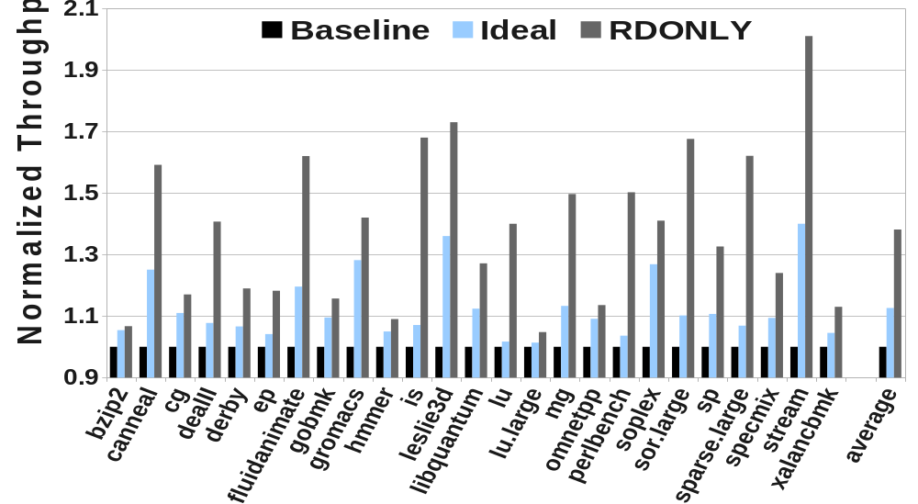

Motivational Results
If all the pending reads could finish their bank access in parallel with the write drain (IDEAL), throughput could be boosted by 14%.
If there were no writes (RDONLY), throughput could be boosted by 35%.
Notes:
Ideal is again unattainable because some banks would be busy servicing writes. Also the reads would have bank conflicts. But this provides an absolute ceiling on what can be achieved by parallelizing reads with writes. In our scheme that I will describe next, we try to get as close to ideal as possible.

Slide 7
Staged Reads - Overview
A mechanism to perform “useful” Read operations during write drain
Decouple a read stalled by write drains into two stages
  1st stage : Reads access idle banks in parallel with the writes; the read data is buffered internally in the chip.
  2nd stage : After all writes have completed, and the bus has been turned-around, the buffered data is streamed out over the chip’s I/O pins.

Slide 8
Staged Reads - Timing
time
BANK 1
Issue Staged-Reads to free banks
Turn around the bus
Drain the Staged Read Registers
WRITE 1
READ 5
READ 8
Start issuing regular reads
SR
BANK 2
WRITE 3
WRITE 4
Lower Queuing delay
Higher bus utilization
BANK 3
READ 6
READ 9
READ 11
SR
SR
BANK 4
WRITE 2
READ 7
READ 10
SR
DATA BUS
1
2
3
4
tWTR
5
6
7
9
11
10
8
Notes:
We are able to utilize the idle banks by decoupling the read operations.

Slide 9
Staged Read Registers
A small pool of cache-line sized (64B) registers
  16 or 32 SR registers, i.e., 256B /chip
  Placed near the I/O pads
Data from each bank’s row-buffer can be routed to the SR pool based on a simple DEMUX setting during the 1st stage of Staged Reads.
Output port of the SR register pool connects to the global I/O network to stream out latched data
Notes:
A DEMUX routs read data from a bank’s

Slide 10
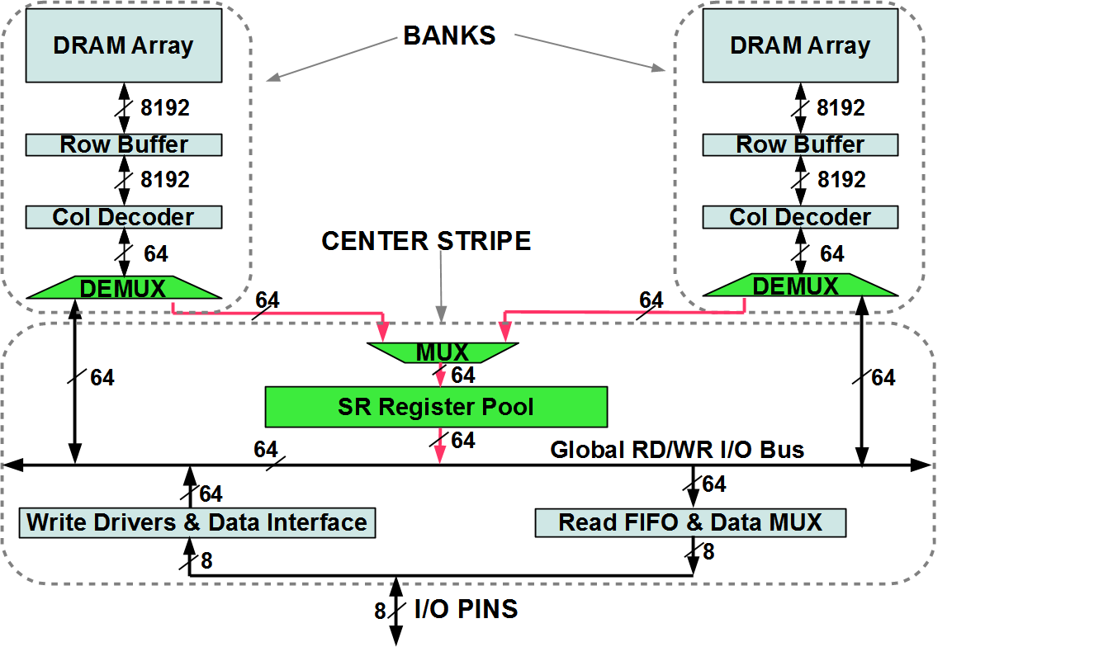
Implementation – Logical Organization
Write
Read
Staged Reads
Notes:
Red and green

Slide 11
Implementability
DRAM Chip Layout
DRAM Array
Row Logic
Cost
Column Logic
SR
Registers
Center Stripe
I/O Gating
We restrict our changes to the least cost-sensitive region of the chip.

Slide 12
Implementation
Staged-Read (SR) Registers shared by all banks
Low area overhead (<0.25% of the DRAM chip)
No effect on regular reads
Two new DRAM commands
  CAS-SR : Move data from the Sense Amplifiers to SR Registers
  SR-Read : Move data from SR Registers to DRAM data pins
Notes:
CACTI
Extra gate delay for new reads
Two new DRAM commands – CAS-SR (very similar to CAS just enables the DEMUX to latch reads into SR)
SR-RD – low latency operation of moving from SR to I/O

Slide 13
Exploiting SR: WIMB Scheduler
SR mechanism works well if there are writes to some banks and reads to others (write-imbalance).
We artificially increase write imbalance
Banks are ordered using the following metric
  M = (pending writes – pending reads)
Writes are drained to banks with higher M values – leaving more opportunities to schedule Staged Reads to low M banks

Slide 14
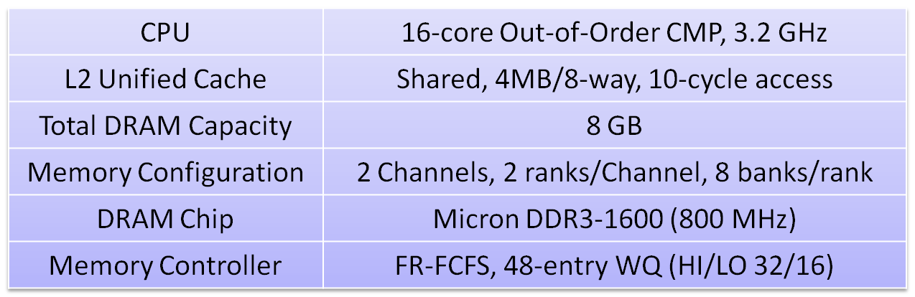
Evaluation Methodology
SIMICS with cycle-accurate DRAM simulator
SPEC-CPU 2006^{mp}, PARSEC^{mp}, BIOBENCH^{mt}, and STREAM^{mt}
Evaluated configurations
  Baseline, SR_16, SR_32, SR_Inf, WIMB+SR_32

Slide 15
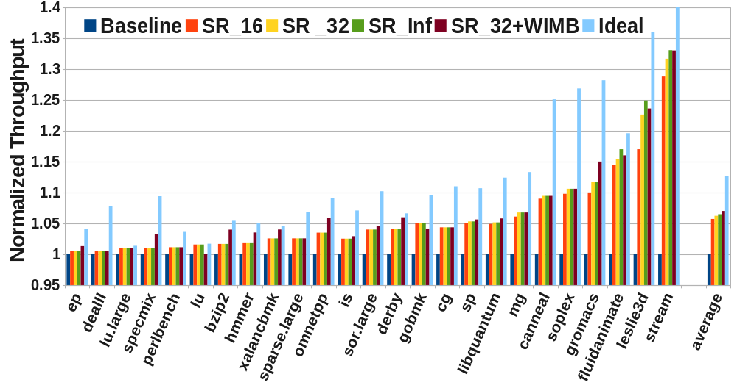
Results
SR_32+WIMB : 7% (max 33%)
Notes:
We simulated SR with baseline write-scheduler with 16 & 32 regs – in addition to estimate the upper bound of staged read opportunities we simulated a config which had no restriction on the number of sr-s
We also simulated a config with the WIMB scheduler and 32 regs
32 SR sufficient SR32 better than SRInf
By artificially creating imbalance, WIMB 7.2% improvement in throughput

Slide 16
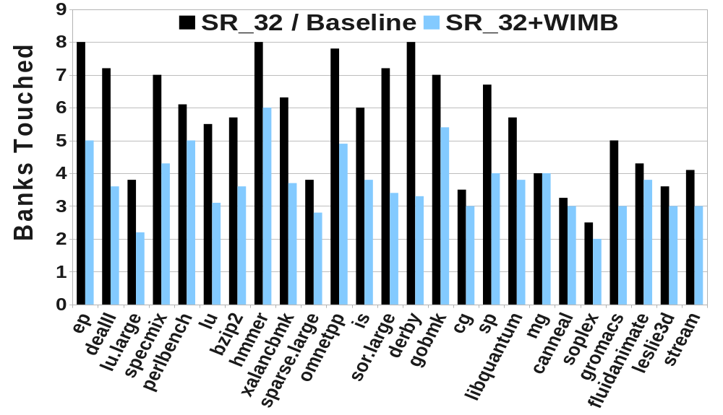
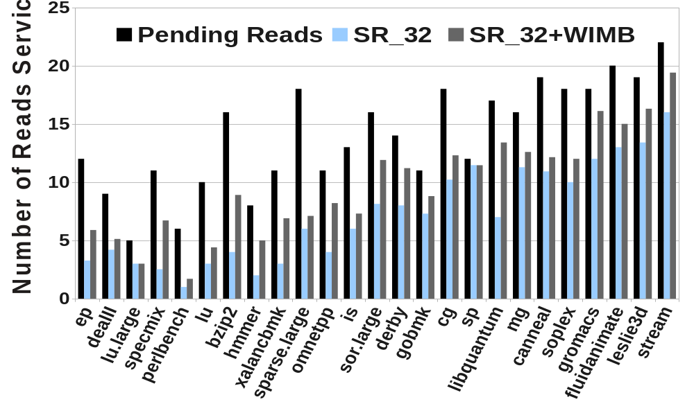
Results - II
High MPKI + Few written banks leads to higher performance with SR
By actively creating bank imbalance, SR_32+WIMB performs better than SR_32.

Slide 17
Future Memory Systems : Chipkill
ECC stored per rank in a separate chip on rank & in RAID-like fashion, parity is maintained across ranks.
Each cache-line write now requires two reads and two writes.
  higher write traffic
SR_32 achieves 9% speedup over a RAID-5 baseline.

Slide 18
Future Memory Systems: PCM
Phase-Change Memory has been suggested as a scalable alternative to DRAM for main memory.
PCM has extremely long write latencies (~4x that of DRAM).
SR_32 can alleviate the long write-induced stalls (~12% improvement)
SR_32 performs better than SR_32+WIMB
  artificial write imbalance introduced by WIMB increases bank conflicts and reduces the benefits of SR

Slide 19
Conclusions : Staged Reads
Simple technique to prevent write-induced stalls for DRAM reads.
Low-cost implementation – suited for niche high-performance markets.
Higher benefits for future write-intensive systems.

Slide 20
Back-up Slides

Slide 21
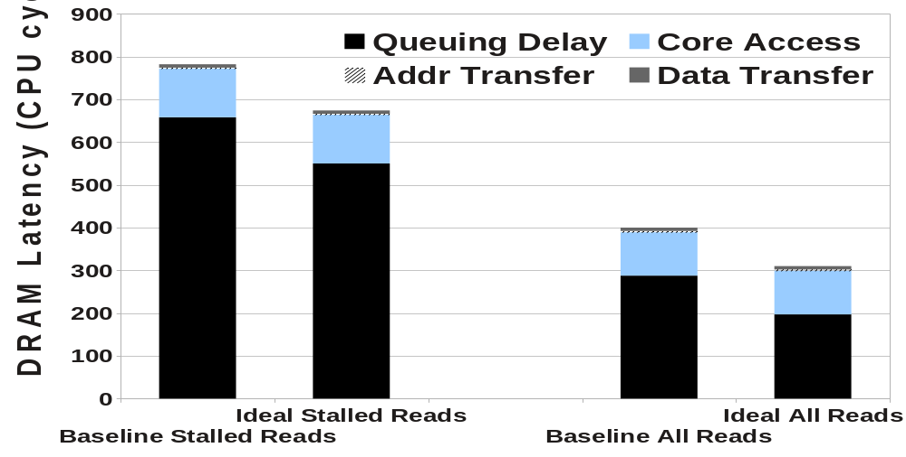
Impact of Write Drain
With Staged-Reads we approximate the Ideal behavior to reduce the queuing delays of stalled reads

Slide 22
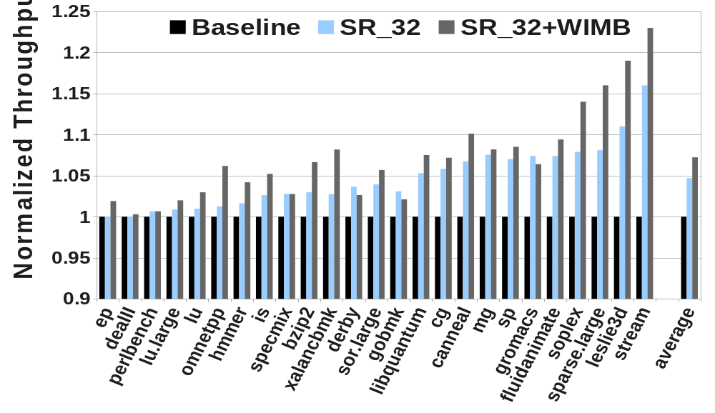
Threshold Sensitivity : HI/LO = 16/8

Slide 23
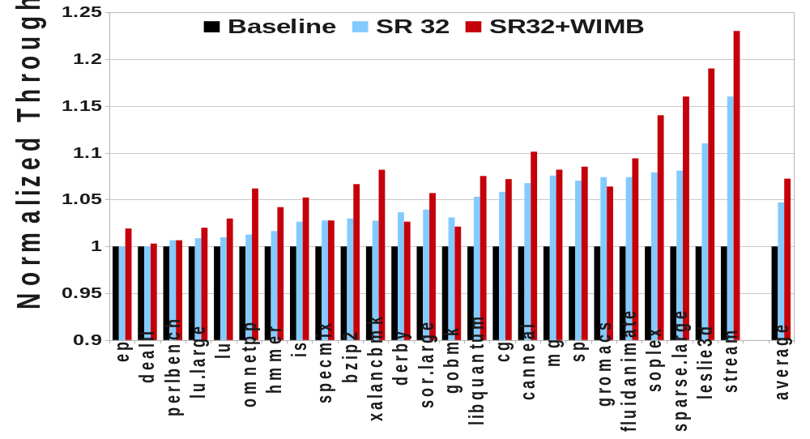
Threshold Sensitivity : HI/LO = 128/64

Slide 24
More Banks , Less Channels

