Slide 1


Leveraging Heterogeneity in DRAM Main Memories to Accelerate Critical Word Access
Niladrish Chatterjee
Manjunath Shevgoor
Rajeev Balasubramonian
Al Davis
Zhen Fang‡†
Ramesh Illikkal*
Ravi Iyer*
University of Utah , NVidia‡ and Intel Labs*
†Work done while at Intel

Slide 2


Memory Bottleneck
DRAM major contributor to system power
DDR ideal for cost/bit
Power consumption on the rise
Latency not improving
LPDRAM instead of DDR (HP Labs, Stanford)
Latency still a concern
Emerging scale-out workloads require low off-chip memory latency
Move towards simpler energy-efficient cores
Other DRAM variants ?

Slide 3
DRAM Variants
Objective
Construct a heterogenenous memory system that outperforms DDR3 with a lower energy cost.
HIGH PERFORMANCE PARTS
BANDWIDTH OPTIMIZED
LATENCY OPTIMIZED
BASELINE
HETEROGENEOUS MEMORY
GDDR
XDR
FCDRAM
RLDRAM
RLDRAM
DDR3
CPU
COMMODITY PARTS
CPU
DDR3
DDR3
RLDRAM
LPDDR
Asynchronous DRAM
FPM / EDO /BEDO
SDRAM
DDR2
DDR3
DDR4
LOW POWER PARTS
Architect RLDRAM and LPDRAM based main memory
Place data to exploit heterogeneous memory
DDR3L
DDR3L-RS
LPDDR
LPDDR
Notes:
We focus on RLDRAM & LPDDR in this study to build a heterogeneous memory with the aim of outperforming DDR3 at a lower energy cost.

Slide 4
Feature Snapshot
 | RLDRAM3 | DDR3 | LPDDR2
Row Cycle Time | 8-12 ns | 48.75 ns | 60 ns
Pin Bandwidth | 2133 Mbps | 3200 Mbps | 1066 Mbps
Density | 576Mb / 1.15 Gb | 1-8 Gb | 512Mb – 2Gb
Interface | SRAM style commands | ACT / CAS / PRE etc. | Similar to DDR
Power | High activate & background power | Background power does not scale with activity | Low Background and Activate Power
Application | Low-response time e.g. 100G Ethernet switches | High-volume desktops and servers | Mobile devices to lengthen battery life

Slide 5
RLDRAM
Low row-cycle time (tRC) of 8-12ns
Reduced bit-line length & fragmented DRAM sub-arrays to reduce word-line delays
Reduced bank contention
2X the number of banks in DDR3.
No restrictions on RAS chaining
no tFAW or tRRD
Robust power delivery network + flip-chip packaging
No write-to-read turnaround (tWTR)
Allows back-to-back RD and WR commands.
Writes are buffered in registers inside the DRAM chip

Slide 6
LPDRAM
Low-power part for mobile devices with lower data-rate
1.2V operating voltage and reduced standby and active currents.
Very little current consumed when the DRAM is inactive
Efficient low power modes
Fast exit from low power modes
Higher core latencies

Slide 7
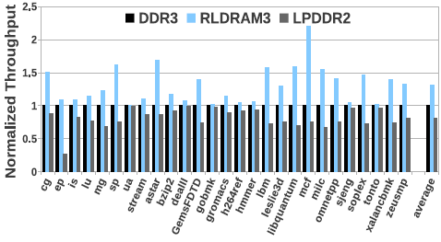
Replacing DDR3 with RLDRAM/LPDDR
RLDRAM3 improves performance by 30%
LPDDR2 suffers a 13% degradation.

Slide 8
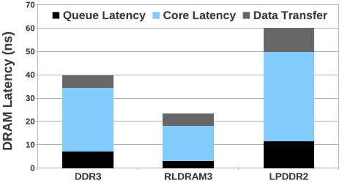
Latency Breakdown
RLDRAM has lower core access latency and lower queuing delay because of fast bank-turnaround, no RAS count restrictions and reduced write-to-read turnaround.

Slide 9
Power
50% bus utilization
LPDDR2 has about 35% lower power consumption on average owing to its low background and activation energy.

Slide 10
Motivation: Heterogeneous Memory
The idealized systems are not realizeable
RLDRAM3 has very high power consumption
Capacity needs to be sacrificed to meet power budget
LPDRAM introduces performance handicaps
Bandwidth concerns alleviated by recent proposals from HP Labs (BOOM, Yoon et al.) and Stanford (Energy proportional memory, Malladi et al.)
Use LPDDR2 and RLDRAM3 synergistically.

Slide 11
Heterogeneous Memory
Performance Optimized Memory
Power Optimized Memory
RLDRAM
LPDDR
CPU
CPU
Page
Page
Page
Page
Page Granularity Data Placement
One cache-line from one DIMM
Page access rates, write traffic, row hit-rate as metrics
Critical Word in the cache-line is fetched from the RLDRAM module
Critical Word returned fast
Rest of cache-line is accessed at low energy.

Slide 12
Accelerating Critical Word Access
Current DDR devices already order the burst to put the critical word at the head of the burst
We fetch the critical word from RLDRAM & rest of the cache-line from LPDRAM
For the scheme to work, the critical word in a cache-line needs to be stable over a long period

Slide 13
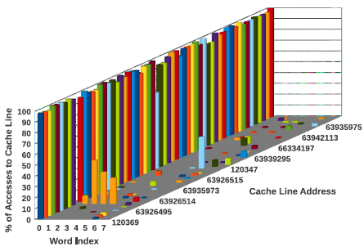
Critical Word Regularity
Profile of DRAM Accesses at cache-word granularity
Accesses to a cache-line are clustered around few words in the line.

Slide 14
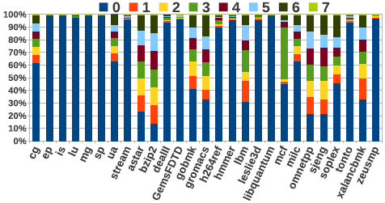
Critical Word Regularity
Word-0 is the most frequent critical word in majority of the workloads.

Slide 15
RLDRAM and LPDRAM DIMMs
High-speed DRAM channels need specialized I/O circuitry to ensure signal integrity.
Termination resistors on the DRAM to reduce signal reflection
DLL to adjust for clock skew.
RLDRAM systems already contain ODTs and DLLs.
LPDDR2 does not incorporate ODTs or DLLs.
LPDDR3 introduces ODT
We evaluate a design where the LPDDR DIMMs are augmented with a buffer which receives and retimes the DQ and C/A signals (proposed by Malladi et al. ISCA 2012).

Slide 16
Memory System Organization
4 Sub-Ranked Channels of RLDRAM, each 0.25GB Data
RLDRAM 0.25GB Data
4 such Data and Add/Cmd Channels
Ch0
Ch1
Ch2
Ch3
8-bit Data + 1-bit Parity
26-bit Addr/Cmd
MRC0
RLMC
38-bit Addr/Cmd
Replace with 4 RLDRAM Chips
CPU
8-bit Data + 1-bit parity RLDRAM Channel
MC0
72-bit Data
+ECC
23-bit Addr/Cmd
64-bit Data
+ECC
4 such
channels
2GB DDR3 DRAM DIMM
LPDRAM DIMM 1.75GB Data+ ECC

Slide 17
Heterogeneous Memory Access
LPDRAM DIMM
RLDRAM Chip
W 0
W1-7
On a LLC Miss
MSHR Entry created
Req for W0 sent to RLCTRL
Req for Words 1-7 to LPCTRL
If W0 is critical word
Forward to core
Else wait for W1-7
Cache-fill after whole word is returned.
CPU
RLCTRL
LPCTRL
MSHR
CL X

Slide 18
Summary of Proposed System
4 LPDDR2 channels each with a 72-bit bus (data+ECC) and a 23 bit C/A bus
Extra controller and one additional command/address bus for RLDRAM
4 subranked RLDRAM3 channels – each x9 (data+parity)
Low pin overhead
MSHR modified to support fragmented transfer of cache-line

Slide 19
Handling ECC Check
In the baseline system correctness of fetched data is determined after the entire cache-line + ECC is received.
In the heterogeneous system, once word-0 is returned from the RLDRAM, it is immediately forwarded to the CPU.
Possible to miss errors in the critical word
Roll-back of the committed instruction not possible
Need to provide mechanism that guarantees same kind of SECDED security as in the baseline.

Slide 20
Handling ECC Check
The RLDRAM word is augmented with 1 bit parity while ECC is stored with rest of the cache-line in LPDRAM DIMM.
When word 0 is returned from RLDRAM and there is a parity error
Word held until rest of the cache-line + ECC is returned
ECC is used to possibly correct the data
Else word forwarded to CPU
If there are 2-bit errors in word-0
Parity bit will not detect error and data corruption will occur
But the ECC will flag error when the whole cache-line is returned

Slide 21
Evaluation Methodology
SIMICS coupled with the DRAM simulator from the USIMM framework.
CPU | 8-core Out-of-Order CMP, 3.2 GHz
L2 Unified Cache | Shared, 4MB/8-way, 10-cycle access
Total DRAM Capacity | 8 GB
DDR3 Configuration | 4 Channels, 1 rank/Channel, 8 banks/rank
DRAM Chips | Micron DDR3-1600 (800 MHz) LPDDR2-800 (400 MHz) RLDRAM3-1600 (800 MHz)
Memory Controller | FR-FCFS, 48-entry WQ (HI/LO 32/16)
SPEC-CPU 2006^{mp}, NPB^{mt}, and STREAM^{mt}
Evaluated systems
RLDRAM + DDR3 (RD)
DDR3+LPDDR2 (DL)
and RLDRAM3+LPDDR2 (RL)

Slide 22
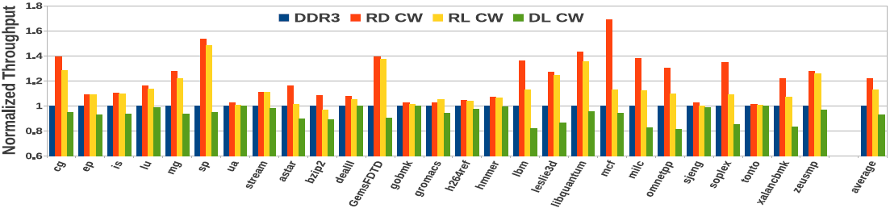
Results : Performance
RL shows 12.9% improvement (22% reduction in latency)

Slide 23
Results: Performance
Applications with high percentage of word-0 accesses benefit the most.
Some applications show no benefit and some degradation despite many word-0 accesses
Subsequent accesses to the cache-line show up before the cache-line is returned from LPDDR2. e.g. tonto.
But 82% of all accesses to the same cache-line occur after the line has been returned from LPDDR.

Slide 24
Results: System Energy
System Energy = Constant Energy + Variable part of CPU Energy (activity dependant) + DRAM Energy
High RLDRAM3 power is alleviated by
Low LPDDR2 power
Sub-ranking that reduces activation energy in RLDRAM3.
Total DRAM energy savings of 15%
Overall system energy savings of 6%

Slide 25
Page Granularity Data Placement
Alternate data placement design point
Heterogeneous system iso-pin-count and iso-chip-count with baseline
3 LPDDR2 channels (total 6GB)
1 RLDRAM3 channel with .5GB capacity
Top 7.6% of highly accessed pages kept in RLDRAM
Throughput improves by 8%
Not all cache-lines in a page are hot
7.6% of top pages account for only 30% of all accesses.
Reduced power compared to critical-word placement scheme
Fewer RLDRAM chips
LPDRAM can find longer sleep times due to reduced activity rates.

Slide 26
Cost
Acquisition cost directly related to volume of production
LPDDR in mass production for mobile devices
Higher cost/bit of RLDRAM kept in check by using it sparingly.
System energy savings translate directly to OpEx savings
If NVM technologies like PCM relieve DRAM of it’s capacity requirements – novel DRAM technologies will become more economically viable for specialized application scenarios

Slide 27
Summary
Low-overhead technique to incorporate existing DRAM variants in mainstream systems.
Critical word guided data placement just one of probably many ways in which heterogeneity can be leveraged.
Explored a very small part of the design space
Many DRAM variants + NVM variants
Diverse application scenarios
Different criticality metrics and data placement schemes.

Slide 28
Backup Slides

Slide 29
Adaptive Data Placement
Dynamically determining which word to place in fast DRAM
Each cache-line has a 3-bit metadata indicating the last accessed critical word.
When a dirty-line is evicted, the last critical word is predicted to be the next critical word and placed in RLDRAM.
This makes it possible to service the critical word from RLDRAM for 79% requests as opposed to 67% using the static scheme.

Slide 30
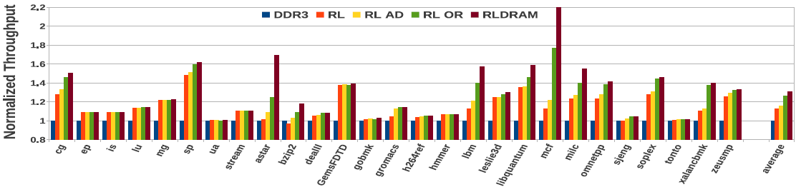
Results : Performance of RL
RL_AD provides 16% improvement
In mcf word 0 and word 3 are the most frequent critical words.
RL_AD performance is dictated by write-traffic

