Slide 1




Managing DRAM Latency Divergence in Irregular GPGPU Applications
Niladrish Chatterjee
Mike O’Connor
Gabriel H. Loh
Nuwan Jayasena
Rajeev Balasubramonian

Slide 2

Irregular GPGPU Applications
Conventional GPGPU workloads access vector or matrix-based data structures
Predictable strides, large data parallelism
Emerging Irregular Workloads
Pointer-based data-structures & data-dependent memory accesses
Memory Latency Divergence on SIMT platforms
Warp-aware memory scheduling to reduce DRAM latency divergence

Slide 3
SIMT Execution Overview
Warps
THREADS
SIMT Core
Lockstep execution
Warp stalled on memory access
SIMT Core
I
N
T
E
R
C
O
N
N
E
C
T
SIMT Core
Warp 1
Memory Partition
Warp Scheduler
Warp 2
Memory Controller
Warp 3
L2 Slice
GDDR5
GDDR5
Warp N
Channel
SIMD Lanes
Memory Partition
L2 Slice
Memory Controller
Memory Port
GDDR5
GDDR5
L1
Channel

Slide 4
Memory Latency Divergence
SIMD Lanes (32)
Coalescer has limited efficacy in irregular workloads
Partial hits in L1 and L2
1st source of latency divergence
DRAM requests can have varied latencies
Warp stalled for last request
DRAM Latency Divergence
Load Inst
Access Coalescing Unit
L1
L2
GDDR5

Slide 5
GPU Memory Controller (GMC)
Optimized for high throughput
Harvest channel and bank parallelism
Address mapping to spread cache-lines across channels and banks.
Achieve high row-buffer hit rate
Deep queuing
Aggressive reordering of requests for row-hit batching
Not cognizant of the need to service requests from a warp together
Interleave requests from different warps leading to latency divergence

Slide 6
Warp-Aware Scheduling
Stall Cycles
Stall Cycles
SM 1
A: LD
A: Use
A: Use
Stall Cycles
SM 2
B: LD
B: Use
A
A
B
B
MC
A
A
B
B
Reduced Average Memory Stall Time
Baseline
GMC Scheduling
A
B
A
B
A
B
A
B
Warp-Aware Scheduling
A
A
A
A
B
B
B
B

Slide 7
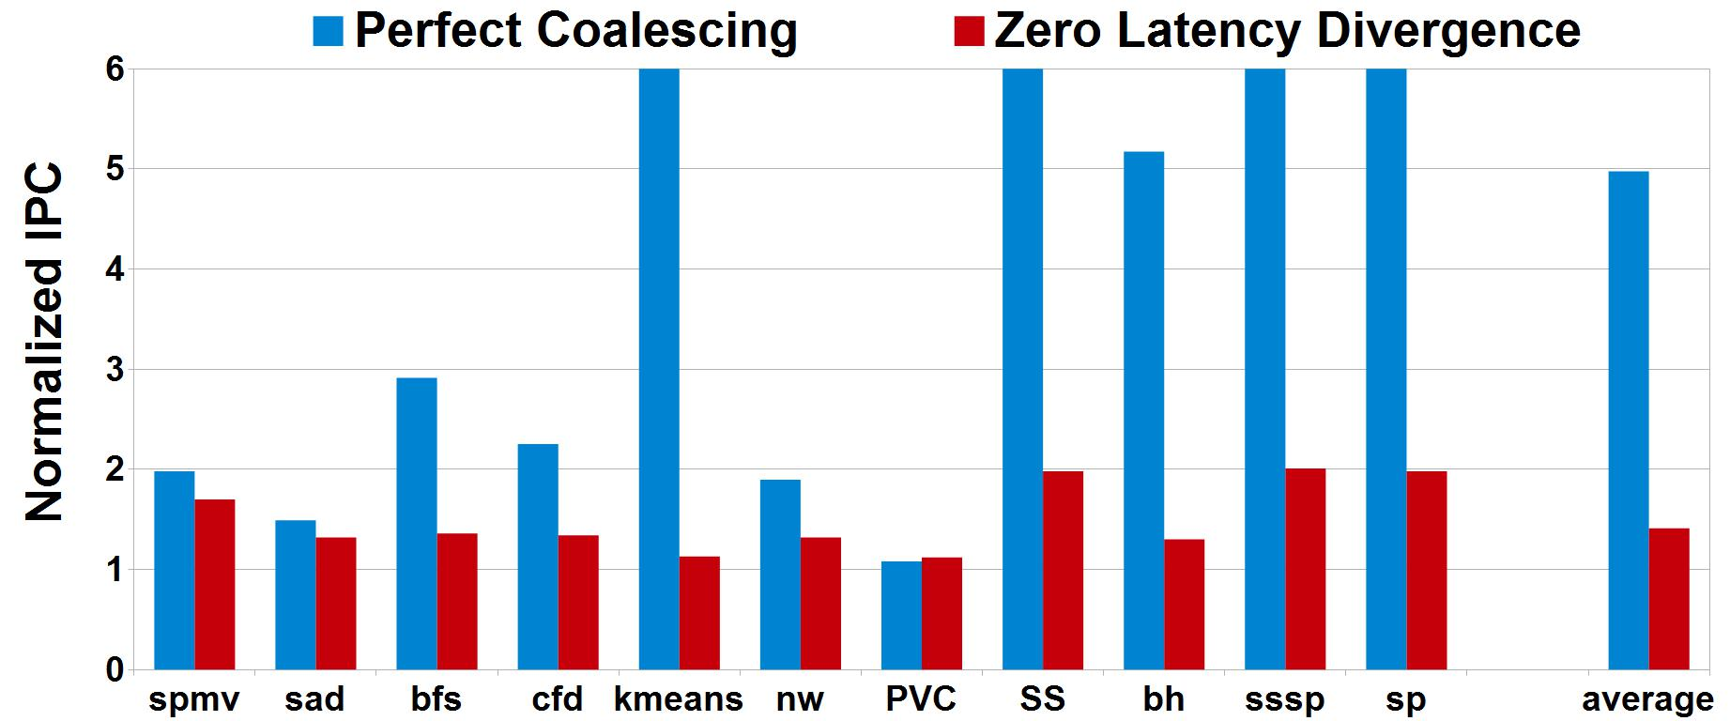
Impact of DRAM Latency Divergence
If all requests from a warp were to be returned in perfect sequence from the DRAM –
~40% improvement.
If there was only 1 request per warp – 5X improvement.

Slide 8
Key Idea
Form batches of requests from each warp
warp-group
Schedule all requests from a warp-group together
Scheduling algorithm arbitrates between warp-groups to minimize average stall-time of warps

Slide 9
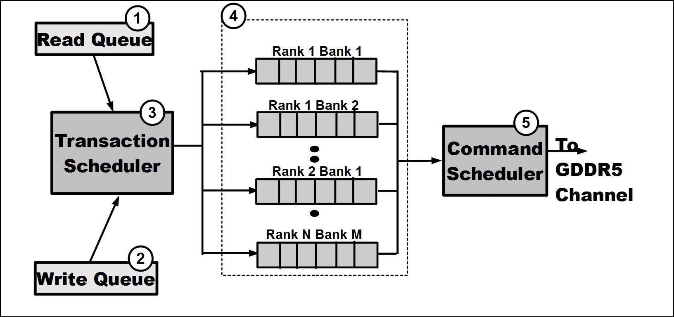
Controller Design

Slide 10
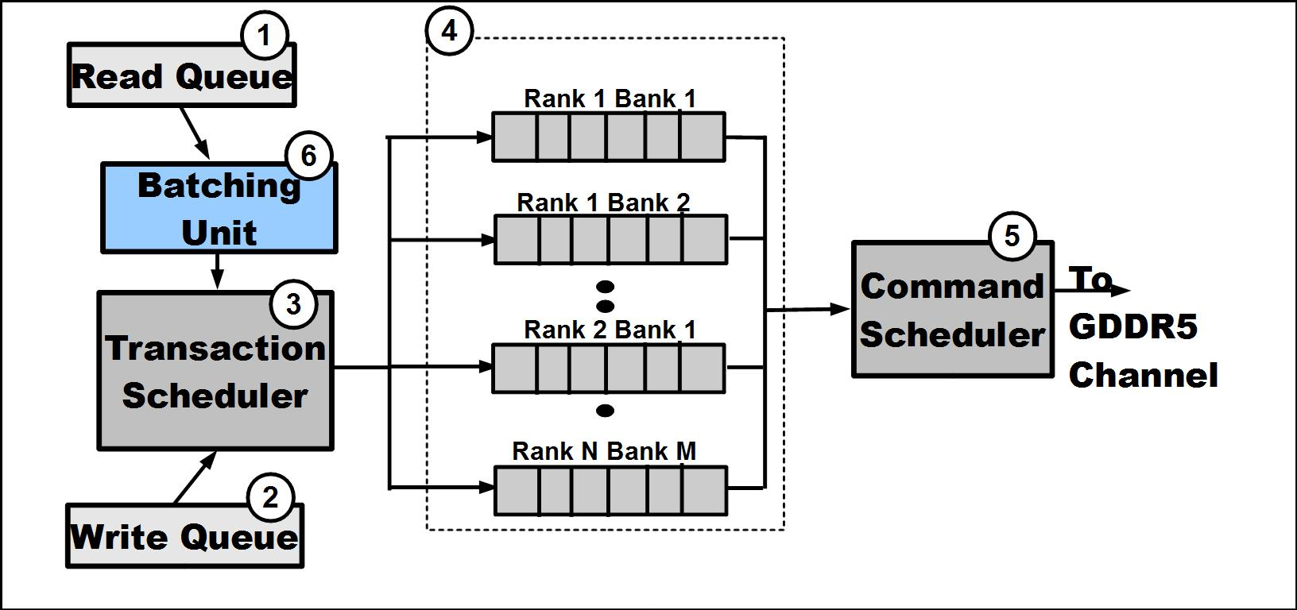
Controller Design

Slide 11
Warp-Group Scheduling : Single Channel
Pending Warp-Groups
Each Warp-Group assigned a priority
Reflects completion time of last request
Higher Priority to
Few requests
High spatial locality
Lightly loaded banks
Priorities updated dynamically
Transaction Scheduler picks warp-group with lowest run-time
Shortest-job-first based on actual service time
Row hit/miss status of reqs
Queuing delay in cmd queues
# of reqs in warp-group
Warp-group priority table
Transaction Scheduler
Pick warp-group with lowest runtime

Slide 12
WG-scheduling
GMC Baseline
WG
Latency Divergence
Ideal
Bandwidth Utilization

Slide 13
Multiple Memory Controllers
Channel level parallelism
Warp’s requests sent to multiple memory channels
Independent scheduling at each controller
Subset of warp’s requests can be delayed at one or few memory controllers
Coordinate scheduling between controllers
Prioritize warp-group that has already been serviced at other controllers
Coordination message broadcast to other controllers on completion of a warp-group.

Slide 14
Warp-Group Scheduling : Multi-Channel
Pending Warp-Groups
Row hit/miss status of reqs
Queuing delay in cmd queues
# of reqs in warp-group
Periodic messages to other channels about completed warp-groups
Priority Table
Transaction Scheduler
Status of Warp-group in other channels
Pick warp-group with lowest runtime

Slide 15
WG-M Scheduling
GMC Baseline
WG
Latency Divergence
WG-M
Ideal
Bandwidth Utilization

Slide 16
Bandwidth-Aware Warp-Group Scheduling
Warp-group scheduling negatively affects bandwidth utilization
Reduced row-hit rate
Conflicting objectives
Issue row-miss request from current warp-group
Issue row-hit requests to maintain bus utilization
Activate and Precharge idle cycles
Hidden by row-hits in other banks
Delay row-miss request to find the right slot

Slide 17
Bandwidth-Aware Warp-Group Scheduling
The minimum number of row-hits needed in other banks to overlap (tRTP+tRP+tRCD)
Determined by GDDR timing parameters
Minimum efficient row burst (MERB)
Stored in a ROM looked up by Transaction Scheduler
More banks with pending row-hits
smaller MERB
Schedule row-miss after MERB row-hits have been issued to bank

Slide 18
WG-Bw Scheduling
GMC Baseline
WG
Latency Divergence
WG-Bw
WG-M
Ideal
Bandwidth Utilization

Slide 19
Warp-Aware Write Draining
Writes drained in batches
starts at High_Watermark
Can stall small warp-groups
When WQ reaches a threshold (lower than High_Watermark)
Drain singleton warp-groups only
Reduce write-induced latency

Slide 20
WG-scheduling
GMC Baseline
WG
Latency Divergence
WG-Bw
WG-M
WG-W
Ideal
Bandwidth Utilization

Slide 21
Methodology
GPGPUSim v3.1 : Cycle Accurate GPGPU simulator
USIMM v1.3 : Cycle Accurate DRAM Simulator
modified to model GMC-baseline & GDDR5 timings
Irregular and Regular workloads from Parboil, Rodinia, Lonestar, and MARS.
SM Cores | 30
Max Threads/Core | 1024
Warp Size | 32 Threads/warp
L1 / L2 | 32KB / 128 KB
DRAM | 6Gbps GDDR5
DRAM Channels Banks | 6 Channels 16 Banks/channel

Slide 22
Performance Improvement
Restored Bandwidth Utilization
Reduced Latency Divergence

Slide 23
Impact on Regular Workloads
Effective coalescing
High spatial locality in warp-group
WG scheduling works similar to GMC-baseline
No performance loss
WG-Bw and WG-W provide
Minor benefits

Slide 24
Energy Impact of Reduced Row Hit-Rate
Scheduling Row-misses over Row-hits
Reduces the row-buffer hit rate 16%
In GDDR5, power consumption dominated by I/O.
Increase in DRAM power negligible compared to execution speed-up
Net improvement in system energy

Slide 25
Conclusions
Irregular applications place new demands on the GPU’s memory system
Memory scheduling can alleviate the issues caused by latency divergence
Carefully orchestrating the scheduling of commands can help regain the bandwidth lost by warp-aware scheduling
Future techniques must also include the cache-hierarchy in reducing latency divergence

Slide 26
Thanks !

Slide 27
Backup Slides

Slide 28
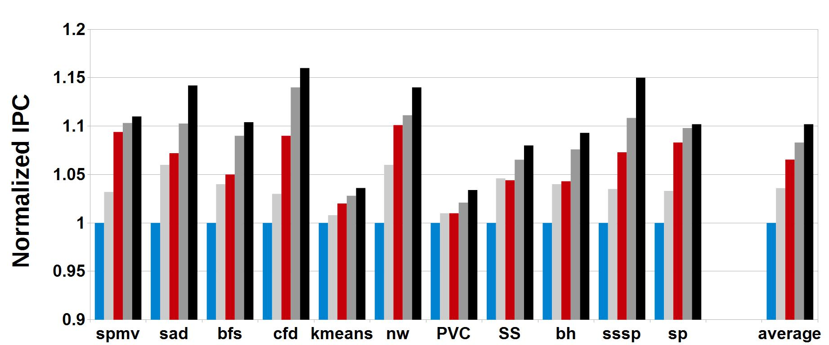
Performance Improvement : IPC

Slide 29
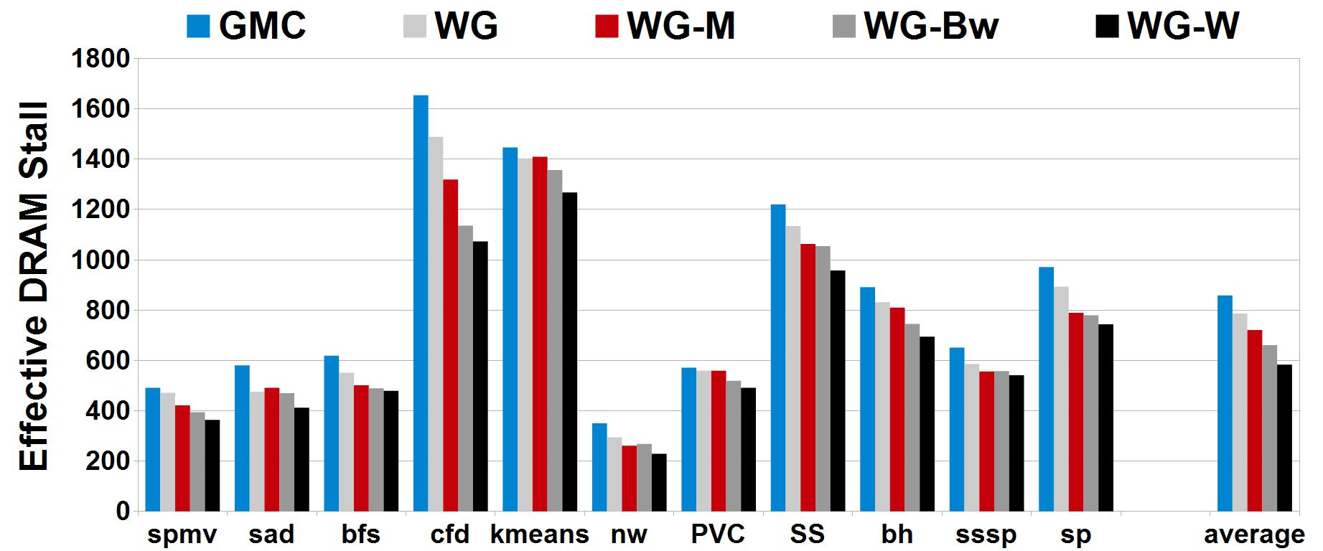
Average Warp Stall Latency

Slide 30
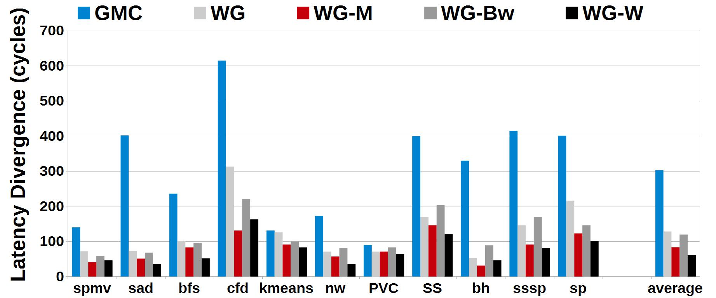
DRAM Latency Divergence

Slide 31
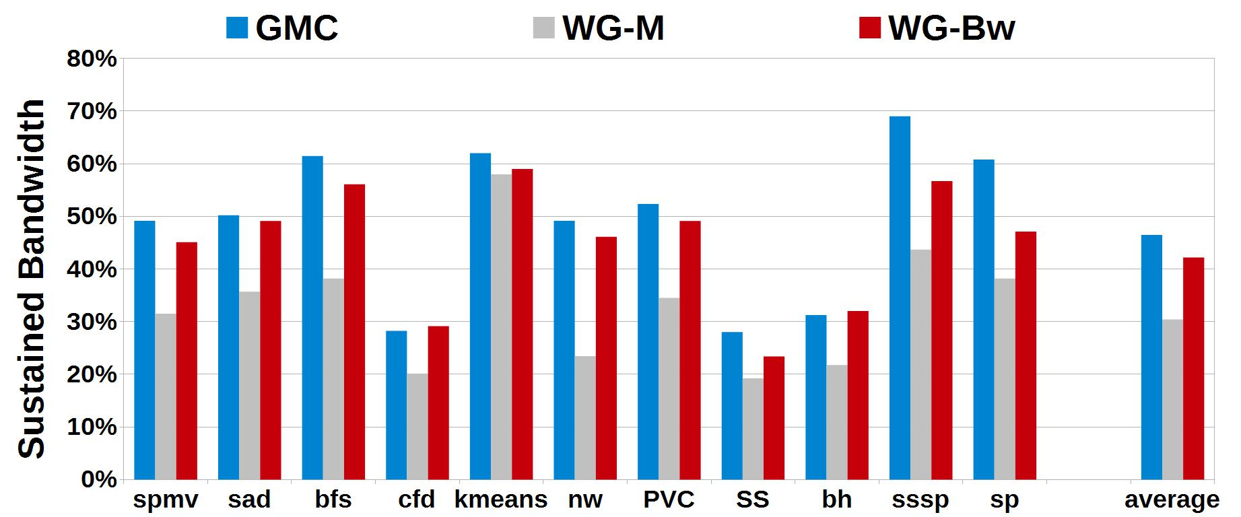
Bandwidth Utilization

Slide 32
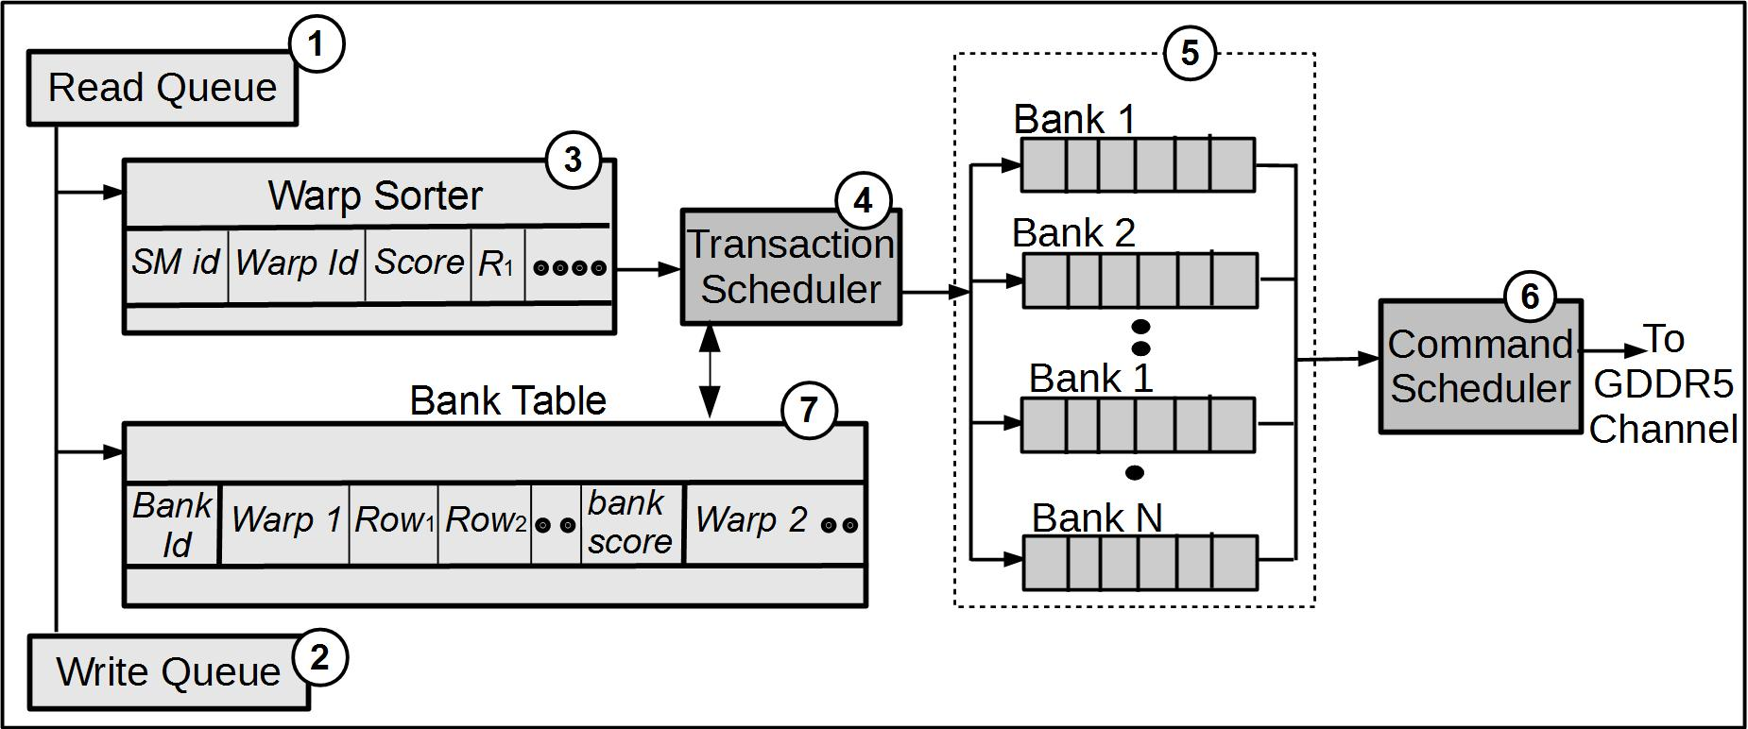
Memory Controller Microarchitecture

Slide 33
Warp-Group Scheduling
Every batch assigned a priority-score
completion time of the longest request
Higher priority to warp groups with
Few requests
High spatial locality
Lightly loaded banks
Priorities updated after each warp-group scheduling
Warp-group with lowest service time selected
Shortest-job-first based on actual service time, not number of requests

