Slide 1
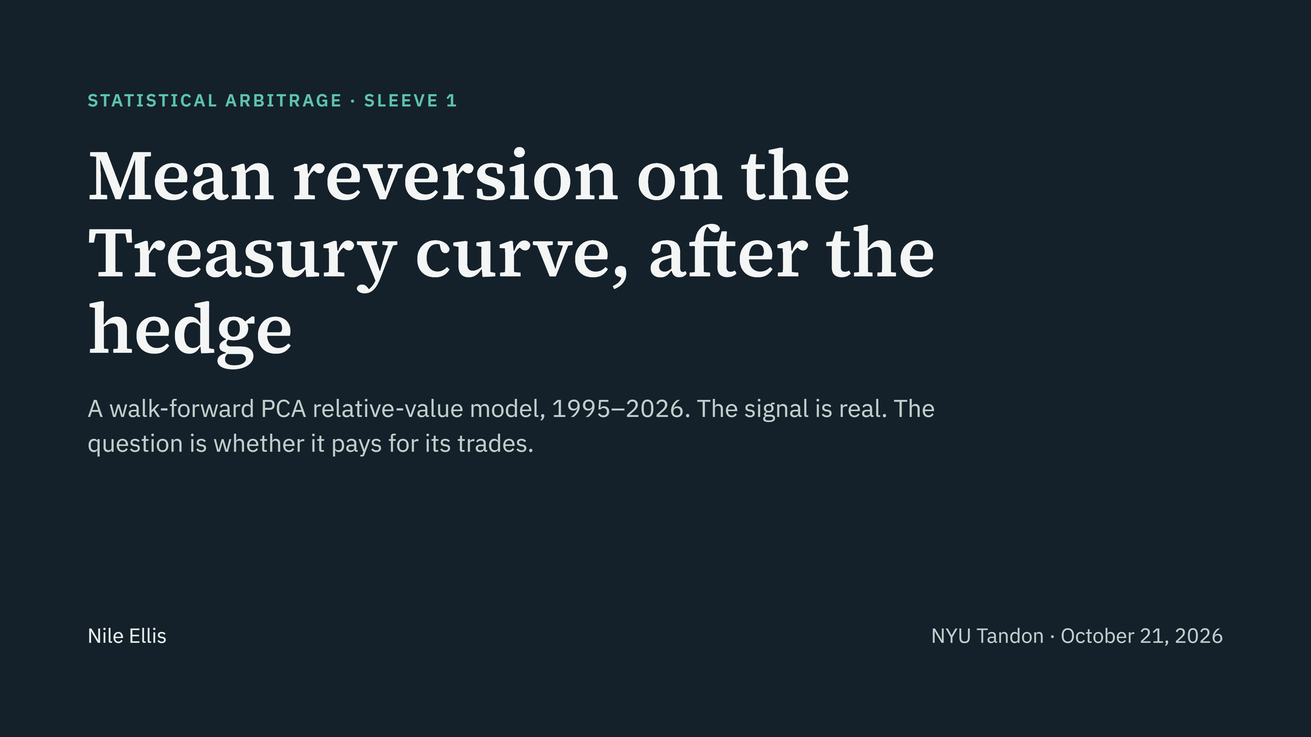
Notes:
Open: We built one sleeve of a fixed-income stat arb book. It hedges the Treasury curve against its common moves and trades what is left when it is stretched. Everything you will see is out of sample, from a walk-forward test over 31 years. Short version of the result: the mean reversion is real, but it is smaller than what it costs to trade at 0.25 bp a leg. The rest of the talk shows exactly where the money goes.

Slide 2
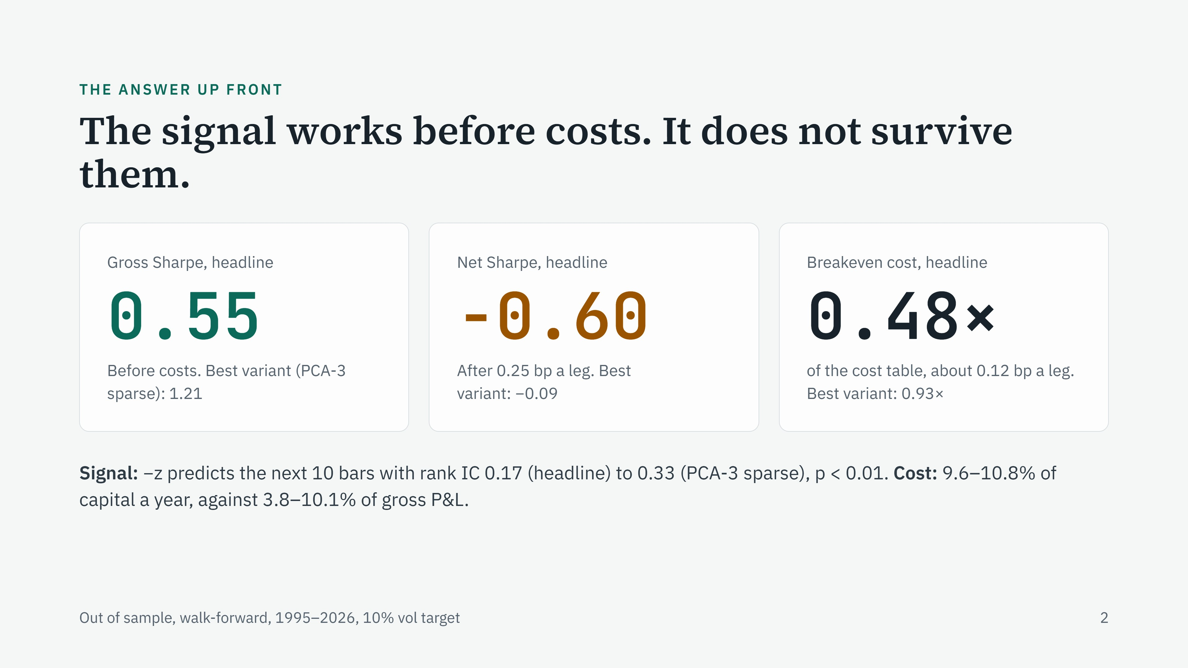
Notes:
Lead with the conclusion. Gross Sharpe is the return before trading costs divided by volatility. Net is after costs. The headline model, which we named before running it on real data, earns 0.55 gross and loses 0.60 net. The best variant we found afterwards, PCA-3 sparse, earns 1.21 gross and is roughly flat net at −0.09. Breakeven cost is the fraction of our cost table at which net P&L would be zero: the headline needs trading to cost less than half of what we assume, about 0.12 bp per leg. The signal is real: IC is the rank correlation between the signal and the next 10 days of the residual, and it is positive and significant. The problem is size: costs run about 10% of capital a year.

Slide 3
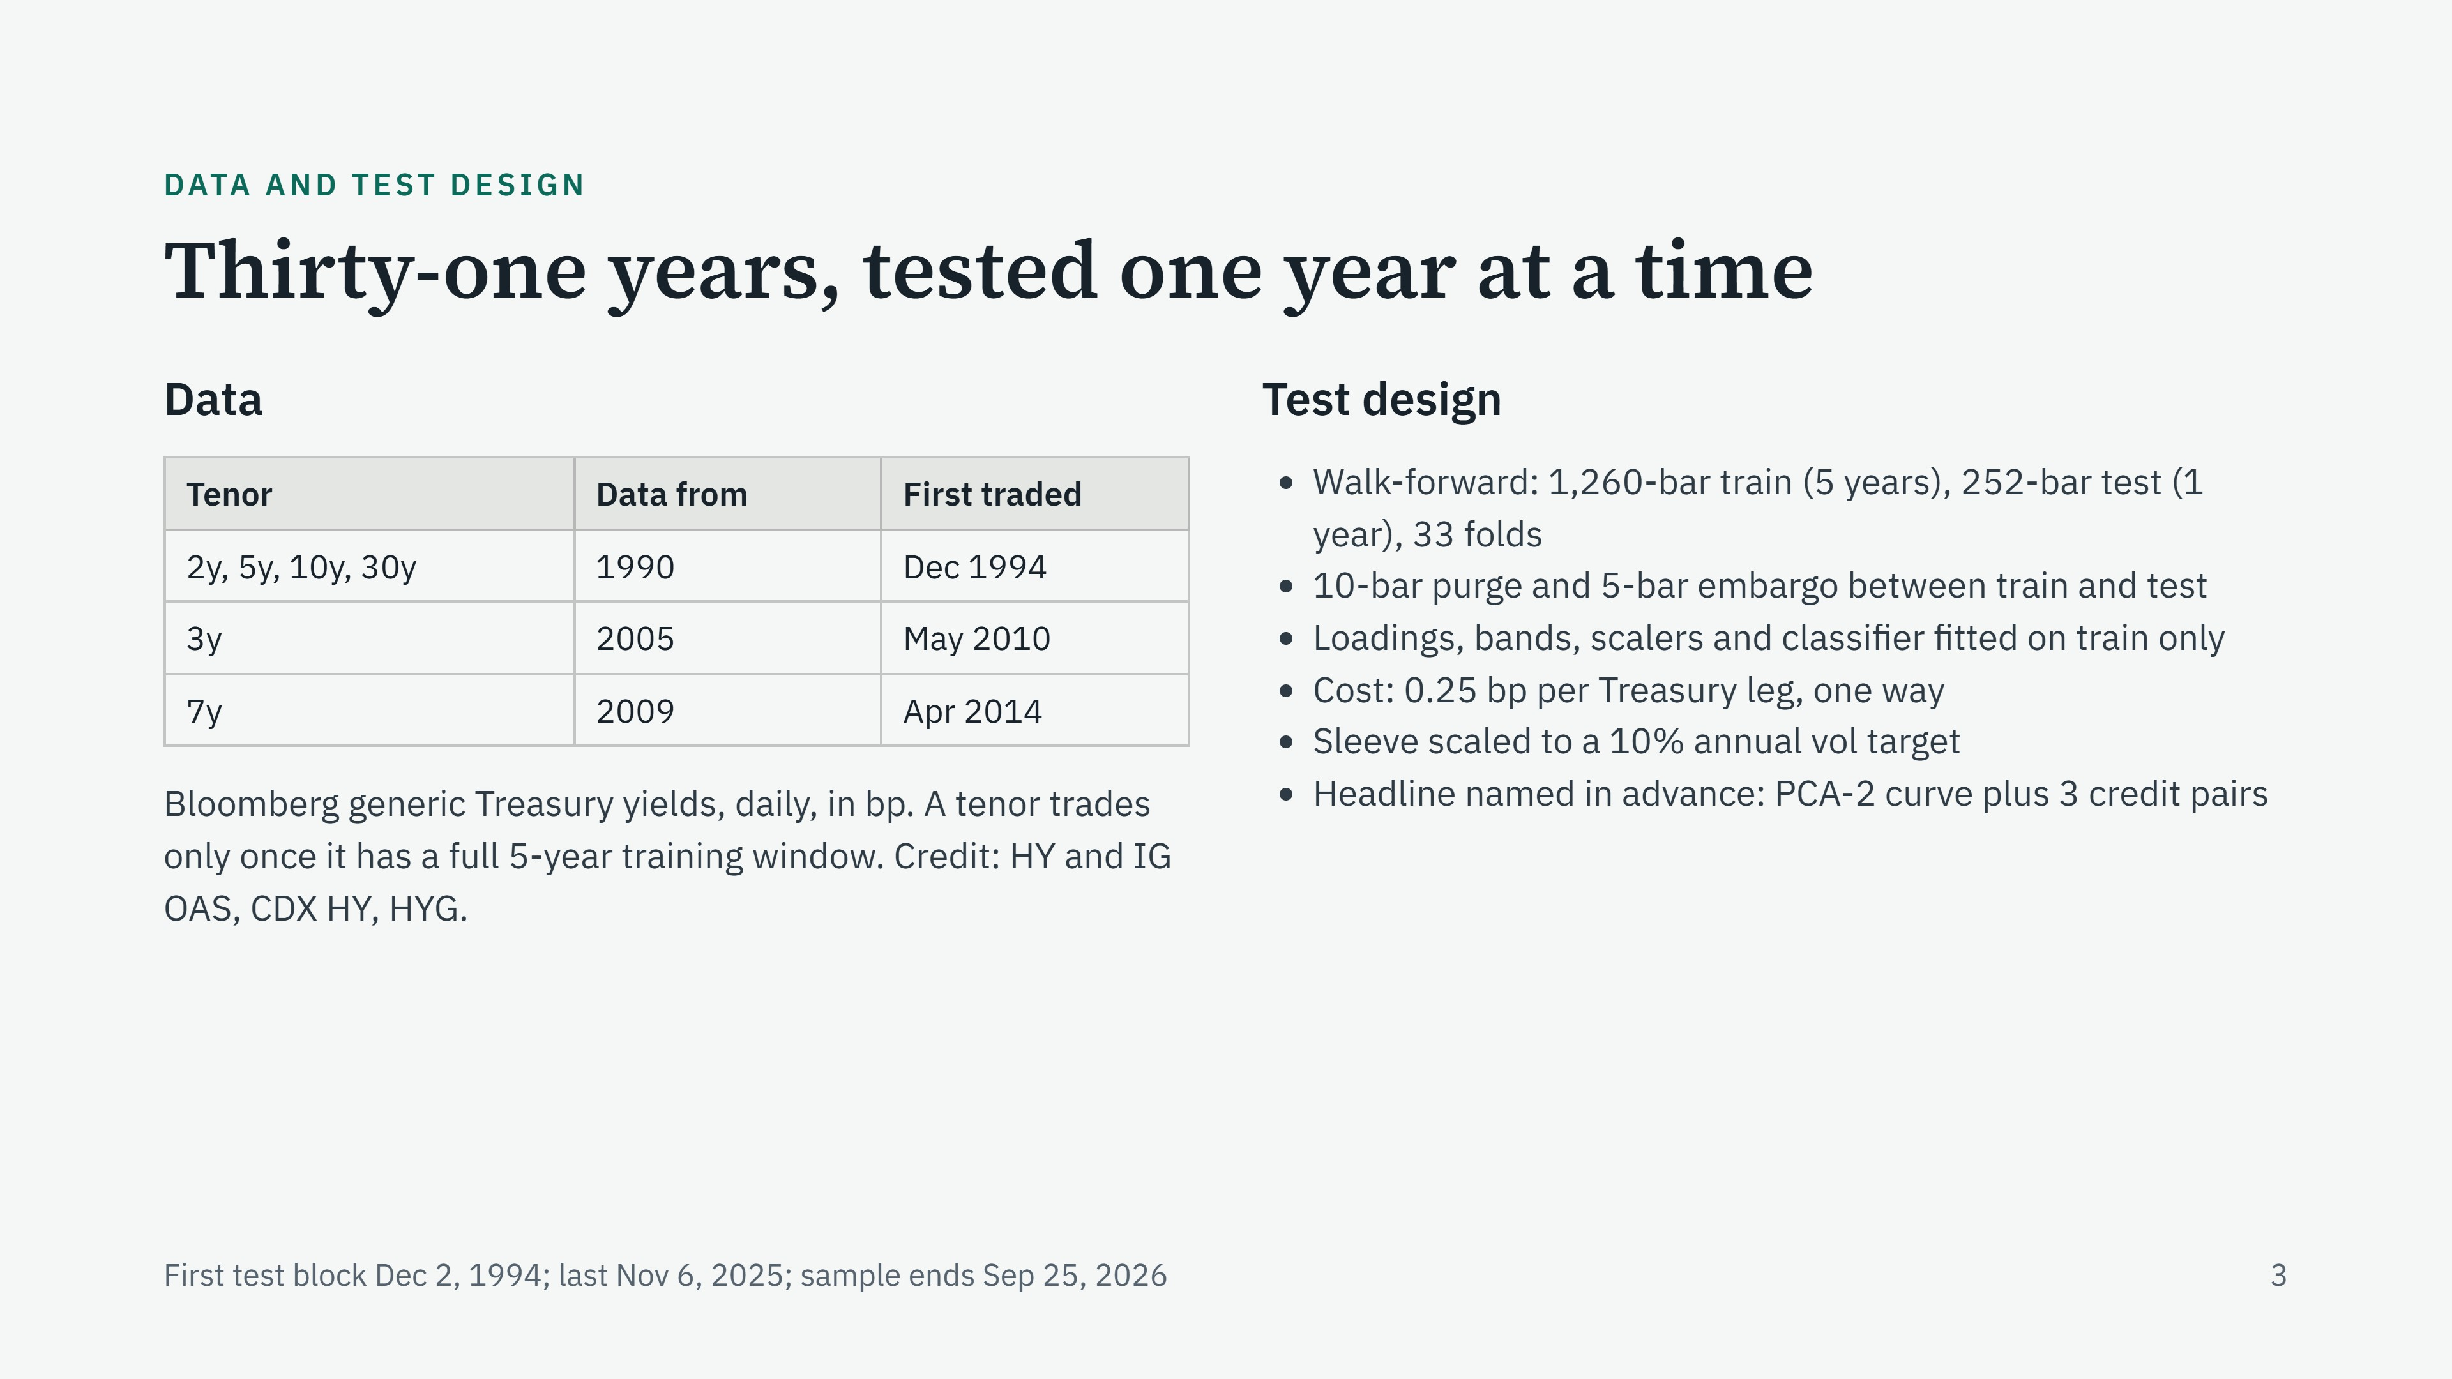
Notes:
Walk-forward means we fit on five years, trade the next year with those fixed parameters, then roll forward a year and refit. That gives 33 out-of-sample years. The purge is a 10-bar gap between training and test because the neural gate's label looks 10 bars ahead; without it the last training labels would see into the test year. The embargo is 5 more bars of buffer. The headline model was named before the PCA was run on real data, so we cannot be accused of picking the best result after the fact. Its curve part is PCA-2; the credit part is three spread pairs: HY vs IG OAS, the CDX cash basis and HYG vs CDX.

Slide 4
RESEARCH QUESTION
Does the residual revert enough to trade?
“After hedging level and slope with PCA, does the Treasury curve residual mean-revert enough to trade profitably after realistic costs?”
Answer: it reverts, but the reversion per trade is smaller than the round-trip cost.
0.17–0.33
0.45 < 0.73
−0.60
Rank IC of −z with the next 10 bars on entry days (headline to PCA-3 sparse). The signal points the right way.
bp. PCA-2: mean realised move per trade, against the median round-trip cost.
Headline net Sharpe at 0.25 bp a leg; 0.55 before cost.
Out of sample, walk-forward 1995–2026, 0.25 bp a leg. Sources: deck_numbers.md §E and §A (reversion vs round-trip cost).
3.1
Notes:
Line to say: The question is simple. Once we hedge level and slope, does what is left mean-revert enough to pay for trading it? The answer is that it does revert: the signal points the right way. But the move we capture per trade, about 0.45 bp on average for PCA-2, is smaller than the 0.73 bp round trip. That gap is the whole story.

Slide 5
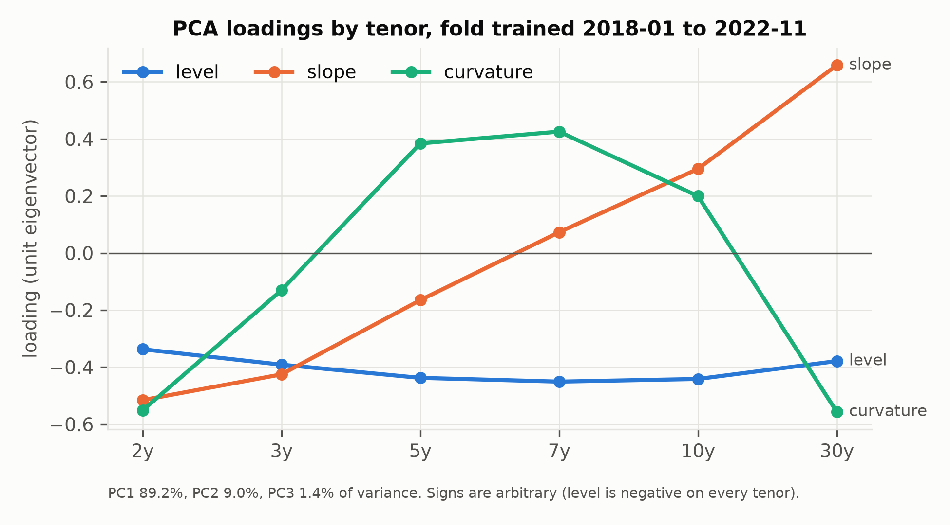
PCA · IN AND OUT
Three factors explain 99.6% of moves
Δy: daily changes, bp, 6 tenors, 1,259 days
Σ = cov(Δy) = VΛVᵀ; L = top-k eigenvectors
Tenor | Level | Slope | Curvature
2y | −0.337 | −0.516 | −0.552
3y | −0.391 | −0.425 | −0.131
5y | −0.438 | −0.165 | +0.384
7y | −0.451 | +0.073 | +0.426
10y | −0.442 | +0.295 | +0.200
30y | −0.379 | +0.659 | −0.557
Eigenvalue, bp² | 138.0 | 13.88 | 2.14
Variance share | 89.2% | 9.0% | 1.4%
Level moves every tenor the same way; slope is front vs back; curvature is belly vs wings.
Refit every fold on that fold's own 5-year training window.
Fold with test window from 2022-12-12; eigenvector signs are arbitrary (level is negative on every tenor). Source: deck_numbers.md §B.
3.2
Notes:
Line to say: The input is daily yield changes in basis points, six tenors, five years of training data, about 1,260 days. The covariance matrix gives us eigenvalues and eigenvectors. In this fold the first factor, level, explains 89% of variance, slope another 9%, and curvature 1.4%. Together that is 99.6%. Everything we trade lives in the last half percent.

Slide 6
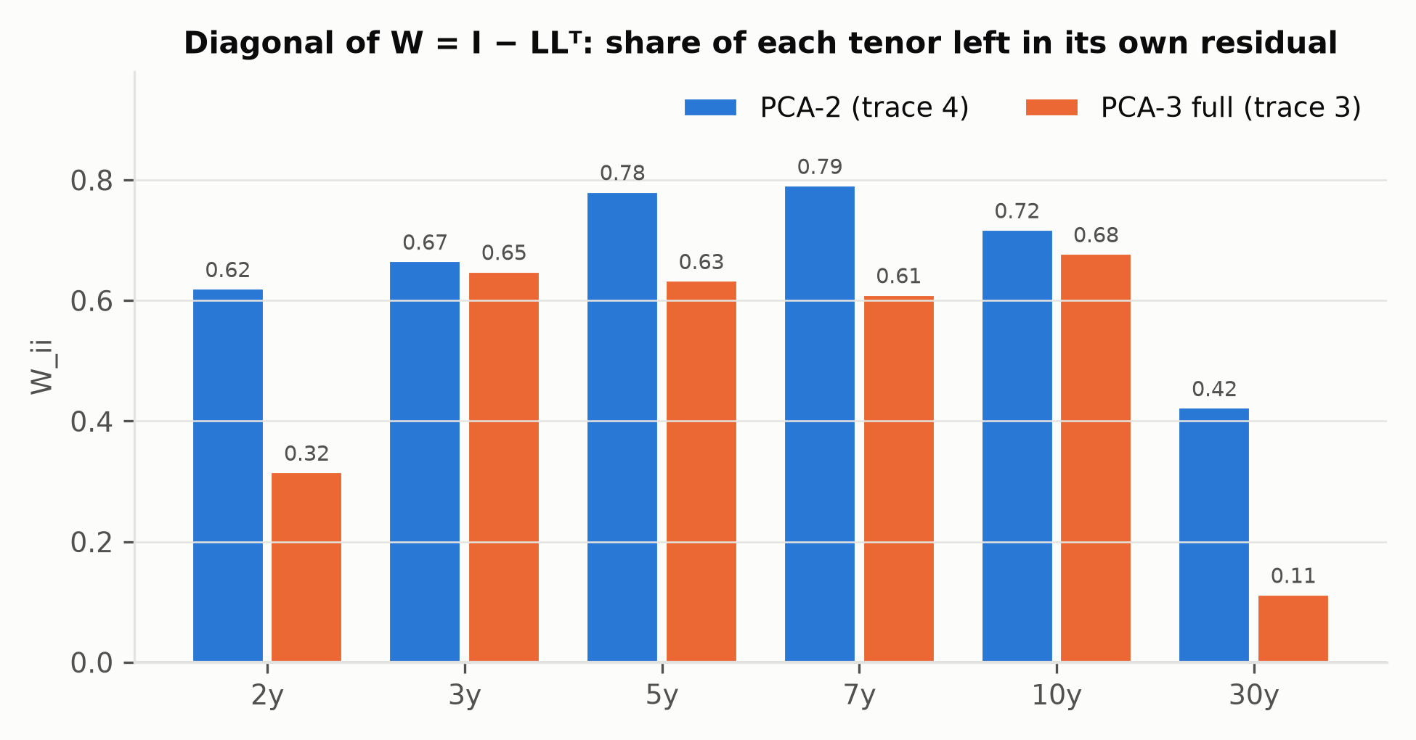
THE HEDGE MATRIX
W = I − LLᵀ keeps what the factors miss
W = I − L Lᵀ, Lᵀ W = 0
trace(W) = 6 − 2 = 4
5y package, one row of W (bp of yield)
2y | 3y | 5y | 7y | 10y | 30y
−0.23 | −0.24 | +0.78 | −0.19 | −0.14 | −0.06
Wᵢᵢ = ‖W eᵢ‖²: the share of tenor i's own direction left after the hedge.
Butterfly: long the 5y, short both sides, so no level or slope exposure.
Hedging curvature too (PCA-3) leaves only 0.32 of the 2y and 0.11 of the 30y.
Fold trained 2018-01 to 2022-11. Package weights in bp of yield per unit of the 5y residual. Source: deck_numbers.md §B.
3.3
Notes:
Line to say: W is the hedge. It removes level and slope from every tenor, so W times L is zero. Its trace equals tenors minus factors, six minus two, four. The diagonal says how much of each tenor's own direction survives the hedge: most of the belly, less than half of the 30-year. One row of W is one tradeable package. The 5-year row is a butterfly: long 0.78 of the 5-year, short its neighbours and the wings.

Slide 7
THE SIGNAL · OU S-SCORE
Fade the residual when it is stretched
C_t = a + b·C_{t−1} + e last 60 bars, refit every bar
m = a/(1 − b) σ_eq = sd(e)/√(1 − b²) z = (C_t − m)/σ_eq
trade only if 0 < b < 1 and half-life = ln 2/κ = −ln 2/ln b < 30 bars
PCA-2 tenor | Half-life, bars | σ_eq, bp | Screen pass
2y | 6.36 | 1.60 | 88.0%
3y | 5.50 | 0.91 | 94.6%
5y | 5.98 | 1.47 | 89.6%
7y | 7.08 | 1.11 | 87.1%
10y | 6.28 | 1.10 | 91.6%
30y | 6.99 | 1.53 | 88.7%
Entry ∈ {1.0 … 2.5}, exit ∈ {0 … 0.75}, set per fold by training net Sharpe; stop at |z| > 4.
z > 0: tenor yield high vs the factors → buy the tenor, sell the hedge legs.
5y on 2023-03-13: z = +2.87, σ_eq = 2.80 bp → 8.03 bp from equilibrium.
Half-life is used only in the screen, never for sizing or timing.
PCA-2, live test bars passing the screen. Code: sleeves/pca.py:50-69, models/ou.py:44-90. Source: deck_numbers.md §A, §C, §K.
3.4
Notes:
Line to say: The signal is the Avellaneda-Lee s-score. On the last 60 days of the cumulative residual we fit an AR(1), refit every day. That gives an equilibrium m, a stationary sigma, and z, how many sigmas we are away. We only trade if the fit actually mean-reverts with a half-life under 30 days, which passes about 90% of days. Positive z means the tenor's yield is high against the factors, so we buy the tenor and sell the hedge. After SVB the 5-year was 2.87 sigmas out, about 8 basis points from its equilibrium.

Slide 8
ONE TRADE, END TO END
The 5y after SVB, entry to exit
Entry (signal bar) | 2023-03-13
z at entry | +2.87
σ_eq at entry | 2.80 bp
Gap from equilibrium, z × σ_eq | 8.03 bp
Size (vol 1.90 bp/day) | −0.526 risk units
Exit | 2023-04-10, 20 bars, z = 0.49
Residual move | −6.20 bp (in our favour)
Gross / cost / net, risk units | +3.26 / 0.52 / +2.74
Gross / cost / net, $1m | +$15.3k / $2.4k / +$12.9k
Leg | Weight | $ per bp
2y | −0.233 | +600
3y | −0.241 | +622
5y | +0.781 | −2,012
7y | −0.185 | +477
10y | −0.145 | +372
30y | −0.057 | +147
Net / gross |  | +206 / 4,230
Long 5y DV01 against short wings: the trade is the residual, not duration.
$/bp = P&L on $1m for +1 bp in that yield. Member pca2_ust_5y, fold from 2022-12-12, bands 2.5 / 0.5. Source: deck_numbers.md §K.
3.5
Notes:
Line to say: Here is one real trade. The Monday after SVB failed, the 5-year residual jumped to 2.87 sigmas, 8 basis points cheap. We bought the 5-year and sold the other five tenors in the W weights: long about $2,000 of 5-year DV01 per basis point, but net DV01 only about $200, so this is a curve trade, not a duration bet. Twenty trading days later z fell to 0.49, inside the 0.5 exit band. The residual moved 6.2 basis points our way: plus $15,300 gross, $2,400 cost, plus $12,900 net on a million.

Slide 9
HIT RATIO · CONDITIONAL GAIN AND LOSS
Wins are frequent; losses are twice as big
Model | Hit gross | Hit net | Gross | Cost | Net | W | L | W ÷ L
Headline | 68.1% | 54.5% | +0.71 | 1.33 | −0.62 | 1.94 | 3.68 | 0.53
PCA-3 sparse | 83.1% | 57.6% | +1.74 | 2.08 | −0.33 | 1.52 | 2.86 | 0.53
PCA-2 full | 67.2% | 54.4% | +0.69 | 1.39 | −0.70 | 2.04 | 3.97 | 0.51
Pairwise NN | 69.0% | 54.0% | +0.48 | 1.10 | −0.62 | 1.89 | 3.56 | 0.53
Fly 2s5s10s | 56.7% | 51.7% | −0.19 | 1.07 | −1.26 | 1.90 | 4.63 | 0.41
Fly 3s5s7s | 74.4% | 44.2% | +1.12 | 2.27 | −1.15 | 1.74 | 3.43 | 0.51
Breakeven hit rate
1/(1 + W÷L) = 1/1.53 = 65%
Net hit rates are 44–58%: below it for every model.
Expectancy
p·W − (1 − p)·L
L ≈ 2×W everywhere, so only a stop or a regime gate shrinks it.
Why the band is wide
round trip 0.73 bp, fixed
Captured ≈ (entry − exit)·σ_eq, so the band widens: entry at the grid top (2.5) in 45–70% of PCA-2 folds.
Units: risk units = one trailing daily σ at entry (not σ_eq, not bp). PCA-3 sparse: distinct trades. Source: deck_numbers.md §D.
3.6
Notes:
Line to say: Every model wins more trades than it loses, even after cost. The problem is size: the average loser costs about twice the average winner. With win over loss near 0.53, you need a 65% hit rate to break even, and we get 44 to 58. The band is wide because cost is a fixed 0.73 basis points a round trip, so the optimiser wants each trade to capture as much reversion as possible; it sits at the top of the grid in half or more of the folds. Raising the hit rate will not fix this. Only something that cuts the losers, a stop or a regime gate, shrinks L.

Slide 10
QUIET VS VOLATILE ENTRIES
Quiet markets can't pay a fixed cost
Model | Tercile cuts, bp/day | Round trip ÷ vol, low | Net, low | Net, mid | Net, high
Headline | 0.50 / 1.03 | 1.78 | −1.25 | −0.27 | −0.33
PCA-3 sparse | 0.92 / 1.54 | 2.32 | −0.48 | +0.04 | +0.48
PCA-2 full | 0.47 / 0.77 | 1.96 | −1.47 | −0.20 | −0.45
Pairwise NN | 1.23 / 3.01 | 1.30 | −1.77 | −0.01 | −0.09
Entry vol = the trailing EW-60 residual vol on the entry bar (bp/day), the same vol used for sizing.
Position = 1/vol, so a quiet market buys more DV01 per unit of edge: the round trip costs 1.3–2.3× a day's move in the low tercile.
Low-vol trades lose for every model; only PCA-3 sparse's high-vol third earns (+0.48σ per trade).
Basis: member trades; terciles pooled per model over the full sample (ex post, descriptive). Net in risk units. Source: deck_numbers.md §F.
3.7
Notes:
Line to say: We split trades by how volatile the residual was when we entered. Cost is fixed in basis points, but we size to one over volatility, so in a quiet market we buy more DV01 for the same expected edge, and the round trip costs up to twice a day's move. Low-volatility trades lose for every model. Only PCA-3 sparse's high-volatility third makes money.

Slide 11
PER DOLLAR
$1 million in: earned vs paid
Model | Gross $/yr | Cost $/yr | Net $/yr | Take-home per $1 | Gross DV01 $/bp | Net DV01 $/bp
Headline | 45,500 | 95,800 | −50,300 | −$1.10 | 6,632 | 446
PCA-3 sparse | 100,500 | 107,600 | −7,100 | −$0.07 | 9,374 | 175
PCA-2 full | 38,500 | 96,700 | −58,200 | −$1.51 | 7,596 | 498
Pairwise NN | 35,600 | 55,500 | −20,000 | −$0.56 | 3,856 | 263
$1.07
cost per $1 of gross P&L, PCA-3 sparse
$2.10
cost per $1 of gross P&L, headline
Take-home per $1 of gross = 1 − cost ÷ gross.
Gross DV01 $3.9k–9.4k per bp, net only $175–498: long and short the curve at once.
Basis: $1m of capital at the 10% vol target (not notional); additive returns. DV01 is the mean over live days. Source: deck_numbers.md §G.
3.8
Notes:
Line to say: Put a million dollars of capital behind PCA-3 sparse and it makes about $100,000 a year before cost, then pays $108,000 to trade. Every dollar it earns costs a dollar and seven cents. The headline pays two dollars ten for every dollar it earns. The book is large in gross DV01 but nearly flat in net DV01: it is long and short the curve at the same time, which is why the cost adds up.

Slide 12
MODEL COMPARISON
Best and worst models side by side
Model | Gross SR | Net SR | Breakeven × | IC, 10d | Trades/yr | Cost, % pa
PCA-3 sparse (best) | 1.21 | −0.09 | 0.93 | 0.33 | 7.9 | 10.8
Headline (PCA-2 + credit) | 0.55 | −0.60 | 0.48 | 0.17 | 13.1 | 9.6
Pairwise NN | 0.46 | −0.26 | 0.64 | 0.13 | 7.7 | 5.6
PCA-2 full | 0.45 | −0.67 | 0.40 | 0.20 | 10.6 | 9.7
Fly 3s5s7s | 0.38 | −0.77 | 0.32 | — | 43 total | 10.1
Fly 2s5s10s (worst) | 0.11 | −0.42 | 0.22 | — | 60 total | 3.9
Every model is positive gross and negative net.
The fixed flies, traded with the same rules, earn far less gross (0.11–0.38): the PCA hedge adds signal.
Trades/yr = trades ÷ (live bars ÷ 252), identical trades merged; headline 13.1 = 426 trades. Source: deck_numbers.md §E.
3.9
Notes:
Line to say: Same pipeline, same costs. The best model, PCA-3 sparse, has a gross Sharpe of 1.2 and breaks even at 93% of the cost table, so it is close. The worst are the fixed butterflies traded with the same rules, which tells you the PCA hedge is adding signal, not just the trading rule. Every model is positive before cost and negative after it.

Slide 13
COST ROUND 1
Freezing size helps; nothing clears zero
Net Sharpe at cost × | 0.5× | 1× | 2× | Cost % pa
Headline · baseline | −0.03 | −0.60 | −1.64 | 9.6
Headline · freeze size | +0.10 | −0.35 | −1.20 | 8.2
Headline · freeze + gate | +0.06 | −0.22 | −0.76 | 4.5
PCA-3 sparse · baseline | +0.58 | −0.09 | −1.28 | 10.8
PCA-3 sparse · freeze size | +0.63 | +0.07 | −0.95 | 9.5
PCA-3 sparse · freeze + gate | +0.33 | +0.09 | −0.38 | 3.9
Freeze size (no parameter): cost −11 to −14%, net SR +0.16 to +0.25.
Vol gate (X fitted per fold, a trial): halves cost again, and halves PCA-3 sparse gross (1.17 → 0.56).
Headline still negative at 1x (−0.22).
PCA-3 sparse +0.09 at 1x; deflated Sharpe 0.002 at 47 trials.
Bands and the gate level X are fitted at 1x; 0.5x and 2x re-price the same positions. Source: deck_numbers.md §H, §J.
3.10
Notes:
Line to say: We tried two cost cuts. Freezing the position size at entry has no parameter: it cuts cost by 11 to 14% and adds 0.16 to 0.25 of net Sharpe. Adding a volatility gate, fitted per fold, halves cost again but also halves PCA-3 sparse's gross Sharpe. The headline stays negative. PCA-3 sparse reaches plus 0.09, but with 47 trials its deflated Sharpe is 0.002. Honestly: not distinguishable from zero.

Slide 14
PROJECT EVOLUTION
Seven steps, 47 trials, one answer
1
2
3
4
5
6
7
Pairwise, 10 spreads
Universe to 27–31
4 design revisions
PCA models
Filters + curve rules
Step-8 experiments
Cost round 1
NN gate 0.51 / −0.01
NN gate 0.46 / −0.26
no Sharpe saved
PCA-3 sparse 1.21 / −0.09
16 variants
best 1.20 / −0.00
best 0.56 / +0.09
47
0.002
0.42
documented trials: 11 models, 8 cost filters, 8 curve rules, 4 revisions, 12 experiments, 4 cost-round configs
deflated Sharpe, net, of the best variant (PCA-3 sparse freeze + vol gate)
deflated Sharpe, gross, same variant: a 42% probability the true gross Sharpe is above zero
No git history: steps from dated table snapshots. Pairs are gross / net Sharpe. Source: deck_numbers.md §J.
3.11
Notes:
Line to say: This is how we got here. We started with pairwise spreads, widened the universe, revised the design four times, moved to PCA residuals with the headline named in advance, then tried filters, curve rules, experiments and one cost round. That is 47 trials in all. Correcting for them, the probability that the best variant's true Sharpe is above zero is 42% before cost and 0.2% after it.

Slide 15
WARNINGS
Read the best result with care
1 · Hedge defect, 2010–13
+68.2 / −120.9 / +68.9
3y hedged by a near-singular 2y/5y/10y solve. Trades in the four folds lost 34 risk units across 13 distinct trades (20 from the 3y).
2 · Overlap
6 members = 2.3 effective bets
The 2y, 3y and 5y members are often one portfolio. Counting each distinct portfolio once: net SR −0.097 vs −0.087.
3 · Selection
47 trials → net DSR 0.002
Several experiment settings were chosen after full-sample results were seen.
4 · Optimistic signal
half-life 6.4 vs 103 bars
The 60-bar AR(1) is biased fast (small sample); the entry band sits at the grid top in 45–70% of PCA-2 folds.
The defect is deliberately not fixed: a fix chosen after seeing results is another trial. Source: deck_numbers.md Defect, §I, §J, §A, §C.
3.12
Notes:
Line to say: Four warnings before you believe the best number. One, a construction defect: in 2010 to 2013 the 3-year was hedged with nearly collinear tenors, weights of plus 68, minus 121, plus 69, and trades in those four folds lost 34 risk units across 13 distinct trades. Two, overlap: six members are 2.3 independent bets, though counting each portfolio once barely moves the Sharpe. Three, selection: 47 trials. Four, the 60-day OU fit is biased fast, so the signal promises more than it delivers.

Slide 16
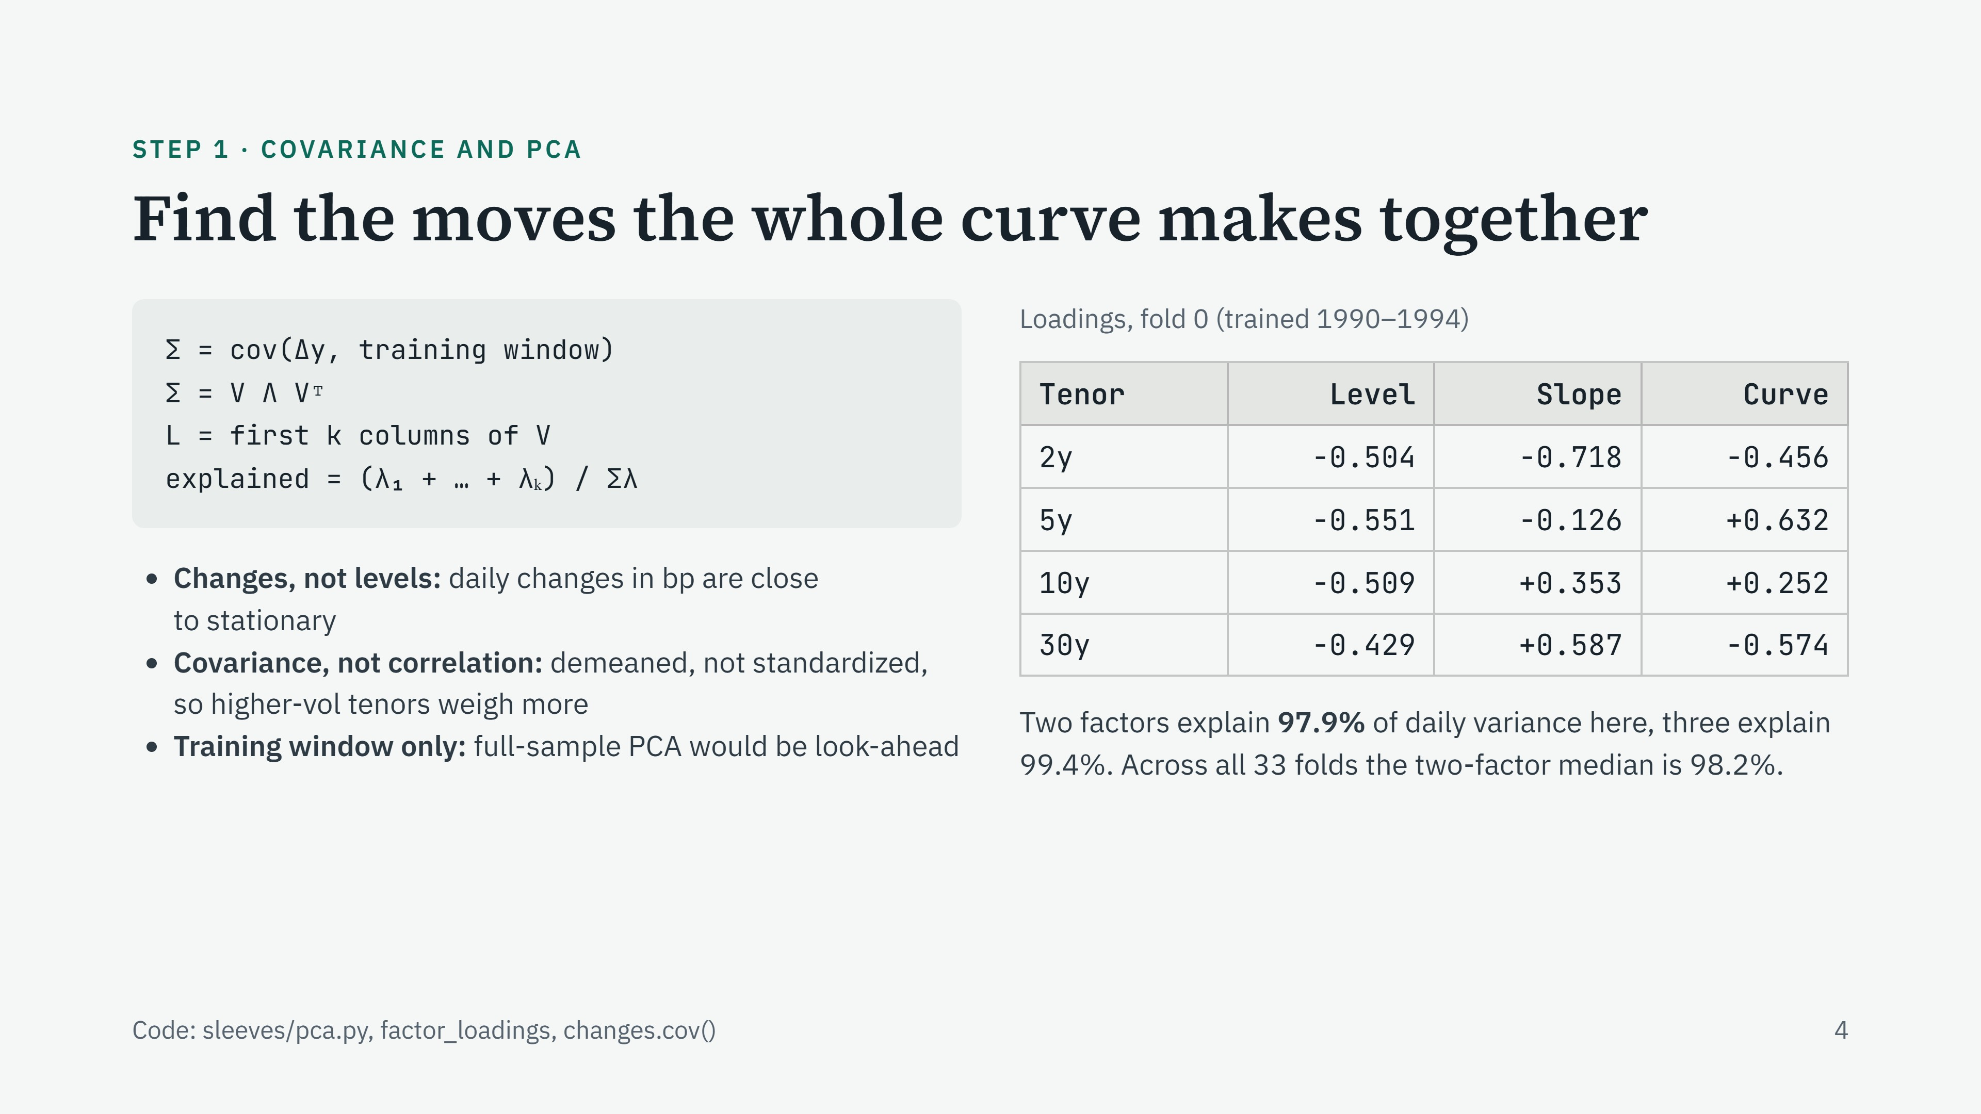
Notes:
Variance is how much one tenor moves around its average, in bp squared; its square root is the daily standard deviation. Covariance is how much two tenors move together. The covariance matrix holds every tenor's variance on the diagonal and every pair's covariance off it. PCA finds the directions that explain the most of that matrix. Read the loadings: level, all four the same sign, so the curve moves together (the sign itself is arbitrary). Slope runs from −0.72 at the 2y to +0.59 at the 30y: steepening or flattening. Curvature, the 5y at +0.63 against both wings: the belly moving against the ends. We use covariance, not correlation, so a tenor that moves more pulls the factors toward itself. And we fit only on the training window, otherwise we would be using future data.

Slide 17
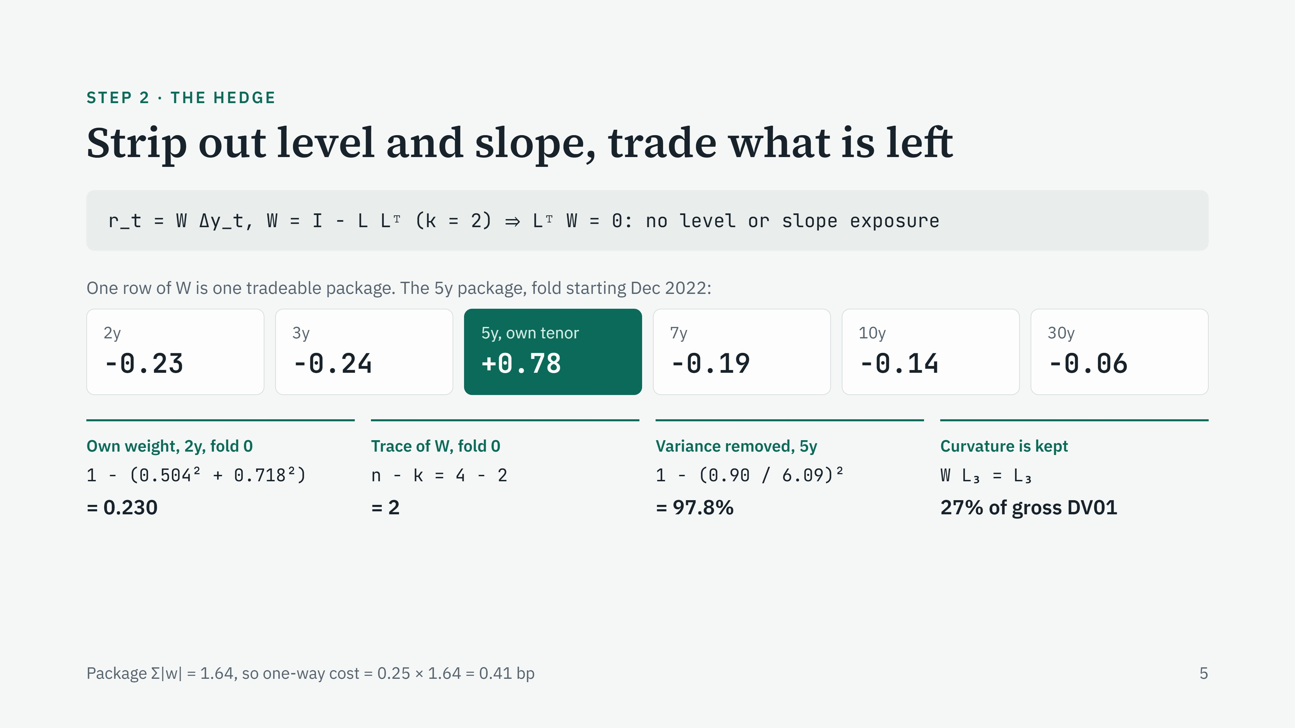
Notes:
W removes the part of every yield move that level and slope explain. Each row of W is a package you can actually hold. The 5y package is long 0.78 of the 5y yield and short a little of every other tenor: a butterfly whose weights PCA chose rather than me. A pure level move, every yield up the same amount in the level shape, gives this package exactly zero P&L. Four numbers to know. Own weight: 1 minus the tenor's squared loadings on the kept factors; the 2y loads heavily on slope, so only 23% of it is left. Trace: the sum of the diagonal, which equals tenors minus factors. Variance removed: 1 minus the squared ratio of residual to raw standard deviation; the 5y residual moves 0.90 bp a day against 6.09 raw, so 97.8% of the variance is gone. Remember to square the ratio; without squaring you get 85%, which is the cut in standard deviation, not variance. Curvature is untouched because the PCs are orthogonal, so PCA-2 is partly a curvature bet by design.

Slide 18
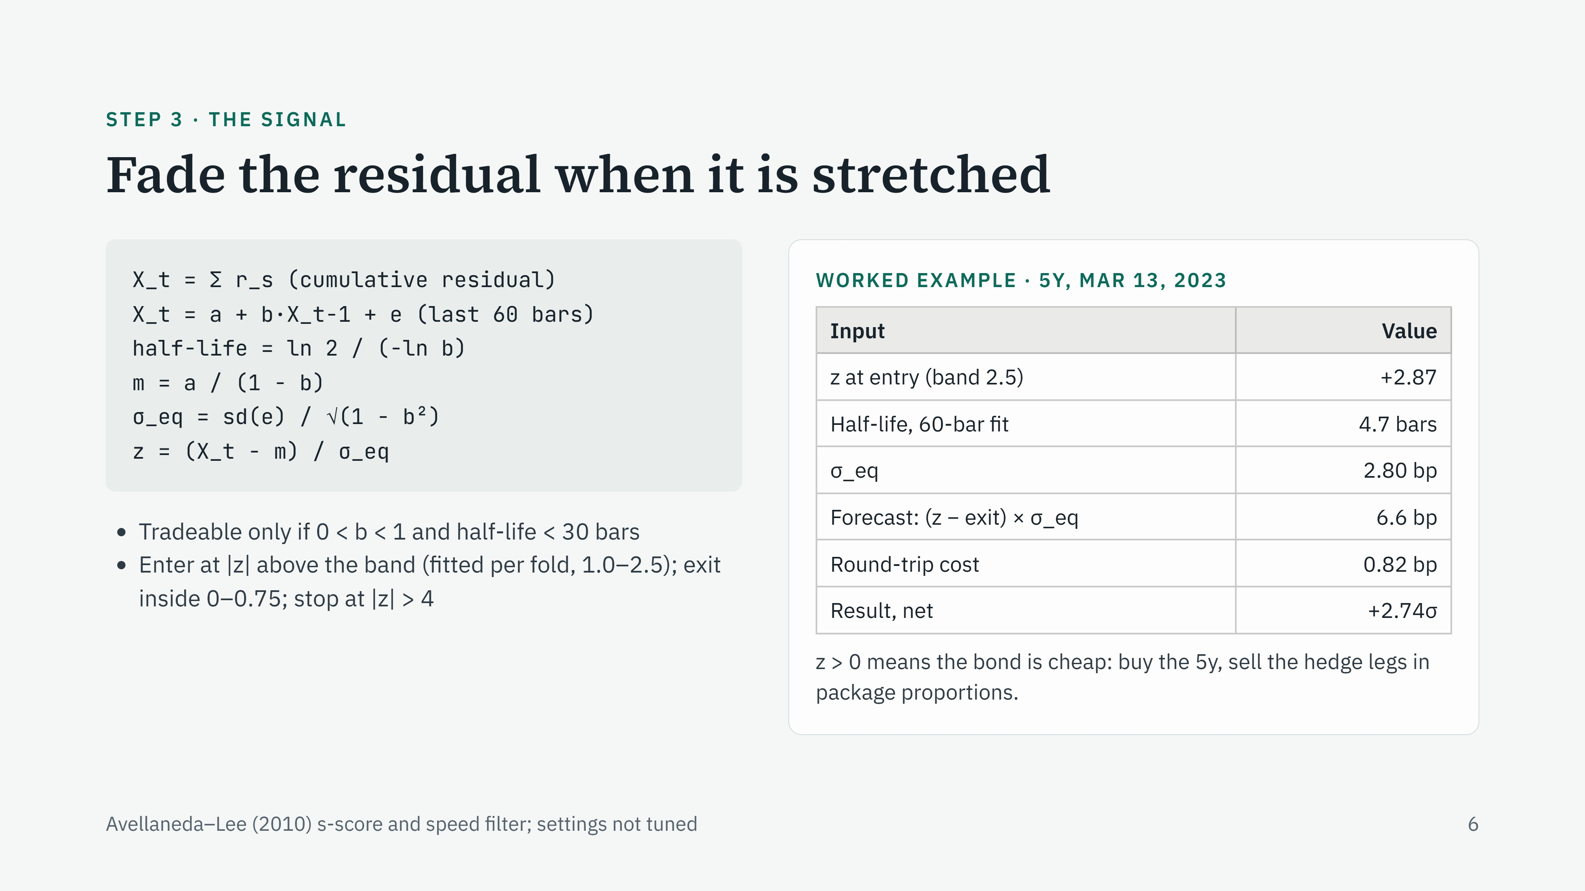
Notes:
Add up the residual's daily changes and you get a level, X. If the hedge works, X wanders around a mean and gets pulled back. We model that pull as an Ornstein–Uhlenbeck process, fitted as an AR(1) on the last 60 days. b near 1 means slow reversion; the half-life is how many days it takes to close half the gap. m is the local mean and sigma_eq is how far X typically sits from it. z is the distance in those units. The bands are chosen on the training window. Direction: a high z means the 5y yield is too high relative to the curve, so the bond is cheap; we buy it and sell the hedges, and we profit if the residual yield falls back. The SVB week trade is the textbook case: the model expected 6.6 bp of reversion against a 0.82 bp round trip, and it made 2.74 daily sigmas net.

Slide 19
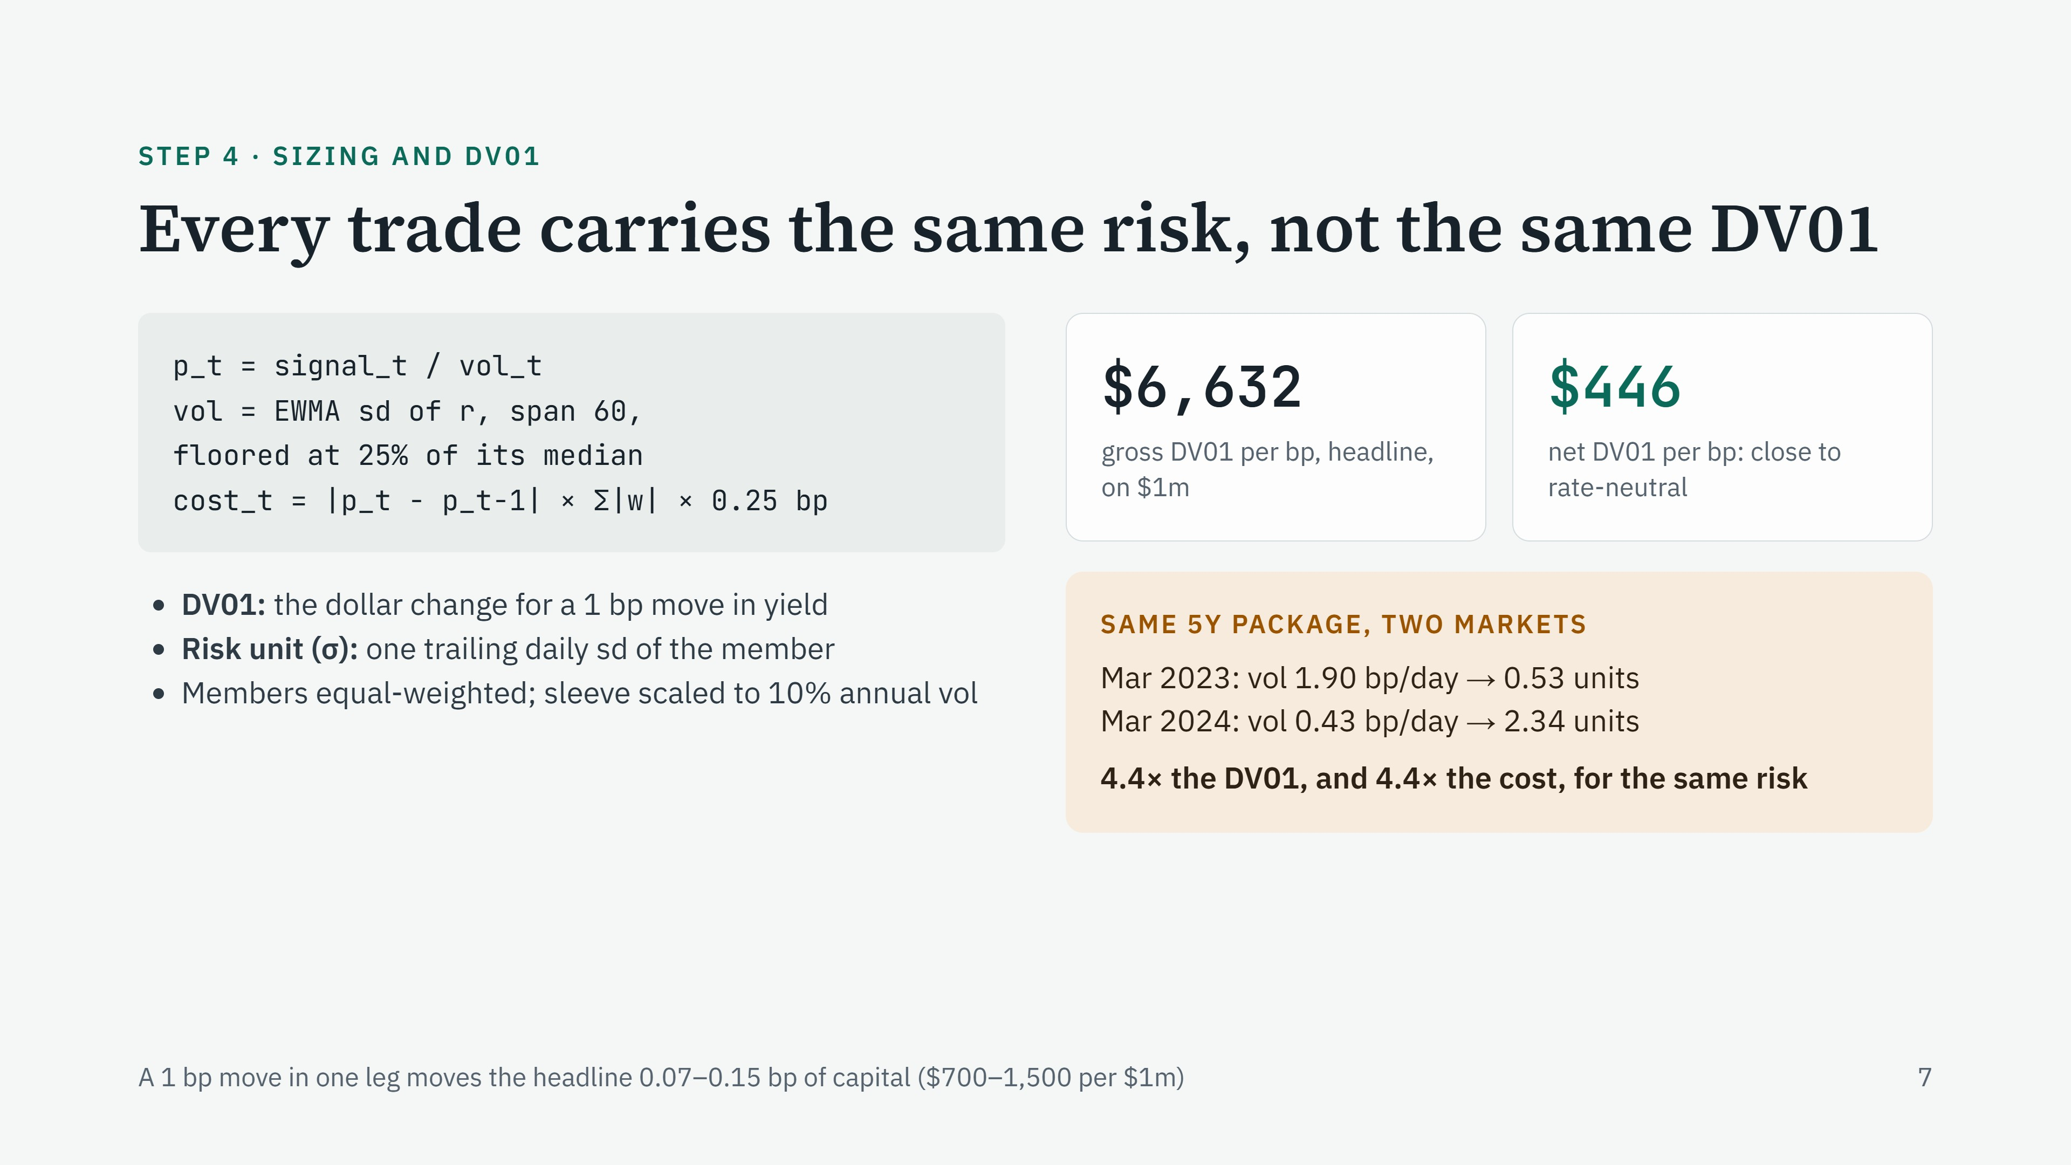
Notes:
DV01 is dollar value of one basis point: how much money the position makes or loses if a yield moves 1 bp. We size each trade by dividing the signal by recent residual volatility, so every trade risks the same amount, one daily standard deviation. Gross DV01 adds up the absolute exposure on every leg: about $6,600 per bp on a $1 million book. Net DV01 lets longs and shorts offset: only about $450, because the packages are built to be neutral to level moves. That is the hedge working. The catch is on the right. The same package in a quiet market, at 0.43 bp a day, needs 4.4 times the DV01 to carry the same risk. Cost is charged per unit traded, in bp, so the quiet-market trade pays 4.4 times more cost per unit of risk. That single line is the core of why the strategy loses.

Slide 20
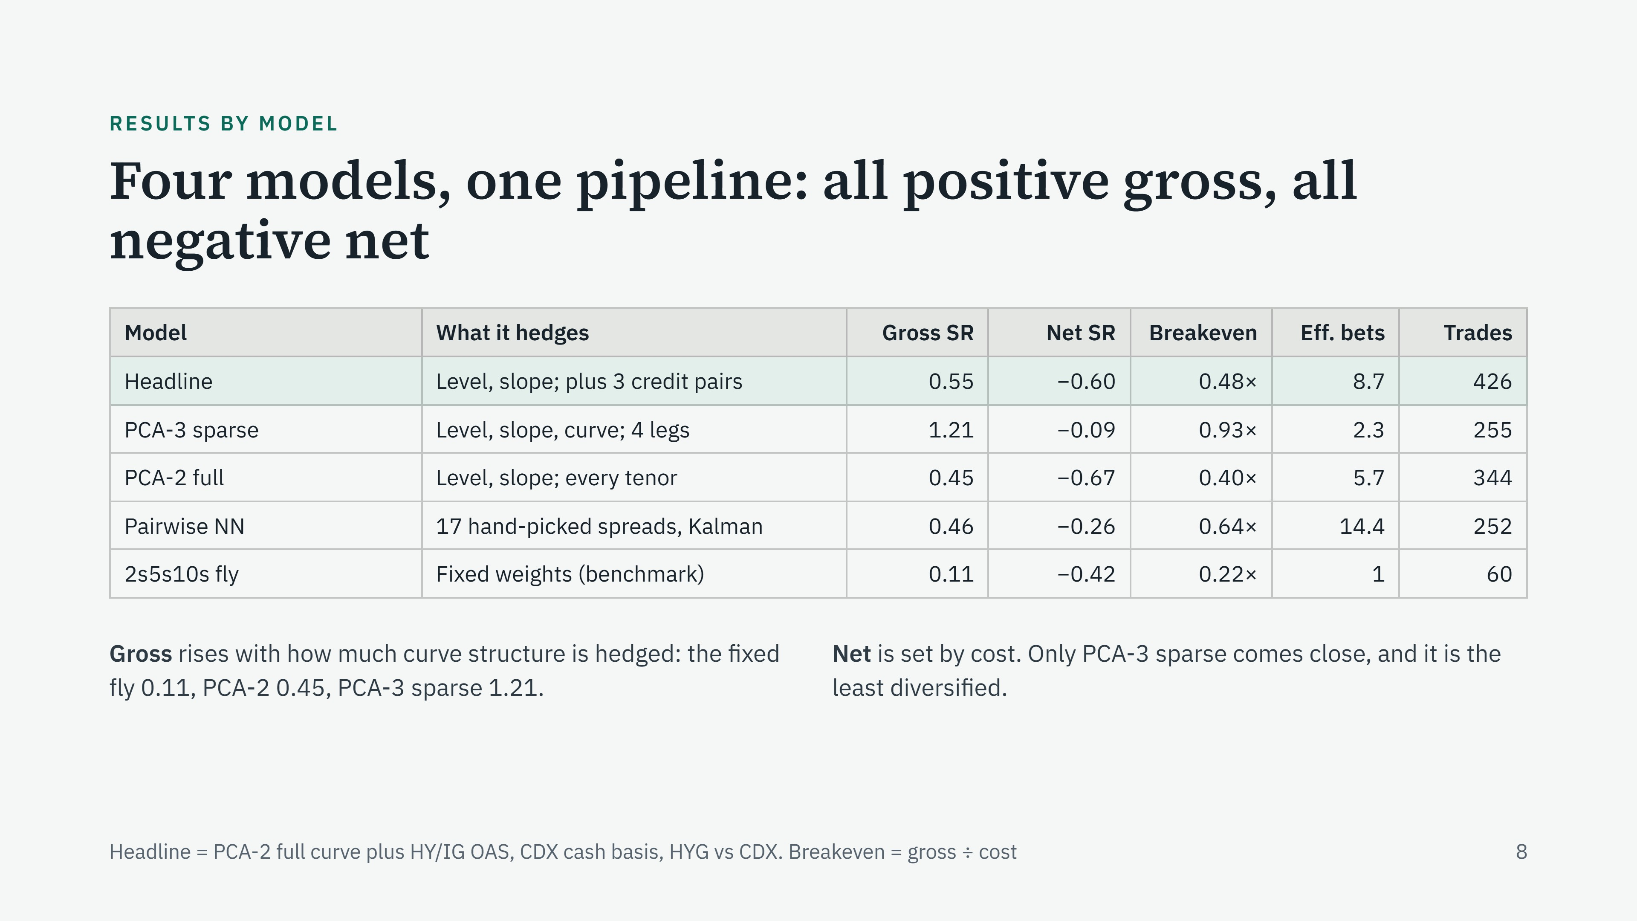
Notes:
Four models through the same engine, folds and costs. The headline is the one we committed to in advance, so it is the one to judge us on. PCA-2 full is the headline without the credit pairs; its curve results are identical. PCA-3 sparse also hedges curvature and uses only the tenor and its three nearest neighbours. Pairwise is the classic approach: hand-picked spreads with Kalman hedge ratios, a cointegration screen and a neural gate. Effective bets measures diversification: 1 if all members move as one, the member count if they are uncorrelated. The fixed 2s5s10s fly is a benchmark traded with the same rules: it barely earns anything gross, which shows the PCA weights are doing real work. Pattern: the more structure you hedge, the stronger the signal, but every model still pays more than it earns.

Slide 21
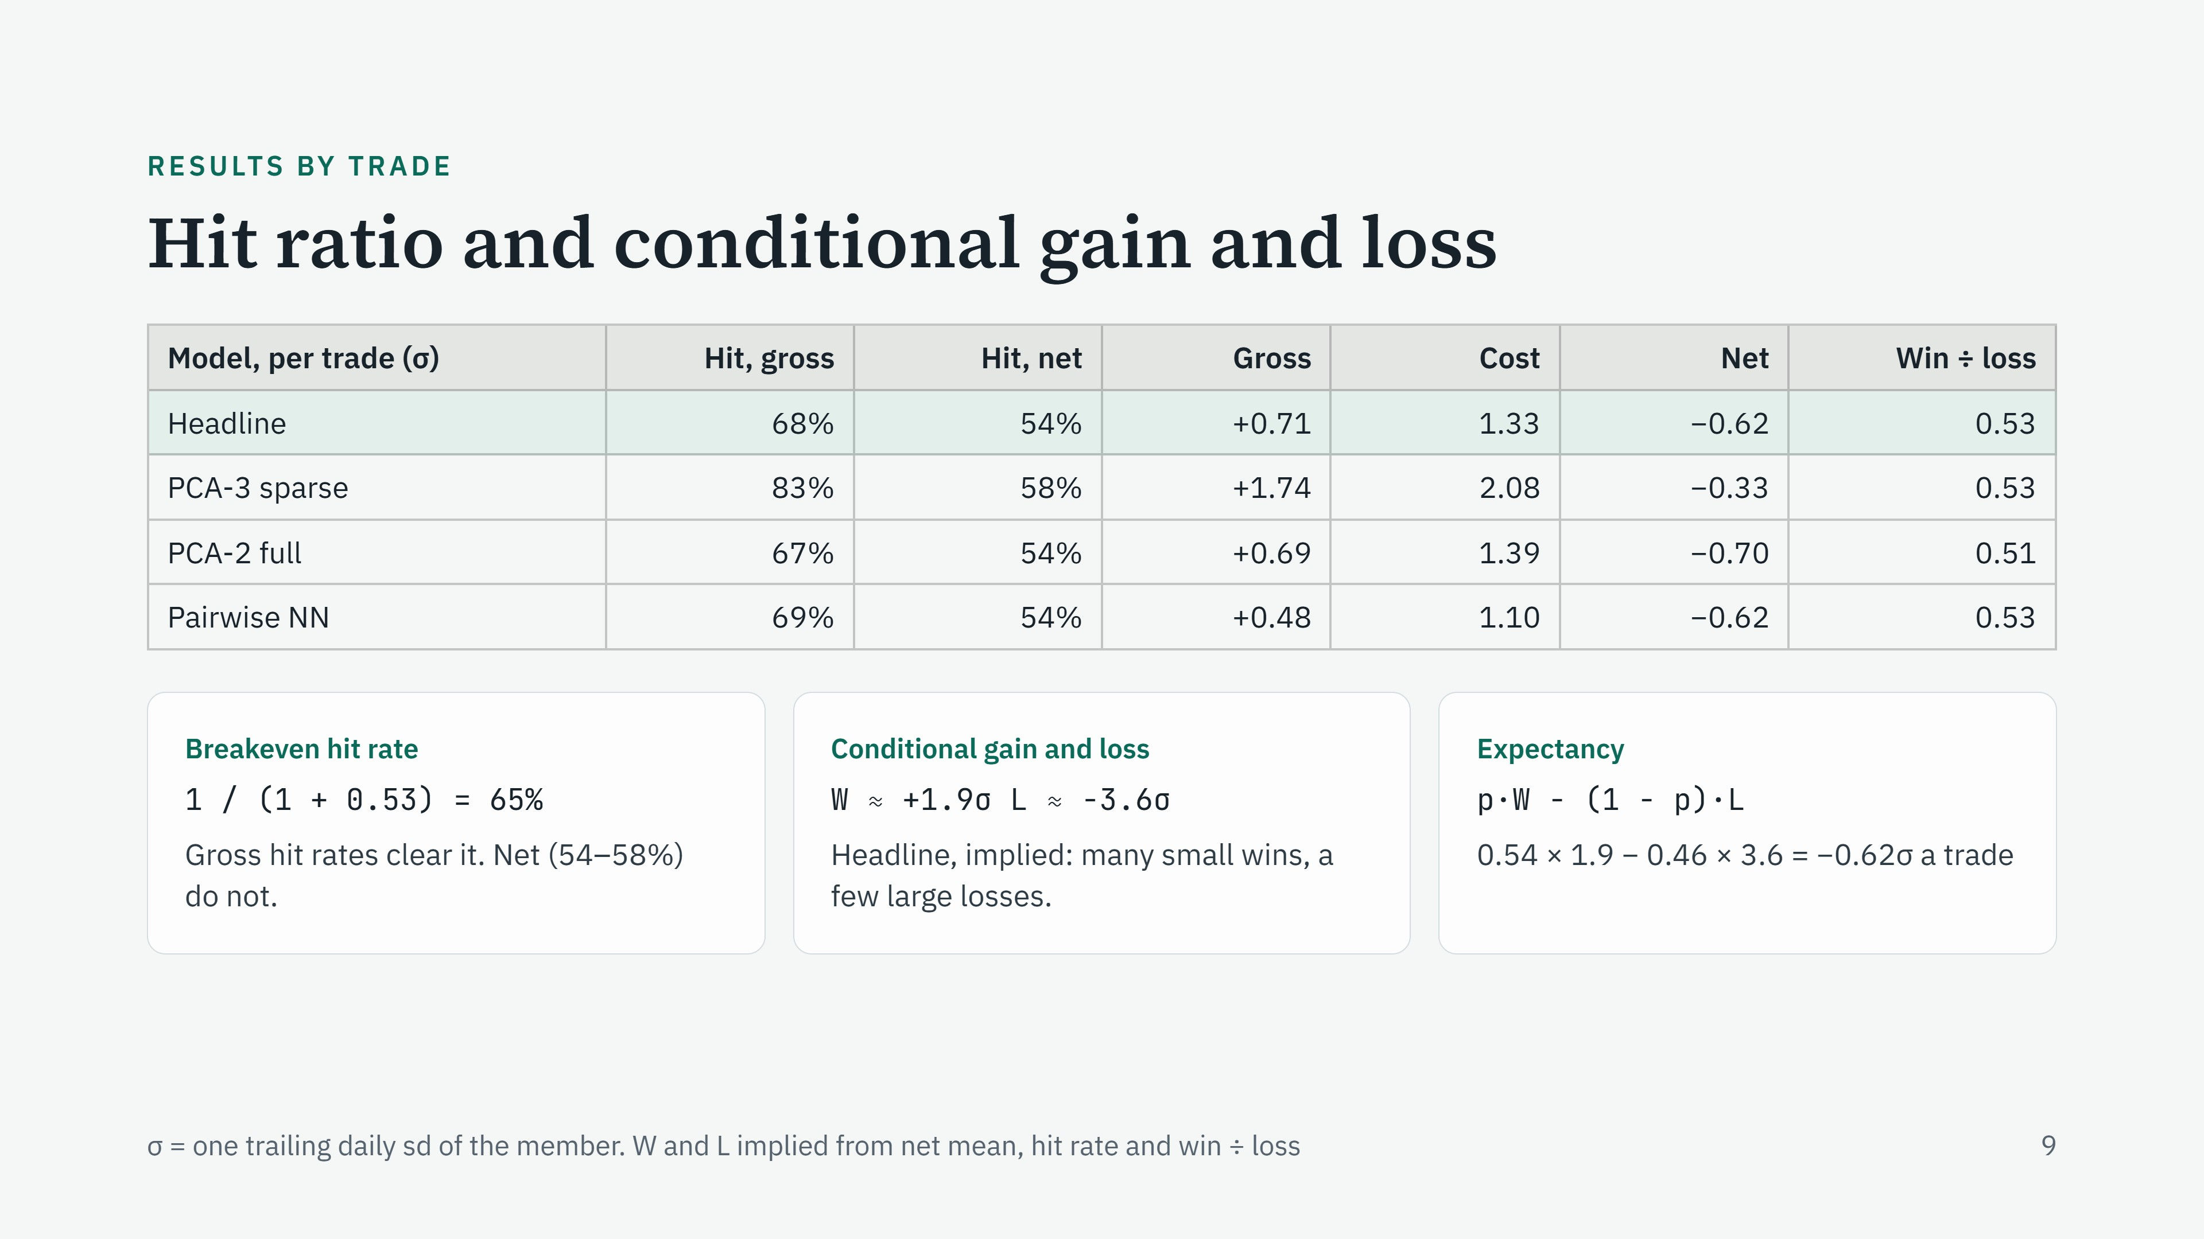
Notes:
Hit ratio is the share of trades that make money. Before costs, 7 or 8 trades in 10 win, which is what a real mean-reversion signal looks like. After costs it falls to 54–58%. Conditional gain is the average size of a winning trade, conditional on it winning; conditional loss is the average size of a losing trade, conditional on it losing. Their ratio is 0.53 in every model: the average winner is about half the average loser. That is the classic mean-reversion shape, many small wins and a few large losses. With that payoff you need to win 1 / (1 + 0.53) = 65% of the time just to break even. Gross hit rates clear 65%, net hit rates do not. For the headline the implied average win is about +1.9 sigma and the average loss about −3.6 sigma; plug them into expectancy and you get the −0.62 sigma per trade in the table. These W and L are derived, not reported directly: say so if asked.

Slide 22
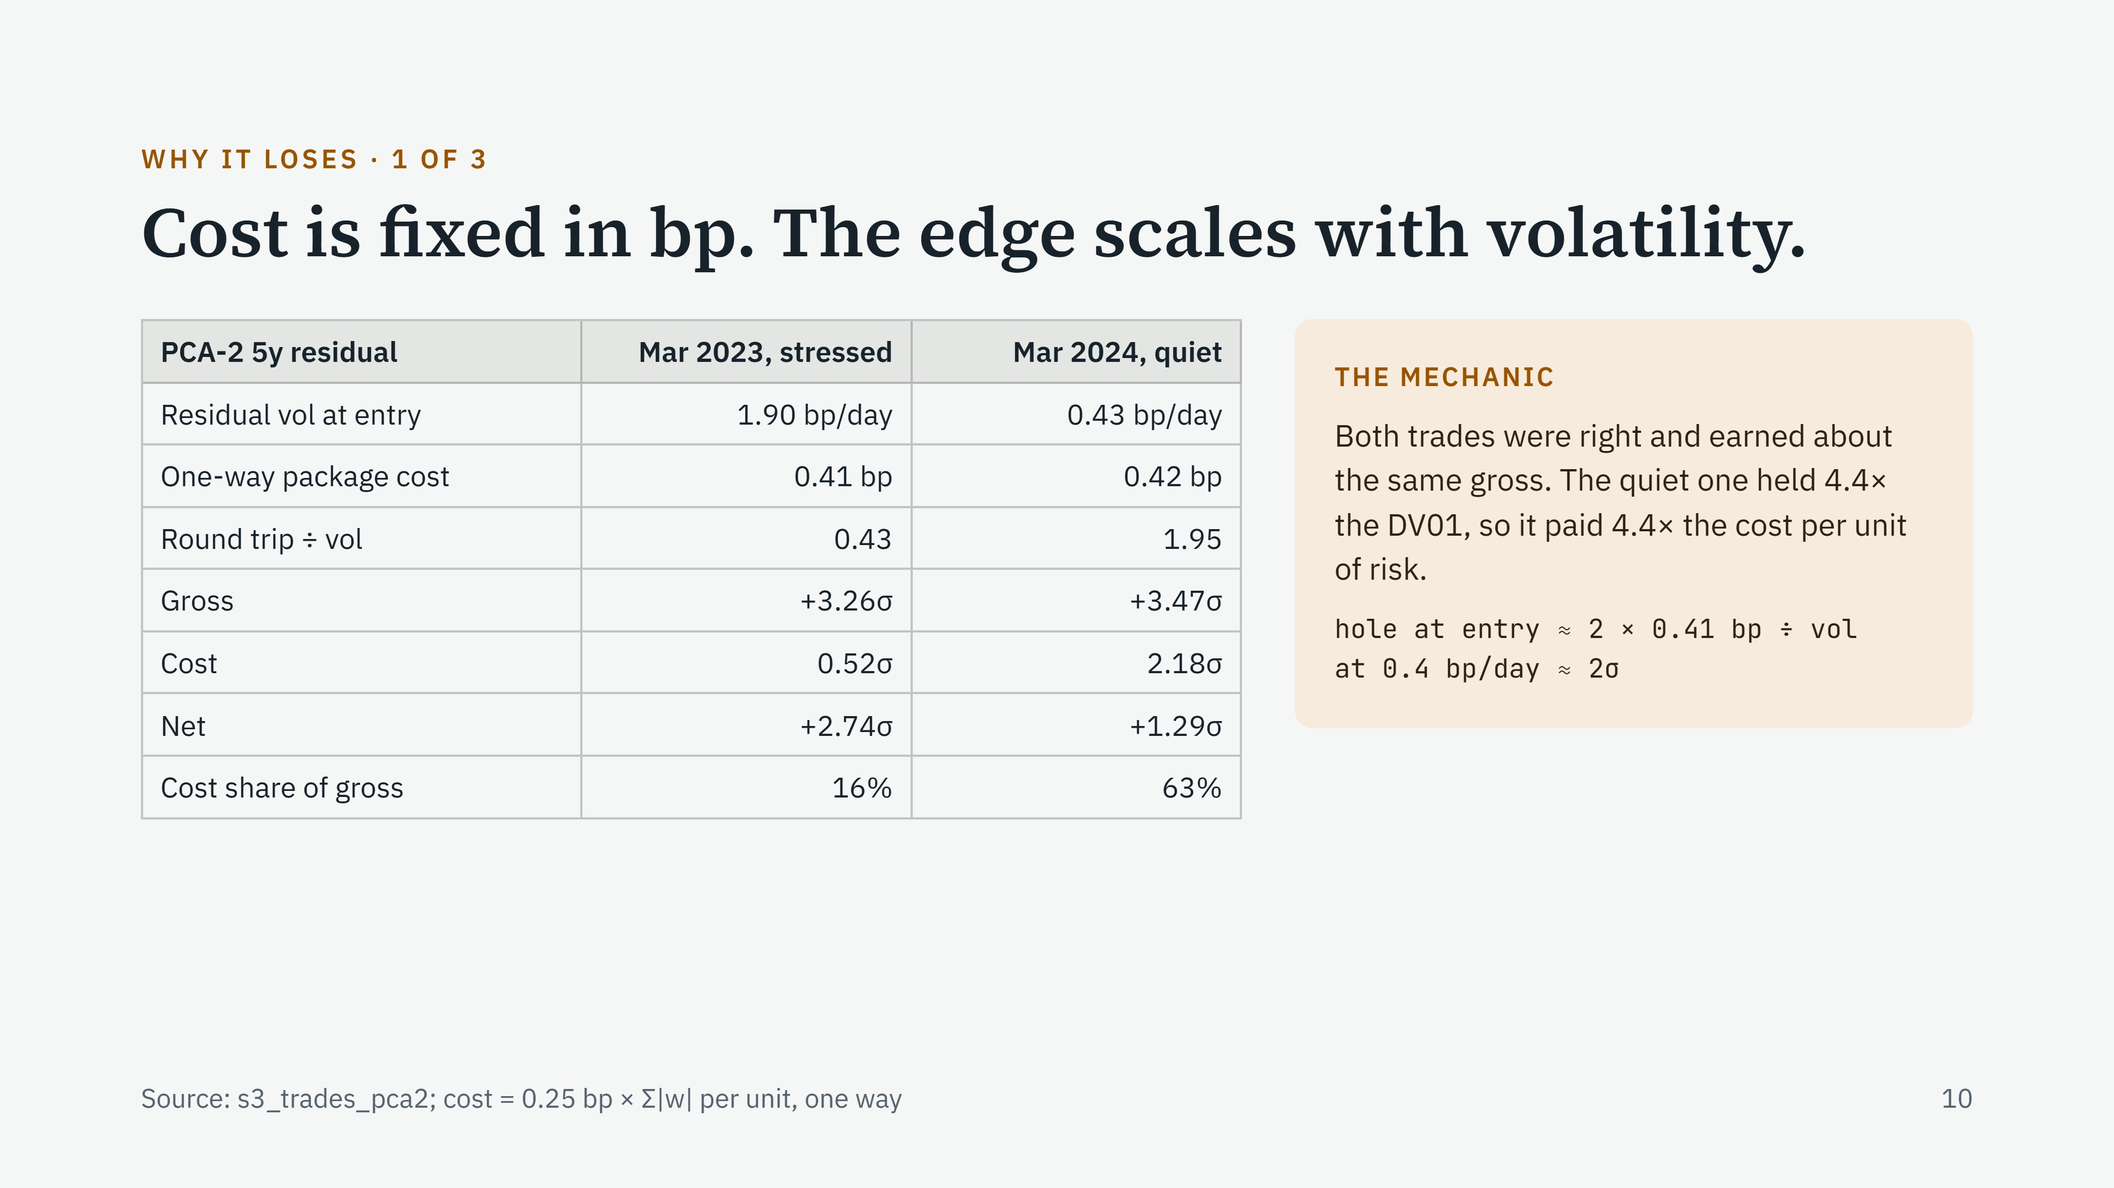
Notes:
This is the clearest picture of the problem. Same package, a year apart, both trades worked and made about 3.3 to 3.5 daily sigmas gross. The bp cost of one unit of the package is the same, 0.41 bp each way. What differs is volatility at entry: 1.90 bp a day in the SVB week, 0.43 in a quiet March 2024. Because we size to equal risk, the quiet trade holds 4.4 times as many units, so it pays 4.4 times the cost measured in risk. Cost ate 16% of the gross in the stressed trade and 63% in the quiet one. Every quiet-market trade starts in a hole of about two times the one-way cost divided by vol: about 2 sigma at 0.4 bp a day, which is roughly what the median trade earns gross.

Slide 23
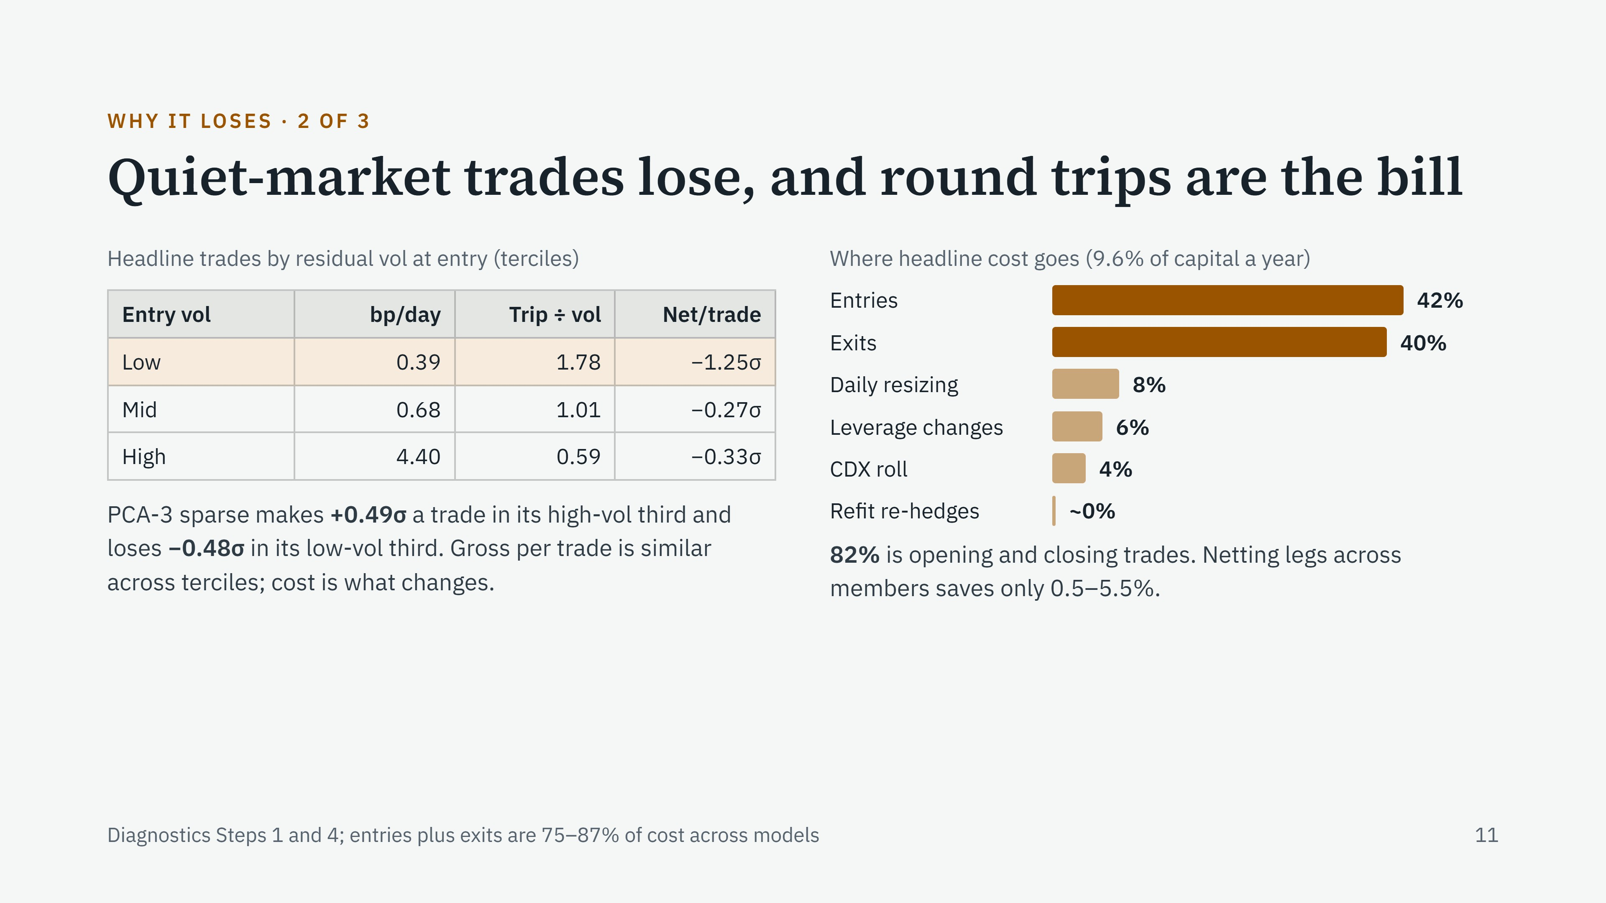
Notes:
This generalizes the two-trade example. Split every trade into thirds by residual volatility at entry. In the quiet third, the residual moves 0.39 bp a day and a round trip costs 1.8 times a day's move; those trades lose 1.25 sigma each on average. In the volatile third the round trip is 0.6 times a day's move. The signal itself is about as good in each third; it is the cost, in risk terms, that changes. This is a conditional result: conditional on a quiet market at entry, the trade loses. Right side: where the cost comes from. 82% is entries and exits. Resizing open positions and leverage changes are small, and re-hedging when loadings are refit is essentially free. So reducing cost means fewer, better round trips, not tidier maintenance.

Slide 24
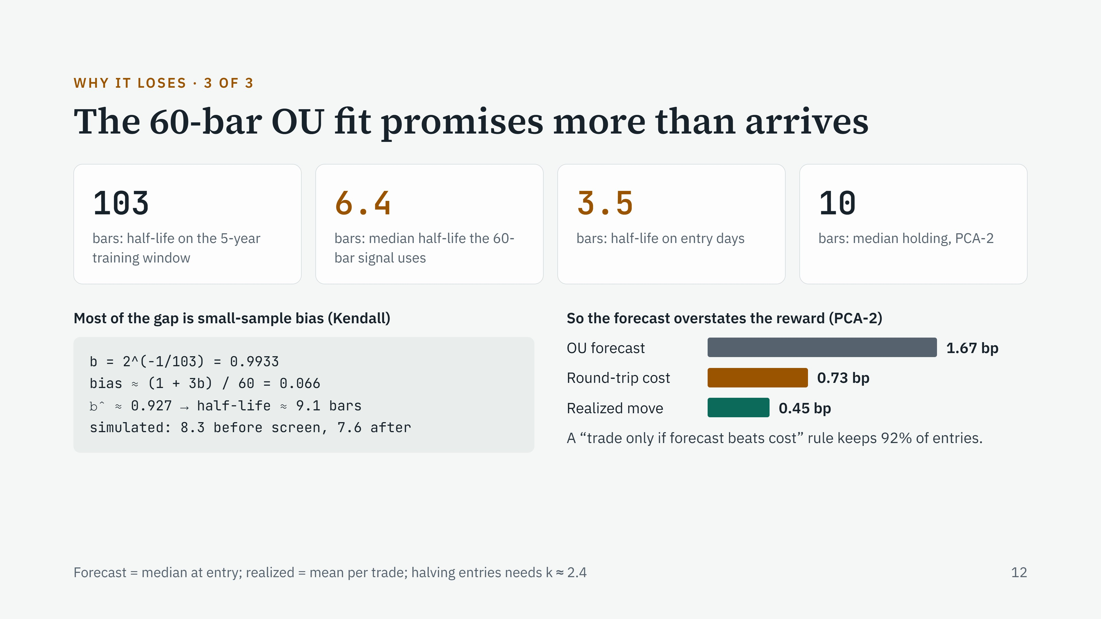
Notes:
Half-life is how long the residual takes to close half its gap to the mean. Fitted on five years, the PCA-2 residual is slow: 103 days. The signal uses a 60-day fit, and that reads it as about 6 days, and about 3.5 on the days we enter. Why? An AR(1) fitted on a short sample is biased toward fast reversion. Kendall's first-order correction says the estimate of b is too low by about (1 + 3b) divided by the sample length. Work it through: b of 0.9933 becomes about 0.927, which is a 9-day half-life. Simulating the slow process and fitting it on 60 bars gives 8.3 days. So it is mostly the estimator, not the market. Consequence: the model forecasts 1.67 bp of reversion per trade, the round trip is 0.73 bp, and what actually arrives is 0.45 bp. A cost filter built on the forecast barely filters because the forecast is inflated.

Slide 25
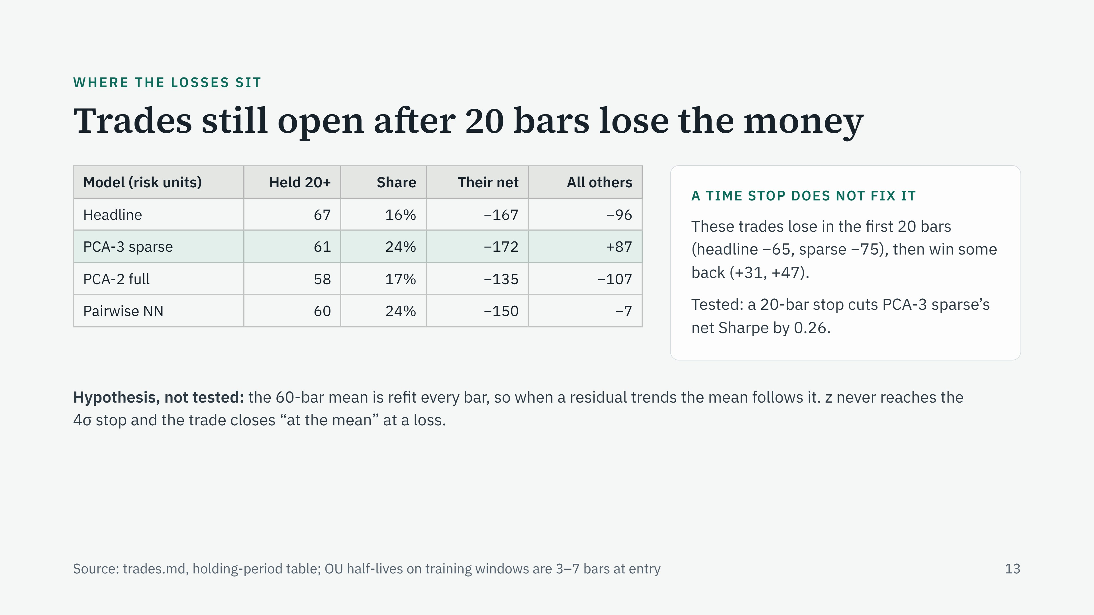
Notes:
Look at where the losses sit by holding period. Trades still open after 20 days are only 16 to 24% of trades, but they lose more than everything else combined. For PCA-3 sparse, every other trade together makes money: plus 87 risk units. The obvious fix is a time stop: close anything older than 20 days. The data says no. These trades lost their money early, in the first 20 bars, then recovered some of it afterwards. A stop at bar 20 locks in the loss and gives up the recovery, and when we tested it walk-forward it cut PCA-3 sparse's Sharpe by 0.26. A trade that runs long is a trade that went wrong early. My hypothesis, not yet tested: because the mean is re-estimated every day on 60 bars, a trending residual drags the mean with it, so the trade never hits its stop and exits at a moving mean.

Slide 26
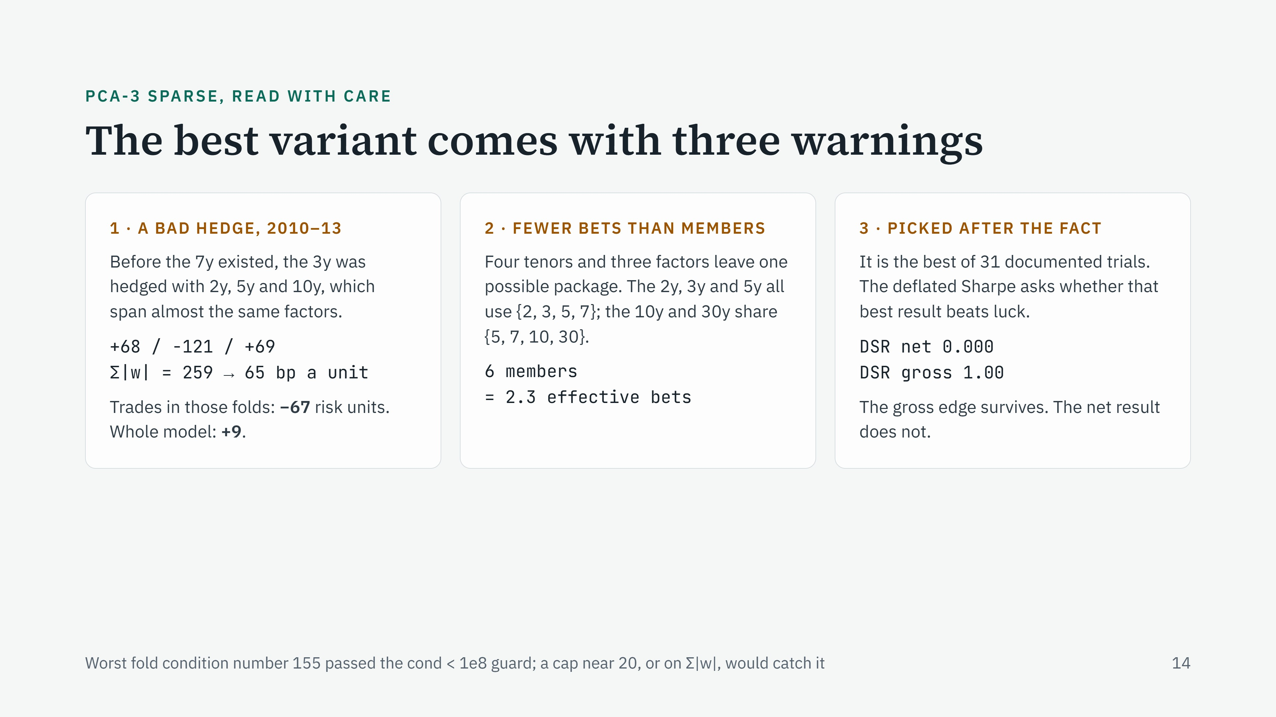
47
Trades in those folds: −34 risk units
(13 distinct trades).
Notes:
PCA-3 sparse looks closest to working, so it is the one I am most careful with. First, a construction defect. In 2010 to 2013 the 3y had to be hedged with the 2y, 5y and 10y, and those three have nearly the same loading pattern, so the three-by-three solve needed huge offsetting weights: plus 68, minus 121, plus 69. Cost scales with the sum of absolute weights, so one unit cost about 65 bp instead of 0.4. Trades in those four folds lost 34 risk units across 13 distinct trades, 20 of it from the 3y; counting overlapping members separately it is 67. The condition-number check only guards against true singularity, so it did not fire. Second, overlap: with four tenors and three factors to neutralize there is only one solution up to scale, so members sharing a tenor set are the same trade. Six members behave like 2.3 independent bets. Third, selection: we have tried 47 things in all. The deflated Sharpe ratio, from Bailey and López de Prado, is the probability that the true Sharpe is above zero after picking the best of many trials. For the best variant at 47 trials, gross is 0.42 and net is 0.002.

Slide 27
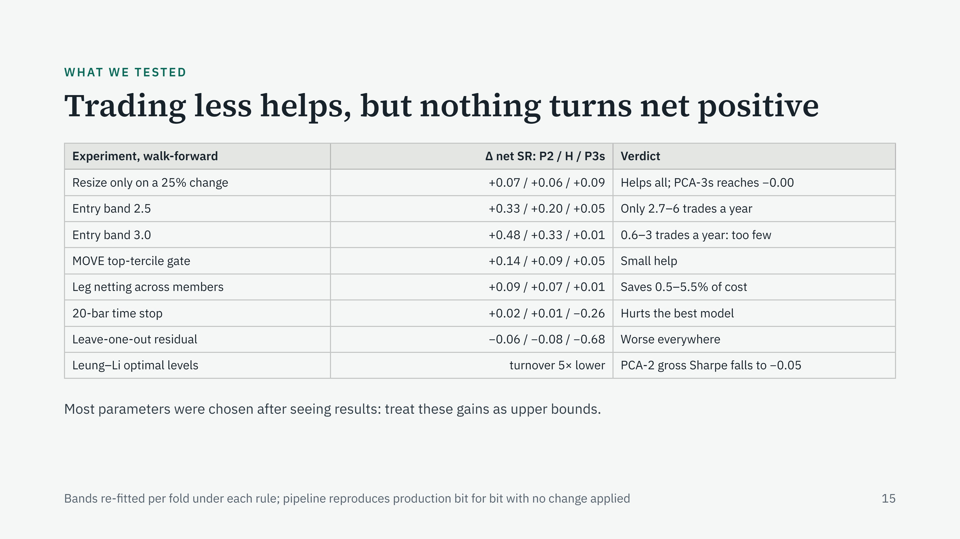
Notes:
Every experiment runs through the same walk-forward pipeline, which reproduces production exactly when nothing is changed. Holding positions unless the target size moves by more than 25% helps every model and takes PCA-3 sparse to flat. Raising the entry band cuts cost a lot, but leaves so few trades that the result is not trustworthy, and the band was chosen after seeing results. The rates-volatility gate helps a little. A 20-bar time stop hurts the best model. The Leung–Li optimal stopping levels are the most instructive: they cut turnover five times, and the gross edge disappeared with the trades. The lesson is that trading less is not enough. A fix has to remove the expensive trades, the quiet-market ones, and keep the good ones.

Slide 28
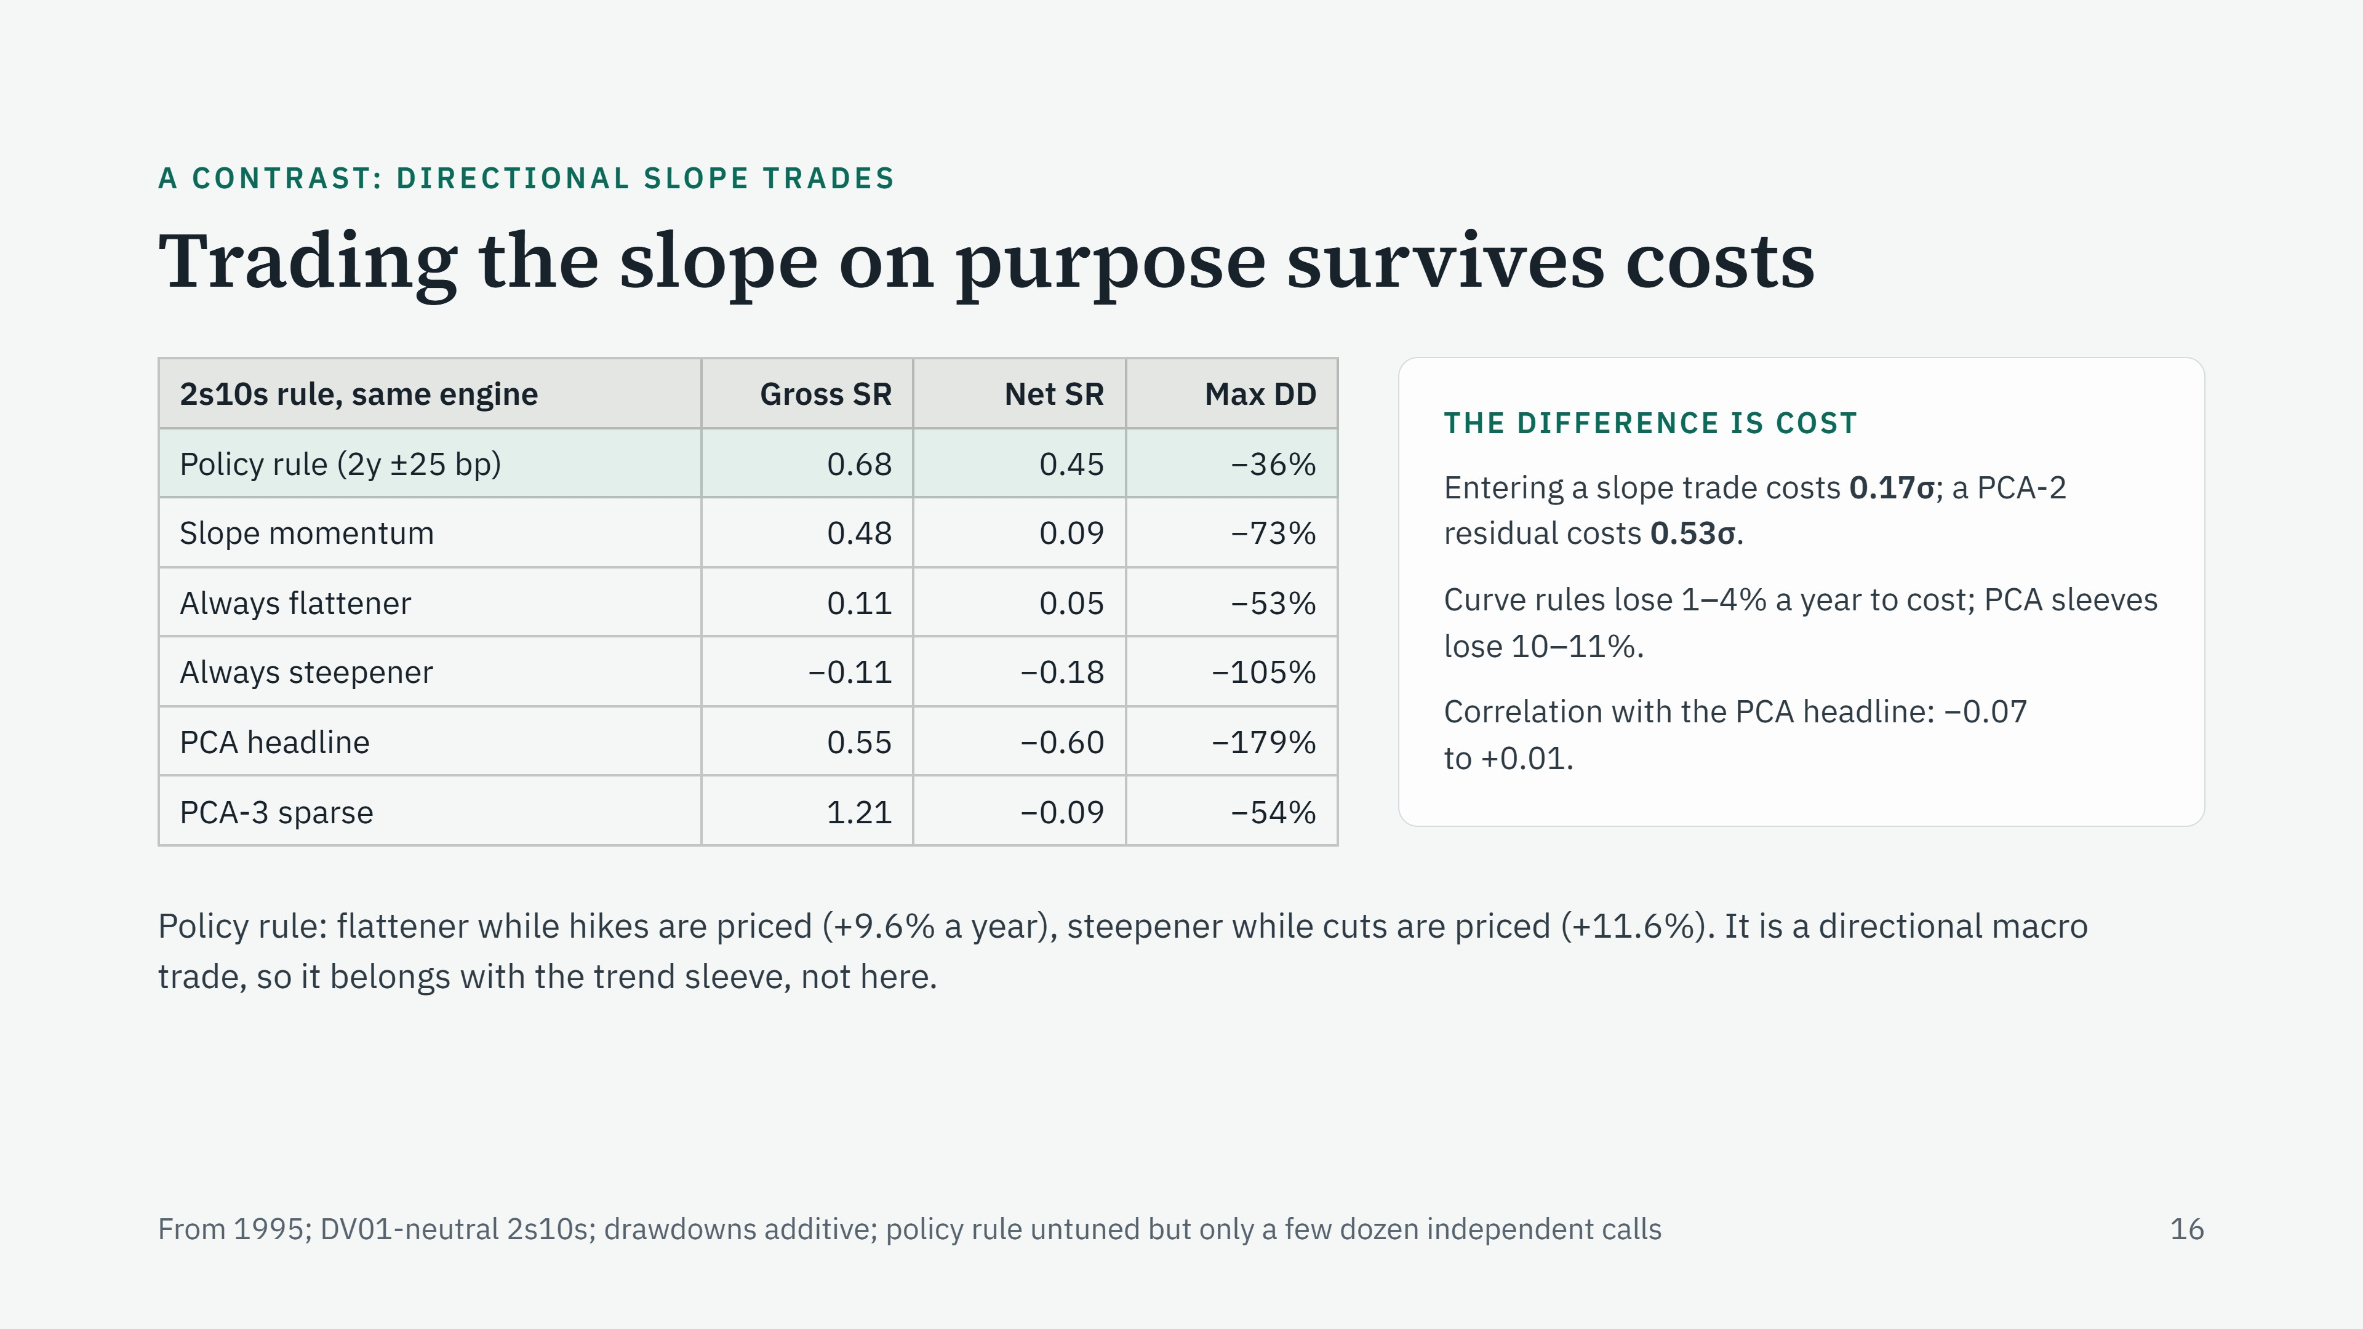
Notes:
As a contrast, we ran simple steepener and flattener rules on 2s10s through the same engine and cost model. A steepener is long the 2-year, short the 10-year, DV01-neutral. The policy rule goes flattener when the 2-year has risen more than 25 bp over six months, meaning hikes are being priced, and steepener when it has fallen more than 25 bp. It earns 0.45 net. The reason is not a better signal: PCA-3 sparse has a much stronger gross signal. It is cost. A slope trade is two legs on a quantity that moves about 3 bp a day, so entering costs 0.17 daily sigmas, against 0.53 for a PCA residual. And it is nearly uncorrelated with the PCA sleeve, so it would diversify. But it is a directional macro bet, not mean reversion, so it fits with the trend sleeve in the full project. Hold it lightly: the rule changes sign only a few times a year, so 30 years is a few dozen independent decisions.

Slide 29
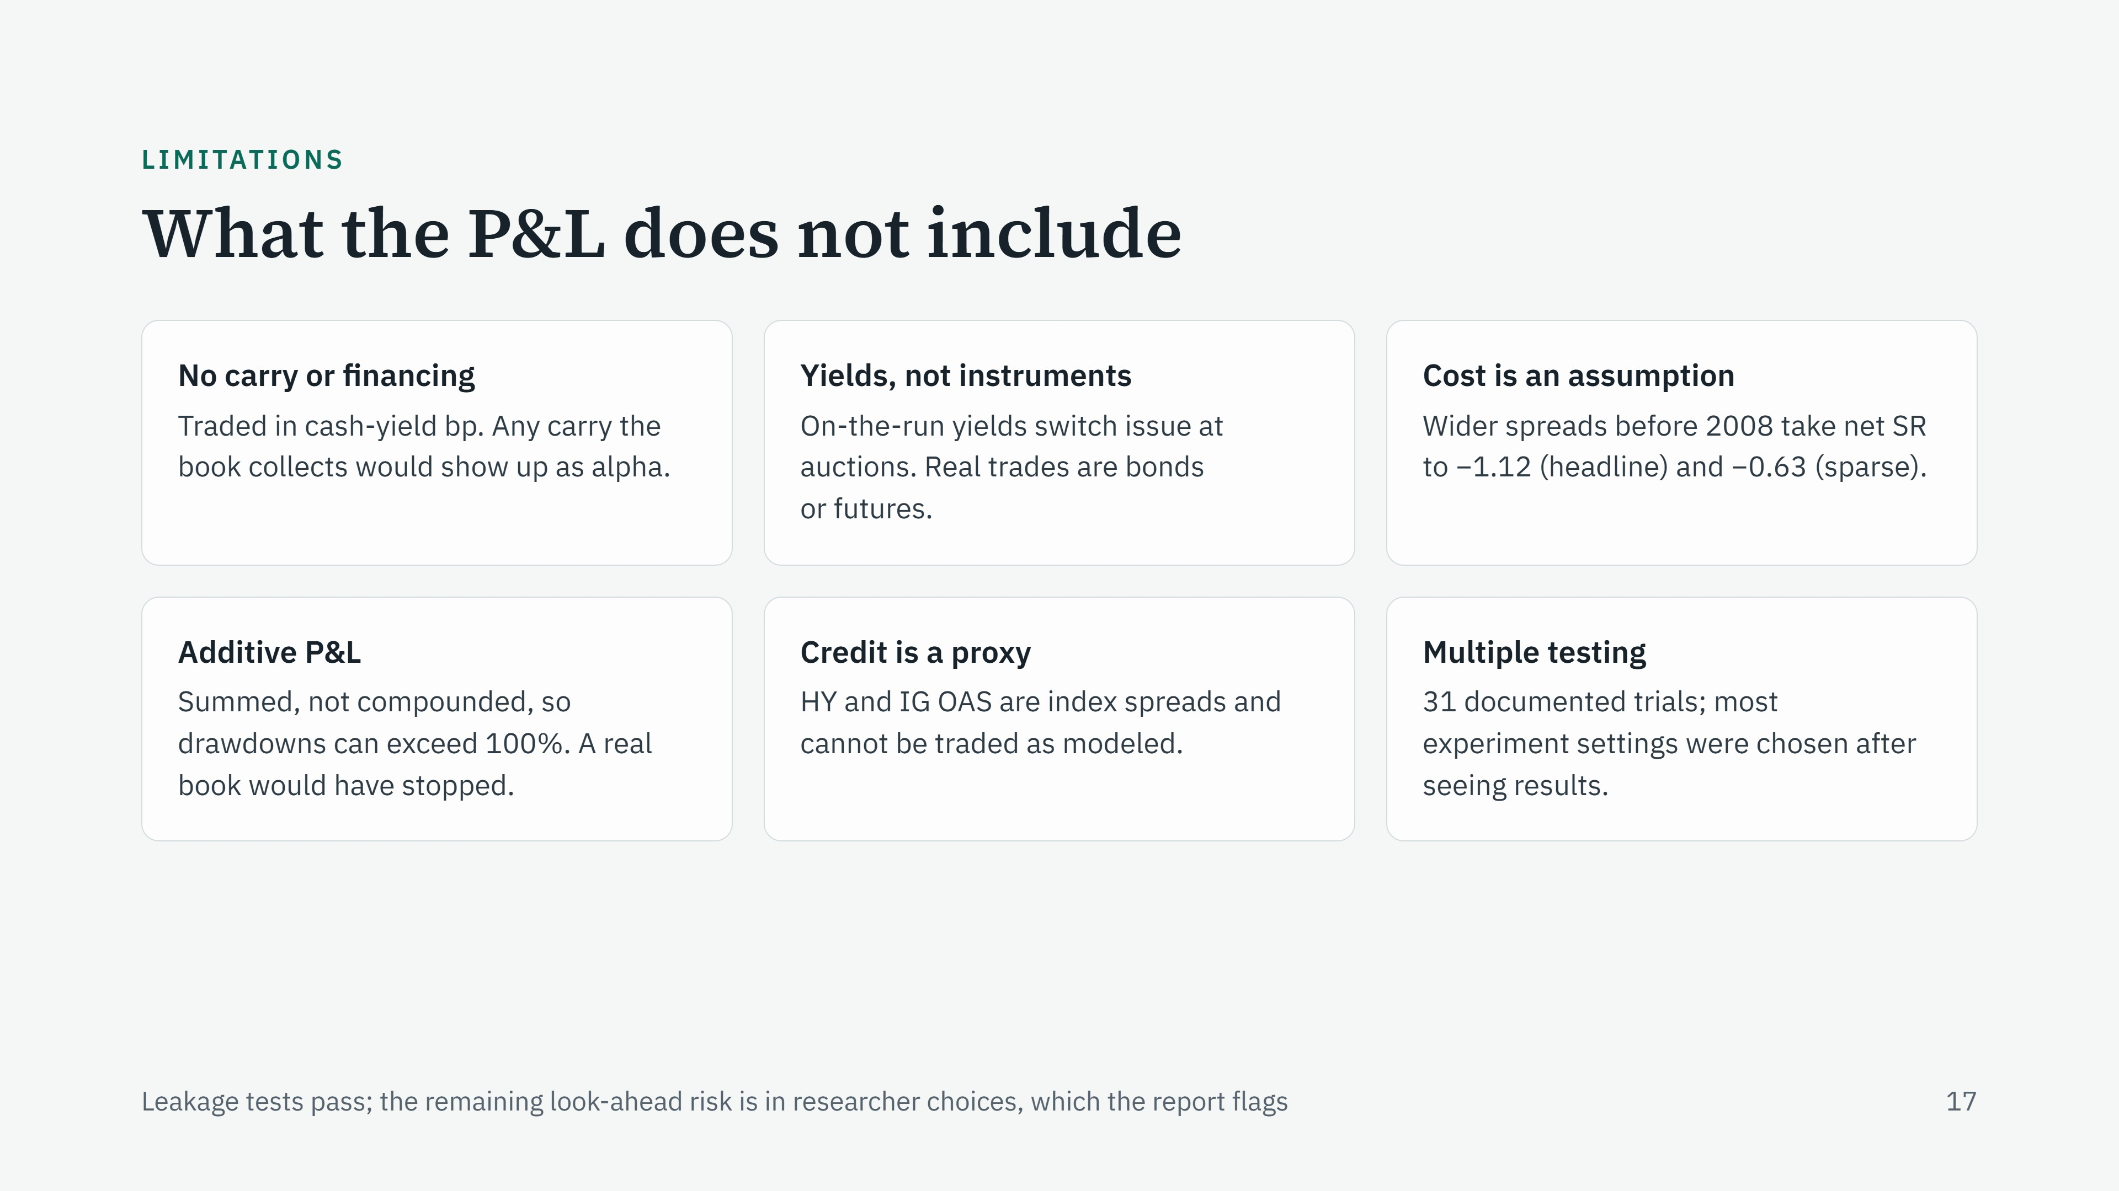
47
Notes:
Be upfront about these before someone else raises them. Carry and roll-down are missing: on an upward-sloping curve, a position long the higher-yielding tenors earns carry we do not count, and the attribution regression would book it as alpha. Its sign and size are unmeasured, so it is a stated limitation, not a rescue. We trade yield basis points, not actual bonds or futures. The 0.25 bp cost is an assumption and probably generous before 2008. P&L is added up rather than compounded, which is why drawdowns can exceed 100% over 31 years of losing; it is a measuring convention. The credit spreads are research proxies. And we tried 47 things, which the deflated Sharpe already accounts for.

Slide 30
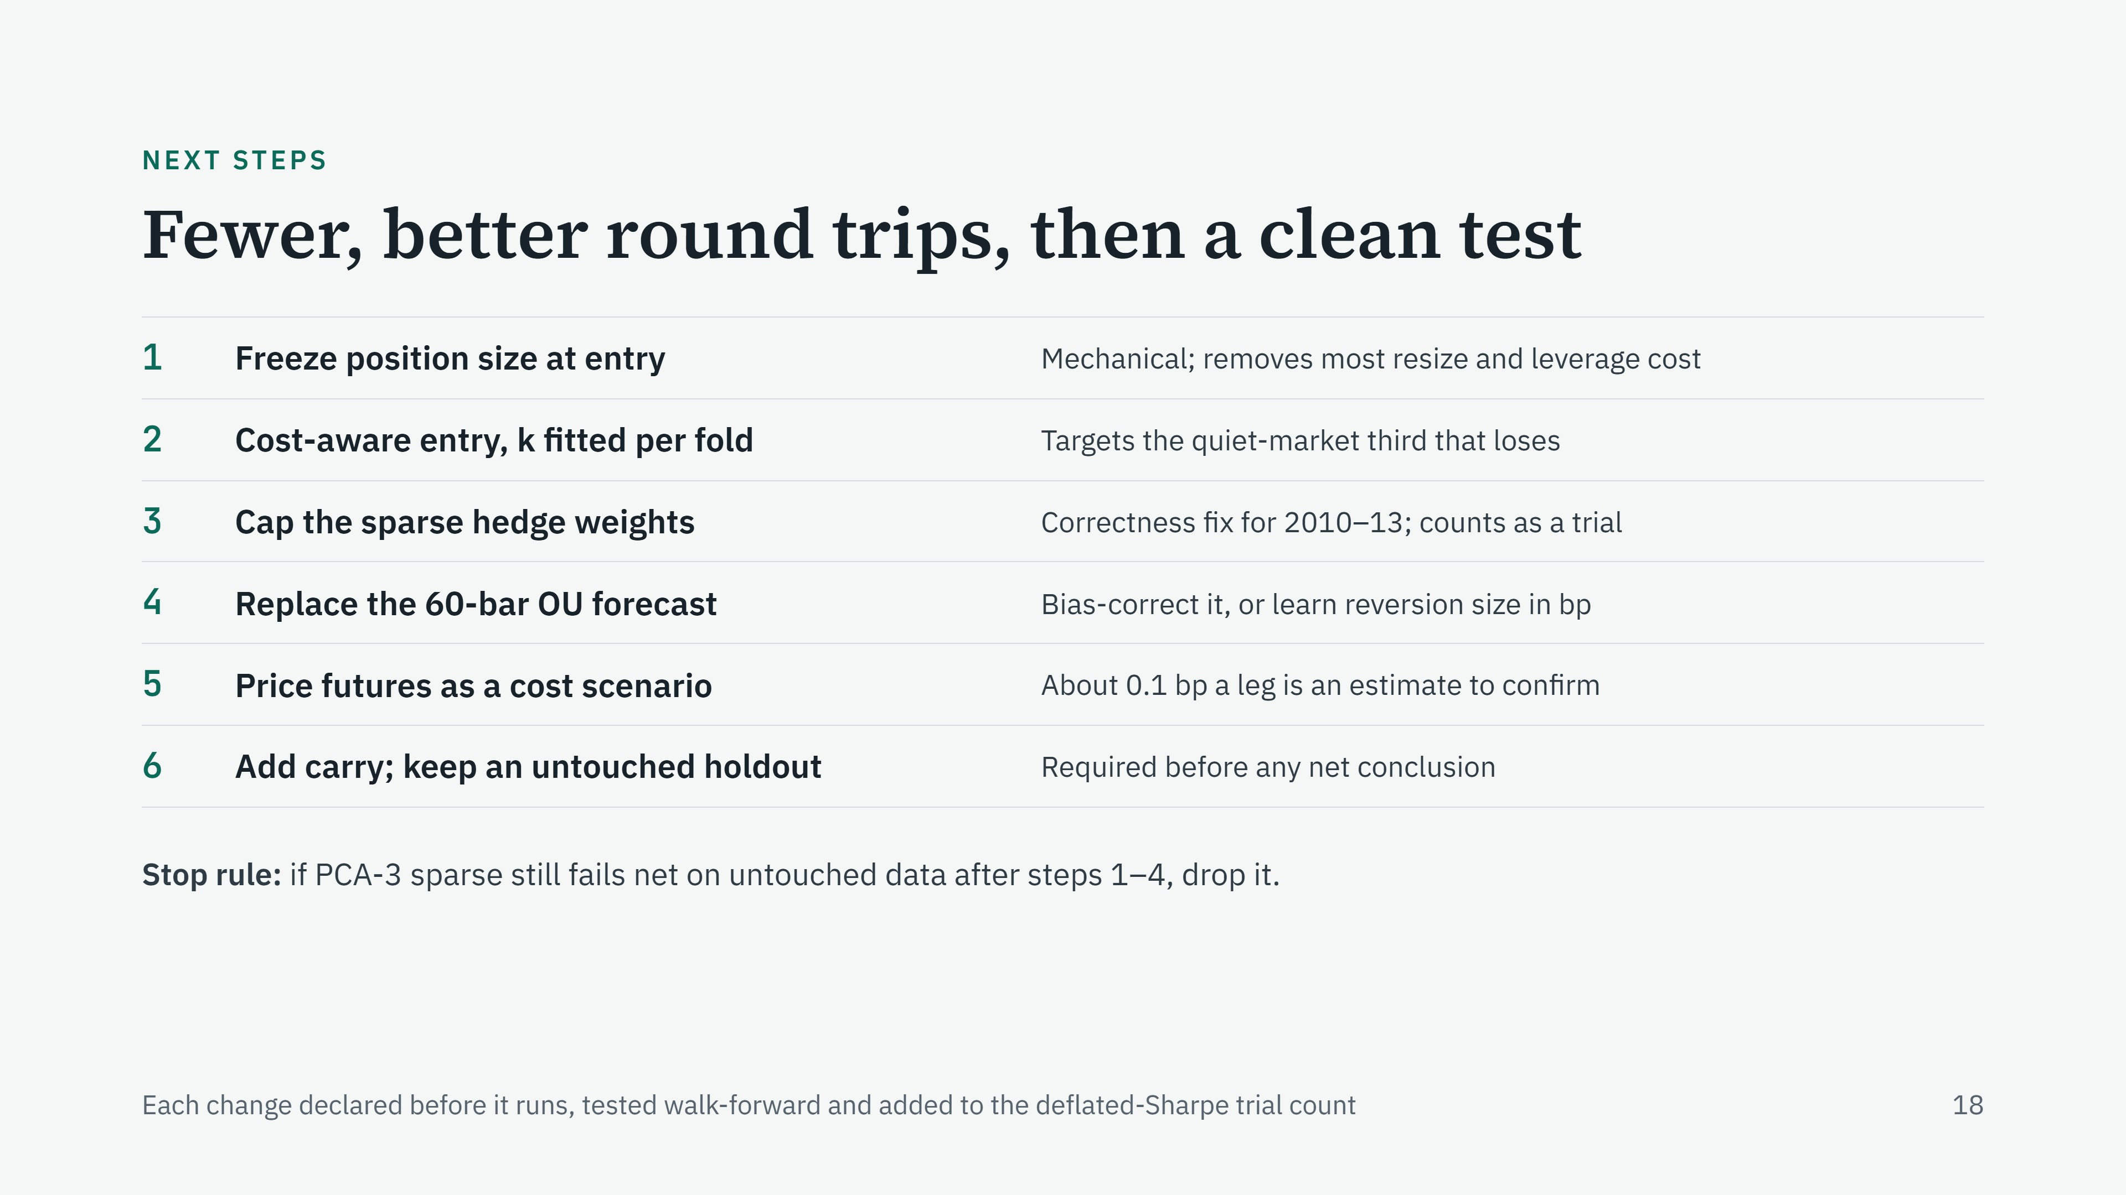
Notes:
The order matters. First, freeze the position size at entry instead of resizing every day: it is mechanical, has almost no free parameters, and attacks the 14 to 17% of cost spent on resizing and leverage changes. Second, a cost-aware entry: only trade when the expected move clears a multiple k of the round-trip cost, with k fitted on each training window, or a simpler volatility floor. That targets the quiet-market trades. Third, cap the sparse hedge weights so the 2010 to 2013 defect cannot recur. Fourth, replace the biased 60-bar forecast, either with a bias correction or with a model that predicts reversion size directly; that is where machine learning would add the most. Fifth, price futures execution separately, without making it the baseline. Last, add carry and test on data nobody has looked at. And set a stop rule in advance so we do not keep tuning until something works.

Slide 31
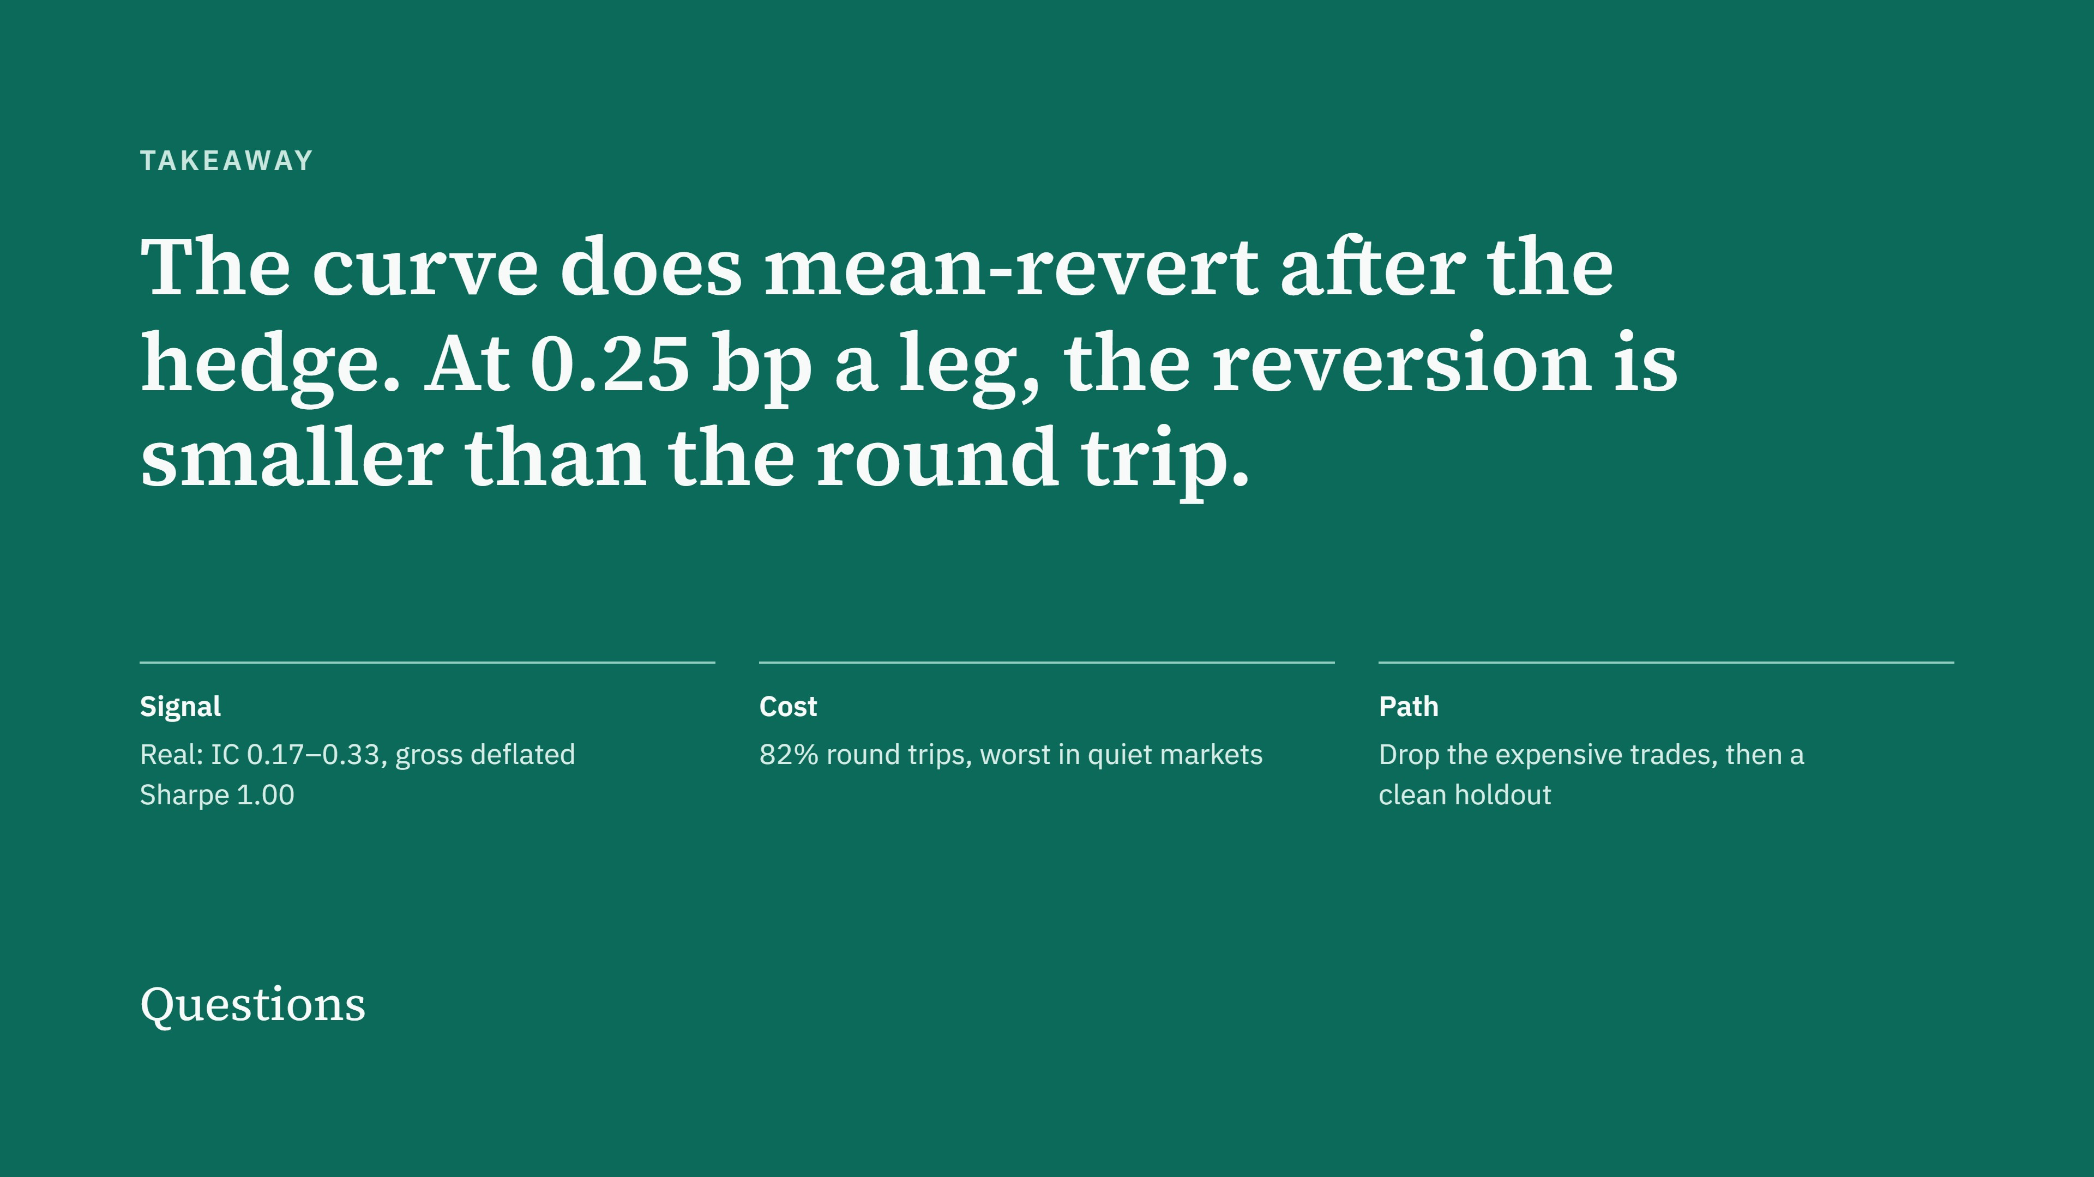
Notes:
Close on the one sentence: the curve does mean-revert after you hedge out level and slope, but at our cost assumption the reversion is smaller than a round trip. The signal is real: positive information coefficients and a gross result that survives the multiple-testing correction. The cost is concentrated in opening and closing trades, especially in quiet markets where equal-risk sizing means large DV01. The path forward is to drop those expensive trades rather than simply trade less, and then test on untouched data. Then take questions.

Slide 32
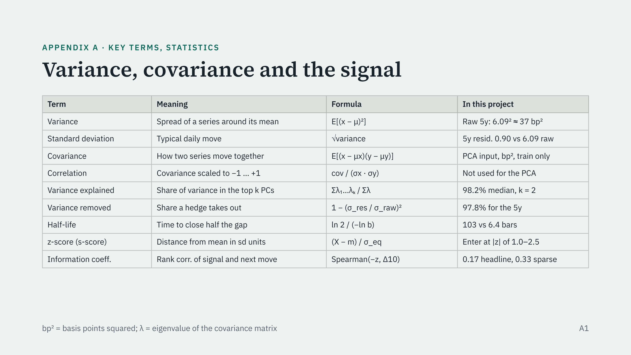
Notes:
Reference slide for questions. Variance and standard deviation: the residual’s standard deviation is 0.90 bp a day against 6.09 for the raw 5y, so its variance is about 0.81 against 37 bp squared. Covariance is the input to PCA; correlation would rescale every tenor to the same volatility, which we deliberately do not do. Variance explained is the share of total variance captured by the factors we hedge; variance removed is how much of one tenor’s variance the hedge takes out. Half-life comes from the AR(1) coefficient b. The z-score is the residual’s distance from its local mean in standard deviations. The information coefficient is a rank correlation between the signal and the next 10 days of residual change.

Slide 33
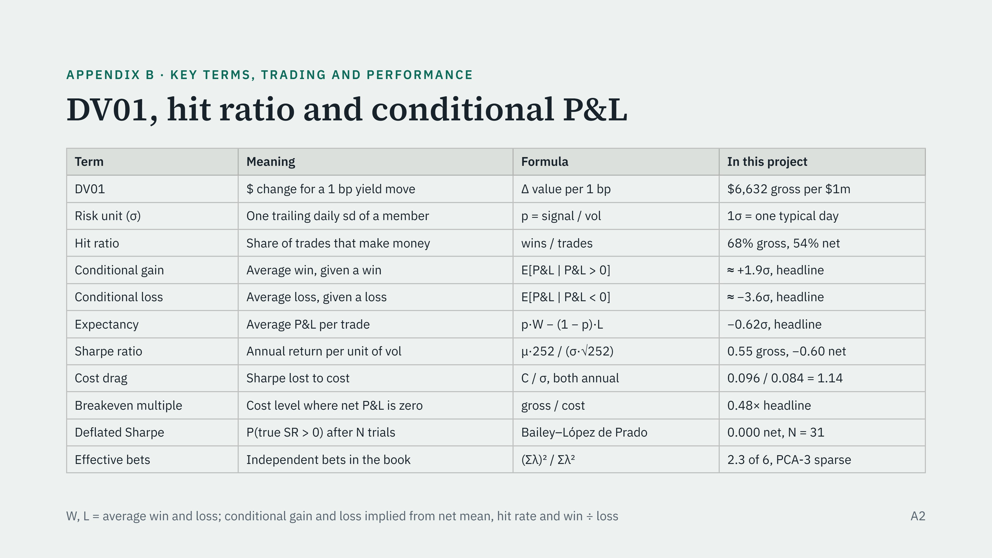
47
Notes:
DV01 is the dollar value of a one basis point move. Gross DV01 sums the absolute exposure of every leg; net lets longs and shorts offset. A risk unit is one trailing daily standard deviation of the member, which is how trades are sized and how trade P&L is reported. Hit ratio is wins over trades. Conditional gain is the average P&L of winning trades; conditional loss is the average of losing trades. Expectancy combines them: hit rate times average win minus miss rate times average loss. The Sharpe ratio is annualized return over annualized volatility. Net Sharpe is roughly gross Sharpe minus cost divided by volatility, which is the cost drag. Breakeven multiple is gross P&L over cost. The deflated Sharpe is the probability that the true Sharpe is above zero after selecting the best of N trials. Effective bets come from the eigenvalues of the members’ P&L correlation matrix.

Slide 34
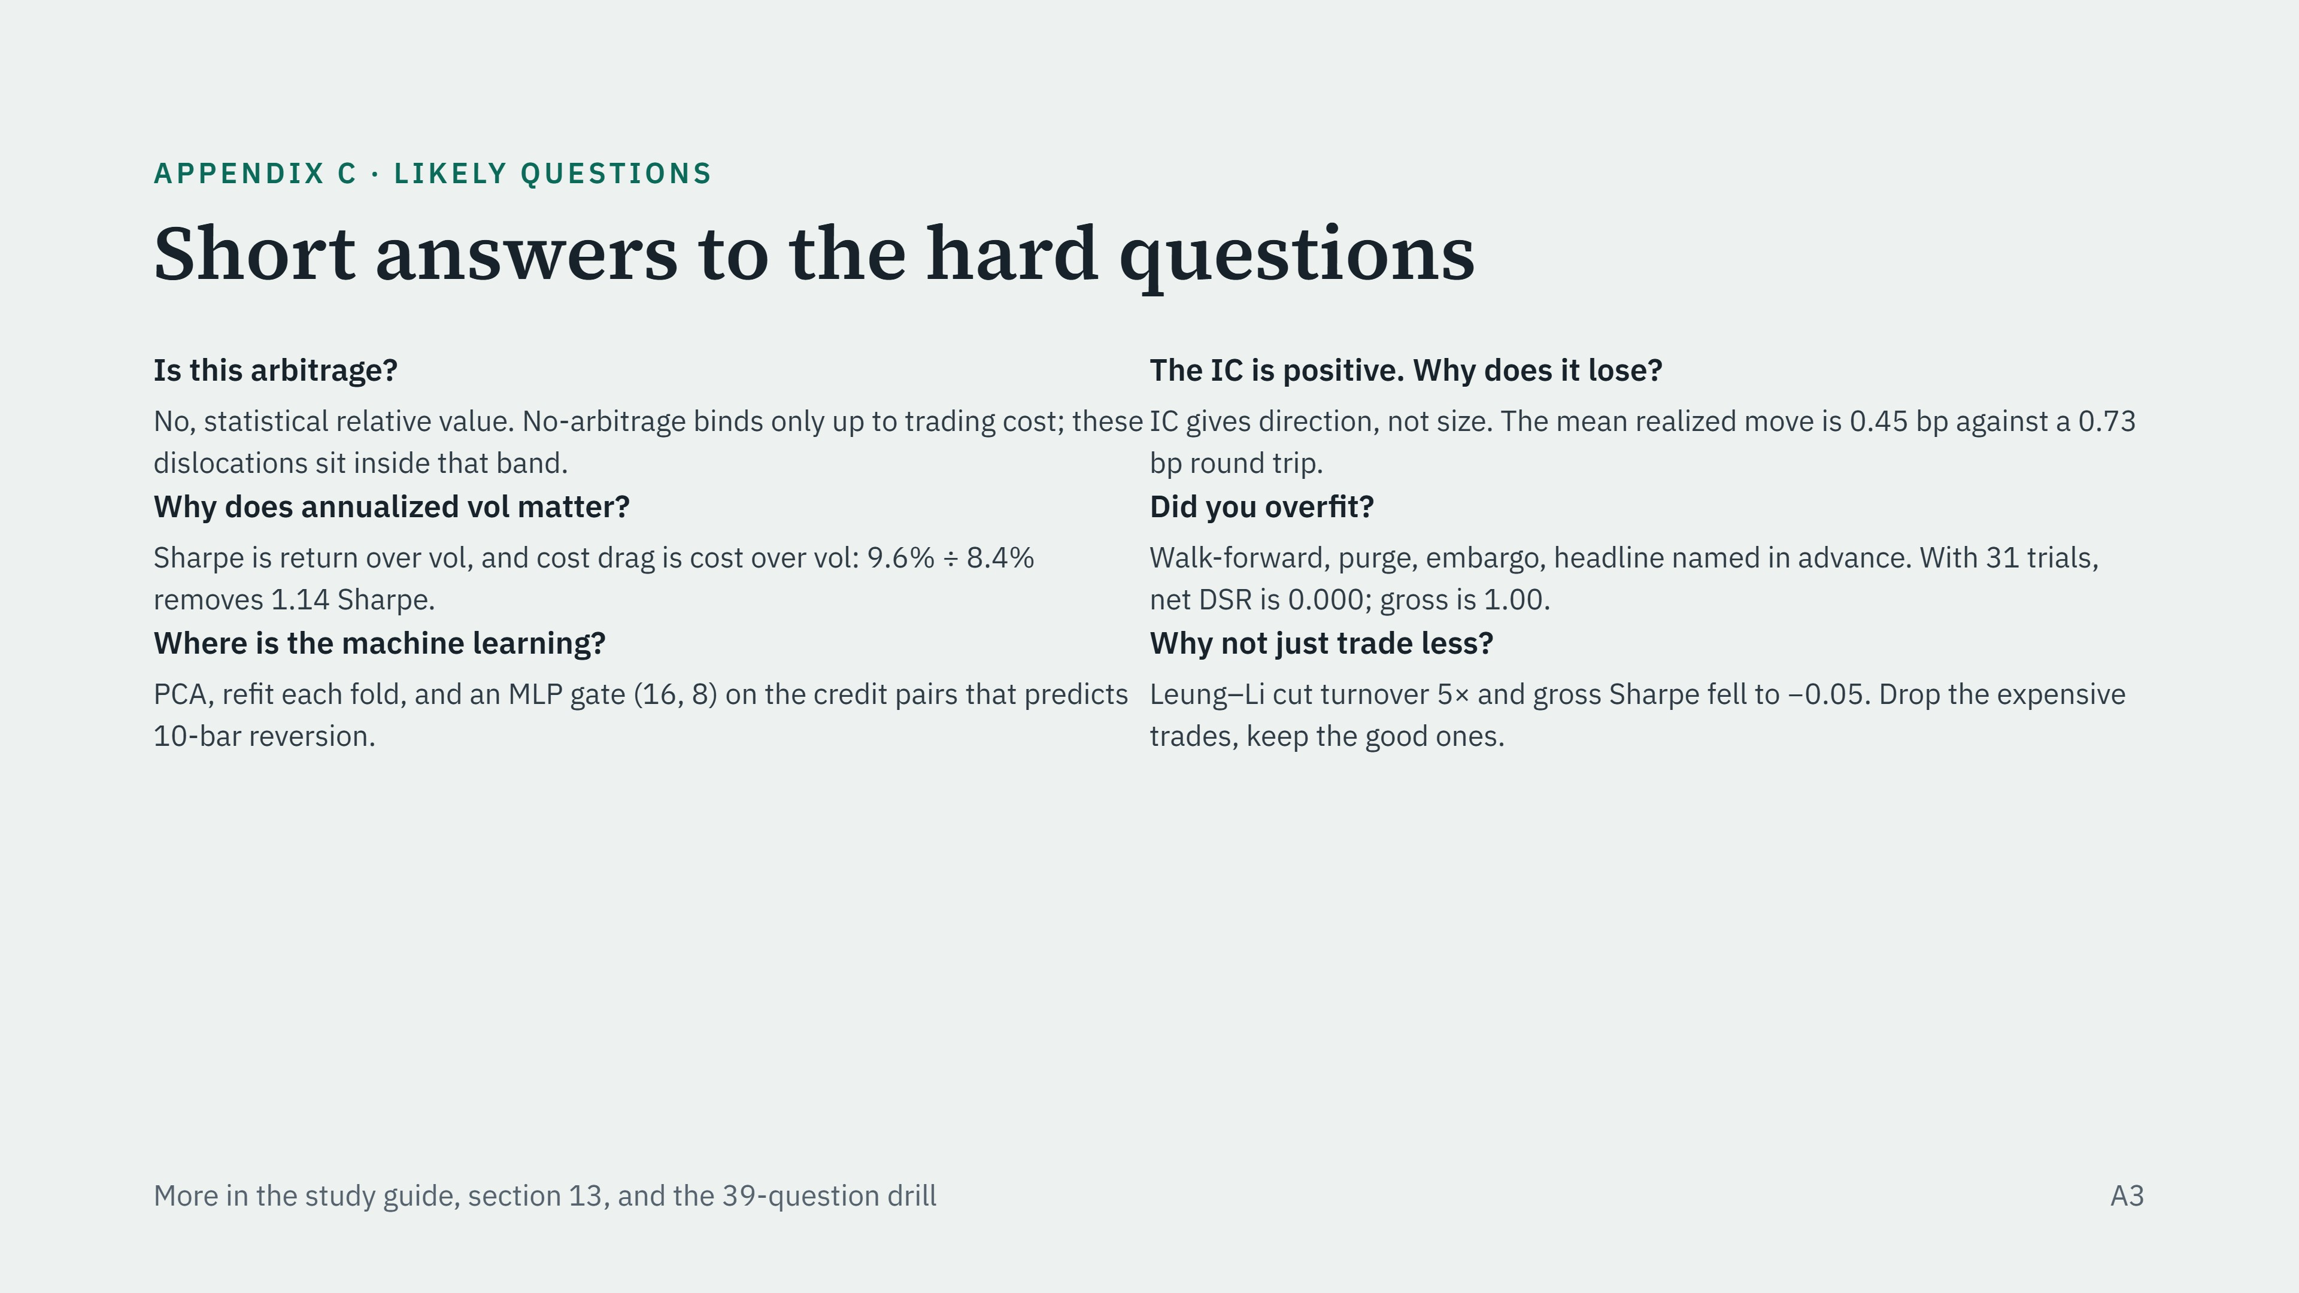
47
Notes:
Other questions to be ready for. Why drawdowns above 100%? P&L is summed, not compounded, at a constant 10% vol target for 31 years; it is a measuring convention, and yes, a real book would have stopped. Is there look-ahead? Everything that sets a position uses the training window or trailing data; the purge covers the classifier's 10-bar label and the leakage tests pass. The remaining risk is researcher look-ahead in experiment choices. Why a 60-bar OU window? It is the Avellaneda–Lee default, untuned; its weakness is the small-sample bias. Why PCA rather than pairs? PCA hedges the factors behind 98% of curve variance in one consistent construction; pairs leak factor risk, about 11% of gross DV01 in slope. Why did the curve not trade in 2022? Bands of 2.5 were never reached: large trending moves are not residual dislocations. Where is carry? Not modeled; concede it.

Slide 35
REFERENCES
References
Avellaneda, M., and Lee, J.-H. (2010). Statistical arbitrage in the U.S. equities market. Quantitative Finance, 10(7), 761–782.
Bailey, D. H., and López de Prado, M. (2014). The deflated Sharpe ratio: Correcting for selection bias, backtest overfitting, and non-normality. Journal of Portfolio Management, 40(5), 94–107.
Bloomberg L.P. (2026). Generic US Treasury yields (USGG2YR–USGG30YR), LF98OAS and LUACOAS OAS indices, CDX HY 5Y, HYG. Bloomberg Terminal.
Board of Governors of the Federal Reserve System (2026). DFEDTAR, DFEDTARU. FRED, Federal Reserve Bank of St. Louis.
Engle, R. F., and Granger, C. W. J. (1987). Co-integration and error correction: Representation, estimation, and testing. Econometrica, 55(2), 251–276.
Johansen, S. (1991). Estimation and hypothesis testing of cointegration vectors in Gaussian vector autoregressive models. Econometrica, 59(6), 1551–1580.
Kalman, R. E. (1960). A new approach to linear filtering and prediction problems. Journal of Basic Engineering, 82(1), 35–45.
Kendall, M. G. (1954). Note on bias in the estimation of autocorrelation. Biometrika, 41(3/4), 403–404.
Leung, T., and Li, X. (2015). Optimal mean reversion trading with transaction costs and stop-loss exit. International Journal of Theoretical and Applied Finance, 18(3), 1550020.
Litterman, R., and Scheinkman, J. (1991). Common factors affecting bond returns. Journal of Fixed Income, 1(1), 54–61.
Data are Bloomberg terminal exports (licensed, not distributed). Full list: report.md.
23
Notes:
Line to say: These are the works the code and the reasoning actually rely on: Avellaneda and Lee for the s-score, Litterman and Scheinkman for the factors, Bailey and López de Prado for the deflated Sharpe, Kendall for the AR(1) bias, Leung and Li for the optimal-stopping variant, and the cointegration and Kalman papers behind the pairwise model.

