Slide 1
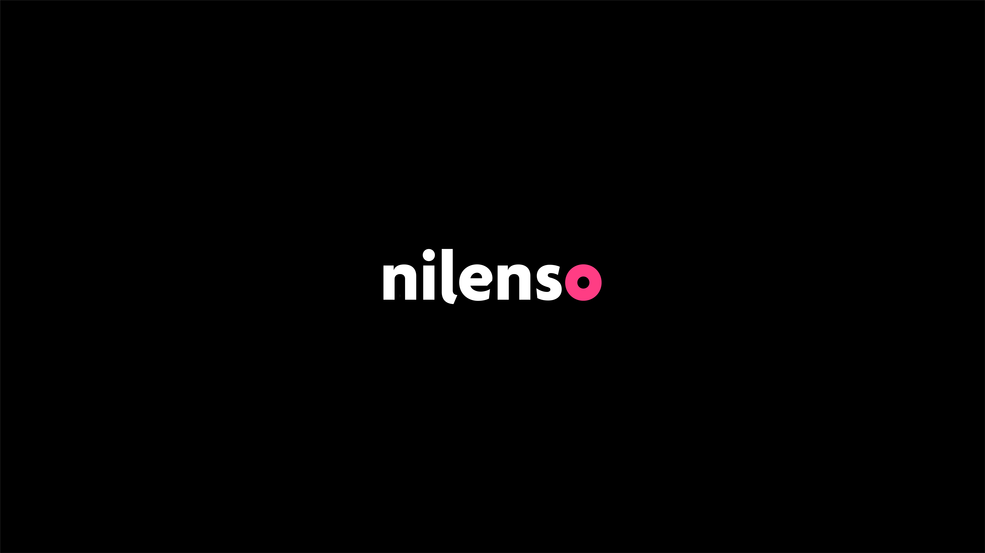
a quick showcase

Slide 2
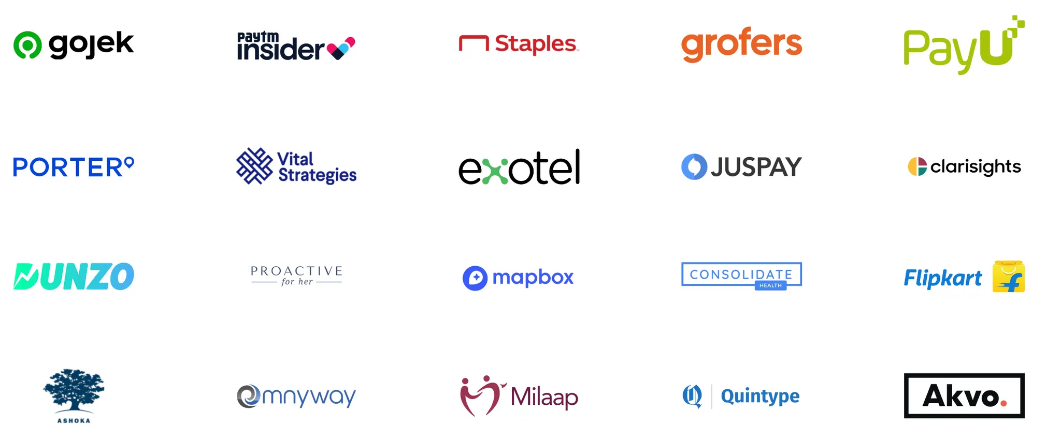

About us
We are a 13 year old product and engineering consultancy with a track record of delivering outcomes.
We are trusted by CEOs and CTOs of companies such as Gojek, Porter, Exotel, Flipkart, Staples, Blinkit (now with Zomato), Dunzo, Paytm Insider, PayU, Juspay and more. We build core systems the business depends on, designed to scale and stand the test of time.

Slide 3
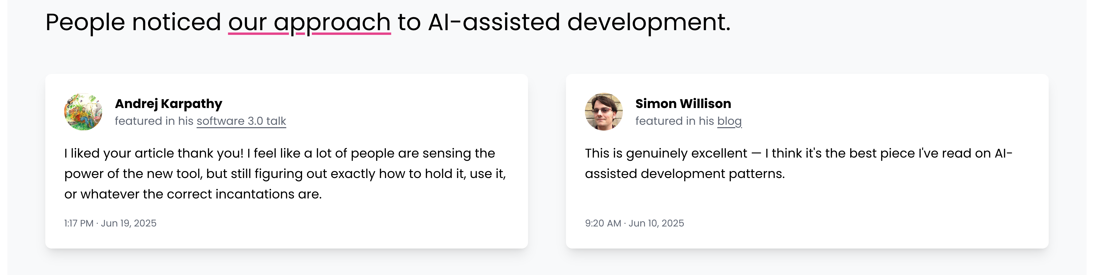
✨ Featured

Slide 4
A tailored deck
Rather than a holistic overview of our repertoire,
we present examples from our recent and relevant work.

Slide 5
Cloud telephony platform
AI Powered Voice and Conversation Quality Analytics (CQA) platform
Built and shipped STS voice bots
Using Gemini and Pipecat
Evaluated and benchmarked ASR models across languages and dialects
Introduced data-driven eval process
Improved call containment by 10%
Production hardening at scale
250x API speedup
Fixed 20-40% duplicate analysis bug
10x query optimization, added observability
Built CQA platform from zero to production
Multi-tenant (200+ schemas)
50k calls/day for their largest enterprise customer
10M rows/day real-time CDC pipeline
Led architecture across multiple teams
Introduced documentation practices and engineering rigour

Slide 6

AI Voice Assistant
For a leading identity platform. 1M+ app downloads.
Shipped to production
Demo in 1 day
Live calls with 1,000 internal users in 2 months
Owned full voice backend
real-time bidirectional audio streaming
VAD, barge-in
end-of-speech detection
multilingual transcription
intent classification
live and post-call summarization
Solved hard real-time problems
Interruption handling
Human vs robot caller detection
Dynamic mid-call goal changes from user input
Setup mature practices
Built evaluation framework
Setup observability
Talks
Fifth Elephant Annual Conference in 2025 (Agentic AI track): The correct way to evaluate LLM-based systems

Slide 7
Profiles
A balanced team of 3 who would be a good fit for you
highlighting their recent and relevant experiences

Slide 8
Srihari Sriraman
Engineering leader with ~15 years of experience across domains and technologies Focused on AI strategy, platform design, and developer tooling
AI Strategy & Architecture at Porter
Provided architecture guidance for Porter’s vision and AI strategy
Created an engineering handbook with AI best practices and recipes to extract skills from existing code
Platform & Systems Design at Porter
Designed and delivered a data science platform enabling rapid model building and serving
Evolved the org’s micro-service architecture to be event-driven
Internal Projects & Tooling
Built context-viewer: turns opaque LLM context windows into analysable artifacts
Built ask-github: an agentic search tool that works over APIs
Writing & Thought Leadership
Co-authored (with Drew Breunig) on how system prompts shape agent behaviour; follow-ups on model biases, artefacts, and agent autonomy
Framed why AI feels different — three simultaneous paradigm shifts

Slide 9
Atharva Raykar
nilenso’s original AI enthusiast. Expert in Voice AI. Brings systems thinking and empirical rigour
AI Voice Assistant (Most Recent)
Built major backend components for an AI Voice Assistant (200k DAU)
Voice LLM integration, websocket and telephony management
Onboarding verification flow, observability and metrics
Talk at Fifth Elephant 2025 (Agentic AI): evaluating LLM-based systems
AI Playbook & Talks
Created AI-assisted engineering playbook, endorsed by Karpathy and Willison
Talk at Fifth Elephant Pune (AI in SDLC): systems thinking for AI, designing agent environments
Previous Engagements
Dunzo: queue management system, ETA calculator, payout system
Simple.org: health data integration APIs across organisations and nations
Writing
On utility and traps of benchmarking and evaluating AI systems
On evolving LLM system design, informed by Sutton’s bitter lesson
Pre-nilenso
Ported large parts of Git’s submodule functionality to C (GSoC)

Slide 10
Siri P
Full-stack engineer with deep voice AI experience Consistently ramps up and delivers across new domains and stacks within days
Voice AI & Agentic Systems
Built conversational bots using Gemini STS models and LangGraph for a contact centre platform
Created evaluation datasets for noisy telephonic conversations; iterated on quality metrics
Tuned VAD configurations, optimised ASR applications
Implemented tool calling for language switching in Gemini STS bots
Contributed to ask-forge: open-source AI agent for GitHub/GitLab repos
Event-Driven Architecture at Porter
Key contributor to event-driven migration (Kafka & Confluent) for real-time order allocation across millions of daily transactions
Built observability layer for data science platform: dashboards, alerts, load tests, data correctness validations
Testing & Engineering Excellence at Porter
Drove ephemeral testing framework onboarding, cutting integration test times via isolated, parallelised testing

Slide 11
Get in Touch
Email: business@nilenso.com,
Blog: blog.nilenso.com, Work: nilenso.com/work, Talks: nilenso.com/talks

