Slide 1

Mini Project / Industrial Training Presentation SESSION 2023-24 BCC-351
Department of Information Technology
ABES Engineering College, Ghaziabad, UP
Name-Nilesh Shukla
Class & Section: IT-C
Roll No. – 2300320130163
Admission No. – 2023B0130195

Slide 2
Contents:
Abstract
Problem statement
Objectives
Novelness, features, CHALLENGES AND LIMITATIONS
Modular structure of the project
Results (include graphs, tables if applicable)
Conclusion and future work
OTHER TOPIC (if any)
Annexures: A. Certificate(s)
B. Code snippets
C. Project Demo Snippets

Slide 3
ABSTRACT
CardioVision is an advanced artificial intelligence (AI) system designed to predict cardiovascular and related diseases based on user-provided symptoms. Leveraging state-of-the-art machine learning algorithms, this system aims to provide accurate, early-stage disease predictions to improve health outcomes and reduce medical intervention costs. By integrating a user-friendly interface and comprehensive data analytics, CardioVision represents a significant step forward in personalized healthcare solutions.

Slide 4
PROBLEM STATEMENT
Cardiovascular diseases (CVDs) are the leading cause of death globally, often resulting from delayed diagnosis and lack of accessible screening tools. Current healthcare systems lack efficient, predictive solutions for early identification of potential heart-related conditions. This gap necessitates the development of an intelligent, accessible tool to assist in the early detection and prevention of such diseases.

Slide 5
OBJECTIVE
Develop an AI-driven platform for predicting cardiovascular diseases based on symptom analysis.
Provide an intuitive user interface for easy symptom input and real-time predictions.
Enhance prediction accuracy through continuous model training with large datasets.
Support healthcare professionals by offering supplementary diagnostic insights.
Promote preventive healthcare by encouraging timely medical consultations

Slide 6
Novelness, Features, Challenges, and Limitations
Novelness:
Combines symptom-based analysis with machine learning for personalized predictions.
Incorporates real-time updates to improve model accuracy.
Offers a scalable solution adaptable to various demographic and geographic data inputs.
Features:
Symptom input via natural language processing (NLP).
AI-driven prediction models with explainable outputs.
Integration of patient history for enhanced accuracy.
Cloud-based system for accessibility and scalability

Slide 7
Challenges:
Ensuring the quality and diversity of training data is a significant challenge, as biased or incomplete data can compromise prediction accuracy. Additionally, addressing biases in AI algorithms remains a critical concern to ensure equitable outcomes. Maintaining data privacy and meeting stringent healthcare regulations adds further complexity, requiring robust security measures and compliance frameworks.
Limitations:
The system’s reliance on user-provided symptoms introduces a limitation, as incomplete or inaccurate inputs can lead to incorrect predictions. CardioVision is not a substitute for professional medical diagnosis, making it essential to pair its insights with expert consultation. Furthermore, its applicability to rare or complex conditions may be constrained by the availability of extensive, high-quality datasets.

Slide 8
MODULAR STRUCTURE OF PROJECT
Data Collection and Preprocessing: Aggregates and cleans data from user inputs, electronic health records, and public datasets.
Model Development: Implements machine learning algorithms for disease prediction.
NLP Interface: Allows users to input symptoms in natural language.
Prediction Engine: Generates disease likelihood scores and detailed insights.
Feedback Loop: Continuously improves accuracy through user feedback and updated datasets.

Slide 9
RESULTS
Accuracy: Initial testing achieved an 85% accuracy rate in predicting common cardiovascular
conditions.
Graphs:
Symptom correlation with disease prediction probabilities.
Accuracy improvement trends over iterative model training cycles.
Tables:
Performance comparison of different machine learning algorithms.
User feedback metrics for system usability.

Slide 10
CONCLUSION AND FUTURE WORK
CardioVision demonstrates the potential of AI in revolutionizing cardiovascular disease prediction and prevention. The system’s ability to analyze symptoms and provide actionable insights can empower users and healthcare professionals alike. Future work includes:
Expanding datasets to include more diverse populations and conditions.
Enhancing the system’s interpretability for medical professionals.
Developing mobile applications for increased accessibility.
Collaborating with healthcare providers to validate predictions in clinical settings.

Slide 11
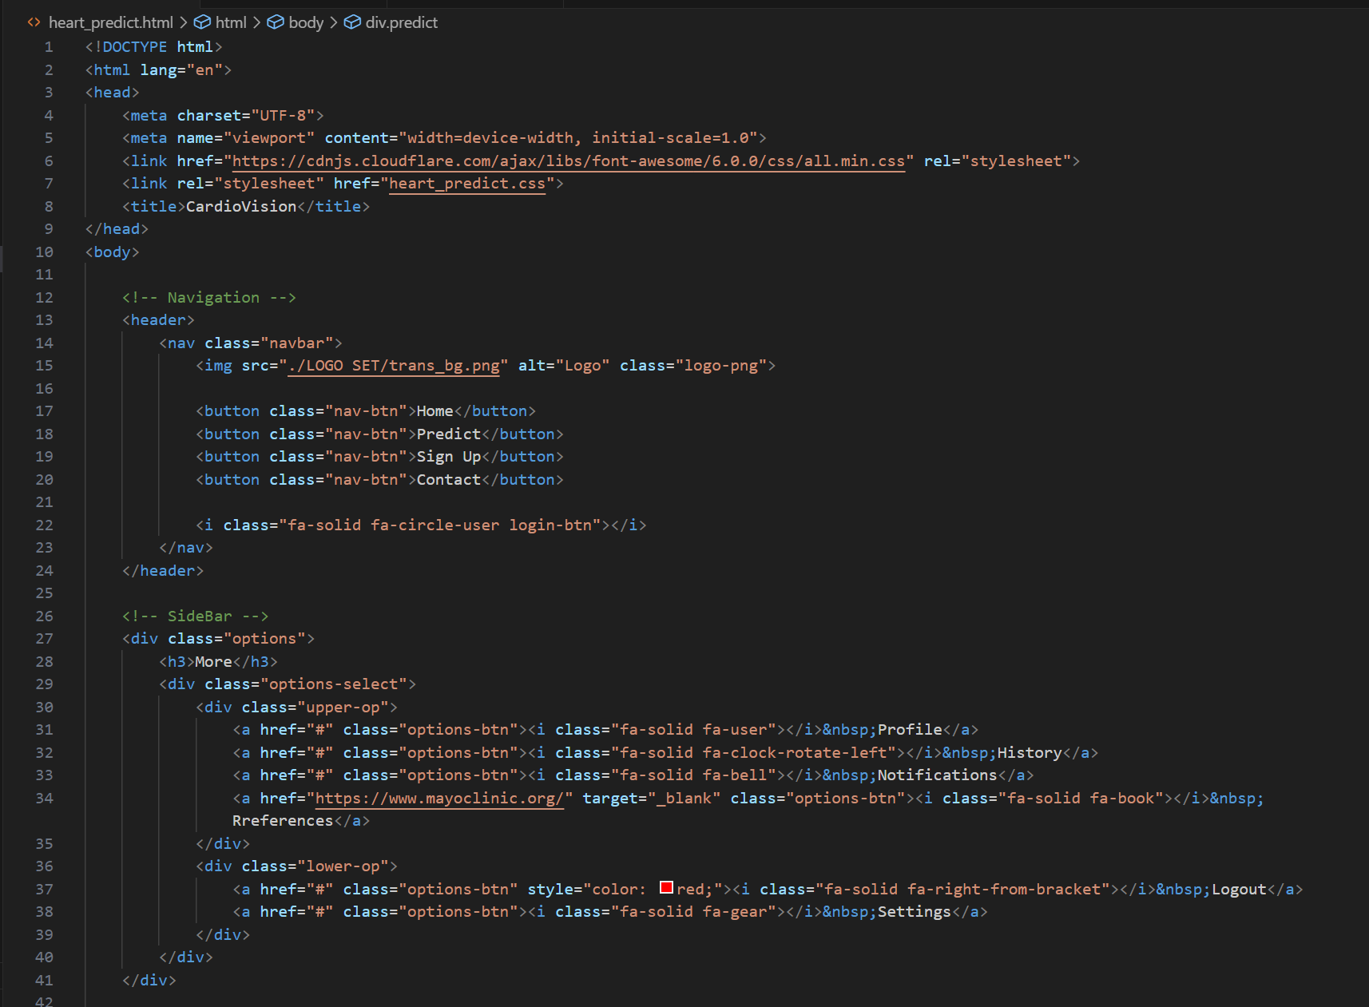
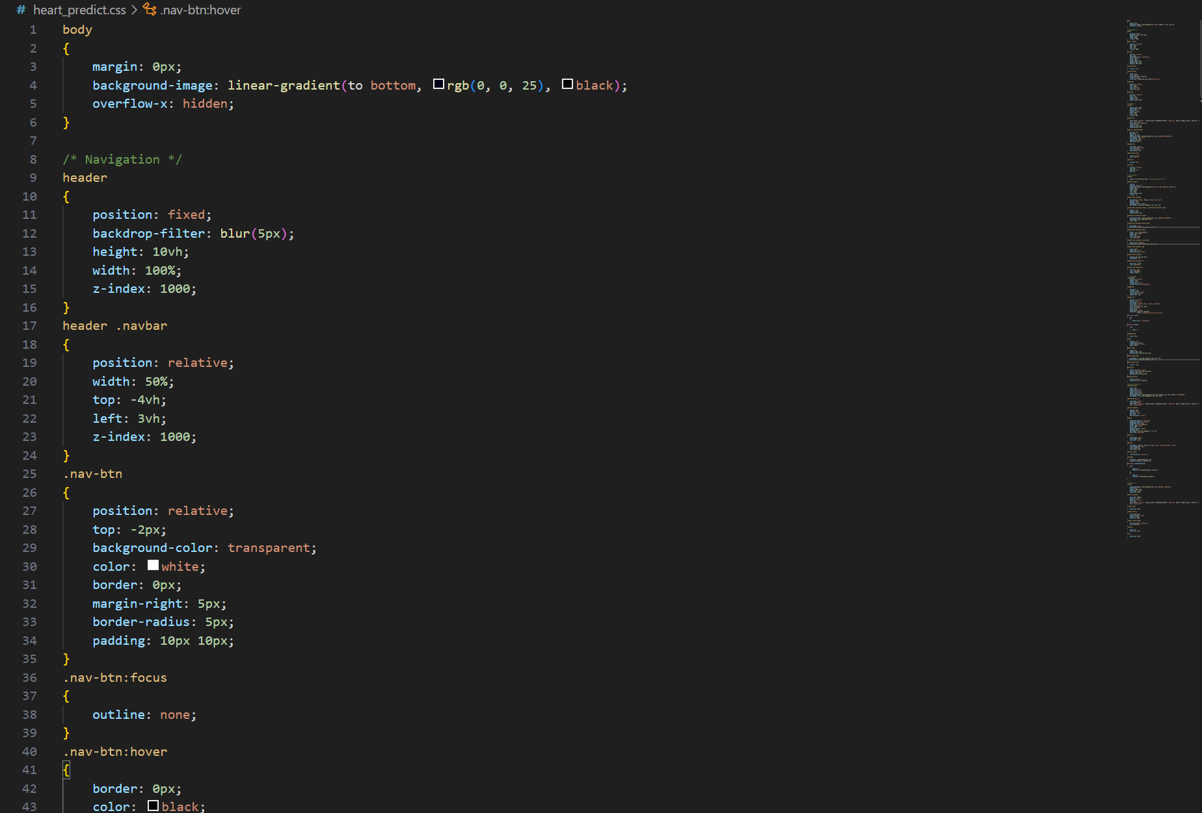
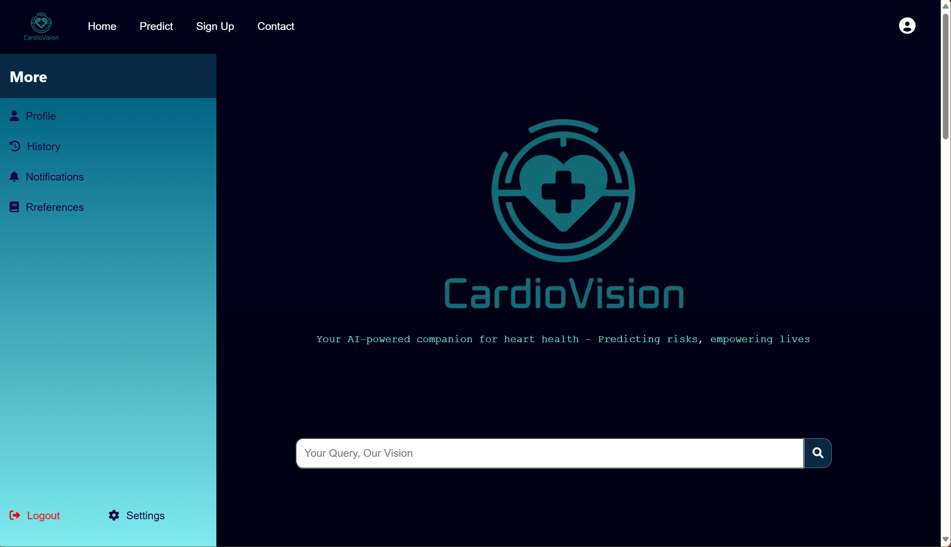
ANNEXURES:
A glimpse of home page

