Slide 1
CRM & Email Marketing
Course2_Sprint3_Project
$
Guided by Chhavi Patel Ma’am

Slide 2
Cotext setting
Marketing Automation using CRM and Email Marketing
Company Name | EcoTrands
Tool Used | HubSpot - https://app-na2.hubspot.com/
CRM | Configure Customer data into HubSpot CRM contact
Email Marketing | Email campaign to promote a new product launch
Landing page | Landing page for conversions by ensuring it has a clear call-to-action, compelling content and user-friendly design
Form | Customer feedback and gather user data

Slide 3

Our company
EcoTrends a company that sells eco-friendly Lifestyle products such as reusable water bottles, bamboo toothbrushes and biodegradable packaging materials

Slide 4
CRM
Group customers into specific list based on criteria:
Purchase History
Location
Engagement level
And the “Engagement level” are measured by how actively customers interact with a brand so I took “Purchase History” with every 6 months to the accounts to determine the level.

Slide 5
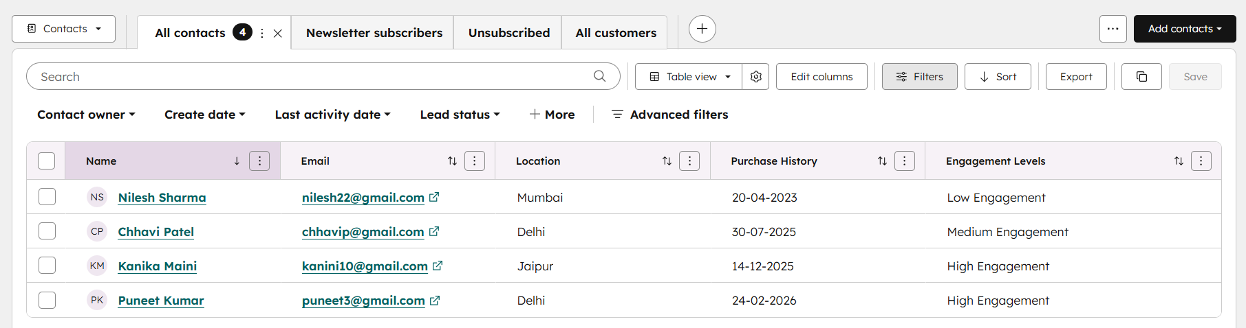
CRM - Contacts
Purchase within 6 months – High Engagement
No purchase for 6 months – Medium Engagement
No purchase for 1 year – Low Engagement

Slide 6

EMAIL MARKETING – NEW PRODUCT LAUNCH
Email link:
https://245115863.hubspotpreview-na2.com/_hcms/preview/content/314945099501?portalId=245115863&_preview=true&cacheBust=1771328703897&preview_key=jBBtNnRQ&hsPreviewerApp=email

Slide 7
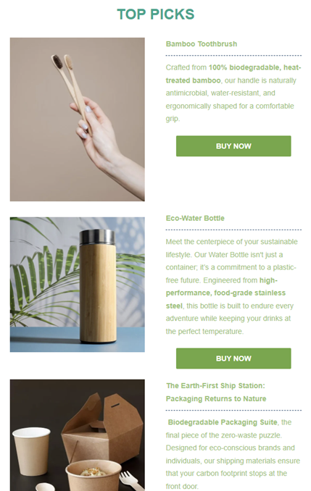
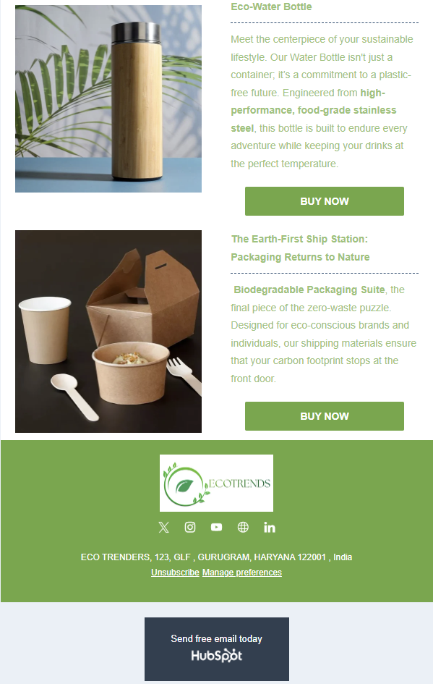
EMAIL MARKETING – NEW PRODUCT LAUNCH

Slide 8
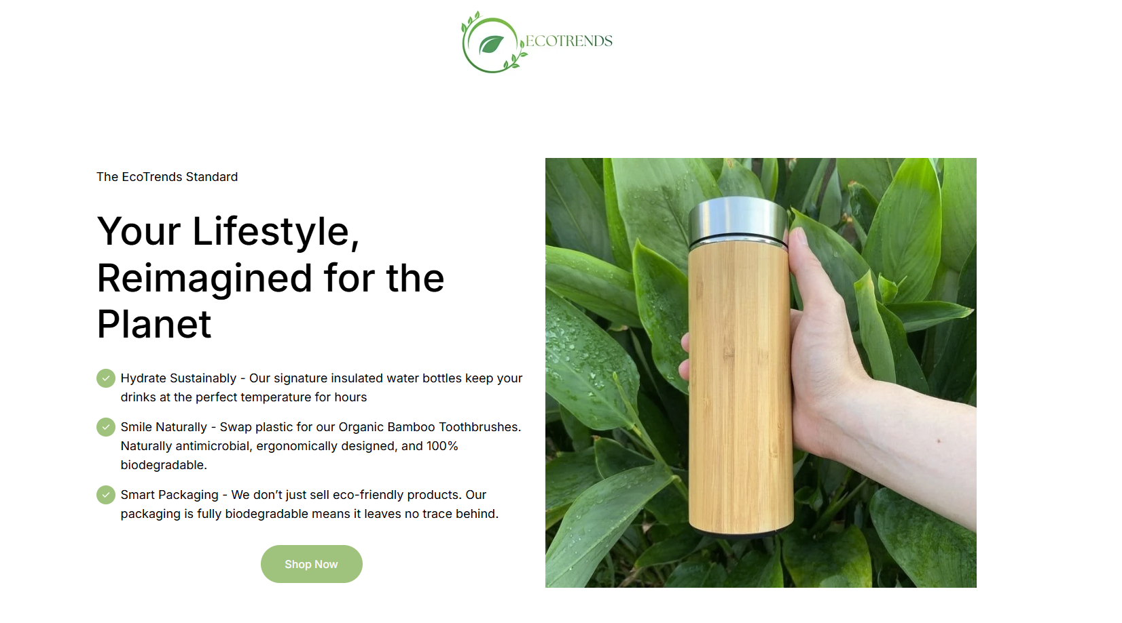
LANDING PAGE – FOR CONVERSIONS
Page Link:
https://245115863.hs-sites-na2.com/ecotrends-landing-page?hs_preview=YxeVEuZO-315616190189&

Slide 9
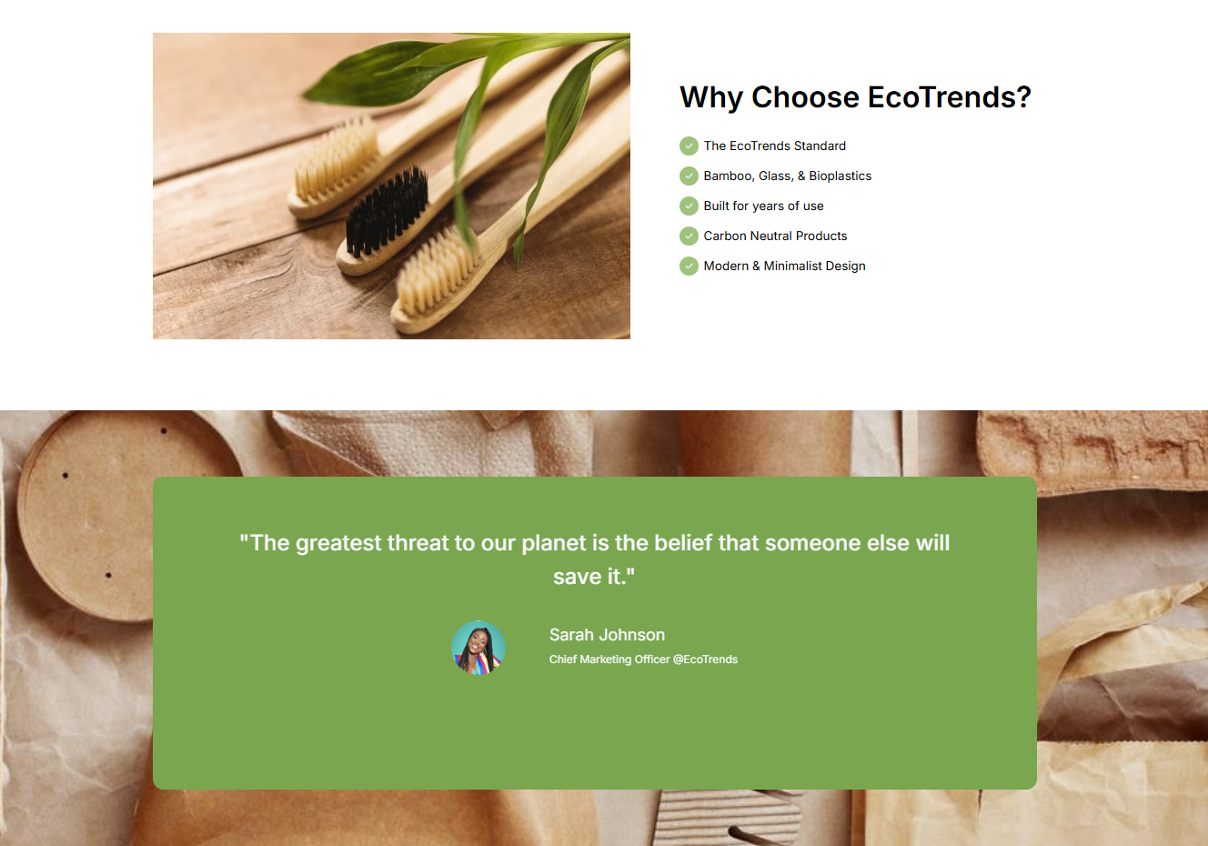
LANDING PAGE – FOR CONVERSIONS

Slide 10
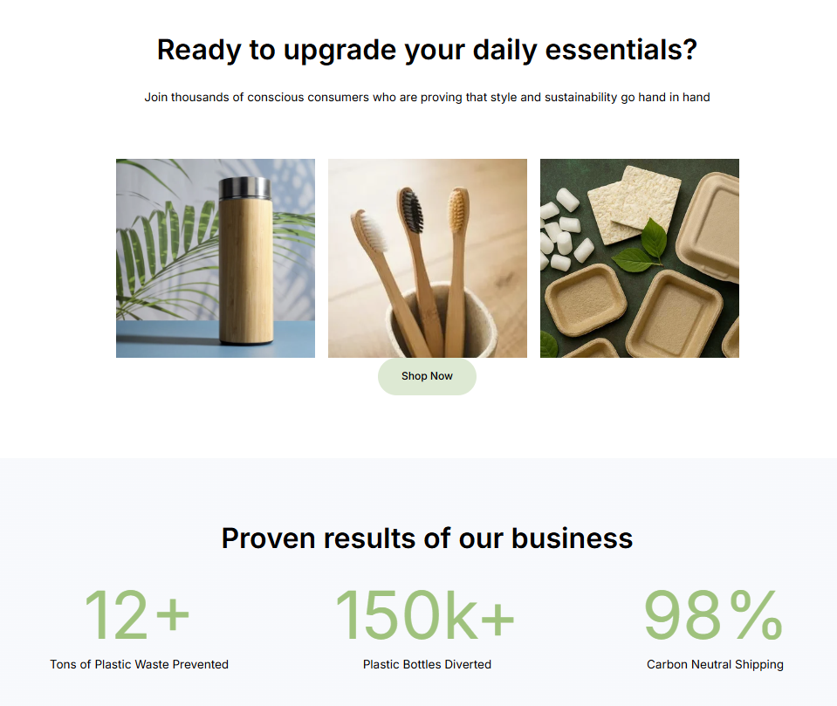
LANDING PAGE – FOR CONVERSIONS

Slide 11
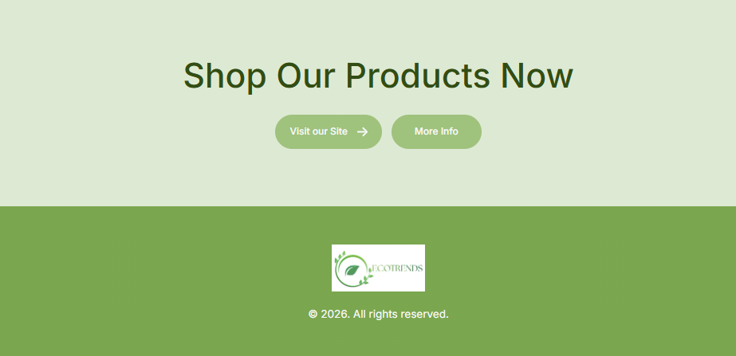
LANDING PAGE – FOR CONVERSIONS

Slide 12
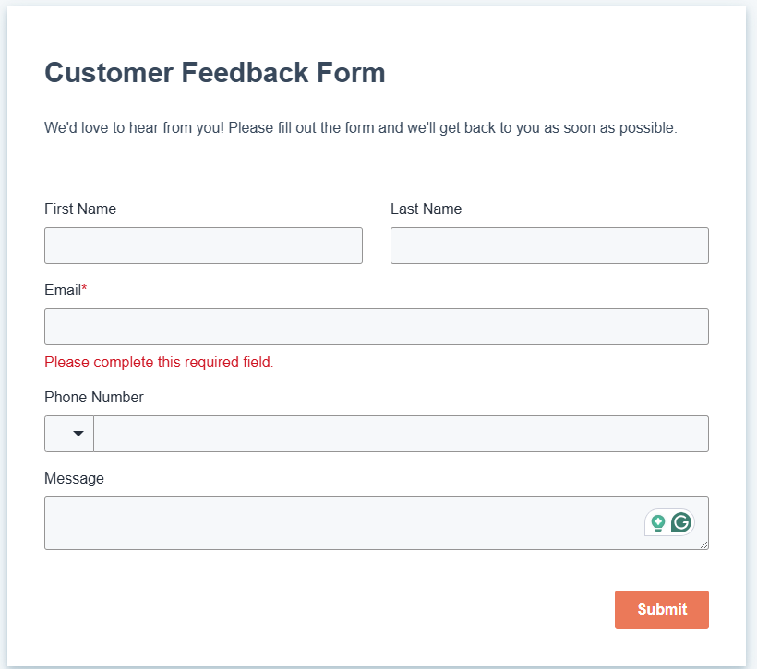
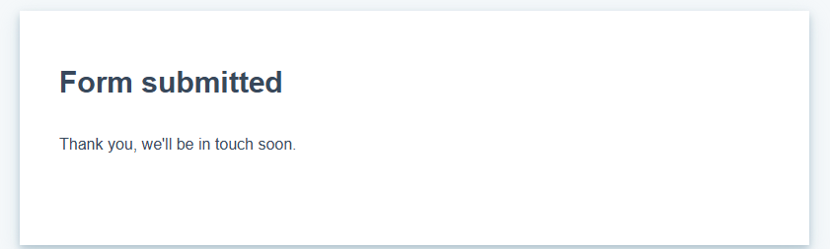
Form link:
Form – Customer Feedback
https://share-na2.hsforms.com/2IcgZAUaoQAWj4Wc8edd0zw41xolz

Slide 13
Thank you
By Nilesh

