Slide 1
Building & Managing Online Reputation
Course5_Project
Guided by Chhavi Patel Ma’am

Slide 2

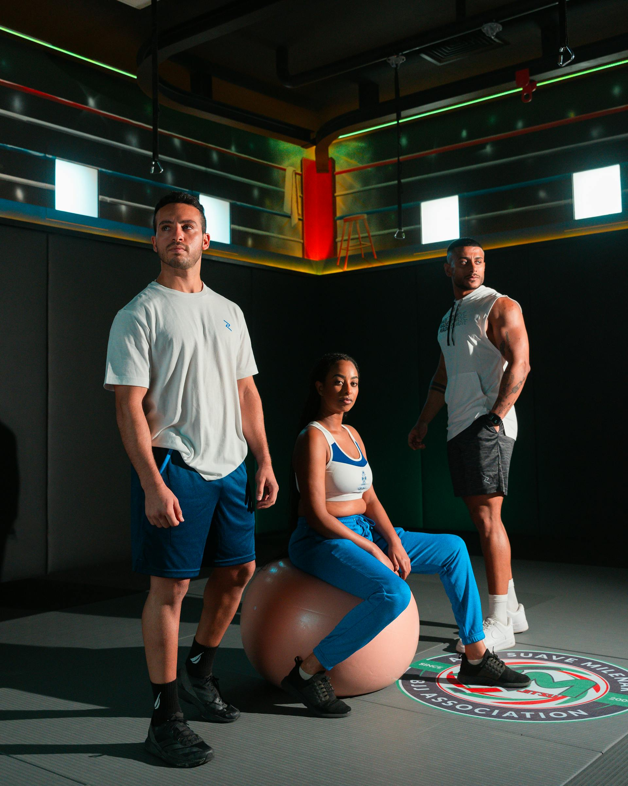
Tasks
About the Brand
Target Audience
Competitive Analysis
Strategic Goal
Add social media profiles to insights
Analysis and Strategy formulation
ORM strategy and implementation plan
TATs and SLAs
Deliverables Evaluation
ORM strategy components
Roadmaps for each components

Slide 3
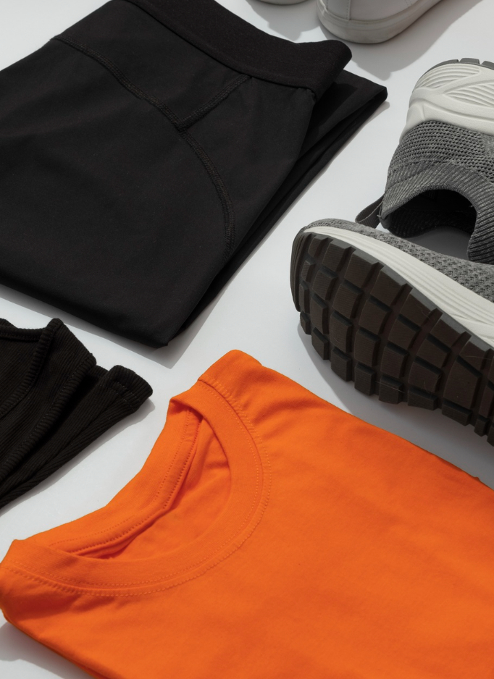
About Apex Kinetic
Apex Kinetic is a moden activewear founded on the belief that human movement is the ultimate form of technology, the brand was born in a garage gym where the limitations of standard cotton and rigid synthetics became an obstacle to progress.
The founders wanted to create a "second skin" that didn't just sit on the body but responded to it. This led to the development of the Kinetic System, a design philosophy where every stitch serves a purpose: to support the body’s natural mechanics while stripping away the weight of traditional athletic gear.
It is a brand built for the "Apex" moment— where preparation meets performance and a new personal best is established.

Slide 4
Target Audience
Demographic segmentation
Psychographic Segmentation
Age group: 18-45 years
Gender: Male & Female
Primary Location: New Delhi
Annual Income range: ₹5-35 Lakhs
Lifestyle: Actively engaged in sports/fitness and health-conscious
Values: Health, Safety, Performance, Style
Personality Traits: Goal-Driven, Knowledgeable about the clothes, Aware what material of clothes benefits their workouts

Slide 5
Competitor Analysis with MarketShare
Puma (29%)
Decathlon (23%)
Adidas (16%)
They have successfully positioned themselves as the bridge between performance and street style.
Weakness: Frequent discounting have made it highly accessible but weakened its "premium" image
Operates on a unique model, acting as both a retailer and a manufacturer.
Weakness: Lack of aspiration and "Cool" factor, hyper-utility focused and low costs
Holds a strong legacy position, its high-profile partnership with the BCCI (Indian Cricket Team).
Weakness: Stuck in the "middle-price trap" between Puma and Nike.
Nike (10%)
Skechers (8%)
Local/Others (14%)
Premium company-owned stores and digital sales rather than mass-market penetration.
Weakness: high entry-level price point locks out the massive volume in India
Explosive growth in India, primarily through footwear, by focusing on a specific niche: comfort. Weakness: Limited to "comfort footwear"; rarely considered for serious activewear
Brands like HRX, BlissClub sell the idea of fitness to the mass-market. Weakness: struggle to compete with global giants on lack of genuine fabric innovation technology/R&D.

Slide 6
Strategic goal
Positive Image & growth mindset
Build and maintain a strong and positive brand image on all online platforms by friendly customer service and good product quality will build long-term trust and loyalty eventually leading towards growth

Slide 7




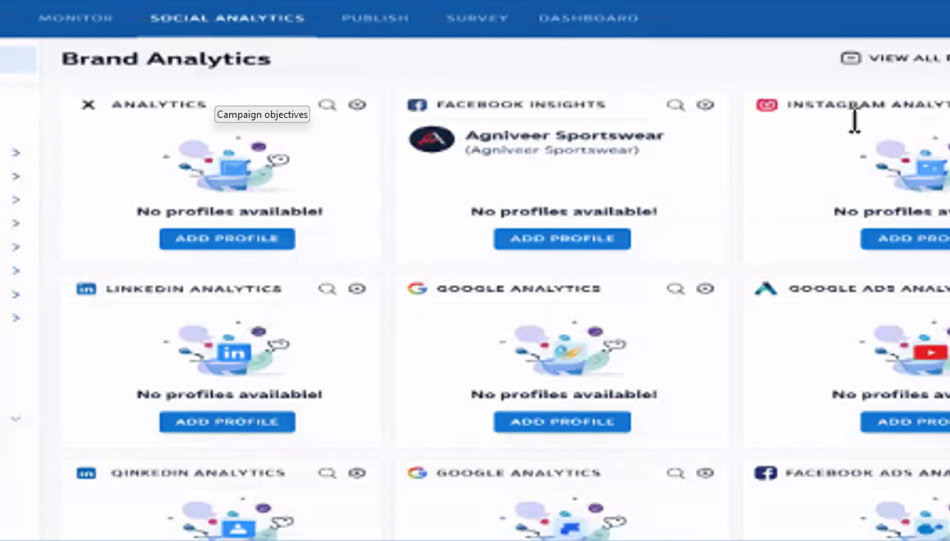
Add social media profiles to insights
On Konnect Insights – Social Analysis – Add Profile – Add your social media accounts

Slide 8
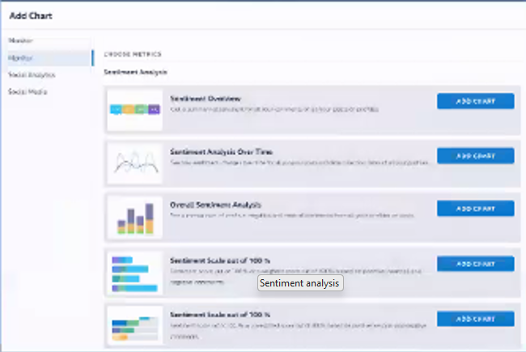
Sentiment Analysis
Analysis and strategy formulation
On Konnect Insights – Dashboard – Add Charts – Monitor – Sentiment Analysis

Slide 9
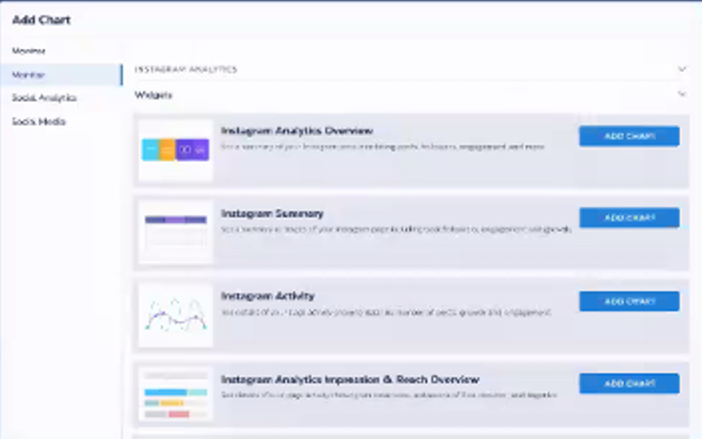
Competitive Analysis
Analysis and strategy formulation
On Konnect Insights – Dashboard – Add Charts – Social Media Analysis – Instagram Comparison

Slide 10
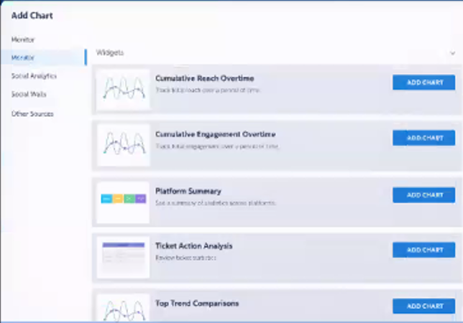
ORM Strategy and Implementation Plan
Customer Success Stories
Show genuine customer feedback along with their fitness photos or videos while using Apex Kinetic products
Review & Rewards
Encourage customers to share their reviews or mention Apex Kinetic on social media to get a chance to earn discounts or rewards
3. Inside the Making
Share behind-the-scenes clips of how Apex Kinetic products are designed, produced and quality-checked to highlight comfort and performance
4. Feature Our Customers
Highlight happy customers by posting their photos or reels (with approval) or repost their tagged content wearing Apex Kinetic products
Engagement
On Konnect Insights – Dashboard – Add Charts –Widgets – Engagement Overview

Slide 11
TAT & SLA Area
TAT (Turnaround Time) | Description
Definition | The total time required to complete a task or activity from start to end.
Community engagement (Comments, Dms ) | Respond to customer comments and messages within 2 hours to maintain quick and active interaction.
Crisis Response (Negative Feedback/ Brand Issues) | Acknowledge and handle negative feedback within 1 hour to prevent escalation and protect brand reputation
Stories (Static / Interactive) | Post approved stories within 24 hours to keep the audience consistently engaged
SLA (Service Level Agreement) | Description
Definition | Set performance guidenlines to ensure quick communication and a strong, consistent brand presence.
Content for planned campaigns | All campaign images and text must be submitted at least 48 hours before the scheduled posting time for review and approval
Live / Event – based content (athlete features, launches) | Posts or live updates should be shared within 24-48 hours after the content is captured
Community Management | At least 95% of customer comments and messages should be replied to within 5 hour during working hours
Influencer and partner coordination | All messages or requests from influencers and partners should receive a response within 24 hours

Slide 12
Targeted keywords
Brand & Category
Product Based
1
Activewear for workouts
Best workout shoes
Workout clothes
Gym clothes
Apex kinetic Sportwear
Premium activewear
2
Men's sports clothes
Ladies sports clothes
Sportswear gym t-shirts
Stretchable activewear
Feature Based
Style Based
3
Football sportswear
Breathable sportswear
spandex gym outfit
Nylon shorts
4
Modern sportswear
Activewear for workouts
Trendy fitness outfits
Athleisure style

Slide 13
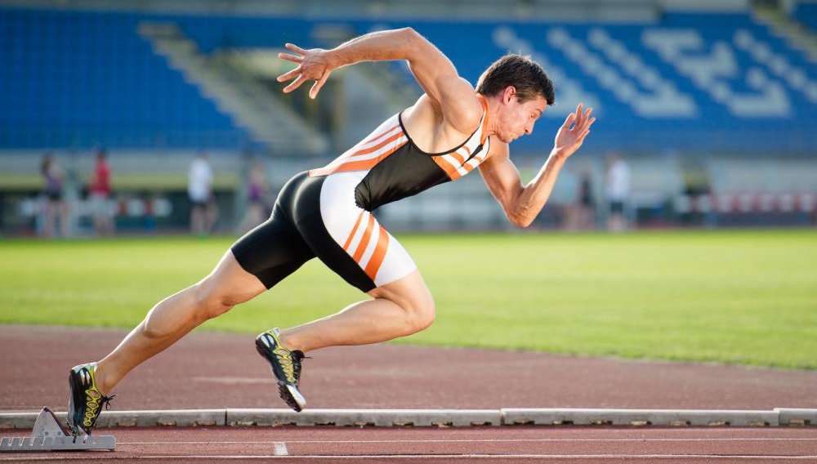
Keywords incorporated
Username
Proflie Description
Captions & Post copy
Hashtags
Content (Reels, Static Posts, Stories)
Polls / Engagement Feature

Slide 14
ORM Strategy Components
Create a strong online presence
Maintain a professional and consistent brand image across all online platforms.
Handle negative feedback properly
Address complaints respectfully, solve issues quickly and protect the brand’s reputation
Listen and Reply to customers
Monitor reviews, tags, mentions, respond quickly to customer messages & comments
Measure results and
Improve
Promote customer feedback
Regularly review engagement and feedback data to improve services, content and overall brand growth
Encourage customers to share honest reviews and showcase positive customer expriencess

Slide 15
Roadmap for each component
Strengthen online presence
Motiotor & engage with feedback
Ensure uniform branding, visuals and messaging across all digital channels.
Share high-quality content that emphasizes product features, fitness benefits and brand values
Keep track of mentions, comments, direct messages and reviews on social media and e-commerce platforms
Respond promptly and professionally to foster trust and enhance customer satisfaction
Promote customer reviews
Handle negative publicity
Encourage customers to leave reviews after purchase via links, messages or social media channels
Highlight authentic customer experiences and cinsider rewarding participation when appropriate
Respond to negative comments quickly with empathy and clear solutions
Resolve serious concerns privately while maintaining a positive image of the brand publicly
Monitor performance and optimize
Regularly analyze online reputation metrics, customer sentiment and engagement trends
Use insights to refine content, enhance products and improve overall customer experience

Slide 16
Thanks ! By Nilesh

