Slide 1

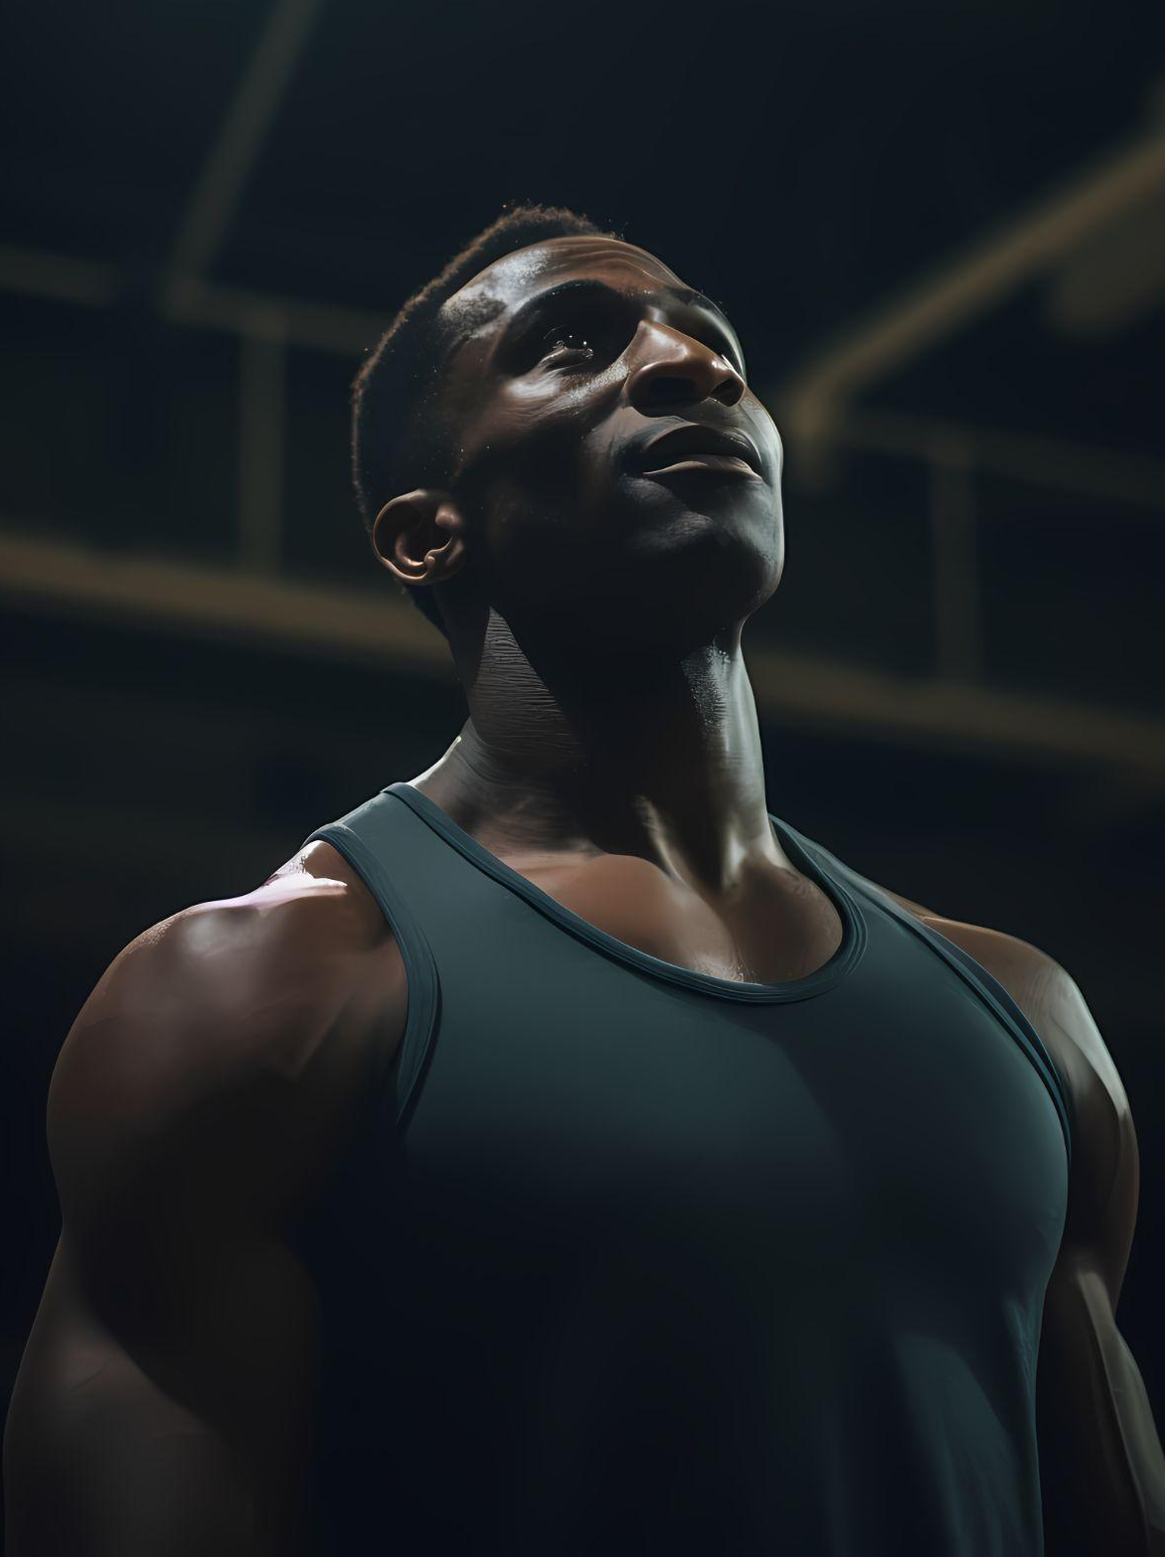

Promoting Products on the Google Ecosystem
Course4_Sprint9_Project
Guided by Chhavi Patel Ma’am

Slide 2
Introduction
About Brand :-
AthloLite is a business deals in sportswear, already launched through social media platforms like Facebook and Instagram. Recently added a range of new products under the reflective running gear category like running shorts, hats, vests, thermal & shoes.
OBJECTIVES:
Increase the brand awareness and accelerate buisness growth by using paid marketing on google and youtube focus points are the quality, comfort and style
driving early – stage engagement through clicks and interactions.

Slide 3
Tasks
Promoting products on the google ecosystem
Task 1 | Pre-Campaign Preparation
Task 2 | Campaign Planning
Task 3 | Campaign Setup
Task 4 | Campaign Launch and Optimization

Slide 4
Task 1 – Pre-Campaign Prep
DEMOGRAPHIC SEGMENTS:
Age: 18-50 years
Gender: Male and Female both
Location: 1 tier and 2 tier cities
Income: Middle to Upper Class
PSYCHOGRAPHIC SEGMENTS
Lifestyle: Fitness Conscious, Outdoor Enthusiasts and Runners
Values: Health, Safety, Performance, Style
Personality Traits: Goal-Driven, Knowledgeable about the clothes, Aware what material of clothes benefits their workouts
BEHAVIOURAL SEGMENTS:
Online behaviour: frequent online-shopper,fitness video viewers on youtube
responds to discount offers

Slide 5
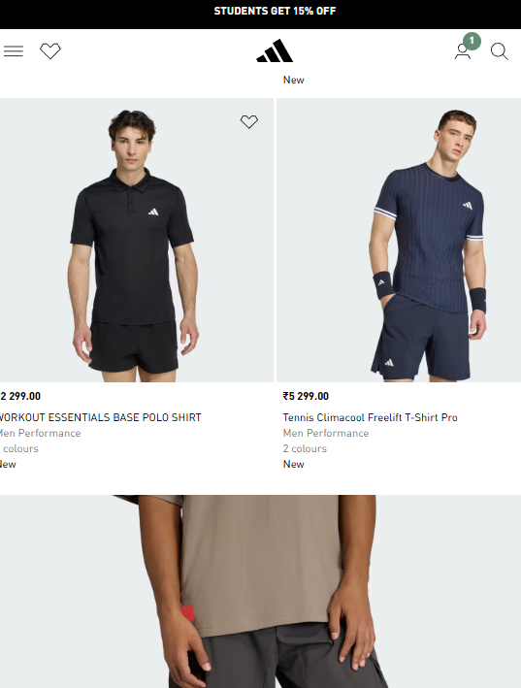
Competitor Analysis
Adidas
Decathlon
Premium brand, innovation-driven
Emotional, to empower lives through sport
Strong on YouTube & Instagram
Have variety of products
Affordable, functional sportswear for everyone
Practical & user – friendly
Community focused campaign
Focused on other fitness relation equipment’s too

Slide 6
Task 2 – Campaign Planning
To create effective marketing plan for AthloLite at a budget of ₹6,00,000. By using strategies, targeting audiences and allocating cost as per expenses on them using the mode of channels that this could be done effectively.
Increase website Traffic:
Objective: Introduce AthloLite to a broader audience across google platforms, increase website traffic by 30% within the next three months.
Key Metrics: Total website visits, click – through rate (CTR) from google ads, bounce rate.
Boost User engagement:
Objective: Encourage users to visit the website and explore the product range.
Key Metrics: Average session duration, number of pages per session, number of returning visitors and engagement rate.

Slide 7
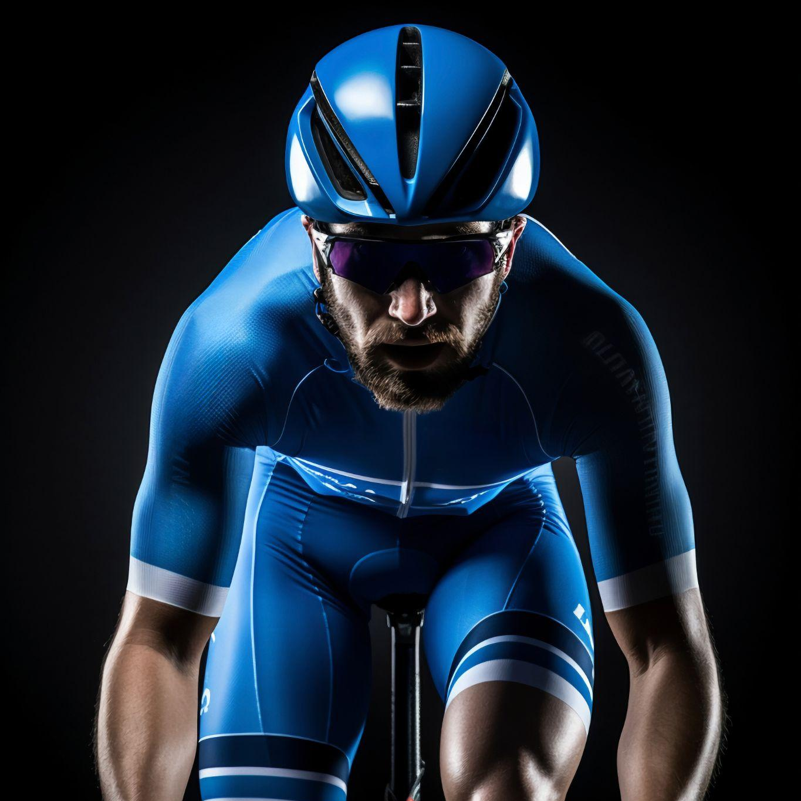
Budget Allocation
Search Ads
Budget:- 3,00,000
Google search ads are ideal for capturing high-intent customers activity searching for reflective running products like Athlolite shoes.
To optimize search ads for maximum impact
1. Keyword strategy:
Brand keywords
Product keywords
Long-tail keywords
2. Ad copy:
Headline
Description
Call to action (CTA)
3. Extension:
Site link extensions
Callout extensions

Slide 8
Budget Allocation
Display ads
Video ads (YouTube)
Budget – 1,00,000
Google display ads help increase brand awareness and reach potential customers while they browse their favorite websites, watch videos or use mobile apps.
1. Audience targeting:
Demographic targeting
Affinity audiences
In-market audiences
2. Ad design:
Visuals
Branding
Messaging
3. Placement strategy:
Managed placements & remarketing
Budget – 2,00,000
YouTube video ads are perfect for storytelling and showcasing brand in action, capturing the attention of users through engaging visuals and narratives
1. Ad formats:
Skippable ads
Non-Skippable ads
Bumper ads
2. Content ideas:
Product showcases
Customer testimonials
Behind the scene
3. Targeting options:
Demographics and interest
Custom affinity audiences
Video remarketing

Slide 9
TASK 3 – Campaign Setup
(Keyword selection)
Focus keywords:
Negative keywords:
Athletic clothes
Men's sports clothes
Ladies sports clothes
Sportswear tshirts
Football sportswear
Modern sportswear
Best workout shoes
Workout clothes
Activewear for workouts
Gym clothes
Nike sport clothes
Sportswear jackets
Puma gym wear
Ugly clothes
Cheap clothes
Adidas sportswear
Hoodies
Sports equipment
Sports Helmets
Overrated sportswear

Slide 10
Ad Creation
Google Search Ads:
Search ads are keyword-driven digital ads. The search term a user enters determines which ads appear on the search engine results page (SERP). These ads are displayed across Google's search network to capture relevant, high-intent traffic.
(Click here to see the setup)
Google Display Network:
Google display network (GDN) is a vast collection of over 2 million websites, apps and videos where your google ads can appear. It helps you reach users as they browse the web, even if they’re not actively searching.
(Click here to see the setup)

Slide 11
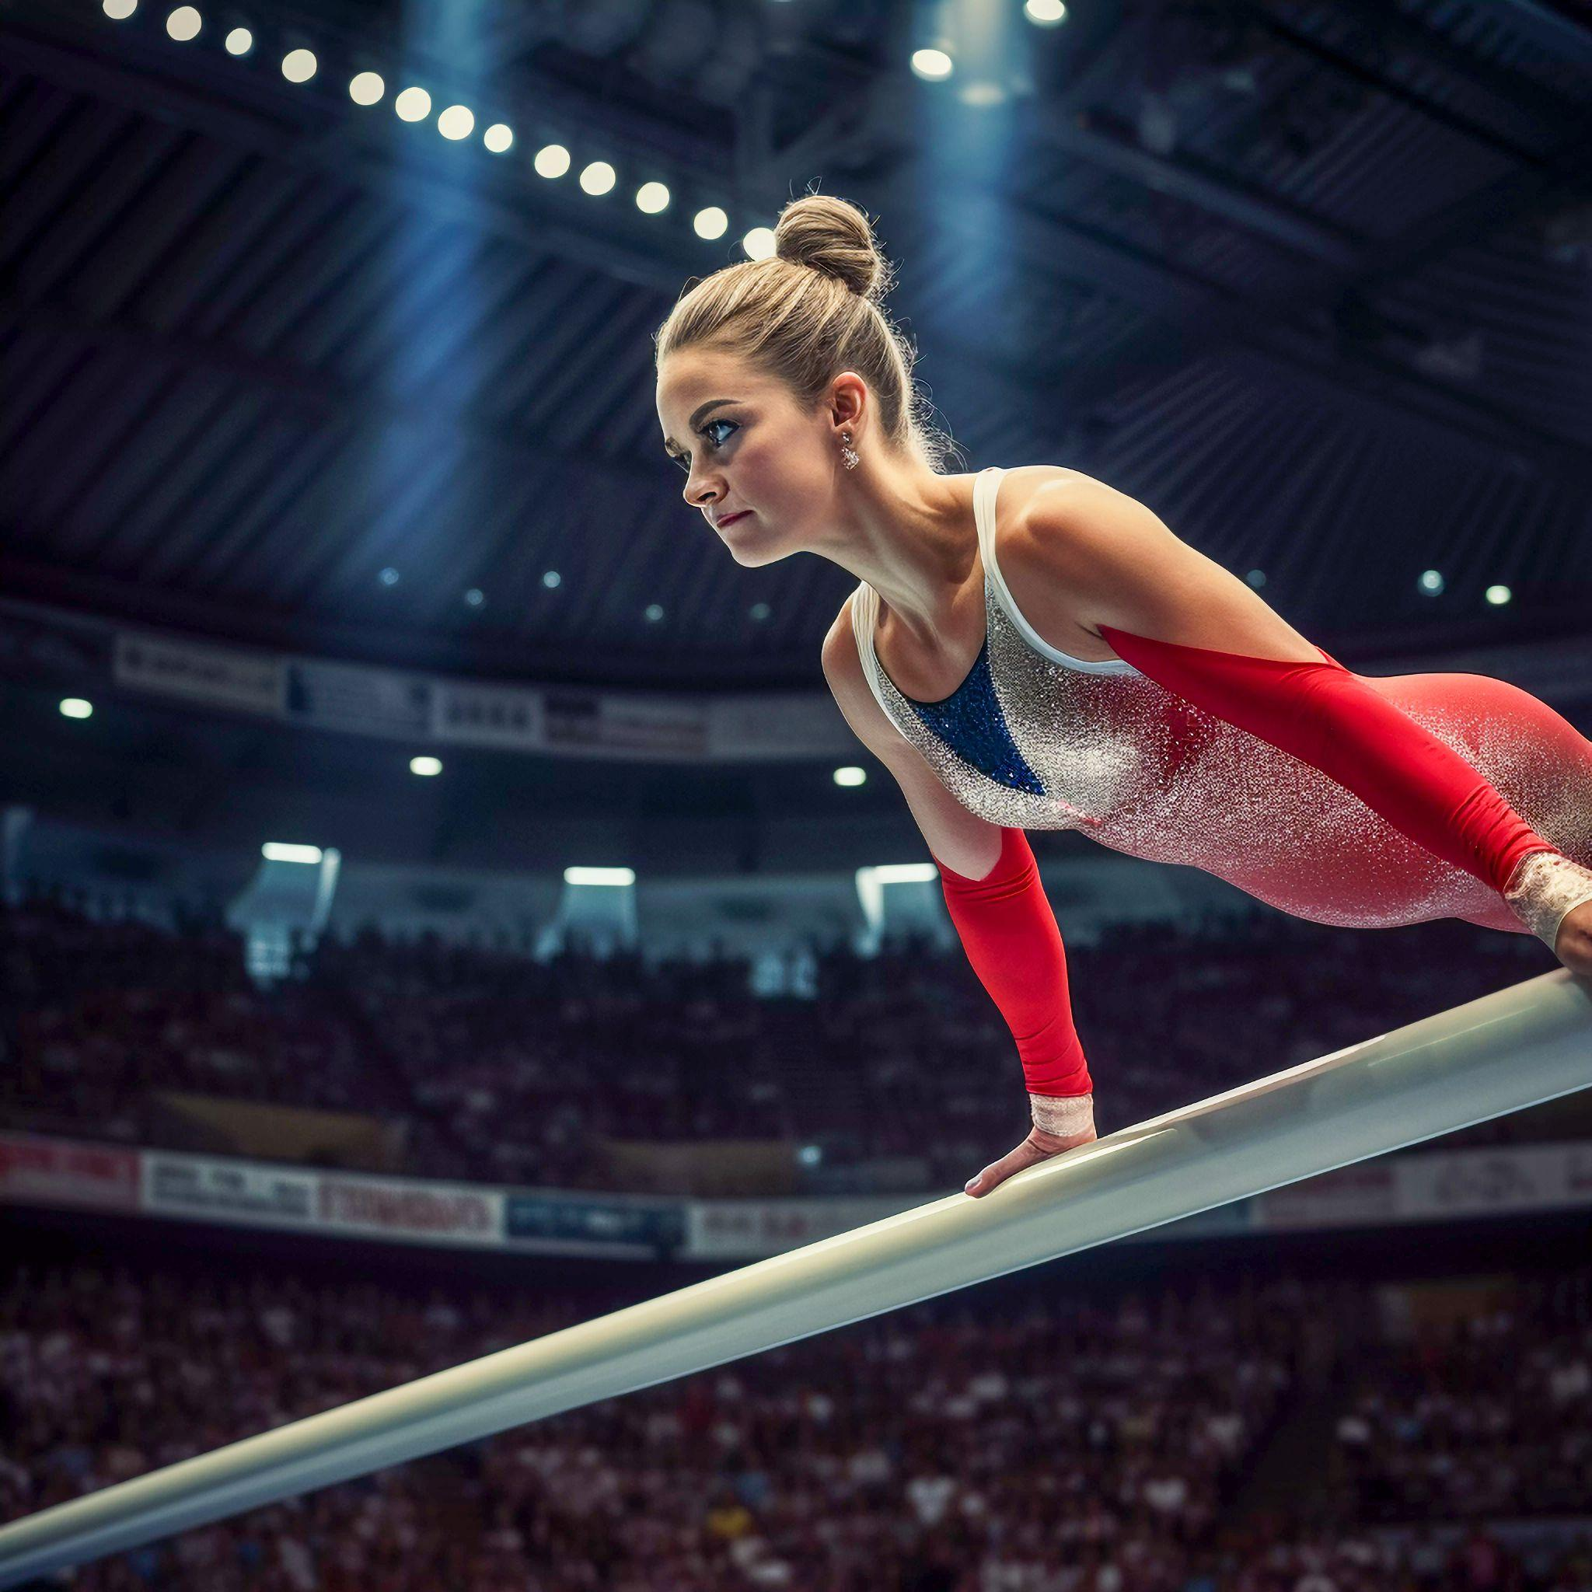
YouTube Ads:
YouTube ads are video-based promotions that run on YouTube and its partner sites.
Therse ads can be charged on a pay-per-view or pay-pre-click basis
(Click here to see the setup)

Slide 12
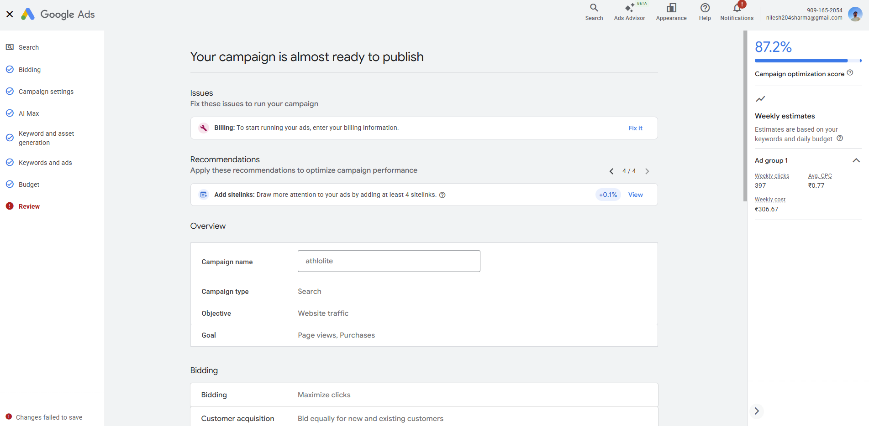
TASK 4 – Campaign Launch & Optimization

Slide 13
Campaign Optimaztion Result
The overall monitoring for search as, display ad, YouTube ads
Impression
Clicks
Click through rate
Search ads – 4,00,000
Display ads – 50,000
YouTube ads – 1,00,000
Search ads – 36,000
Display ads – 4,700
YouTube ads – 8,000
Search ads: 3,960 - 11%
Display ads: 141 – 3%
YouTube ads: 640– 8%

Slide 14
Learnings
01
02
03
Search ads
Display ads
YouTube ads
This ads got the highest number of clicks and we should use more of this ads
Actions:
Use Dynamic display ads automatically customize
Use all available ad assets (sitelinks, callouts, prices)
Good amount of impressions but had lower click
Actions:
Do more keyword search and find new search terms
Do A/B testing with copy & graphics
Viewers does find videos more intresting and want to know more
Actions:
Analyze the competitor ads and follow google trends
Limiting number of time ads repeats by frequency capping

Slide 15
Suggestion
01
02
Shopping ads
Improvements
We can use google merchant to do the shopping ads shown in (SERP)
Using more attractive visuals and better copy for targeting and to increase engagement

Slide 16
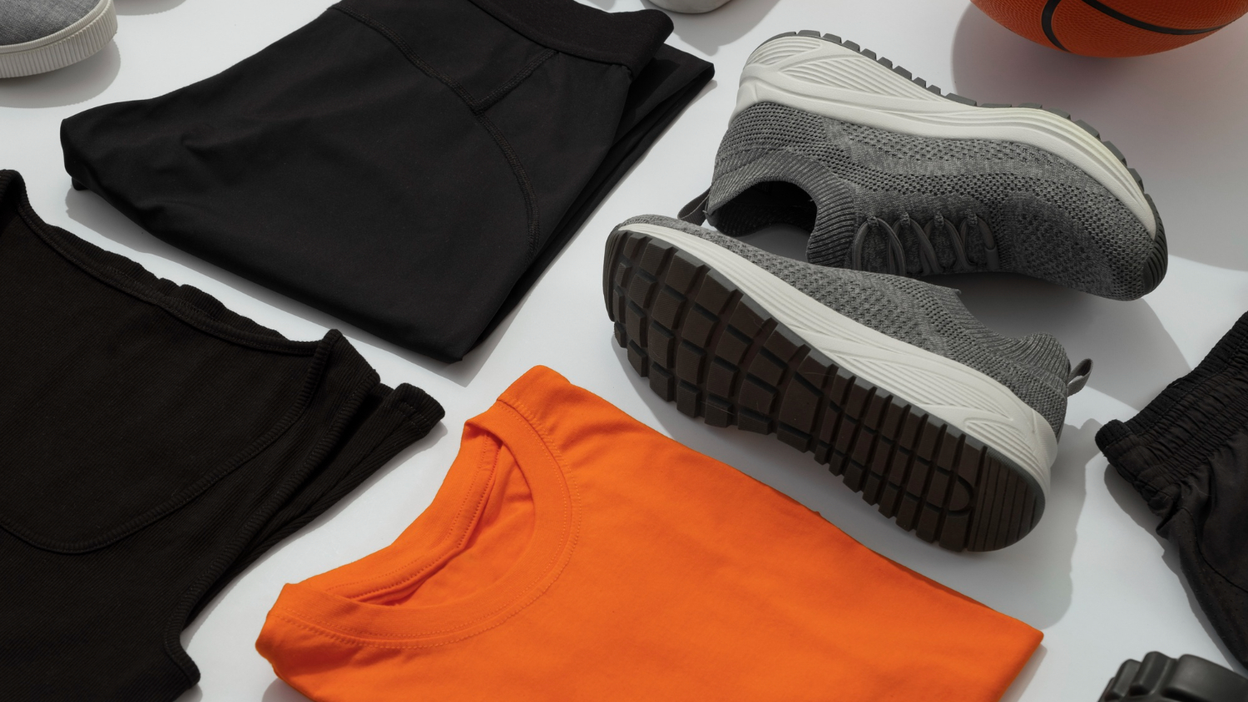
Thanks by Nilesh

