Slide 1
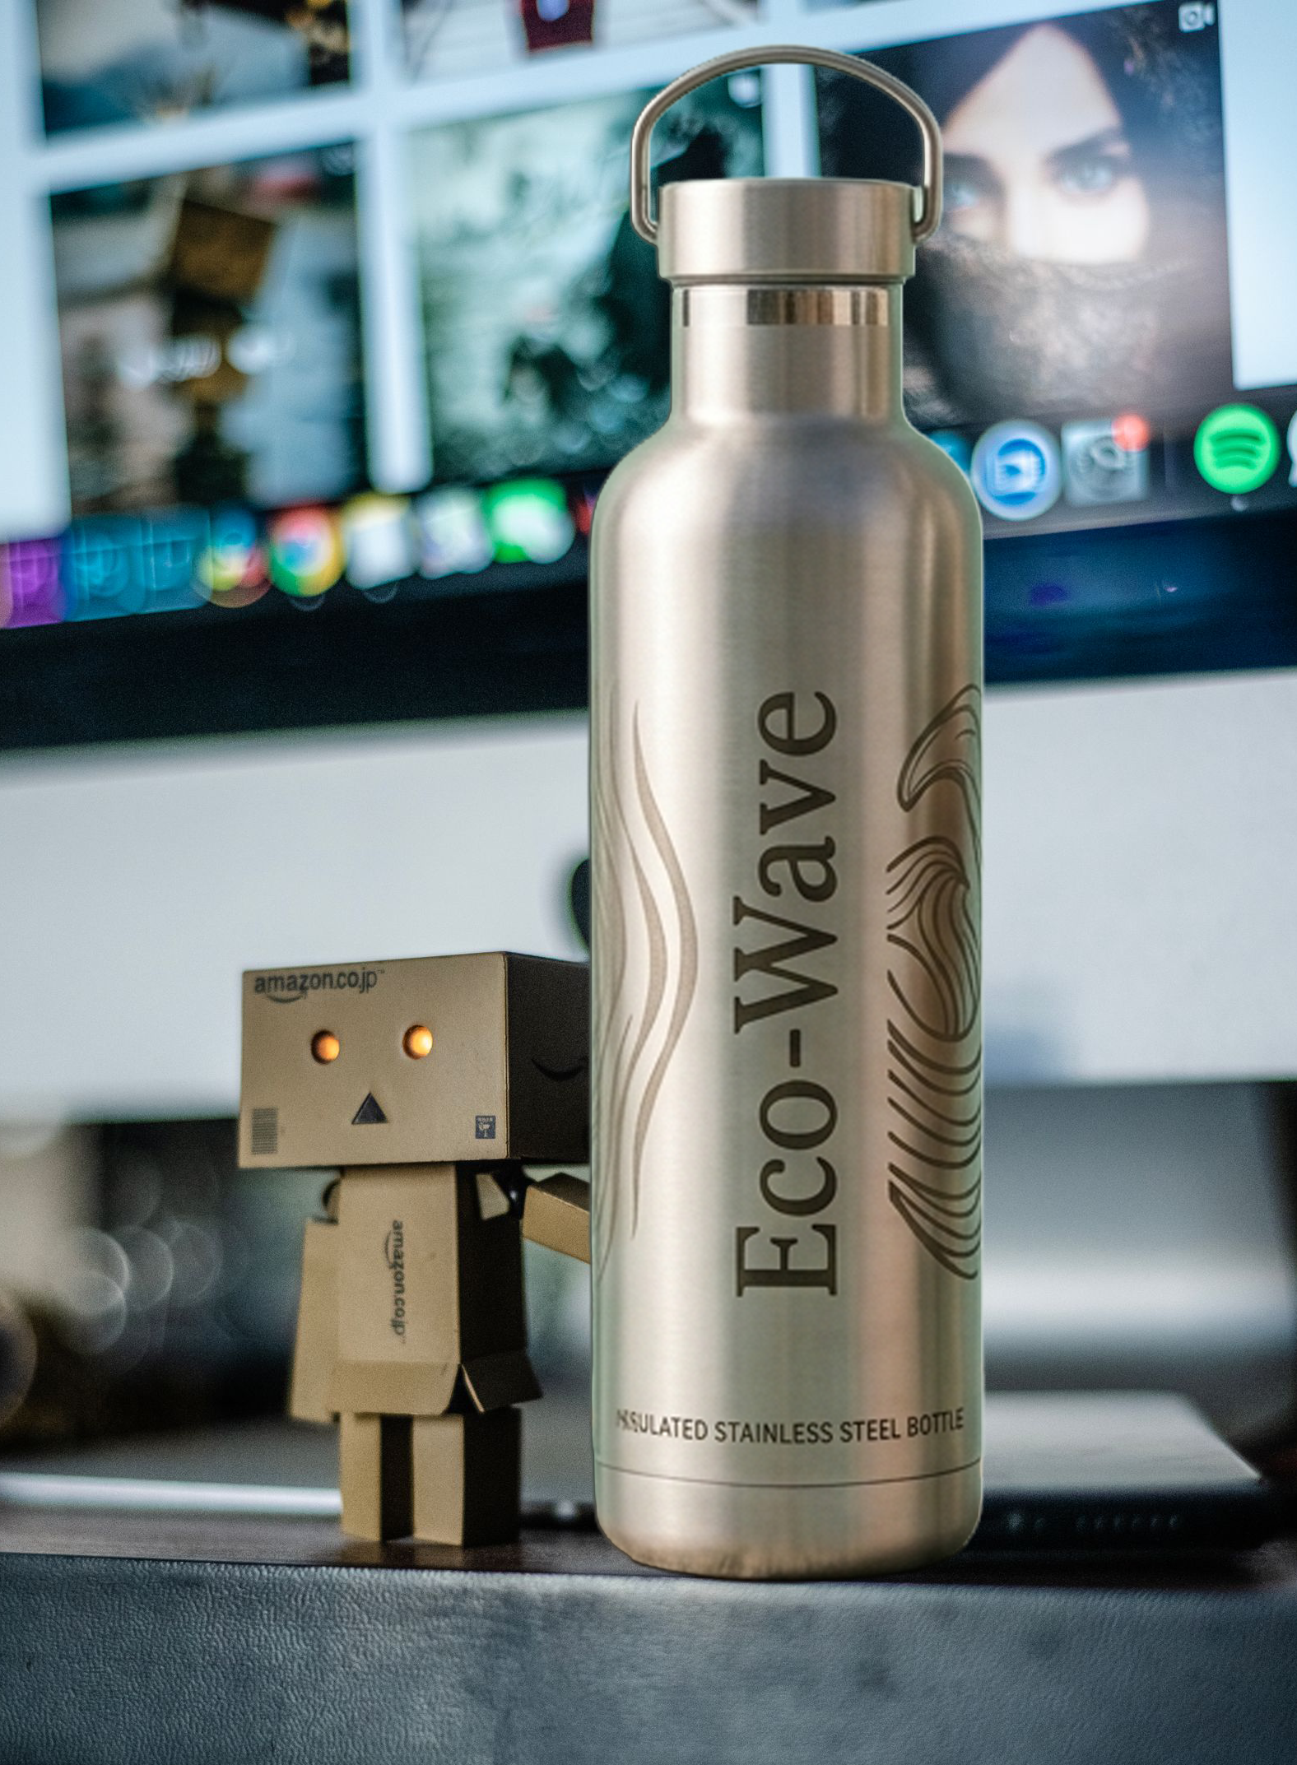
Launching & Optimizing a Product on Amazon
Course7_Project
Guided by Chhavi Patel Ma’am

Slide 2
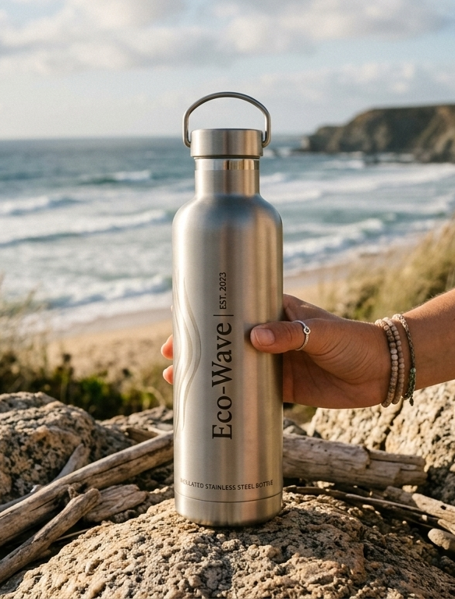
The Eco-Wave Story
We love the ocean, but we hated seeing it filled with plastic trash. So, we started Eco-Wave to fix it by making premium, reusable steel bottles out of clean, eco-friendly materials.
Great design meets a cleaner planet. Our insulated stainless-steel bottles keep your drinks ice-cold or piping hot all day, helping you cut down on plastic with every single sip

Slide 3
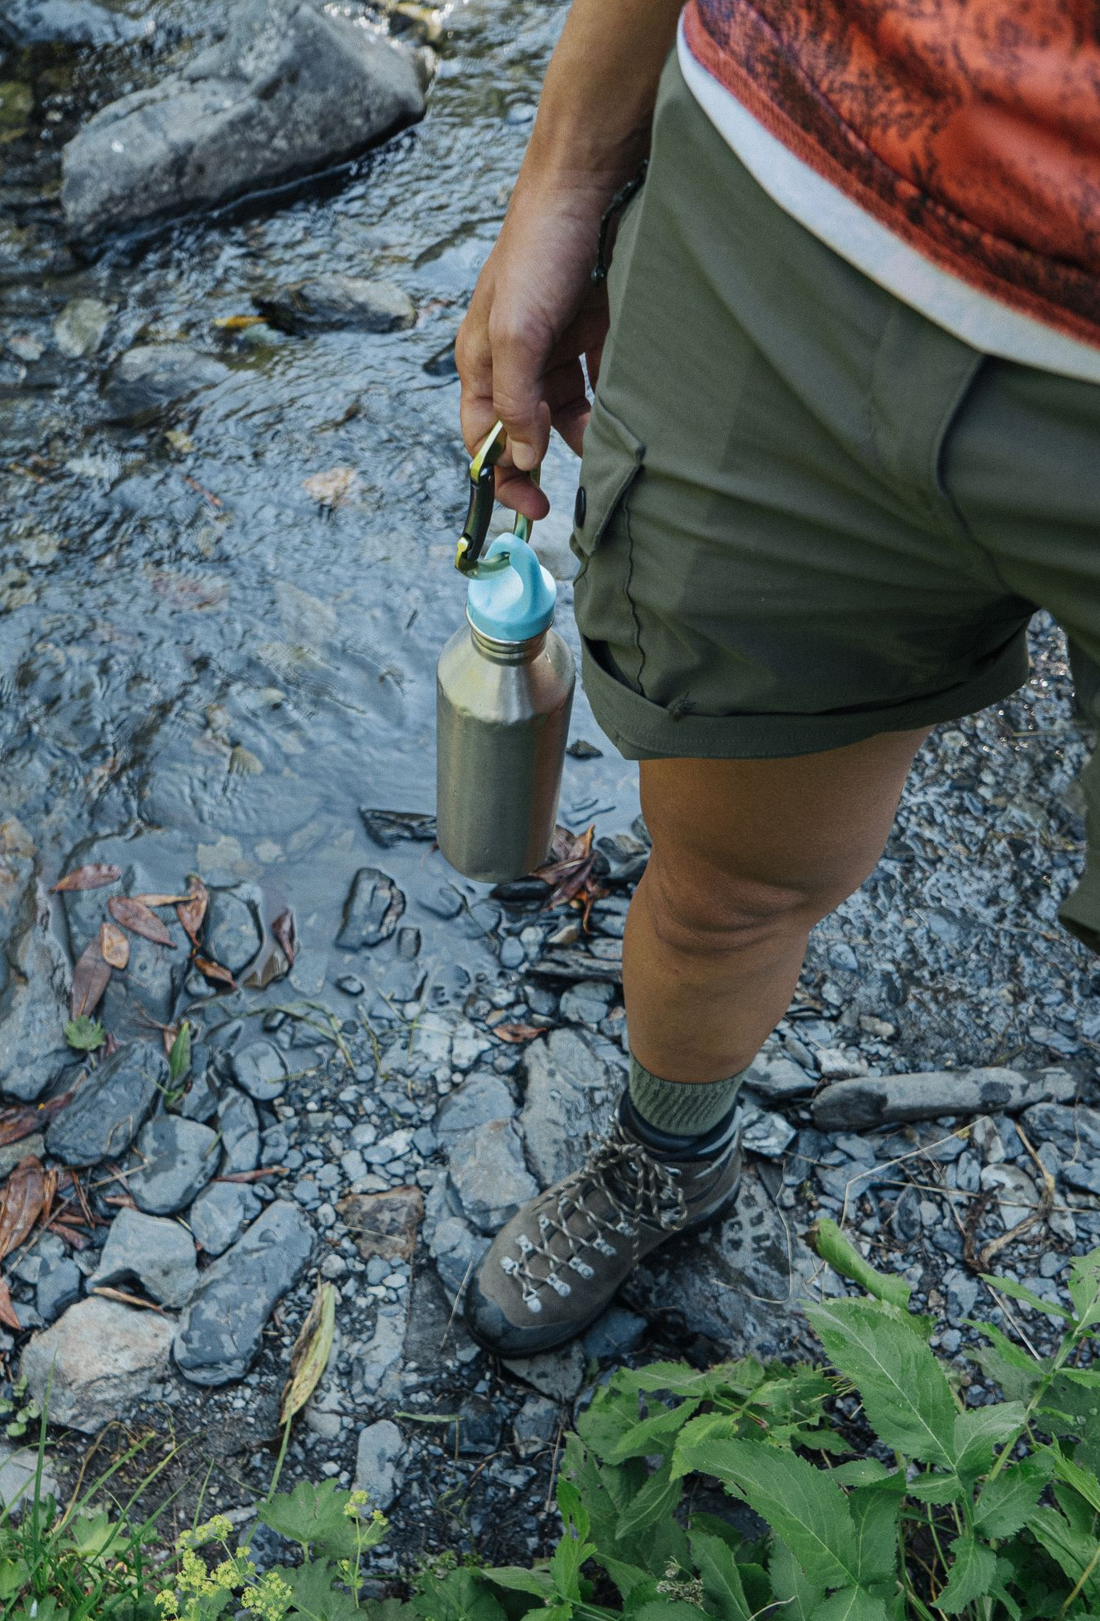
To protect the planet for future generations by providing high-quality, stylish stainless-steel bottles that reduce single-use plastics and make sustainable living easily by building a brand on amazon.
Objective

Slide 4
Key Values
Sustainability
Quality
Style
Prioritizing eco-friendly materials and practices
Offering durable and reliable products build to last
Designing bottles that are modern, functional, and attractive
Innovation
Responsibility
Accessibility
Continuously improving products for better user experience
Encouraging conscious choices that reduce environmental impact
Making eco-friendly living simple and available to everyone

Slide 5
Key Product Features
Eco-Friendly Material | Made from high-quality, sustainable stainless steel
Durable & Long Lasting | Built to last through daily use and outdoor trips
Temperature Control | Keeps your drinks hot or cold for hours
Reusable | Helps you stop using disposable plastic bottles
Design | Modern style that is perfect for the gym, travel, or everyday use
No Spills, Safe to Use | A tight lid that prevents leaks so you can drink safely
Easy to Carry | Lightweight and perfect for taking with you on outdoor activities or your daily commute

Slide 6
Tasks
Setup Amazon Seller Account & Create product listing
Apply Amazon algorithm knowledge
Implement SEO techniques
Set up Amazon PPC Ad campaign
Apply advance bidding strategies
Develop Review & customer engagement strategies
Analyse performance and make adjustments

Slide 7
Setup Amazon Seller Account & Product listing
Task 1
• Set up the Seller account on Amazon for Eco-Wave and created the product listing with detailed features, images, and optimized description.
Click to view the Steps to create product listing

Slide 8
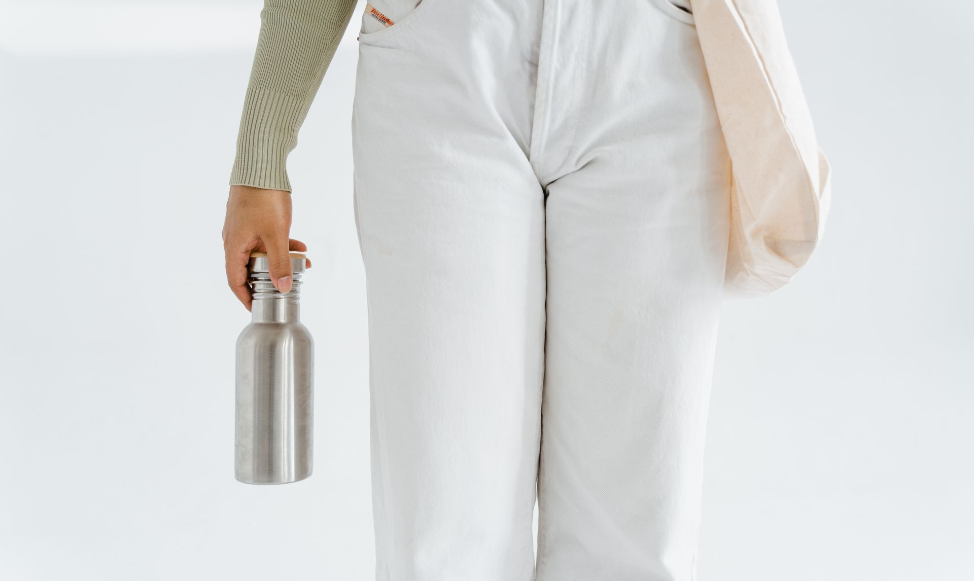
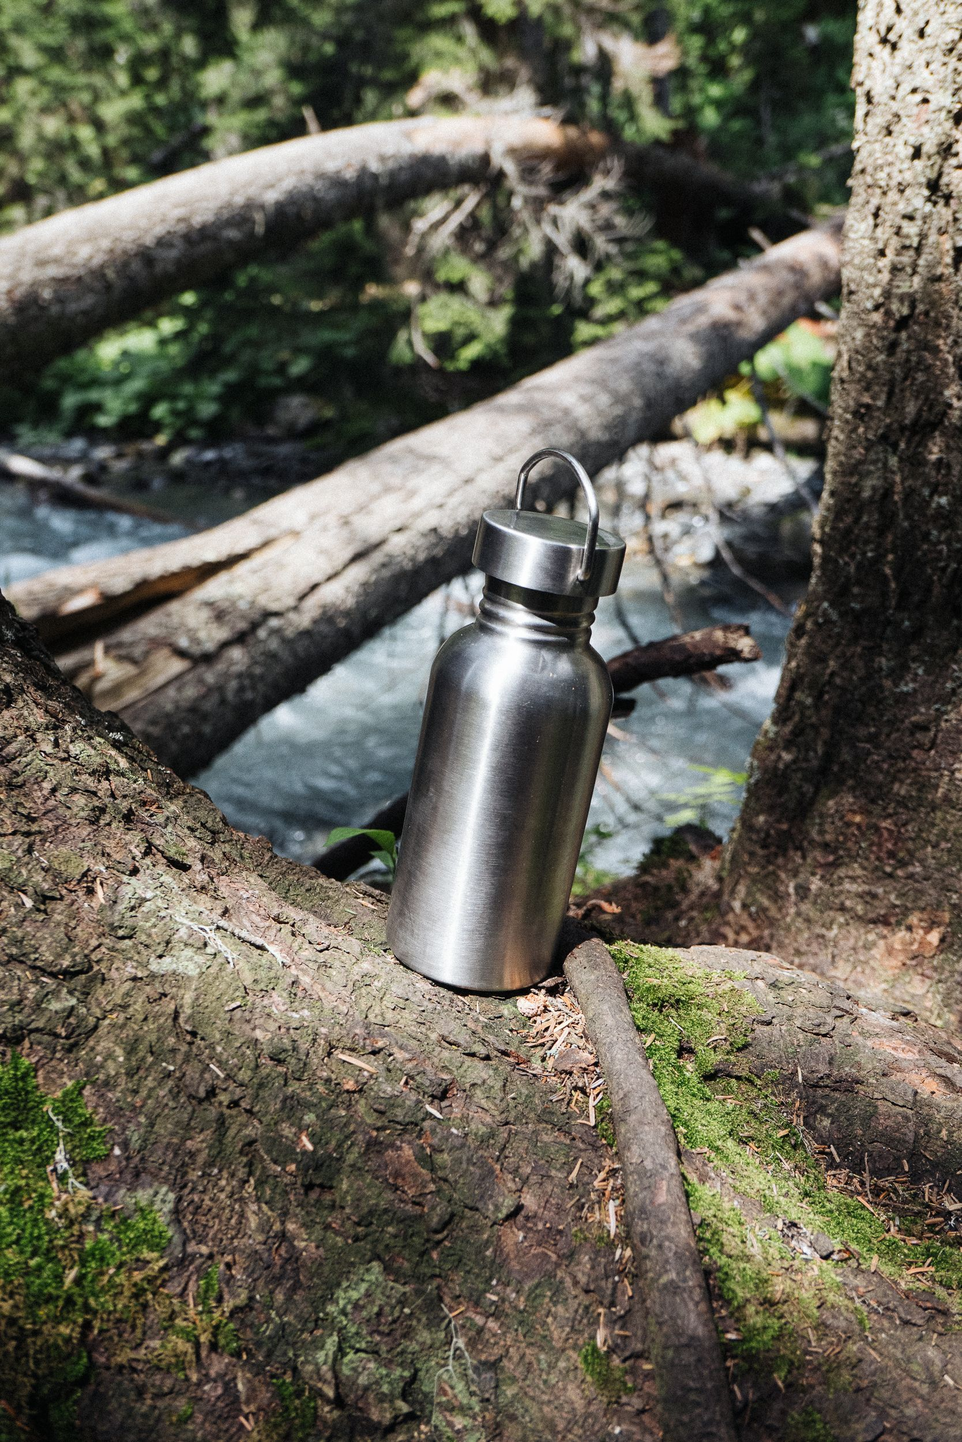
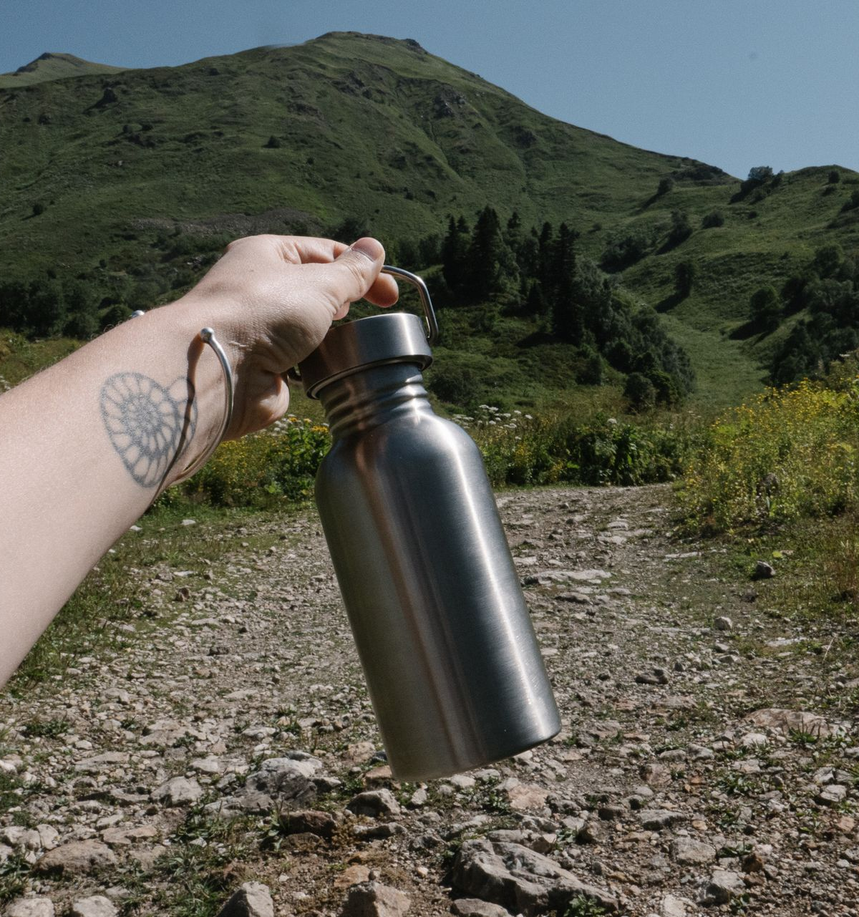

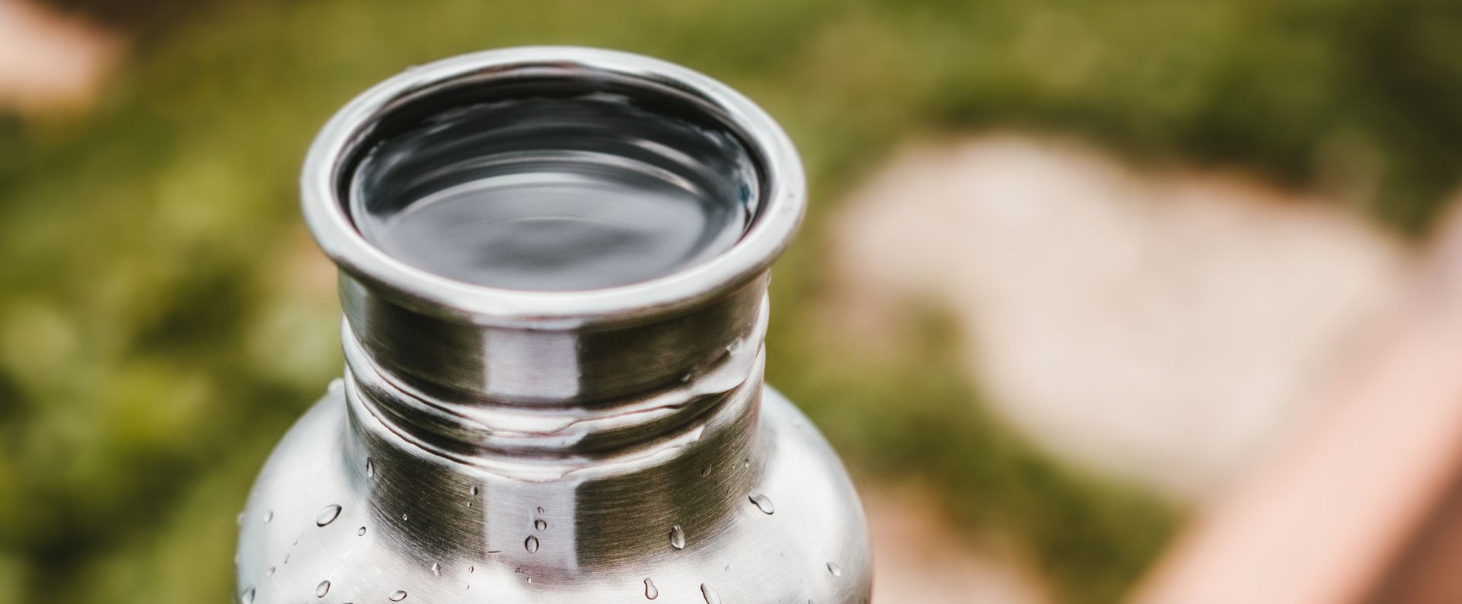
Amazon Algorithm Knowledge
Task 2
I understand how Amazon's system
(the A9/A10 algorithm) works to help the
Eco-Wave product listing get seen by
more people and get more sales.
Here is what I did

Slide 9
Algorithm Knowledge
Added popular keywords to the title, description, and search tags so the product shows up higher in search results
Keyword optimization
01
A catchy title and clear bullet points highlighting key features (like eco-friendly, durable, and stylish) to convince people to buy
Enhance Product Listing
02
Used high-quality images and graphics to get more clicks and keep buyers interested
03
Visual content

Slide 10
Algorithm Knowledge
Make plans to get more customer reviews and ratings. This helps build trust and improves how high the product shows up in searches
Customer Engagement
04
Created Sponsored Product to bring more shoppers to the page and speed up sales
Advertising & PPC
05
Chose smart prices and gave out discounts or coupons to get more people to buy and meet Amazon's goals
06
Competitive Pricing & Offers
Doing these things helps the Eco-Wave product pages look better in search results, bring in more buyers, and boost sales on Amazon.

Slide 11
Implement SEO techniques
Task 3
Keywords Optimization
Compelling Content
Added high-volume keywords (insulated stainless steel bottle, eco-friendly reusable bottle, leak-proof gym flask) in title, bullets, description, and backend
Created benefit-driven bullets & storytelling description with SEO keywords and customer reviews also helps with SEO
This makes eco-wave bottle more searchable, visible and conversion-friendly

Slide 12
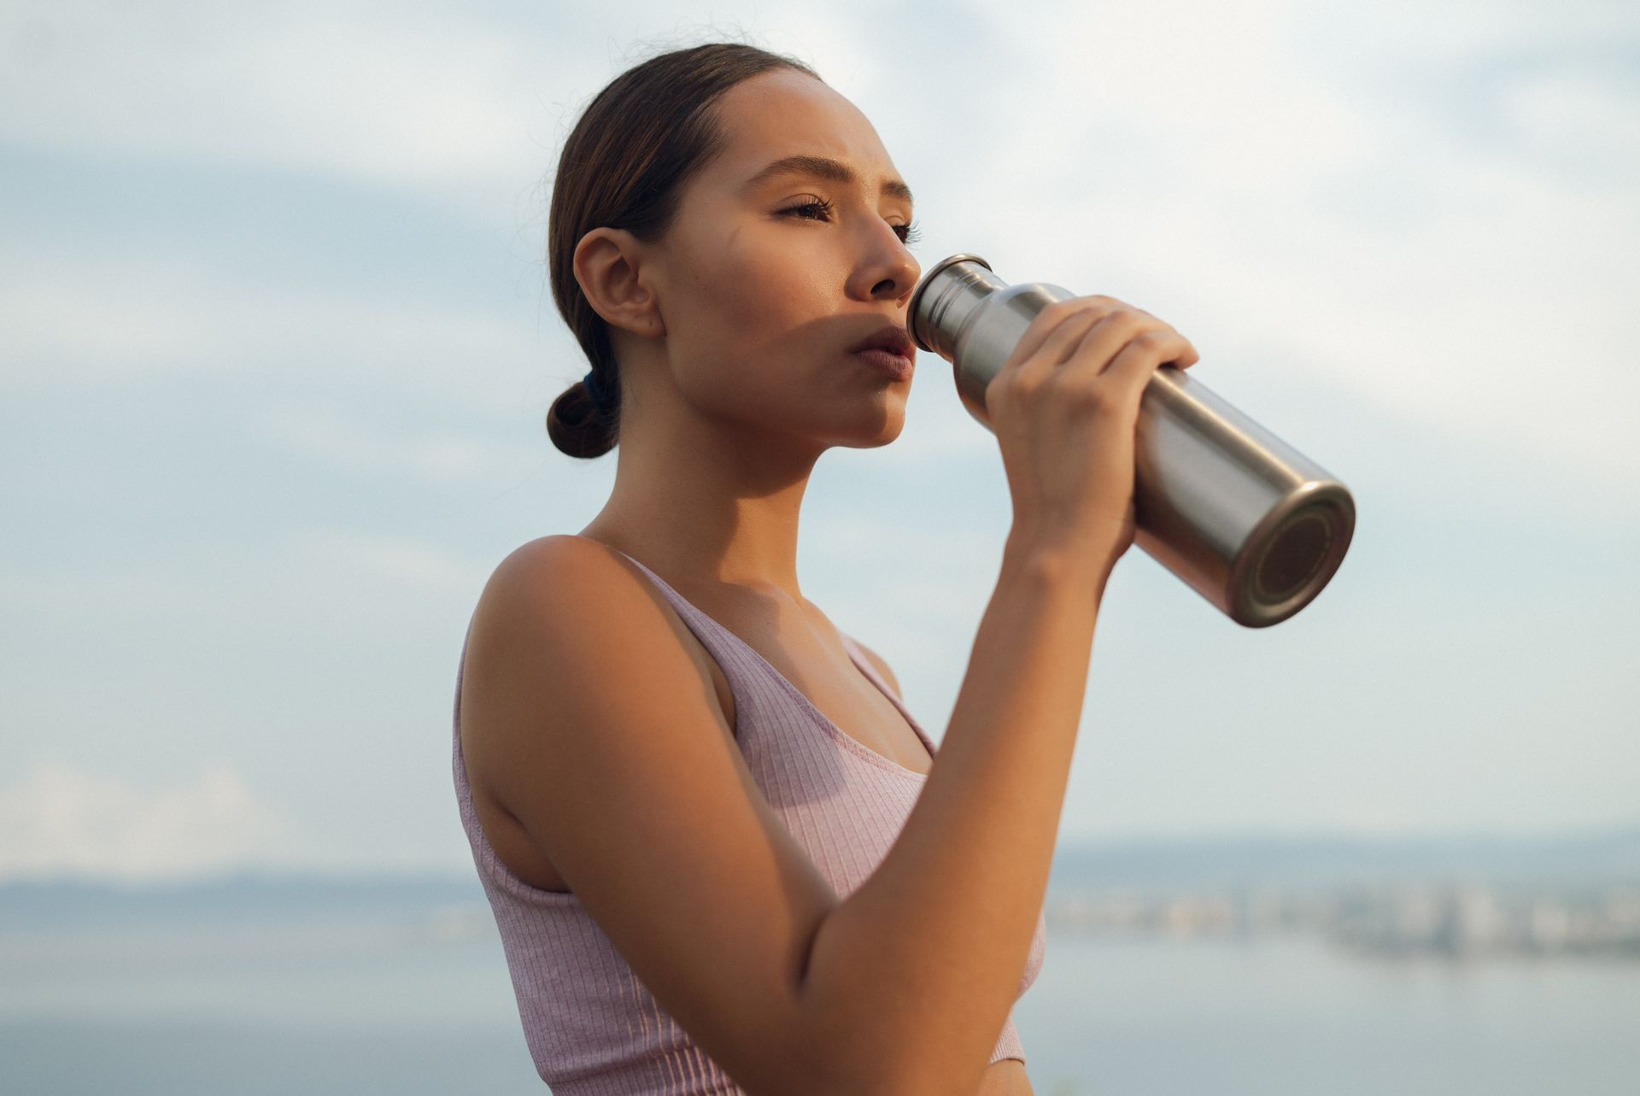
PPC Ads
Click to view the amazon PPC Ad Campaign set up
Setup amazon ad campaign
Task 4

Slide 13
Bidding Strategies
Dynamic bidding
Task 5
This setting allows Amazon to automatically raise your ad bids when a shopper is highly likely to buy your product. This happens during busy shopping periods like mornings, travel seasons etc.
Placement Bidding
Top of the First Page: The bid is increased by 50% to secure spots at the very top of search results. This is the best way to make the product visible and get more sales.
Product page: The bid is increased by 20% to show ads directly on other product pages. This is a great way to target shoppers who are already looking at rival brands

Slide 14
Bidding Strategies
Keyword Match Strategy
Exact Match: High bids for your top converting keywords (insulated stainless steel water bottle, eco-friendly bottle).
Phrase Match: Medium bids for related searches (reusable gym bottle, travel flask). Broad Match: Lower bids to discover new keyword opportunities.
Negative Keywords
Add irrelevant terms (e.g., plastic bottle, kids' sipper) to avoid wasted spend.
Bid on misspelled & Variant Keywords
Include common misspellings and keyword variations to capture overlooked traffic.

Slide 15
Review & Customer Engagement Strategies
Task 6
Reviews
Add thank-you insert cards with a gentle review request
Send polite follow-up messages via Amazon's system
Use "Request a Review" button regularly
Use Amazon Vine for early authentic reviews.
Customer Engagement
Run social media campaigns (#MyEcoWave)
Share eco-friendly tips & bottle care content
Quickly respond to Amazon Q&A & reviews
Offer bundles/discounts for repeat buyers
This keeps Eco-Wave customers engaged, loyal, and more likely to leave positive reviews

Slide 16
Analyze performance & make adjustments
Task 7
1. Keywords & SEO
2. Sales & Conversions
Result: Main keyword “Insulated stainless steel bottle” moved from page 5 to page 2. CTR improved 1.5% to 3.8%.
Adjustment: Add more long-tail keywords (eco-friendly gym bottle, leak-proof travel flask) + optimize backend search terms.
Result: Sales grew 300 to 500 units/month. Conversion rate steady at 12%.
Adjustment: Improve product images & add infographic (Hot/Cold 24 hrs.). Launch bundle offer (Set of 2 bottles) to raise conversion to 15–18%.

Slide 17
Analyze performance & make adjustments
3. Ad Campaigns
Result:
Sponsored Products to ACoS 42% (too high, reducing profitability).
Sponsored Brands to ACoS 22% (healthy, driving awareness).
Sponsored Display to ACoS 28% (moderate, good for retargeting).
Adjustment:
Lower bids on low-performing keywords in Sponsored Products.
Shift 30% budget to Sponsored Brands (stronger ROI).
Add negative keywords (e.g., "plastic bottle") to reduce wasted spend.

Slide 18
Analyze performance & make adjustments
4. Reviews & Engagement
5. Customer Retention
Result: Reviews jumped 20 to 75,
avg rating 4.3 stars. Positive on style, but 15% noted
cap tightness issue.
Adjustment: Highlight “Improved Leak-Proof Cap” in listing. Use follow-up emails + packaging insert to request reviews from happy buyers.
Result: Repeat purchase rate 15%, mainly gym & outdoor users.
Adjustment: Launch seasonal promo (Eco-Wave Summer Hydration), retarget past buyers with Sponsored Display + 10% off coupon.

Slide 19
Overall Impact
ACoS reduced from 42% to 28% average by reallocating budget & optimizing bids.
Sales increased by 66% (300 to 500 units).
Visibility & CTR has increased.
Reviews & trust improved, leading to stronger long-term ranking.

Slide 20
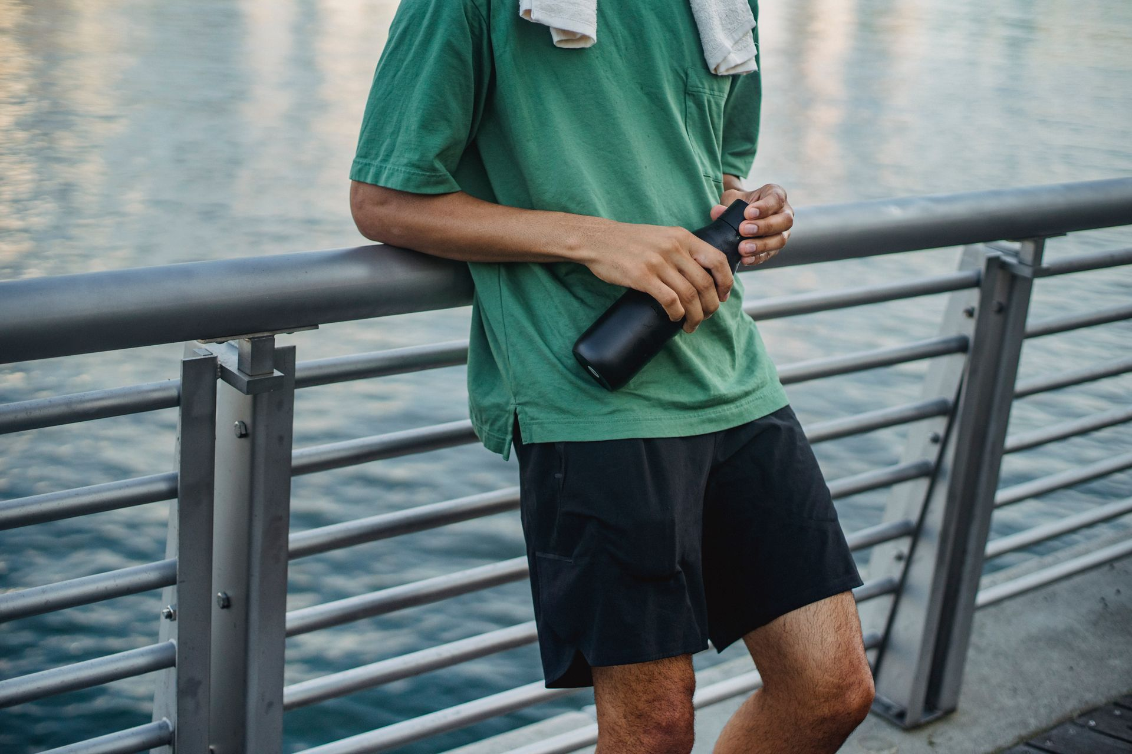
THANK YOU
BY NILESH .S

