Slide 1
Course 1 project Presentation by – Nilesh guided by– chhavi patel

Slide 2
search engine optimization
Website link : https://nileshumeshsharma.niitlearning.in/
Focused Keyword - Anniversary Cake
Title – Anniversary Cakes| Handcrafted Vegan Cakes for Your Special Day
Slug - home
Meta description - Visit Our Local Bakery to Get Custom Anniversary Cakes. Fresh Components, Elegant Designs, and Same Day Delivery. Love at First Slice!

Slide 3
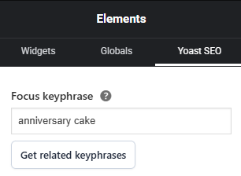
Applied the focused keyword Using Yoast SEO

Slide 4
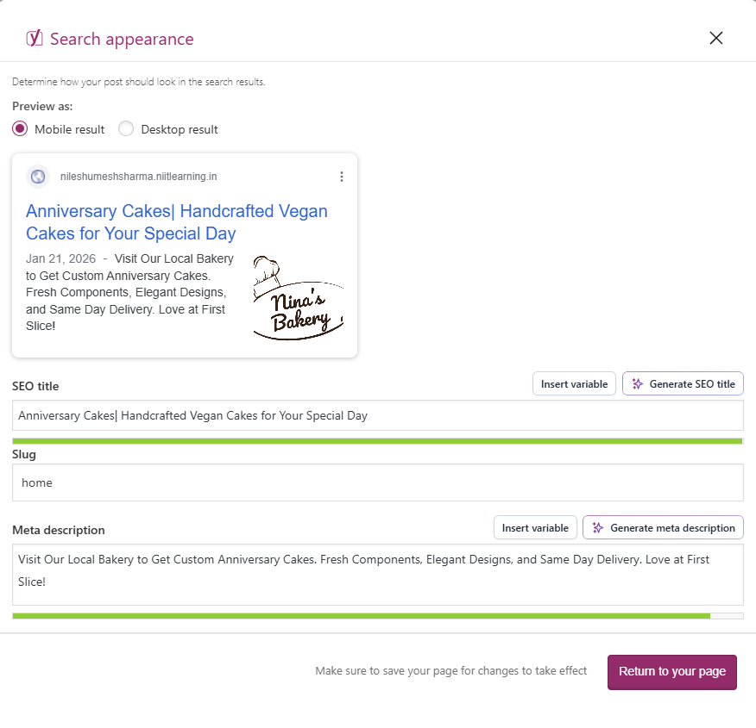
applied title, sLUG and meta description
Using Yoast SEO

Slide 5
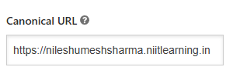
Canonical url Pasted the URL In The Canonical URL Section Under Advance Section

Slide 6
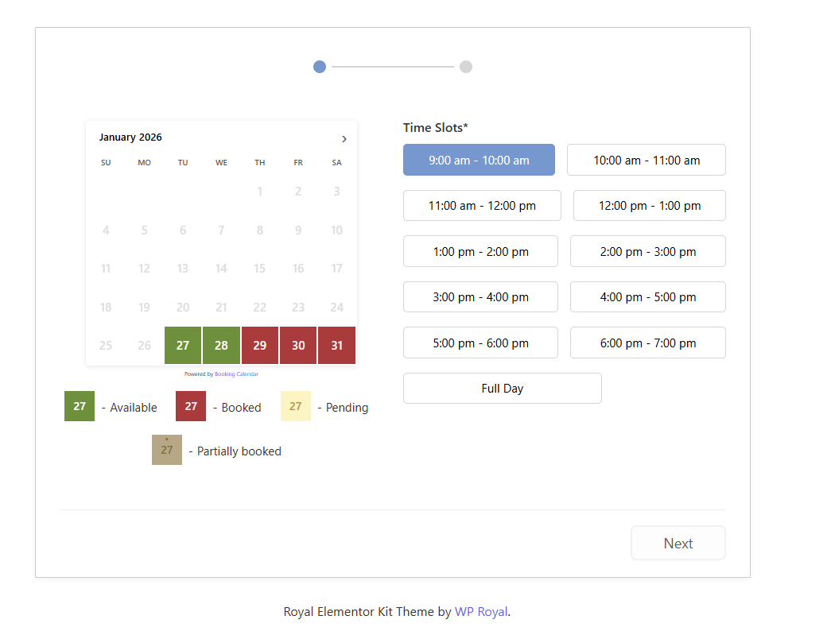
Booking calendar Link: https://nileshumeshsharma.niitlearning.in/wp-booking-calendar/

Slide 7
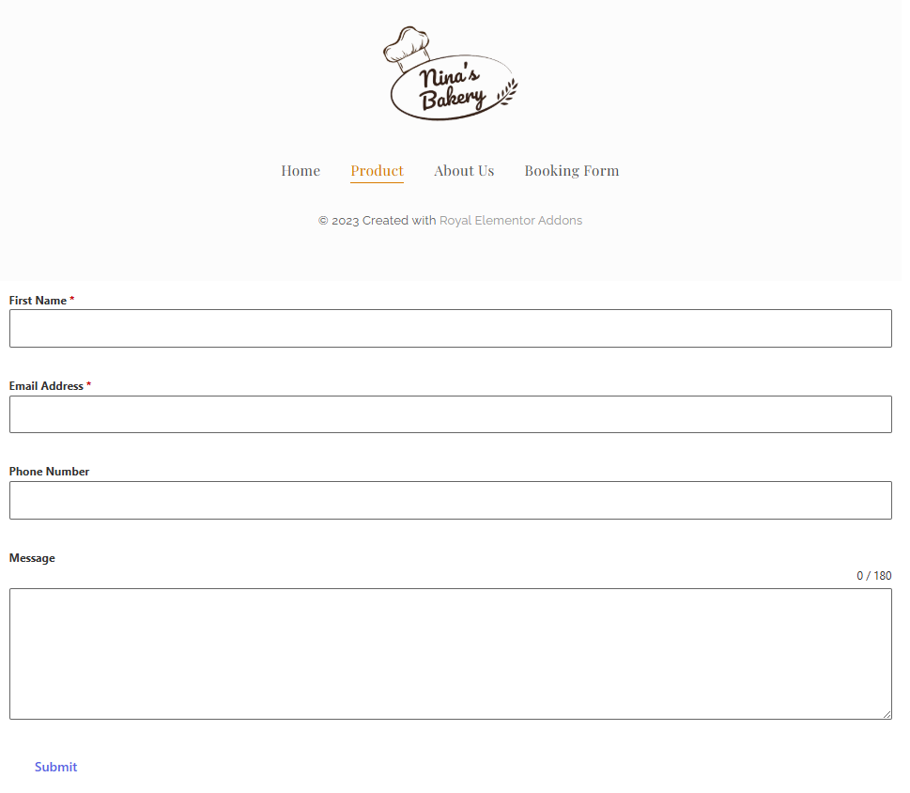
Booking Form Form link: https://nileshumeshsharma.niitlearning.in/product/

Slide 8
Thank you
By Nilesh

