Slide 1





Google Analytics Implementation and Reporting
Course 3_Sprint 7_Project
Guided by Chhavi Ma’am

Slide 2


Context Setting
Intro
Home
Reports
Explore
Advertising
Learnings
Introduction to Google Analytics 4 - Account Setup and Data Configuration
Dashboard Overview
Key Metrics & Terminologies
Lifecycle Reports, Comparison Analysis & Customized report
Explore Page Visualization
Advertising and Attributions
My Learnings and Actions

Slide 3
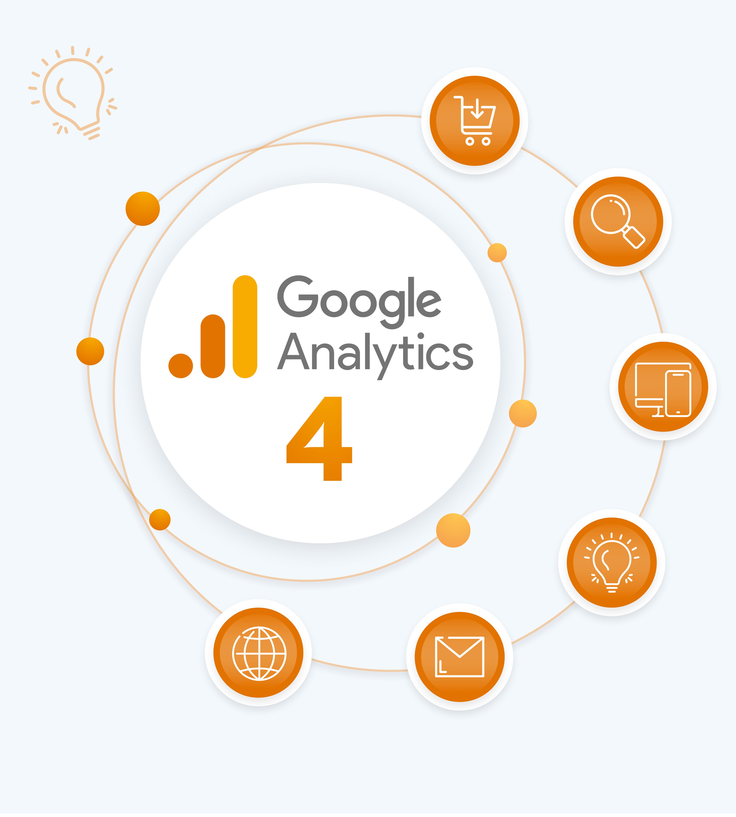

What is GA4 ?
Intro
Home
Reports
Explore
Advertising
Learnings
GA4 is the latest version of google analytics designed for modern Websites and Apps
Tracking: It’s ideal for tracking the entire customer journey and users actions as events, giving more detailed understanding of user behavior
Platforms: It works across both web & mobile, combining data into one view.
Privacy: It supports better privacy, Fewer cookies and smarter machine learning insights

Slide 4
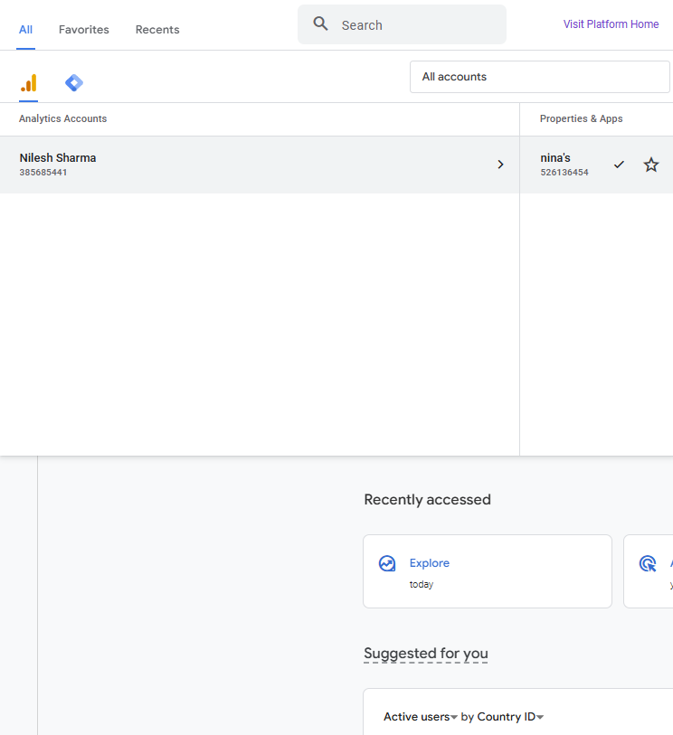
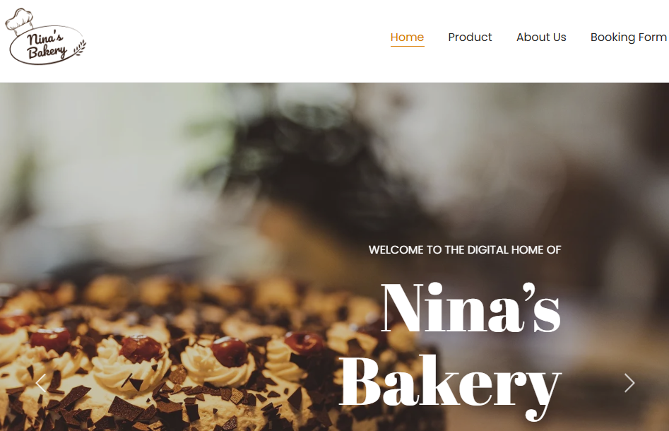
Account Setup & Data Configurations
Intro
Home
Reports
Explore
Advertising
Learnings
We created a GA4 account, added a property and then created data streams for my website called
“Nina’s Bakery”.

Slide 5
Intro
Home
Reports
Explore
Advertising
Learnings
Property & Data Streams Roles
Property
Data Streams
A property is the specific container that houses your data and reports. You can track – events, conversions, audiences and settings are stored inside this property limited to 50 data streams per property (max 30 app streams)
A data stream is the actual source from where GA4 receives information it could be from your app or website, Each stream sends user actions like clicks, page views, device details and sessions into the property all your data flows into one place

Slide 6

Home
Intro
Home
Reports
Explore
Advertising
Learnings
Dashboard Overview
4 Key Sections:
Overview of users, sessions, engagement and real-time activity
Reports
Insights on acquisition, engagement, monetization and retention
Explore
Custom reports and advanced data analysis
Advertising
Tracks Google ads performance and attribution models

Slide 7
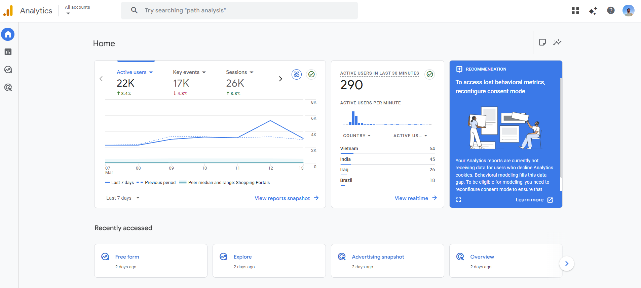
GA4 Dashboard Overview

Slide 8
Key Metrics & Terminologies
Intro
Home
Reports
Explore
Advertising
Learnings
Metric | Description
Sessions | The number of times users engage with your site (1 session = engagement time > 10 sec and <= 30min)
Engagement Rate | Where users actively interact for at least 10 seconds or trigger key events.
Avg Engagement Time | The average time users spend actively engaging with your content
Event Count | The total number of tracked interactions such as clicks, video plays or form submissions.
Conversions | The number of times users complete important actions like purchases or sign-ups
Bounce Rate | Where users leaves within <10sec

Slide 9
Data Recording
Intro
Home
Reports
Explore
Advertising
Learnings
Event-Based Tracking
Automatic Data Collection
GA4 tracks every user interaction like clicks, scrolls and views as individual events for deeper understanding
GA4 automatically records basic interactions such as page views, scrolls and outbound clicks without extra setup
Custom Event Tracking
Real-Time Data Processing
You can create your own events to track specific actions that matter to your business, like form submissions or button clicks
GA4 Shows live user activity instantly, helping you monitor traffic, behavior and events as they happen

Slide 10
Lifecycle Reports
Intro
Home
Reports
Explore
Advertising
Learnings
It shows how users interact from the moment they arrive until they convert
This includes:
Acquisition : Shows how users discovered your website or app through ads, search, social or direct visits.
Engagement: Highlights what users do after they arrive such as clicks, views and time spent on the content.
Monetization: Display how your platform earns revenue through purchases, ads or subscriptions.
Retention: measures how often users come back and how well you keep them engaged over time

Slide 11
Acquisition
Intro
Home
Reports
Explore
Advertising
Learnings
User Acquisition
Traffic Acquisition
Shows where new users are coming from and which channels attract first time visitors
Reveals how all sessions start, helping you understand the overall flow of visits from every channel
Performance Analysis
Optimization Insights
Helps you evaluate which sources, campaigns or channels are performing best based on key metrics
Provides actionable ideas to improve traffic boost engagement and strengthen marketing results

Slide 12
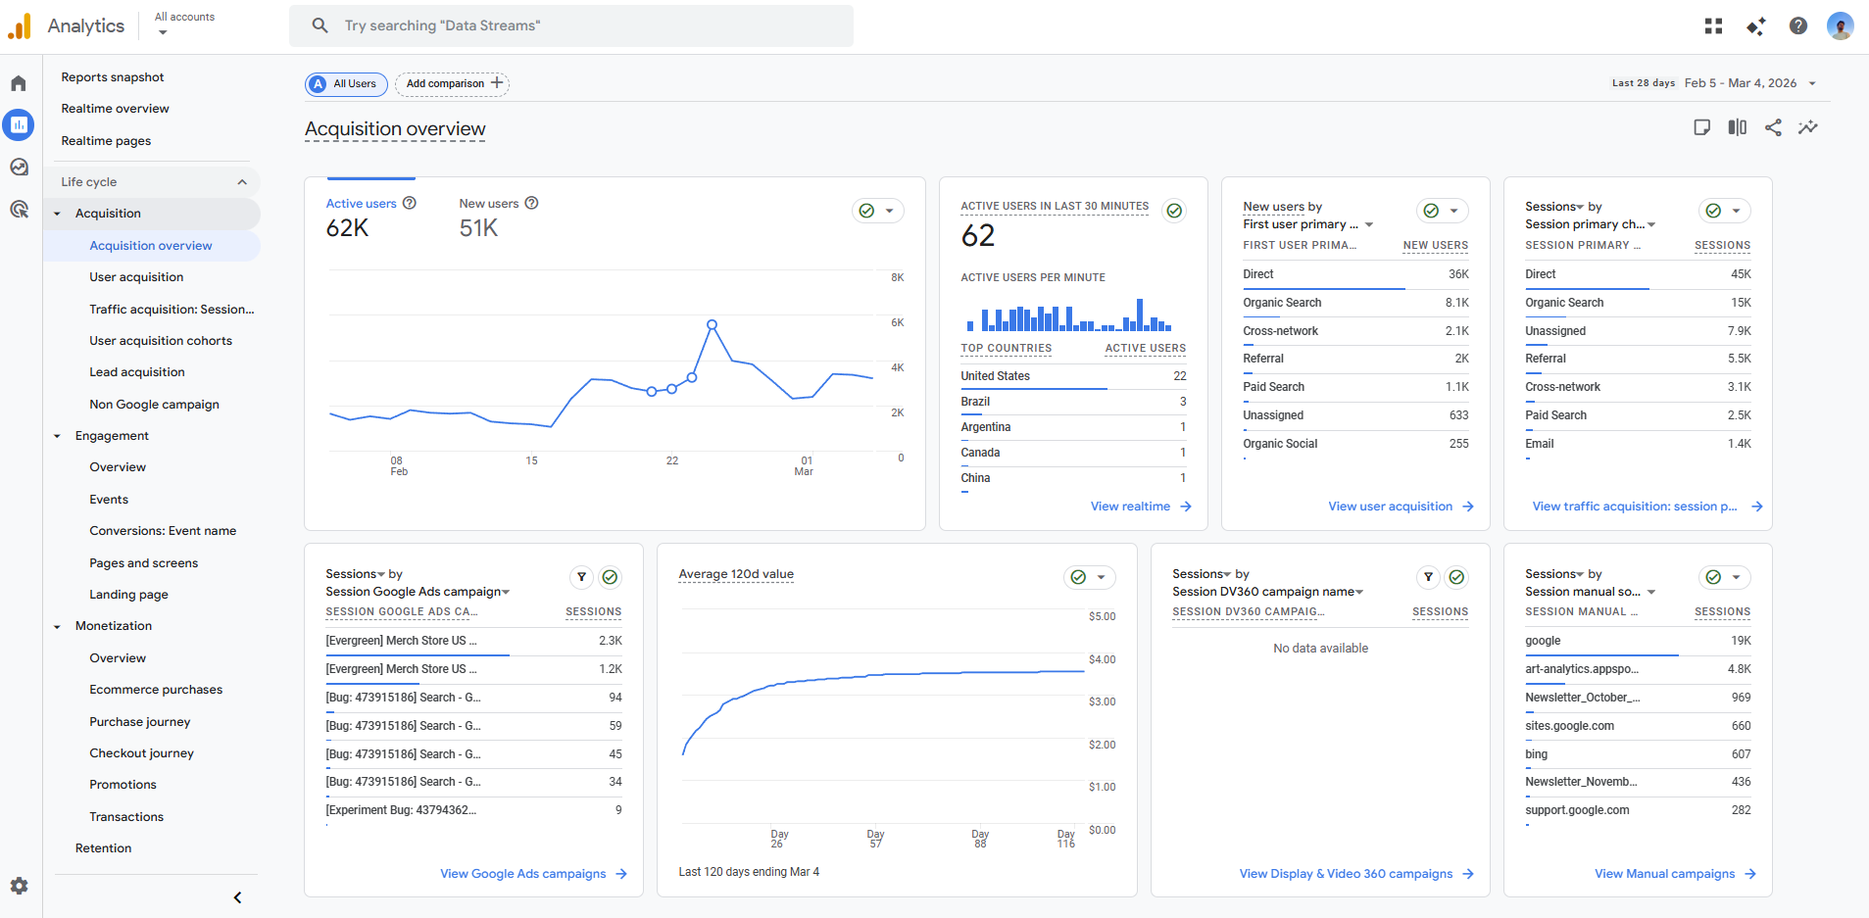
Acquisition Overview

Slide 13
Engagement
Intro
Home
Reports
Explore
Advertising
Learnings
Overview of User Interactions
Pages and Screens
Shows how users behave on the site or app including actions, patterns and engagement levels
Displays which pages or screens users visit most and how they navigate through your content
Event Tracking
Conversion Analysis
Captures specific user actions like clicks, scrolls, video plays or downloads for deeper insight
Helps to understand how users complete key goals such as sign-ups, purchases or form submissions

Slide 14
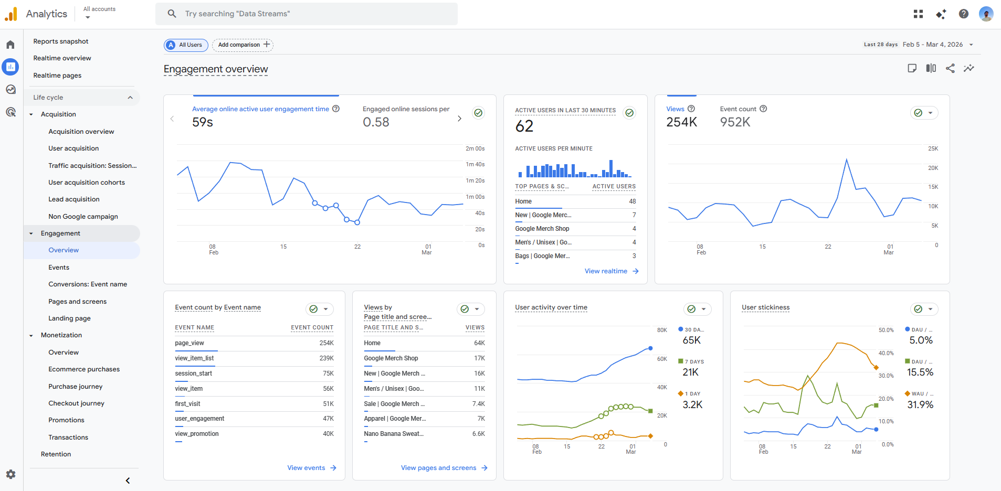
Engagement Overview

Slide 15
Monetization
Intro
Home
Reports
Explore
Advertising
Learnings
Revenue Tracking
E-commerce Purchase
Total income from the website or app generates from different user actions
Tracks online product sales, order value and purchase behaviour on the website
In-App Purchase
Ad Revenue
Measures revenue from items or features users buy inside mobile app
Display earnings generated from ads shown on the site or app

Slide 16
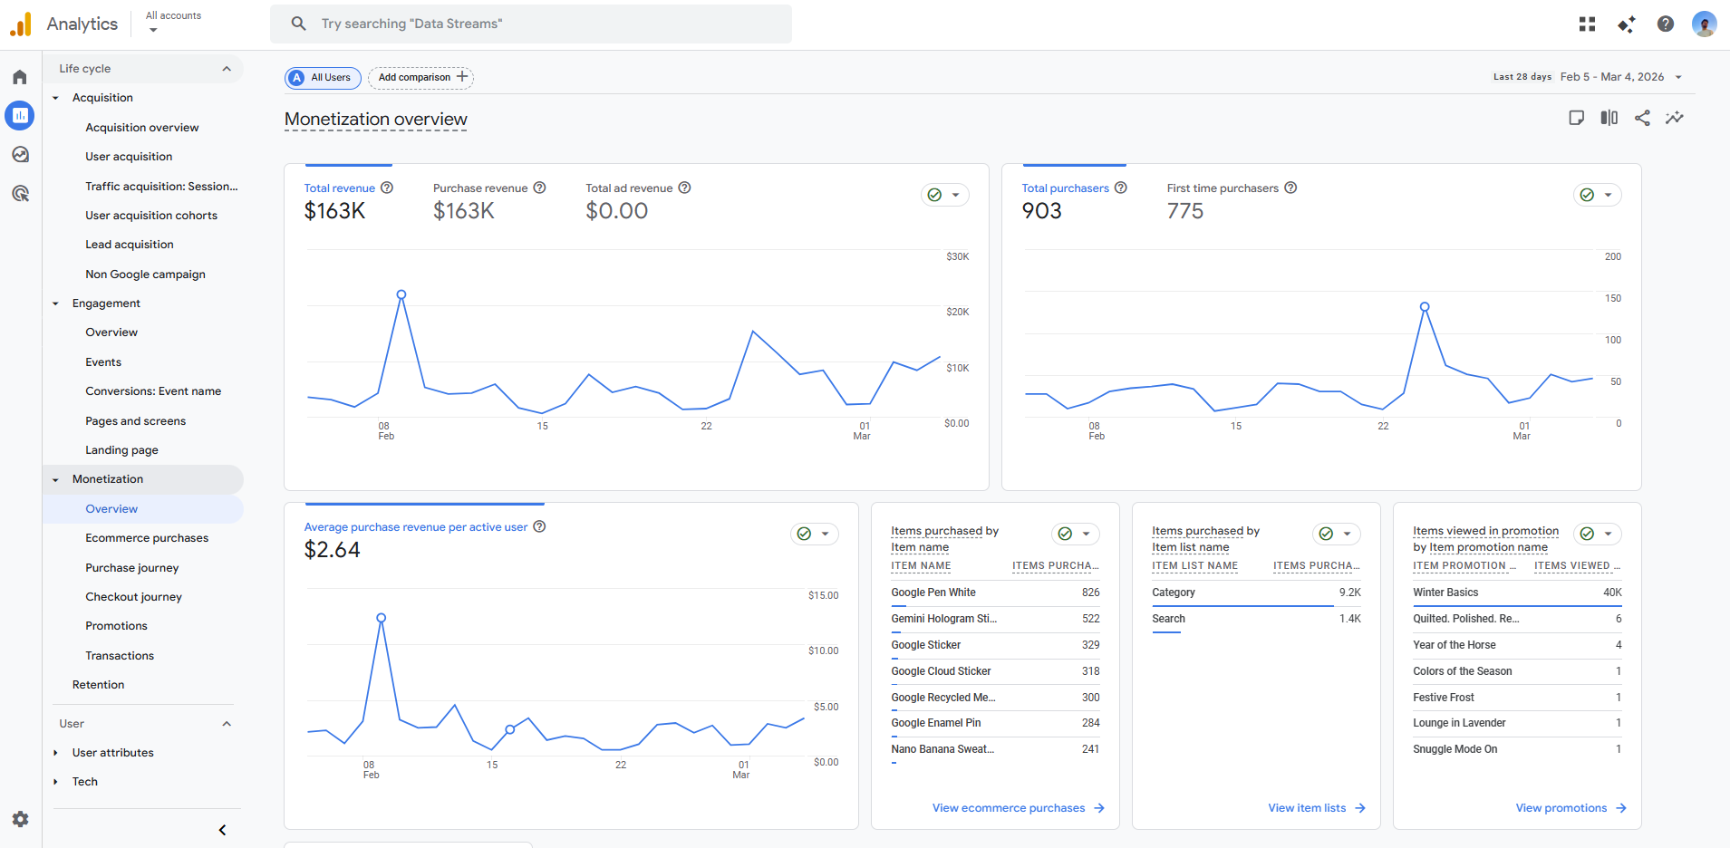
Monetization Overview

Slide 17
Retention
Intro
Home
Reports
Explore
Advertising
Learnings
User retention Analysis
New vs Returning Users
How well we keep our users those they come back after their first visit
Compares first-time visitors with users who come back again
Engagement Trends
Churn Rate Insights
Highlight user activities changes over time based on interactions
Identifies how many users stop returning and where drop offs may happen

Slide 18
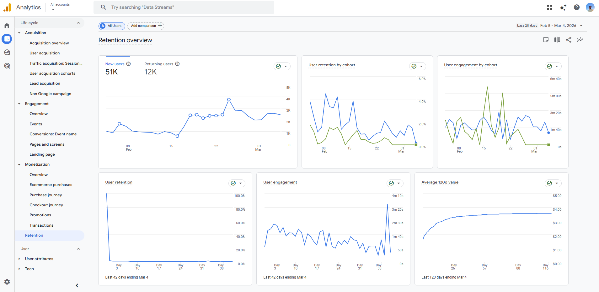
Retention Overview

Slide 19
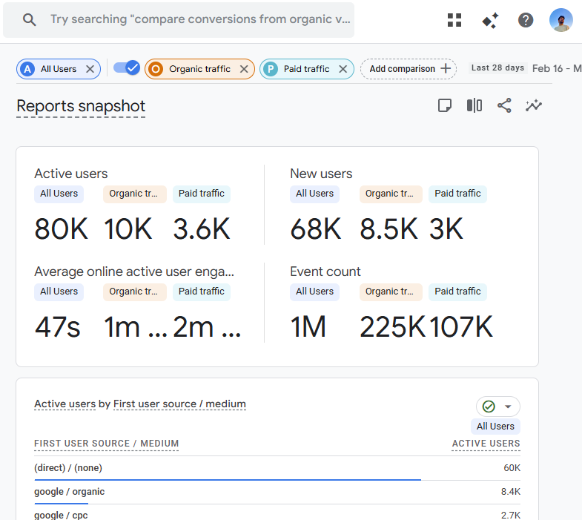
Intro
Home
Reports
Explore
Advertising
Learnings
Comparative Analysis
Before vs After Performance: Compares metrics over time periods to show what improved or declined
Traffic Source Effectiveness: Reveals which channels bring the highest quality traffic and best results
User Behavior Changes: How user actions shift over time due to new content, campaigns or updates
Data-Driven Decision Making: Helps you make smarter choices by using insights instead of assumptions

Slide 20
Customized Reports
Create reports focused on specific business goals.
Intro
Home
Reports
Explore
Advertising
Learnings
Tailor-made insights
Flexible metrics & dimensions
Deeper analysis
Choosing exactly what we want to analyze events, users, revenue etc.
Helps uncover patterns that standard reports may not show.
Decision making
Easy sharing
Provides insights unique to the website/app
Export or share custom reports with your team

Slide 21
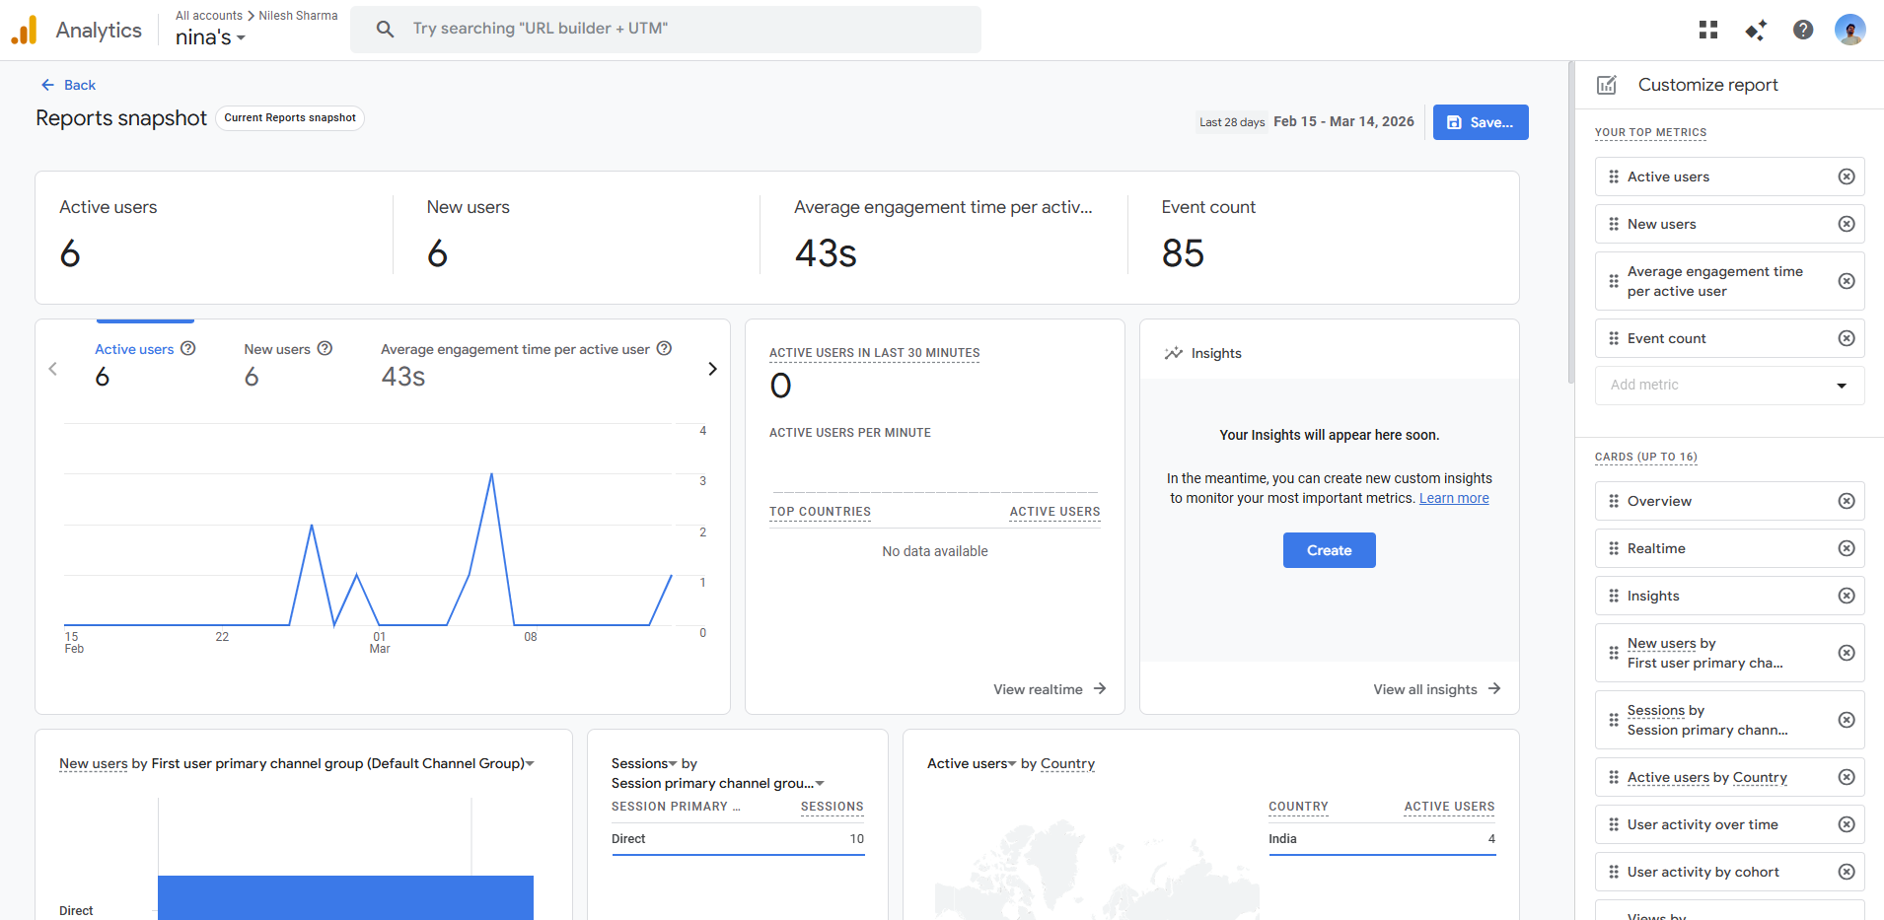
Customized Reports

Slide 22
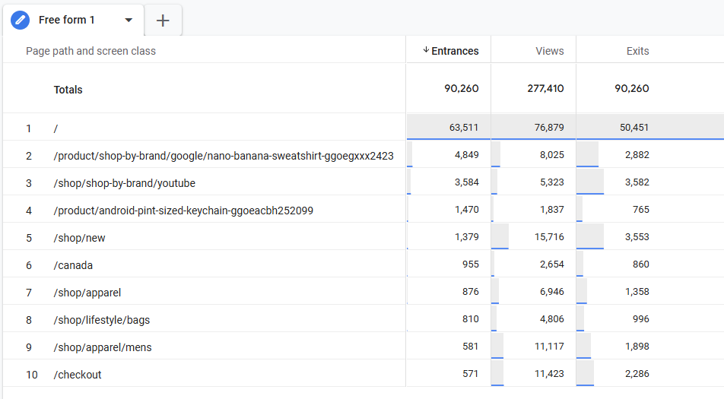
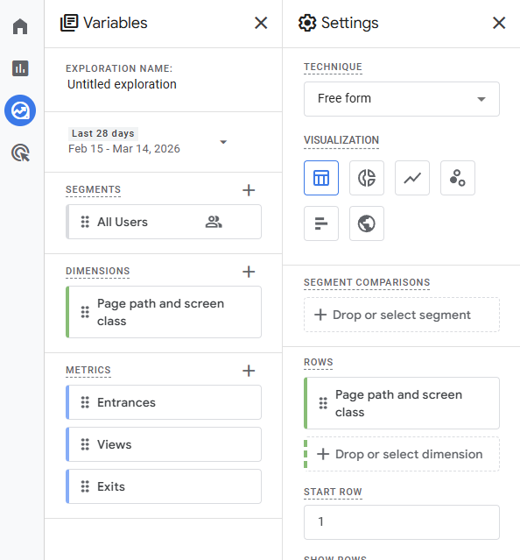
Explore Overview
Intro
Home
Reports
Explore
Advertising
Learnings
Explore page is the workspace for advanced data discovery. While standard reports provide high-level summaries, Explorations allow raw data to answer specific business questions through visuals.

Slide 23
Intro
Home
Reports
Explore
Advertising
Learnings
Key Exploration Techniques
What the Explore Page Does:
Goes beyond standard reports: Accesses raw event and user-level data that isn't available in the basic reporting tabs.
Non-standard queries: Allows you to quickly create custom reports to answer "one-off" questions.
Drag-and-drop interface: easily move dimensions, metrics, and segments onto a canvas to build visualizations.
Offers deep-dive techniques: Provides specific analytical "lenses" (like funnels or paths) to see exactly how users behave.

Slide 24
Advertising
Intro
Home
Reports
Explore
Advertising
Learnings
Google Ad Performance
Attribution Models
Shows how your google ads are driving traffic, clicks, conversions and revenue.
Explain how credit for a conversion is assigned across different user touchpoints
Campaign Effectiveness
Conversion Path
Measures how well your marketing campaigns achieve goals like traffic, leads or sales
Displays the sequence of user interactions that lead to a final conversion

Slide 25
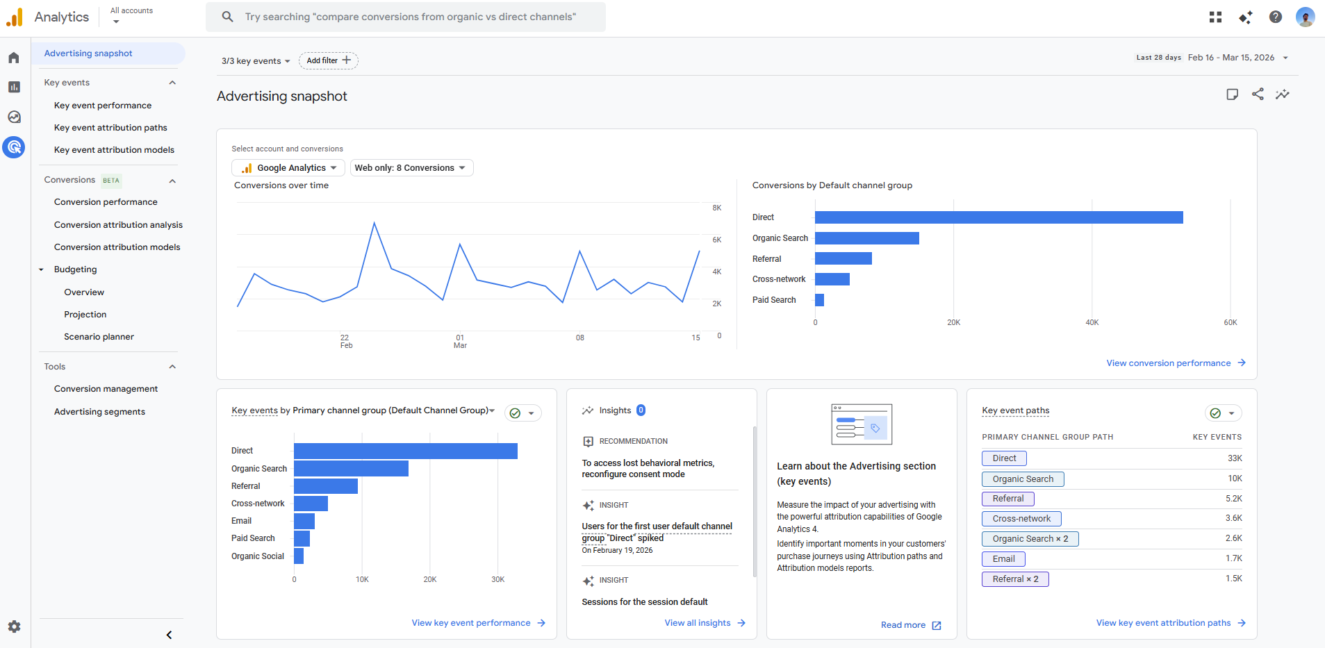
Advertising Overview

Slide 26
Attribution Paths
Intro
Home
Reports
Explore
Advertising
Learnings
Track User Conversion Journeys
Identify Key Touchpoints
Optimize Marketing Spend
Steps users take from first interaction to final conversion.
Highlights the most impactful moments that influence user decisions.
Helps you invest more in high performing channels and reduce waste on low performing ones

Slide 27
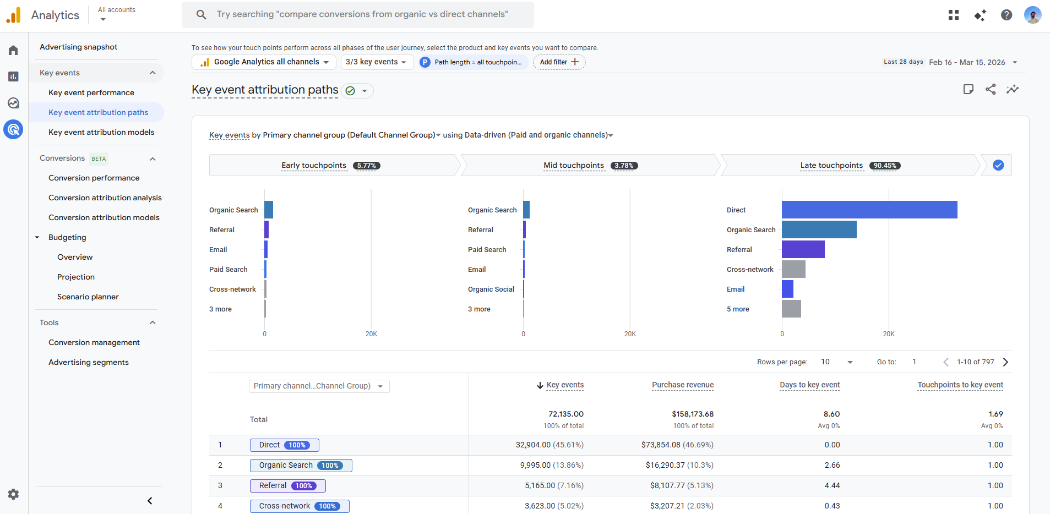
Attribution Path

Slide 28
Early Touchpoints
Intro
Home
Reports
Explore
Advertising
Learnings
Touch Points
Touchpoints are all the interactions a user has with you brand before completing a conversion
The very first interaction a user has with the brand (e.g. Google search click)
Mid Touchpoints
Interactions happening during their evaluation journey (e.g. Browsing pages, watching videos)
Late Touchpoints
The final interaction before a user converts (e.g. Final ad click or CTA click)

Slide 29
Attribution Models
Intro
Home
Reports
Explore
Advertising
Learnings
Attribution Models | Description
Last click | Gives full credit to the last touchpoint before conversion
First click | Assigns all credit to the first interaction in the user journey
Linear | Distributes credit equally across all touchpoints
Time Decay | Gives more credit to touchpoints closer to conversion
Position-Based | Assigns 40% credit to first and last touchpoints, with 20% distribution among mid touchpoints
Data Driven | Use machine learning to assign credit based on actual impact

Slide 30
Attribution Models
Intro
Home
Reports
Explore
Advertising
Learnings
Attribution models help identify which user interactions (touchpoints) contributed to a conversion.
They show how credit is assigned across different steps in the user journey.
Useful for understanding which channels, ads or campaigns truly drive results.
Helps marketers make smarter decisions and optimize budget based on real impact.

Slide 31
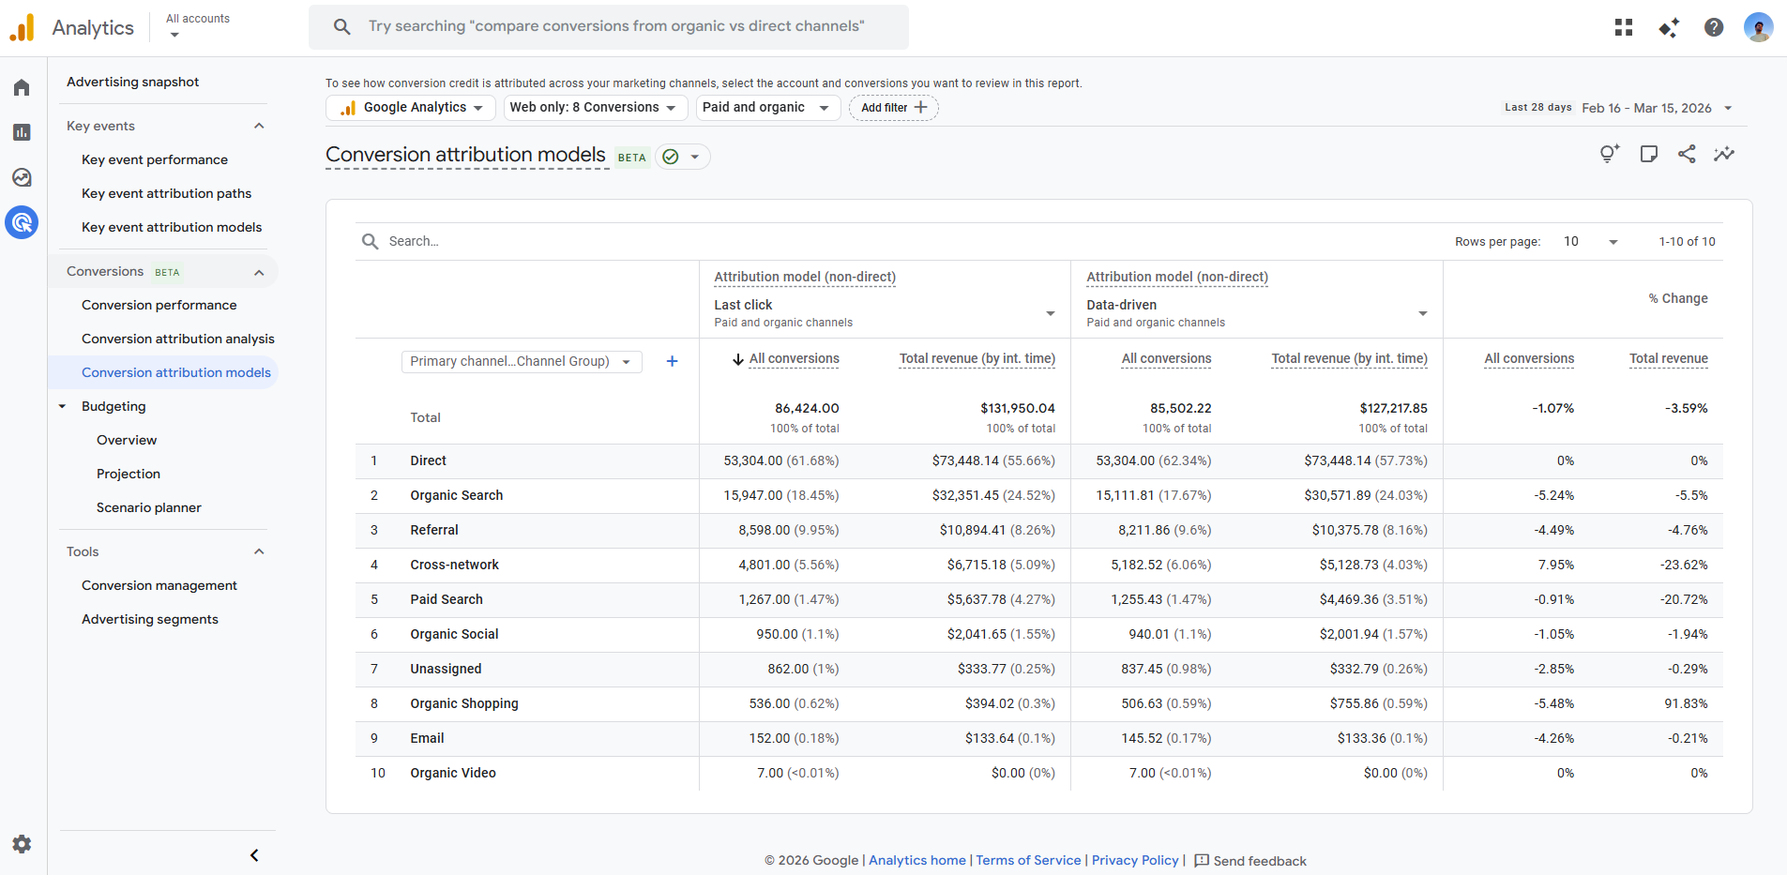
Attribution Models

Slide 32

My learnings
Intro
Home
Reports
Explore
Advertising
Learnings
Presenting my understanding on the GA4 as a tool:
Data as a new fuel: GA4 provides actionable insights for data driven decision making from user engagement to conversion
Behavioral Insights: Understanding user behavior analyzing reports helps track user journeys, rentention and key interaction points
Visual Summary: Custom reports enhances data visualization helps with strategic planning and standard summaries of acquisition, engagement, and monetization
Logical strategies: Attribution models and paths analysis improve campaign effectiveness and helps to make less assumptions

Slide 33
My Actions
Intro
Home
Reports
Explore
Advertising
Learnings
Refine Strategies
Monitor Growth
GA4 can help us to optimize ad spend, SEO for website with detailed page wise insights as well as user engagement session wise
With reports we can do comparative analysis with past and present reports and customize according to business needs
Platform Improvements
In-Depth Analysis
GA4 shows data regarding the platform and devices people use to interact with our brand so it can tell if we really need an app or not
Can download the data and collaborate with data scientist for more in depth knowledge of data to create visualizations for presentation

Slide 34
Thank you
Presentation by
Nilesh

