Slide 1


[2]
[1]
Stack overflow
tag prediction
CS-725 Project work
Shivam Dixit - 193050012
Nilesh Tanwar - 203050060
Ankit Kumar - 203050109
Team name : COT

Slide 2

Problem statement
Stack overflow , a collection of a lot of questions and related answers.
To distribute questions to the right person and to suggest the best to the best we need some identifiers some tag for each question.
[3]
Actual motivation of the project

Slide 3

Machine learning and our task
What we are trying to do is to auto predict tags for user queries that could help in classifying queries that would lead to efficient circulation of query to the right peoples.
How machine learning techniques us achieve that ? This question is answered by explaining our approach in further slides.
[4]

Slide 4

Dataset
Dataset taken from kaggle : https://www.kaggle.com/stackoverflow/stacksample
Dataset consists 3 files Answers.csv, Questions.csv and Tags.csv.
In our approach we have made use of question text body to predict the tag, so we have worked on Questions.csv and Tags.csv only.
*More complex models can be designed by analysing the answers to predict the tags. (Future Scope)
[5]

Slide 5
Approach 1 – The SA approach
Data Cleaning task.
Modelling words in terms of frequency and obtaining a suitable inference from it.
Training using sklearn libraries and comparing the accuracy.

Slide 6
Step-1 : Data Cleaning
Main objective:
Remove unnecessary/unimportant data from our dataset.
Obervations:
Question body is very crucial in determining the tags, so preserve it.
Remove html tags, punctuations and stop words, they don’t any role in tag prediction.
Lemmatized each word.

Slide 7

Step-2 : Modeling word with frequency
This is important, as it gives weights to different words based on it’s importance.
This can be well understood as vectorization of the question body and convert it to suitable vectors which can be sent directly as input to various models directly.
Used TF-IDF method for this task, it returns a vectorized form of the input text.
Label encoding for tags.
[6]

Slide 8
Step-3 : Training a model
The dataset is then exposed to different predefined sklearn library classifiers:
Ridge Classifier
Perceptron classifier
Naïve Bayes Classifier
Logistic Regression Classifier
Linear SVM Classifier

Slide 9
Approach 2 – The SN approach
Data Cleaning task (somewhat similar to approach-1), also made use of BeautifulSoup library to get text out from HTML elements (present in Question Body)
Drawing inference from data patterns and vectorization of text data (using tf-id).
Merging of Tags.csv and Question.csv on ‘Id’ field to form a suitable data frame which models the dependencies in a better way.
Training using sklearn libraries and comparing the accuracy to find a suitable fit. Training was done on similar models as were mentioned in approach-1.

Slide 10

Differences between the approaches
Approach-2 is follows the same path as approach-1 does for data cleaning (except that approac-2 uses BeautifuleSoup instead of regex) and training the model.
But if we see the data representations and the merging of two .csv to form a single dataframe with unique identifier as [Id + Tag] instead of just [Id].
This change let us go beyond the bounds to map a question to a set of tags to a one to one mapping between the question Id and tag.
[7]

Slide 11
Accuracy analysis and conclusion
We have measured the accuracy and time of execution (on test set) for each model in each approach and landed on some common grounds :
On one side where Ridge classifier (82% accurate) beats all in terms of accuracy, Naïve Bayes (62% accuracy) classifier can be good choice if we instant execution with moderate accuracy.
Moreover the SGDClassifer (Linear SVM- 80% accuracy) approximates the results of Ridge Classifier.
The assumption of Naïve Bayes did not hit the accuracy of model that bad and showed quick and accurate results.
But as a final recommendation we would suggest the use of Ridge classifier for tag prediction task due to its high accuracy and highly accurate tag prediction.

Slide 12
Further possible approaches
Although we have worked out 2 different approaches to classify the data but still there is a huge scope of further exploring the data and coming up with a more accurate model like :
The Answers.csv file can be used to predict the context of the answer which in turn can predict the tag for that question Id.
Also the change in popularity of certain tags can be modelled ad this data can also provide a different dimension to the analysis.
We can build a neural network to predict a suitable tag that can implicitly learn some new data patterns that can help to study the prediction procedure in a different domain.
and lots more…

Slide 13
Work distribution
As it is quite evident from the name of each approach that approach-1 (SA) was a team effort of Ankit Kumar and Shivam Dixit, where Shivam handled major data cleaning tasks and Ankit assisted in development of certain data patterns that can be observed from EDA, followed by an accuracy analysis done on the test set to find a suitable model among them.
Approach-2 (SN) was mainly led by Nilesh Tanwar, gaining suitable help for data cleaning from Shivam. Shivam also contributed to the Beautiful Soup library usage and choice of suitable model. The data preparation task and choice of correlated input columns was made by observing different data patterns by Nilesh.
The final conclusion is a mix of discussions among all 3 members. We discussed the outcomings from different models and compared them to suggest a suitable model for prediction.

Slide 14
Github repository link
The code files are uploaded to the following Github repository along with this presentation :
Link- https://github.com/nilesh046/cot
The repository has this presentation named COT.pptx
For both the approaches there is one code file.
Approach-1 – approach1.py file
Approach-2 – approach2.ipynb file
A README file.

Slide 15
References
Meghashyam Chinta, https://medium.com/datadriveninvestor/predicting-tags-for-the-questions-in-stack-overflow-29438367261e
Susan Li, https://towardsdatascience.com/auto-tagging-stack-overflow-questions-5426af692904
Miljan Stojiljkovic, https://www.kaggle.com/miljan/predicting-tags-for-stackoverflow
Shubham Jain, https://www.analyticsvidhya.com/blog/2017/08/introduction-to-multi-label-classification/
https://scikit-learn.org/stable/
Dataset: https://www.kaggle.com/stackoverflow/stacksample

Slide 16
References for images
https://stackoverflow.blog/2018/05/03/stack-overflow-for-teams-is-now-available/
https://stackoverflow.com/
https://www.vectorstock.com/royalty-free-vector/shopping-tag-price-vector-12085923
https://www.springboard.com/blog/machine-learning-engineering/
https://en.wikipedia.org/wiki/Kaggle
https://design.tutsplus.com/tutorials/quick-tip-convert-photoshop-text-to-vector-for-use-in-illustrator--psd-10315
https://help.olivetree.com/hc/en-us/articles/213709006-What-s-the-difference-between-a-Concordance-and-a-Cross-Reference-?mobile_site=true
https://gabnewsonline.com/local-firefighter-thankful-for-walmart-vision-center-p3998-205.htm

Slide 17
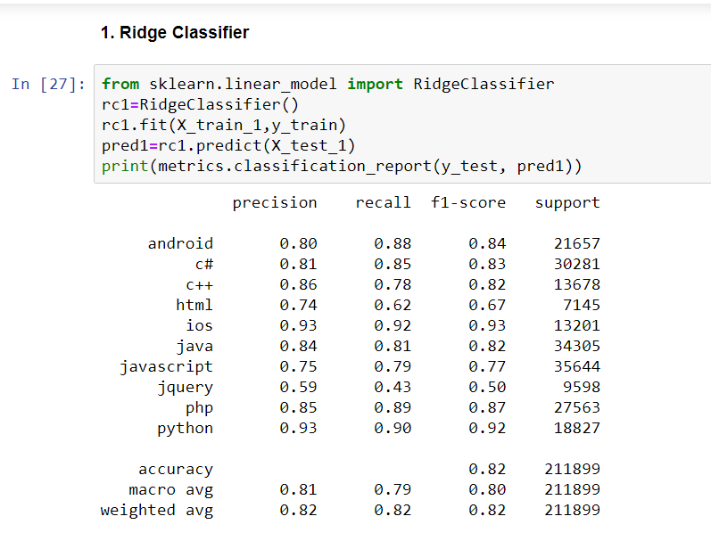
Appendix-I
Screenshot-1 : Output from Ridge regression classifier

Slide 18
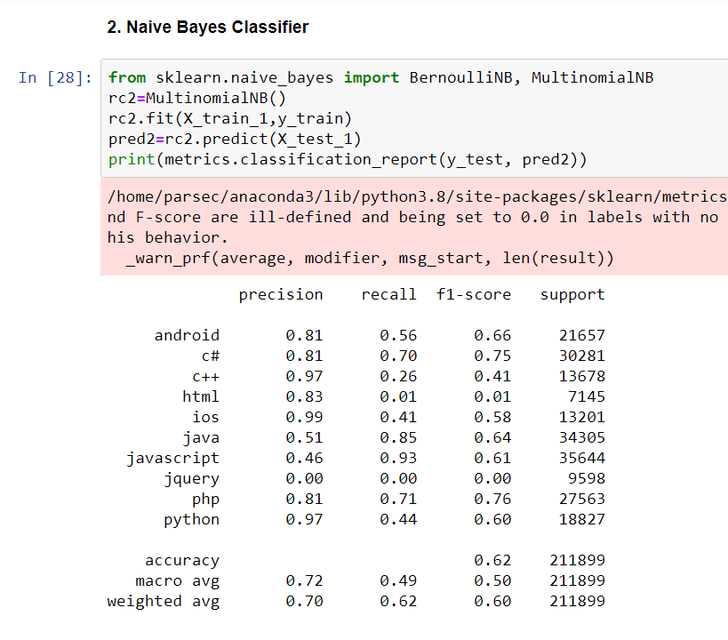
Appendix-II
Screenshot-2 : Output from Naïve Bayes classifier

Slide 19
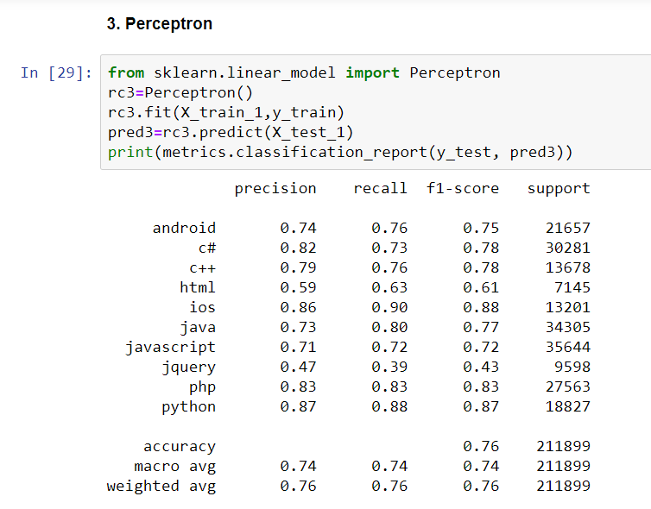
Appendix-III
Screenshot-3 : Output from Perceptron classifier

Slide 20
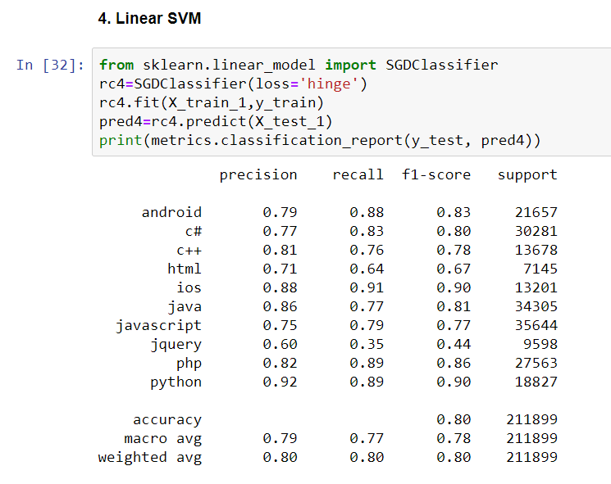
Appendix-IV
Screenshot-4 : Output from Linear SVM classifier

Slide 21
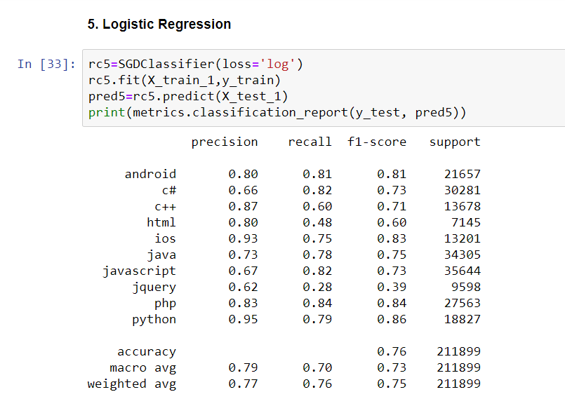
Appendix-V
Screenshot-5 : Output from Logistic Regression classifier

Slide 22

[8]
Team name : COT

