Slide 1

DEEP LEARNING
FOR FONT RECOGNITION
Guide :- Dr. Pavan Kumar Perepu
Project Code :- B25PKP01

Slide 2

GROUP MEMBERS
CHANDRA SAILESH
S20220010110
G.NILESH
S20220010072
K. TARAK REDDY
S20220010113

Slide 3
OVERVIEW
Introduction
Data Collection
Problem Statement
Experimental Results and Analysis
Motivation
Literature Review
Work Done
Future Work Plan
References

Slide 4
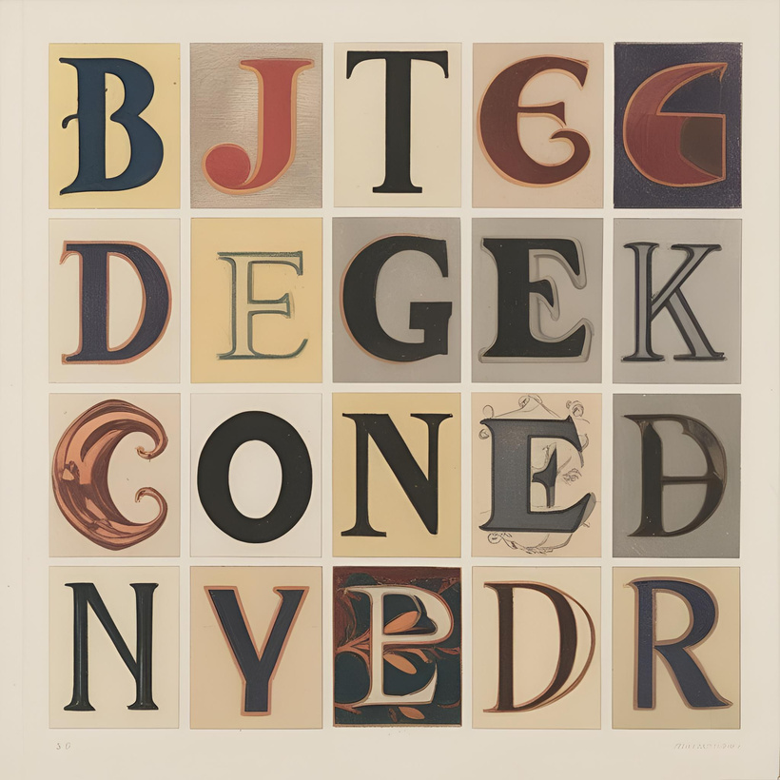
INTRODUCTION
Font recognition is the process of identifying and classifying different fonts in images or scanned documents. With thousands of fonts available, traditional methods struggle to recognize them accurately, especially when fonts are similar or distorted. Deep learning, especially Convolutional Neural Networks (CNNs), has proven to be a powerful approach because it can automatically learn features from images instead of relying on fixed rules.
src:- co-pilot

Slide 5
PROBLEM STATEMENT
Traditional font-recognition methods rely on handcrafted features and rule-based approaches, which often struggle with complex fonts, noisy images, and varying text styles.
The key challenges in font recognition include:
Large Font Variability: Fonts come in thousands of styles, including serif, sans-serif, cursive, and decorative fonts, making classification challenging.
Text Distortions and Noise: Scanned documents, handwritten text, and artistic fonts introduce distortions that affect recognition accuracy.
Font Similarity: Many fonts have minor variations, requiring deep feature extraction to differentiate them accurately.
Scalability: As new fonts are continuously developed, a robust recognition model must generalize well to unseen font styles.

Slide 6
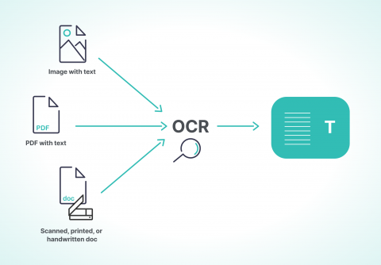
MOTIVATION
Enhancing OCR Accuracy for Diverse Fonts – Traditional OCR systems struggle with recognizing complex, decorative, or distorted fonts, leading to misclassification and poor text extraction. Deep learning-based font recognition improves OCR accuracy by learning intricate font patterns, enabling better character segmentation and recognition in diverse text styles.
Src:- blog.roboflow.com

Slide 7
LITERATURE REVIEW
S.No | Title | Reference | Problem Addressed | Key Takeaways
1. | Incremental Recognition of Multi-Style Tibetan Character Based on Transfer Learning​ | IEEE Access, vol. 12, pp. 44190-44206, 2024 | Tibetan script recognition is challenging due to stylistic variations.Traditional methods require full retraining for new styles, making them computationally expensive. | Pre-trained with ResNet-50 on Uchen Standard Tibetan and fine-tuned for Uchen Variants and Antiquarian styles.Improves accuracy from 90.14% to 98.40% with incremental training
2. | Real-Time Classifier of Multilingual Font Styles (Yue Wu) | Frontiers in Computing and Intelligent Systems, 2023 | Recognizing multilingual fonts in real-time is complex due to diverse character structures | Uses ResNet, SwordNet, Logistic Regression, and Random Forest algorithms. Achieved 90% accuracy on a multilingual font dataset.Dynamically chooses between ML/DL models
3. | Exploring Multi-Tasking Learning in Document Attribute Classification | Tanmoy Mondal, Abhijit Das, and Zuheng Ming, Pattern Recognition Letters, 2022 | Simultaneous classification of font type, size, emphasis, and scanning resolution | Multi-task learning framework effectively classifies multiple document attributes

Slide 8
LITERATURE REVIEW
S.No | Title | Reference | Problem Addressed | Key Takeaways
4. | ​Using Neural Networks Application for the Font Recognition Task Solution | 2020 55th International Scientific Conference on Information, Communication and Energy Systems and Technologies (ICEST) | Classifying fonts efficiently based on slope, style, and weight due to the lack of a standard classification system. | A neural network-based font classification system was developed, achieving high accuracy in recognizing font attributes and assisting in digital document structure identification.
5. | Convolutional Neural Networks for Font Classification | Chris Tensmeyer, Daniel Saunders, and Tony Martinez, ICDAR 2017 | Challenges in OCR due to font variations | CNN-based method achieves high accuracy in font classification Achieved 98.8% accuracy on Arabic fonts and 86.6% on Latin manuscripts
6. | Character-Independent Font Recognition on a Single Chinese Character (Xiaoqing Ding et al.)​ | IEEE Transactions on Pattern Analysis and Machine Intelligence, 2007 | Recognizing fonts from single Chinese characters is difficult due to high intra-class variance.Existing methods require text blocks, making them less flexible.. | Single character: 90.28% (Database B), 91.29% (Database A). 99.01% accuracy with 5 characters. Compared to Zhu & Tan’s method (which uses text blocks), the proposed approach achieves similar or better accuracy with fewer characters.

Slide 9


DATA COLLECTION AND DISTRIBUTION
Sample Outputs
Objective – Generate labeled text images for font style and size prediction.
Font – Use 5 styles (Arial, Times New Roman, Courier New, Verdana, Georgia).
Text – Select random samples.
Render-Vary Font Size (10–60px) for regression, fixed sizes (16,24,32px) for classification.
Done – 300 samples for style classification, 60 for regression, 300 for combined classification.

Slide 10
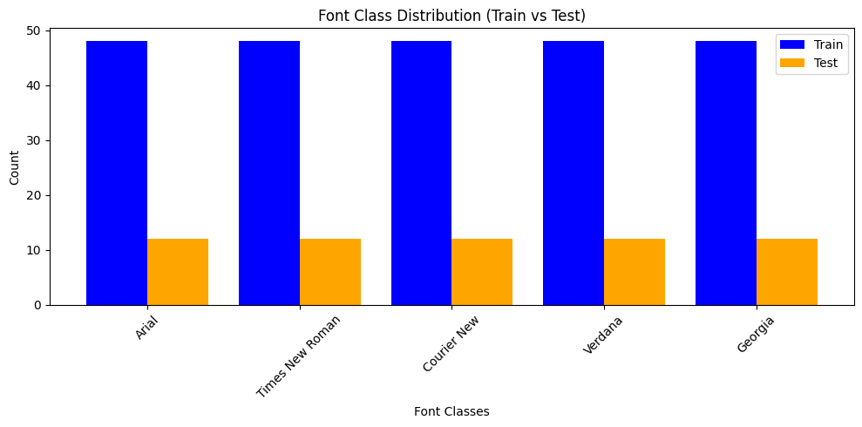
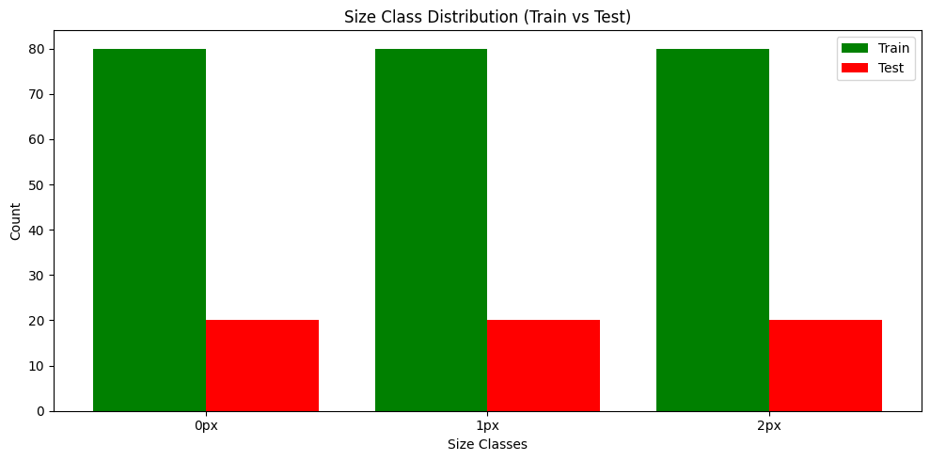
DATA COLLECTION AND DISTRIBUTION

Slide 11
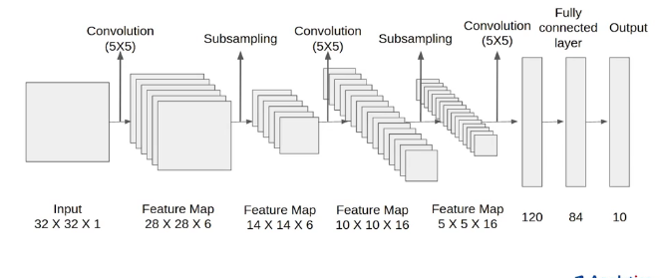
MODEL ARCHITECTURE
(LeNet-5)
Src:- analyticsvidya
Why LeNet?
Low Computational Cost: With fewer layers and parameters, LeNet is efficient and well-suited for font recognition on resource-constrained devices.
Robust to Variations: Its pooling layers help handle minor distortions in font style, thickness, and size, ensuring stable recognition performance.
Effective for Low-Resolution Inputs: Designed for grayscale images, LeNet performs well on low-resolution font images common in OCR tasks.

Slide 12
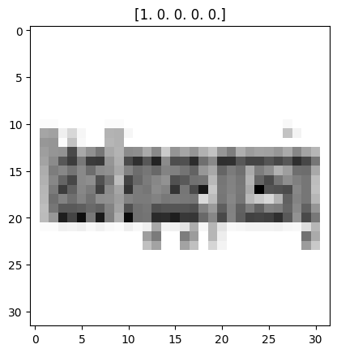
IMAGE PREPROCESSING
3.Normalize Pixel Values
Raw grayscale pixel values range from 0 to 255, which can make training unstable.
Normalization rescales the values between 0 and 1, improving CNN performance and convergence speed.
1. Convert to Grayscale
Since color information is not necessary for font recognition, we convert images to grayscale.
This reduces computational complexity and focuses on text shape rather than color.
In Python, this is done using:
img=Image.open(image_path).convert("L")
"L" mode stands for luminance, which keeps only intensity values (0-255).
Example:
A black pixel has a value of 0.
A white pixel has a value of 255.
Gray shades are in between.
2. Resize to (32x32) Pixels

Slide 13
MODELS
Model | Architecture | Task | Dataset | Metrics Used | Optimization Techniques
Font Recognition | CNN (LeNet-5) | Classify font styles | 5 font styles, 3 sizes (Total: 300 samples) | Accuracy, Confusion Matrix, Loss Curve | Early Stopping, Reduce LR on Plateau
Font Size Regression | CNN Regression | Predict font size (10-60px) | 60 samples | RMSE, R² Score, Loss Curve | Early Stopping, Reduce LR on Plateau
Font Style,Size (2 stage classification) | CNN (LeNet-5) | Classify both font style & size | 5 font styles × 3 sizes (Total: 300 samples) | Accuracy, Loss | Early Stopping,ReduceLROnPlateau, Categorical Crossentropy Loss, Adam Optimizer
Font Style & Size (15 class Classification) | CNN (LeNet-5) | Classify both font style & size | 5 font styles × 3 sizes (Total: 300 samples) | Accuracy, Confusion Matrix, Loss Curve | Early Stopping, Reduce LR on Plateau, L2 Regularization

Slide 14
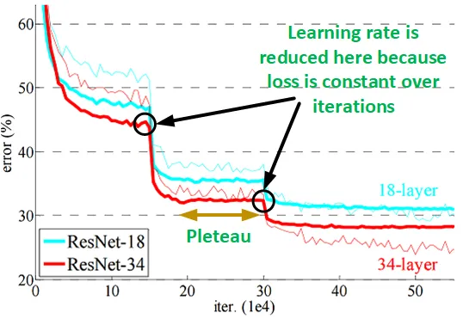
OPTIMIZATION TECHNIQUES
1. Early Stopping
It monitors the model’s performance on a validation set during training and stops the training process when the validation loss stops improving. This prevents the model from continuing to learn noise in the training data, which can degrade its generalization ability.
2. Reduce Learning Rate on Plateau
Learning rate is reduced when the validation loss stops improving for a specified number of epochs. This helps the model escape local minima or saddle points and converge to a better solution.
Src:- Medium

Slide 15
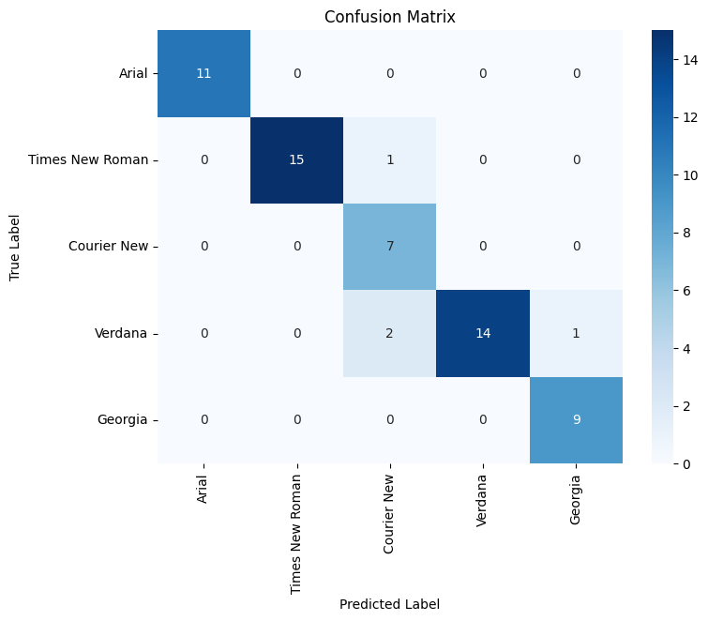
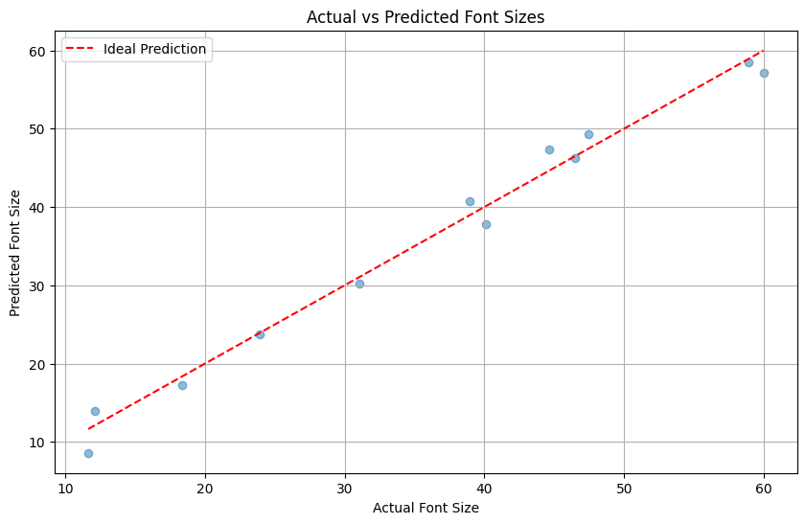
RESULTS AND ANALYSIS
I) FontRecognition Model (Classification)
Final Accuracy: 93.33% (Test)
Validation Accuracy: 94.51%
Loss: 0.1669 (Test)
II) FontSizeRegression Model (Regression)
Final Mean Absolute Error (MAE): 0.03 px (Test)
Validation MAE: 0.0325 px
Validation Loss: 0.0015

Slide 16
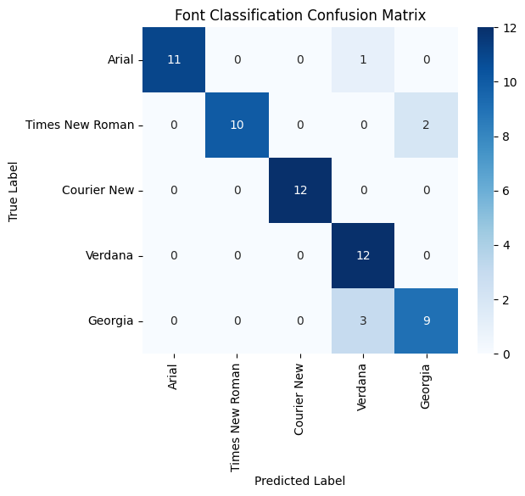
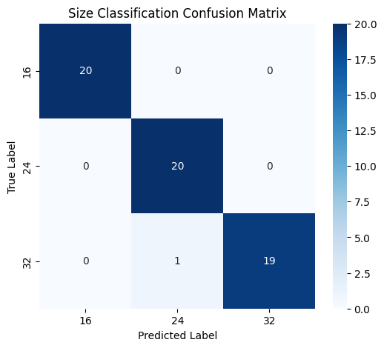
RESULTS AND ANALYSIS
III) Font Style, Size Classification
(2-stage classification)
Font Recognition Accuracy: 89.99%
Size Recognition Accuracy: 98.33%
Font Loss: 0.4513
Size Loss: 0.0650
Total Loss: 1.3619

Slide 17
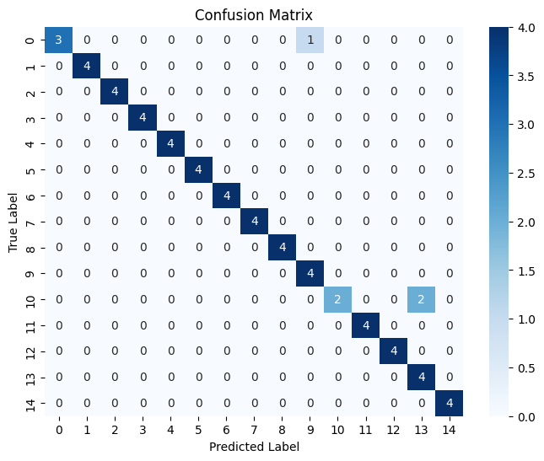
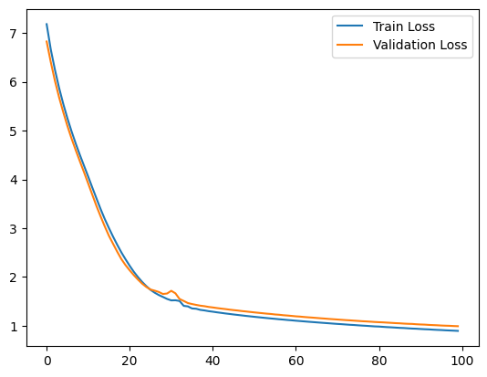
RESULTS AND ANALYSIS
IV) Font Style & Size Classification
(15 class classification)
Final Test Accuracy: 95.63%
Validation Accuracy: 95.00%
Loss: 0.9908 (Test)

Slide 18
OVERVIEW
Model | Task | Accuracy / MAE | Validation Accuracy / MAE | Loss / Validation Loss
Font Recognition | Classification | 93.33% | 94.51% | 0.1669
Font Size Regression | Regression | 0.03 px (MAE) | 0.0325 px (MAE) | 0.0015
Font Style,Size (2 stage classification) | Classify both font style & size | Font : 89.99% Size : 98.33% | Font : 90% Size : 98.33% | Font Loss: 0.4513 Size Loss: 0.0650
Font Style & Size Classification | Classification (15-classes) | 95.63% | 95.00% | 0.9908

Slide 19




FUTURE WORK PLAN
INCREASING DATASET SAMPLES & ANALYZING RESULTS
APPLYING TRANSFER LEARNING FOR INDIC SCRIPT FONT RECOGNITION
Expand Dataset: Collect more images for each font and size variation to enhance model robustness.Performance Analysis: Evaluate accuracy, loss trends, and misclassification patterns to refine the model architecture or training process.
Model Selection: Choose a pre-trained CNN model (e.g., ResNet, SwordNet) and fine-tune it for Indic script font classification.
Domain Adaptation: Train on a mix of existing Latin-script font data and newly collected Indic script data to enhance cross-language generalization.
COLLECTING DATA FOR INDIC SCRIPTS
Script Selection: Identify key Indic scripts such as Tamil, Telugu, Kannada, or Bengali for dataset creation.
Data Collection: Gather font samples from publicly available sources, create synthetic datasets, or crowdsource handwritten samples.

Slide 20
REFERENCES
Statistical pattern recognition: a review
A. K. Jain, R. P. W. Duin and Jianchang Mao, "Statistical pattern recognition: a review," in IEEE Transactions on Pattern Analysis and Machine Intelligence, vol. 22, no. 1, pp. 4-37, Jan. 2000, doi: 10.1109/34.824819.
A Novel Procedure for Font Recognition through Deep Learning
S. Zia and J. Pan, "A Novel Procedure for Font Recognition through Deep Learning," 2019 IEEE International Conference on Cybernetics and Intelligent Systems (CIS) and IEEE Conference on Robotics, Automation and Mechatronics (RAM), Bangkok, Thailand, 2019, pp. 18-23, doi: 10.1109/CIS-RAM47153.2019.9095854.
Recognition of font and tamil letter in images using deep learning
Manikandan, S., Rani, A. D. C., Rajeswari K, C., Suma, T., & Sivabalaselvamani, D. (2021). Recognition of font and Tamil letter in images using deep learning. Applied Computer Science, 17(2), 90–99.doi: 10.23743/acs-2021-15.
Convolutional Neural Networks for Font Classification
C. Tensmeyer, D. Saunders and T. Martinez, "Convolutional Neural Networks for Font Classification," 2017 14th IAPR International Conference on Document Analysis and Recognition (ICDAR), Kyoto, Japan, 2017, pp. 985-990, doi: 10.1109/ICDAR.2017.164.
Real-time Classifier of Multilingual Font Styles based on ResNet, SwordNet, Logistic Regression and Random Forest Algorithms
Convolutional Neural Networks for Font Classification C. Tensmeyer, D. Saunders and T. Martinez, "Convolutional Neural Networks for Font Classification," 2017 14th IAPR International Conference on Document Analysis and Recognition (ICDAR), Kyoto, Japan, 2017, pp. 985-990, doi: 10.1109/ICDAR.2017.164.
Character Independent Font Recognition on a Single Chinese Character
X. Ding, L. Chen and T. Wu, "Character Independent Font Recognition on a Single Chinese Character," in IEEE Transactions on Pattern Analysis and Machine Intelligence, vol. 29, no. 2, pp. 195-204, Feb. 2007, doi: 10.1109/TPAMI.2007.26.
Robustness of Contrastive Learning on Multilingual Font Style Classification
Memon, I., Muhammad, A. u. H., & Choi, J. (2023). Robustness of Contrastive Learning on Multilingual Font Style Classification Using Various Contrastive Loss Functions. Applied Sciences, 13(6), 3635.

Slide 21
REFERENCES
A Novel CNN Model for Classification of Chinese Historical Calligraphy Fonts
Huang, Q., Li, M., Agustin, D., Li, L., & Jha, M. (2024). A Novel CNN Model for Classification of Chinese Historical Calligraphy Styles in Regular Script Font. Sensors, 24(1), 197
Towards Robust Pattern Recognition: A Review
X. -Y. Zhang, C. -L. Liu and C. Y. Suen, "Towards Robust Pattern Recognition: A Review," in Proceedings of the IEEE, vol. 108, no. 6, pp. 894-922, June 2020, doi: 10.1109/JPROC.2020.2989782.
fMRI: preprocessing, classification and pattern recognition
Sharaev, Maxim & Andreev, Alexander & Artemov, Alexey & Bernstein, Alexander & Burnaev, Evgeny & Kondratyeva, Ekaterina & Sushchinskaya, Svetlana & Akzhigitov, Renat. (2018). fMRI: preprocessing, classification and pattern recognition. 10.48550/arXiv.1804.10167.
A novel artificial fish swarm algorithm for pattern recognition with convex optimization
L. Shi, R. Guo and Y. Ma, "A novel artificial fish swarm algorithm for pattern recognition with convex optimization," 2016 International Conference on Communication and Electronics Systems (ICCES), Coimbatore, India, 2016, pp. 1-4, doi: 10.1109/CESYS.2016.7889830.
Large-Scale Visual Font Recognition
G. Chen et al., "Large-Scale Visual Font Recognition," 2014 IEEE Conference on Computer Vision and Pattern Recognition, Columbus, OH, USA, 2014, pp. 3598-3605, doi: 10.1109/CVPR.2014.460.
Using Neural Networks Application for the Font Recognition Task Solution
O. Bychkov et al., "Using Neural Networks Application for the Font Recognition Task Solution," 2020 55th International Scientific Conference on Information, Communication and Energy Systems and Technologies (ICEST), Niš, Serbia, 2020, pp. 167-170, doi: 10.1109/ICEST49890.2020.9232788.
Incremental Recognition of Multi-Style Tibetan Character Based on Transfer Learning​
G. Zhao, W. Wang, X. Wang, X. Bao, H. Li and M. Liu, "Incremental Recognition of Multi-Style Tibetan Character Based on Transfer Learning," in IEEE Access, vol. 12, pp. 44190-44206, 2024, doi: 10.1109/ACCESS.2024.3381039.

Slide 22
REFERENCES
FONTNET: On-Device Font Understanding and Prediction Pipeline
R. S, R. Khurana, V. Agarwal, J. R. Vachhani and G. Bhanodai, "Fontnet: On-Device Font Understanding and Prediction Pipeline," ICASSP 2021 - 2021 IEEE International Conference on Acoustics, Speech and Signal Processing (ICASSP), Toronto, ON, Canada, 2021, pp. 2155-2159, doi: 10.1109/ICASSP39728.2021.9413410.
A Character-Independent Font Identification
Haraguchi, D., Harada, S., Iwana, B.K., Shinahara, Y., Uchida, S. (2020). Character-Independent Font Identification. In: Bai, X., Karatzas, D., Lopresti, D. (eds) Document Analysis Systems. DAS 2020. Lecture Notes in Computer Science(), vol 12116. Springer, Cham. https://doi.org/10.1007/978-3-030-57058-3_35
Exploring Multi-Tasking Learning in Document Attribute Classification
Tanmoy Mondal, Abhijit Das, Zuheng Ming,Exploring multi-tasking learning in document attribute classification,Pattern Recognition Letters,Volume 157,2022,Pages 49-59,ISSN 0167-8655,https://doi.org/10.1016/j.patrec.2022.02.015.

Slide 23
Thank You

