Slide 1


Python
Mini-Project
Stock Prices Analysis
- Nilesh Sonawane
- Dhanashree Sul
- Smera Nimje
- Yash Sonje

Slide 2


Dataset Description:
Our dataset contains historical price data with 4,838 entries and 8 columns.
The columns include:
Date: The date of each record.
Open_Price: The opening price on the date.
High_Price: The highest price reached.
Low_Price: The lowest price reached.
Close_Price: The closing price.
Traded_Value^: The total traded value (in currency).
No_Of_Trades: The number of trades.
Traded_Quantity: The total quantity traded.
The dataset spans multiple dates and captures essential trading metrics for each day.

Slide 3
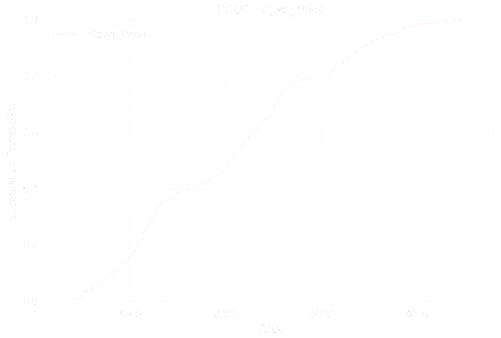
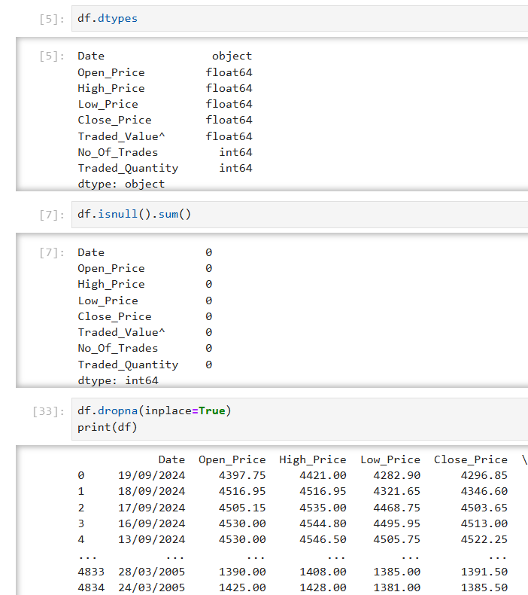
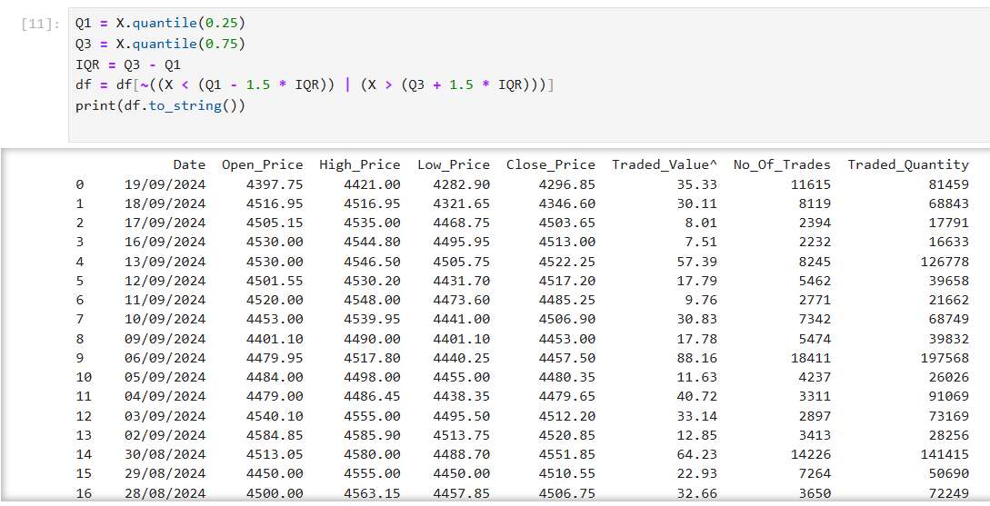
Data Preprocessing and Cleaning
Data Cleaning:
Involves correcting or removing inaccuracies and inconsistencies in data.
Key steps: handling missing values, removing duplicates, correcting errors, and addressing outliers.
Goal: Improve data accuracy and quality.
Data Preprocessing:
Transforms raw data into a suitable format for analysis or modeling.
Key steps: data transformation, feature engineering, scaling/normalization, and encoding categorical variables.
Goal: Enhance data compatibility and prepare for reliable analysis.

Slide 4
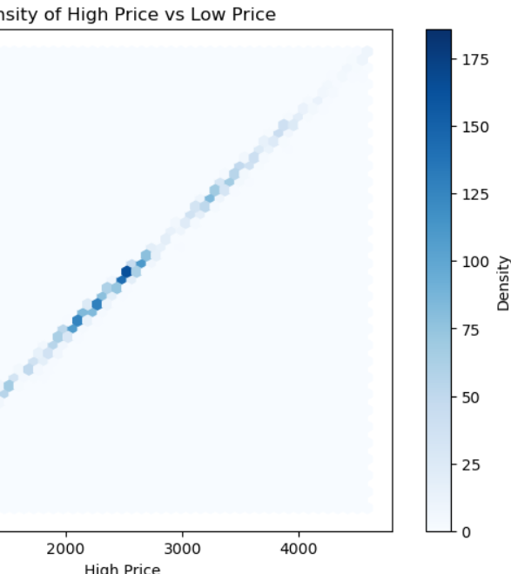
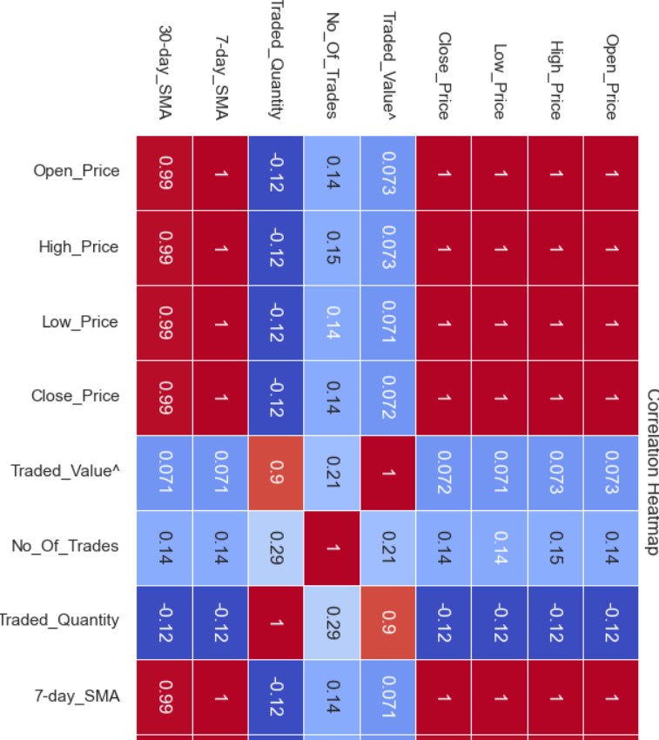
Exploratory Data Analysis (EDA):
Univariate Analysis: This focuses on individual variables to understand their distributions and detect any outliers.
Examples:
Histograms display the frequency distribution of values, showing skewness and variability.
Box Plots help identify outliers and the spread of data in each variable.
Bivariate Analysis: This examines relationships between two variables to identify patterns or correlations.
Examples:
Scatter Plots show potential relationships (linear or nonlinear) between pairs of variables.
Pair Plots provide a quick overview of all numerical variable relationships in one grid, revealing trends or clusters.
Correlation Heatmap:
A visual representation of correlation coefficients between numerical variables.
Helps identify which variables have strong positive or negative relationships, with values close to 1 or -1 indicating a strong correlation.

Slide 5
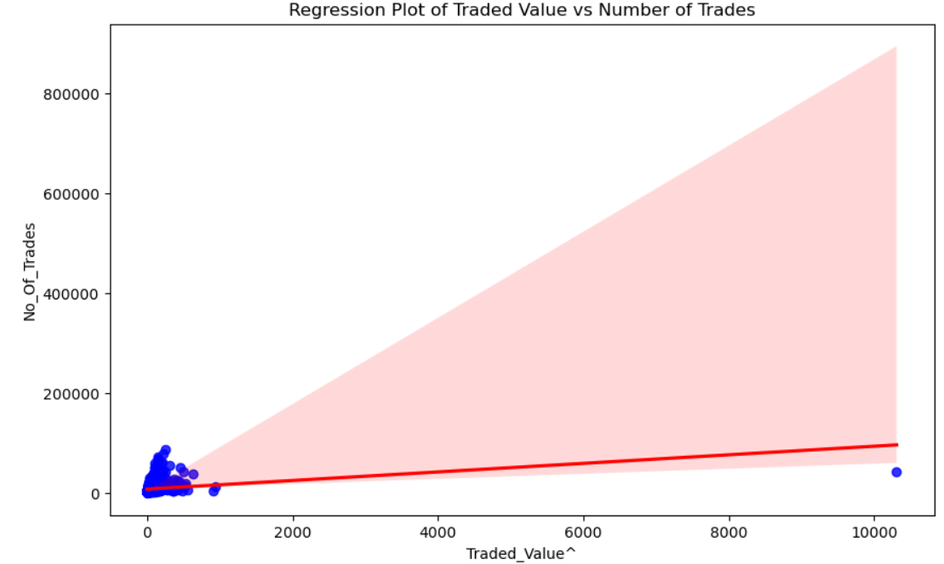
Data Visualization:
Matplotlib:
A foundational Python library for data visualization, known for its versatility and customizability.
Provides basic plotting tools like line plots, scatter plots, and bar charts.
Allows detailed customization of colors, sizes, labels, and styles, making it powerful for creating tailored visualizations.
Seaborn:
Built on top of Matplotlib, Seaborn simplifies data visualization and makes it aesthetically pleasing.
Offers a higher-level interface and comes with themes and color palettes, creating clean and visually attractive graphs by default.
Ideal for statistical plots, including heatmaps, violin plots, box plots, and distribution plots, making it suitable for data exploration and analysis.

Slide 6
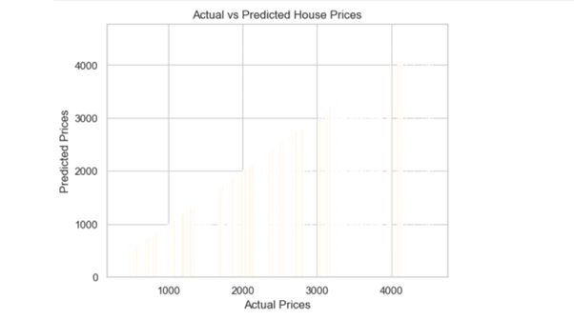
MACHINE LEARNING MODELLING
Linear Regression:
Purpose: Linear Regression is a regression model used for predicting continuous outcomes
Code Implementation:
The model is trained on the historical prices (Open_Price, Low_Price, High_Price) as input features to predict the Close_Price.
Evaluation Metrics:
RMSE (Root Mean Square Error): Measures the average magnitude of prediction errors. Lower RMSE indicates a better model fit.
R-squared: Indicates the proportion of variance in the dependent variable (Close_Price) that’s explained by the model’s inputs. Higher R-squared means the model explains more variability.
Visualization: A plot of Actual vs. Predicted Close Prices helps compare model predictions against actual values, making it easy to see the model’s effectiveness.

Slide 7
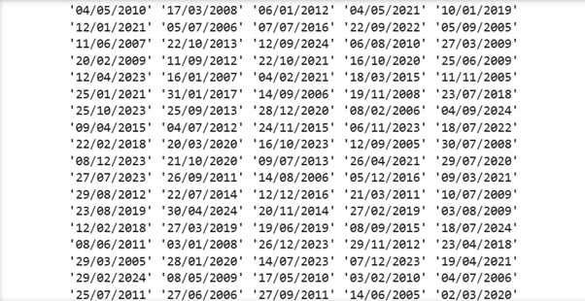
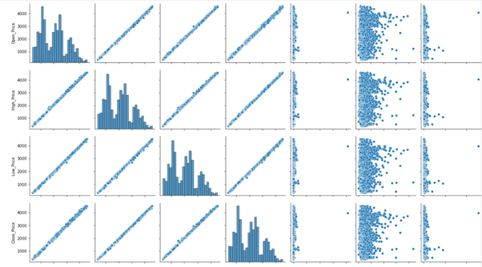
Random Forest Classifier:
Purpose: This ensemble model aggregates predictions from multiple decision trees to improve classification accuracy.
Code Implementation:
Trains on the same features as the Logistic Regression model to predict Price_Increase.
Evaluation Metrics:
Accuracy
Confusion Matrix
Classification Report
Logistic Regression:
Purpose: Logistic Regression is a classification model used to predict binary outcomes.
Code Implementation:
The model is trained on features like Open_Price, Low_Price, High_Price, and others to predict whether Price_Increase is 0 (no increase) or 1 (increase).
Evaluation Metrics:
Accuracy
Precision
Recall
F1 Score
Classification Report
LOGISTIC REGRESSION

Slide 8
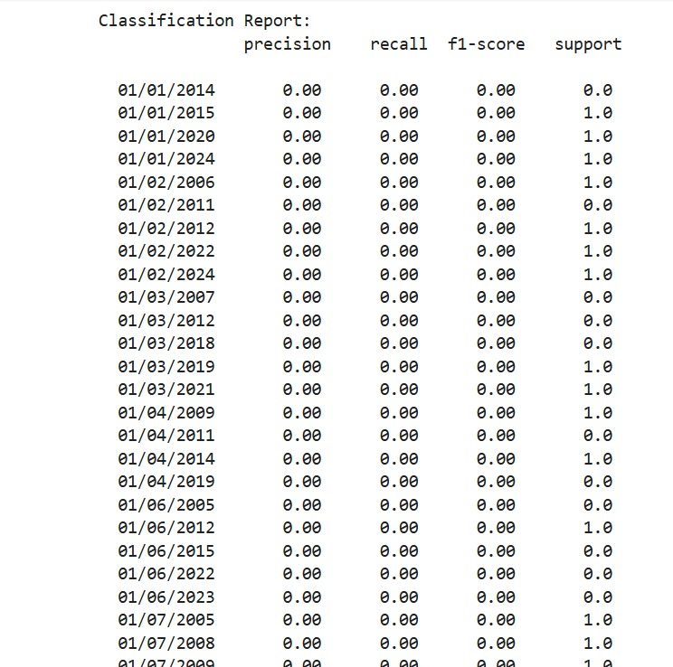
HYPOTHESIS TESTING
A binomial test helps assess if a model’s accuracy is significantly better than random guessing.
Null Hypothesis (H₀): The model's accuracy is not different from random guessing (e.g., 50% in binary prediction).
Alternative Hypothesis (H₁): The model's accuracy is better than random guessing.
Result Interpretation: If the p-value from the test is less than the significance level (α = 0.05), we reject the null hypothesis, concluding that the model’s accuracy is statistically better than random guessing.

Slide 9
Conclusion:
Trend: TCS stock shows potential growth trends over time, indicating investor confidence.
Volume Impact: Higher traded quantities often correlate with price changes, reflecting investor sentiment.
Volatility: The stock’s volatility levels suggest either stability for long-term investors or risk for short-term trades.
Market Comparison: TCS’s performance relative to benchmarks shows its market positioning.
Future Predictions: Forecast models suggest possible future trends, guiding investment decisions.

Slide 10
Thank You!!

