Slide 1
Generalized Zero-Shot Extreme Multi-label Learning
Nilesh Gupta*, Sakina Bohra‡, Yashoteja Prabhu*, Saurabh Purohit*, Manik Varma*†
(*: Microsoft Research, †: IIT Delhi, ‡: Microsoft)
Notes:
Hi everyone, I am Nilesh Gupta and today I'll be talking about our recent work on generalized zero-shot extreme multi-label learning. This work was done at Microsoft Research India in collaboration with Microsoft Bing Ads team. Before we delve in, let’s quickly take an overview of extreme multi-label learning which in shorthand is often referred to as XML in the literature.

Slide 2


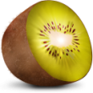









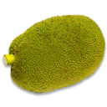

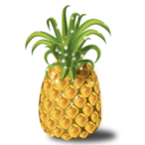

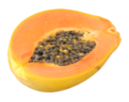

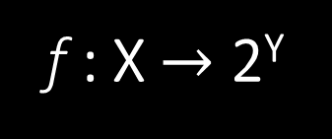
eXtreme Multi-label Learning (XML)
Given a data point, tag it with the most relevant (subset of) labels from a large universe of $L$ labels
f : X $→$ 2^{Y}
X: Data Points
Y: Labels
Notes:
Extreme multi-label learning involves tagging a data point with the most relevant subset of labels from an extremely large set of label choices. This research area has seen a surge in popularity in recent years owing to its numerous applications in document tagging, product recommendation, computational advertising and language modeling.

Slide 3

XML Ranking and Recommendation
Recommend most relevant queries for an ad
Ad
Predicted Bing Queries
geico auto insurance
geico car insurance
geico insurance
www geico com
care geicos
geico com
need cheap auto insurance
Notes:
For instance, the search advertising task can be posed as predicting the subset of all possible search queries (labels) from users for which an ad (a data point) could receive clicks. In this particular example, the ad document is of a car insurance page from geico and the most relevant queries that can lead a click to this ad are geico auto insurance, geico car insurance, need cheap auto insurance, etc. Since the total number of queries that can get asked on a search engine can easily go beyond millions, this problem becomes non-trivial for traditional ML methods and requires special solutions developed for XML.

Slide 4

XML Ranking and Recommendation
Recommend most relevant queries for an ad
Ad
Predicted Bing Queries
geico auto insurance
geico car insurance
geico insurance
www geico com
care geicos
geico com
need cheap auto insurance
wisconsin cheap car insurance quotes
cheap auto insurance florida
all state car insurance coupon code
Notes:
An unaddressed challenge in XML is that of predicting unseen labels. XML makes a critical assumption that the set of label choices is fixed and every label has been seen at least once during training. However in many practical scenarios like this one this is not the case since the label set grows continuously over time with evolving user activities and needs. The labels that have no training instance but are available for prediction are often referred to as zero-shot labels or unseen labels.

Slide 5
Zero-Shot Labels
Zero-shot labels have no train instance, but available for prediction
Abundant in many applications, majority of user queries in Bing are new
Often serve fresh and personalized information desired by the end users
Generalized Zero-Shot XML (GZXML) paradigm
Tag a data point with the most relevant labels from a large universe of both seen and unseen labels
Better suited for large-scale ranking and recommendation than XML
Existing XML methods incapable of modelling such new labels
Need frequent and expensive re-training to mitigate the label churn
Notes:
Zero-shot labels are abundant in large-scale recommendation applications and correctly predicting them is highly desirable as oftentimes they serve fresh and specific information to the end user. Motivated by these observations, our work explores the Generalized Zero-Shot extreme multi-label learning problem where the task is to tag a data point with the most relevant labels from a large universe of both seen and unseen labels. Existing XML approaches sidestep this challenge by completely discarding unseen labels and restricting their learning to only the seen labels that have enough training points. In consequence, they need frequent and expensive model re-trainings to mitigate the label churn and are still unable to predict completely new labels.

Slide 6
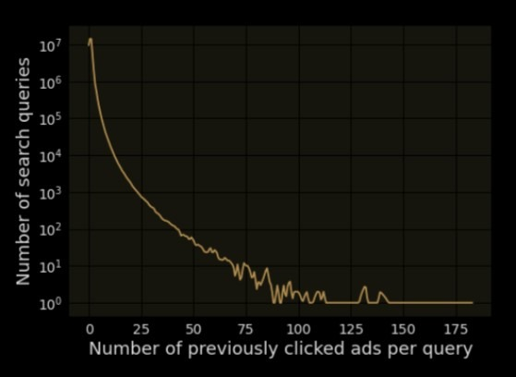
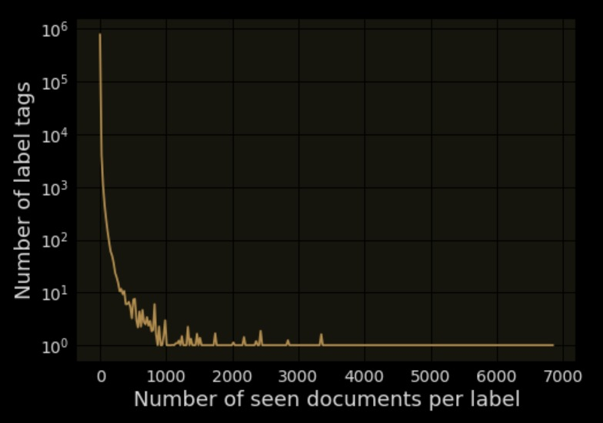

GZXML Challenges
Seamlessly model many, few and zero shot labels
Many-shot labels may require complex representation
Few and zero-shot labels require information sharing
Efficient training and prediction both in terms of time and memory
Sub-linear scaling with $L$, critical at extreme scales
Real-time label updates during prediction
New labels continually arrive in practical applications (e.g., queries in Bing Ads)
ZestXML, highly scalable solution to GZXML
leverages label features to address these challenges
Notes:
A successful solution to the GZXML problem should address the following 3 key challenges: First of all, it should seamlessly model labels belonging to all data regimes. The data regimes can be roughly categorized into many-shot labels i.e. popular labels, few-shot labels i.e. rare but seen labels and zero-shot labels i.e. unseen labels. This is important because labels belonging to different regimes have different characteristics such as many-shot labels have enough training instances for them but may require a complex model to fit all their training points, on the other hand rare labels lack representative training points hence they require information sharing between labels for the model to generalize well during prediction. Second challenge is that it should be efficient and both training and prediction should scale sub-linearly with the number of labels. This is essential to scale to applications with several million labels. Finally, the underlying data structure used for efficient prediction should support real-time label updates, since new labels continuously arrive in large-scale applications. To address these challenges we propose the ZestXML algorithm which effectively leverages label features to model both seen and unseen labels.

Slide 7
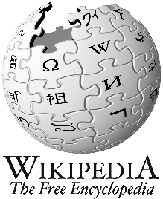
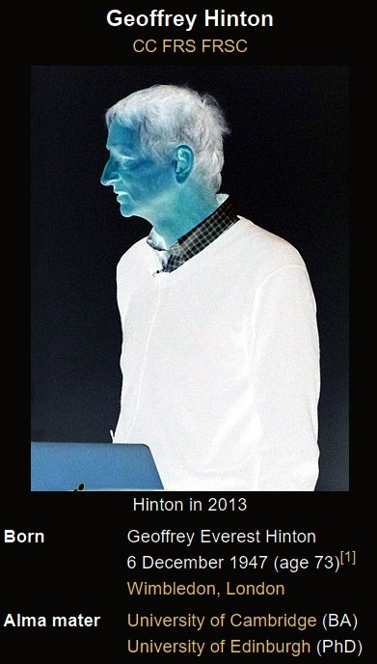
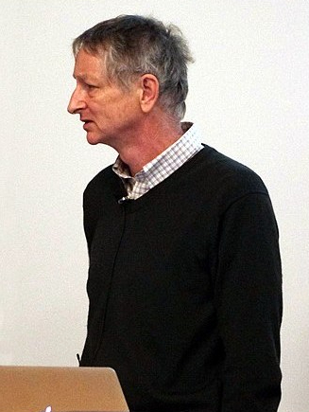
ZestXML Modelling Motivation
Geoffrey Everest Hinton CC FRS FRSC[11] (born 6 December 1947) is a British-Canadian cognitive psychologist and computer scientist, most noted for his work on artificial neural networks. Since 2013, he has divided his time working for Google (Google Brain) and the University of Toronto. In 2017, he co-founded and became the Chief Scientific Advisor of the Vector Institute in Toronto… Hinton is viewed as a leading figure in the deep learning community …Hinton received the 2018 Turing Award, together with Yoshua Bengio and Yann LeCun, for their work on deep learning…
Computer Scientist
Scientist
Researcher
Turing Award
:
Artificial Intelligence Researchers
Artificial Intelligence
Neural Networks
Intelligence
Deep learning
Google brain
Notes:
To motivate the modelling intuition of zestxml let’s look at the following example where our data-point is the wikipedia page of geoff hinton and we want to predict the tag “artificial intelligence researchers” for it. We represent both the document and label as their sparse tf idf weighted bag of words representation, notice that even though the token “researcher” never occurs in the document text, but there are plenty of tokens like “scientist”, “computer scientist”, etc in the document text which are very relevant to the “researcher” label feature. Similarly, document features like “deep learning”, “neural networks” strongly support for “artificial intelligence” label feature.

Slide 8






ZestXML Formulation
$$W$$
Computer Scientist
Relevance between data point $x_{i}$ and label $z_{l}$ is
$f\left(x_{i},z_{l}\right)=$ ${x_{i}}^{T}Wz_{l}$
Problem setup, minimize
$\sum_{i}{\sum_{l}{log \left(1+e^{− y_{il} f\left(x_{i},z_{l}\right)}\right) }}$
Solving this naively is not possible!
Scientist
Turing Award
:
Neural networks
Deep learning
$$10^{6}×10^{6}$$
Google brain
$$x_{i}$$
$$z_{l}$$
:
Intelligence
Artificial Intelligence
:
:
$$10^{6}×10^{6}$$
Researcher
Notes:
To describe this intuition formally let the document feature vector be xi and the label feature vector be zl, here both the feature vectors are sparse tf idf weighted bag of unigrams and bigrams. We model the relevance between a document and label by the numerical value of xiTWzl, where W is a matrix and each entry in this matrix captures the relevance of each document feature, label feature pair. For example in this particular case notice that we want the entry corresponding to “researcher” and “scientist” in the W matrix to be higher. A typical way of learning W is by defining negative log likelihood over this relevance function. But there are two challenges here that make this problem in-tractable, first, since the dimension of both label feature vector and document feature vector can be in millions, size of W matrix is extremely huge, second considering all labels for all points in the loss function is also humongous since typically both labels and documents can easily be in millions for large-scale problems.

Slide 9

eXtreme Hard Thresholding Pursuit (XHTP)
Key: Only a few feature interactions are useful for modelling relevance
$\min_{f}{\sum_{i}{\sum_{l}{log \left(1+e^{− y_{il} f\left(x_{i},z_{l}\right)}\right) }}}$s.t. ${{∥W}_{i} ∥}_{0} ≤K≈10 ∀i ∈\{1, ⋯,C\}$
NP Hard problem, ZestXML solves this using novel XHTP optimizer
Approximate $W$, retain top $K$parameters in each row of approx$W$
Shortlist $∼$100 labels for each data-point by ${x_{i}}^{T}Wz_{l}$ scores
Refine non-zero values in $W$ to better fit the original objective with the negative shortlist obtained in step 2
Notes:
The key to solving this problem is the observation that only a few document feature and label feature interactions are relevant and the rest of the interactions can be safely ignored. More formally this boils down to making the W matrix row-wise sparse i.e. we enforce that each document feature is only relevant to upto K label features. ZestXML efficiently solves this new objective by using the novel XHTP optimizer which stands for extreme hard thresholding pursuit. The highlights of the XHTP optimizer can be summarized in following 3 steps:
In the first step, it approximately solves the objective to get an approximation of W and then we retain only top K parameters in each row of W to satisfy the sparsity constraint. Typically in an iterative hard thresholding pursuit method, W is approximated using the newton approximation by calculating the hessian, but at the extreme scale computing the hessian is just not at all feasible. So we make the assumption that the features in xi and zl are independent of each other, and under this assumption the first newton update term takes a simple form which can be computed very efficiently. In practice the approximate obtained using this assumption gives fairly good estimate of W.
In the second step, using the sparsified approximate W we shortlist O(100) labels for each data-point based on the relevance scores, notice that since W is sparse this shortlist can be computed very efficiently
In the third step we re-learn the non-zero values of W to better fit the original objective with the loss function applied only over the shortlisted labels. Notice that because we are only learning the non-zero values in W and for each data-point we are only considering a few labels in the loss function, the loss function becomes tractable and a standard optimizer can be used to learn this objective.

Slide 10




Prediction
Maintain inverted index over labels, label indexed against its features $z_{l}$
For a test point $x_{i}$ get ${\overline{x_{i}}=W}^{T}x_{i}$, for each non-zero dimension of $\overline{x_{i}}$, its inverted index list is perused and the scores for the indexed labels are aggregated
Researcher
$$⋯$$
Artificial Intelligence
Researcher
:
Intelligence
$$⋯$$
Artificial Intelligence
$$⋯$$
Notes:
For prediction, ZestXML adopts an inverted index based search algorithm i.e. it maintains an inverted index over the labels where the keys are the label features and each label is indexed against all of its label features. When a test point comes its features are first projected onto the label feature space by applying the learnt matrix W, we denote the projected sparse vector as x bar, now for each non-zero feature in x bar, its inverted index list is perused and the scores for the indexed labels are aggregated. Because of the simplicity of inverted index data structure, adding a new label during prediction is fairly straightforward. This sums up the details of the zestxml algorithm, let’s examine the performance of zestxml in comparison to other baseline methods.

Slide 11
Results on Wikipedia-1M
10000
96
5000
44
Notes:
On the public wikipedia-1M dataset which has over 1 million labels and 2.2 million training points, the task is to tag a wikipedia page with the most relevant subset of tags. As we can see in the plots below Zestxml trains in a few hours on a single core of a commodity desktop and performs significantly better than the baselines on propensity scored precision values with few milliseconds of prediction latency. This shows that ZestXML can accurately predict tail labels while being very efficient at the same time. We request the audience to have a look at our paper for the full set of results on various other datasets.

Slide 12
Comparison with IR Methods
ZestXML significantly outperforms IR methods on Wikipedia-1M
Notes:
When compared against traditional Information retrieval methods such as Tf Idf and BM25, the shortlisting performance of zestxml is significantly superior to the baselines. In-particular ZestXML can be upto 10% and 8% better than Tf-idf and BM25 respectively. This demonstrates that ZestXML brings many useful cross feature correlations which TFIDF and BM25 fail to capture.

Slide 13
Performance on Rare Labels
ZestXML performs well across both Zero-Shot and Few-Shot regimes
PSP@5
Notes:
The following plot shows PSP values of different methods in zero-shot and few-shot label regimes, as we can see ZestXML consistently performs better on both regimes of rare labels whereas existing extreme classification methods make no predictions for zero-shot labels and most of them perform poorly on few-shot labels since not much training data is available for such labels. On the other hand BERT and Fasttext embedding based ANNS approaches perform reasonably well on zero-shot labels but ZestXML significantly outperforms them on few-shot labels.

Slide 14
Application to Computational Advertising
Improved Click Yield and unseen query coverage by 17% and 3.4% resp.
Trains in just 30 hours on single core and predicts in ∼20 ms latency
PSP@5
Notes:
Deployment of ZestXML for sponsored search advertising on bing, led to significant gains and helped in boosting the contribution of click yield of IR based system by 17% in online A/B testing. The algorithm also helped in expanding the coverage to completely unseen queries by a factor of 3.4%.

Slide 15
Summary
Explore the problem of zero-shot labels in extreme multi-label learning
Develop novel ZestXML algorithm for generalized zero-shot predictions
ZestXML is up to 14% and 10% more accurate at generalized zero-shot learning relative to leading XML methods and dense ANNS methods
ZestXML trains in just 30 hours on single core and predicts in ∼20 ms latency on largest dataset with 31 million labels
Deploying ZestXML in Sponsored Search Advertising on Bing improved the click yield and unseen query coverage by 17% and 3.4% resp.
Notes:
In summary, with this work we explore the problem of zero-shot labels in extreme multi-label learning and develop the novel ZestXML algorithm for generalized zero-shot predictions. On public datasets ZestXML can be upto 14% and 10% more accurate at generalized zero-shot learning problem when compared to leading XML methods and dense ANNS methods. At the same time ZestXML is highly efficient and on the largest dataset with 31 million labels, it trains in just 30 hours on a single core and predicts in ~20ms prediction latency. Deploying ZestXML in Sponsored Search Advertising on Bing improved the click yield and unseen query coverage by 17% and 3.4% resp.

Slide 16
Thanks!
Paper: http://manikvarma.org/pubs/gupta21.pdf
Code & Datasets: https://github.com/nilesh2797/zestxml
Notes:
With this, we have reached the end of the presentation. I thank everyone for taking their time to listen to the talk and hope that you enjoyed it. We’ll release the code of zestxml and public datasets used in the work at the link below.

