Slide 1
Course No: SEWP ZC322 Course Title: Database Management Systems

Slide 2
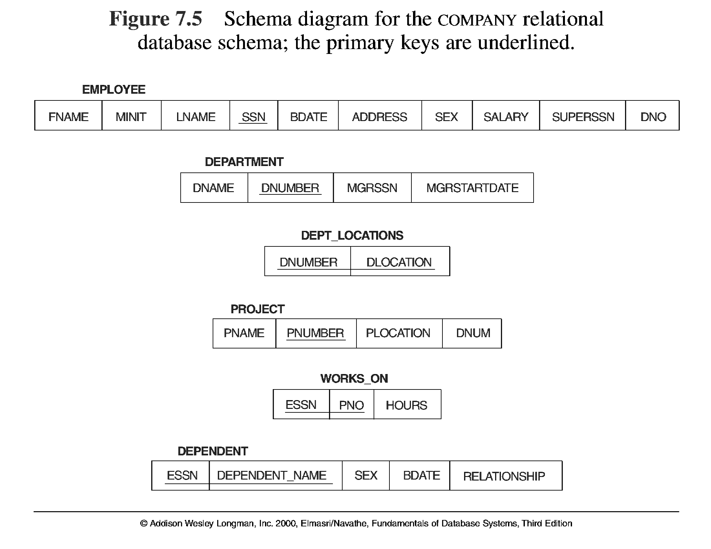
Database State for COMPANY

Slide 3
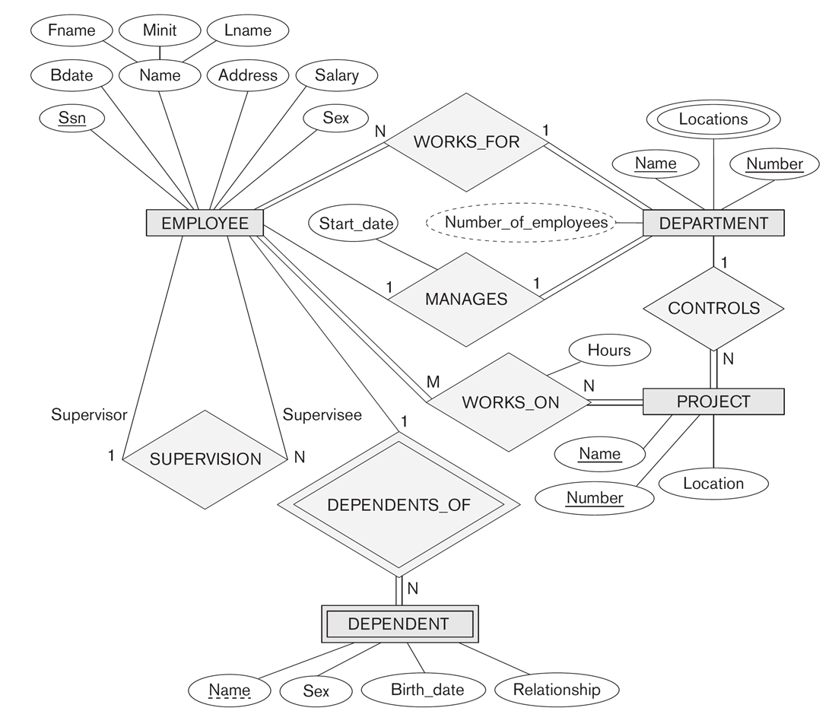
ER DIAGRAM – COMPANY DATABASE
Entity Types: EMPLOYEE, DEPARTMENT, PROJECT, DEPENDENT
Relationship Types: WORKS_FOR, MANAGES, WORKS_ON, CONTROLS, SUPERVISION, DEPENDENTS_OF

Slide 4
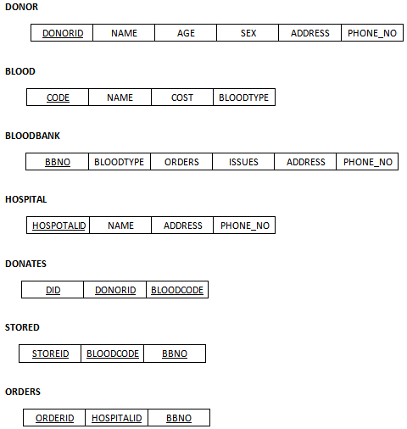
Database State for BLOOD BANK

Slide 5
ER DIAGRAM – COMPANY DATABASE
IDENTIFY THE FOLOWING:
Entity
Attributes
Relationships
Entity Integrity
Referential Integrity

Slide 6
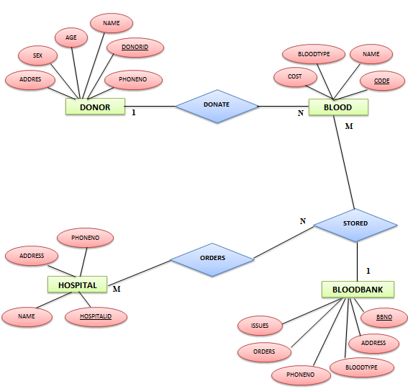
ER DIAGRAM – BLOOD BANK DATABASE

Slide 7
Database State for MERCHANT PAYMENT PROCESSING
CUSTOMERS
ID
NAME
ADDRESSLINE1
ADDRESSLINE2
CITY
STATE
ZIPCODE
CUNTRYCODE
CONTACTNAME
CONTACTEMAIL
CONTACTPHONE
SIZE
ROWVERSION
MERCHANTS
ID
NAME
CODE
TYPE
CANPROCESSSALE
CANPROCESSCREDIT
CUSTOMERID
ROWVERSION
TRANSACTIONS
ID
REFERENCEID
TYPE
CARDNUMBER
CARDHOLDER
AMOUNT
REQUESTDATE
RESPONSEDATE
ISAPPROVED
RESPONSECODE
CUSTOMERID
MERCHANTID
TERMINALID
ROWVERSION
TERMINALS
ID
CODE
CANPROCESSSALE
CANPROCESSCREDIT
MERCHANTID
ROWVERSION
COUNRIES
CODE
NAME

Slide 8
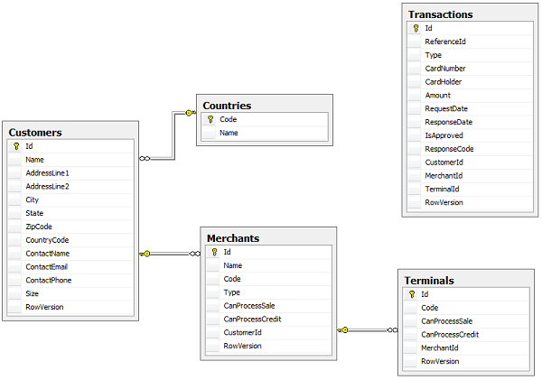
ER DIAGRAM – MERCHANT PAYMENT PROCESSING

Slide 9
Thank You

