Slide 1
Course No: SEWP ZC322 Course Title: Database Management Systems

Slide 2
BIOMETRIC SYSTEM
A BioMetric system provides many benefits to organizations. It enables an employer to have full control of all employees working hours. It helps control labor costs by reducing over-payments, which are often caused by transcription error, interpretation error and intentional error. Manual processes are also eliminated as well as the staff needed to maintain them.
It is often difficult to comply with labor regulation, but a time and attendance system is invaluable for ensuring compliance with labor regulations regarding proof of attendance.
Companies with large employee numbers might need to install several time clock stations in order to speed up the process of getting all employees to clock in or out quickly or to record activity in dispersed locations. In the business world of today we all know one simple truth…TIME IS MONEY! We work to keep the amount of time it takes to complete even the simplest tasks down to the minimum.

Slide 3
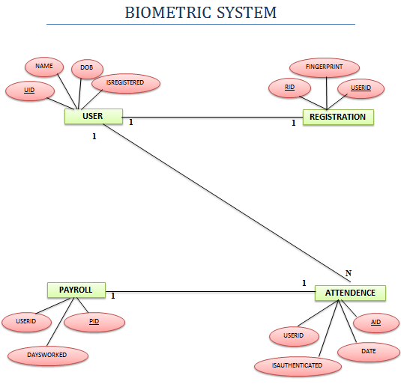

Slide 4
VEHICLE COMPARER FRAMEWORK
Vehicle comparison is one of the most happening comparison when people opt and choose a type of vehicle.
The Vehicle Comparer Framework allows user to find the most economical models available, or choose a specific vehicle and decide on purchasing the vehicle.
Vehicle Comparer Framework also allows you to compare the performance, Engine Details and running costs.

Slide 5
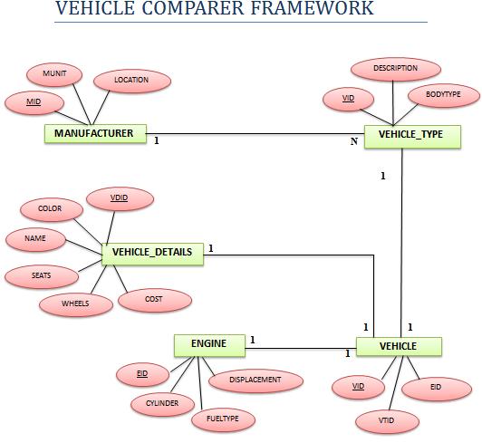

Slide 6
Thank You

