Slide 1
Data Structures Algorithm and Design SSZG519
Mr. Chennupati R Prasanna

Slide 2
SSZG519- Introduction to tree

Slide 3
Linear data structures
Here are some of the data structures we have studied so far:
Arrays
Singly-linked lists and doubly-linked lists
Stacks and queues
These all have the property that their elements can be adequately displayed in a straight line
How to obtain data structures for data that have nonlinear relationships

Slide 4
How should one decide which data structure to use ?
What need to be stored
Cost of operations
Memory use
Ease of implementation ☺

Slide 5
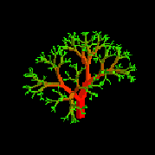
Nature View of a Tree
leaves
branches
root

Slide 6
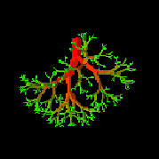
Computer Scientist’s View
root
leaves
branches
nodes

Slide 7
What is a Tree
A tree is a finite nonempty set of elements.
It is an abstract model of a hierarchical structure.
consists of nodes with a parent-child relation.
Applications:
Organization data
File systems /storing naturally
Trie -dictionary
Network routing algorithm.
Computers”R”Us
Sales
Manufacturing
R&D
US
International
Laptops
Desktops
Europe
Asia
Canada

Slide 8
Tree Terminology
Root: node without parent (A)
Siblings: nodes share the same parent
Internal node: node with at least one child (A, B, C, F)
External node (leaf ): node without children (E, I, J, K, G, H, D)
Ancestors of a node: parent, grandparent, grand-grandparent, etc.
Descendant of a node: child, grandchild, grand-grandchild, etc.
Degree of a node: the number of its children
Degree of a tree: the maximum number of its node.
Depth of x = no of edges in path from root to x.
Height of x= no of edges in longest path from x to a leaf.
Subtree: tree consisting of a node and its descendants
A
subtree
B
C
D
E
F
G
H
I
J
K

Slide 9
Binary Tree
Each node can have at most 2 –child
This is also binary tree
What about this ?

Slide 10
Strict/proper binary tree
Each node can have either 2 or 0 children.

Slide 11
Complete Binary tree
L0
All levels except possibly the last are completely filled and all nodes are as left as possible.
L1
L2
L3
Max no of nodes at level i = 2^{i}
This is not the left as possible

Slide 12
Complete Binary tree[cont..,]
All levels except possibly the last are completely filled and all nodes are as left as possible.

Slide 13
Complete Binary tree [cont..,]
L0
All levels except possibly the last are completely filled and all nodes are as left as possible.
L1
L2
L3
This is the lest as possible

Slide 14
Perfect binary tree
Maximum no of nodes in a binary tree with height h
= 2⁰ + 2¹ + ….. + 2^{h}
= 2^{h+1} - 1
= 2^{(no of levels)} – 1
n = 2^{h+1} – 1
In perfect binary all levels will be complete filled.
Now you can find the high of a tree, with n
n = 2^{h+1} – 1
2^{h+1} = n+1
h = log₂(n+1) – 1
Height of complete binary tree h = floor (log₂n)

Slide 15
Now you can find the high of a tree, with n
n = 2^{h+1} – 1
2^{h+1} = n+1
h = log₂(n+1) – 1
Height of complete binary tree h = floor (log₂n)
Proof of complete binary can be found the introduction to algorithms.

Slide 16
Min and max height of a binary tree
L0
Min-height of n- nodes = floor (log₂n)
L1
L2
Max-height of n- nodes = n-1

Slide 17
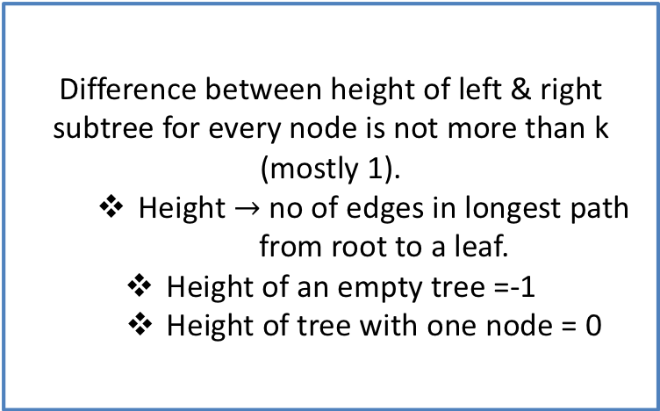
Balanced binary tree
Difference between height of left & right subtree for every node is not more than k (mostly 1).
Height $→$ no of edges in longest path from root to a leaf.
Height of an empty tree =-1
Height of tree with one node = 0

Slide 18
Binary tree implementation
We can implement binary tree using
Dynamically created nodes
Arrays [ this will only happen to complete binary tree]

Slide 19
Complete Binary Trees: Array Representation
Complete Binary Trees can be represented in
memory with the use of an array A so that all
nodes can be accessed in O(1) time:
Label nodes sequentially top-to-bottom and left-to-right
Left child of A[i] is at position A[2i]
Right child of A[i] is at position A[2i + 1]
Parent of A[i] is at A[i/2]

Slide 20
Complete Binary Trees: Array Representation
1
Left child of A[i] is at position A[2i]
Right child of A[i] is at position A[2i + 1]
14
2
3
10
16
4
5
6
7
8
12
15
18
8
9
10
11
7
9
11
13
14 | 10 | 16 | 8 | 12 | 15 | 18 | 7 | 9 | 11 | 13

Slide 21
Binary Trees: Linked List Representation
A Binary tree is a linked data structure. Each node contains data (including a key and satellite data), and pointers left, right and p.
Left points to the left child of the node.
Right points to the right child of the node.
p points to the parent of the node.
If a child is missing, the pointer is NIL.
If a parent is missing, p is NIL.
The root of the tree is the only node for which p is NIL.
Nodes for which both left and right are NIL are leaves.

Slide 22
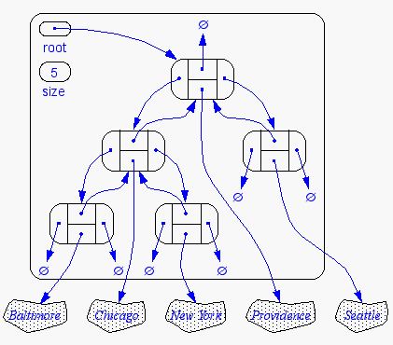
Binary Trees: Linked List Representation

Slide 23
Binary Tree Traversals
A binary tree is defined recursively: it consists of a root, a left subtree and a right subtree
To traverse (or walk) the binary tree is to visit each node in the binary tree exactly once.
Tree traversals are naturally recursive.
Since a binary tree has three parts, there are six possible ways to traverse the binary tree:
root, left, right : preorder (root, right, left)
left, root, right: inorder (right, root, left)
left, right, root: postorder (right, left, root)

Slide 24
Binary Tree Traversals
1
preorder: 1 2 3
inorder: 2 1 3
postorder: 2 3 1
2
3

Slide 25
Tree Traversal: InOrder
In-order traversal
Visit left subtree (if there is one) In Order
print the key of the current node
Visit right subtree (if there is one) In Order
I

Slide 26
Tree Traversal: PreOrder
Another common traversal is PreOrder.
It goes as deep as possible (visiting as it goes) then left to right
print root
Visit left subtree in PreOrder
Visit right subtree in PreOrder

Slide 27
Tree Traversal: PostOrder
PostOrder traversal also goes as deep as possible, but only visits internal nodes during backtracking.
recursive:
Visit left subtree in PostOrder
Visit right subtree in PostOrder
print root

Slide 28
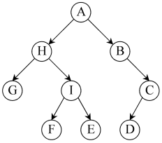
Tree Traversal: examples
Preorder (DLR) traversal yields: A, H, G, I, F, E, B, C, D
Postorder (LRD) traversal yields: G, F, E, I, H, D, C, B,A
In-order (LDR) traversal yields: G, H, F, I, E, A, B, D, C

Slide 29
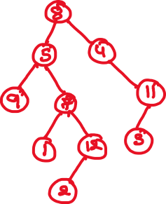




Slide 30



Slide 31

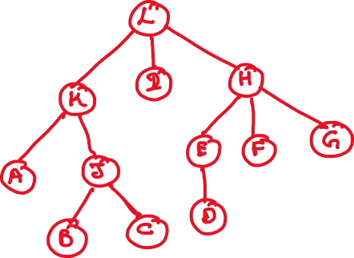

Slide 32




Slide 33
Thank You!!

