Slide 1
SSZG 518: Database Design and Applications
Today’s Class
Normalization

Slide 2
OUTLINE
4NF
5NF

Slide 3
4 NF
BCNF removes any anomalies due to FDs
Further research has led to the identification of another type of dependency called Multi-valued Dependency (MVD)
Proposed by R Fagin* in 1977
MVDs can also cause data redundancy
MVDs are a generalization of FDs
* R Fagin: “Multi-valued Dependencies & a new normal form for relational databases,” ACM TODS2, No. 3 (Sept. 1977)

Slide 4
4 NF
Consider the following relation:
In relational databases, repeating groups are not allowed
Course | Teacher | Texts
DBS | N Goyal J P Misra Yash | Garcia Korth Elmasiri Raghu
Networks | S Mohan Rahul J P Misra | Tannenbaum Keshav Petterson

Slide 5
4 NF
1 NF Version
CTX
COURSE | TEACHER | TEXTS
DBS | N GOYAL | GARCIA
DBS | N GOYAL | KORTH
DBS | N GOYAL | ELMASIRI
DBS | N GOYAL | RAGHU R
DBS | J P MISRA | GARCIA
DBS | J P MISRA | KORTH
DBS | J P MISRA | ELMASIRI
DBS | J P MISRA | RAGHU R
NETWORKS | S MOHAN | TANNENBAUM
NETWORKS | S MOHAN | KESHAV
NETWORKS | S MOHAN | KUROSE
NETWORKS | RAHUL | TANNENBAUM
NETWORKS | RAHUL | KESHAV
NETWORKS | RAHUL | KUROSE

Slide 6
4 NF
ANY REDUNDANCY? ANY ANOMALIES?
CTX
COURSE | TEACHER | TEXTS
DBS | N GOYAL | GARCIA
DBS | N GOYAL | KORTH
DBS | N GOYAL | ELMASIRI
DBS | N GOYAL | RAGHU R
DBS | J P MISRA | GARCIA
DBS | J P MISRA | KORTH
DBS | J P MISRA | ELMASIRI
DBS | J P MISRA | RAGHU R
NETWORKS | S MOHAN | TANNENBAUM
NETWORKS | S MOHAN | KESHAV
NETWORKS | S MOHAN | PETTERSON
NETWORKS | RAHUL | TANNENBAUM
NETWORKS | RAHUL | KESHAV
NETWORKS | RAHUL | PETTERSON

Slide 7
4 NF
Redundancy is due to the constraint that the texts for a course are independent of the instructors
This constraint cannot be expressed in terms of FDs
Example of MVD
Is CTX in BCNF?
New Teacher for DBS
New Text for Networks
Teacher teaching DBS leaves

Slide 8
4 NF
Decompose CTX into CT & TX
TX
CT
COURSE | TEACHER
DBS | N GOYAL
DBS | J P MISRA
DBS | S JAGADISH
NETWORKS | S MOHAN
NETWORKS | RAHUL
NETWORKS | J P MISRA
COURSE | TEXT
DBS | GARCIA
DBS | KORTH
DBS | ELMASIRI
DBS | RAGHU R
NETWORKS | TANNENBAUM
NETWORKS | KESHAV
NETWORKS | PETTERSON

Slide 9
4 NF
Decompose CTX into CT & TX is not done on the basis of FDs
Decompose CTX into CT & TX is done on the basis of MVDs
MVDs
Represents a dependency between attributes of a relation, such that for every value of A, there is a set of values of B & a set of values of C, The set of values for B & C are independent of each other
course →→ teacher course →→ text

Slide 10
Multi-Valued Dependencies
A multi-valued dependency occurs when a determinant determines more than one dependent, and the dependents are independent of each other
Example course implies teacher; course implies text, where teacher and text are independent
A relation with course, instructor and text is all key, and exhibits redundancy, but is in 3NF
Updates can exhibit anomalies

Slide 11
4 NF
An MVDs A →→ B is trivial if
(a) B ⊆ A or
(b) A U B = R
A relation that is in BCNF & contains no non-trivial MVDs is said to be in 4NF
CTX is not in 4NF because course →→ teacher is a non trivial MVD

Slide 12
Fourth Normal Form
Relation R is in 4 NF if and only if, whenever there exist subsets A and B of the attributes of R such that the nontrivial multi-valued dependency A multi-determines B is satisfied, then all attributes of R are also functionally dependent on A
In the previous example, decompose course,instructor, text into two relation: course, instructor, and course text

Slide 13
Multi-Valued Dependencies
An MVD is an assertion that 2 attributes or sets of attributes are independent of each other
Generalization of the concept of FD in the sense that every FD implies a corresponding MVD
Independence of attribute sets cannot be explained using FDs
SO what causes MVDs?
Role of MVDs in database schema design

Slide 14
Multi-Valued Dependencies
Most common source of redundancy in BCNF schemas is to put 2 or more M:M relationships in a single relation
Note that in CTX, there are no non-trivial FDs
If you fix the values for one set of attributes, then the values in certain other attributes are independent of all the other attributes in the relation

Slide 15
Multivalued Dependencies (MVDs)
Let R be a relation schema and let α ⊆ R and β ⊆ R. The multivalued dependency
α →→ β
holds on R if in any legal relation r(R), for all pairs for tuples t₁ and t₂ in r such that t₁[α] = t₂ [α], there exist tuples t₃ and t₄ in r such that:
t₁[α] = t₂ [α] = t₃ [α] = t₄ [α] t₃[β] = t₁ [β] t₃[R – β] = t₂[R – β] t₄ [β] = t₂[β] t₄[R – β] = t₁[R – β]

Slide 16
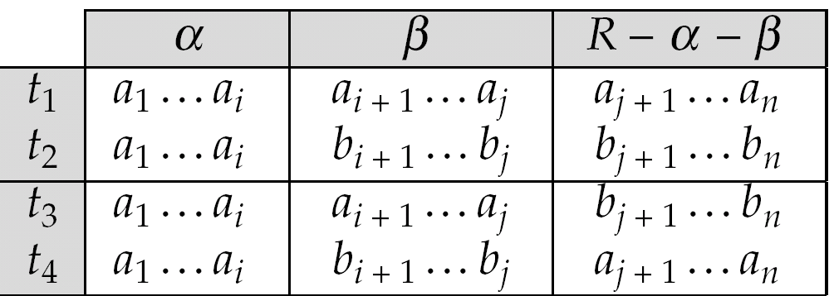
MVD (Cont.)
Tabular representation of α →→ β

Slide 17
Formal Definition of MVD
The MVD
A1A2….An →→ B1B2…Bm
holds for a relation R if
for each pair of tuples t & u that agree on As, we can find a tuple v that agrees
With t & u on As
With t on Bs
With u on all attributes of R that are not among As & Bs

Slide 18
MVD
A →→ B
A’s
B’s
Others
t
v
u

Slide 19
Higher Order Normal Forms
4NF
5NF
6NF
DKNF
Notes:
19

Slide 20
4th Order Normal Form
Fourth Normal Form(4NF)
Eliminates data redundancy caused by Multi-valued dependencies. (MVD)
A given relations in 4NF may not contain more than one multi-valued dependency.
Notes:
20
Every 4NF schema is also in BCNF
To be in Fourth Normal Form, a relation must first be in Boyce-Codd Normal Form. Additionally, a given relation may not contain more than one multivalued dependency.

Slide 21
4th Normal Form (cont’)
MVD?
Multi-value Dependencies (X→→Y) hold in a relation R if when ever we have two tuples of R that agree on all the attributes of X, then we can swap their Y components and get two tuples that are also in R.
Notes:
21

Slide 22
4th NF(cont’)
A
1
1
B
7
3
C
4
2
Then that table should also contain two other tuples where B’s are swapped.
Do this for all tuples that have the same A values.
1
1
3
7
4
2
Example
In Relation R(A,B,C) how can we find if A→→B
If the relation has two tuples
Notes:
d2 j4 p4 $
d2 j3 p2 #
d2 j3 p4 $
d2 j4 p2 #
22

Slide 23
4th Normal Form(cont’)
What is so bad about having a table with multiple multi-valued dependencies?
Example:
Consider R(Departments, Jobs , Resources Used)
The table has the following MVDs
department →→ Parts
department →→ Jobs
Notes:
Resouces used on the project by that department
23

Slide 24
Department d1 works on jobs j1, and j2 with parts p1 and p2
Department d2 works on jobs j3, j4, and j5 with parts p2 and p4
Department d3 works on job j2 only with parts p5 and p6.
Department Job Part#
-------------------------------------------------
d1 j1 p1
d1 j1 p2 Department →→ Job
d1 j2 p1
d1 j2 p2
d2 j3 p2 Department →→ Part
d2 j3 p4
d2 j4 p2
d2 j4 p4
d2 j5 p2
d2 j5 p4
d3 j2 p5
d3 j2 p6
Notes:
What’s so bad about 4th NF?
If department D1 decides to upgrade to the latest part p7 then we would need to update two rows. Instead of one. Its the same delete and adding information to such a table.
24

Slide 25
If you want to add a part to a department, you must create more than one new row.
Likewise, to remove a part or a job from a row can destroy information.
Updating a part or job name will also require multiple rows to be
changed.
The solution is to split this table into two tables, one with
(department, projects) in it and one with (department, parts) in it.
**Only desirable MVD is the ones whose determinant is a super key of R.
Special Case:
Assume R has the following two-multi value dependencies:
A →→ B and B →→ C
In this case R will be in the fourth normal form iff B and C are dependent on each other.
Notes:
What’s so bad about 4th NF?
25

Slide 26
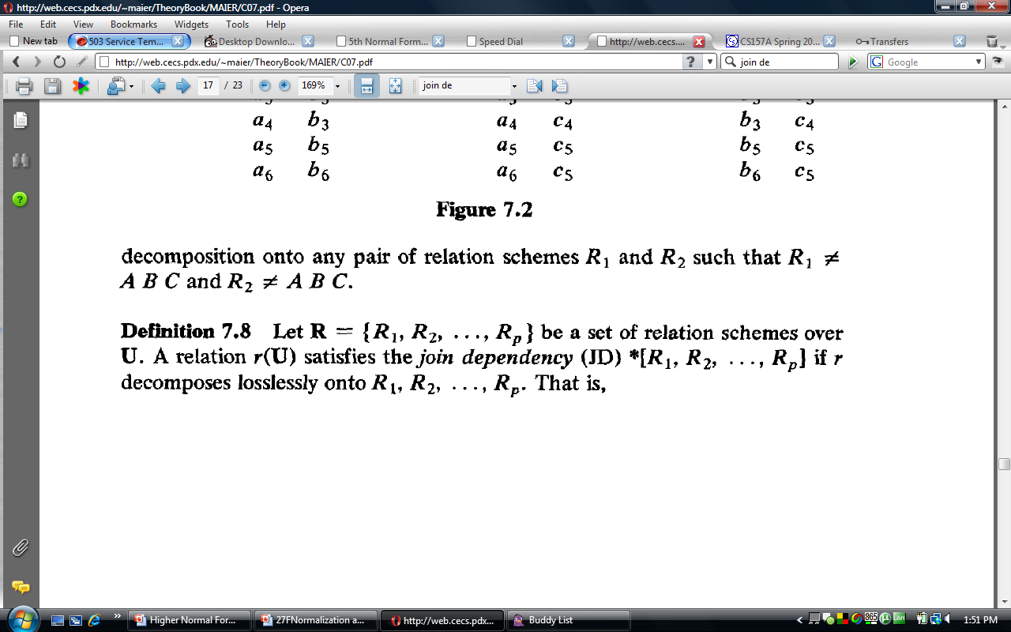
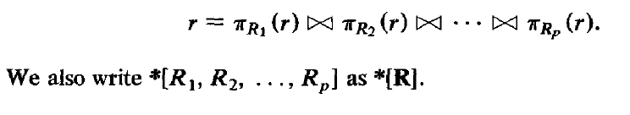
5th Normal Form
A relation R is in 5NF if for all join dependencies at least one of the following holds.
(R1, R2, ..., Rn) is a trivial join-dependency.
Every Ri is a candidate key for R.
Notes:
(a) that is, one of Ri is R
26

Slide 27
5th Normal Form
A table is said to be in the 5NF iff it is in 4NF and every join dependency in it is implied by the candidate keys.
Sometimes its impossible to break the table into 2 tables, that is when you can use the rules of 5NF to normalize.
Generally a table in 4th NF is always in 5th NF, but sometimes real world constraint will cause the Relation to be not comply with 5th NF.
Notes:
Some times its impossible to
27

Slide 28
5th Normal Form(cont’)
Join Dependencies: They are basically generalization of MVD.
A condition where the natural join of all its projections results in the reconstruction of R.
If such a condition is present then that relation should be replaced with the tables that consist of its projections.
Notes:
28

Slide 29
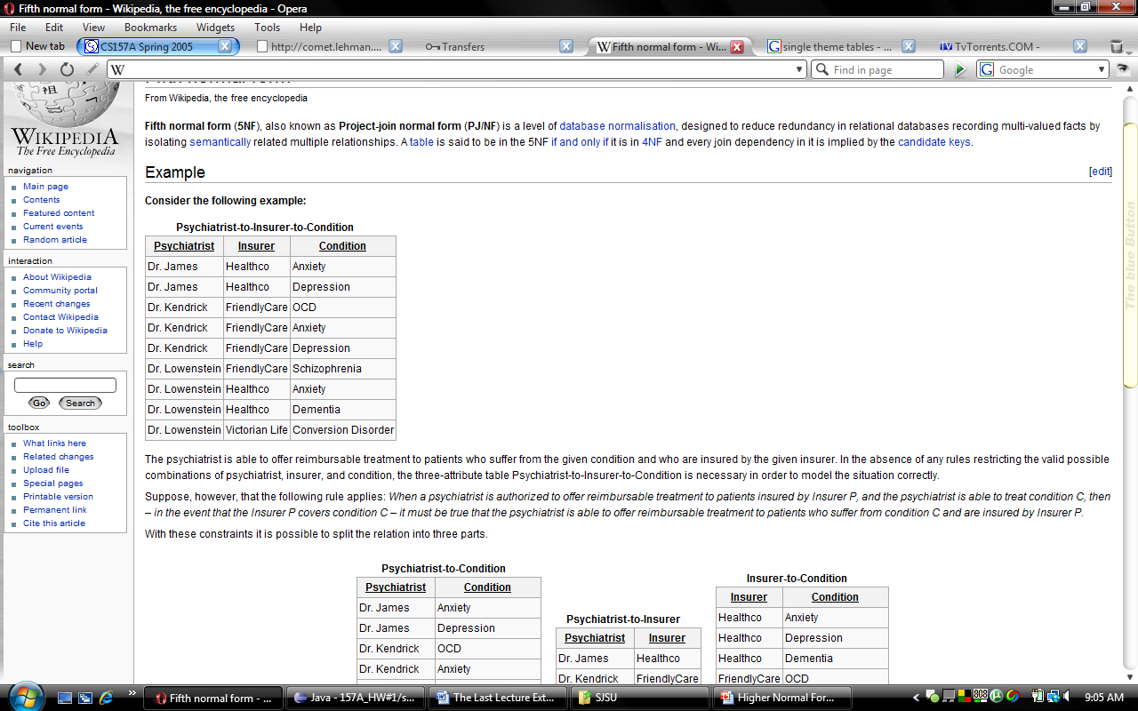
5th Normal Form(cont’)
The psychiatrist is able
to offer reimbursable treatment to patients who suffer from the given condition and who are insured by the given insurer. Psychiatrist-to-Insurer-to-Condition is necessary in order to
model the situation correctly.
Notes:
Dr.
29

Slide 30
5th Normal Form(cont’)
Suppose, however, that the following rule applies: When a psychiatrist is authorized to offer reimbursable treatment to patients insured by Insurer P, and the psychiatrist is able to treat condition C, then – in the event that the Insurer P covers condition C – it must be true that the psychiatrist is able to provide treatment to patients who suffer from condition C and are insured by Insurer P.
Notes:
Basically if insurance P ever starts covering condition C then any patient that belongs to that insurance also gets free treatments for theat condition
30

Slide 31
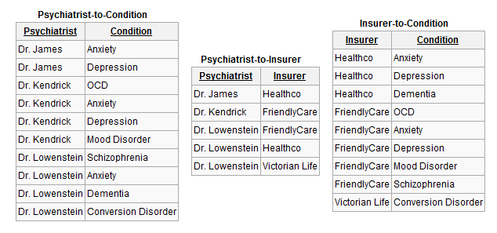
5th (cont’)
These are all the possible projections of the Previous table. And if (R1 |X| R2) or (R2 |X| R3) or (R1 |X| R3) result in R then there are MVD (4th NF), and if NJ of {R1, R2, R3} results in R then JD exist and the original table is not in 5th NF
Notes:
This setup helps to remove redundancy. Suppose that Dr. James becomes a treatment provider for FriendlyCare. In the previous setup we would have to add two new entries since Dr. James is able to treat two conditions covered by FriendlyCare: anxiety and depression. With the new setup we need only add a single entry (in Psychiatrist-to-Insurer).
31

Slide 32
5th (cont’)
Only in rare situations does a 4NF table not conform to 5NF. These are situations in which a complex real-world constraint governing the valid combinations of attribute values in the 4NF table is not implicit in the structure of that table.
Notes:
In the real world applications take up the responsibility to present the
32

Slide 33
Fifth Normal Form
A relation R is in 5NF – also called projection-join normal form, if and only if every nontrivial join dependency that is satisfied by R is implied by the candidate key(s) of R
It is the most general form possible for projection-based normalization

Slide 34
DKNF
DKNF offers a complete solution to the problem of avoiding modification abnormalities
Domain/key normal form (DKNF). A key uniquely identifies each row in a table.
By enforcing key and domain restrictions, the database is assured of being freed from any modification inconsistency.
Notes:
34
A domain is the set of permissible values for an attribute
DKNF is the normalization level that most designers aim to achieve

Slide 35
DKNF
Ronald Fagin (1981) proved that if a Relation is in DKNF then it is free from any anomalies(redundancies). Including the ones caused by FDs, MVDs, JDs.
DKNF seems simple enough then why all the hoopla about 1NF, 2NF, 3NF, BCNF, 4NF, 5NF
Notes:
35

Slide 36
DKNF
DKNF not always achievable, and there is no formal definition to verify if a relation schema is in DKNF
In short, sets of single-theme tables will most likely be in DKNF.
Notes:
36
In fact, it isn't even a rule, since there's no known procedure or algorithm to guarantee it

Slide 37
Denormalization
Denormalization is said to be necessary to improve performance
Technically normalization is a model concept, not related to stored files
In practice, denormalization will speed up some queries, and drag down others

