Slide 1

SAIP Chapter 16: J2EE/EJB
Industry Standard Computing Infrastructure
Russell Greenspan
rgreensp@uiuc.edu
CS527
September 30, 2004

Slide 2
Outline
Introducing J2EE/EJB
Quality Attributes and Requirements
Architectural Overview of J2EE/EJB
Beans, beans, and more beans
  EJB Programming
  Deployment Descriptors
Conclusion
  Architectural tactics support requirements
  Other similar systems - Microsoft COM+, .NET
  Your comments

Slide 3
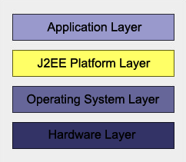
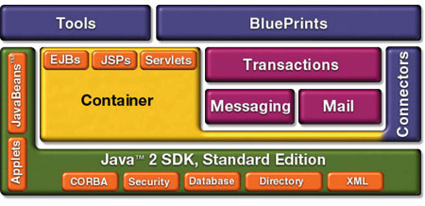
Introducing J2EE/EJB
“J2EE describes the overall multi-tier architecture for designing, developing, and deploying component-based, enterprise-wide applications.” [Bass, Clements, Kazman, 406]
J2EE composed of more than a dozen services (of which EJB is one) that function together to facilitate development of distributed applications

Slide 4
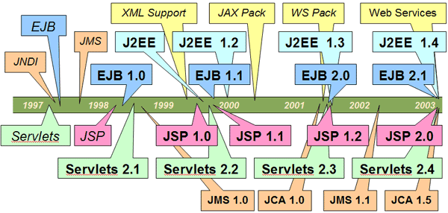
Introducing J2EE/EJB (2)
Brief History

Slide 5
Introducing J2EE/EJB (3)
Sun vs. Microsoft battles
  1996 Microsoft releases ASP; in 1998 Sun releases JSP
  1997 Microsoft releases ADSI; in 1998 Sun releases JNDI
  1997 Microsoft releases MSMQ; in 1998 Sun releases JMS
  1997 Microsoft releases Microsoft Transaction Server; in 1998 Sun releases EJB
  1998 Microsoft releases MSXML; in 2001 Sun releases JAXP
  2000 Microsoft releases Queued Components; in 2001 Sun releases Message Driven Beans
  2000 Microsoft releases XML Web Services; in 2001 Sun releases Java Web Services Developer Pack

Slide 6
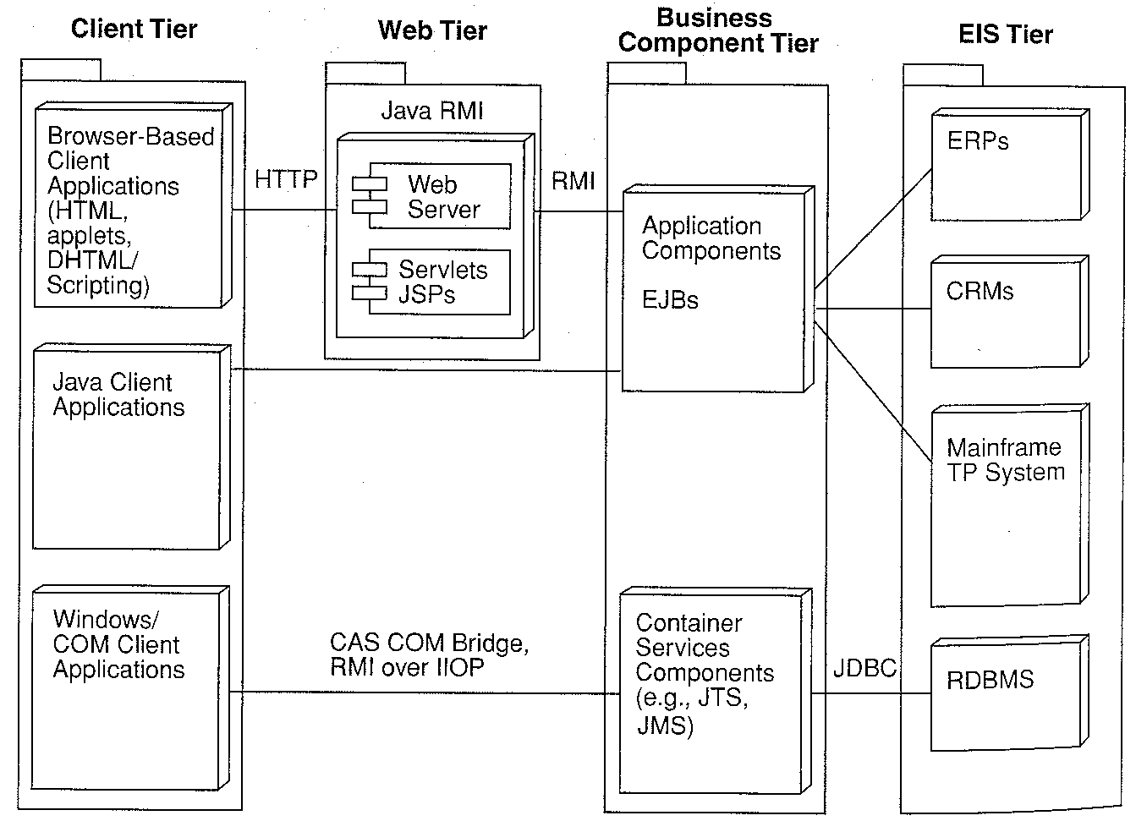
Introduction - J2EE Overview
Client tier
  Internet browser or Java client
Web tier
  Web server handling requests through JSPs and servlets
Business component tier (EJBs)
  Functional units that implement business rules and manipulate data
Enterprise information systems tier
  Databases, CRMs, mainframes, etc.

Slide 7
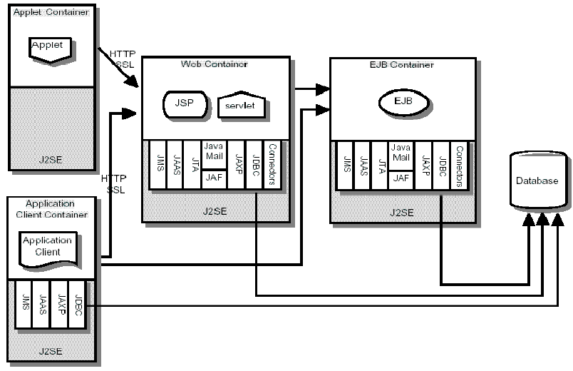
Introduction - J2EE Overview (2)

Slide 8
J2EE Quality Attributes and Requirements
Usability
  Buildability
    Inherent transaction management, security, naming services
  Implementation Transparency
    Client programs independent of object implementation details
  Interoperability
    Allow bridges for J2EE->CORBA->MS transitions
  Portability
    Expand “write once, run anywhere” to server-side applications

Slide 9
J2EE Quality Attributes and Requirements (2)
Modifiability
  Balanced Specificity
    Provide enough details for component developers and integrators, but keep general enough for vendor-specific features and optimizations
  Evolvability
    Allow incremental technology adoptions
  Extensibility
    Allow incorporation of new technologies as they are developed

Slide 10
J2EE Quality Attributes and Requirements (3) – Web-based
Performance
  Scalability
    Support variations in load due to bursty nature of requests
  Responsiveness
    Servers must respond with quick reply

Slide 11
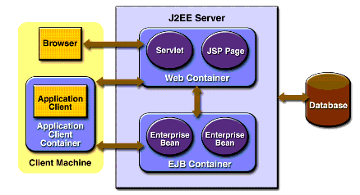
Architectural Overview – EJB within J2EE

Slide 12
Architectural Overview – EJB
Container approach provides component separation
  Provides OS process (and thread creation) to host one or more EJB components
  Interfaces with the underlying systems that support the components (RDBMS)
  Manages all resources on the component’s behalf and all external interactions

Slide 13
Architectural Overview – EJB (2)
Home and Remote interfaces handle remote instantiation and method calling
  Home
    Provides communication path with the container
    Is responsible for creating or removing one or more beans and returning Remote interfaces
    For entity beans, the home interface also defines finder methods used to locate entity beans (findbyPrimaryKey)
  Remote
    Link to the bean through which all method calls occur

Slide 14
Architectural Overview – EJB (3)
Why Remote/Home separation?
  Clear division of roles and responsibilities
  Home functions as Factory object and Remote as the object produced by the Factory
    Home might manage a pool of beans, such that the client does not need to know which actual bean it is using
    Remote provides calling wrapper for business methods

Slide 15
Architectural Overview – EJB (4)
New EJB 2.0 interfaces allow bean to bean method calls within the same container via Local interfaces
Avoids expensive RMI calls
  Local Interface
    Similar to the Remote interface
    Extends javax.ejb.EJBLocalObject
  Local Home Interface
    Similar to the Home interface
    Extends javax.ejb.EJBLocalHome

Slide 16
Beans, beans, and more beans
Session beans
  Stateless
  Stateful
Entity beans
Message-driven beans

Slide 17
Session Beans
Perform a task for a client
Stateless
  Any bean can satisfy any request
  Performs a generic function for all clients, collects read-only data
Stateful
  State retained (through use of secondary storage) for life of the client-bean session

Slide 18
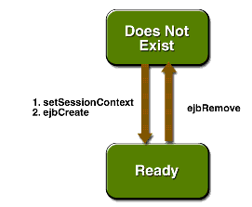
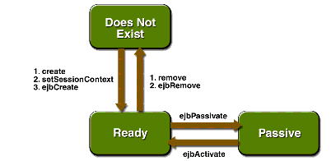
Session bean lifecycle
Stateless vs. Stateful
Client code calls create/remove methods on Home interface, which forward calls to appropriate ejbCreate and ejbRemove implementations

Slide 19
Session Bean Implementation
Must implement the SessionBean interface
Must implement one or more ejbCreate methods
Must contain a public constructor with no parameters
Must not define the finalize method
Class must be defined as public
Class cannot be defined as abstract or final

Slide 20
Session bean example – ShoppingCart (from java.sun.com)
Home implementation (CartHome)
  Defines the create methods that a remote client can invoke
  Every create method in the home interface corresponds to an ejbCreate method in the bean class
Remote implementation (CartRemote)
  Wrapper for bean’s business methods
Session bean class (CartBean)

Slide 21
CartHome
import java.io.Serializable;
import java.rmi.RemoteException;
import javax.ejb.CreateException;
import javax.ejb.EJBHome;
public interface CartHome extends EJBHome {
CartRemote create(String person) throws
RemoteException, CreateException;
CartRemote create(String person, String id) throws
RemoteException, CreateException;
}

Slide 22
CartRemote
import java.util.*;
import javax.ejb.EJBObject;
import java.rmi.RemoteException;
public interface CartRemote extends EJBObject {
public void addBook(String title) throws RemoteException;
public void removeBook(String title) throws
BookException, RemoteException;
public Vector getContents() throws RemoteException;
}

Slide 23
CartBean
import java.util.*;
import javax.ejb.*;
public class CartBean implements SessionBean {
String customerName;
String customerId;
Vector contents;
public void ejbCreate(String person) throws CreateException {
if (person == null) {
throw new CreateException("Null person not allowed.");
}
else {
customerName = person;
}
customerId = "0";
contents = new Vector();
}
public void ejbCreate(String person, String id) throws CreateException {
if (person == null) {
throw new CreateException("Null person not allowed.");
}
else {
customerName = person;
}
IdVerifier idChecker = new IdVerifier();
if (idChecker.validate(id)) {
customerId = id;
}
else {
throw new CreateException("Invalid id: "+ id);
}
contents = new Vector();
}
public void addBook(String title) {
contents.addElement(title);
}
public void removeBook(String title) throws BookException {
boolean result = contents.removeElement(title);
if (result == false) {
throw new BookException(title + "not in cart.");
}
}
public Vector getContents() {
return contents;
}
public CartBean() {}
}

Slide 24
Walkthrough
Client instantiates CartHome object
  Calls desired create() method
  Internally, CartHome calls the corresponding ejbCreate method in CartBean
  CartHome object returns CartRemote interface pointer to created bean
Client calls methods on returned CallRemote interface
  CartBean responds to calls via its CartRemote implementation

Slide 25
Entity bean
Represents a business entity object that exists in persistent storage
  Bean-managed persistence, you write the persistence code
  Container-managed, EJB generates persistence calls
Inherent transaction management for multiple clients accessing the same data

Slide 26
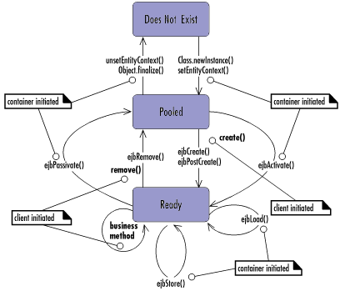
Entity bean – lifecycle
After instantiation, the entity bean moves to a pool of available instances. While in the pooled stage, the instance is not associated with any particular EJB object identity. All instances in the pool are identical.
Beans are readied from the pool when a client calls create (i.e. creates a new instance of the business object), or when the EJB container activates the bean
Beans are pooled when a client removes the bean (i.e. deletes the business object from the database) or when the EJB container passivates the bean when it is not busy

Slide 27
Bean distinction
Entity beans are used when the bean represents a business entity and not a procedure
  For example, CreditCardBean would be an entity bean, but CreditCardVerifierBean would be a session bean
Entity beans are instances of a business object, Session beans are more like static method calls

Slide 28
More beans - Message-driven beans
Introduced in EJB 2.0
Acts as a listener for the Java Message Service (JMS) API, processing messages asynchronously
Similar to Stateless Session bean
  Instances retain no data or state for a client
  All instances are equivalent, allowing the EJB container to assign a message to any message-driven bean instance and to pool instances
  One bean can process messages from multiple clients

Slide 29
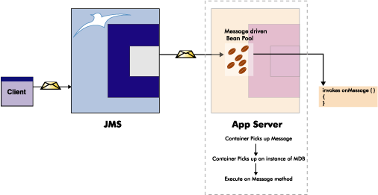
More beans - Message-driven beans (2)
Clients communicate by sending JMS messages for which the message-driven bean class is the MessageListener

Slide 30
Deployment Descriptors
XML document specifying which services a bean, servlet, JSP, etc. uses and how it uses them
  Persistence
  Security
  Transaction management
  Stateless vs. stateful
Location of data sources
  Primary keys, Database field mappings
External dependencies

Slide 31
Deployment Descriptors (2)
<ejb-jar> <enterprise-beans> <session> <description>Shopping Cart</description> <ejb-name>Cart</ejb-name> <home>sample.ejb.CartHome</home> <remote>sample.ejb.CartRemote</remote> <ejb-class>sample.ejb.CartBean</ejb-class> <session-type>Stateless</session-type> <transaction-type>Container</transaction-type> </session> <entity> etc... </entity> </enterprise-beans> </ejb-jar> | <web-app> <display-name>AppCart</display-name> <description>J2EE Web Module</description> <servlet> <servlet-name>AppServlet</servlet-name> <display-name>AppServlet</display-name> <servlet-class>AppServlet</servlet-class> </servlet> <servlet-mapping> <servlet-name>AppServlet</servlet-name> <url-pattern>AppServlet</url-pattern> </servlet-mapping> <session-config> <session-timeout>0</session-timeout> </session-config> </web-app>
See http://java.sun.com/dtd/ejb-jar_2_0.dtd for the complete specification and http://java.sun.com/xml/ns/j2ee/ejb-jar_2_1.xsd for the entity bean specification

Slide 32
How Architectural Tactics Support Requirements - Usability
Abstract common services, Maintain interfaces, Hide information
  Buildability – provide ready-to-use services such as transaction support, persistence, threading, resource management
Semantic Coherence, Use an intermediary
  Implementation Transparency – Home and Remote interfaces, Deployment Descriptors
Generalize modules, Separate user interface
  Portability – provide functionality without regard to lower-level implementation

Slide 33
How Architectural Tactics Support Requirements (2) - Modifiability
Configuration files
  Balanced Specificity – deployment descriptors offer meaningful description, but can be generalized in XML standard format
Anticipate expected changes
  Extensibility – component based approach allows for future extensions (such as Message-driven beans)
Semantic coherence
  Evolvability – specification partitioned into separately evolvable subcategories

Slide 34
How Architectural Tactics Support Requirements (3) - Performance
Load balancing
  Scalability – built-in mechanisms for expanding available servers and balance load across them
Maintain multiple copies
  Responsiveness – distributed component approach allows performance tuning
Garbage collection/JVM?

Slide 35
Comparison of J2EE to COM+
COM+ as an extension of COM
  Requires registry entries
  Registry entry for each class can point COM runtime to another box, allowing network-aware components
Object lives on remote box until client destroys it (i.e. reference count = 0)
Remoting handled internally

Slide 36
Comparison of J2EE to .NET
C# very similar to Java
  Rich set of libraries
  Virtual Machine paradigm employed
Event-driven web development
Nothing comparable to session/entity bean specification
Webservices
  Support for webservices has been added to J2EE, but .NET was built directly on top of the technology and relies on it extensively for distributed programming

Slide 37
When to use J2EE/EJB
Your responses:
  Reliability, Scalability, Modifiability, Security
    Online banking site
    Online store
    eBay-like auction site
  Portability, Usability
    Time tracking system
    Payroll system

Slide 38
Other tactics to apply
Caching
  “EJB is essentially an interface to DB. Certain queries are bound to be repeated. Provide a cache for storing most interesting queries (e.g. popular stock quotes) in EJB container.”
Allow EJBs to take over container’s responsibilities to maximize performance
  “The containers do allow the programmer to not have to worry about many administrative tasks, but this improved buildability may come at an expense.”

Slide 39
Your comments
“The text does a good job of explaining EJB, but lousy job with J2EE.”
“One thing I wished the chapter talked more about was the limitation of the JVM.”
“While evolvability over a large period of time is possible, it does not support evolvability over short periods of time. As an example, many extreme programming groups will avoid using EJBs at all costs due to the difficulty in rapidly making changes.”

