Slide 1
Information Retrieval
Dr. Maheswari Karthikeyan

Slide 2
Lecture Outline
Dictionaries and Tolerant Retrieval
Dictionary Data Structures
Tolerant Retrieval
Wild-card queries

Slide 3
Ch. 3
Dictionaries and Tolerant
Retrieval
Develop techniques that are robust to typographical errors in the query, as well as alternative spellings.
Dictionary data structures
Tolerant retrieval
Wild-card queries
Spelling correction
Phonetic correction

Slide 4
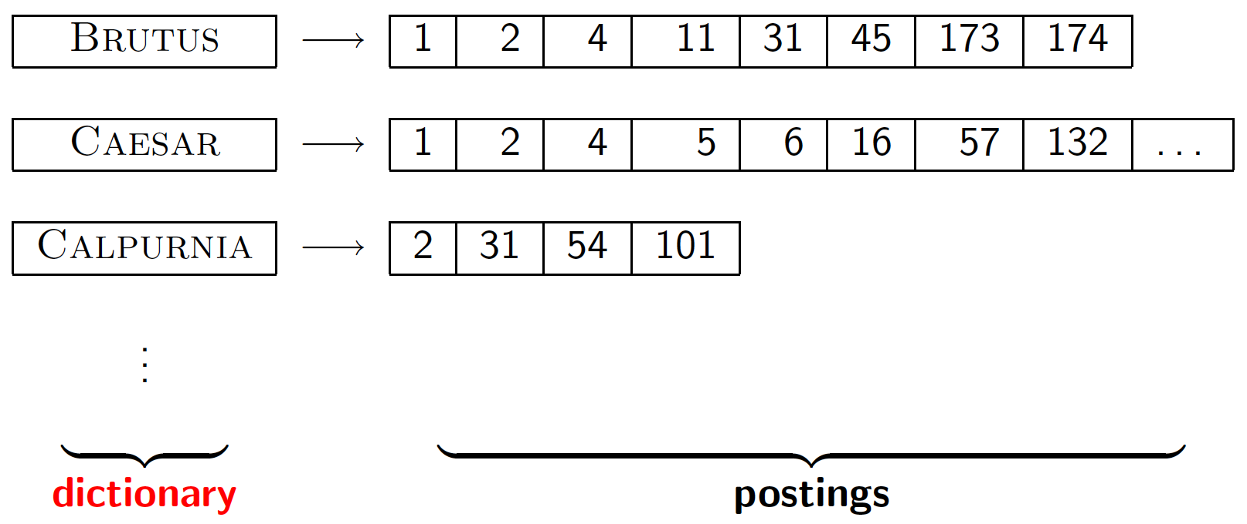
Search structures for dictionaries
Sec. 3.1
The dictionary data structure stores the term vocabulary, document frequency, pointers to each postings list … in what data structure?

Slide 5
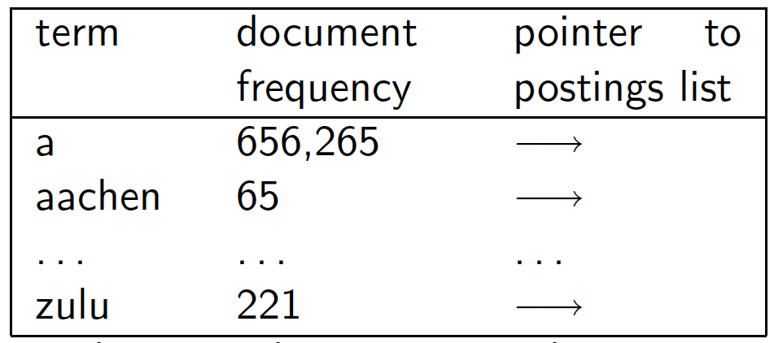
A simple dictionary
Sec. 3.1
An array of structures:
char[20] int Postings *
20 bytes 4/8 bytes 4/8 bytes
Efficient Storage ?
Efficient Retrieval ?

Slide 6
Dictionary data structures
Sec. 3.1
Two main choices:
Hashtables
Trees
The choice of solution (hashing, or search trees) depends on:
No. of keys(Terms)
Keys remain static or dynamic
The relative frequencies with which various keys will be accessed

Slide 7
Hashtables
Sec. 3.1
Each vocabulary term is hashed to an integer
Pros:
Lookup is faster than for a tree: O(1)
Cons:
No easy way to find minor variants:
judgment/judgement
No prefix search [tolerant retrieval]
If vocabulary keeps growing, need to occasionally do the expensive operation of rehashing everything

Slide 8
Tree: Binary Tree
Sec. 3.1
Root
a-m
n-z
a-hu
hy-m
n-sh
si-z
huygens
sickle
zygot
aardvark

Slide 9
Tree: B-tree
Sec. 3.1
Definition: Every internal nodel has a number of children in the interval [a,b] where a, b are appropriate natural numbers, e.g., [2,4].
a-hu
n-z
hy-m

Slide 10
Trees
Sec. 3.1
Pros:
Solves the prefix problem (terms starting with hyp)
Cons:
Slower: O(log M) [and this requires balanced tree]
Rebalancing binary trees is expensive
But B-trees mitigate the rebalancing problem
Demands that the characters used in the document collection have a prescribed ordering.

Slide 11
Tolerant Retrieval
Wild-card queries
Uncertain of the spelling of a query term (e.g., Sydney vs. Sidney, which leads to the wildcard query S*dney)
Seeking documents containing the variants (e.g., color vs. colour)
Seeking documents containing variants of a term that would be caught by stemming, but is unsure whether the search engine performs stemming (e.g., judicial vs. judiciary, leading to the wildcard query judicia*)
Uncertain of the correct rendition of a foreign word or phrase (e.g., the query Universit* Stuttgart).

Slide 12
Wild-card queries: *
Sec. 3.2
mon*: (trailing wildcard query) find all docs containing any word beginning with “mon”.
Easy with binary tree (or B-tree) lexicon: retrieve all words in range: mon ≤ w < moo

Slide 13
Wild-card queries: *
Sec. 3.2
*mon: (leading wildcard query) find words ending in “mon”:
Maintain an additional B-tree (reverse B-tree)
Reverse B-tree is one in which each root-to-leaf path of the B-tree corresponds to a term in the dictionary written backwards:
Can retrieve all words in range: nom ≤ w < non.

Slide 14
Wild-card queries: *
How can we handle *’s in the middle of query term?
co*tion
We could look up co* AND *tion in a B-tree and intersect the two term sets
Expensive
The solution: transform wild-card queries so that the *’s occur at the end
This gives rise to the Permuterm Index.

Slide 15
Wildcard Query Processing
Permuterm indexes
K-gram indexes
Both techniques express the given wildcard query q_{w} as a Boolean query Q on a specially constructed index, such that the answer to Q is a superset of the set of vocabulary terms matching q_{w}
Each term in the answer to Q is checked against q_{w,} discarding those vocabulary terms that do not match q_{w}

Slide 16
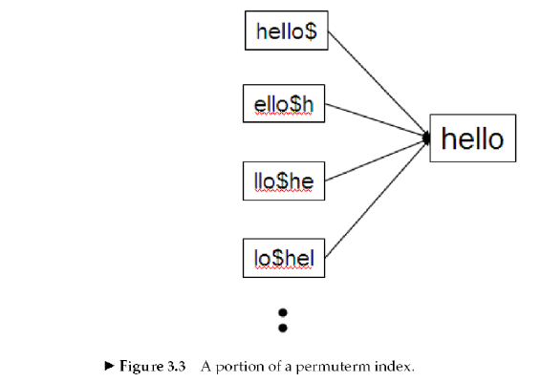
Permuterm indexes
Sec. 3.2.1
Introduce a special symbol $ into the character set, to mark the end of a term.
For term hello, index under:
hello$, ello$h, llo$he, lo$hel, o$hell, $hello
where $ is a special symbol.

Slide 17
Permuterm indexes
Sec. 3.2.1
From the permuterm we can get the term and then from the standard index we can get the documents containing the term.

Slide 18
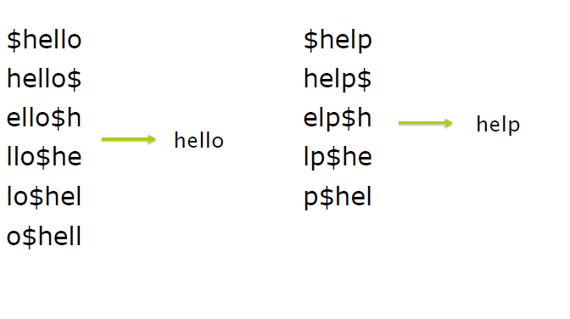
Permuterm indexes

Slide 19
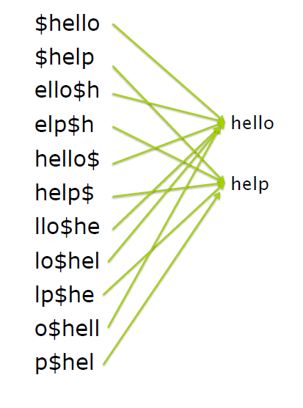
Permuterm indexes

Slide 20
Permuterm indexes
Consider the wildcard query m*n.
Rotate this wildcard query so that the * symbol appears at the end of the string
Rotated wildcard query becomes n$m*
Look up this string in the permuterm index and get the terms
Search in the inverted index all the documents indexed by these terms

Slide 21
k-gram indexes
A k-gram is a sequence of k characters.
cas, ast and stl are all 3-grams occurring in the term castle.
The full set of 3-grams generated for castle is: $ca, cas, ast, stl, tle, le$
In a k-gram index, the dictionary contains all k-grams that occur in any term in the vocabulary
Each postings list points from a k-gram to all vocabulary terms containing that k-gram

Slide 22
Sec. 3.2.2
k-gram indexes
The k-gram index finds terms based on a query consisting of k-grams (here k=2).
$m
mace
madden
mo
among
amortize
on
along
among
Maintain a second inverted index from bigrams to dictionary terms that match each bigram.

Slide 23
k-gram indexes
Sec. 3.2.2
Query mon* can now be run as
$m AND mo AND on
Gets terms that match AND version of the wildcard query.
But the enumerated term moon will also be retrieved (False Positive)
Must post-filter these terms against query.
Surviving enumerated terms are then looked up in the term-document inverted index.
Fast, space efficient.

Slide 24
Thank You!

