Slide 1



Consumer Goods Insights
By Nilesh Gohil

Slide 2
Introduction
Atliq Hardwares (imaginary company) is one of the leading computer hardware producers in India and well expanded in other countries too.
However, the management noticed that they do not get enough insights to make quick and smart data-informed decisions.
They want to expand their data analytics team by adding several junior data analysts
Providing them proper insights using MySQL queries.
The content of each slides will have following things-
1- Problem Statement
2- Mysql Query
3- Visual & Insights

Slide 3
Data Overview
The dataset of fiscal year 2020 and 2021 is available.
Atliq Hardwares fiscal year starts from 1st September and ends on 31st
August.
Atliq Hardware database (atliq_hardware_db) has 6 main tables
1. dim_customer : Consists of customer-related data
2. dim_product : Consists of product-related data
3. fact_gross_price : Consists of gross price information for each product
4. fact_manufacturing_cost : Consists of the cost incurred in the production of each product
5. fact_pre_invoice_deductions : Consists of pre-invoice deductions information for each product
6. fact_sales_monthly : Consists of monthly sales data for each product

Slide 4
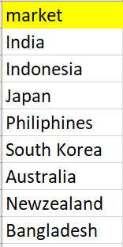
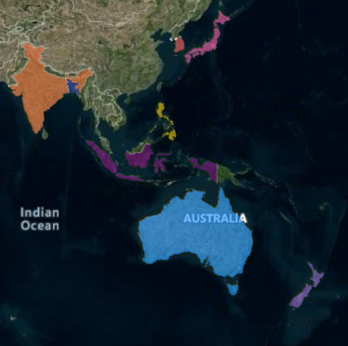
Request 1
Provide the list of markets in which customer "Atliq Exclusive" operates its business in the APAC region.
Query-
select distinct(market)
from dim_customer
where customer = "atliq exclusive" and region = "APAC";
Insight-
“Atliq Exclusive” Operates in the 8 countries of apac region shown in visuals

Slide 5
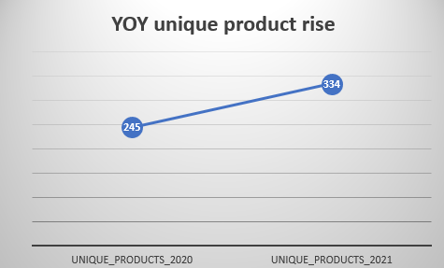
Request 2
What is the percentage of unique product increase in 2021 vs. 2020? The final output contains these fields, unique_products_2020 unique_products_2021 percentage_chg
Query-
with cte as(select
sum(case when fiscal_year = 2020 then 1 else 0 end) as unique_products_2020,
sum(case when fiscal_year = 2021 then 1 else 0 end) as unique_products_2021
from fact_gross_price)
select unique_products_2020,unique_products_2021,
round((unique_products_2021-unique_products_2020)/
unique_products_2020*100,2) as percent_chng
from cte ;
Insight-
A 36.33% increase in unique product count from 2020 to 2021 which indicates growth in unique product

Slide 6
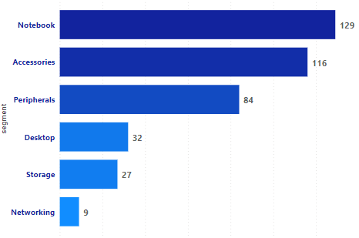
Request 3
Provide a report with all the unique product counts for each segment and sort them in descending order of product counts. The final output contains 2 fields, segment product_count
Query-
select count(distinct product_code) as product_count, segment
from dim_product
group by segment
order by product_count desc;
Insight-
Notebook Segment has the max rise in unique product count while networking had minimum, product counts varied from 9 to 129 in six segments.

Slide 7
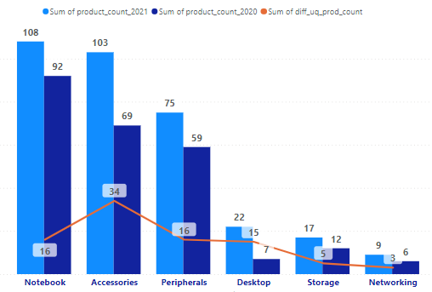
Request 4
Which segment had the most increase in unique products in 2021 vs 2020? The final output contains these fields, segment product_count_2020 product_count_2021 difference
Query-
with Unq_Prod_Cd as
(select segment,
count(distinct case when fiscal_year='2020' then fs.product_code end)
as product_count_2020,
count(distinct case when fiscal_year='2021' then fs.product_code end)
as product_count_2021
from dim_product dp
join fact_sales_monthly fs
on fs.product_code = dp.product_code
group by segment)
select segment, product_count_2020,product_count_2021,
(product_count_2021-product_count_2020)as diff_uq_prod_count
from Unq_Prod_Cd
order by diff_uq_prod_count desc;
Insight-
Accessories segment drove the highest of all by having 34 unique products in 2021 while other segments were in range of 5 to 16 but networking had least of all segments with only 3 unique products in year 2021

Slide 8
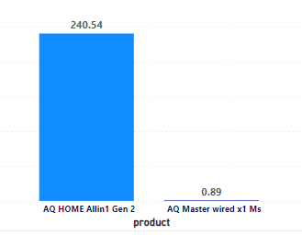

Request 5
Get the products that have the highest and lowest manufacturing costs.
The final output should contain these fields,product_code ,product & manufacturing_cost
Query-
select product,mf.product_code,manufacturing_cost
from fact_manufacturing_cost mf
join dim_product dp
on mf.product_code = dp.product_code
where manufacturing_cost in (select max(manufacturing_cost) from fact_manufacturing_cost)
or manufacturing_cost in (select min(manufacturing_cost) from fact_manufacturing_cost);
Insight-
AQ Home Allin1 Gen 2 has the highest manufacturing cost while AQ Master wired x1 Ms has the lowest manufacturing cost

Slide 9
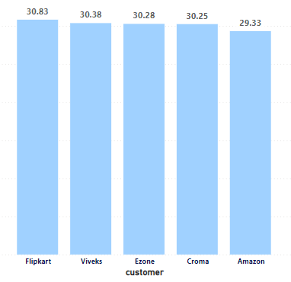
Request 6
Generate a report which contains the top 5 customers who received an average high pre_invoice_discount_pct for the fiscal year 2021 and in the Indian market. The final output contains these fields, customer_code customer average_discount_percentage
Query-
Select customer_code,customer,
round ( avg (pre_invoice_discount_pct) *100, 2 ) as average_discount_percentage
from fact_pre_invoice_deductions
join dim_customer using(customer_code)
where fiscal_year = 2021 and market = 'india’
Group by customer_code
Order by average_discount_percentage
Desc limit 5 ;
Insight-
Flipkart is on top of the list with a 30.83% average discount percentage, which is the highest, followed by Viveks with a 30.38% average discount percentage,
then Ezone, Croma, and Amazon.

Slide 10
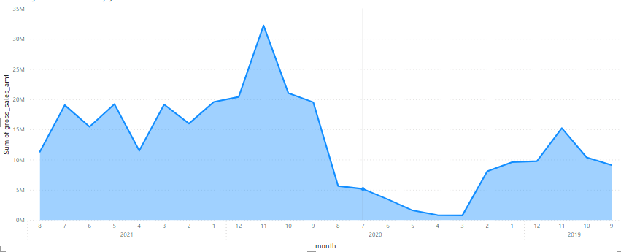
Request 7
Get the complete report of the Gross sales amount for the customer “Atliq Exclusive” for each month. This analysis helps to get an idea of low and high-performing months and
take strategic decisions.
Query-
select
Round(Sum(sold_quantity *
gross_price),2) as gross_sales_amt,
month(date) as `month`, year(date) as `year`
from dim_customer dc
join fact_sales_monthly fs
on dc.customer_code = fs.customer_code
join fact_gross_price fg
on fs.product_code = fg.product_code
where customer = 'Atliq Exclusive'
group by month(date),year(date)
order by year(date);
Insight-
the gross sales amount is continuously fluctuating across all time frames. There is a huge decline in March’ 22, which is due to effect of Covid, then Market goes on pick point on Oct’22, which just after covid wave.

Slide 11
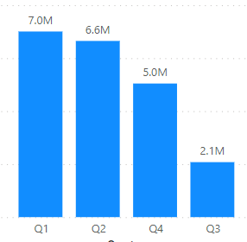
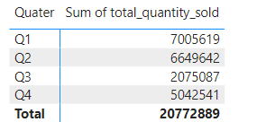
Request 8
In which quarter of 2020, got the maximum total_sold_quantity? The final output contains these fields sorted by the total_sold_quantity, Quarter total_sold_quantity
Query-
select case when month(date) in (9,10,11) then "Q1"
when month(date) in (12,1,2) then "Q2"
when month(date) in (3,4,5) then "Q3"
else "Q4"
end as Quater,
sum(sold_quantity) as total_quantity_sold
from fact_sales_monthly
where fiscal_year = '2020'
group by quater
order by total_quantity_sold;
Insight-
In 2022, Q1 contributed the most with 7 million (33.7%) of the total quantity sold, followed by Q2 and Q4. where Q3 contributed just 2.1 million (10%), which is the minimum in 2020.

Slide 12
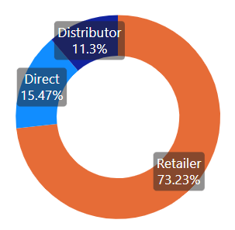
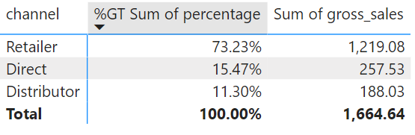
Request 9
Which channel helped to bring more gross sales in the fiscal year 2021 and the percentage of contribution? The final output contains these fields, channel & gross_sales_mln percentage
Query-
with cte as
(select channel,
round(sum(fs.sold_quantity * fg.gross_price)/1000000,2) as gross_sales
from fact_sales_monthly fs
join fact_gross_price fg
on fs.product_code = fg.product_code
and fs.fiscal_year = fg.fiscal_year
join dim_customer
on fs.customer_code = dim_customer.customer_code
where fg.fiscal_year = '2021'
group by channel)
select channel,gross_sales,
concat(round((gross_sales/(select sum(gross_sales)from cte ))*100,2),'%') as percentage
from cte
group by channel
order by percentage;
Insight-
Retail Channel is the biggest source of gross sales in year 2021, with 73.22 percent (1924 gross sales) of contribution. While just Direct is contributing just 15.48 % & Distributor is contributing 11.31% (297 gross sales) which is lowest amongst these three.

Slide 13
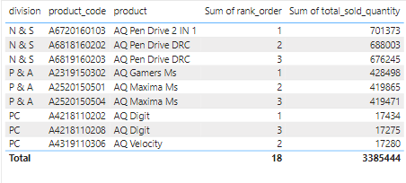
Request 10
Which channel helped to bring more gross sales in the fiscal year 2021 and the percentage of contribution? The final output contains these fields, channel & gross_sales_mln percentage
Query-
with cte as
(select division,fs.product_code,product,
sum(sold_quantity) as total_sold_quantity,
dense_rank() over(partition by division
order by sum(sold_quantity)desc) as rank_order
from fact_sales_monthly fs
join dim_product dp
on fs.product_code=dp.product_code
where fiscal_year ='2021'
group by division,fs.product_code
)
select *
from cte
where rank_order <= 3;
Insight-
Below table is showing top 3 products in each of the division based on Total Quantity Sold in the Fiscal year 2021.AQ Pen Drive 2 IN 1, AQ Gamers Ms. AQ Digit are in top of their respective divisions.

Slide 14
THANK YOU

