Slide 1
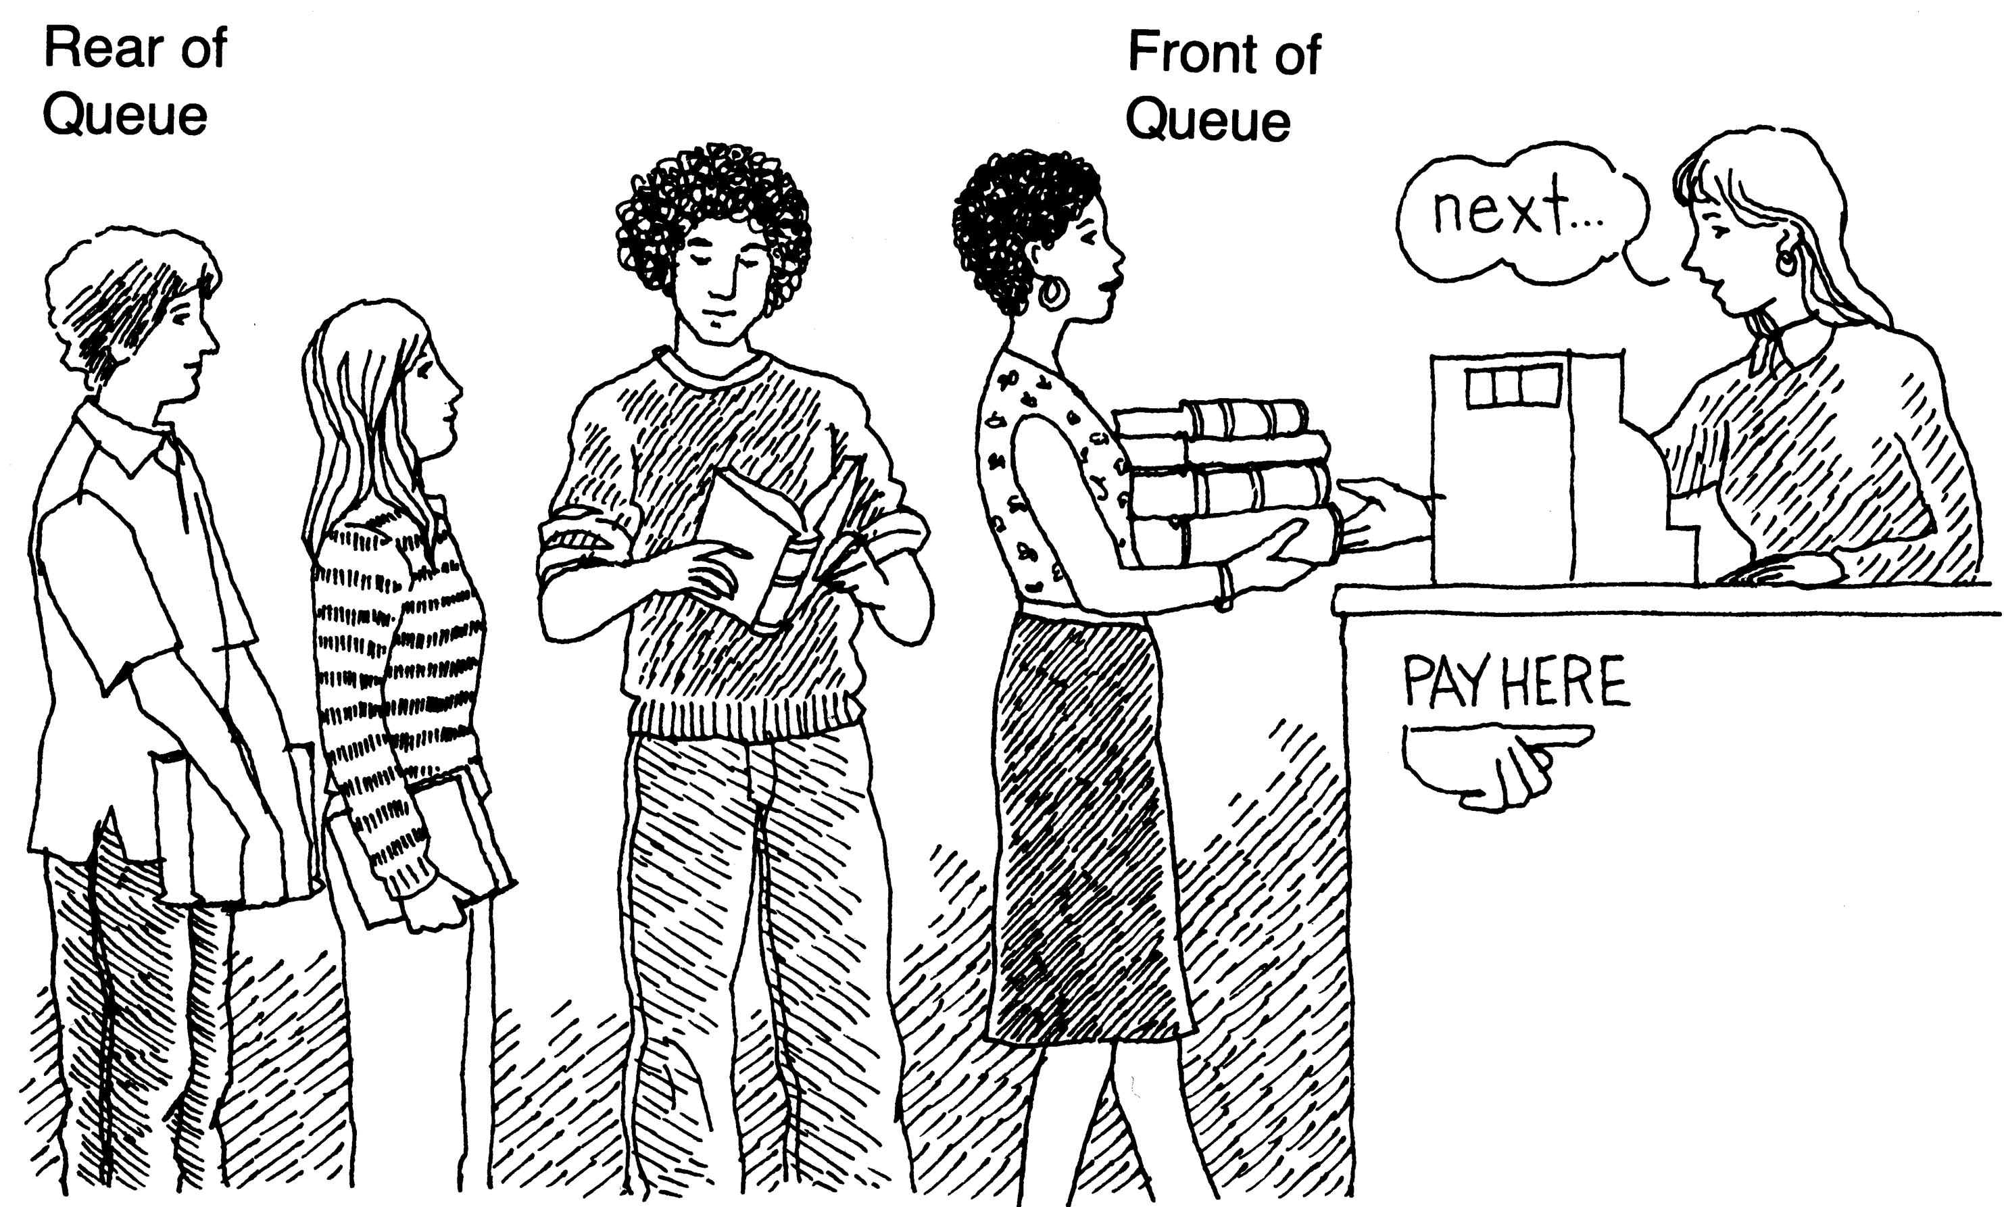
Queues

Slide 2
Queues
A linear list of elements in which
  Inserting can take place at the other end called rear.
  deletion can take place only at one end called front.
Queue principle : FIFO
Conditions
  If there is no element in queue/ empty queue
    FRONT =-1 ; REAR =-1

Slide 3
Queues
  If there is exactly one element in queue
    FRONT = REAR
      a1
Whenever an element is added to the queue,
REAR =REAR +1 or REAR++
If the item being added is the first element, FRONT=0, indicating the queue is no longer empty.

Slide 4
Operations on queues
Four basic operations on queue
  Enqueue :
    Queue insert operation is called as enqueue.
    The data is inserted in the rear.
    If there is not room to insert another data in the queue , the queue is said to be in an overflow state.
    Diagram
    algorithm

Slide 5
Algorithm Enqueue(struct queue *q, int item)
To add the data to the queue using array implementation
pre: struct stack *s : pointer to the queue structure
item : data to be pushed in the stack
post : to add data to the queue
1.[check if array is full]
if (q->rear=ARR-1)
print "\n QUEUE IS FULL"
2. [increment rear and add item to the array]
1. q->rear++
2. q->a[q->rear]=item;
3. count++;
3. [if the array is empty
(front =-1) ,set front=0]
if(q->front =-1)
q->front=0

Slide 6
Operations on queues
  Dequeue:
    Queue delete operation is called as dequeue.
    Data is removed from the front of the queue.
    If there are no data in the queue, when a dequeue is attempted , then the queue is in an underflow state.
    Diagram
    algorithm

Slide 7
Algorithm int dequeue(struct queue *q)
To remove data from the queue using array implementation
pre: struct stack *s : pointer to the queue structure
post:data is removed from the queue and returned to the calling program
[if the queue is empty return null]
if(q->front =-1)
return NULL
2. [fetch data from the front of the queue]
1. data=q->a[q->front]
2. q->a[q->front]=NULL;
3. [ if last element was removed from the queue,
if(q->front=q->rear)
q->front=q->rear=-1;
else
q->front++;
return data;

Slide 8
Operations on queues
  QueueFront:
    Returns data which is at the front of the queue without changing the contents of the queue.
    If there are no data in the queue, when a queue front is attempted , then the queue is in an underflow state.
    Diagram
    Algorithm

Slide 9
Algorithm int queuefront(struct queue *q)
To display the data which is in the front of the queue
pre: struct stack *s : pointer to the queue structure
Post : data which is in the front of the queue is returned to the calling program
Assignment

Slide 10
Operations on queues
  QueueRear:
    Returns data which is at the rear of the queue without changing the contents of the queue.
    If there are no data in the queue, when a queue rear is attempted , then the queue is in an underflow state.
    Diagram
    Algorithm

Slide 11
Algorithm int queuerear(struct queue *q)
To display the data which is in the rear end of the queue
pre: struct stack *s : pointer to the queue structure
Post : data which is in the rear end of the queue is returned to the calling program
Assignment

Slide 12
Display the contents of the queue
Algorithm displayqueue(struct queue *q)
To display the contents of the queue
Pre : struct stack *s : pointer to the queue structure
1.[initialize]
x=0
2.[if rear=-1 then the queue is empty]
1. if(q->rear==-1)
print “QUEUE IS EMPTY”
return;
2. repeat while(x<=q->rear)
1. printf q->a[x]
2. x=x+1

Slide 13
Circular Queues
Disadvantage of linear queues:
  If an item is removed from the linear array, the space remains unutilized. To overcome this, the circular array is used.
  Algorithm:

Slide 14
Algorithm to insert data in a Circular Queue
Algorithm ins_circular_q(Struct queue *cq, int item)
To insert data into circular queue
Pre :
Post:
[Check if the queue is full]
  If q->REAR =MAX -1 and
  q-> Front =0
    print “ circular queue is full”
    return
2. If q-> REAR = MAX -1
q->REAR=0
else
increment q->REAR
if(q->a[q->rear]==0 ||
q->a[q->rear] ==-999)
q->a[q->REAR]= item
else
printf("QUEUE IS FULL");
3. [If an item is inserted , then queue is not empty]
if q-> front =-1
q->front =0

Slide 15
Algorithm to delete data from a Circular Queue
Algorithm int delete_from_circular_queue(
{struct queue *q)
1. [Check if the queue is empty]
if(q->front ==-1)
return
2. Assign the value of array to the variable data and set the array element to 0
data=a[q->front]
a[q->front]=0
3.[check if the queue is empty]
if(q->front==q->rear)
q->front=q->rear=-1
else
if(q->front=MAX-1)
q->front=0;
else
q->front++
return data

Slide 16
Priority Queues
Collection of elements where each element is assigned a priority and the order in which elements are deleted and processed.
The following are the rules:
  All elements of higher priority is before any element of lower priority.
  2 elements with the same priority are processed according to the order in which they are added to the queue.

Slide 17
Priority Queues
  Eg: Time Sharing System
    Programs of high priority are processed first and programs with the same priority form a standard queue.
Eg:
Algorithm

Slide 18
Algorithm for inserting data in the priority queue
Algorithm add_priority_jobs(struct priorityqueue *pq,struct data dt)
Post: to add jobs in a priority queue
1.[declare variables]
struct data temp
int i,j
2. if(pq->rear==MAX -1)
display “ QUEUE IS FULL”
return

Slide 19
3. rear++;
d[pq->rear]=dt;
if pq->front==-1
pq->front =0;
4. Repeat for(i=0;i<=pq->rear;i++)
1. Repeat for(j=i+1; j<= pq-> rear;j++)
A. If(priority1 >priority2)
swap the jobs
B. If(priority1=priority2)
1. if(orderno1>orderno2)
swap the jobs

Slide 20
Algorithm for displaying data in the priority queue
void displaycircularqueue(struct circularqueue *q)
1[initialize]
x=0
2. Repeat while(x<=MAX -1)
1. display q->a[x]
2. x++

