Slide 1
Searching

Slide 2
Two Basic Searches for arrays
Sequential Search:
  Can be used to locate an item in any array.
Binary Search:
  Requires an ordered list.

Slide 3
Sequential Search
Used when the list is not ordered.
Used for small lists or lists that are not searched often.
Algorithm of Linear Search

Slide 4
Sequential Search
Used when the list is not ordered.
Used for small lists or lists that are not searched often.
Algorithm of Linear Search

Slide 5
Algorithm of Linear Search
int linearSearch(int a[], int first,
int last, int key)
Searches a[first]..a[last] for key.
returns: index of the matching element if it finds key, otherwise -1.
a in array of (possibly unsorted) values.
first, last in lower and upper subscript bounds key in value to search for.
returns:
index of key, or -1 if key is not in the array.
1. Repeat for i=first to last
a. if (key = a[i])
display “key found at location I”
2. return -1; // failed to find key

Slide 6
Efficiency of linear search
Model | No. of Comparisions | Comparisions as a function of n
Best Case (fewer comparisions) | 1(target is the first item) | 1
Worst Case(most comparisions) | n(target is the last item) | n
Average Case(Avg no. of comparisons) | n/2(target is the middle item) | n/2

Slide 7
Disadvantage of sequential search
Sequential search is very slow.
Eg:

Slide 8
Binary Search
Binary search is used when the list is sorted.
It is used whenever the list starts to become large.(more than 15 elements).
Working:

Slide 9
Algorithm of Binary Search
Step 3:
mid=(first+last)/2
Step 4:
if(value<a[mid])
last=mid -1
elseif(value>a[mid])
first=mid+1
elseif(value==a[mid])
print “search
successful”
and location of
the element mid
flag=1
binarysearch(int a[],int value, int n)
//a[]:list of elements
//value:the value to be searched
//n:no. of elements in the list
Step 1:[initialize]
first=0
last =n-1
flag=0
Step 2:
repeat through step 4
while(first<=last)

Slide 10
Algorithm of Binary Search
Step 5:
if( flag=0)
print “search is
unsuccessful)
Step 6:
Exit

Slide 11
Efficiency of binary search
Model | No. of Comparisions | Comparisions as a function of n
Best Case (fewer comparisions) | 1(target is the middle item) | 1
Average Case |  | Log₂ n
Worst Case(most comparisions) | n(target is the last item) | n

Slide 12
Indexed Sequential search
Is another searching technique for a sorted list.
In this an auxiliary “array index” is maintained in addition to the sorted list.
Each element in the “array index” consists of a key value and a link to the record in the sorted list that corresponds to the key.
Imp:
  The elements in the “array index” as well as the elements in the original list must be sorted on the key.
Example:
Advantage:
  Even if elements in the list are examined sequentially, the search time is sharply reduced as the search is performed on the smaller index rather than on the larger one.
  Once the correct index position has been found in the original list, a second sequential search is performed on a smaller position of the original list itself.

Slide 13
Interpolation search
Used for searching an ordered array.
More efficient than the binary search, if the elements are sorted in a array.
The key is expected to be at mid such that
mid=first+(last –first) * [ (key –A[first]) / A[last] -A[first]) ]
Algorithm

Slide 14
Algorithm of Binary Search
interpolationsearch(int a[],int value, int n)
//a[]:list of elements
//value:the value to be searched
//n:no. of elements in the list
Step 1:[initialize]
first=0
last =n-1
flag=0
Step 2:
repeat through step 4
while(first<=last)

Slide 15
Step 3:
mid=first+(last –first) * [ (key –A[first]) / A[last] -A[first]) ]
Step 4:
if(value<a[mid])
last=mid -1
elseif(value>a[mid])
first=mid+1
elseif(value==a[mid])
print “search
successful”
and location of
the element mid
flag=1

Slide 16
Efficiency of interpolation search
Model | No. of Comparisions | Comparisions as a function of n
Best Case (fewer comparisions) | 1(target is the middle item) | 1
Average Case |  | Log₂ n
Worst Case(most comparisions) | n(target is the last item) | n

Slide 17
Hashed List Searches
Hashing or hash function is a key-to-address transformation in which the keys map to the addresses in the list.
Hashing is a key-to-address mapping process
Diagram
Example:
Key
Hash Function
Address

Slide 18
Synonyms
The set of keys that hash to the same location is called a synonym.
Example

Slide 19
Collision
A Collision occurs when a hashing algorithm produces an address for a key and that address is already occupied.
The address produced by the hashing algorithm is known as the home address.
The memory that contains all of the home addresses is known as the prime area.

Slide 20
Hashing Methods
Basic Hashing Techniques
Hashing Methods
Direct
Modulo Division
Mid Square
Rotation
Subtraction
Digit Extraction
Folding
Pseudo
Random Generation

Slide 21
Direct Hashing
In direct hashing, the key is the address without any algorithmic manipulation.
Therefore the data structure must contain an element for every possible key.
Advantage
  Applications of direct hashing are limited but can be powerful because there are no synonyms and therefore no collisions.
  Cont…

Slide 22
Direct Hashing
Disadvantage
  Address space is as large as the key space
Direct hashing is an ideal method but its application is very limited.It can be used only for small lists in which the keys map to a filled list
Eg:

Slide 23
Subtraction Method
In this method, the key is transformed to an address by subtracting a fixed number from it.
It is simple and guarantees that there will be no collisions.
Limitations:
limited.It can be used only for small lists in which the keys map to a filled list

Slide 24
Similarity between Direct Hashing and Subtraction Method
The direct hashing and substraction methods both guarantee search with no collisions.They are one-to-one hashing methods.i.e. only one key hashes to each address

Slide 25
Modulo-Division Method
Also known as division remainder, this method divides the key by the array size.and uses the remainder for the address.
address = key MOD listsize
when address range from 0 to listsize-1
Or
address = (key MOD listsize ) +1
when address range from 1 to listsize

Slide 26
Modulo-Division Method
This method works with any list size.However a list size that is a prime number produces fewer collisions than other list sizes.Therefore make the array size a prime number.
Example

Slide 27
Digit Extraction Method
In this method, selected digits are extracted from the key and used as the address.
Example:
  using six-digit employee number to hash to a three-digit address (000–999), we could select the first, third and fourth digits (from the left) and use them as the address.

Slide 28
MidSquare Method
In midsquare hashing , the key is squared and the address is selected from the middle of the squared numbers.
Advantage:
  Entire key is used to calculate the
  address, reducing chances of collisions

Slide 29
MidSquare Method
Disadvantage:
  The size of the key.Eg. If a key is 6 digits, the product will be 12 digits which is beyond the max integer size of many computers.
Variation of Mid Square Method
  Select a portion of the key such as the first 3 digits and then use the midsquare method.

Slide 30
Folding Methods
Two folding methods are used
  Fold shift
  Fold boundary
Fold Shift
  In fold shift, the key value is divided into parts such that the
    size of the parts = size of the required address
  The left and right parts are shifted and added with the middle part.
  If sum>size of the address , discard the leading digits.

Slide 31
Fold Boundary:
  The left and right numbers are folded on a fixed boundary between them and centre number.The two outside values are thus reversed.
  examples

Slide 32
Rotation Method
Rotation hashing is not used by itself but is incorporated in combination with other hashing methods.
Most useful when key are assigned serially.
A simple hashing algorithm tends to create synonyms when hashing keys are identical except for the last character.
Rotating the last character to the front of the key minimizes this effect.

Slide 33
Rotation Method
Modula division method do not work well with rotation method.
Rotation is used only in combination with folding and pseudorandom hashing

Slide 34
Pseudorandom hashing
In this the key is used as the seed in a pseudorandom number generator.
The resulting random number is then scaled into the possible range using modulo-division method.
A common random number generator is
  y=ax + c
  x = key
  a and c = factors that should be prime numbers since prime numbers minimize collisions
Example

Slide 35
IMP NOTE
All hash functions except direct hashing and subtraction hashing are in such a way that “many keys hash to one address”

Slide 36
Collision Resolution
Collision Resolution
Open Addressing
Linked List
Buckets
Linear Probe
Quadratic Probe
Pseudorandom
Key offset

Slide 37
Concepts for collision resolution methods:
Load factor:
  The load factor(α-alpha)of a hashed list is :
Number of elements in the list *100
Number of physical elements
allocated for the list
  Fullness of a file is measured by its load factor
  When the address space of a relative file gets full, the probability of collision arises dramatically.
  A load factor 70% or 80% gives reasonable performance.
  Example. If a file contains n records, the address space should have room for storing 1.25n records(80%)

Slide 38
Clustering
Clustering:
  As the data are added to the list ,some hashing algorithms tend to cause data to group within the list.
  This tendency of data to build up unevenly across a hashed list is known as clustering.
  Clustering is usually created by collisions.

Slide 39
Types of clustering
Two types of clusters exist:
  Primary clustering:
    Occur when data cluster around a home address.
      The collision resolution is based on home address
      Easy to identify.
      Primary cluster slows down the operations
      Example

Slide 40
Types of clustering
  Secondary clustering:
    The collision resolution is not based on the home address.
    The collision resolution algorithm spreads the collisions across the entire list.
    Not easy to identify
    The time to locate a requested element of data becomes faster.
    Example

Slide 41
Open Addressing:
  Resolves collisions in the prime area i.e. the area that contains all of the home addresses.
  When a collision occurs, the prime area addresses are searched for an unoccupied element where the data can be placed.

Slide 42
Linear Probe
In a linear probe, when data cannot be stored in the home address, the collision is resolved by adding 1 to the current address.
Example
As an alternative to a simple linear probe, we can add 1, subtract 2, add 3 subtract 4 and so forth until an element is located.

Slide 43
Linear Probe
We must ensure that the next collision resolution address lies within the boundaries of the list. Eg: if a key hashes to the last location in the list, adding 1 must produce the address of the first element. Similarly if a key hashes to the first location in the list, subtracting 1 must produce the address of the last element.
Advantages:
  Simple to implement.
  Data tend to remain near their home address.
  Linear probes tend to produce primary clustering.
  Linear probes tend to make the search algorithm more complex.

Slide 44
Quadratic probe:
In the quadratic probe,
  the increment = the collision probe number squared
  The new address = collision location + increment
  Disadvantage:
    Time required to square the probe number. Therefore instead of multiplication factor, we can use an increment factor that increases by 2 with each probe.
    It is not possible to generate a new address for every element in the list.

Slide 45
Double Hashing
The pseudorandom collision resolution and key offset

Slide 46
pseudorandom collision resolution and key offset
In each method, rather than use an arithmetic probe function, the address is rehashed
Both methods prevent primary clustering.

Slide 47
Pseudorandom collision resolution
Uses pseudorandom number to resolve the collision.
In this, rather than use the key as a factor in the random-number calculation, we use the collision address.
Advantage:
  Pseudorandom collision resolution have simple solution
  Produces only one collision resolution path through the list.

Slide 48
Key offset:
It is a double hashing method that produces different collision paths for different keys.
The pseudorandom number generator produces a new address as a function of the previous address, key offset produces a new address as a function of the previous address and the key.
Example
Therefore each key resolves its collision at a different address

Slide 49
Linked List Collision resolution
Major disadvantage of open addressing is that each collision resolution increases the probability of future collisions. This disadvantage is eliminated by Linked list collision resolution.
Example
Linked list collision resolution uses separate area to store collisions and chains all synonyms together in a linked list.

Slide 50
Linked List Collision resolution
Uses two storage areas :prime area and overflow area :
  Each element in the prime area contains an additional field- a link head pointer to a linked list of overflow data in the overflow area.
  When collision occurs , one element is stored in the prime area and chained to its corresponding linked list in the overflow area.
  The linked list data can be stored in any order, but a LIFO sequence is the most common as it the fastest.

Slide 51
Bucket Hashing
The keys are hashed to buckets. The buckets are nodes that accommodate multiple data occurrences.
Because a bucket can hold multiple data, collisions are postponed until the bucket is full.
Problems in bucket hashing:
  It uses more space because many of the buckets are empty or partially empty at any given time.
  It does not completely resolve the collision problem.
Example

Slide 52
Application of Hashing
Hash tables are good in situations where you have enormous amounts of data from which you would like to quickly search and retrieve information.
A few typical hash table implementations would be in the following situations:
  For driver's license record's. With a hash table, you could quickly get information about the driver (ie. name, address, age) given the licence number.
  For compiler symbol tables. The compiler uses a symbol table to keep track of the user-defined symbols in a C++ program. This allows the compiler to quickly look up attributes associated with symbols (for example, variable names)
  For internet search engines.
  For telephone book databases. You could make use of a hash table implementation to quickly look up John Smith's telephone number.
  For electronic library catalogs. Hash Table implementations allow for a fast find among the millions of materials stored in the library.
  For implementing passwords for systems with multiple users. Hash Tables allow for a fast retrieval of the password which corresponds to a given username.

Slide 53
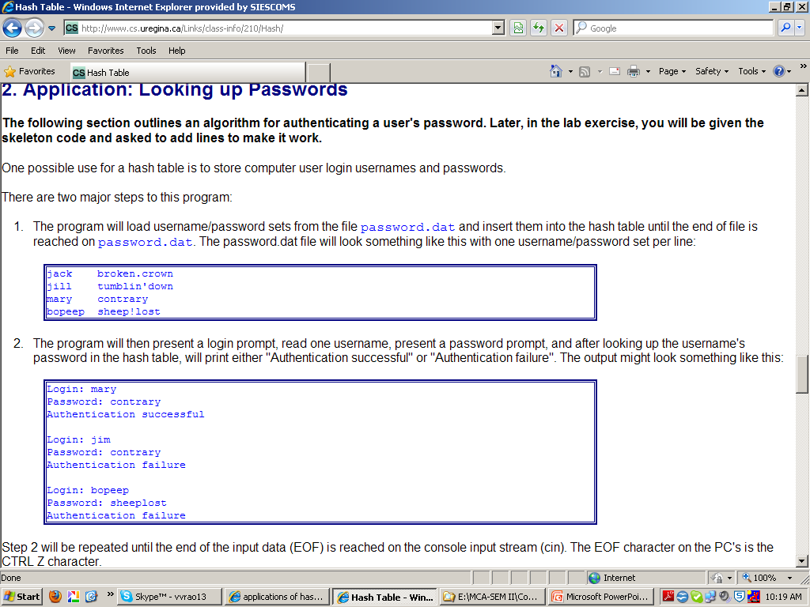

Slide 54
Symbol table:
  The symbol table records information about each symbol name in a program.
  Many compilers set up a table for the various variables in the program and fill in the information about the symbol later during semantic analysis when more information about the variable is known

Slide 55
