Slide 1
Welcome ITR Presentation
Topic: Website on Travel Agency
Group Members:
1.Palak Nilesh Agrawal.
2.Nilesh Dattu Khandekar.
3.Karishma Rahul Pakale.
4.Akshay Sudhir Sonawane.
5.Sejal Dinesh Yadav.
Under the guidance of :- Sir Atul Chaudhari

Slide 2
Introduction of Industrial Training:
Industrial training is a short duration training course provided in any company or industry to help students to get Industry knowledge.
Industrial training is most important for students.
It provides practical knowledge to the students and explains how the industry works.
It exposes the students to actual working environment and enhances their knowledge and skill from what they have learned in the college.

Slide 3
Objectives of Industrial Training:
Students will be able to understand the psychology of the employees.
Students realize the size and scale of industry.
Student should get an opportunity to apply their knowledge in problem solving in their project assignment.
Students understand the scope, function and the job responsibilities in various departments of an organization.

Slide 4

Company’s History:
Sumago Infotech is a company established in Oct 2013.
It has industry-specific software expertise in technology, healthcare, financial, media, manufacturing and many other sectors.
This company specializes in offering Web Designing, Web Application Development, Mobile App Development, Software Development, Digital Marketing, Software Testing, Quality Assurance Services and many more.

Slide 5
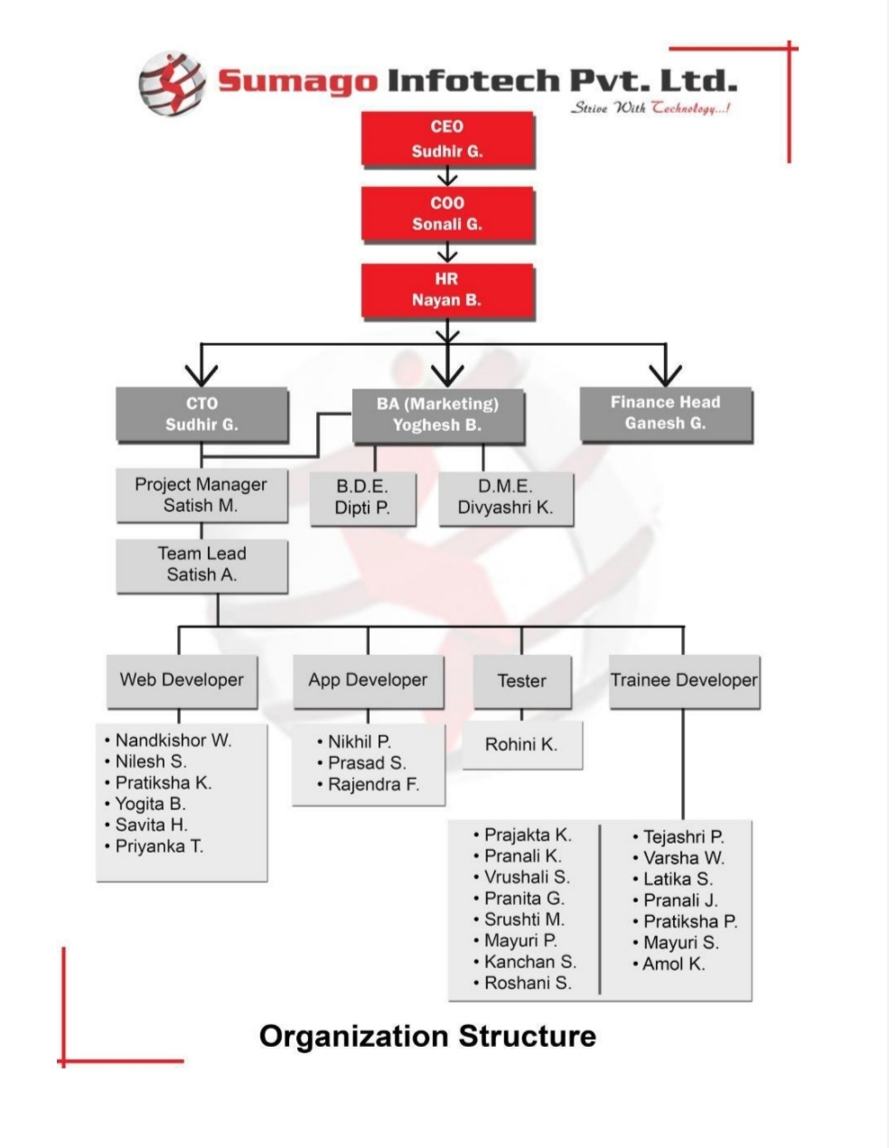
Organization chart:

Slide 6
Company’s Business Activities:
Online Examination System
ERP
Magic Bricks Application
Food Delivery Application
Online Service Provider Application
Home Automation System
E-commerce Application

Slide 7
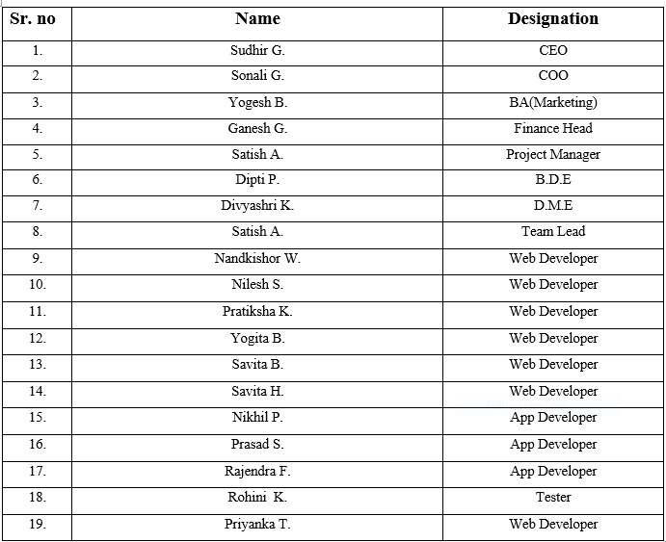
Organization Profile:

Slide 8
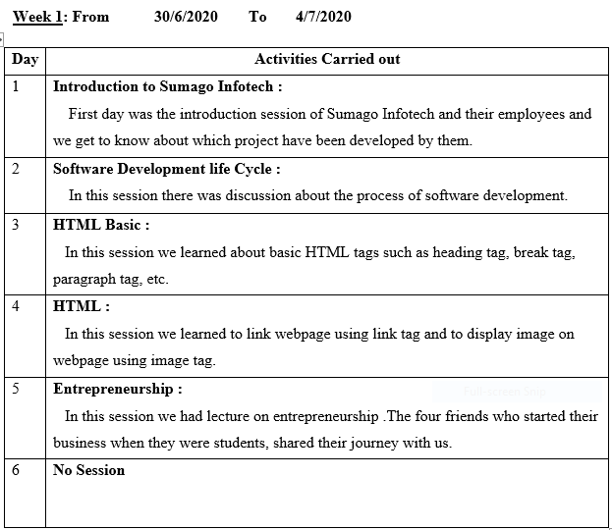
Weekly Report:

Slide 9
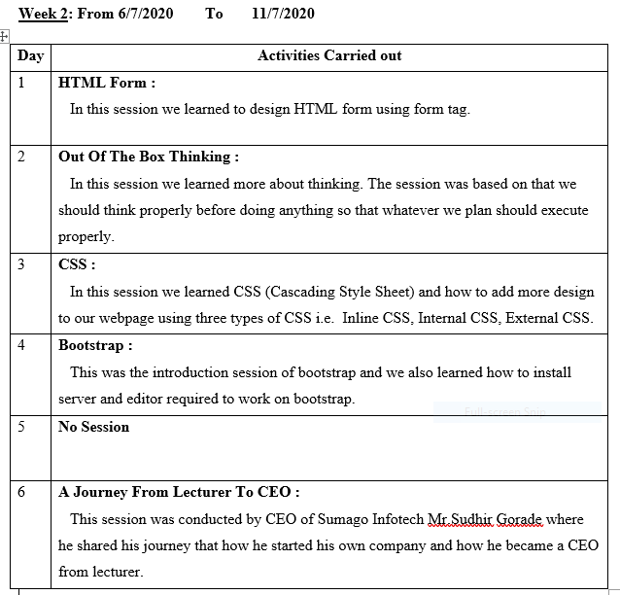
2nd Week

Slide 10
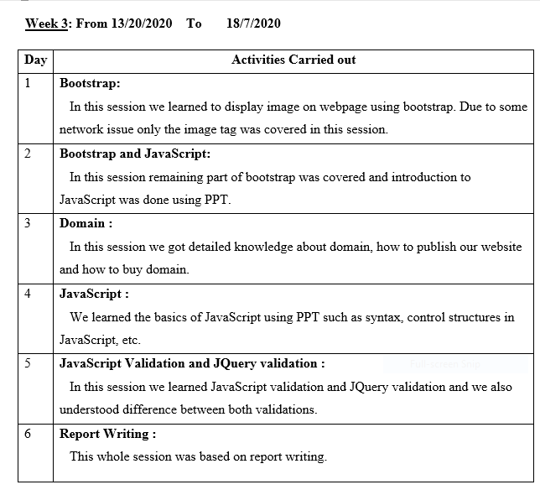
3rd Week

Slide 11
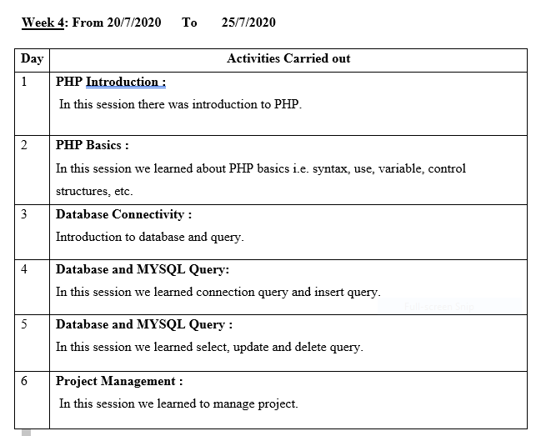
4th Week

Slide 12
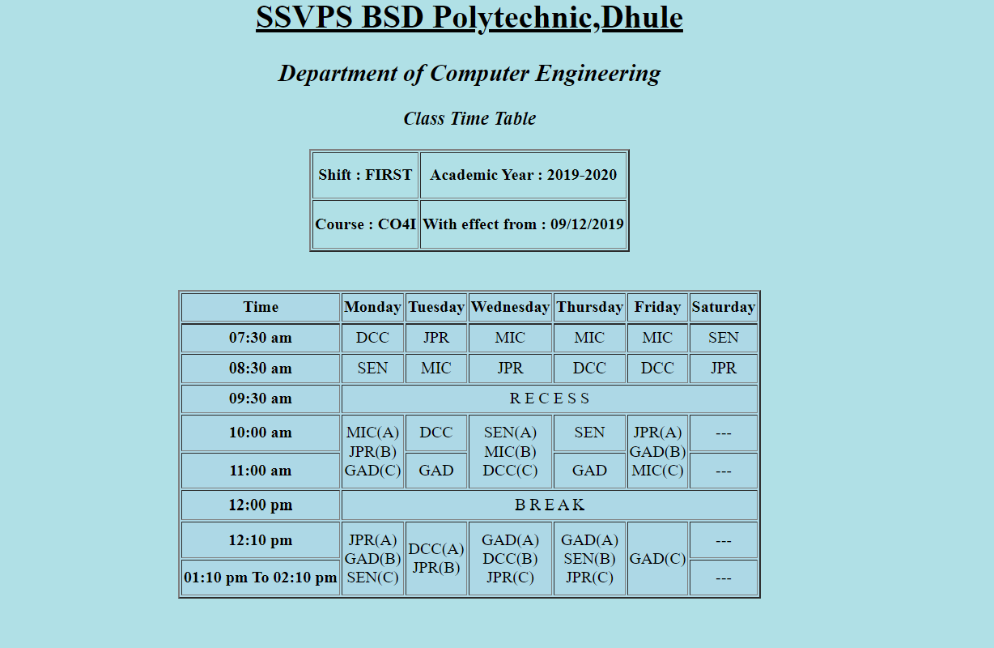
During the period of 4 weeks of Industrial Training we have completed following assignments:
Timetable of your collage using tags of HTML.

Slide 13
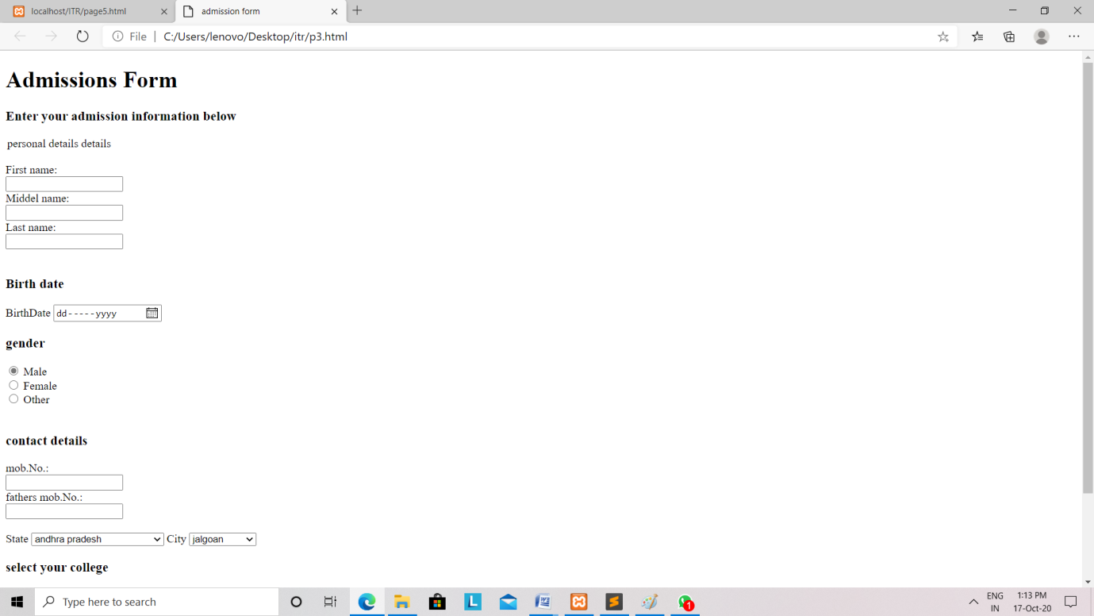
An admission Form using tags of HMTL.
We have developed a basic college admission form using HTML tags.

Slide 14
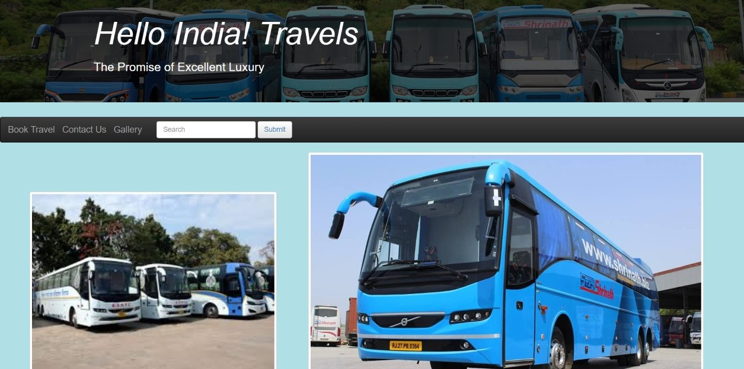
Introduction to our Mini Project:
Topic: Website on Travel Agency
We have developed a mini-project having topic website on Travel Agency. We have used all the skill that we have learned in industrial training . We have developed this mini-project by using HTML, CSS, Bootstrap, etc.
On the home page we have displayed the images of different busses to make it look better. We have created a Menu bar containing various menus. By clicking on these menus the user will be directed to another page.

Slide 15
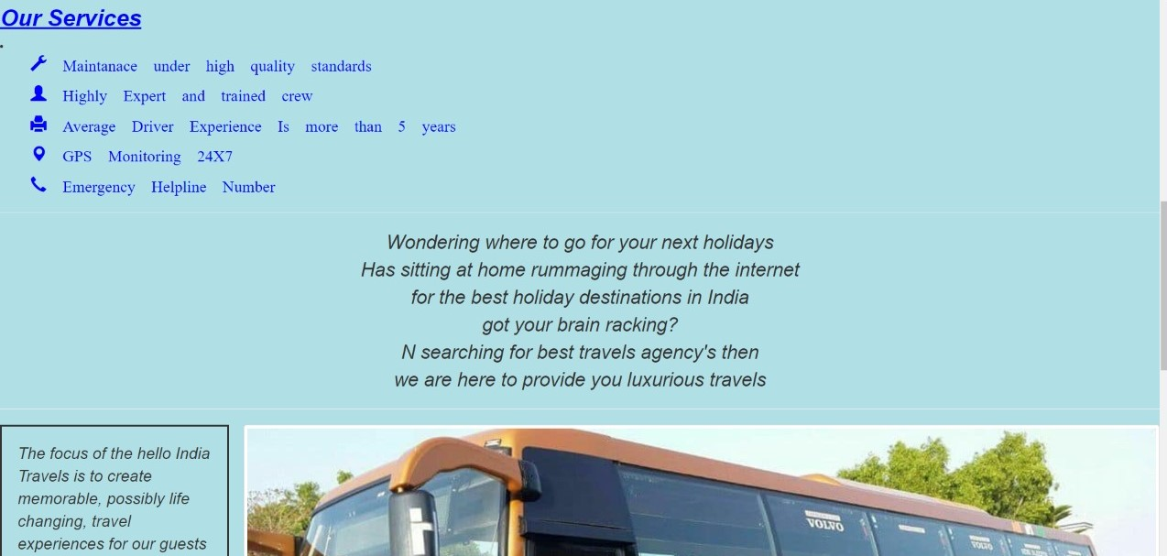
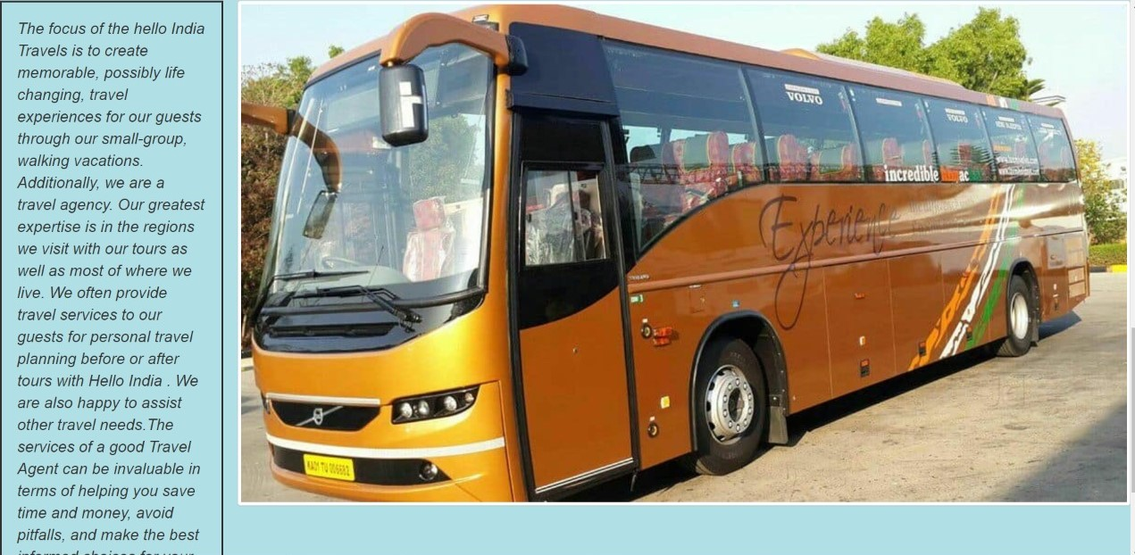
The home page also contains some attractive quotes and thoughts. It also displays the services
using icons that travel agency provides.

Slide 16
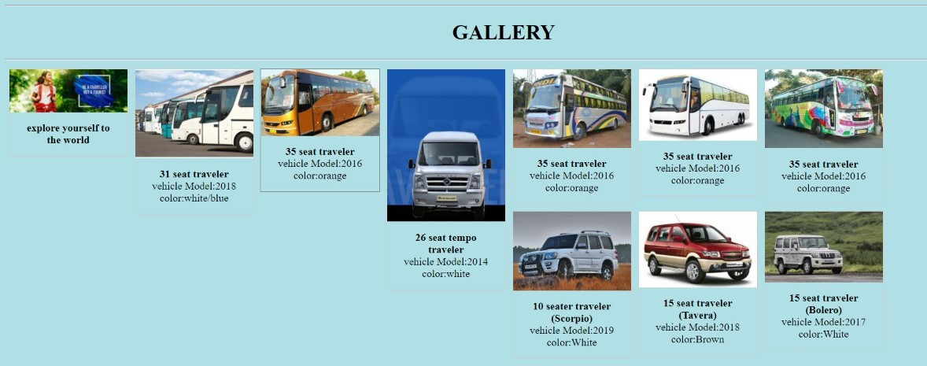
This page displays the images of various buses and cars with their short description
such as model, color that are available for booking .

Slide 17
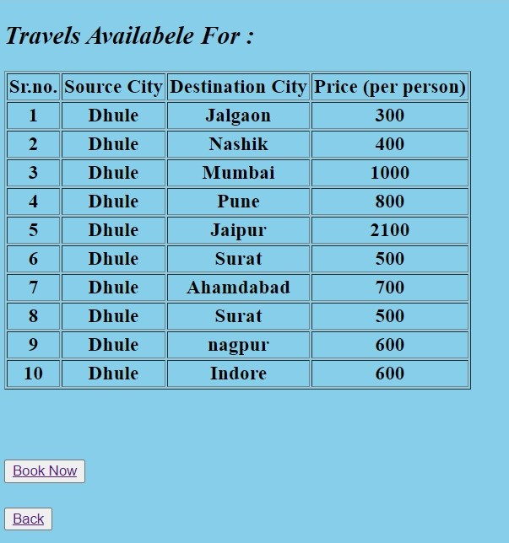
This page displays the source and destination that are available for booking with
their price.

Slide 18
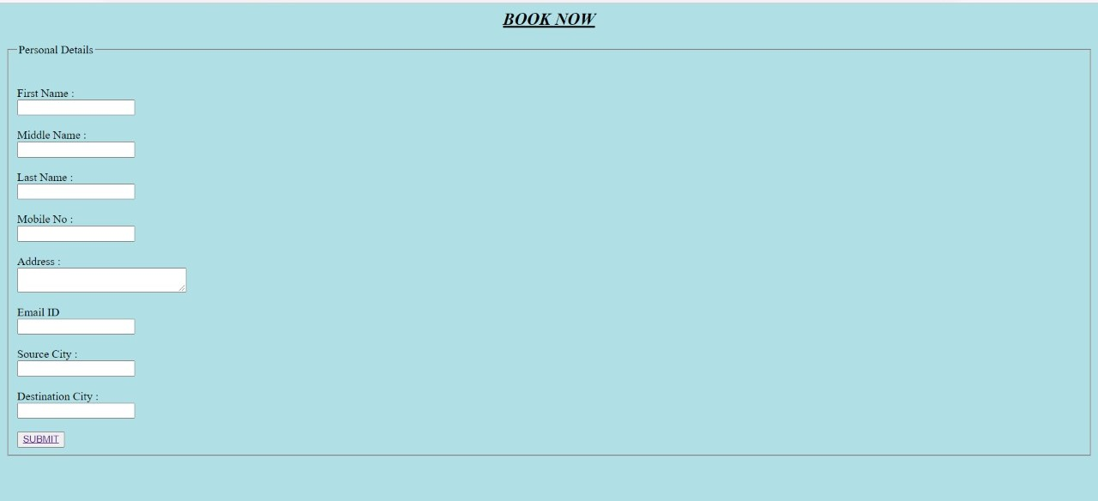
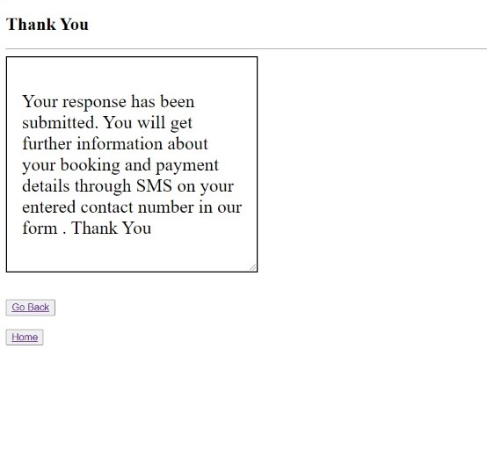
After Clicking ‘Book Now’ option it will be directed to following page.
After Clicking on ‘submit’ button following information will be displayed.

Slide 19
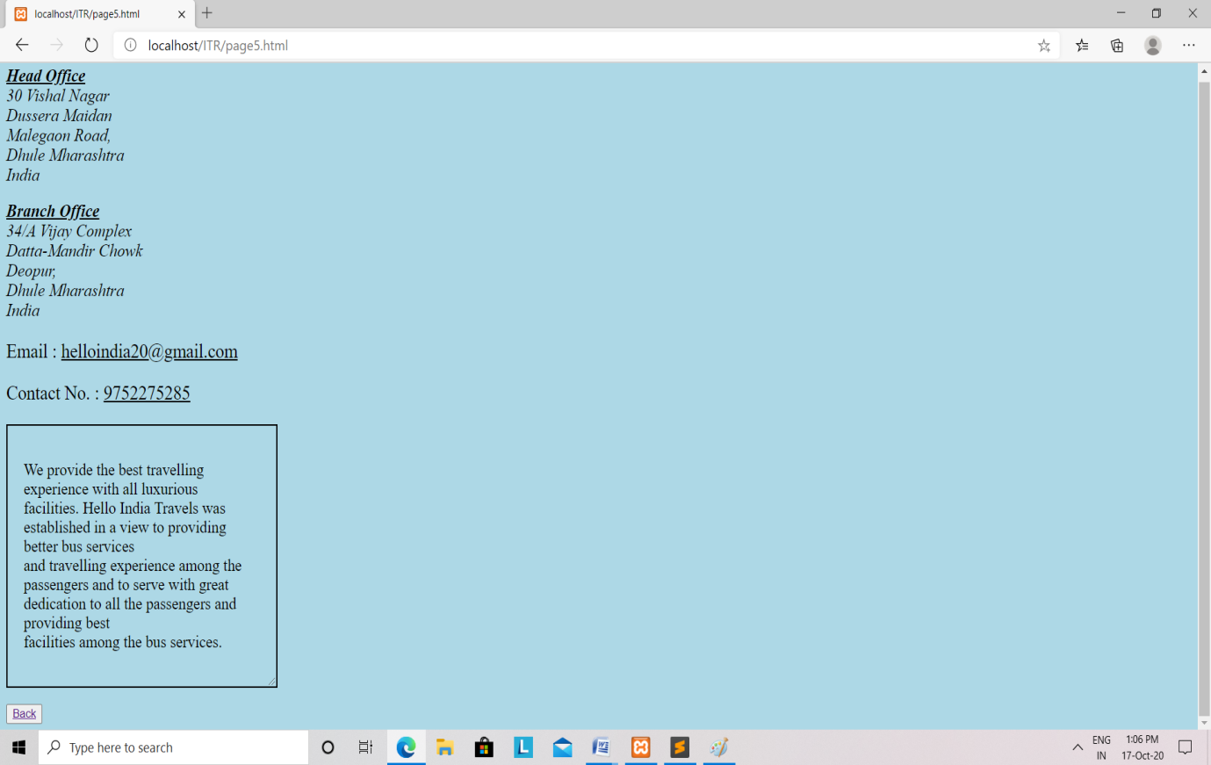
This webpage displays the details such as address, email, contact number of
the travel agency.

Slide 20
Findings:
During the training period, We were exposed to an environment that is professional in identifying the tasks of employee. From there, we can see how a programmer may play his/her role in a company.
Suggestions
The company should avoid giving different directions to students. This is
because students will feel confused when getting different instructions
from different staff. The mistakes in the assignment can be avoided if the
company provides correct and accurate instructions.

Slide 21
Conclusion:
After undergoing a 4 weeks of industrial training at Sumago InfoTech pvt.ltd. There is a lot of new knowledge that can be learned and we get to understand altogether on how this firm plays an important role in industrial field, especially in Quantity Surveying. Exposure that have been given to us by Sumago InfoTech pvt.ltd staff about the working and technical aspect is a very meaningful knowledge to us in order to prepare ourselves before stepping into the real work environment on the upcoming days.

Slide 22
Thank You!

