Slide 1
Artificial Intelligence in Law
Rahil Shah 09005011
Namit Rawal 09005014
Aditya Gupta 09005017

Slide 2
Contents
Introduction
A Brief History
Why do we need AI in law?
What are the major challenges?
Some Related Concepts and their meanings
Expert Systems
Legal Expert Systems
Shyster
Advantages/Disadvantages
Conclusion

Slide 3
Introduction
What is Artificial Intelligence and Law?

Slide 4
Introduction
What is Artificial Intelligence in Law?
According to Wikipedia:
Artificial intelligence and Law (AI and Law) is a subfield of artificial intelligence (AI) mainly concerned with applications of AI to legal informatics problems and original research on those problems
What are Legal Informatics Problems?
.

Slide 5
A Legal Informatics Problem:
Information retrieval related to law (both manual and automated systems)
Information access issues (such as making legal and government information more accessible to the public, both physically and intellectually)
Practice issues (applications which help lawyers in their day-to-day operations).
Law and policy (issues such as privacy, copyright, security, the rule of law, making judgements, proving criminal intent)

Slide 6
Why Is AI in Law an Interesting Research topic?
Theoretical Research Interests?
Practical Research Issues?

Slide 7
Defeasibility
Reasoning is defeasible when the corresponding argument is rationally compelling but not deductively valid.
Non-Demonstrative reasoning
Reasoning does not produce a full or complete demonstration of a claim

Slide 8
Defeasibility: An Example
Example Claim: I don’t have a sister
Reasoning:
If I had a sister, I would certainly have known about it (Assumption)
Since I don’t know whether I have a sister, I don’t have one.
This statement is defeasible
Reason: The argument nullifies, if I realize I have a sister in the future

Slide 9
Applications of Defeasibility to Law
No vehicles in a park:
What if the government places a fully functional war vehicle as a memorial in the park?
Are roller blades allowed?

Slide 10
Defeasibility: importance in AI
Defeasibility is non-monotonic.
Human Reasoning is and should be non-monotic
Monotonic Reasoning is too restrictive
It can be dangerous to believe things that are false, but it can be just as dangerous not to believe things that are true.
E.g. Milk in a fridge.
Notes:
We often reject old conclusions based on new evidence, even when those old conclusions were
justiﬁed by the evidence we had at the time we arrived at them.
Why should human reasoning be nonmonotonic? Because monotonic reasoning is too restrictive. Monotonic reasoning in general and truth preserving
reasoning in particular work primarily to prevent us from reaching false conclusions.
It only allows us to reach conclusions that we could not possibly doubt so
long as our original reasons remain intact.
It can be dangerous to believe things that are false, but it can be just as dangerous not to believe things that are true.
We need a reasoning system that lets us draw likely conclusions with less
than conclusive evidence. And we need a mechanism for correcting this kind of reasoning in light of further evidence.
The absence of information can sometimes be a positive reason for believing something. Is there any milk in the refrigerator? We look and we do not see any
milk. The failure to ﬁnd evidence of milk in this case is a good reason to believe that there is no milk in the refrigerator. For another example, I believe that there is a cat in front of me. I believe this because there appears to be a cat in front of me. That seems to be ample evidence

Slide 11
Formalization of Defeasible Reasoning
Proposed by Donald Nute
In defeasible logic, there are three different types of propositions:
Strict Rules: Specify that a fact is always a consequence of another;
Defeasible Rules: Specify that a fact is typically a consequence of another;
Undercutting Defeaters: Specify exceptions to defeasible rules.
A priority ordering over the defeasible rules and the defeaters can be given.
During the process of deduction, the strict rules are always applied, while a defeasible rule can be applied only if no defeater of a higher priority specifies that it should not.

Slide 12
Law Is Normative
Normative: Something ought to be done according to a value/moral position .
It is not always the rule that matters but the goal or purpose of law.
Legal philosophy is deeply concerned with normative, or "evaluative" theories of law
Normative arguments can be conflicting, to the extent that different values can be inconsistent with one another

Slide 13
Examples: Law Is Normative
The case of Cannibalism, Boston Legal
Case of Over speeding
The Ayodhya Case
Insubordination for the greater good.
Bottom-line: Laws are not and should not be rigid

Slide 14
Importance to AI: Deontic Logic
Branch of symbolic logic
Studies formal properties of normative concepts.

Slide 15
Expert System
-Artificial Intelligence

Slide 16
Definition
In artificial intelligence, an expert system is a computer system that emulates the decision-making ability of a human expert.
Expert systems are designed to solve complex problems by reasoning about knowledge, like an expert.
Expert Systems do not follow the procedure of a developer as is the case in conventional programming.

Slide 17
Look Behind
Expert systems were introduced by researchers in the Stanford Heuristic Programming Project
Edward Feigenbaum is considered as the father of expert systems.
Expert systems were among the first truly successful forms of AI software
Development of expert systems was aided by the development of the symbolic processing languages Lisp and Prolog.

Slide 18
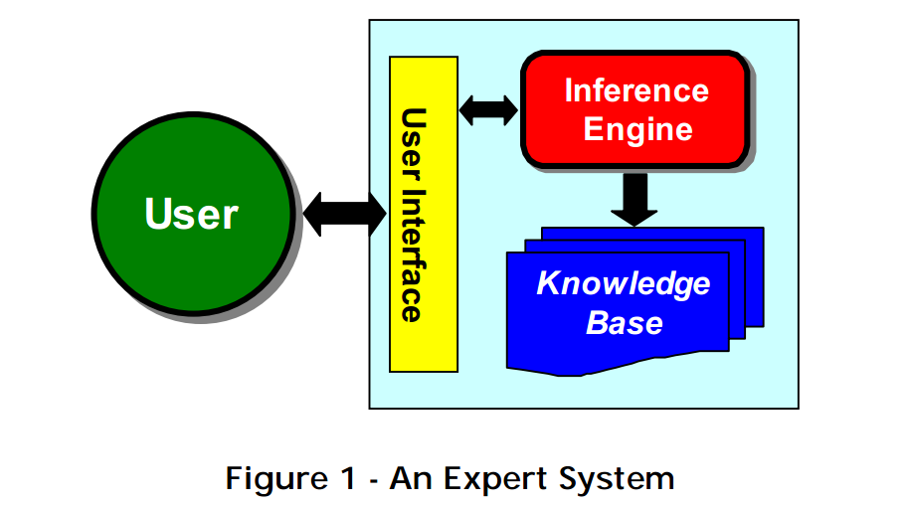
Software Architecture
The Rule Base or Knowledge Base
The Working Memory
The Inference Engine

Slide 19
Software Architecture (cont.)
The inference engine and knowledge base are separated because:
the reasoning mechanism needs to be as stable as possible;
the knowledge base must be able to grow and change, as knowledge is added;
this arrangement enables the system to be built from, or converted to, a shell.

Slide 20
Working of an Expert System
The system holds a collection of general principles which can potentially be applied to any problem - these are stored in the knowledge base.
Working memory contains the data that is received from the user during the expert system session.
Informations are processed by the inference engine.

Slide 21
Rule-Based Reasoning
Knowledge is stored as rules in the rule-base
Rules are of the form:
IF some condition THEN some action
Examples:
if - the customer closes the account
then - delete the customer from the database
The essence of a rule-based reasoning system is that it goes through a series of cycles.

Slide 22
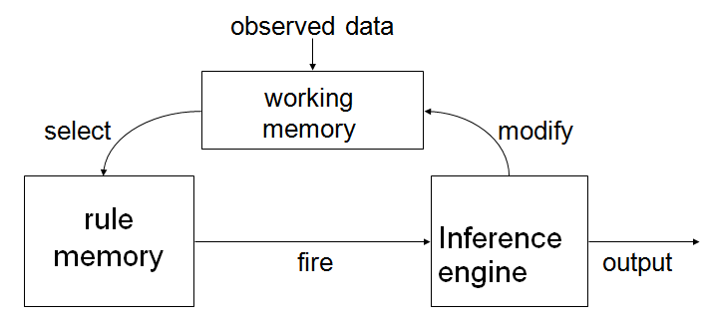
Rule-Based Reasoning (cont.)
In each cycle, it attempts to pick an appropriate rule from its collection of rules, depending on the present circumstances, and to use it as described above.

Slide 23
Working Memory
Working memory refers to task-specific data for a problem.
This is a database used to store collection of facts which will later be used by the rules.
Working memory is used by the inference engine to get facts and match them against the rules. The facts may be added to the working memory by applying some rules.

Slide 24
The Inference Engine
The inference engine is a computer program designed to produce a reasoning on rules.
it is the "brain" that expert systems use to reason about the information in the knowledge base for the ultimate purpose of formulating new conclusions.
Inference engines are considered to be a special case of reasoning engines, which can use more general methods of reasoning.

Slide 25
The Inference Engine (cont.)
In order to produce a reasoning, it is based on logic.
There are several kinds of logic: propositional logic, predicates of order 1 or more, epistemic logic, modal logic, temporal logic, fuzzy logic, etc.
Propositional logic is the basic human logic, that is expressed in syllogisms.
The expert system that uses propositional logic is also called a zeroth-order expert system.

Slide 26
The Inference Engine (cont.)
The inference engine can be described as a form of finite state machine with a cycle consisting of three action states: match rules, select rules, and execute rules.
The Forward chaining and Backward chaining are two techniques often used by Inference engine for drawing inferences from the knowledge base.

Slide 27
The Inference Engine (cont.)
Forward Chaining
It is reasoning from facts to the conclusion which lead to actions being executed.
Forward chaining is a top-down method.
Backward chaining
It starts with goals (or actions) and queries the user about information which may satisfy the conditions contained in the rules.
It is a bottom-up procedure.

Slide 28
Legal Expert System
The Robotic Lawyer

Slide 29
Definition
A legal expert system, as Popple uses the term, is a system capable of performing at a level expected of a lawyer: “
AI systems which merely assist a lawyer in coming to legal conclusions or preparing legal arguments are not here considered to be legal expert systems;
A legal expert system must exhibit some legal expertise itself.
Also called ‘computerized legal advisory systems’.

Slide 30
Skills of a Good Lawyer
General domain knowledge
Formal knowledge
Logical reasoning
Interpretative skills
Research skills
Organizational skills
Strategic skills
Communication skills
‘Real world knowledge'

Slide 31
Types of Legal expert Systems
Formal advisory systems
These systems simulate formal legal reasoning.
The aim of the system is to produce advice on a question of law, supported by arguments which would be accepted in a Court.
Strategic' advisory systems
These systems attempt to simulate the weighing of formal and non-formal factors considered by a lawyer in, say, giving advice to a client on what was a suitable amount for which to settle a damages claim.

Slide 32
Types of Legal expert Systems
Automatic document generators
The purpose of such programs is to capture the expertise that experienced practitioners have in drafting particular legal documents, in the form of a `template' of a that type of document.
`Intelligent' litigation
A step beyond automated drafting are programs which assist in all stages of the management of a specific piece of litigation or a transaction such as a conveyance.

Slide 33
Shyster
An example of legal expert system developed in Australia.

Slide 34
Introduction
The doctoral dissertation of James Popple.
Shyster is a legal expert system developed at the Australian National University in Canberra.
Shyster attempts to model the way in which lawyers argue with cases
A case-based system.
Proposes that a legal expert system need not be based upon a complex model of legal reasoning in order to produce useful advice.
Notes:
Although SHYSTER attempts to model the way in which lawyers argue with cases, it does not attempt to model the way in which lawyers decide which cases to use in those arguments.

Slide 35
Approach towards legal systems
2 Approaches:
Jurisprudence must supply the models of law and legal reasoning to build expert systems in law.
Jurisprudence is of limited value to developers of legal expert systems
Shyster is developed on basis of the latter.
Notes:
The fact that many lawyers have mastered the process of legal reasoning, without having been immersed in jurisprudence, suggests that it may indeed be possible to develop legal expert systems of good quality without jurisprudential insight

Slide 36
Working
Knowledge base:
Very simple knowledge base structure.
Its knowledge of the law is acquired, and represented, as information about various cases from the past.
The various attributes of in the cases are given different weight according to their importance.
Dependencies between attributes is also stored.
Notes:
Weights are given by asking lawyers if the attribute is important.(1 for yes, 0 for no)
Then the weight is redefined to the inverse of the variance of the current weight and weight of that attribute for all other cases.
Two types: 1) Decided the importance of an dependency by checking the pair in other cases. 2) if else one

Slide 37
Working(contd..)
Inference Rule:
It produces its advice by examining, and arguing about, the similarities and differences between cases.
Need to choose cases on which it can construct its opinion.
Shyster calculates distances between cases by weighing the attributes and checking dependencies.
Nearest cases are used to produce an argument
Notes:
Nearest Cases are chosen based on the distances
Nearest cases are chosen for argument based on similarities and differences.
Shyster assumes that the instant case will be decided the same way as was the nearest case

Slide 38
Evaluation
Shyster was evaluated under the following
Usefulness
Generality
Quality of its advice
Limitations
Shyster has shown itself to be capable of good advise.
Disadvantage: Need further theory to predict useful features of past cases.
Notes:
Despite its simple knowledge case structure, it has shown itself capable of producing good advice, and its simple structure has facilitated the specification of different areas of law.
suffers from intractable theoretical obstacles: without some further theory it cannot be predicted what features of a case will turn out to be relevant. Users of SHYSTER therefore require some legal expertise.

Slide 39
Conclusion

Slide 40
References
http://www.wikipedia.org/
http://cs.anu.edu.au/~James.Popple/publications/books/shyster.pdf
http://www.iaail.org/
http://austlii.edu.au/~alan/ai.htm
http://www2.austlii.edu.au/cal/papers/robots89/
http://www.cs.uky.edu/~lewis/papers/inf-engine.pdf
http://www2.austlii.edu.au/cal/papers/robots89/
www.icsd.aegean.gr/lecturers/konsterg/teaching/KE/Rules.ppt

Slide 41
Thank You!
Questions ?

