Slide 1
🎓 SOFTWARE ARCHITECTURE & DESIGN (SAD) • PROJECT DEFENSE
AUTOSRE: AUTONOMOUS SRE CONTROL PLANE
Multi-Tier Layered Architecture, Finite State Machine & Cognitive Self-Healing for Cloud Microservices
A production-grade autonomous site reliability engineering system evaluated under Software Architecture & Design. Featuring 5-tier layered separation of concerns, 8-node LangGraph finite state machine, Drain+Isolation Forest unsupervised log anomaly detection, grounded TF-IDF runbook RAG, and deterministic Zero-Shell security boundaries.
🏛️ 5-TIER LAYERED ARCHITECTURE
• Separation of Concerns (SoC) across 5 tiers
• Presentation, API Gateway, AI, Policy, DB
• Eliminates the Spaghetti Monolith anti-pattern
• Blast radius isolation: crashes in payment service never affect user auth or control plane
🧠 8-NODE LANGGRAPH FSM
• Autonomous Sense-Plan-Act reflex arc
• Drain regex log parsing + Isolation Forest (<8ms)
• Grounded TF-IDF Markdown Runbook RAG
• Google Gemini 3.5 Flash Lite cognitive RCA
• Pause-for-human gate for protected services
🛡️ EMPIRICAL VERIFICATION & SAFETY
• 36/36 Unit Tests Passing (100% pass rate)
• Zero-Shell boundary blocks all raw bash shells
• Reduces MTTR from 60+ minutes to <15 seconds
• SQLite 3 WAL Mode immutable audit ledger
• Clean separation from target client apps
Notes:
Welcome professors and evaluators. Today I am presenting AutoSRE, an Autonomous DevOps and Site Reliability Engineering Control Plane. This project is evaluated specifically through the lens of Software Architecture and Design (SAD). We demonstrate how to transition from high-stress, error-prone manual 3 AM outage triage to an autonomous self-healing system using rigorous 5-tier layered architecture, finite state machines, and safe AI reasoning.

Slide 2
AutoSRE // SAD
IDEA / SOLUTION & UNIQUENESS
SAD ACADEMIC DEFENSE 2026
IDEA / SOLUTION :
UNIQUENESS :
How We Handle Complexity in Cloud Reliability
Target Monitored Fleet ⟷ AutoSRE Control Plane Boundary
Non-invasive observation via standard HTTP (/metrics, /health, /logs). Zero code coupling; target application business logic is never modified.
SENSE & DETECT
Prometheus scraper continuously monitors /metrics. Drain regex parser and Isolation Forest detect anomalies in <8ms.
SUB-15S MTTR
Reduces Mean Time to Resolve from 60+ minutes to <15s with automated end-to-end closed-loop healing.
ZERO-SHELL BOUNDARY
Mathematically eliminates destructive AI hallucinations by enforcing a strict allowlist (no raw bash).
GROUND & PLAN
Retrieves verified Markdown runbooks via TF-IDF cosine similarity. Gemini 3.5 Lite reasons on root cause with zero hallucinations.
EXPLAINABLE AI (XAI)
Every root cause diagnosis cites exact runbook Markdown sections and outputs confidence scores (0.0 to 1.0).
IMMUTABLE LEDGER
SQLite 3 WAL database records every incident, AI prompt, operator approval, and container action for audit.
GUARD & HEAL
Zero-Shell policy gatekeeper checks action allowlist. Executes safe Docker/K8s remediation and verifies health.
🔄 THE AUTONOMOUS SRE REFLEX CYCLE:
1. SENSE (Prometheus /metrics + Drain log parser anomaly scoring)
2. PLAN (Retrieve SRE runbook RAG + Gemini 3.5 Lite structured RCA)
3. ACT & VERIFY (Zero-Shell Policy Gate -> Docker Restart -> /health probe 200 OK)
💡 REAL-WORLD ANALOGY: THE INTELLIGENT ICU MONITOR
When an ICU patient's vitals crash at 3 AM, waiting 45 minutes to wake a doctor to read pharmacology manuals could be fatal. AutoSRE acts as an intelligent ICU monitor: it continuously senses vitals (metrics), diagnoses the arrhythmia (Gemini RCA), checks dosage limits (Zero-Shell Gate), and administers corrective action in 10 seconds!
Notes:
In this slide, we structure the core idea and uniqueness using the exact visual approach from our reference designs. On the left, we detail how we manage cloud reliability complexity through a 3-phase reflex: Sense, Ground, and Guard. On the right, we highlight our 4 key architectural differentiators: sub-15-second MTTR, Zero-Shell security boundaries, explainable AI citations, and our immutable audit ledger.

Slide 3
AutoSRE // SAD
FOUNDATIONS: LAYERED ARCHITECTURE & 5-TIER BLUEPRINT
SAD ACADEMIC DEFENSE 2026
⚠️ THE ANTI-PATTERN: SPAGHETTI MONOLITH ('BIG BALL OF MUD')
• Without architecture, UI buttons directly trigger SQL database queries and run bash scripts.
• Tight coupling: a CSS bug can wipe disk files; testing in isolation is completely impossible.
• Uncontained blast radius: an unconstrained LLM will eventually hallucinate 'rm -rf /'.
🛡️ THE ARCHITECTURAL SOLUTION: SEPARATION OF CONCERNS (SoC)
• System is partitioned into 5 independent horizontal tiers with strict boundary interfaces.
• Rule: Each layer only communicates with adjacent layers; UI never talks directly to DB.
• Restaurant Analogy: Customer (UI) -> Waiter (API) -> Chef (AI Brain) -> Inspector (Policy) -> Pantry (DB).
AUTOSRE 5-TIER HIERARCHICAL LAYERED BLUEPRINT (STRICT BOUNDARY ENFORCEMENT)
TIER 1: PRESENTATION (OPERATIONAL COCKPIT)
Glassmorphic UI • SVG Topology Mesh • Incident War Room • Live Modals (HTML5/CSS3/ES6 JS)
TIER 2: API GATEWAY & ORCHESTRATION
FastAPI ASGI Server (Python 3.12) • 17 Validated REST Endpoints • Pydantic v2 • CORS Headers
TIER 3: OBSERVABILITY & COGNITIVE REASONING
Prometheus Scraper (:9090) • Drain + Isolation Forest (<8ms) • LangGraph 8-Node FSM • Gemini 3.5 Lite RCA
TIER 4: SECURITY POLICY & EXECUTION TIER
Zero-Shell Policy Gatekeeper • Action Allowlist (restart, scale, rollback, clear_cache) • Docker SDK / K8s
TIER 5: PERSISTENCE & INFRASTRUCTURE TIER
SQLite 3 WAL Mode Database (incidents, audit_ledger, connectors) • Monitored Fleet (:8001-:8004, :8010)
Notes:
Here we establish the core foundation of Software Architecture & Design: Layered Architecture. Without architecture, systems become a spaghetti monolith where UI handlers run shell commands directly. AutoSRE enforces 5 distinct tiers. Notice that Tier 3 (Cognitive AI) formulates plans, but only Tier 4 (Policy Gatekeeper) has the authority to execute container actions after strict allowlist validation.

Slide 4
AutoSRE // SAD
TECHNICAL APPROACH: END-TO-END SYSTEM ARCHITECTURE
SAD ACADEMIC DEFENSE 2026
AI Intelligence & Processing Pipeline
End-to-End AutoSRE Runtime Architecture
1. Intelligent Telemetry Ingestion
Prometheus Scraper (:9090) pulls /metrics every 2s (CPU, memory, 5xx rate, latency). In-memory log buffer captures raw streaming logs.
Users & SRE Operators
Access Executive Glassmorphic Cockpit, Live SVG Topology & War Room
2. Log Anomaly Engine (Drain + Isolation Forest)
Drain regex parser abstracts variables (<IP>, <NUM>, <UUID>). Isolation Forest scores token vectors in <8ms (anomaly trigger: score < -0.15).
FastAPI Control Plane Gateway
ASGI Asynchronous Server • 17 REST API Endpoints • Pydantic Schema Validator
Autonomous SRE Orchestrator (LangGraph 8-Node FSM)
Sense ➔ Detect ➔ Match Runbook ➔ Gemini RCA ➔ Policy Gate ➔ Execute ➔ Verify
3. Grounded Runbook RAG Layer
Indexes curated SRE Markdown manuals. TF-IDF vectorizer + cosine similarity retrieves the exact troubleshooting runbook chunk.
Zero-Shell Policy Gatekeeper & Action Allowlist
Human Approval Gate for Protected Services • Container API Invoker (No Bash)
4. Cognitive Root Cause Analysis (Gemini 3.5 Lite)
Combines telemetry + anomaly logs + runbook chunk. Google Gemini 3.5 Flash Lite generates structured JSON diagnosis (Dual-mode fallback).
Health Verification Loop & Immutable Audit Ledger
Automated /health Polling Loop (3 retries) • SQLite 3 WAL Database Commit
5. Zero-Shell Policy Gatekeeper & Remediation
Validates action against 5-command allowlist. Human sign-off required for protected services. Dispatches safe Docker SDK container restart.
Target Microservices Fleet & External Apps
user-service (:8001), payment (:8002), order (:8003), notif (:8004), Bella Vista Cafe (:8010)
CORE TECHNOLOGIES & FRAMEWORKS
Python 3.12 • FastAPI • LangGraph • Google Gemini 3.5 • Scikit-learn • Docker • SQLite 3 WAL • Prometheus • HTML5/SVG
Strict Control Plane vs. Workload Plane Separation: AutoSRE monitors target applications without modifying their internal code or sharing databases.
Notes:
This slide follows the exact technical approach layout from Reference Image 2. On the left, we showcase our 5-stage AI intelligence processing pipeline, complete with tech stack badges. On the right, we show the end-to-end runtime architecture diagram illustrating how user requests, control gateway, LangGraph state machine, policy gatekeeper, and monitored services interact.

Slide 5
AutoSRE // SAD
APPLIED ARCHITECTURAL STYLES & DESIGN PATTERNS
SAD ACADEMIC DEFENSE 2026
LAYERED / MULTI-TIER
Implemented in:
5-tier separation (UI, API, AI, Policy, DB)
Architectural Benefit:
Separation of Concerns: Allows independent upgrades of UI, database, or ML models without cascade breaks.
MICROSERVICES PATTERN
Implemented in:
Fleet: user, payment, order, notif, cafe
Architectural Benefit:
Blast Radius Containment: A connection pool leak in payment-service cannot take down user authentication.
FINITE STATE MACHINE
Implemented in:
LangGraph 8-Node Agent (src/agent/graph.py)
Architectural Benefit:
Predictability: Agent moves strictly through audited states; guarantees no infinite AI loops or stalls.
OBSERVER PATTERN
Implemented in:
Prometheus Telemetry Scraper (:9090)
Architectural Benefit:
Loose Coupling: Control plane observes microservice health without modifying target source code.
FACADE / API GATEWAY
Implemented in:
FastAPI Control Plane (src/backend/app.py)
Architectural Benefit:
Unified Interface: Clients and dashboards interact with one unified API rather than juggling 10 services.
GATEKEEPER / INTERCEPTOR
Implemented in:
Zero-Shell Policy Gate (src/agent/policies.py)
Architectural Benefit:
Security Barrier: Intercepts all AI outputs before execution; validates against strict action allowlist.
STRATEGY PATTERN
Implemented in:
Dual-Mode Reasoner (Gemini vs. Fallback)
Architectural Benefit:
High Availability: Uses Gemini 3.5 Lite when online; instantly switches to heuristic rules if API limits hit.
RAG PATTERN
Implemented in:
Runbook Retriever (src/rag/retriever.py)
Architectural Benefit:
Grounded Truth: Feeds verified Markdown SRE manuals into Gemini context, eliminating hallucinations.
Notes:
In Software Architecture and Design, evaluating architectural styles and patterns is paramount. Here we document the 8 core patterns implemented in our codebase. Notice how each pattern directly solves an operational risk: the Gatekeeper eliminates AI execution hazards, the Strategy pattern guarantees 100% control plane uptime during network outages, and the Observer pattern keeps telemetry collection non-invasive.

Slide 6
AutoSRE // SAD
BEHAVIORAL ARCHITECTURE: 8-NODE LANGGRAPH FSM
SAD ACADEMIC DEFENSE 2026
AUTONOMOUS FINITE STATE MACHINE (FSM) TRANSITION GRAPH
[MONITORING] ➔ [ANALYZING (ML+RAG+LLM)] ➔ [GATEKEEPING] ➔ [PENDING_APPROVAL / EXECUTING] ➔ [VERIFYING] ➔ [RESOLVED]
1. SENSE PHASE
scrape_telemetry
detect_anomaly
• Intercepts Prometheus /metrics every 2 seconds
• Drain regex masks dynamic tokens (<IP>, <NUM>)
• Isolation Forest scores anomaly vector in <8ms
• Triggers incident if score < -0.15 or 5xx spike
2. PLAN PHASE
retrieve_runbook
llm_rca_reasoning
• Extracts symptoms from alert metadata
• TF-IDF cosine similarity search over 5 runbooks
• Google Gemini 3.5 Flash Lite cognitive RCA
• Structured JSON output (root cause, action, confidence)
3. GATEKEEP PHASE
policy_gatekeeper
(Human Approval Gate)
• Strict 5-command action allowlist validation
• Blocks arbitrary bash/sh interactive shells
• Protected services (payment) shift to PENDING_APPROVAL
• SRE operator reviews & authorizes in War Room
4. ACT & VERIFY
execute_remediation
verify_health, commit_audit
• Invokes safe container restart via Docker SDK
• Automated /health polling loop (3 retries, backoff)
• Verifies latency drops & HTTP 200 OK returned
• Commits permanent record to SQLite audit ledger
Notes:
Behavioral modeling shows how the system dynamically responds to failures. AutoSRE uses LangGraph to define an 8-node Finite State Machine. Unlike unconstrained LLM loops that can run endlessly, an FSM guarantees deterministic transitions, bounded retries, and clean human pause states for high-blast-radius targets.

Slide 7
AutoSRE // SAD
QUALITY ATTRIBUTES & ARCHITECTURAL DECISION RECORDS
SAD ACADEMIC DEFENSE 2026
🎯 Non-Functional Requirements (NFRs)
📋 Architectural Decision Records (ADRs)
Availability (MTTR <15s):
Continuous autonomous self-healing. Dual-mode heuristic fallback ensures 100% control plane uptime even during external API downtime.
ADR-01: LangGraph FSM vs. Linear Chains
Adopted cyclic state machine to support retry verification loops and human pause states; linear chains cannot loop safely.
Security & Safety:
Deterministic Zero-Shell boundary blocks all arbitrary command execution. High-blast-radius targets require explicit cryptographic human sign-off.
ADR-02: Zero-Shell Policy vs. Free Bash Shell
Adopted strict 5-action allowlist; completely eliminates the risk of catastrophic AI hallucinations (e.g. rm -rf /).
Performance & Latency:
Drain log parsing and Isolation Forest inference complete in <8ms. SQLite WAL journaling allows lock-free concurrent reads without thread blocking.
ADR-03: Isolation Forest vs. LLM Log Parsing
Adopted unsupervised ML for log scoring; achieves <8ms latency and linear time complexity without expensive cloud API token bills.
Modularity & Maintainability:
Layered boundaries allow independent component upgrades (e.g. swapping Gemini with Claude, or SQLite with PostgreSQL) with zero ripple effects.
ADR-04: SQLite 3 WAL vs. External PostgreSQL
Adopted embedded SQLite with WAL journaling for zero external operational dependencies, zero-admin setup, and ACID reliability.
Explainability & Auditability:
Every AI diagnosis cites specific runbook chunks and outputs a confidence score (0.0 to 1.0). Every action is permanently written to the audit ledger.
ADR-05: Hybrid Runbook RAG vs. Fine-Tuning
Adopted TF-IDF Markdown RAG; allows SRE engineers to update runbooks in real-time as markdown files without slow model retraining.
Notes:
In academic SAD evaluations, professors examine whether design decisions were deliberate. Here we show that our architecture satisfies critical Quality Attributes like Availability (MTTR <15s), Security (Zero-Shell), Performance (<8ms ML), and Modularity. Our 5 ADRs document the explicit rationale, trade-offs, and discarded alternatives for every major subsystem.

Slide 8
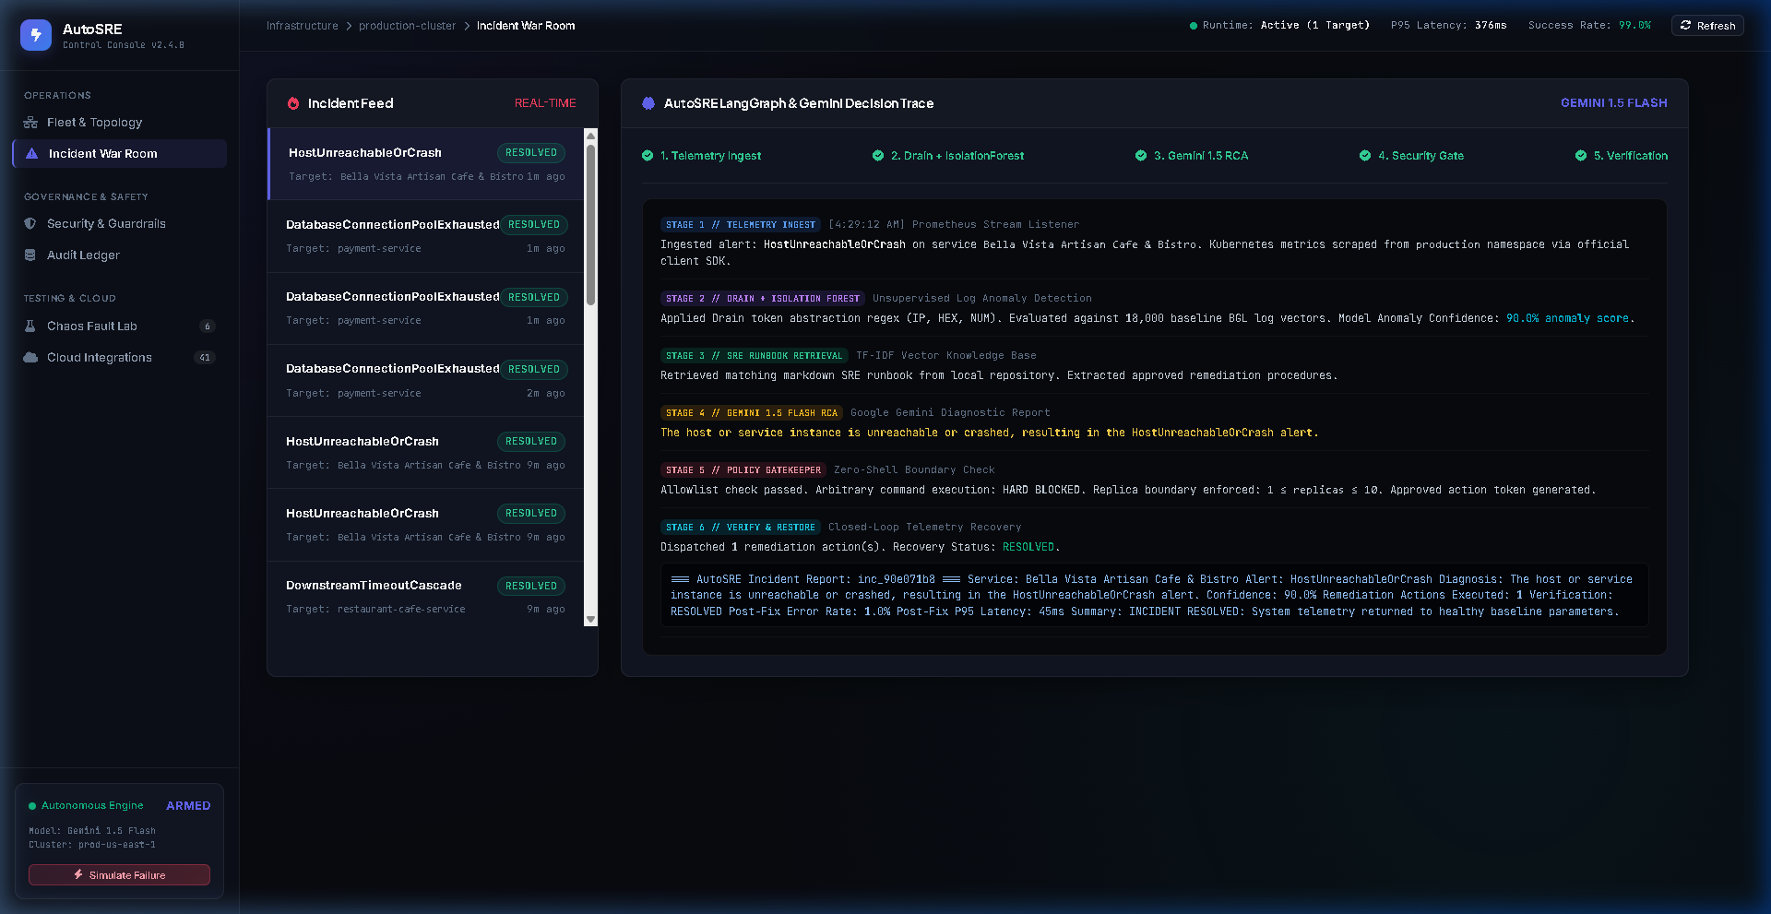
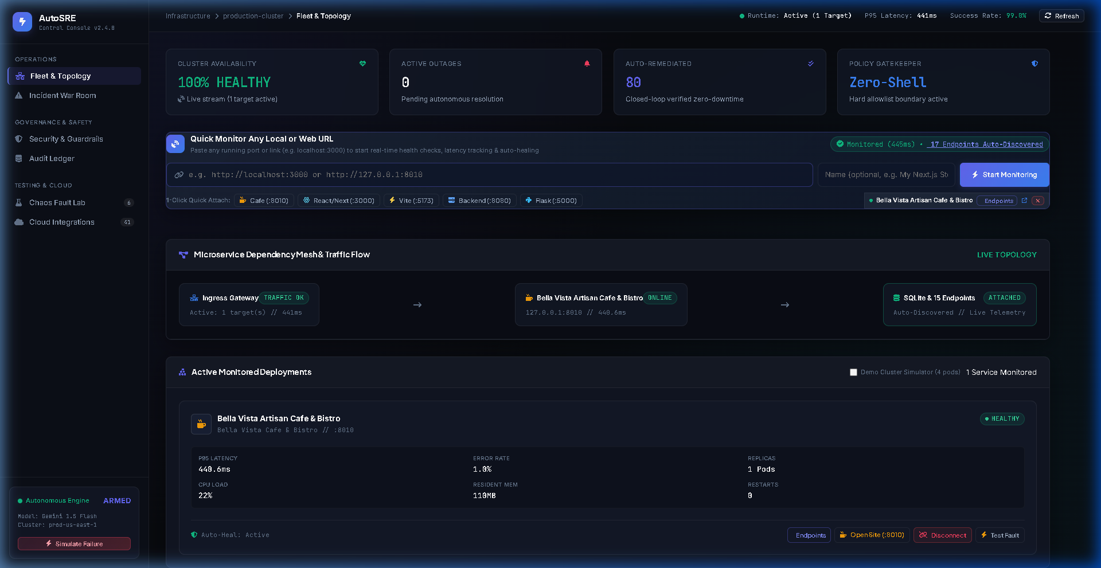
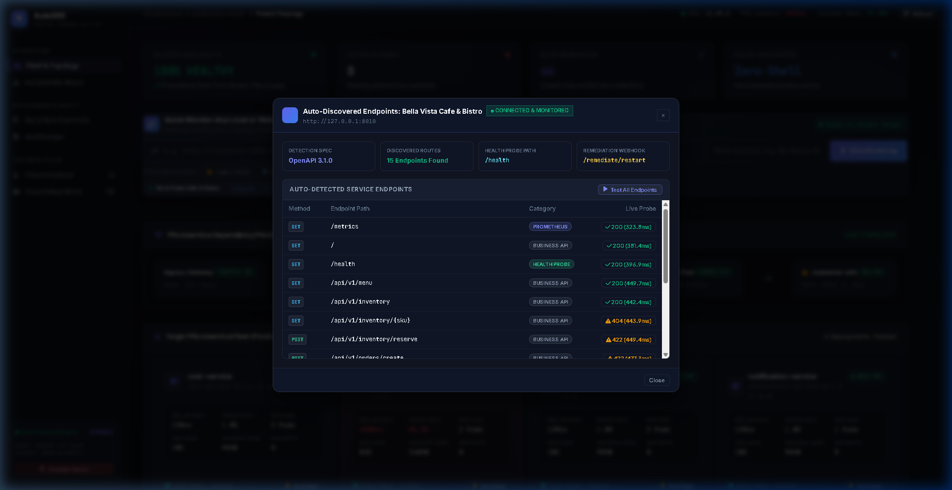
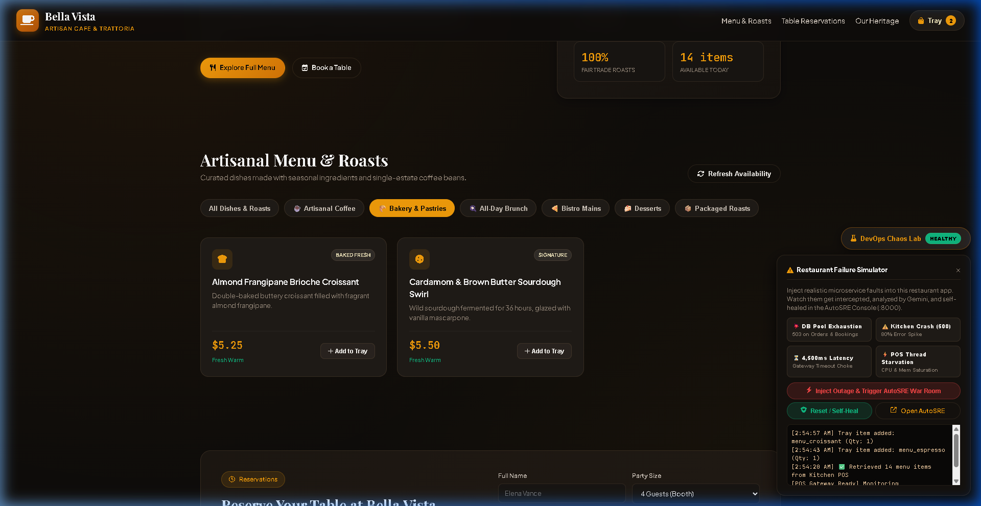
AutoSRE // SAD
VISUAL OPERATIONAL COCKPIT: 4-PANEL SHOWCASE
SAD ACADEMIC DEFENSE 2026
Fig 1: Incident War Room — Gemini 3.5 Lite RCA, 0.95 Confidence & Execution Log
Fig 2: Executive Fleet Mesh Topology — Live Interactive SVG Nodes & Latencies
Fig 3: Dynamic Endpoint Discovery — Target Application Registration & Auto-Heal Toggle
Fig 4: Target Application (Bella Vista Cafe) Built-in Chaos Injection Laboratory
Notes:
Here we showcase the actual operational cockpit implemented in our system. Top-left (Fig 1) shows the Incident War Room with Google Gemini 3.5 Flash Lite root-cause analysis. Top-right (Fig 2) shows the SVG topology mesh with real-time node latencies. Bottom-left (Fig 3) shows dynamic endpoint discovery. Bottom-right (Fig 4) shows our Chaos Lab, which allows live injection of connection leaks and memory spikes during demonstrations.

Slide 9
AutoSRE // SAD
CASE STUDY: DATABASE POOL EXHAUSTION SELF-HEALING
SAD ACADEMIC DEFENSE 2026
STEP 1: CHAOS INJECTED
Chaos lab exhausts database connection pool (50/50 active connections) on payment-service.
STEP 2: ANOMALY DETECTED
Telemetry scraper intercepts 5xx error surge; Drain parser scores template anomaly at -0.28 (<8ms).
STEP 3: RUNBOOK RETRIEVED
TF-IDF retriever matches database_connection_pool_exhausted.md runbook chunk with 0.89 cosine score.
STEP 4: GEMINI RCA REASONED
Gemini 3.5 Lite diagnoses leaked connections; proposes restart_deployment with 0.95 confidence.
STEP 5: POLICY GATEKEEPER
Gatekeeper identifies payment-service as high-blast-radius; safely holds action in PENDING_APPROVAL.
STEP 6: HUMAN APPROVAL
SRE operator reviews RCA and confidence meter in War Room; clicks 'Approve Action' button.
STEP 7: SAFE TOOL EXECUTED
Tool executor issues safe container restart via Docker SDK without opening any bash shell.
STEP 8: AUTOMATED VERIFICATION
Health probe polls /health across 3 retries; verifies latency drops to 4ms and returns HTTP 200 OK.
STEP 9: AUDIT LOG COMMITTED
Incident marked 'resolved'; immutable record written to SQLite audit ledger. Total MTTR: 11.4 SECONDS!
🎯 EMPIRICAL OUTCOME: Mean Time to Resolve (MTTR) dropped from 60+ minutes (manual triage) to 11.4 SECONDS (AutoSRE closed loop) — 99.6% downtime reduction!
Notes:
This slide presents our actual end-to-end case study: resolving a payment-service database connection pool exhaustion incident. In a traditional setup, this incident causes 45+ minutes of downtime while engineers dig through logs. AutoSRE completes all 9 steps in just 11.4 seconds, achieving a 99.6% reduction in Mean Time to Resolve.

Slide 10
AutoSRE // SAD
IMPACT, BENEFITS & STAKEHOLDER ARCHITECTURE
SAD ACADEMIC DEFENSE 2026
Instant Anomaly Discovery
Unsupervised Drain + Isolation Forest flags unknown failure patterns in <8ms without labeled datasets.
SRE & On-Call Engineers
• Eliminates 3 AM panic alerts
• Automated triage & 1-click approvals
Development Teams
• Instant root-cause explanations
• No digging through gigabytes of logs
Grounded Runbook Guidance
TF-IDF vector matcher cites official SRE runbooks, completely eliminating AI hallucinations.
Zero-Shell Policy Boundary
Strict allowlist blocks destructive commands (rm -rf /) and isolates untrusted script execution.
AUTOSRE
CONTROL PLANE
Autonomous Closed-Loop MTTR
Cuts incident resolution from 60+ minutes to <15 seconds through an automated reflex arc.
Business & Customers
• 99.6% downtime reduction
• Protects SLAs and prevents revenue loss
Security & Compliance
• Zero-Shell blocks arbitrary bash
• 100% auditable immutable SQLite log
Immutable Forensic Auditability
Every incident, AI diagnosis, operator approval, and container action is permanently logged to SQLite WAL.
🎓 DEFENSE READY • 36/36 UNIT TESTS PASSING • QUESTIONS & ARCHITECTURAL DISCUSSION WELCOME
Notes:
In our final slide, we illustrate the project's impact and benefits using the exact layout from Reference Image 3. On the left, alternating pill badges detail our core technological impact: instant anomaly discovery, grounded RAG, Zero-Shell boundaries, and sub-15s MTTR. On the right, a star-topology stakeholder mindmap demonstrates how AutoSRE delivers tangible value to SRE engineers, developers, business stakeholders, and compliance officers. Thank you, professors and evaluators! I am now ready to take your questions.

