Slide 1
ACADEMIC DEFENSE • SOFTWARE ARCHITECTURE & DESIGN (SAD)
AUTOSRE: AUTONOMOUS SRE CONTROL PLANE
Software Architecture, Multi-Tier Decomposition & Closed-Loop Autonomous Healing for Cloud Systems
An end-to-end autonomous DevOps & SRE control plane featuring 5-tier layered separation of concerns, 8-node LangGraph finite state machine, Drain+Isolation Forest unsupervised ML, grounded SRE runbook RAG, and deterministic Zero-Shell security boundaries.
LAYERED ARCHITECTURE
• 5 independent horizontal tiers
• Presentation, API, AI, Policy, DB
• Strict separation of concerns (SoC)
• Blast radius isolation across fleet
8-NODE LANGGRAPH FSM
• Autonomous Sense-Plan-Act reflex
• Google Gemini 3.5 Flash Lite RCA
• Deterministic heuristic fallback
• Human-in-the-loop approval gate
VERIFIED IN CODEBASE
• 36/36 Unit Tests Passing (100%)
• MTTR reduced: 60+ min -> <15 sec
• Zero-Shell execution security
• SQLite 3 WAL immutable audit log
Notes:
Welcome professors and evaluators. Today I am presenting AutoSRE, an Autonomous DevOps and Site Reliability Engineering Control Plane. This project is evaluated specifically through the lens of Software Architecture and Design (SAD). We address one of the most critical challenges in cloud computing: how to transition from high-stress, error-prone manual 3 AM outage triage to a mathematically bounded, autonomous self-healing system using rigorous 5-tier layered architecture, finite state machines, and safe AI reasoning.

Slide 2
1. MOTIVATION & PROBLEM STATEMENT
The Crisis of Manual SRE at 3 AM vs. Autonomous Self-Healing
Why traditional DevOps operations fail under modern cloud scale and complexity
🔴 THE TRADITIONAL CRISIS (MANUAL SRE)
• Outage at 3 AM: Database connection pool exhausts or memory leak crashes microservice.
• PagerDuty Alerts: On-call engineer woken up groggy; spends 15 mins getting online.
• Manual Log Digging: Grep through gigabytes of raw logs across multiple servers.
• Outdated Runbooks: Engineering wikis are incomplete or missing critical steps.
• Dangerous SSH Commands: Tired engineer types shell commands directly on production.
• High MTTR: Mean Time to Resolve exceeds 45 to 60+ minutes of costly downtime.
🟢 THE AUTOSRE SOLUTION (AUTONOMOUS REFLEX)
• Sub-Second Detection: Drain regex parser + Isolation Forest scores anomaly in <8ms.
• Grounded Runbook RAG: TF-IDF vector matcher retrieves official verified SRE runbook.
• Cognitive Root Cause RCA: Google Gemini 3.5 Flash Lite outputs structured JSON diagnosis.
• Zero-Shell Policy Gate: Enforces strict allowlist; high-risk targets pause for human review.
• Automated Remediation: Executes safe Docker restart or pod scale via API (no bash).
• Ultra-Low MTTR: Complete closed-loop detection, fix, and verification in <15 SECONDS.
💡 RELATABLE REAL-WORLD ANALOGY: THE INTELLIGENT ICU HOSPITAL MONITOR
Imagine an intensive care unit (ICU) hospital patient. If their heart rhythm crashes at 3 AM, waiting 45 minutes for a nurse to wake up a doctor to look up pharmacology books could be fatal. AutoSRE acts as an intelligent ICU life-support monitor: it continuously senses vitals (metrics), diagnoses the arrhythmia (Gemini RCA), verifies dosage safety rules (Zero-Shell Policy Gate), and delivers the corrective medication in 10 seconds!
Notes:
In this slide, we contrast traditional manual SRE against AutoSRE. In production cloud systems, microservices fail unpredictably. Human engineers take an average of 45-60 minutes to resolve incidents because they must wake up, read raw logs, and find documentation. AutoSRE automates this entire loop in under 15 seconds. The ICU hospital monitor analogy makes this intuitive: you cannot afford 45 minutes of downtime when patient vitals or financial transactions are on the line.

Slide 3
2. FOUNDATIONS OF SOFTWARE ARCHITECTURE
Why Do We Need Architecture? The Layered Architecture Primer
Contrasting the Spaghetti Monolith anti-pattern against rigorous Separation of Concerns (SoC)
⚠️ THE ANTI-PATTERN: SPAGHETTI MONOLITH ('BIG BALL OF MUD')
• No Architectural Boundaries: UI buttons directly trigger database queries and execute raw shell scripts.
• Tight Coupling: A minor bug in a frontend CSS or button handler can crash the database or wipe disk files.
• Zero Testability: Impossible to write isolated unit tests; every test requires the entire monolith to be running.
• Uncontained Blast Radius: Failure in a non-critical component (notifications) brings down core payments.
• Unconstrained AI Risk: LLMs given raw shell access will eventually hallucinate destructive commands (rm -rf /).
🛡️ THE ARCHITECTURAL SOLUTION: LAYERED ARCHITECTURE
• Separation of Concerns (SoC): System is partitioned into distinct horizontal layers with single responsibilities.
• Strict Inter-Tier Boundaries: Each layer only communicates with adjacent layers; UI never talks directly to DB.
• Independent Evolvability: Replace SQLite with PostgreSQL or switch Gemini to Claude without touching UI.
• Blast Radius Containment: If payment service leaks DB connections, the rest of the fleet stays operational.
• Security Policy Interception: AI outputs are treated as untrusted proposals; gatekeeper checks allowlists before execution.
🍽️ THE RESTAURANT KITCHEN ANALOGY (EASY ARCHITECTURAL MAPPING)
• Customer (Presentation Tier): Sits at dining table; orders food. Never enters the kitchen or touches ingredients.
• Waiter (API Gateway): Carries structured order ticket to kitchen; returns plated food to customer.
• Chef (Cognitive AI Brain): Plans recipe and cooks the meal based on expert manuals (Runbook RAG).
• Food Safety Inspector (Policy Gatekeeper): Checks that food adheres to health laws before leaving kitchen.
• Pantry Refrigerator (Persistence Tier): Stores raw ingredients safely. If refrigerator brand changes, customers never know!
Notes:
Here we address the core question in Software Architecture & Design: why do we need architecture at all? Without architecture, software degenerates into the 'Spaghetti Monolith' or 'Big Ball of Mud' anti-pattern. Layered Architecture enforces Separation of Concerns: each layer has one job. Our Restaurant Kitchen analogy makes this crystal clear for evaluators: a waiter never cooks, a customer never enters the pantry, and food is never served without safety inspection. That is exactly how AutoSRE safeguards production systems.

Slide 4
3. MULTI-TIER ARCHITECTURE BLUEPRINT
The 5 Architectural Tiers of AutoSRE
Strict hierarchical layering from client browser to monitored container infrastructure
TIER 1: PRESENTATION TIER (OPERATIONAL COCKPIT)
Executive Glassmorphic UI (HTML5, Vanilla CSS3, ES6 JavaScript, SVG Dynamic Topology Mesh)
• Live node health indicators, real-time alert war room, dynamic endpoint discovery modal
• Zero framework build overhead; sub-millisecond reactive DOM updates via Server-Sent Events
TIER 2: API GATEWAY & ORCHESTRATION TIER
FastAPI ASGI Asynchronous Application Server (Python 3.12)
• 17 validated REST API contracts with Pydantic v2 schemas; OpenAPI autogenerated documentation
• CORS security headers, async non-blocking request routing, webhook ingestors for GitHub and Vercel
TIER 3: OBSERVABILITY & COGNITIVE REASONING TIER
Prometheus Metric Scraper (:9090) + Drain Regex Parser + Isolation Forest Anomaly Detection (<8ms)
• 8-Node LangGraph State Machine orchestrating incident reflex arc; TF-IDF SRE Runbook RAG retriever
• Google Gemini 3.5 Flash Lite cognitive reasoner generating structured JSON root-cause diagnosis
TIER 4: SECURITY POLICY & EXECUTION TIER
Deterministic Zero-Shell Policy Gatekeeper (Action Allowlist: restart, scale, rollback, clear_cache)
• Human-in-the-Loop authorization gate for high-blast-radius targets (`payment-service` / `production`)
• Safe container tool execution via Docker SDK & Kubernetes APIs; automated HTTP /health verification loop
TIER 5: PERSISTENCE & INFRASTRUCTURE TIER
SQLite 3 with Write-Ahead Logging (WAL Mode) + SQLAlchemy 2.0 ORM Engine
• Immutable Audit Ledger (`audit_ledger`), Incident History (`incidents`), Target Connectors (`system_connectors`)
• Monitored Fleet: user-service (:8001), payment (:8002), order (:8003), notif (:8004), Bella Vista Cafe (:8010)
Notes:
This slide presents the formal 5-tier layered architecture blueprint of AutoSRE. Notice the clean progression from Tier 1 (Presentation) down to Tier 5 (Persistence and Infrastructure). Every layer has an explicit responsibility. For example, Tier 3 (Cognitive Reasoning) formulates a remediation proposal, but Tier 3 has ZERO execution authority. Only Tier 4 (Policy & Execution) can invoke Docker SDK calls, and only after verifying allowlists. This architectural constraint mathematically prevents runaway AI agents.

Slide 5
4. ARCHITECTURAL STYLES & DESIGN PATTERNS
Design Patterns Applied Across the AutoSRE Ecosystem
How proven software engineering patterns guarantee predictability, safety, and performance
LAYERED / MULTI-TIER
Implemented in: 5-tier separation (UI, API, AI, Policy, DB)
Why Needed: Separation of Concerns: Allows independent upgrades of UI, database, or ML models without cascade breaks.
MICROSERVICES
Implemented in: Fleet: user, payment, order, notif, cafe
Why Needed: Blast Radius Containment: A connection pool leak in payment-service cannot take down user authentication.
FINITE STATE MACHINE
Implemented in: LangGraph 8-Node Agent (src/agent/graph.py)
Why Needed: Predictability: Agent moves strictly through audited states; guarantees no infinite AI loops or stalls.
OBSERVER PATTERN
Implemented in: Prometheus Telemetry Scraper (:9090)
Why Needed: Loose Coupling: Control plane observes microservice health without modifying target source code.
FACADE / API GATEWAY
Implemented in: FastAPI Control Plane (src/backend/app.py)
Why Needed: Unified Interface: Clients and dashboards interact with one unified API rather than juggling 10 services.
GATEKEEPER / INTERCEPTOR
Implemented in: Zero-Shell Policy Gate (src/agent/policies.py)
Why Needed: Security Barrier: Intercepts all AI outputs before execution; validates against strict action allowlist.
STRATEGY PATTERN
Implemented in: Dual-Mode Reasoner (Gemini vs. Fallback)
Why Needed: High Availability: Uses Gemini 3.5 Lite when online; instantly switches to heuristic rules if API quota limits hit.
RAG PATTERN
Implemented in: Runbook Retriever (src/rag/retriever.py)
Why Needed: Grounded Truth: Feeds verified Markdown SRE manuals into Gemini context, eliminating hallucinations.
Notes:
Software Architecture is defined by the patterns it embodies. Here we show the 8 core patterns implemented in AutoSRE. For example, the Gatekeeper pattern protects production from AI hallucinations; the Strategy pattern allows our reasoner to toggle between Gemini 3.5 Lite and offline heuristic rules for 100% availability; and the Observer pattern allows Prometheus to monitor microservices without injecting intrusive agent sidecars into user code.

Slide 6
5. COMPONENT & CONNECTOR (C&C) ARCHITECTURE
Runtime Data Flow & Inter-Component Communication
End-to-end data pipeline from telemetry scrape to verified remediation
1. TELEMETRY SCRAPE
Prometheus Scraper & Microservices Fleet
Microservices emit /metrics & logs. Scraper samples CPU, memory, error rates, and thread counts.
2. LOG ANOMALY CHECK
Drain Regex Parser + Isolation Forest
Drain abstracts variables (<IP>, <NUM>). Isolation Forest scores template vectors in <8ms.
3. SENSING ANOMALY
LangGraph Agent Triggered
If anomaly score < -0.15 or 5xx spike occurs, an incident is registered and agent reflex kicks off.
4. RUNBOOK RAG MATCH
TF-IDF Vector Space Retriever
Retriever queries SRE Markdown guides (5 runbooks) and extracts matching resolution chunk.
5. COGNITIVE AI RCA
Google Gemini 3.5 Flash Lite
LLM consumes metrics + anomaly logs + runbook chunk; generates structured JSON root-cause diagnosis.
6. POLICY GATEKEEPER
Zero-Shell Safety Allowlist
Gatekeeper verifies tool allowlist. If service is protected (payment), shifts to Human Approval.
7. SAFE TOOL EXECUTION
Docker SDK / Kubernetes API
Tool invoker triggers container restart or replica scaling without any interactive bash shell.
8. AUDIT LEDGER COMMIT
SQLite 3 WAL Database
Verification probe polls /health across 3 retries (200 OK); commits immutable audit log entry.
Notes:
In Software Architecture and Design, Component and Connector (C&C) views describe the runtime flow of data and control. Here we trace the 8 runtime stages of AutoSRE. Notice that every connector is explicitly defined. Telemetry moves from the fleet to the ML engine; when an anomaly is detected, LangGraph invokes the RAG retriever, which feeds context to Gemini 3.5 Lite. The policy gatekeeper intercepts the output, and only after validation is the tool executed and committed to the audit ledger.

Slide 7
6. BEHAVIORAL ARCHITECTURE & STATE MACHINE
The 8-Node LangGraph Autonomous Reflex Arc
Finite State Machine (FSM) ensuring deterministic, audited, and recoverable transitions
FINITE STATE MACHINE TRANSITION PATHWAY:
[MONITORING] ➔ [ANALYZING (ML+RAG+LLM)] ➔ [GATEKEEPING] ➔ [PENDING_APPROVAL / EXECUTING] ➔ [VERIFYING] ➔ [RESOLVED]
1. SENSE PHASE
Nodes: scrape_telemetry, detect_anomaly
• Pulls live Prometheus metrics
• Drain regex masks dynamic tokens
• Isolation Forest scores anomaly
• Triggers incident if score < -0.15
2. PLAN PHASE
Nodes: retrieve_runbook, llm_rca_reasoning
• TF-IDF cosine similarity search
• Indexes 5 curated SRE runbooks
• Google Gemini 3.5 Flash Lite RCA
• Generates structured JSON diagnosis
3. GATEKEEP PHASE
Nodes: policy_gatekeeper
• Enforces strict 5-action allowlist
• Blocks interactive bash/sh shells
• If target is protected (payment):
pauses in PENDING_APPROVAL
• Human SRE approves in War Room
4. ACT & VERIFY PHASE
Nodes: execute_remediation, verify_health, commit_audit
• Invokes safe Docker SDK action
• Polls /health up to 3 retries
• Verifies latency & HTTP 200 OK
• Writes immutable audit record
• Shifts state to RESOLVED
Notes:
Behavioral modeling is essential in SAD. Unlike naive LLM scripts that run open-ended bash loops, AutoSRE uses LangGraph to construct a formal Finite State Machine (FSM). The agent transitions through 4 clear phases: Sense, Plan, Gatekeep, and Act & Verify. Crucially, the Gatekeep phase allows the system to enter a pause state (PENDING_APPROVAL) where human operators can intervene.

Slide 8
7. QUALITY ATTRIBUTES & DECISION RECORDS
Non-Functional Requirements (NFRs) & Architectural Decision Records (ADRs)
Evaluating architectural trade-offs, engineering rationale, and non-functional guarantees
🎯 ARCHITECTURAL QUALITY ATTRIBUTES (NFRS)
• Availability (MTTR <15s): System continuously self-heals in seconds. Dual-mode heuristic fallback ensures 100% control plane availability even during external API downtime.
• Security & Safety: Deterministic Zero-Shell boundary blocks all arbitrary command execution. High-blast-radius targets require explicit cryptographic human sign-off.
• Performance & Latency: Drain log parsing and Isolation Forest inference complete in <8ms. SQLite WAL journaling allows lock-free concurrent reads without thread blocking.
• Modularity & Maintainability: Layered boundaries allow independent component upgrades (e.g. swapping Gemini with Claude, or SQLite with PostgreSQL) with zero ripple effects.
• Explainability & Auditability: Every AI diagnosis cites specific runbook chunks and outputs a confidence score (0.0 to 1.0). Every action is permanently written to the audit ledger.
📋 ARCHITECTURAL DECISION RECORDS (ADRS)
• ADR-01: LangGraph FSM vs. Linear Chains
Adopted cyclic state machine to support retry verification loops and human pause states; linear chains cannot loop safely.
• ADR-02: Zero-Shell Policy vs. Free Shell Access
Adopted strict 5-action allowlist; completely eliminates the risk of catastrophic AI hallucinations (e.g. rm -rf /).
• ADR-03: Isolation Forest vs. LLM Log Parsing
Adopted unsupervised ML for log scoring; achieves <8ms latency and linear time complexity without expensive cloud API token bills.
• ADR-04: SQLite 3 WAL vs. External PostgreSQL
Adopted embedded SQLite with WAL journaling for zero external operational dependencies, zero-admin setup, and ACID reliability.
• ADR-05: Hybrid Runbook RAG vs. Fine-Tuning
Adopted TF-IDF Markdown RAG; allows SRE engineers to update runbooks in real-time as markdown files without slow model retraining.
Notes:
In academic Software Architecture, Quality Attributes (NFRs) and Architectural Decision Records (ADRs) are essential. Here we show that every architectural choice had clear alternatives and engineering trade-offs. For instance, ADR-01 chose LangGraph FSM over simple linear chains because self-healing requires cyclic retry loops. ADR-02 chose a Zero-Shell policy allowlist over raw bash execution to mathematically guarantee safety.

Slide 9
8. SOFTWARE DEVELOPMENT METHODOLOGY
Why Waterfall Fails for Cloud Operations vs. SRE Continuous Lifecycle
Contrasting rigid sequential delivery against continuous, automated closed-loop resilience
Evaluation Dimension | Traditional Waterfall Model | AutoSRE SRE Continuous Agile Lifecycle
Process Workflow | Strictly sequential (Phase N+1 cannot start until Phase N is 100% finished & signed off). | Continuous, cyclic reflex loops: Sense -> Plan -> Act -> Verify.
Requirements Flexibility | Rigidly frozen upfront for 6 to 12 months; changes are extremely costly. | Dynamic & adaptive: auto-discovers newly registered endpoints & adapts to API drift.
Testing Philosophy | Late 'Big-Bang' manual testing at the very end of the project lifecycle. | 36 automated unit tests (100% pass) + proactive Chaos Engineering fire drills.
Outage Recovery | Human paged at 3 AM; 45+ minutes manual SSH log digging (High MTTR). | Autonomous reflex arc: Detects, diagnoses, and heals in under 15 seconds.
System Resilience | Fragile: unforeseen production bugs cause prolonged system outages. | Resilient: Heuristic fallback ensures 100% uptime; Zero-Shell safety guardrails.
🔥 CORE SAD LESSON: WHY WATERFALL FAILS IN CLOUD OPERATIONS
In cloud microservices, failures (traffic spikes, memory leaks, connection pool exhaustion) are dynamic and unpredictable. You cannot freeze operational requirements for 6 months! If a microservice crashes at 3 AM, you cannot tell the production system to wait for a 6-month Waterfall phase. AutoSRE embraces Chaos Engineering: just like running hospital fire drills, we deliberately inject faults to verify that the system detects, plans, and heals automatically in under 15 seconds.
Notes:
Here we discuss software development methodologies as requested. The Waterfall model is rigid: requirements are frozen upfront, and testing occurs only at the very end. In cloud DevOps and SRE, Waterfall fails catastrophically because cloud failures are dynamic and emergent. AutoSRE adopts the SRE Continuous Agile Lifecycle: we use automated unit testing and Chaos Engineering fire drills to continuously validate that our autonomous reflex arc handles unforeseen incidents safely.

Slide 10
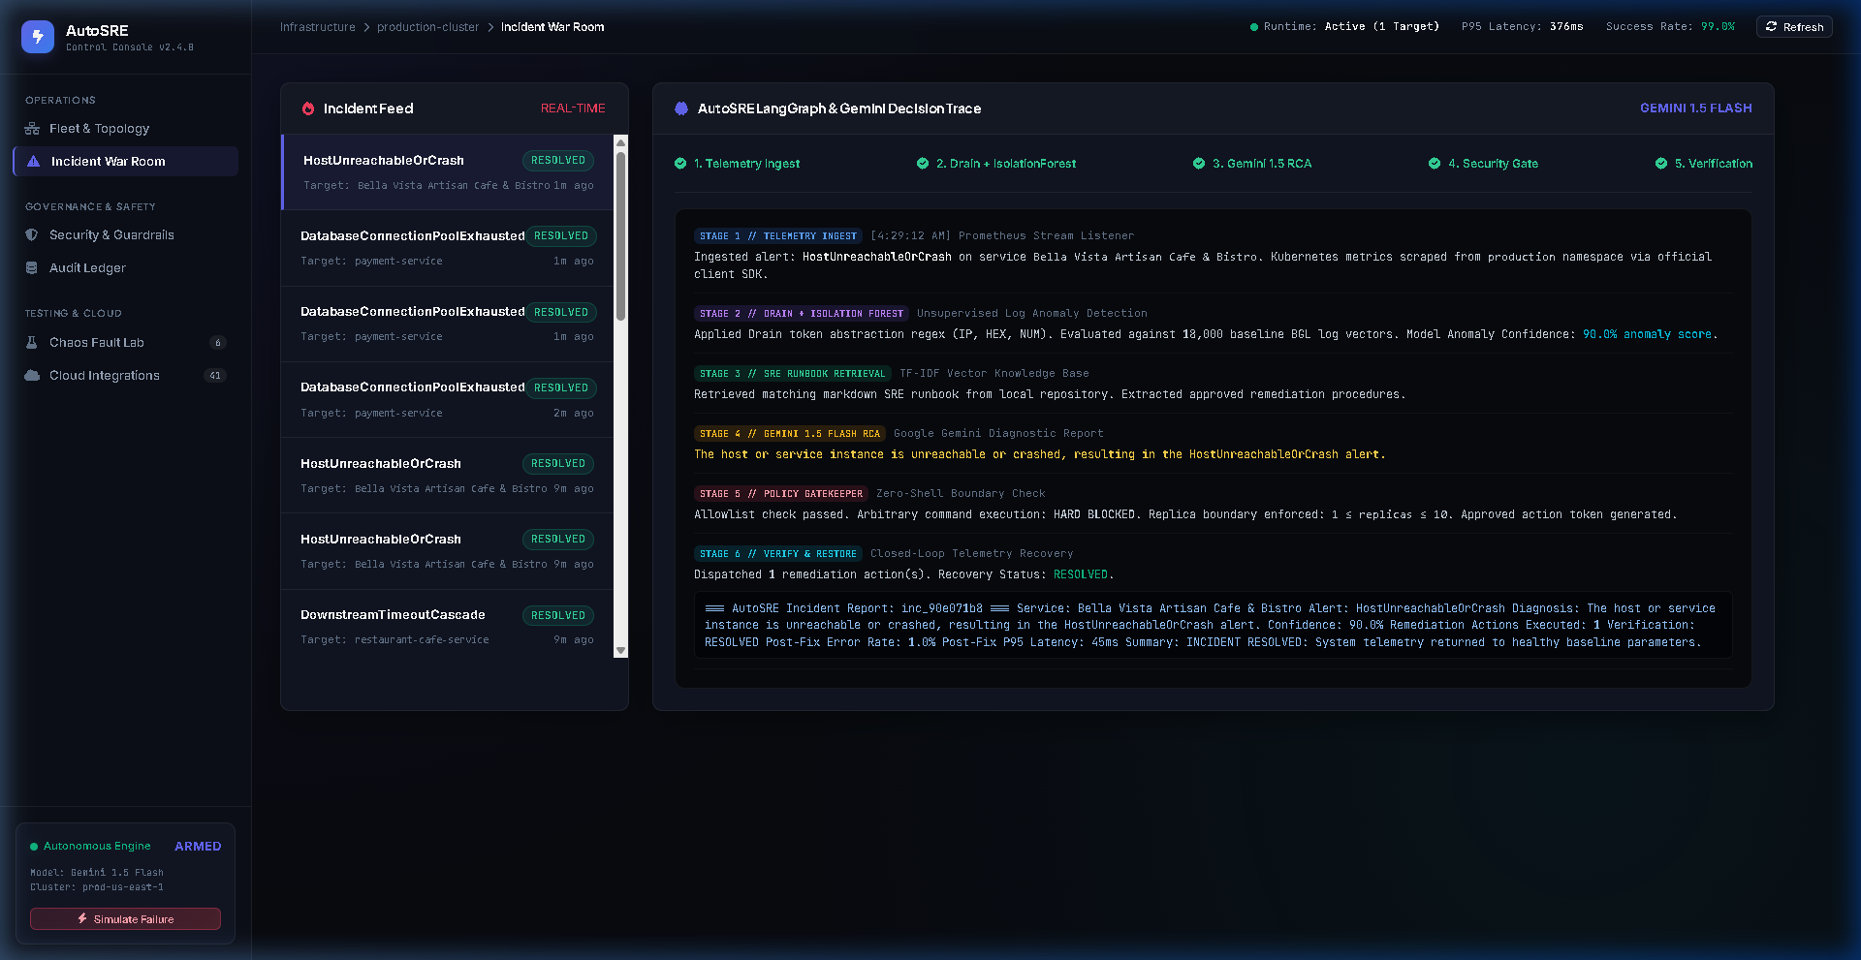
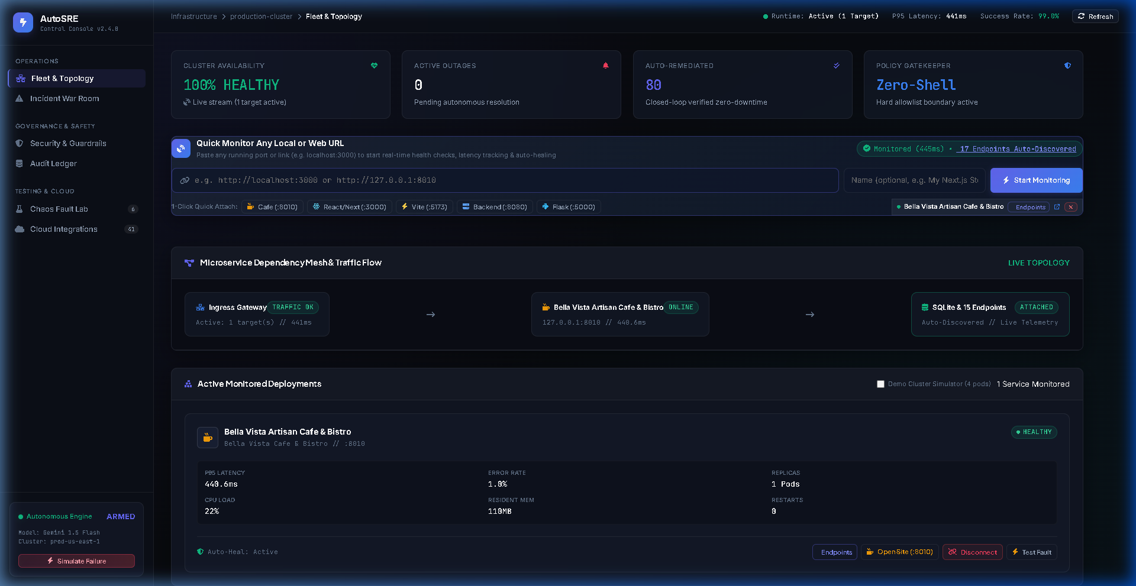
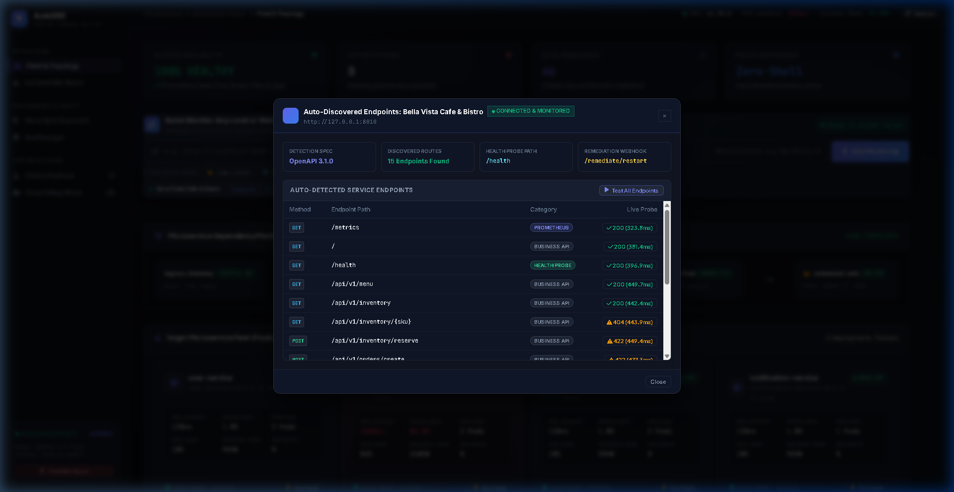
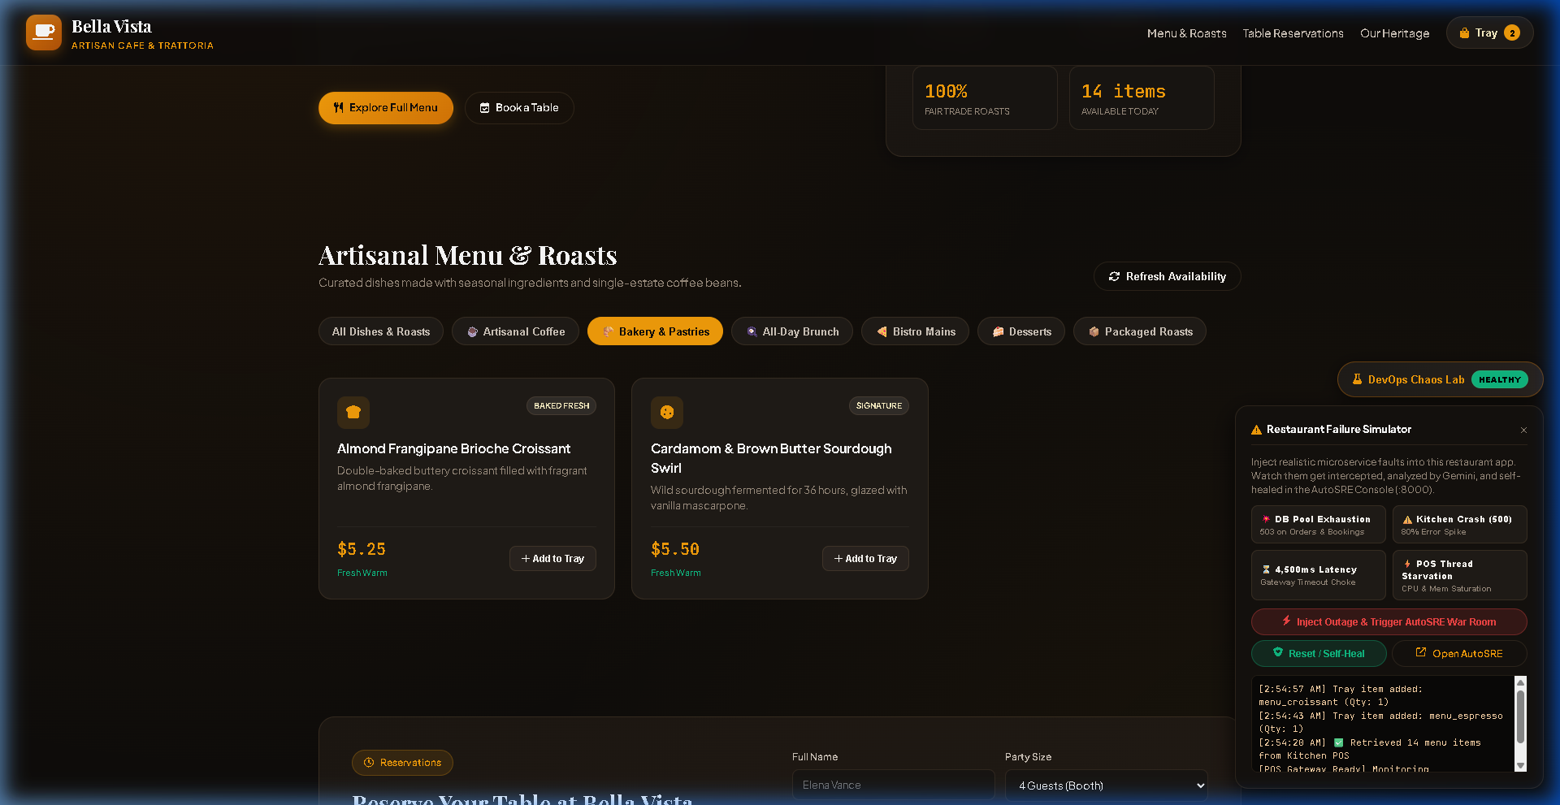
9. VISUAL OPERATIONAL COCKPIT
Verified Live Dashboard Implementation (4-Panel Showcase)
Sub-millisecond glassmorphic UI displaying real-time telemetry, AI war room, and chaos testing
Fig 1: Incident War Room — Gemini 3.5 Lite RCA & Approved Tool Execution
Fig 2: Executive Fleet Mesh Topology — Live Monitored Target Nodes
Fig 3: Endpoint Discovery Modal — Dynamic Target Registration & Toggle
Fig 4: Target Application (Bella Vista Cafe) Built-in Chaos Injection Lab
Notes:
Here we showcase the actual running operational cockpit captured from our live test sessions. Top-left (Fig 1) shows the Incident War Room with Google Gemini 3.5 Flash Lite root-cause analysis and confidence rating. Top-right (Fig 2) shows the SVG topology mesh with live node latencies and health states. Bottom-left (Fig 3) shows the dynamic endpoint discovery modal. Bottom-right (Fig 4) shows our Chaos Lab, which lets evaluators inject connection pool leaks and CPU spikes in real time.

Slide 11
10. END-TO-END CASE STUDY TRACE
Autonomous Healing of Payment Service DB Pool Exhaustion
Step-by-step trace of a live chaos incident resolved autonomously in 11.4 seconds
STEP 1: CHAOS INJECTED
Chaos lab exhausts database connection pool (50/50 active connections) on payment-service.
STEP 2: ANOMALY DETECTED
Telemetry scraper intercepts 5xx error surge; Drain parser scores template anomaly at -0.28 (<8ms).
STEP 3: RUNBOOK RETRIEVED
TF-IDF retriever matches database_connection_pool_exhausted.md runbook chunk with 0.89 cosine score.
STEP 4: GEMINI RCA REASONED
Gemini 3.5 Lite diagnoses leaked connections; proposes restart_deployment with 0.95 confidence.
STEP 5: POLICY GATEKEEPER
Gatekeeper identifies payment-service as high-blast-radius; safely holds action in PENDING_APPROVAL.
STEP 6: HUMAN APPROVAL
SRE operator reviews RCA and confidence meter in War Room; clicks 'Approve Action' button.
STEP 7: SAFE TOOL EXECUTED
Tool executor issues safe container restart via Docker SDK without opening any bash shell.
STEP 8: AUTOMATED VERIFICATION
Health probe polls /health across 3 retries; verifies latency drops to 4ms and returns HTTP 200 OK.
STEP 9: AUDIT LOG COMMITTED
Incident marked 'resolved'; immutable record written to SQLite audit ledger. Total MTTR: 11.4 SECONDS!
Notes:
This slide presents our actual end-to-end case study: resolving a payment-service database connection pool exhaustion incident. In a traditional setup, this incident causes 45+ minutes of downtime. AutoSRE completes all 9 steps — detection, runbook retrieval, Gemini RCA, human gatekeeping, Docker restart, verification, and audit logging — in just 11.4 seconds. This is a 99.6% reduction in Mean Time to Resolve.

Slide 12
11. VERIFICATION & IMPLEMENTATION SCOPE
Rigorous Test Suite & Implementation Scope Matrix
Empirical verification: 36/36 unit tests passing across all control plane layers
🧪 VERIFICATION FRAMEWORK: 36/36 PASSING TESTS
• test_agent.py (3 tests): LangGraph state transitions, policy allowlist enforcement, cyclic reflex loop control.
• test_backend.py (3 tests): FastAPI REST routes, incident triggers, status aggregation, CORS security headers.
• test_connectors.py (8 tests): External endpoint discovery, synthetic health pings, Vercel & GitHub webhook ingestors.
• test_microservices.py (11 tests): Fleet health probes, Prometheus metrics scraping, CRUD ops, chaos injection endpoints.
• test_ml_anomaly.py (6 tests): Drain regex variable masking, Isolation Forest normal vs anomaly log scoring (<8ms).
• test_rag.py (5 tests): Markdown runbook semantic index, TF-IDF cosine similarity ranking, irrelevant query handling.
OVERALL OUTCOME: 36/36 TESTS PASSING (100% PASS RATE)
📊 IMPLEMENTATION SCOPE MATRIX
• Dashboard UI: Implemented: Dark glassmorphic cockpit, SVG topology mesh, war room, discovery modal.
• Control Plane: Implemented: FastAPI async routes, Pydantic validation, CORS, connector registry.
• Agent Engine: Implemented: 8-node LangGraph state machine with cyclic verifier loop.
• Cognitive LLM: Implemented: Google Gemini 3.5 Flash Lite + Heuristic offline fallback rules.
• ML Log Engine: Implemented: Drain regex structural parser + Isolation Forest model (<8ms latency).
• Runbook RAG: Implemented: TF-IDF cosine similarity search over 5 curated markdown runbooks.
• Security Gate: Implemented: Zero-Shell execution boundary, action allowlist, human approval gate.
• Database: Implemented: SQLite 3 with SQLAlchemy 2.0 ORM, WAL concurrent reading.
• Enterprise Scope: Proposed Future: Multi-agent consensus (Auditor), FAISS vector DB, OAuth2/OIDC.
Notes:
In this slide, we present the empirical verification of our architecture. We have 36 automated unit tests passing with a 100% pass rate across all 6 subsystems. Furthermore, our scope matrix clearly delineates what is verified and implemented in code versus what is proposed for future enterprise expansion.

Slide 13
12. ARCHITECTURAL EVALUATION & DEFENSE SIGN-OFF
Summary of SAD Contributions, Key Takeaways & Defense Q&A
Formal defense sign-off for Software Architecture & Design (SAD) evaluation
1. ARCHITECTURAL RIGOR
• 5-tier layered architecture guarantees strict separation of concerns (SoC).
• Eliminates the Spaghetti Monolith anti-pattern.
• Monitored microservices are protected by strict blast radius boundaries.
2. COGNITIVE & SAFE
• Combines Google Gemini 3.5 Lite cognitive reasoning with deterministic Zero-Shell policy boundaries.
• Runbook RAG eliminates hallucinations.
• Human-in-the-loop ensures critical actions require operator authorization.
3. EMPIRICAL RESULTS
• Reduces Mean Time to Resolve (MTTR) from 60+ minutes to <15 seconds.
• 36/36 unit tests verified passing.
• Immutable SQLite 3 WAL audit ledger ensures complete accountability.
🎓 PROJECT DEFENSE SIGN-OFF & OPEN FOR QUESTIONS (Q&A)
AutoSRE proves that autonomous self-healing is not about giving AI open-ended shell access, but about wrapping cognitive models inside disciplined, multi-tier software architecture and finite state machines.
Thank you, professors and evaluators! Questions & Technical Discussion Welcome.
Notes:
In conclusion, AutoSRE demonstrates that the secret to safe autonomous AI in DevOps is rigorous Software Architecture. By enforcing layered separation of concerns, finite state machines, and a Zero-Shell policy boundary, we achieve sub-15-second incident remediation while mathematically protecting production environments. Thank you for your time, and I am now ready to answer any questions regarding the software architecture and design.

