Slide 1
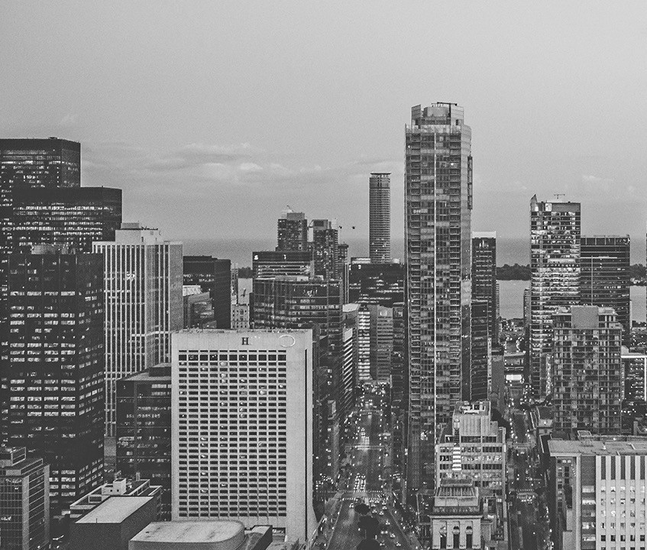
Speech recognition system
Don’t let your thoughts go Unspoken!

Slide 2
ABOUT US
I1-575,576,580

Slide 3
ABSTRACT
As a cross-disciplinary, speech recognition is based on the voice as the research object.
Speech recognition allows the machine to turn the speech signal into text or commands through the process of identification and understanding, and also makes the function of natural voice communication.
Speech recognition involves many fields of physiology, psychology, linguistics, computer science and signal processing, and is even related to the person's body language, and its ultimate goal is to achieve natural language communication between man and machine.
The speech recognition technology is gradually becoming the key technology of the IT man-machine interface .
The paper describes the development of speech recognition technology and its basic principles, methods, reviewed the classification of speech recognition systems and voice recognition technology, analyzed the problems faced by the speech recognition.

Slide 4
INTRODUCTION
Speech recognition is the process by which a computer (or other type of machine) identifies spoken words. Basically, it means talking to your computer, AND having it correctly recognize what you are saying.
The following definitions are the basics needed for understanding speech recognition technology.
1)Utterance
An utterance is the vocalization (speaking) of a word or words that represent a single meaning to the computer. Utterances can be a single word, a few words, a sentence, or even multiple sentences.

Slide 5
2)Speaker Dependance
Speaker dependent systems are designed around a specific speaker. They generally are more accurate for the correct speaker, but much less accurate for other speakers.
3)Vocabularies
Vocabularies (or dictionaries) are lists of words or utterances that can be recognized by the SR system.
4)Accuracy
The ability of a recognizer can be examined by measuring its accuracy - or how well it recognizes utterances.
5)Training
Some speech recognizers have the ability to adapt to a speaker.

Slide 6

PROBLEM STATEMENT
Why do we need speech Recoginition
Most Natural Form Of Communication
Differently abled people
Illiterate
Helplines
Cars
This project has the speech recognizing and speech synthesizing capabilities though it is not a complete replacement of what we call a NOTEPAD but still a good text editor to be used through voice. This software also can open windows based software’s such as Notepad, Ms-paint and more.

Slide 7

SOLUTION
The above problem can be solved through
Speech recognition software can translate spoken words into text using closed captions to enable a person with hearing loss to understand what others are saying.
Speech recognition can also enable those with limited use of their hands to work with computers, using voice commands instead of typing.

Slide 8
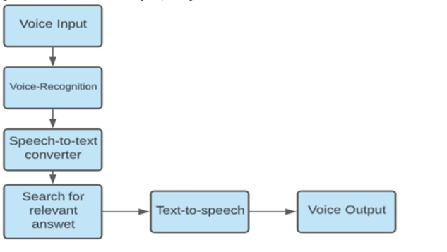
METHODOLOGY
The speech recognition system is essentially a pattern recognition system, including feature extraction, pattern matching, the reference model library. Its basic structure is shown in
5

Slide 9
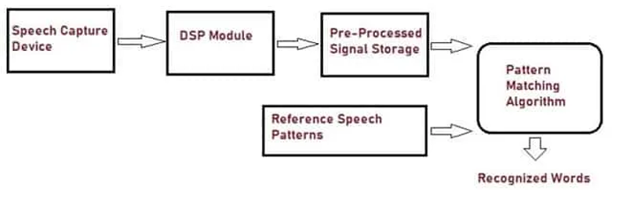
IMPLEMENTATION
SYSTEM ARCHITECTURE
The architecture of the system consists of following modules:
Speech Capturing Device
Digital Signal Processor Module
Pre-processed Signal Storage
Reference Speech Patterns
Pattern Matching Algorithm
5

Slide 10
CONCLUSION
Through this project, we showed underlying emotion from speech audio data and some insights on the human expression of emotion through voice.
This system can be employed in a variety of setups like Call Centre for complaints or marketing, in voice-based virtual assistants or chatbots, in linguistic research, etc.
A few possible steps that can be implemented to make the models more robust and accurate are the following
An accurate implementation of the pace of the speaking can be explored to check if it can resolve some of the deficiencies of the model.
Figuring out a way to clear random silence from the audio clip.
.

Slide 11


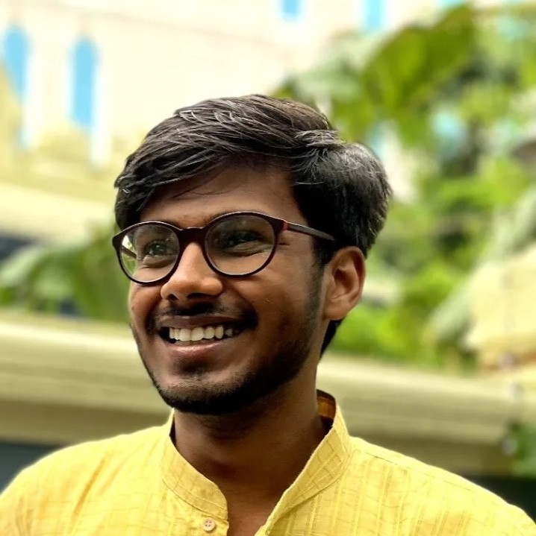

OUR TEAM
Aditya Raunak Raj
Nilesh Kumar
Satwik
Team Member
RA2011003010575
Team Member
RA2011003010576
Team Member
RA2011003010580
11

