Slide 1
Welcome

Slide 2
Presentation on
FOOD DELIVERY APP
Guided by
Prof.Raj Kolhe
Presented By
Name
Nilesh Lokewar
Dinesh Ingole
Nandkishor Desai
Madhura Itke
Akanksha Ladgaonkar

Slide 3
Content :
Introduction
Problem Statement
Data flow chart
Flow Chart
Class Diagram

Slide 4
Introduction:
ONLINE FOOD DELIVERY SYSTEM is a website designed primarily for use in the food delivery industry. This system will allow hotels and restaurants to increase scope of business by reducing the labor cost involved. The system also allows to quickly and easily manage an online menu which customers can browse and use to place orders with just few clicks.

Slide 5
Problem Statement:
Now a days most of the people wants all things at home, Food is one of them so we developed basic Food Delivery app.

Slide 6
Data Flow Chart:
Food Delivery Application-Jagdamba
Admin/User
Database
Add/view/order
Data
View Data

Slide 7
Start
Flow Chart:
Enter
Username
Password
Mobile no.
Address
Register
Do Registration
Login
Enter
Username
Email
Password
Mobile no.
Address
Role
Admin
User
Add Restaurant
Name
Add Id
Add Menu Type
Add Menu
Add Price
Select
Restaurant
Name
Select Id
Select Menu Type
Select Menu
Place Order

Slide 8
A
B
Restaurant name
Menu
Price
Added Successfully
Your order is placed Successfully
End

Slide 9
Class Diagram:
Register
User
Login
+ Register
+ Login
username
email
address
mobile number
password
Role
Id
username
email
address
mobile number
password
username
password
Restaurant Info
Jagadamba
Akansha
Madhu
Jagadamba
Akansha
Madhu
Menu Name
Menu Id
Menu Type
Item
Price
Menu Name
Menu Id
Menu Type
Item
Price
Menu Name
Menu Id
Menu Type
Item
Price

Slide 10
Development Environment:
SOFTWARE REQIUREMENTS
HARDWARE REQUIREMENTS
Languages and Technologies: Java
Operating system: Windows version 7 or higher.
Tools: XAMPP Server(windows-x64-7.3.26-0-VC15), PhpMyAdmin (version:5.0.4).
Processor – i3 or higher.
Memory – 2GB RAM.

Slide 11
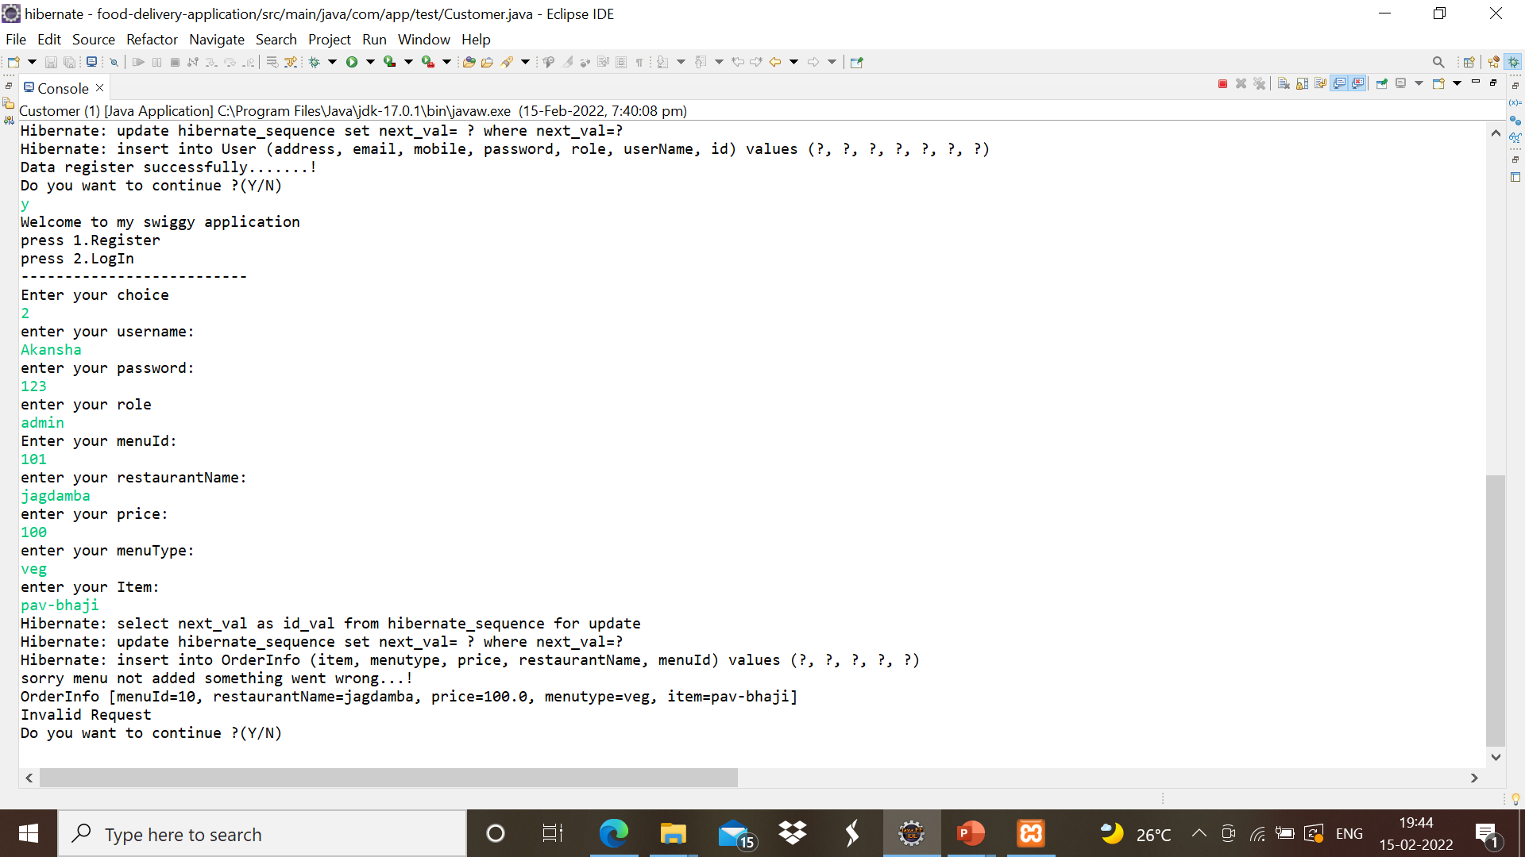
Output:

Slide 12
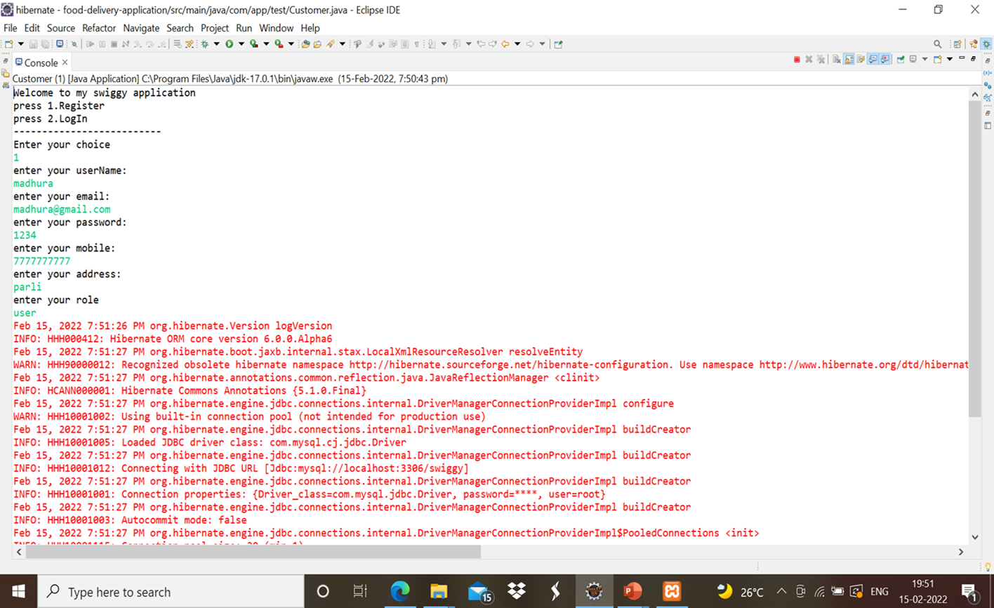

Slide 13
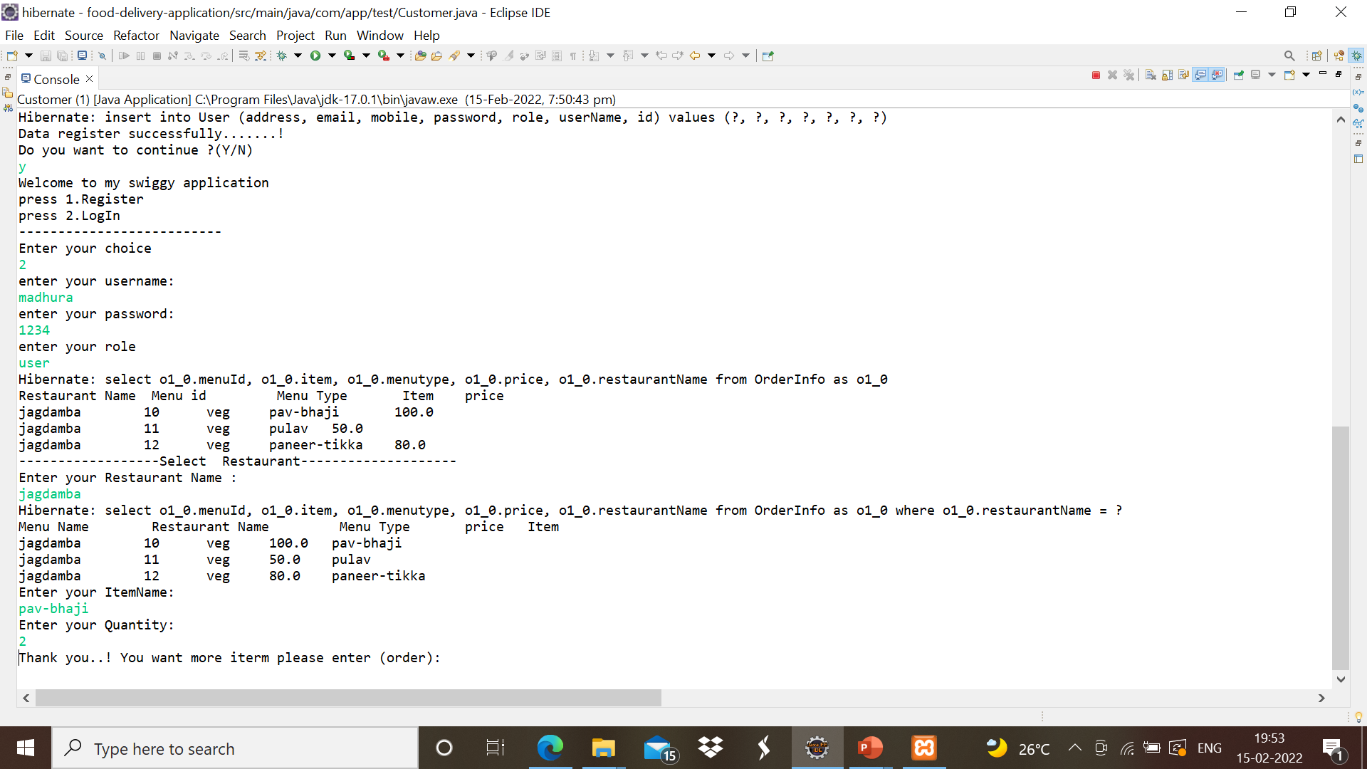

Slide 14
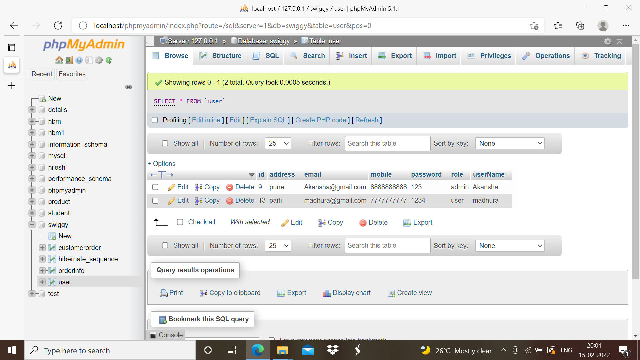


Slide 15
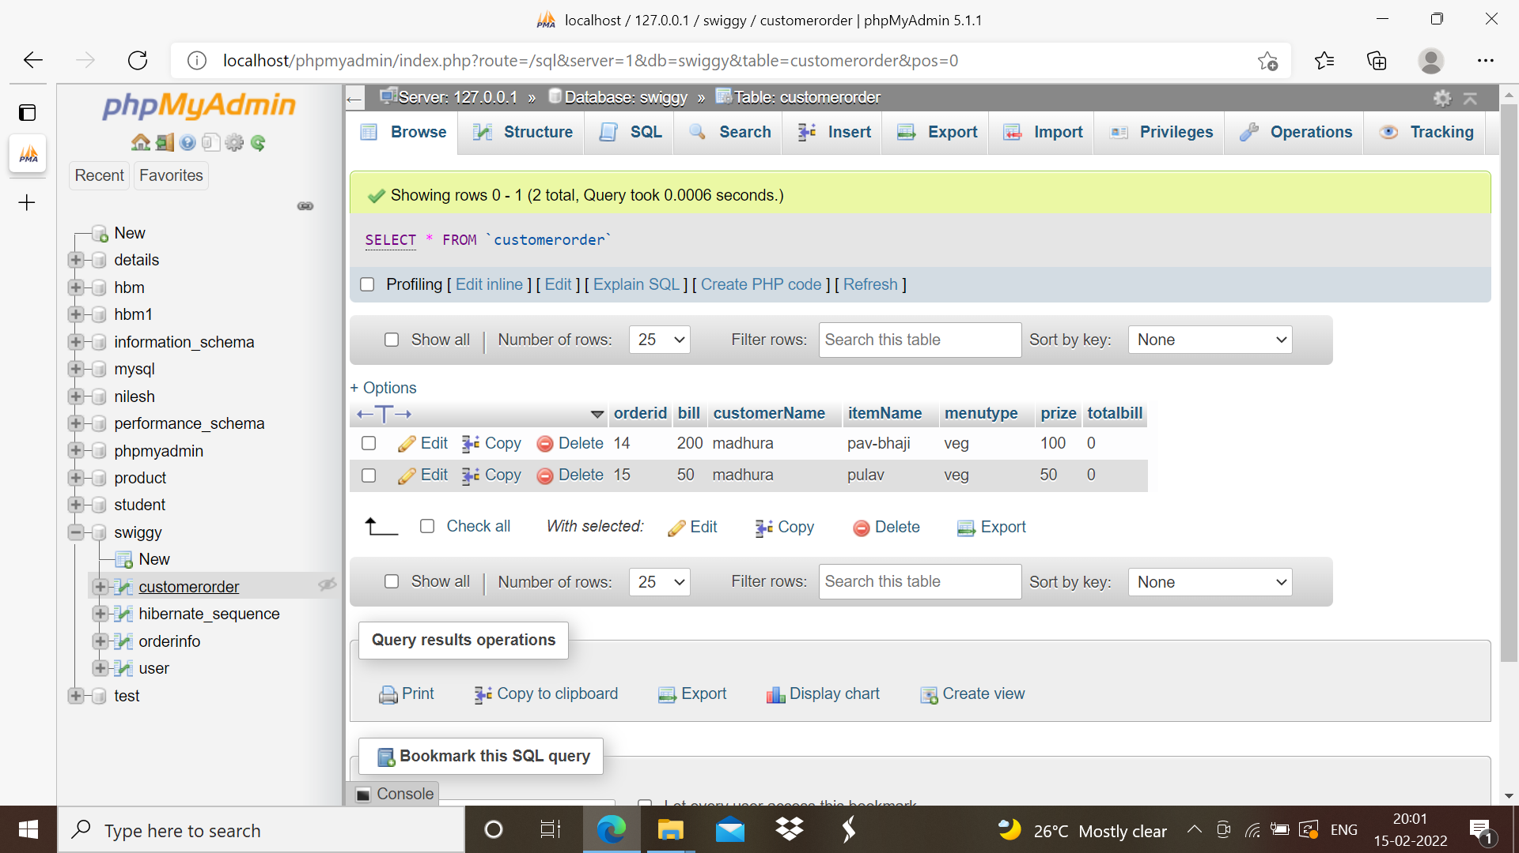

Slide 16
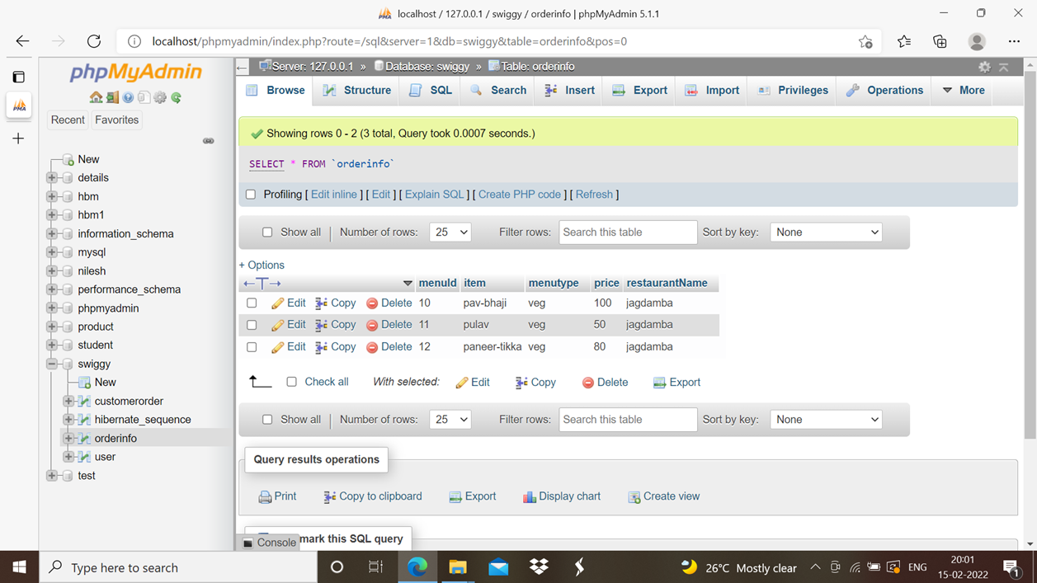

Slide 17
Thank You

