Slide 1
A feature selection approach to increasing classification performance

Slide 2
INTRODUCTION :
System can support any degree of dataset as input.
System focuses on classification task of data mining and high dimenstional issue of preprocessing .
Create groups of similar weight data and select best from group.
Drop unnecessary data using CCE and SU.
Gives best features set.
Notes:
g

Slide 3
Scope:
Feature selection using CCE and SU.
Make groups of same priority and out of them select best.
removes redundant and independent attributes with class level.
CCE is considered for relationship between two variables.
SU is considered to fix minimum value of weight

Slide 4
Objective :
Extracting the better features.
To increase the classification performance.
Reduce high dimensionality.
To reduce dimensionality using CCE and SU.
To devolope methodology to address the high dimensionality issue using clustering and filter based methods.
To devolope and compare with the existing methods using various classifiers.

Slide 5
System Architecture
Input data set
Apply SU
Calculate CCE between every feature
Convert binary weighted matrix
Compare with existing
Group the similar weighted features in one cluster
Choose the strong feature in each cluster
Subset of features

Slide 6
Proposed methodology working
CSV File as input
X | y
43 | 99
 | 10 | 20
21 | 65
25 | 79
10 | 12 | 58
42 | 75
57 | 87
59 | 81
10

Slide 7
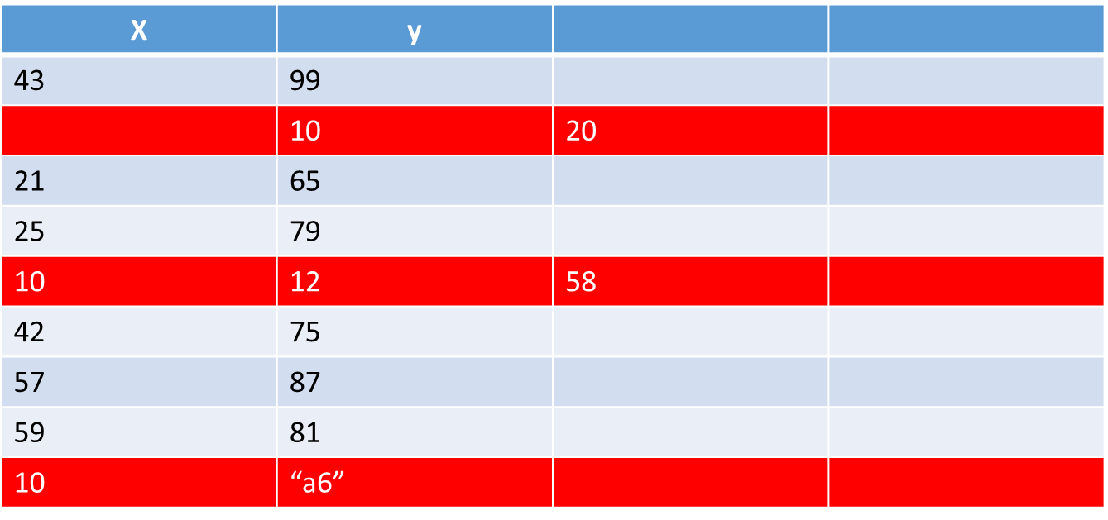
Data Preprocessing
Noisy and Missing values Mislabeled Imbalanced
3 rows are drop due to invalid data
6 rows are selected for next processing

Slide 8
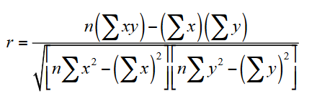
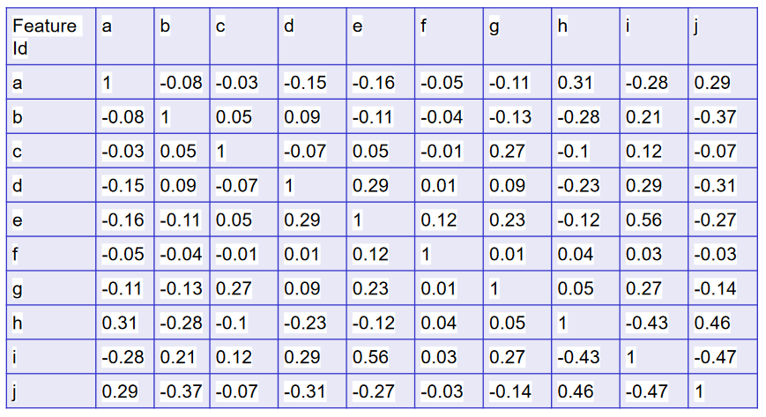
Generate the Correlation coefficient symmetrical matrix

Slide 9
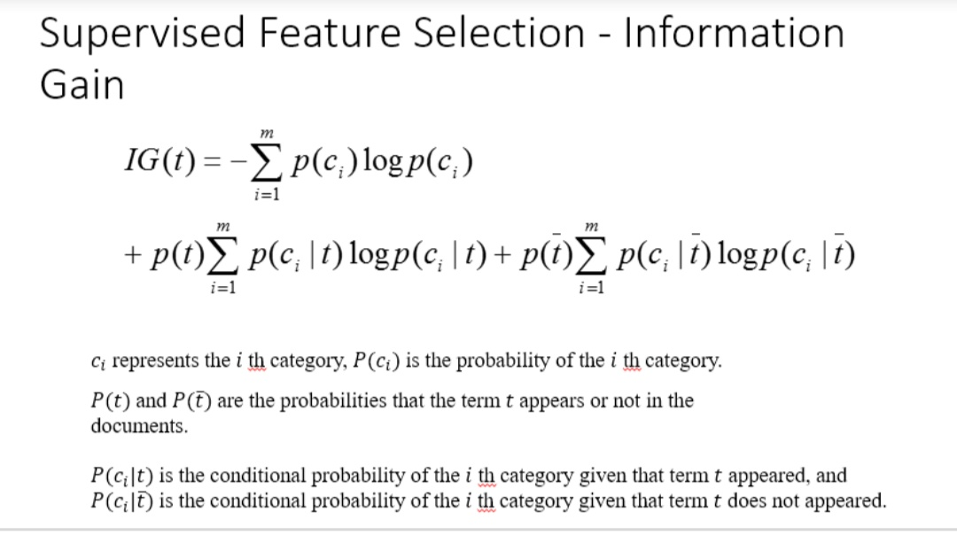
Find SU for each feature and sort decending order by SU
SU | Feature No | Feature Name
.19 | 10 | j
.19 | 8 | h
.19 | 7 | g
.18 | 9 | i
.15 | 2 | b
.09 | 1 | a
.07 | 4 | d
.06 | 3 | c
.06 | 5 | e
.02 | 6 | f
SU=(2*IG)/(H(X)+X(Y))
H(X)=-∫p(x)log(p(x))შx

Slide 10
Choose the middle feature’s SU value as t
SU | Feature No | Feature Name
.19 | 10 | j
.19 | 8 | h
.19 | 7 | g
.18 | 9 | i
.15 | 2 | b
.09 | 1 | a
.07 | 4 | d
.06 | 3 | c
.06 | 5 | e
.02 | 6 | f
t=.15

Slide 11
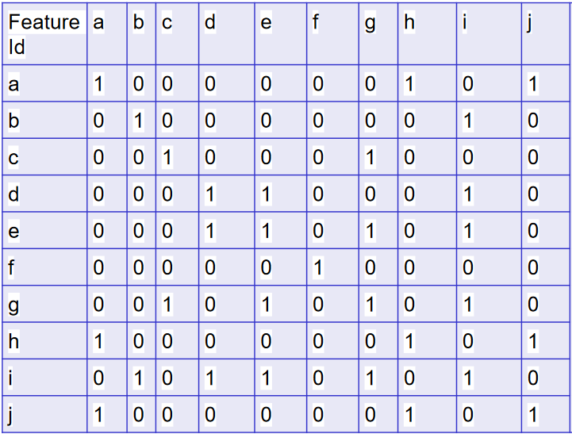
Transform CCE matrix to binary matrix as compare each value to t if less represent as 0 else 1
t=0.15

Slide 12
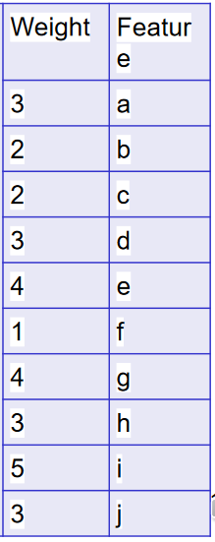
Calculate the total weight using binary matrix row wise

Slide 13
Group the feature which having same weight
Select the one feature from group by first appearance in SU Table
Weight | Feature
3 | a
2 | b
2 | c
3 | d
4 | e
1 | f
4 | g
3 | h
5 | i
3 | j
SU | Feature No | Feature Name
.19 | 10 | j
.19 | 8 | h
.19 | 7 | g
.18 | 9 | i
.15 | 2 | b
.09 | 1 | a
.07 | 4 | d
.06 | 3 | c
.06 | 5 | e
.02 | 6 | f
Group id | Weight | F_name | Selected feature
1 | 1 | f | f
2 | 2 | {b, c} | b
3 | 3 | {a,d,h,j} | j
4 | 4 | {g,e} | g
5 | 5 | i | i

Slide 14
Final candidate feature set:
CFS={ f, b, j, g, I }

Slide 15
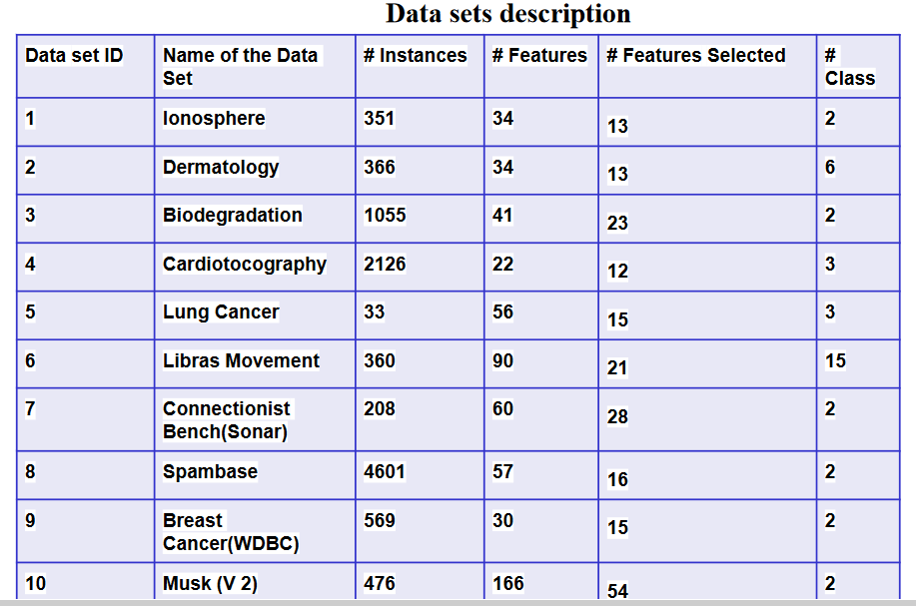

Slide 16
Conclusion:
It reduce the data set dimensionality by selecting the best features in it to boosts-up the classification performance.
.method was compared with four existing filter based methods namely, information gain(IG), Chi-Square (Chi), Grain Ratio (GR), and Relief.
For testing the our proposed method, six different classifiers Jrip, Ridor, J48, Simple cart, Naive Bayes, IBk are applied on Ten different real time data sets.
method displayed better results than existing IG and GR on 7 data sets,

Slide 17
Future scope
The same technique can be implemented using Hadoop framework .

Slide 18
Final candidate feature set:
CFS={ f, b, j, g, I }

Slide 19
references
Correlation Coefficient Based Candidate Feature Selection Framework Using Graph Construction
SP Potharaju, M Sreedevi
Gazi University Journal of Science 31 (3), 775-787

