Slide 1
Angular 2
Authored by: Nilesh Pagar
Presented by: Nilesh Pagar

Slide 2
Agenda
Introduction
Typescript introduction
Angular2 architecture
Modules
Metadata
Services
Dependency Injection
Routing
Setup and Bootstrap Angular2 & Creating our first component and the main app component
Component and Directives
Data binding to component properties.
Nesting components, passing Data to components children and Sending events to parents.
HTTP
Forms and events.
Any Questions?

Slide 3
Introduction to Angular 2
Angular 2 is the next version of Google’s massively popular MV* framework for building complex applications in the browser (and beyond).
Angular 2 comes with almost everything you need to build a complicated frontend web or mobile apps, from powerful templates to fast rendering, data management, HTTP services, form handling, and so much more
Angular 2 has been built using TypeScript that has great support of ECMAScript 6 standard, which helps to resolve complex application design and maintain them.
Great performance.
General simplicity of the interface.
Modularity.

Slide 4
Typescript Introduction
Typescript is a typed superset of Javascript that compiles to plain Javascript.
Perfect support for inheritance and interfaces allows achieving higher OOP experience to JavaScript, which results into the code reuse
The syntax is usually more convenient for C# or Java developers.
Class and Module Support
Static Type-checking
ES6:
Class – Clearer syntax for creating objects and prototypes.
Generics – To create flexible, reusable classes and functions.
Importing and Exporting Modules – To conditionally load modules with declarative syntax.
Fat Arrow Functions – Shorthand notation for writing functions.

Slide 5
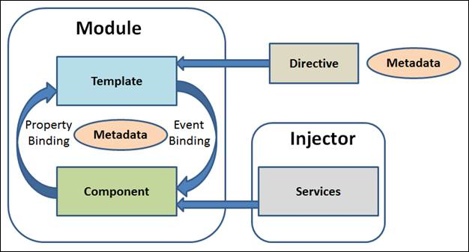
Angular2 architecture

Slide 6
Angular2 architecture
Modules
Contains parts of the application which we export
Components
Application logic which controls parts of the user interface
Templates
Renders the component on the page
Metadata
Information about the angular application parts
With metadata we describe parts of the Angular application and bind those parts together
@Component decorator

Slide 7
Services
Represents shared logic
Share data or functions between different parts of angular application
They minimize number of lines of code (code reusability)
@Injectable() decorator

Slide 8
Dependency injection
The way we give an instance of the object to some other part of the angular application
Instances of services are given through the constructors

Slide 9
Routing
The way we move through the application
<base href=“/”>
ROUTER_PROVIDERS, @Routes, <Router-outlet>, [routerLink]

Slide 10
Setup and Bootstrap Angular2 & Creating our first component and the main app component
Set up our development environment
Write the Angular root component for our app
Add an Angular Module
Bootstrap it to take control of the main web page
Write the main page (index.html)

Slide 11
Component and Component lifecycle
The Component is the most fundamental of Angular concepts.
A component manages a view - a piece of the web page where we display information to the user and respond to user feedback.
Technically, a component is a class that controls a view template.
Lifecycle:
Constructor
ngOnInit
ngOnChange
ngDocheck
ngAfterContentInit
ngAfterContentChecked
ngAfterViewInit
ngAfterViewChecked
ngOnDestroy

Slide 12
Directives
Angular transforms DOM based on instruction from directives
Built in directives
Attribute directives
ngStyle, ngClass – [class.ClassName], [style.color]
Structural directives
They change DOM
*ngIf, *ngFor

Slide 13
Data binding
Used for coordination of communication between component and template
One way data binding
Event biding(Template > Component)
( ) are used
Events like clicked, mouse enter, changed…
Two way data binding
Sends values from component to template, and returns changed values from template to component
[( )]

Slide 14
Nesting components, passing Data to components children and Sending events to parents
@Input
It is used to define an input property to achieve component property binding
@Output
It is used to define output property to achieve custom event binding
@Output will be used with the instance of EventEmitter

Slide 15
HTTP
Service that allows data to be returned or saved using Promises or Observables
RxJs (Reactive Js)
Observables
You need to subscribe to an observable
If something is changes observable notifies all subscribed parts

Slide 16
Forms
Angular offers two form-building technologies: Reactive forms or Model Driven and template-driven forms.
The two technologies belong to the @angular/forms library and share a common set of form control classes.
Ex of template-driven form:
<form #f="ngForm" (ngSubmit)="onSubmitTemplateBased()">
<p>
<label>First Name:</label>
<input type="text"
[(ngModel)]="user.firstName" required>
</p>
<p>
<label>Password:</label>
<input type="password"
[(ngModel)]="user.password" required>
</p>
<p>
<button type="submit" [disabled]="!f.valid">Submit</button>
</p>
</form>

Slide 17
Reactive form controller
A model driven form looks on the surface pretty much like a template driven form.
import { FormGroup, FormControl, Validators, FormBuilder } from '@angular/forms';
@Component({
selector: "model-driven-form",
templateUrl: 'model-driven-form.html'
})
export class ModelDrivenForm {
form: FormGroup;
firstName = new FormControl("", Validators.required);
constructor(fb: FormBuilder) {
this.form = fb.group({
"firstName": this.firstName,
"password":["", Validators.required]
});
}
onSubmitModelBased() {
console.log("model-based form submitted");
console.log(this.form);
}
}

