Slide 1
Data Science (ML)

Slide 2
Vivid Soft Solutions
Vivid Soft Solutions was established in year 2016 as a freelancer development company with a rich experience of developing various software for many onshore and offshore clients. In the vast information technology industry, they are keen technology hunters. Having miscellaneousness and deftness in web development, web desgining and mobile development. They have satisfied there clients in various aspects. There younker team innovates customer imaginations to reach concernment of their requirements. Their approach to requirement gathering and delivering robust solutions have helped many startups in India to boost up their businesses.

Slide 3
About my Project
Title
App Subscription Directing According To User Behaviour (Data Science)

Slide 4
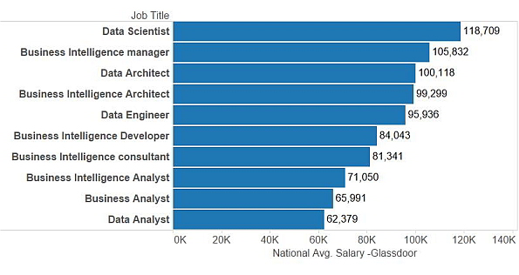
Why Data Science?

Slide 5
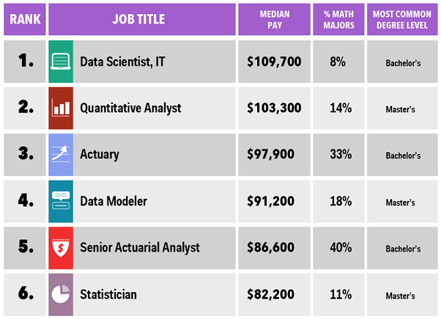
IBM Statistics

Slide 6



What is data science?
Data Science
Applying advanced statistical tools to existing data to generate new insights
Service Change
Converting new data insights into (often small) changes to business processes
Smarter Work
More efficient and effective use of staff and resources

Slide 7
My Role
I did the customers analysis based on the customers behavior on the website or app. It will classify what kind of customers are likely to sign up for the paid subscription of a website. After analyzing and classifying the dataset, we will be able to do the targeting based marketing or recommendation to the customers who are likely to sign up for the paid subscription plan.

Slide 8
Technologies Used
Backend - Python 3.7
Libraries - Numpy , Pandas , Matplotlib , Seaborn , Dateutil
IDE - Jupyter Notebook , Spyder

Slide 9
LET’S DIVE INTO THE CODE

Slide 10
