Slide 1


Slide 2

Mini Project
College Name : Watumull Institute of electronic and computer engineering
Title Of Project : Time table management system
Group Members Names : 22.Riya Singh
29.Ananya Yadav
54. Nilesh Parab
55. Sandesh Parbhane
Under the guidance of : Prof Nilesh Mehta

Slide 3
INTRODUCTION
Timetable Management System contain a data, which stores the
staff and lab personal details.
It is a unanimous requirement for planning class and lab in college.
It is simple and save time and energy.
This is also useful for faculties\students through which they can view when it is classes and practical.

Slide 4
PROBLEM STATEMENT
Timing slots for different teacher are different .
Different subjects are having different weekly time allocated.
One teacher may be teacher for two different subjects of different classes(years)
Humanly it is very time consuming.

Slide 5
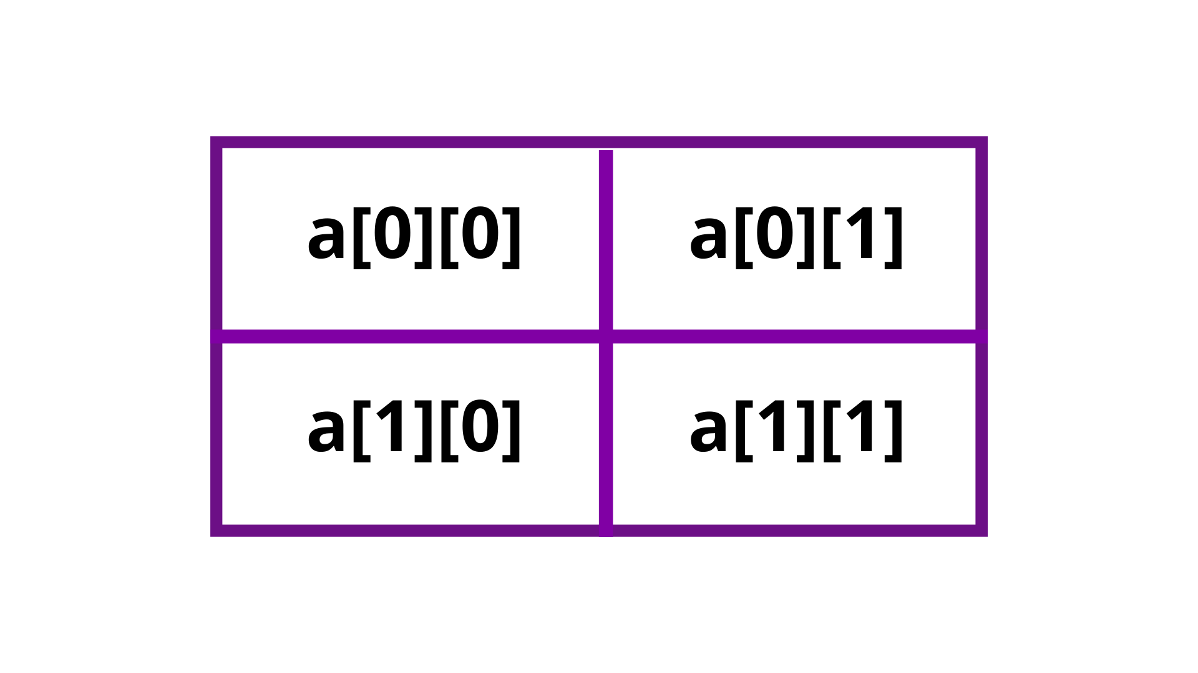
Multi-dimensional lists in Python
There can be more than one additional dimension to lists in Python. Keeping in mind that a list can hold other lists, that basic principle can be applied over and over.
Multi-dimensional lists are the lists within lists. Usually, a dictionary will be the better choice rather than a multi-dimensional list in Python.

Slide 6
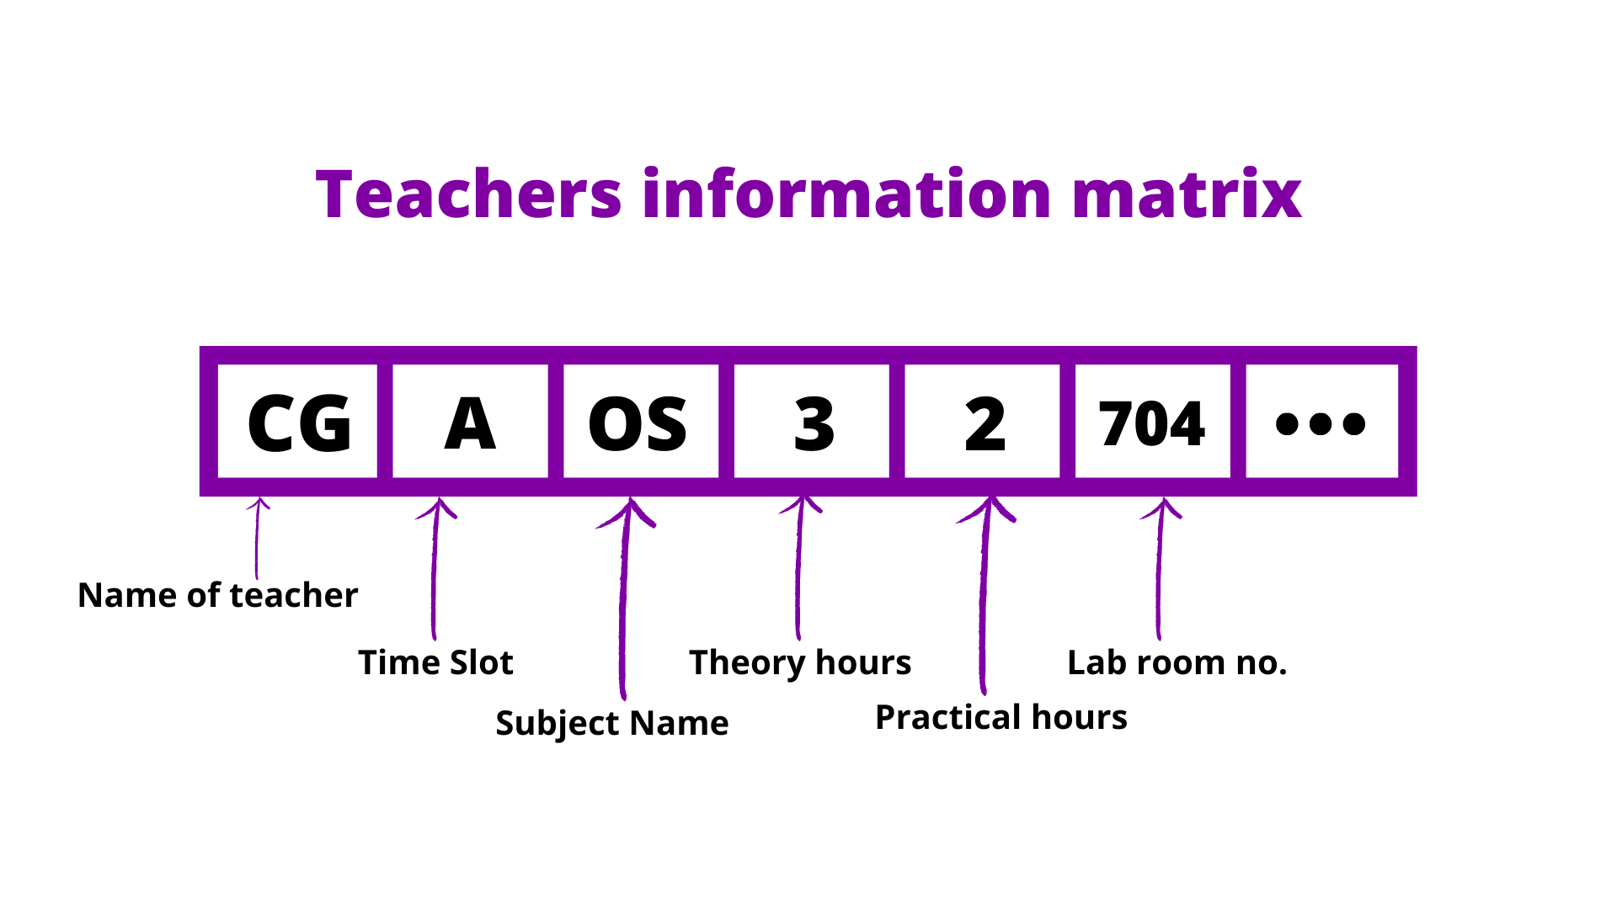

Slide 7
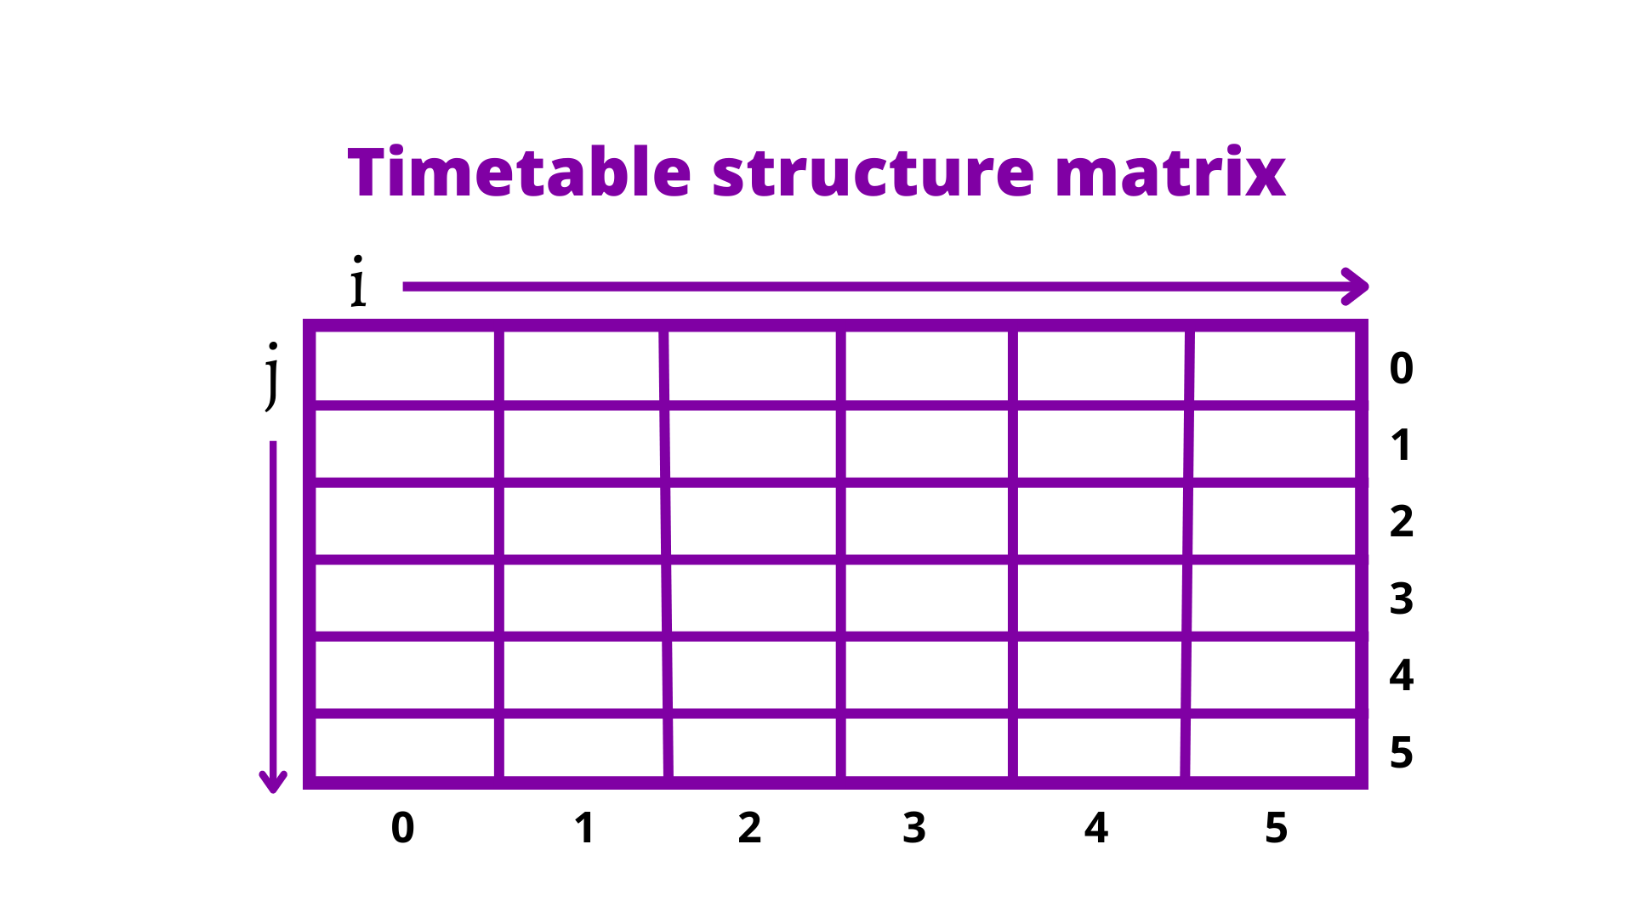

Slide 8
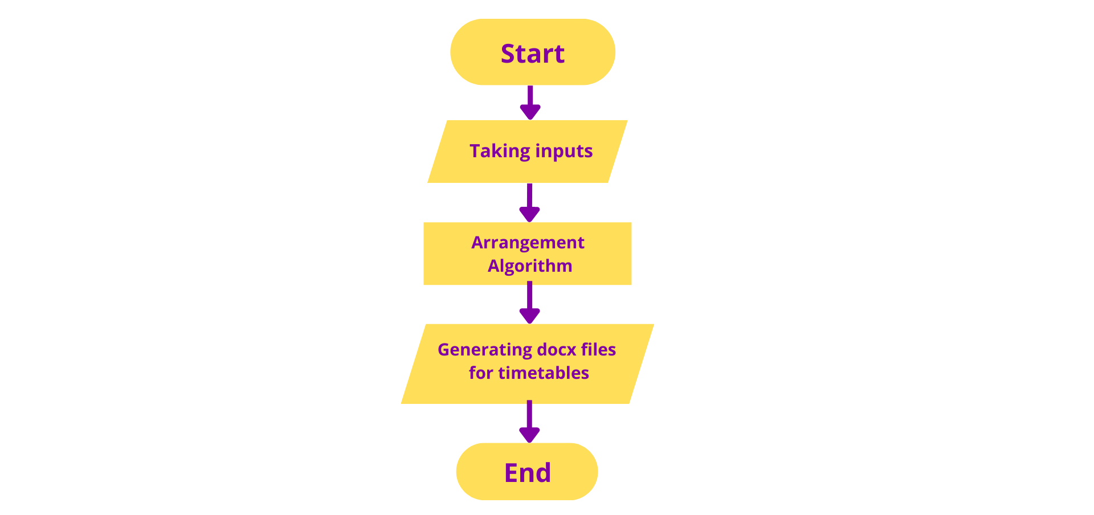
Dataflow diagram

Slide 9
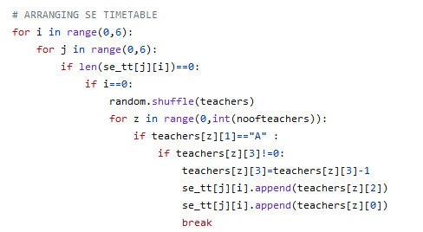
Algorithm

Slide 10
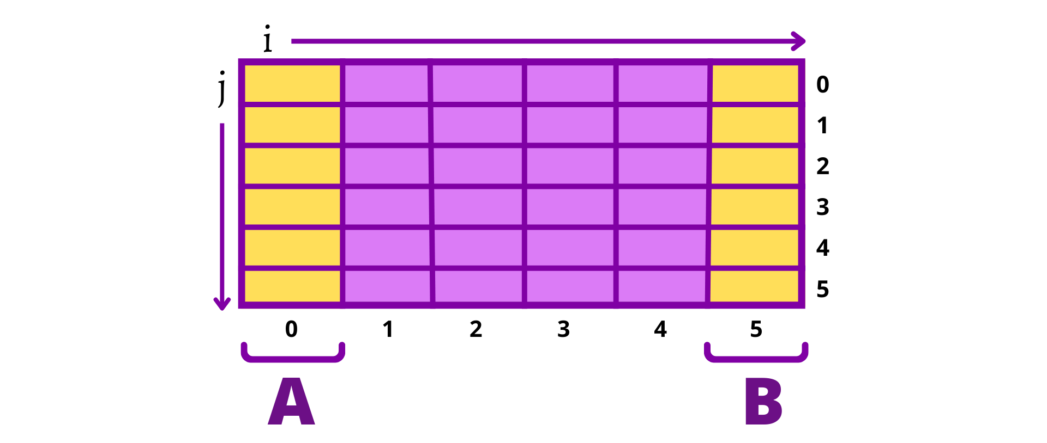
Timeslots in the timetable

Slide 11
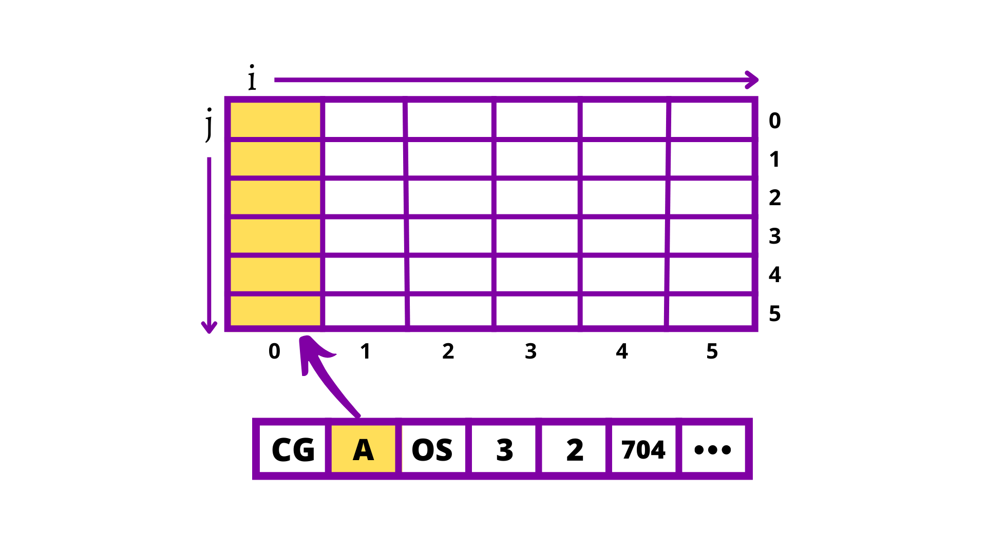
Solution for timeslot problem

Slide 12
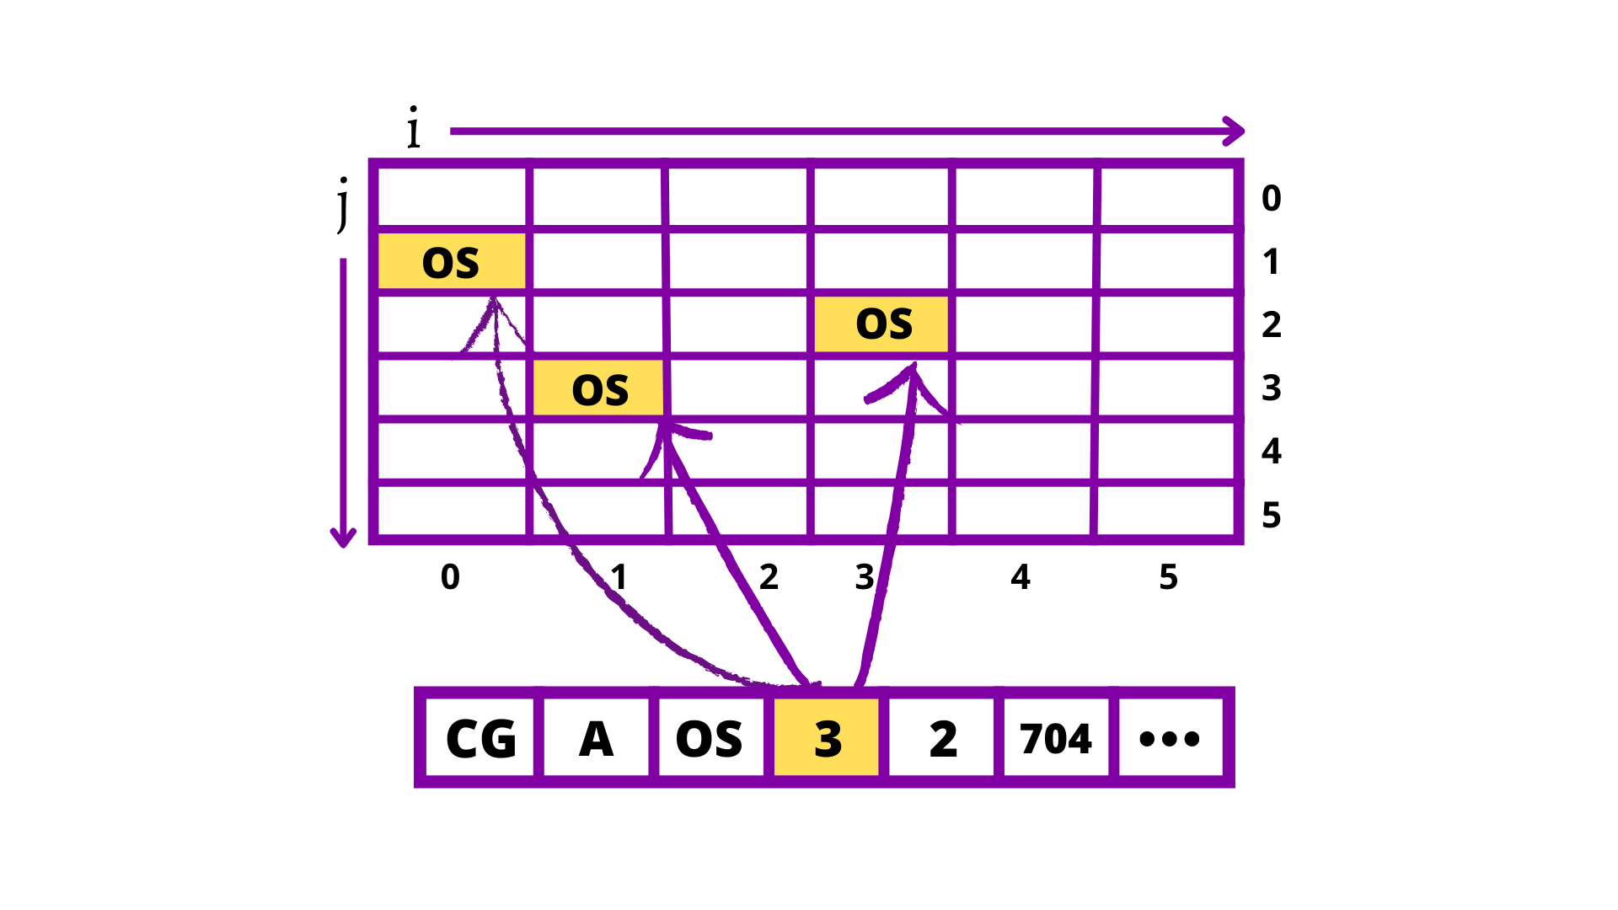
Dynamic allocation of lectures according to lecture duration and allocated time

Slide 13
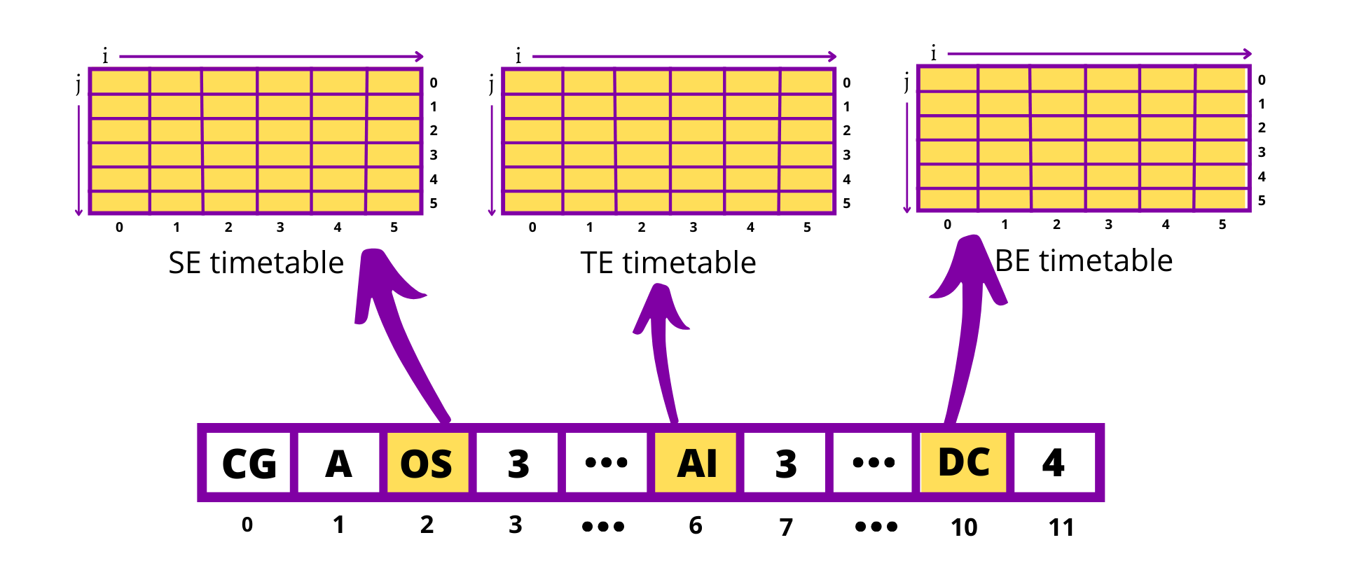
Teachers with multiple classes for teaching

Slide 14
Mapping data to word file with docx module
Word documents contain formatted text wrapped within three object levels. The lowest level- run objects, middle level- paragraph objects, and highest level- document object. So, we cannot work with these documents using normal text editors. But, we can manipulate these word documents in python using the python-docx module.
Python docx module allows users to manipulate docs by either manipulating the existing one or creating a new empty document and manipulating it. It is a powerful tool as it helps you to manipulate the document to a very large extend.

Slide 15
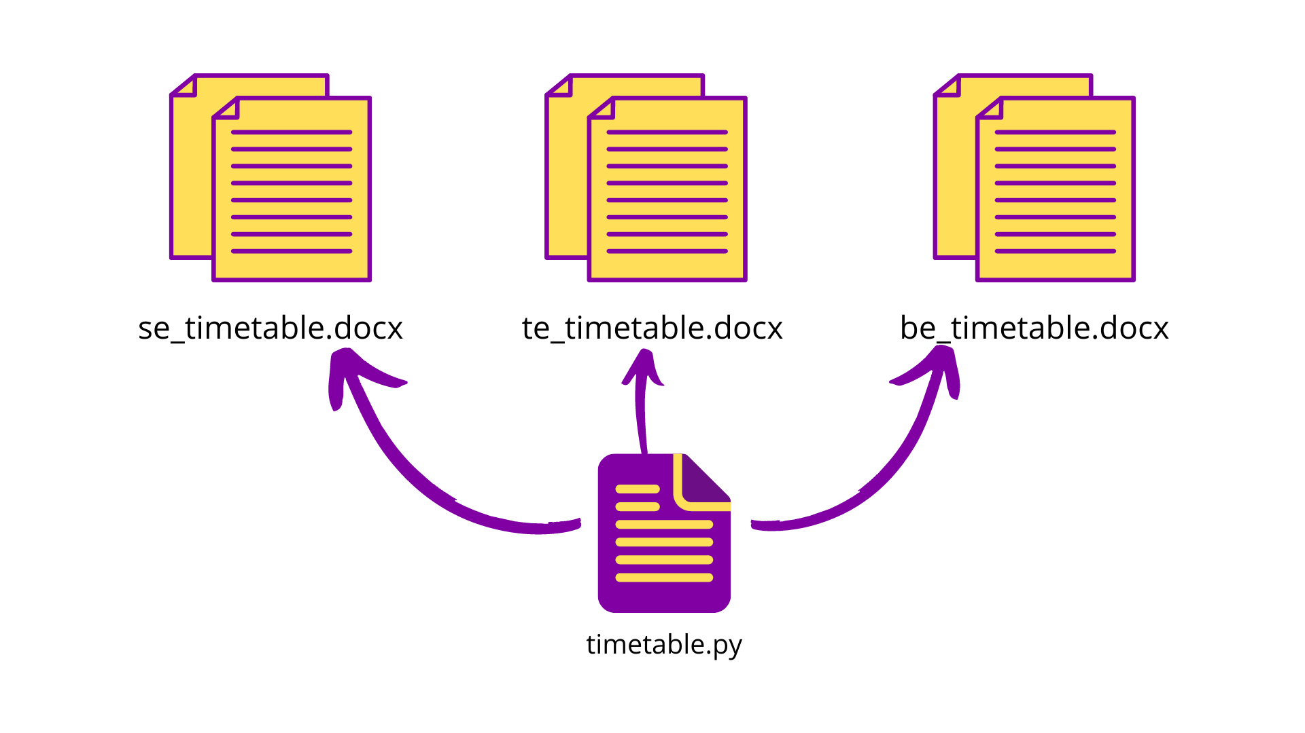
Mapping data to word file with docx module

Slide 16

.

