Slide 1




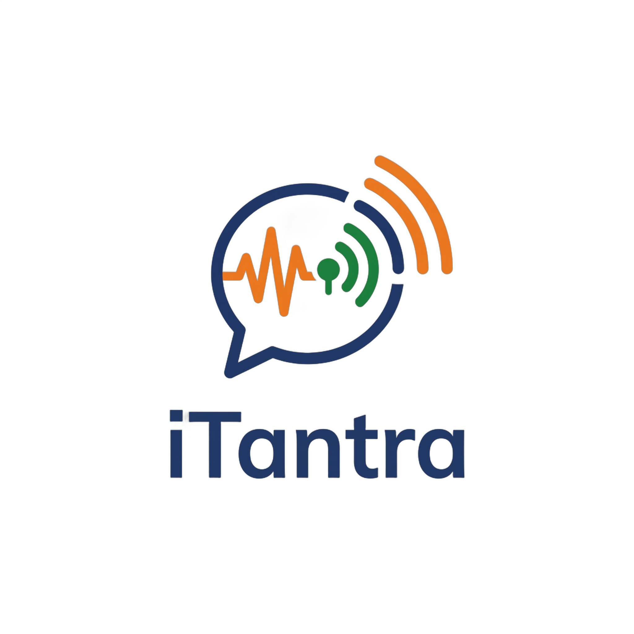
SMART INDIA HACKATHON 2026
iTantra: Voice That Travels as Meaning
Problem Statement ID – SIH26173
Problem Statement Title – iTantra: Indian Multilingual TTS & STT Aided Neural Transceiver Radio Access for low bitrate links
Organisation – Indian Space Research Organisation (ISRO)
Theme – Miscellaneous
PS Category – Software
Team ID –
Team Name (Registered on portal) – Hexabits
Working prototype
10 languages, offline
Fully open source
iTantra Offline speech-to-speech radio for disasters • 10 Indian languages • ~234 bytes per spoken sentence • runs on 3 GB Android phones
Notes:
iTantra turns speech into a tiny signed text packet on the sender's phone, relays it phone to phone over Bluetooth and Wi-Fi Direct, and speaks it again on the receiver. No tower, internet or server.

Slide 2





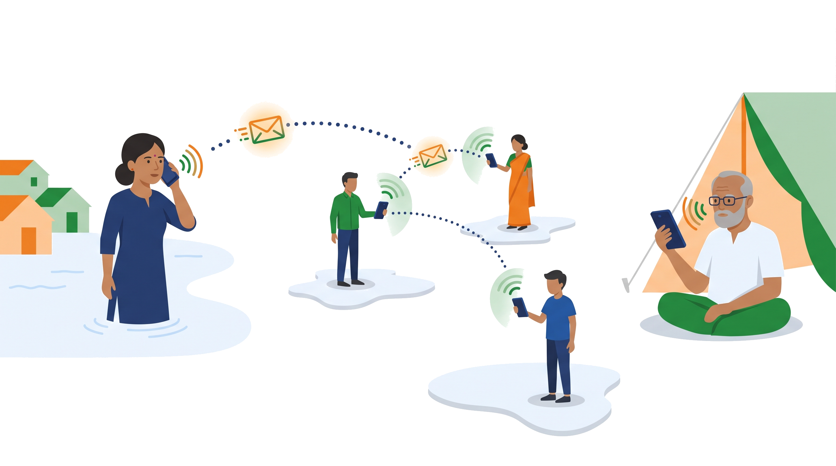






iTantra: Send the Meaning, Not the Audio
Hexabits
❖ Proposed Solution (Describe your Idea/Solution/Prototype)
An Android walkie-talkie that turns speech into a few hundred bytes of signed text, relays it phone to phone, and speaks it again on the other side.
1 Speak
2 On-device STT
3 234 B packet
4 Phone mesh
5 Spoken aloud
Any of 10 Indian languages, push-to-talk or hands-free
Silero VAD finds the pause; IndicConformer writes the sentence
Text + language + Ed25519 signature, TTL 7
BLE + Wi-Fi Direct relays, up to 7 hops, no tower
On-device TTS voice; alerts ring at max volume
How it addresses the problem
Low bitrate: one sentence is ≈234 B (≈0.5 kbps) instead of >64 kbps streamed audio
No network: phones relay for each other; no tower, internet, SIM or server
Inclusive: people who cannot read still hear the message, in their own language
Low-end ready: int8 models, one language in RAM, runs on 3 GB Android phones
Innovation and uniqueness
Semantic radio
Alert-first mesh
Sends meaning + prosody, not the waveform
Floods all hops; loud until acknowledged
≈234 B
per spoken sentence
30× smaller
than Opus 16 kbps
120× smaller
than 64 kbps voice
Tamper-proof
100% on-device
Signed packets; encrypted private messages
No cloud API; language packs download once
Notes:
Pipeline: speak, on-device STT, a ~234 byte signed packet, phone-to-phone mesh, on-device TTS. The byte figures are measured from our packet format: 22 B header, text, 64 B signature.

Slide 3












TECHNICAL APPROACH
Hexabits
Technologies to be used
Working prototype (Android)
App & UI
Flutter (Dart)
Kotlin (native Android)
Pigeon typed bridge
Riverpod
236 ms
Talk · हिन्दी
On-device AI
sherpa-onnx runtime
IndicConformer int8 (STT)
MMS VITS (TTS)
Silero VAD
● STT ready ● Voice ● Offline
Hindi sentence decode
Mesh & security
BLE GATT mesh
Wi-Fi Direct
Ed25519 signatures
X25519 + ChaCha20
हलो हलो
Model tooling
Python
ONNX int8 quantisation
Google Colab
Hugging Face model packs
644 ms
Hindi · STT 236 ms
Methodology and process for implementation (flow)
STT model load
PHONE A · SENDER
Mic capture
Silero VAD
IndicConformer STT
Packetiser
654 ms
16 kHz mono, echo + noise cancel
Pause = end of sentence
int8 CTC, one language resident
Sign, fragment, TTL 7
TTS voice load
Or type a message
Mesh: verify → dedup → relay with jitter (≤7 hops) → store-and-forward outbox when no neighbour
10 / 10
PTT | Call
PHONE B · RECEIVER
languages verified
Verify + reassemble
MMS VITS TTS
Voice note
ALERT mode
Drop unsigned or replayed
Voice in sender's language
Text shown with audio
Alarm stream, max volume, x3
Talk screen of the running app (redrawn); timings measured on a OnePlus CPH2717, Android 16.
Notes:
Everything runs on the phone: Flutter UI, Kotlin native layer, sherpa-onnx for STT, TTS and VAD. The prototype is running on a OnePlus today; timings on the right are measured on that phone.

Slide 4






FEASIBILITY AND VIABILITY
Hexabits
Analysis of the feasibility of the idea
Potential challenges and risks → Strategies for overcoming them
10 / 10
~0.3 GB
<1.1 GB
Short range per hop
7-hop relay, BLE Coded PHY where supported, store-and-forward by moving phones
languages running fully offline
per language (speech + voice packs)
peak RAM (est.), fits 3 GB phones
~60–100 m per Bluetooth hop
Hard speech
Gain control + tuned VAD, distress hotword list, text shown with voice, real-speech test set
Noise, soft voices, Malayalam / Odia accuracy
Low-end phones
int8 models, one language in RAM, duty-cycled scanning, foreground service
RAM, battery drain, background kills
Fake alerts and misuse
Ed25519-signed packets, verified NDMA / ISRO key, built as an authenticated alert tool
Spoofing; mesh apps were flagged in India (Jul 2026)
Voice licence
Swap to CC-BY voices trained on SYSPIN / IndicVoices-R before deployment
Each language: our TTS voice speaks a flood warning, our STT transcribes it back (sherpa-onnx, CPU, 2 threads). STT ran 5–20× faster than real time. Next: real speech from 10 speakers per language.
MMS-TTS voices are non-commercial
Notes:
Feasibility is proven, not assumed: the app runs today and all 10 languages pass a round-trip check. RAM figure is an engineering estimate to be replaced with dumpsys meminfo on a 3 GB phone.

Slide 5


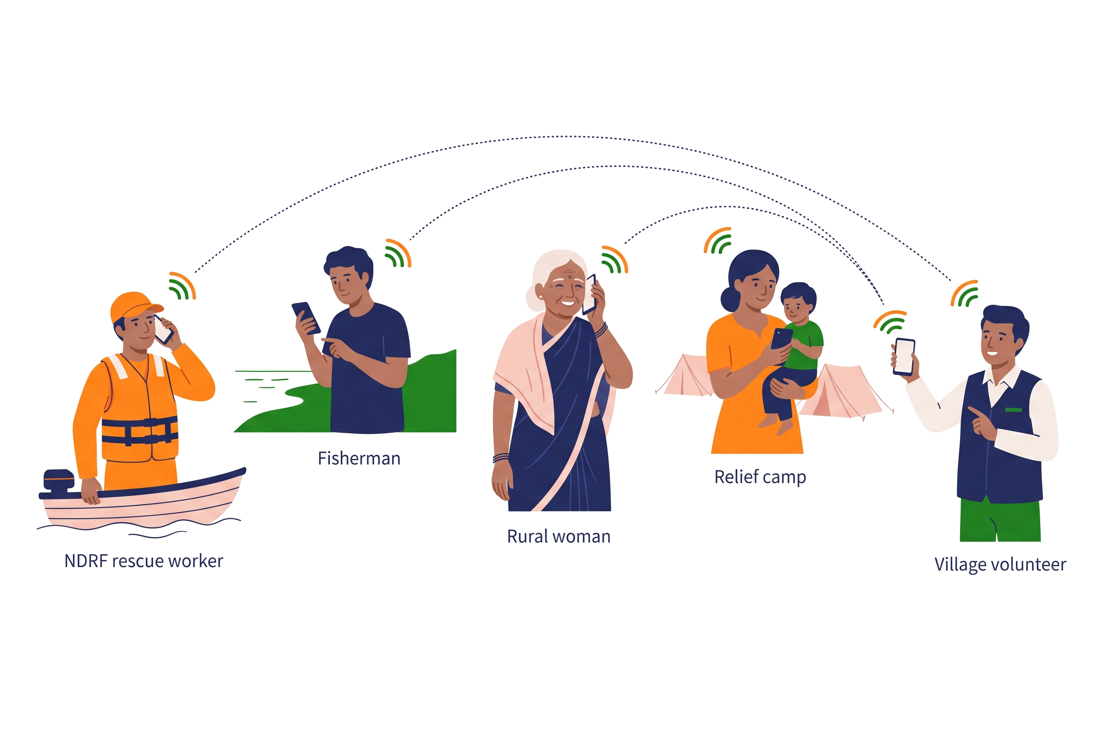





IMPACT AND BENEFITS
Hexabits
85%
of Indians speak one of our 10 languages as mother tongue (Census 2011)
~26%
of Indians aged 7+ cannot read; voice still reaches them (Census 2011)
0
towers, internet, SIM cards or servers needed
₹0
data cost per message, on phones people already own
Potential impact on the target audience
Benefits of the solution
Social
Economic
Voice in 10 languages for non-literate, elderly and visually impaired people; no typing needed.
Runs on existing low-cost phones; zero infrastructure, data or SMS cost; open models.
Environmental
Strategic (ISRO)
No diesel towers or generators; low-power Bluetooth saves battery in long outages.
Byte-sized frames suit NavIC messaging and LoRa links; data never leaves Indian devices.
Next: "heard by N phones" receipts • SMS gateway when any phone regains signal • voice-preserving prosody • 10-phone field trial
Notes:
Census 2011: Hindi, Bengali, Marathi, Telugu, Tamil, Gujarati, Kannada, Odia and Malayalam together are ~85% of mother-tongue speakers; literacy 74% means ~26% of people aged 7+ cannot read.

Slide 6






RESEARCH AND REFERENCES
Hexabits
Details / Links of the reference and research work
Models and tools
Research
Real-world evidence
AI4Bharat IndicConformer ASR (MIT)
github.com/AI4Bharat/IndicConformerASR
IndicVoices: multilingual Indian speech (ACL 2024)
arxiv.org/abs/2403.01926
FireChat mesh, Hong Kong 2014 (500k installs)
en.wikipedia.org/wiki/FireChat
sherpa-onnx: offline speech runtime
github.com/k2-fsa/sherpa-onnx
STCTS: speech at 80 bps via text + prosody
arxiv.org/abs/2512.00451
BitChat in Nepal 2025: 48,781 installs in a day
forbes.com (Sep 11, 2025)
Meta MMS-TTS voices (VITS)
huggingface.co/facebook/mms-tts
IndicVoices-R: Indian TTS corpus (NeurIPS 2024)
github.com/AI4Bharat/IndicVoices-R
Census of India 2011: languages, literacy
censusindia.gov.in
Silero VAD
github.com/snakers4/silero-vad
BitChat mesh protocol whitepaper
github.com/permissionlesstech/bitchat
NDMA: disaster management in India
ndma.gov.in
IndicConformer sherpa-onnx int8 exports
huggingface.co/.../indicconformer-sherpa-onnx
SYSPIN: open CC-BY Indian TTS dataset (IISc)
vaani.iisc.ac.in/dataset/syspindataset
Bridgefy offline mesh adds E2E encryption (2020)
techcrunch.com (Nov 2, 2020)
Our work is open source
Android app, mesh protocol spec and model tooling, plus 20 ready language packs (10 STT + 10 TTS) verified end to end.
App source code
github.com/nileshpatil6/
SIH-Hexabits
Offline model packs
huggingface.co/datasets/
Mr66/itantra-packs
Notes:
All links are clickable in the PDF export.

