Slide 1

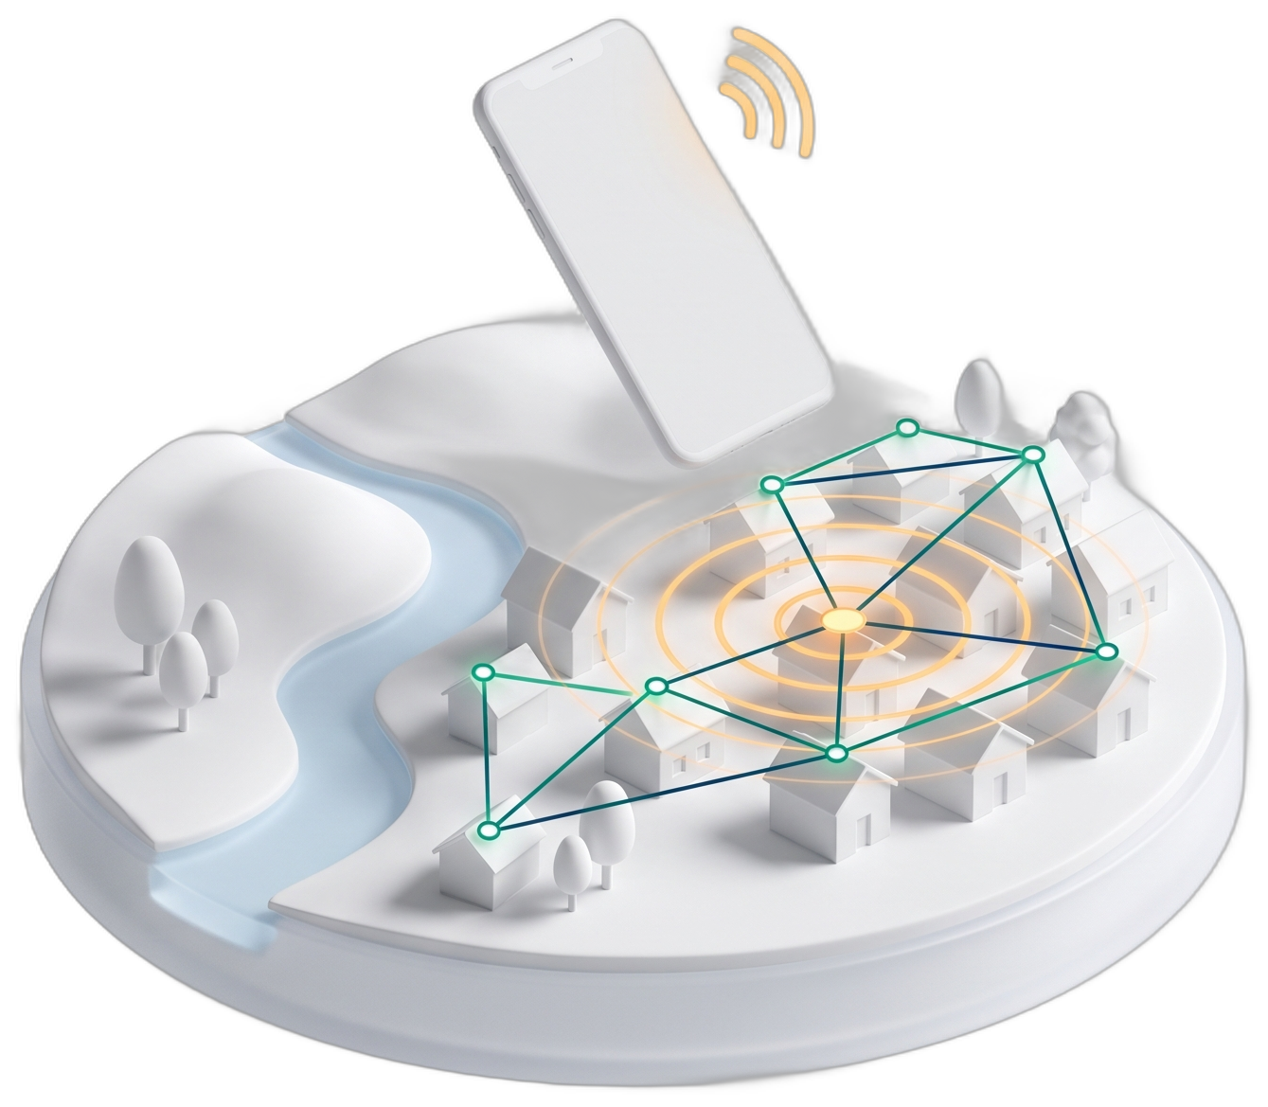
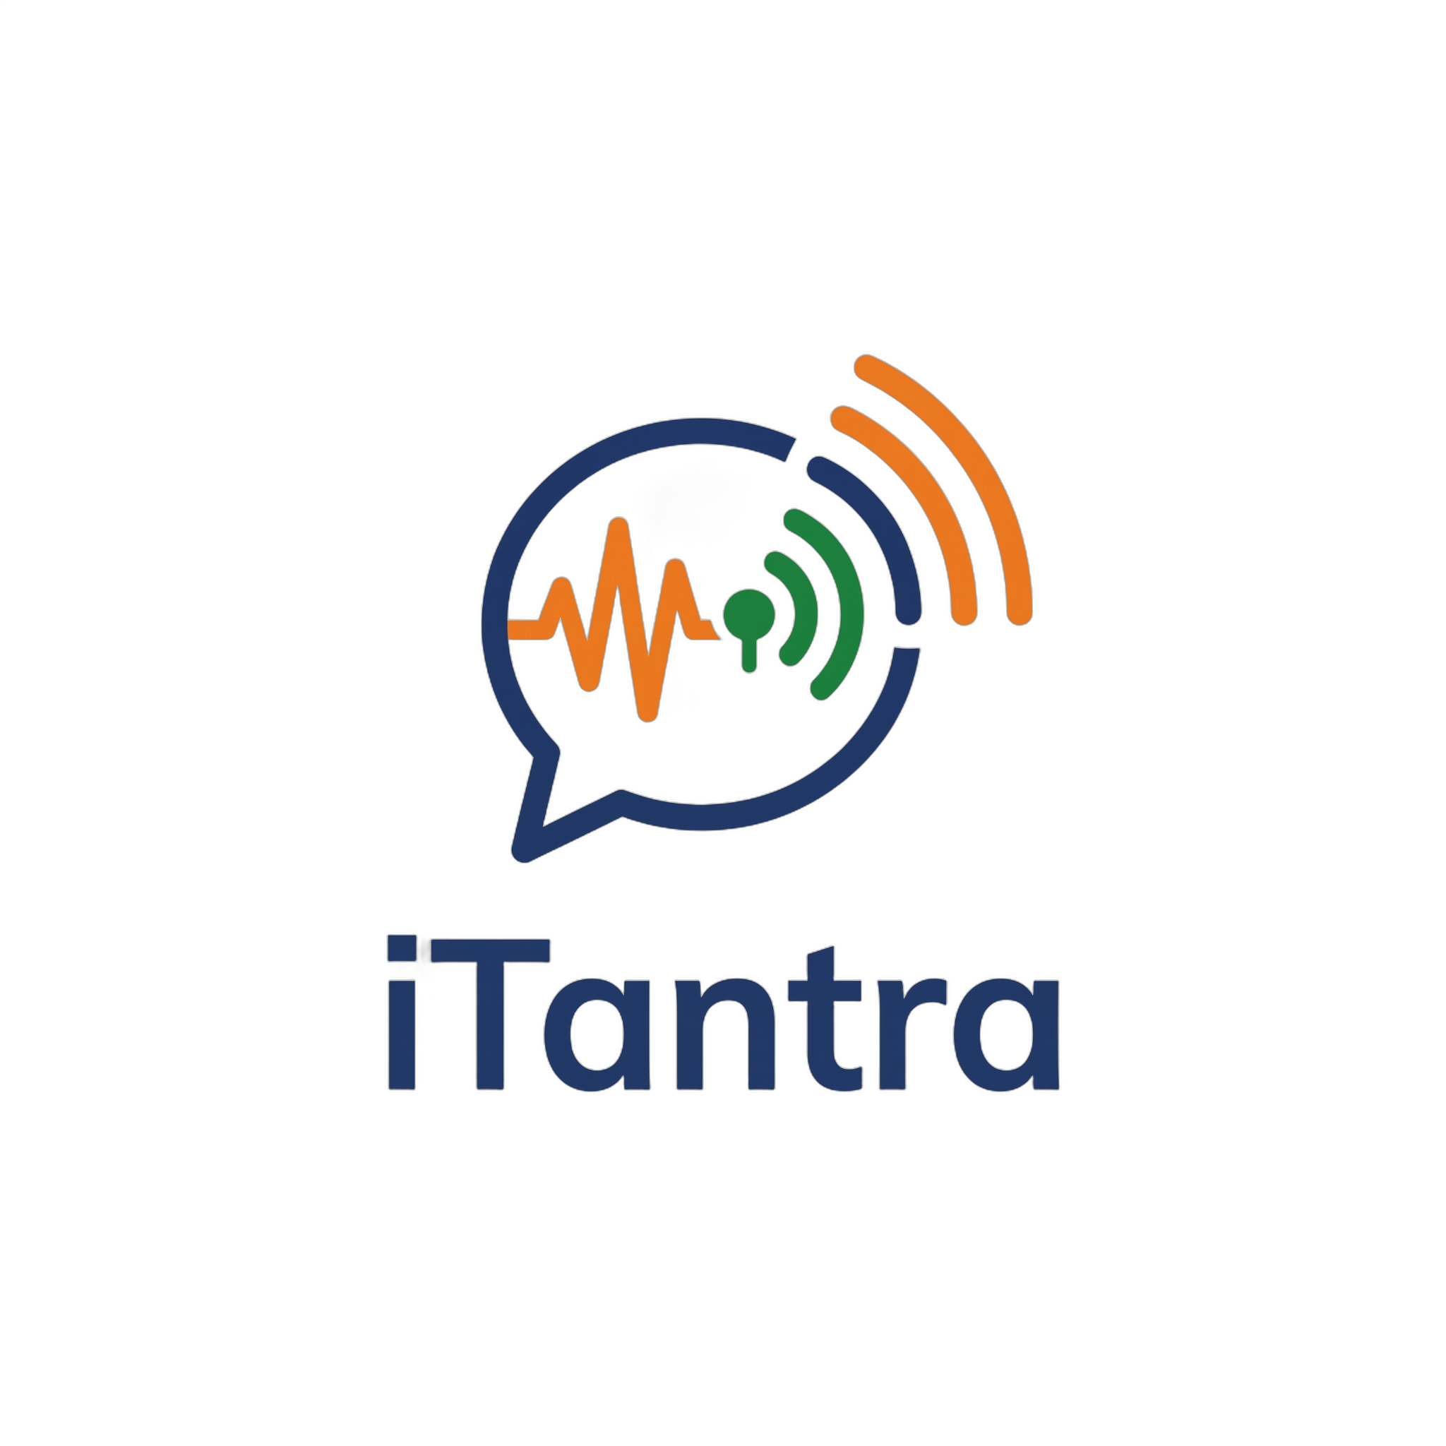





SMART INDIA HACKATHON 2026
SIH 2026 • PS SIH26173 • ISRO
iTantra
Voice that travels as meaning
Speech in, a 234-byte signed packet across a phone-to-phone mesh, speech out. No tower, no internet, 10 Indian languages, on 3 GB phones.
PROBLEM STATEMENT TITLE
iTantra: Indian Multilingual TTS & STT Aided Neural Transceiver Radio Access for low bitrate links
PROBLEM STATEMENT ID
THEME
PS CATEGORY
SIH26173
Miscellaneous
Software
TEAM ID
TEAM NAME (REGISTERED ON PORTAL)
Hexabits
100% offline
234 B / sentence
10 languages
Alert mode
Notes:
iTantra turns speech into a tiny signed text packet on the sender's phone, relays it phone to phone over Bluetooth and Wi-Fi Direct, and speaks it again on the receiver. No tower, internet or server.

Slide 2










iTantra: Send the Meaning, Not the Audio
Hexabits
01
Proposed Solution (Describe your Idea/Solution/Prototype)
Detailed explanation: speech is recognised on the phone, sent as a few hundred bytes of signed text over a phone-to-phone mesh, and spoken again on the receiving phone.
1 Speak + on-device STT
2 234 B packet hops the mesh
3 On-device TTS speaks it
VAD finds the pause, IndicConformer writes it
BLE + Wi-Fi Direct relays, up to 7 hops, no tower
Voice note; ALERTs ring at max volume
How it addresses the problem: bytes to send one 3.5 s sentence
Innovation and uniqueness
Raw voice, 64 kbps
28,000 B
Semantic radio
Alert-first mesh
Opus codec, 16 kbps
7,000 B
Sends meaning + prosody, not the waveform
Floods all hops; loud until acknowledged
iTantra packet
234 B
120× smaller
Tamper-proof
100% on-device
No tower, internet or server
Heard by people who can't read
Runs on 3 GB phones
Ed25519-signed; private messages encrypted
No cloud API; packs download once
Notes:
The bar compares bytes for one 3.5 second sentence: 64 kbps raw voice is 28,000 bytes, Opus 16 kbps is 7,000, our signed packet is 234 bytes (22 B header, text, 64 B Ed25519 signature).

Slide 3






TECHNICAL APPROACH
Hexabits
02
Technologies to be used
04
Working prototype (Android)
APP & UI
Flutter (Dart)
Kotlin (Android)
Pigeon bridge
Riverpod
644 ms
ON-DEVICE AI
sherpa-onnx
IndicConformer int8 (STT)
MMS VITS (TTS)
Silero VAD
STT model load
Talk · हिन्दी
MESH & SECURITY
BLE GATT mesh
Wi-Fi Direct
Ed25519
X25519 + ChaCha20
● STT ready ● Voice ● Offline
MODEL TOOLING
Python
ONNX int8
Google Colab
Hugging Face packs
236 ms
हलो हलो
Hindi · STT 236 ms
Hindi sentence decode
03
Methodology and process for implementation (flow)
654 ms
TTS voice load
SENDER
Mic 16 kHz
Silero VAD
IndicConformer
Packetiser
Or type a message
10 / 10
echo + noise cancel
pause = sentence end
int8 CTC STT
sign · fragment · TTL 7
MESH verify → dedup → relay with jitter (≤7 hops) → store-and-forward outbox
PTT | Call
languages verified
RECEIVER
Verify
MMS VITS TTS
Voice note
ALERT mode
drop unsigned / replayed
sender's language
text shown with audio
max volume, repeat x3
App screen redrawn from the running build; timings measured on OnePlus CPH2717, Android 16.
Notes:
Everything runs on the phone: Flutter UI, Kotlin native layer, sherpa-onnx for STT, TTS and VAD. The prototype runs on a OnePlus today; timings are measured on that phone.

Slide 4










FEASIBILITY AND VIABILITY
Hexabits
05
Analysis of the feasibility of the idea
06
Potential challenges and risks → Strategies to overcome them
10 / 10
~0.3 GB
<1.1 GB
Short range per hop
7-hop relay, BLE Coded PHY where supported, store-and-forward by moving phones
languages running fully offline
per language: speech + voice packs
peak RAM (est.) fits 3 GB phones
~60–100 m per Bluetooth hop
Hard speech
Gain control + tuned VAD, distress hotword list, text shown with voice, real-speech test set
Noise, soft voices, Malayalam / Odia
Low-end phones
int8 models, one language in RAM, duty-cycled scanning, foreground service
RAM, battery drain, background kills
Fake alerts, misuse
Ed25519-signed packets, verified NDMA / ISRO key, positioned as authenticated alert tool
Spoofing; mesh apps flagged in India (Jul 2026)
Voice licence
Swap to CC-BY voices trained on SYSPIN / IndicVoices-R before deployment
≤5%
5–10%
>10%
Our TTS speaks a flood warning, our STT transcribes it back (sherpa-onnx, CPU). STT runs 5–20× faster than real time.
MMS-TTS is non-commercial
Notes:
Feasibility is shown, not claimed: the app runs today and all 10 languages pass a round-trip check. The RAM figure is an estimate to confirm with dumpsys meminfo on a 3 GB phone.

Slide 5

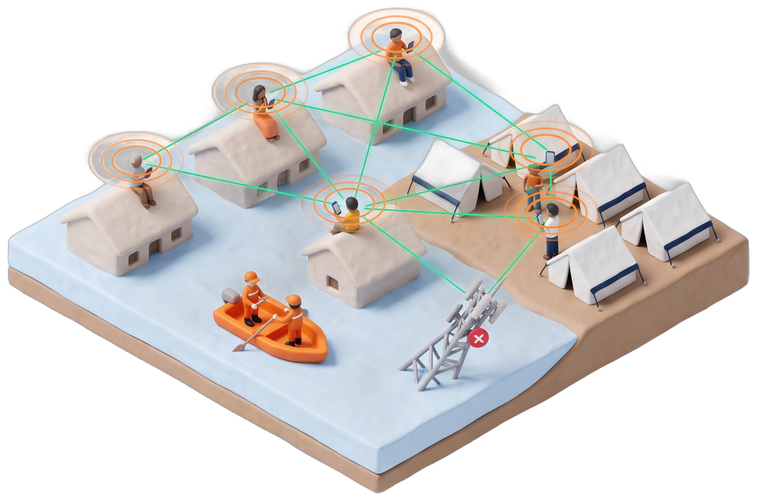




IMPACT AND BENEFITS
Hexabits
85%
~26%
0
₹0
of Indians speak one of our 10 languages as mother tongue
of Indians aged 7+ cannot read: voice still reaches them
towers, internet, SIM cards or servers needed
data cost per message, on phones people already own
Census 2011
Census 2011
fully offline
no data plan
07
Potential impact on the target audience
08
Benefits of the solution
Social
Economic
Relief camps
Flooded villages
Voice in 10 languages for non-literate, elderly and visually impaired people; no typing.
Runs on existing low-cost phones; zero infrastructure, data or SMS cost; open models.
Environmental
Strategic (ISRO)
No diesel towers or generators; low-power Bluetooth saves battery in long outages.
Byte-sized frames suit NavIC messaging and LoRa links; data stays on Indian devices.
NDRF / SDRF rescue teams
NEXT "heard by N phones" receipts • SMS gateway on signal • voice-preserving prosody • 10-phone field trial
Notes:
Census 2011: Hindi, Bengali, Marathi, Telugu, Tamil, Gujarati, Kannada, Odia and Malayalam together are ~85% of mother-tongue speakers; literacy 74% means ~26% of people aged 7+ cannot read.

Slide 6





RESEARCH AND REFERENCES
Hexabits
09
Details / Links of the reference and research work
Foundation models
Academic literature
Field precedents & data
AI4Bharat IndicConformer ASR
MIT
IndicVoices: Indian speech dataset
ACL 2024
FireChat mesh, Hong Kong 2014
500k installs
github.com/AI4Bharat/IndicConformerASR
arxiv.org/abs/2403.01926
en.wikipedia.org/wiki/FireChat
sherpa-onnx offline runtime
Apache-2.0
STCTS: speech at 80 bps (text + prosody)
arXiv 2025
BitChat in Nepal 2025
48,781 / day
github.com/k2-fsa/sherpa-onnx
arxiv.org/abs/2512.00451
forbes.com/sites/digital-assets
Meta MMS-TTS voices
VITS
IndicVoices-R: Indian TTS corpus
NeurIPS 2024
Bridgefy mesh adds E2E encryption
TechCrunch 2020
huggingface.co/facebook/mms-tts
github.com/AI4Bharat/IndicVoices-R
techcrunch.com/2020/11/02
Silero VAD
MIT
SYSPIN open Indian TTS dataset
IISc
Census of India 2011
Language, literacy
github.com/snakers4/silero-vad
vaani.iisc.ac.in/dataset/syspindataset
censusindia.gov.in
IndicConformer sherpa int8 exports
HF
BitChat mesh protocol whitepaper
Open
NDMA disaster management
Govt. of India
huggingface.co/.../indicconformer-sherpa-onnx
github.com/permissionlesstech/bitchat
ndma.gov.in
Built, verified and open source
App source code
github.com/nileshpatil6/
SIH-Hexabits
Offline model packs
huggingface.co/datasets/
Mr66/itantra-packs
Android prototype
20 language packs
10/10 round-trip
Scan to see the code and download the offline model packs.
Notes:
All links are clickable in the PDF export.

